Slide 1
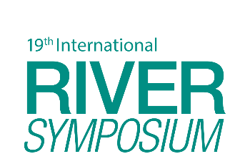

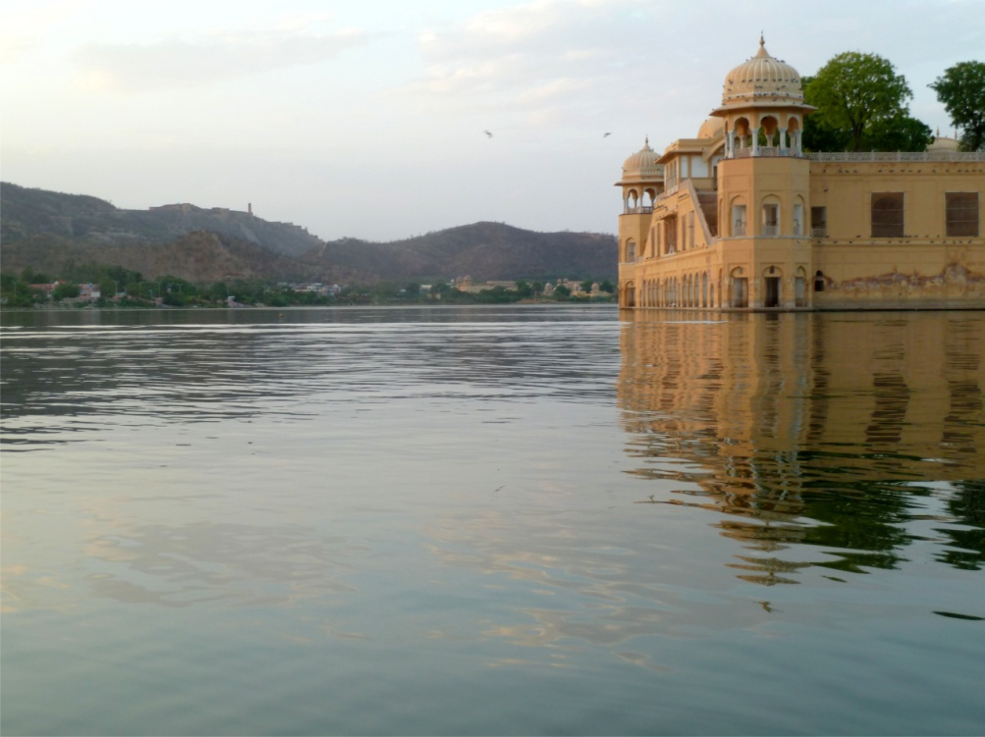
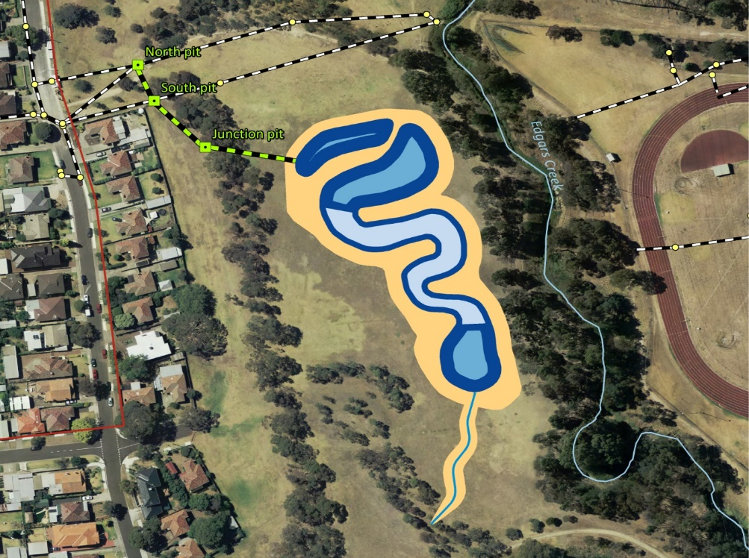

Urban wetlands for liveability
India and Australia
TAJ PALACE, NEW DELHI | 12 – 14 SEPTEMBER 2016
By Harsh Vardhan, Stuart Cleven (Alluvium) and Simon Tilleard (Alluvium)

Slide 2
Liveability
Sum of the factors that add up to a community’s quality of life—including the built and natural environments, economic prosperity, social stability and equity, educational opportunity, and cultural, entertainment and recreation possibilities

Slide 3
The challenge
Making our cities liveable as they
  Become larger (population and area)
  Become warmer
  Have increasingly erratic rainfall
Projection | Jaipur (India) | Melbourne (Australia)
Population density | 4,742 person/km² (2016)¹ 8,000 person/km² (2025)¹ | 440 person/km² (2013)²
Temperature | 2 to 4 °C increase by 2085³ | 0.5 to 1.2°C increase by 2030⁴
Rainfall | Decrease in annual rainfall³ Increase frequency and intensity of extreme events³ | Decrease in annual rainfall⁴ Increased intensity of extreme events⁴
Jaipur Master Development Plan 2025
Australian Bureau of Statistics
3. TERI
4. CSIRO
Notes:
Melbourne, my home town, recently ranked as the most liveable city by the Economist for the fifth year running

Slide 4
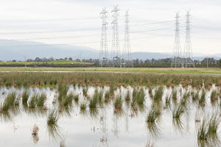
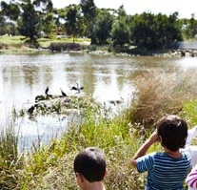
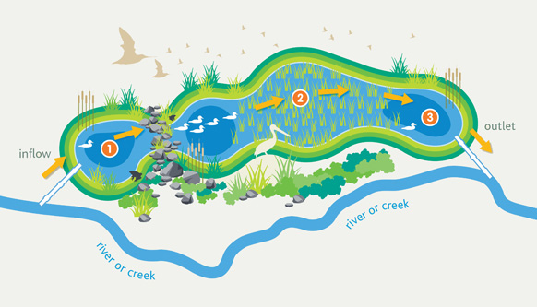
Urban wetlands for liveability
Built to improve liveability
Blue, green and cool cities
Community activity, passive and active recreation and amenity
Indigenous flora and fauna species
Water treatment
Pictures source: Melbourne Water
Notes:
One solution being explored around the world, including India and Australia is the use of wetlands constructed to increase livability
Urban water management is evolving from delivering traditional water cycle services to playing a role in realising the vision of future cities that are blue, green and cool
WSUD is transforming to systems that also provide community activity, passive and active recreation and amenity through open space integration with the surrounding developments
For example, vegetation selection is moving towards indigenous species that will reduce the urban landscape heat, provide ‘community cool zones’ for residents during heatwaves, and habitat for fauna

Slide 5
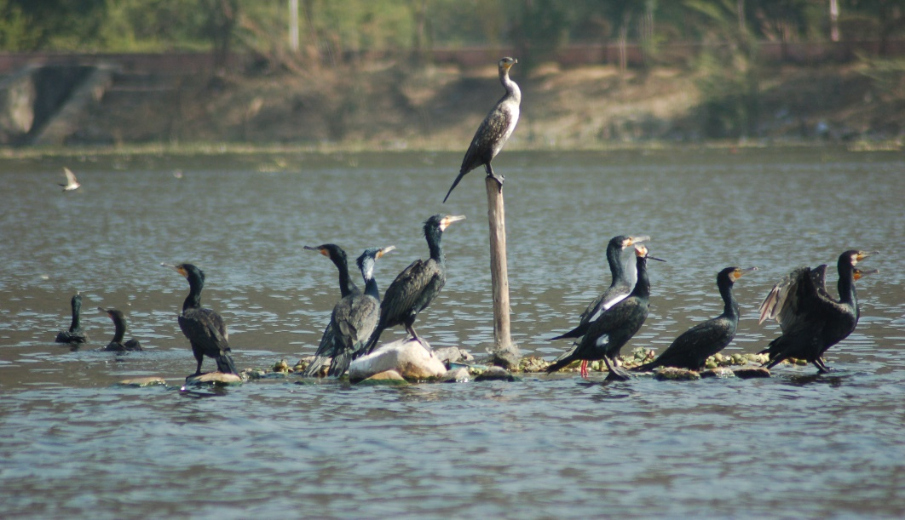
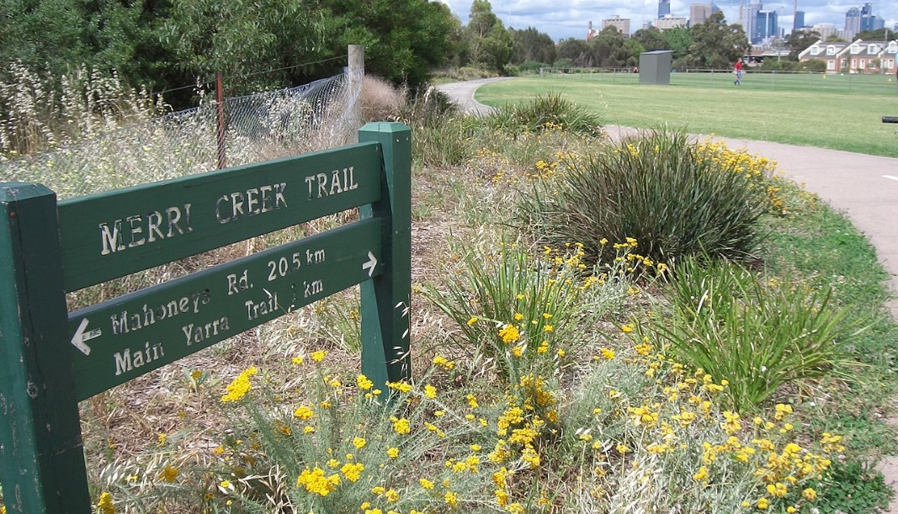
Study aim
Compare case studies to draw lessons and inform future wetland construction for liveability in India and Australia
Compared under four key themes: drivers, objectives, institutions and design

Slide 6
Comparison framework
Drivers
What instigated the wetland construction?
Examples: Public pressure, legislation, a champion, local government, civil society…
Objectives
What was the aim of the wetland construction?
Examples: Water treatment, recreational space, liveability…
Institutions
Primary stakeholders involved in wetland construction and maintenance?
Example: National government, local government, private companies, NGOs…
Design
How is the wetland designed to improve livability?
Example: Green spaces, recreational access…

Slide 7
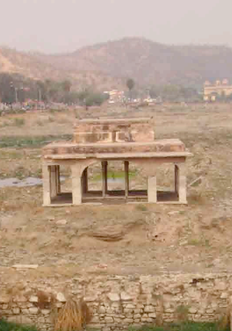
India case study – Man Sagar Lake
Man-made lake constructed more than 400 years ago
Jal Mahal palace constructed in the 1730s by Raja jai Singh
1900s - lake was a cesspool with storm water and sewerage directly entering the lake and drying out every summer

Slide 8
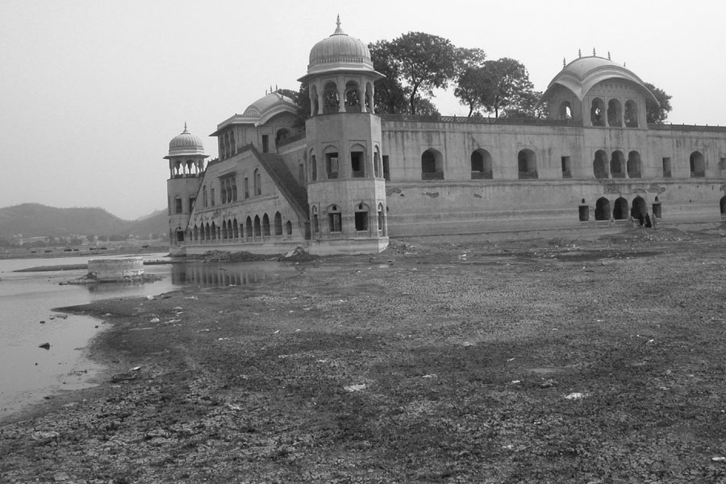
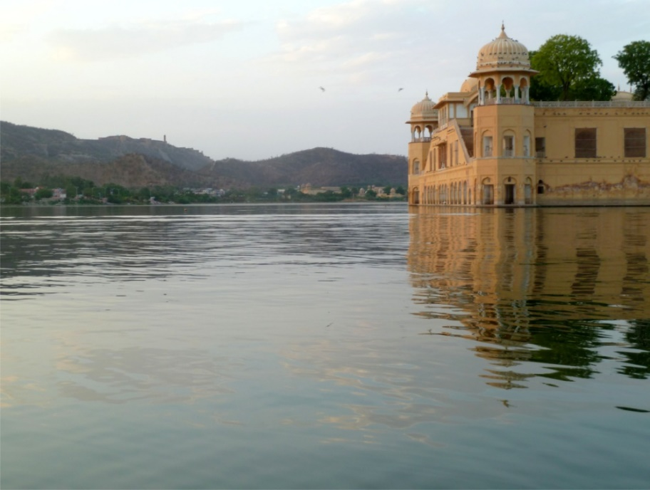
India case study – Man Sagar Lake
Mid 2000s - works undertaken to improve the lake
  Desilting of bed
  Diversion of main sewerage drain
  Sedimentation basin
  Established bird interpretation center and Bird Fair
  Constructed wetlands to treat water
2005
After 2006

Slide 9
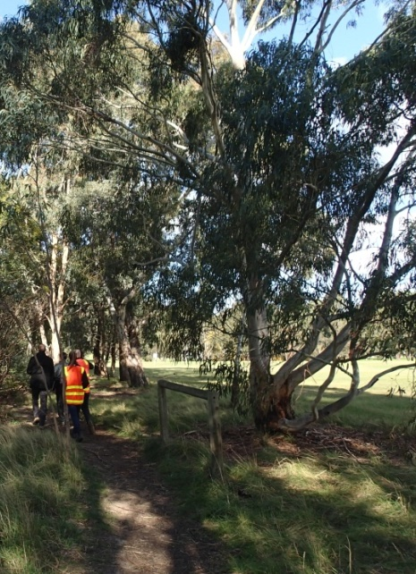
Australian case study – Merri Creek
Degraded grassland with invasive weed threat
Adjoining areas of natural vegetation with biodiversity of national, state, regional and local significance
Open space along creek valued by community for amenity
Notes:
Melbourne’s Merri Creek has a highly urbanised catchment, yet still maintains areas of Australian national, state, regional and local biological significance, with surviving remnant populations of increasingly rare species such as the Growling Grass Frog.
The wetland site was a degraded grassland with an established invasive weed threat from Chilean Needle Grass.
The adjoining Edgars Creek channel and open space has existing areas of Creekline Grassy Woodland, Plains Grassy Woodland and Escarpment Shrubland enhanced through a long term commitment to ongoing weed control and revegetation by Friends of Edgars Creek, MCMC, Council and Melbourne Water.
Establishment of the new wetland will add a critical element to the biodiversity mix, enabling partial restoration of wetland and floodplain vegetation communities missing from urban areas of the catchment

Slide 10
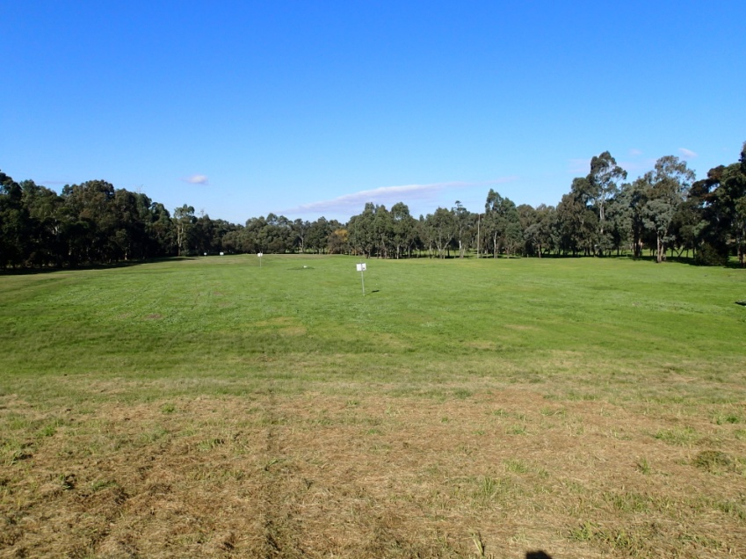
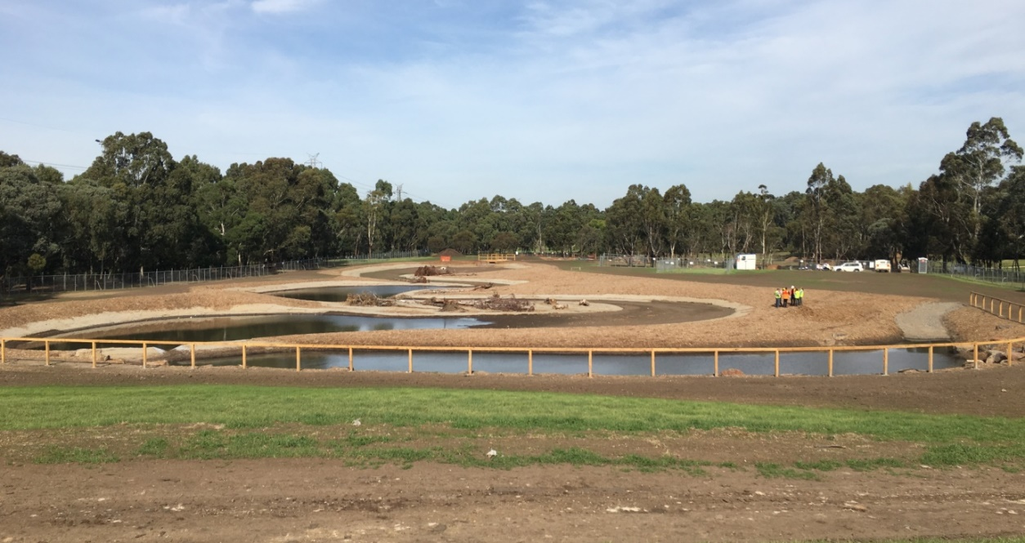
Australian case study – Merri Creek
Urban wetland to
  Enhance habitat and biodiversity values
  Restore wetland and floodplain vegetation communities
  Retain natural character
  Add to natural aspect values for community
  Integrate recreational access
Notes:
Wetland enhances habitat and biodiversity values however the small catchment and extensive cut required for establishment required very careful handling to balance the preferred habitat and water quality treatment model with community expectations for landscape amenity.
The open space along the creek is a precious resource, valued by the local community for its natural aspect and escape from the urban environment.
The wetland development formed an important addition to these values and sensitive integration of recreational access and retention of a natural rather than constructed character are key aspects of the design.
Establishment of the new wetland will add a critical element to the biodiversity mix, enabling partial restoration of wetland and floodplain vegetation communities missing from urban areas of the catchment.

Slide 11
Comparison
Drivers
Man Sagar
Merri Creek
Design
Objectives
Institutions
Notes:
Drivers
Community through to Government regulation
Objectives
WQ only through to multiople benefits
Institutions
Government run through to inclusive/participaitory
Design
First time/piloting done in the country through to established guidelines/standards

Slide 12
Comparison - Drivers
Drivers
Man Sagar
Community
Merri Creek
Government
Design
Objectives
Institutions
Notes:
Drivers
Community through to Government regulation
Objectives
WQ only through to multiople benefits
Institutions
Government run through to inclusive/participaitory
Design
First time/piloting done in the country through to established guidelines/standards

Slide 13
Comparison – Objectives
Drivers
Man Sagar
Merri Creek
Multiple benefits
Design
WQ only
Objectives
Institutions
Notes:
Drivers
Community through to Government regulation
Objectives
WQ only through to multiople benefits
Institutions
Government run through to inclusive/participaitory
Design
First time/piloting done in the country through to established guidelines/standards

Slide 14
Comparison institutions
Drivers
Man Sagar
Merri Creek
Design
Government run
Objectives
Inclusive/participatory
Institutions
Notes:
Drivers
Community through to Government regulation
Objectives
WQ only through to multiople benefits
Institutions
Government run through to inclusive/participaitory
Design
First time/piloting done in the country through to established guidelines/standards

Slide 15
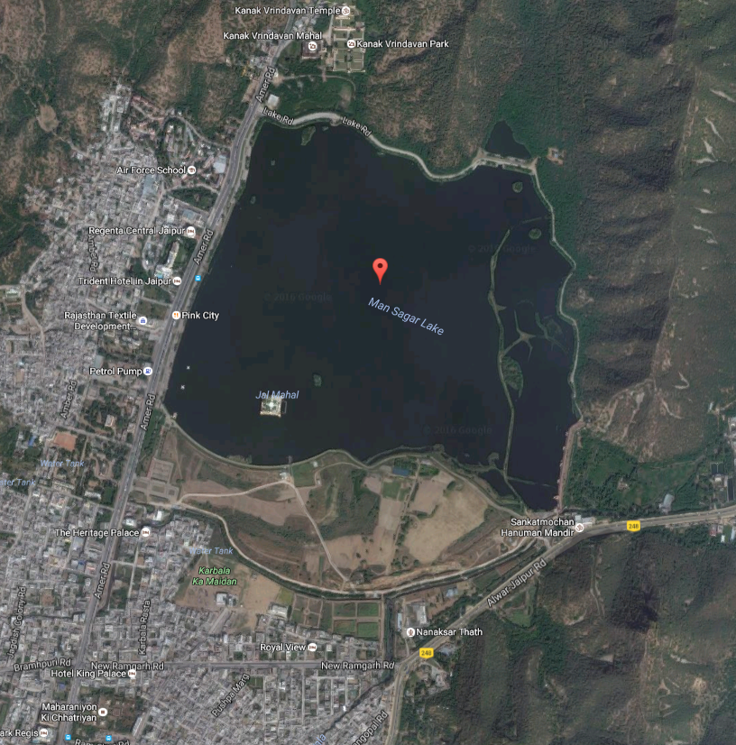
Design – Man Sagar
Wetlands part of broader rehabilitation
Role: treat water from treatment plant and stormwater
Three gated constructed wetlands
One ungated sedimentation basin and wetland
Components include diversion pipe, gross pollutant trap, sediment pond and main wetland pond

Slide 16
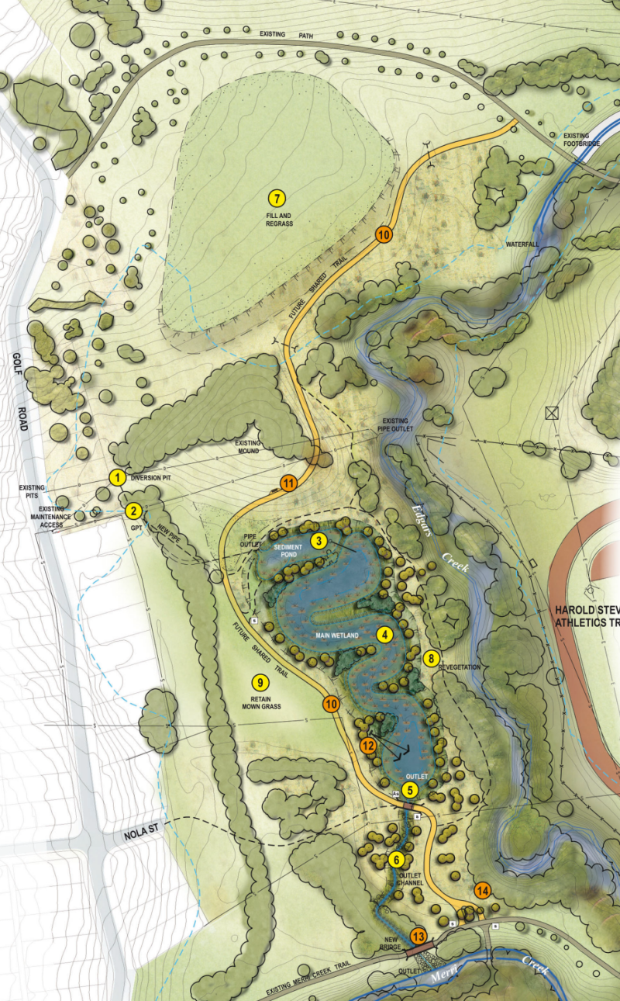
Design – Merri Creek
State and council design guidelines and standards
Role: treat stormwater and habitat creation
Components - diversion pipe, gross pollutant trap, sediment pond, main wetland pond, adjustable weir and outfall channel
Future works to improve amenity
Notes:
State and council design guidelines and standards
No broader rehabilitation works
Components include diversion pipe, gross pollutant trap, sediment pond, main wetland pond, adjustable weir and outfall channel
Future works to improve amenity – pathway, seating, boardwalk and signage

Slide 17
Key findings
Driver
  Merri Creek – legislative requirements and open space strategies with state environmental policies
  Man Sagar – private sector, community and government
Objectives
  Merri Creek – water quality and ecology
  Man Sagar – water quality, economy and liveability
Design
  Merri Creek – treat stormwater; standard wetland design
  Man Sagar - treat stormwater and sewerage; pilot application
Notes:
Caveats
Different scale projects
Driver for urban wetlands in Merri Creek is from legislative requirements and state environmental policies focussed on ecology and water quality, in the case of Man Sagar the community and amenity of the receiving waters have been the key driver for the use of wetlands.
In both cases objectives of the wetland has been to improve water quality and increase liveability and amenity, although in Australia this has required treatment of only stormwater runoff whereas in Man Sagar the wetlands had to be designed to treat both stormwater and treated sewerage.
In Australia, where strong government support for constructed wetlands exists, there are clear state and council design guidelines and standards, whereas in Man Sagar the engineers had no guidelines to follow

Slide 18
Thinking forward
In both countries, storm water asset design is moving away from a treatment-only focus to a broader mix of cultural ecological and community values where wetlands are no longer considered as civil assets, but rather community assets
Our findings can assist future constructed wetland design in both countries
  India needs state or municipal guidelines for constructed wetland design
  Australia could further expand focus of constructed wetland design to better consider cultural and ecological values
  In both countries Public Private Partnerships can help fund wetland construction, but need to be self-sustaining
Notes:
Our findings can assist future constructed wetland design in both countries
India needs state or municipal guidelines for constructed wetland design to help achieve more consistent approach between engineering, ecology, landscape design, urban planning and natural resource management
Australia could further expand the focus of constructed wetland design to better consider cultural and ecological values
In both countries Public Private Partnerships can help fund wetland construction, but need to be self-sustaining
In both countries, storm water asset design is moving away from a treatment only focus to a broader mix of cultural ecological and community values where wetlands are not longer considered as civil assets, but rather community assets
An evolving process – the design and science is evolving and the objectives and purpose is evolving

Slide 19
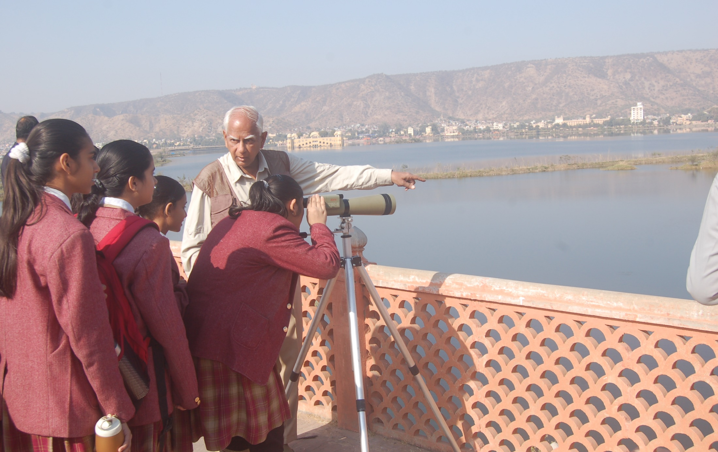
Thank you

