Slide 1
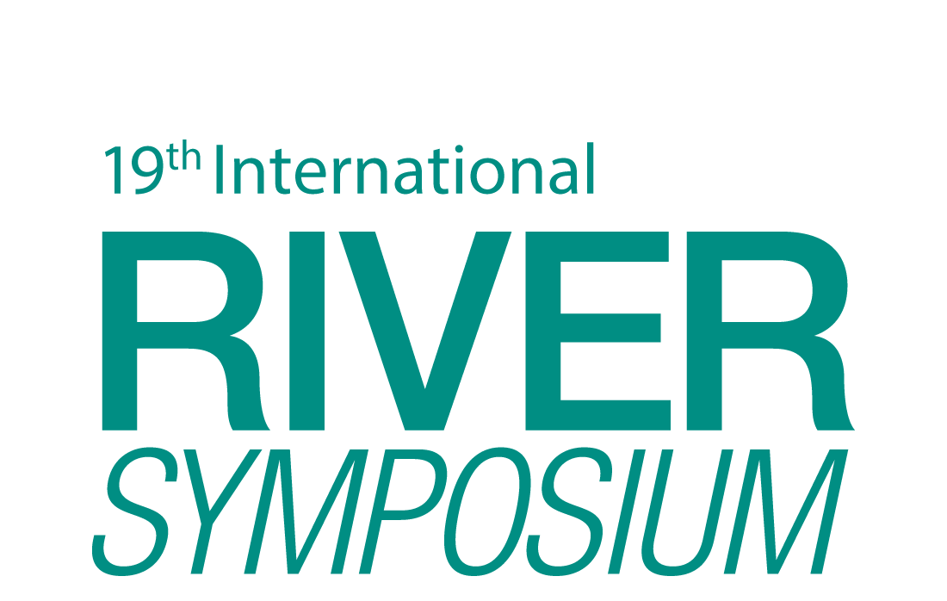
TAJ PALACE, NEW DELHI | 12 – 14 SEPTEMBER 2016
Water Insecurity and IWRM in West Timor, Indonesia
Mark Wolfsbauer

Slide 2
Timor Barat – West Timor

Slide 3
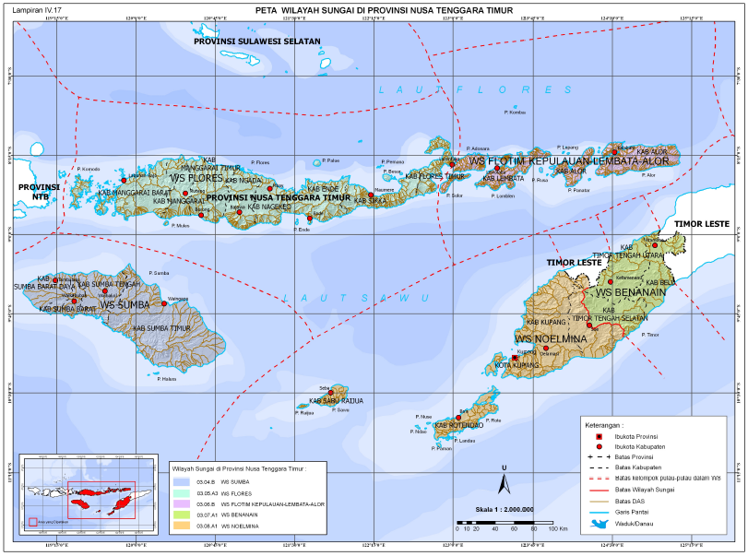

Slide 4
Climate and Hydrology
West Timor has a semi-arid monsoonal climate
Wet season occurs over December to March with a dry season from April to November
Rainfall in the province of NTT varies during the year from 600mm in the wet season to 0mm in the dry season
Annual average rainfall can vary significantly year by year, with the number of rainy days ranging from 35 to 144

Slide 5
Climate and Hydrology
The geology consists of porous karst rock (old limestone), metamorphic rock, sandstone, clay and alluvial rock
Limestone is prevalent and has been found as high as 1,600 m above sea level
Karst rock allows for high conductivity of groundwater and rapid recharge of aquifers, but also short residence times as the water quickly flows to the sea
Surface water runoff is common, most rivers are ephemeral with high rates of discharge in wet season

Slide 6
Drought in Eastern Indonesia
El Nino linked to 93% of drought years in Indonesia during the period 1877 to 1997
East Indonesia is particularly affected by El Nino and La Nina events
Most recent drought occurred in 2015 and 2016 in parallel with a strong El Nino event

Slide 7
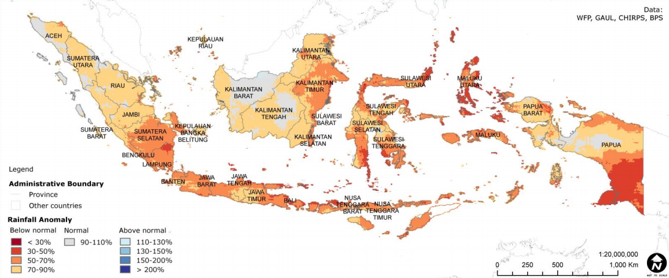
Drought of 2015/16

Slide 8
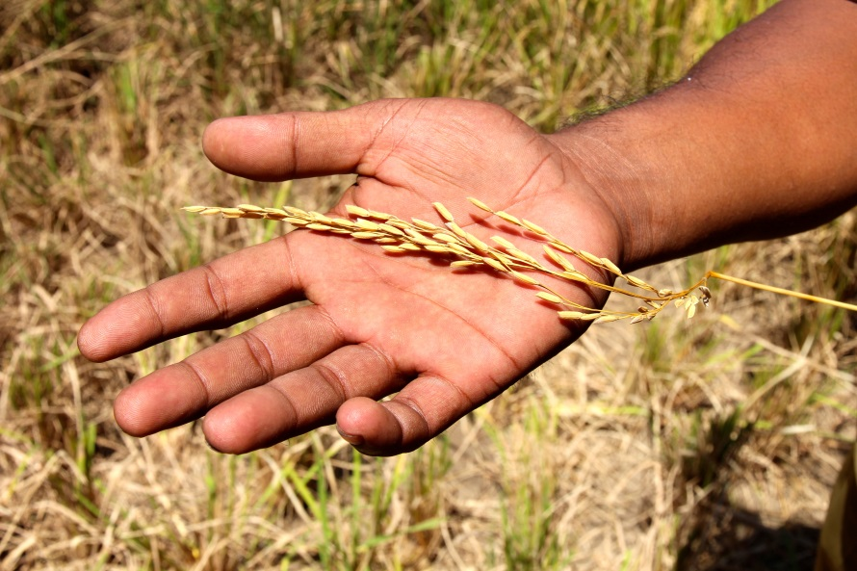
Drought of 2015/16
WFP investigation found that 180,000 people were in need of food assistance and 200,000 people were at risk of needing food assistance in West Timor

Slide 9
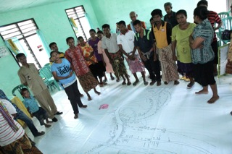
Investigating Drought Impacts in Kupang District

Slide 10
A Risk Assessment Matrix for Assessing Drought Impacts

Slide 11
Findings: Expected Impacts

Slide 12
Water Insecurity
Lack of drinking water
50% of shallow wells and boreholes were reported to be empty during the dry season in Kupang District
The most common source of drinking water during the dry season is a protected spring
Dependence on rainfed irrigation
Roughly 4% of land is irrigated but no data on size of irrigable land in West Timor
An estimated 70% of the rural population in East Timor is reliant on rainfed agriculture
Notes:
Many households are using unprotected sources in the dry season, including rivers, unprotected wells, unprotected springs, dams and lakes
Limited use of irrigation, which is often small scale, serving only one hamlet within a village

Slide 13
Food Insecurity
Crop failure
Indonesian Government has started a food distribution program ‘Rice for Poor Households’
Each household in the NTT Province will receive one 15kg bag of rice per month for six months, beginning April 2016
Malnutrition
Prevalence of malnutrition in West Timor
Drought events are likely to exacerbate problem
There is a need to address the broader causes of food insecurity in West Timor

Slide 14
Findings on Malnutrition
The prevalence of acute, chronic and under-weight children aged 6-59 months in 6 Sub-Districts of Kupang District in West Timor was assessed in 2015 by Action Contre la Faim.
21.2% of children were experiencing global acute malnutrition, of which 3.9% were suffering from severe acute malnutrition
Evidence of stunting was also identified for 51.4% of the sample population
Global acute malnutrition prevalence in all areas of the survey exceeds the World Health Organisation’s ‘critical’ threshold (≥15%), with stunting levels also ‘very high’ (≥40%)

Slide 15
Areas for Further Research
% of irrigable land covered by irrigation systems
Appropriate choice of irrigation systems and management approaches
Potential for adoption of household rainwater harvesting
Farmer coping capacity – current strategies and recommendations to improve resiliency
Watershed assessment – current condition and areas where reforestation is most likely to reduce evaporation and surface water runoff

Slide 16
Short Report on IWRM
Investigated governance arrangements for integrated water resource management in NTT Province
Limited progress towards IWRM
Revocation of 2004 Water Law
Short report available at this seminar
Bibliography for this presentation included in report

Slide 17
Questions

