Slide 1
A presentation on “Assessing a varying demand scenario using WEAP for Damanganga project, India”
TAJ PALACE, NEW DELHI | 12 – 14 SEPTEMBER 2016
PREPARED BY :
Dr. S. M. Yadav
Minal. M. Jariwala
CO-AUTHORED BY :

Slide 2
DETAILS OF THE AUTHORS:
Dr. S. M. Yadav, Professor, Department of Civil Engineering, S. V. National Indian Institute of Technology, Ichchhanath,Surat-395007, India
Minal Jariwala, P.G Scholar, Water Resources Engineering and Management, Dr. S & S. S. Ghandhy G.E.C, Nr Majura Gate, Surat-395001, India

Slide 3
CONTENTS
Preface
Critical review
Study area
Methodology
Key findings
Implications
Research limitations
References

Slide 4
Preface
River basins
Inherently complex systems with many interdependent components (streams, aquifers, reservoirs, canals, cities, irrigation districts, farms etc)
A River Basin Model
A Mathematical model that represents the relevant processes in a river basin
Predict the behavior of the basin under different conditions or management scenarios
Helps decision-makers to make rational water allocation among various users and sectors

Slide 5
Issues among various users in river basins:
Water Resources allocation
Maintaining water quality
Rapidly growing demand
Neither water managers nor water users have incentives to conserve water
Result→ Overuse and wastage of water instead of being treated as a scarce resource
Remedy for sustaining Water Resources→ Integrated Water Resources Management

Slide 6
Efficient and comprehensive river basin models :
Utilizes simulation and optimization algorithms
To formulate water resources alternatives
Analyze their impacts
Interpret
select the appropriate options for implementation
SOBEK | HYMOS
MODSIM | MIKE-BASIN,
WBalMO (Water Balance Model) | RIBASIM (River Basin Simulation Model)
WEAP (Water Evaluation And Planning)

Slide 7
Critical Review
Through the Hydrology Project at Water Resources Department Government of Maharashtra, India, RIBASIM model was used to predict the water shortages in the Godavari river basin, India for years 2015 and 2020, and to develop decisions for minimizing deficit
Omar (2013) used RIBASIM to simulate and evaluate water demands and shortages for Fayoum, Egpyt
Zakari (2011) used WEAP to investigate scenarios of future water resource development in the Niger River Basin in Niger Republic

Slide 8
WEAP model was used to simulate current and future water demands by McCartney et al. (2009) for Blue Nile
Arranz and McCartney (2007) used WEAP model to assess future water demands and resources in the Olifant catchment, South Africa
Rukuni (2006) modeled the response of small multi-purpose reservoirs to hydrology for improved rural livelihoods in Mzingwane catchment using WEAP for Limpopo Basin

Slide 9
Study area - Damanganga Reservoir Project
Located near Madhuban village in Dharampur taluka of Valsad district of Gujarat, India
Canal network irrigates area of 566.30 sq km
Dam height above the deepest foundation : 50 m
Gross storage: 567 Mm³ , Effective storage: 502 Mm³
Major purpose
Irrigation,
Water supply for Domestic and Industrial use
Power generation (2.0 MW)

Slide 10
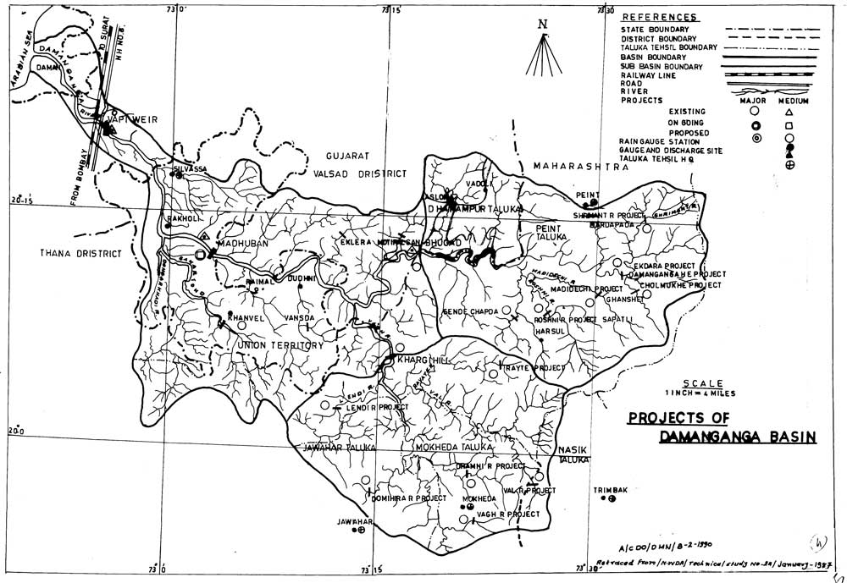
Damanganga Basin, India

Slide 11
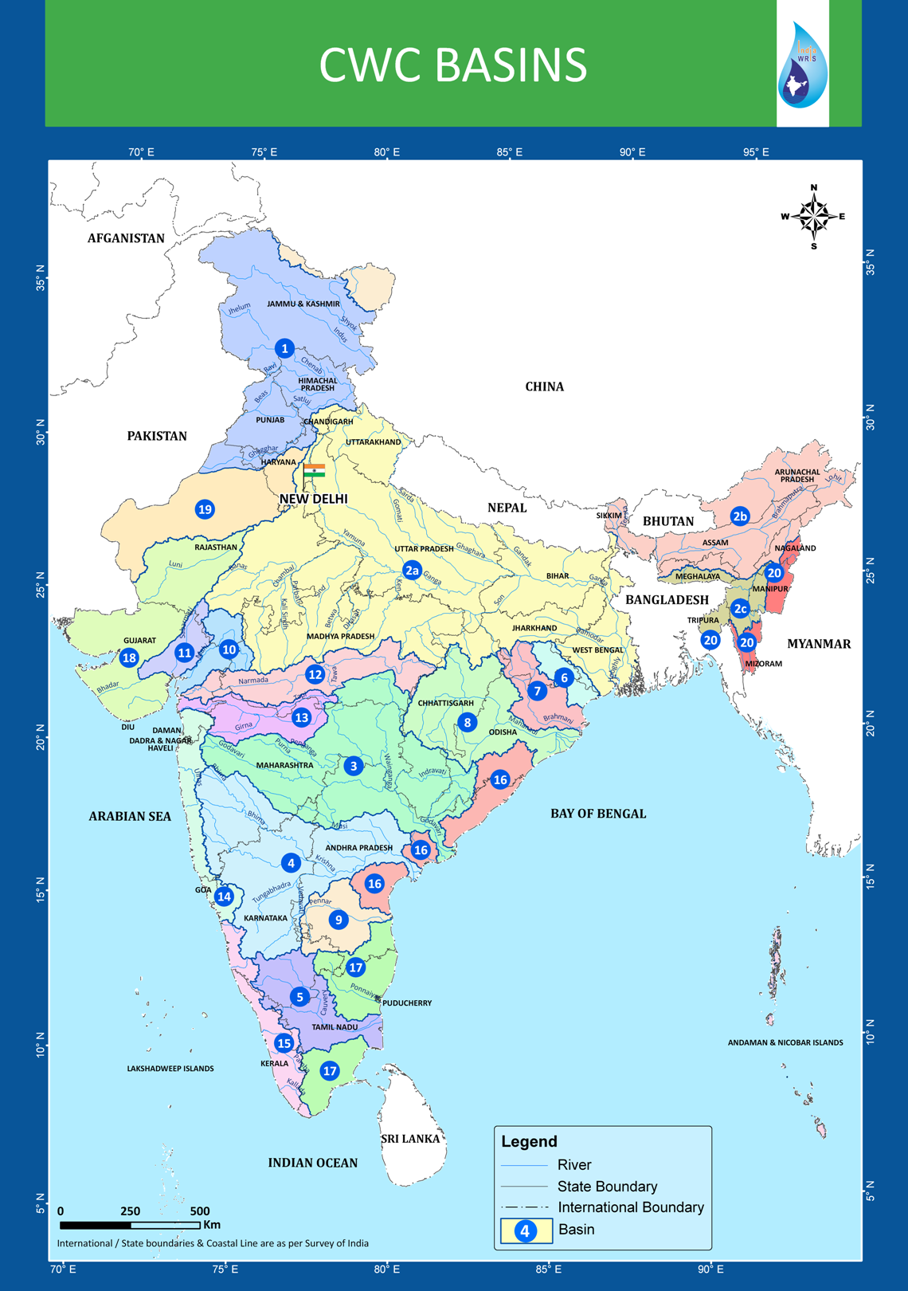
Among 22 CWC Basins, Damanganga lies under Basin name West Flowing river from Tapi to Tadri with basin code 14 having total drainage area of 55940 sq km

Slide 12
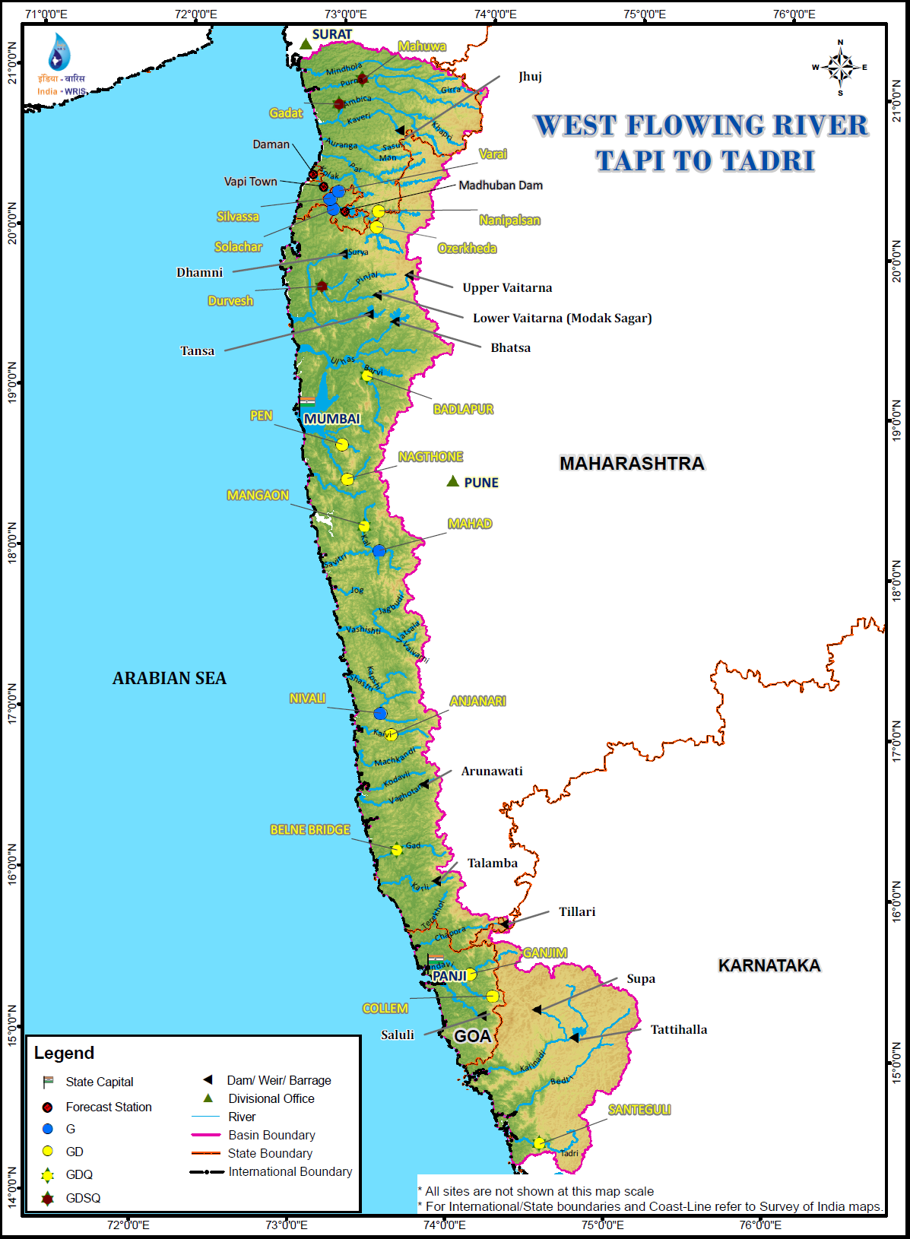
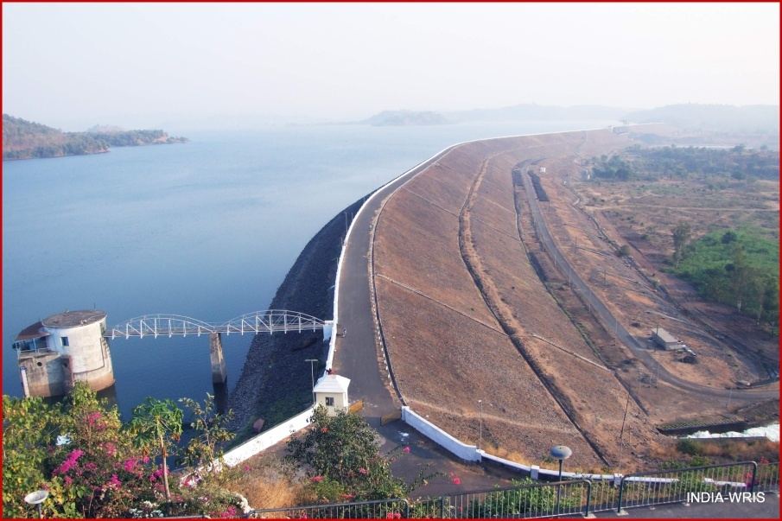

Slide 13
Table 1. Distribution of Drainage Area
Sr. No | Name of District / State | C.A. in sq. km. | % of Total C.A. | Volume of water shared
1 | Nasik / Maharashtra | 1408 | 60.74 | 34.20 Mm³
2 | Valsad / Gujarat | 495 | 21.36 | 399.19 Mm³
3 | Dadara & Nagar Haveli & Daman /U.T. | 415 | 17.90 | 83.33 Mm³

Slide 14
Need of the study
Damanganga reservoir project faces many water-related problems being:
Acute shortage of drinking water in the downstream area
Daman and Silvassa drinking water problems
Poor agricultural practices
Decreasing rainfall trend.
Repeated floods
Industries in Vapi, Pardi and Bhilad draw water from Madhuban dam

Slide 15
Objective of the study
To calibrate WEAP model and simulate the base year condition and predict water demand for the future year 2021 for three districts of Damanganga reservoir project
Vapi
Pardi
Bhilad
To evaluate the influence of increased population on the future water demands of Damanganga project

Slide 16
Methodology
Water Evaluation And Planning (WEAP) developed by the Stockholm Environment Institute's U.S. Center is used
Deals with problems pertaining to water resources allocation among agricultural, municipal and environmental uses
Water supply
Water demand
Water quality

Slide 17
WEAP modeling:
Defining study area (Establishing the time frame, spatial boundaries, system components)
Formulation of current accounts
Implementation of scenarios
Evaluation of scenarios

Slide 18
Data collected (from two divisions: Madhuban Division, Silvasa and Irrigation Division, DCSD Div No.3 Balitha, Vapi) includes:
Population number and population growth for year 2001 and 2011
Total agricultural area (ha of area irrigated, water use rate etc)
Number of factories and total industrial demand
Streamflow data (River Inflow)
Reservoir storage data (Gross storage, effective storage, Dead storage, initial storage at the beginning of simulation, observed storage)
Water released for demand sites viz. Drinking, Industrial and Irrigation use

Slide 19
Based on site visits and assembled data, Damanganga water balance was developed for Water Resources analysis in year 2014.
Water Balance for Damanganga reservoir project in year 2014
Inflow= 3045.1325MCM
Total Spillover=2788.3925MCM
Storage= 256.74MCM
Table 2. Water Balance for Damanganga reservoir project in year 2014
Water consumed (MCM) |  | Losses (MCM)
Irrigation | 102.20 | Evaporation | 59.8
Drinking | 3.37 | Others | 16.7
Industries | 49.40
Tanks/Ponds | 24.51

Slide 20
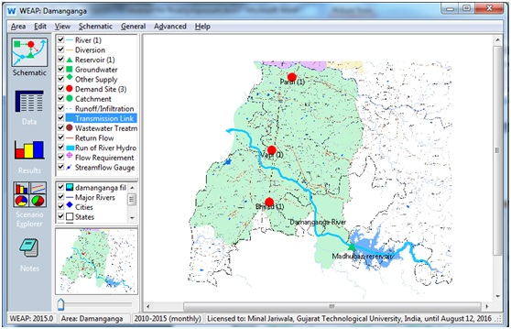
WEAP Schematization

Slide 21
The schematization of WEAP was done for present study using
River element
Reservoir node (Madhuban dam)
Demand site nodes (Vapi, Pardi and Bhilad)
Each demand site node was disaggregated showing the percent of annual share for Irrigation, Domestic and Industry.

Slide 22
Model Validation
For the model to be used to evaluate future water demands, validation was done by entering data for demand sites for base year 2014 and comparing with actual (observed) water demand

Slide 23
Table 3. Input data for WEAP Model for base year 2014
Month | Jan | Feb | Mar | April | May | June
River Inflow (CMS) | 00.00 | 00.00 | 00.00 | 00.00 | 00.00 | 19.18
Observed Storage (MCM) | 455.56 | 394.56 | 332.26 | 254.250 | 190.030 | 124.560
Month | July | Aug | Sept | Oct | Nov | Dec
River Inflow (CMS) | 189.9 | 143.6 | 106.1 | 60.53 | 13.41 | 0.894
Observed Storage (MCM) | 95.170 | 268.830 | 382.870 | 510.160 | 510.160 | 457.750
Demand site | Vapi | Pardi | Bhilad
Agricultural Area (ha) | 2191.34 | 2875.75 | 2524.49
Water use rate( m³/ha) | 6041.96 | 9614.88 | 12877.85
Population for year 2014 | 206100 | 29500 | 9800
Water use rate (lpcd) | 200 | 200 | 200

Slide 24
Simulated water demand obtained using WEAP were compared with the actual observed water demand obtained from Damanganga Canal Distry divisions for three demand sites.
Table 4. Simulated Vs Actual Demands (MCM) for year 2014
Division | Simulated water demand (MCM) | Actual water demand (MCM)
Vapi | 26.1018642 | 26.093
Pardi | 30.7252733 | 30.71
Bhilad | 33.2086203 | 35.38
SUM | 90.0357577 | 92.183

Slide 25
For the verification of base case 2014 and to measure the accuracy of numerical model predictions for the current scenario, Root Mean Square Error was used which is calculated as:
Where, Ys is simulated demand and Yi is actual demand

Slide 26
Simulated and Actual (observed) water demands for year 2014
The lower RMSE value of 0.865 indicated that WEAP can perform well to evaluate the future scenario

Slide 27
Future Scenario
Future scenario was formulated to show the impact of increase in population growth (varying demand) on water demands
It assumes the population growth of 10% for Vapi, 3% for Pardi and 4% for bhilad
Table 5. Input Data for WEAP model for Future year 2021
Demand site | Vapi | Pardi | Bhilad
Water use rate (lpcd) | 200 | 200 | 200
Increased Population growth for year 2021 | 10% | 3% | 4%

Slide 28
Table 6. Comparison of Simulated water demands (MCM)
Scenario formulated indicates a total water demand of 102.48 MCM for future scenario of increased population
Division | Current scenario | Future scenario
Vapi | 26.10 | 38.83
Pardi | 30.72 | 30.27
Bhilad | 33.21 | 33.37
Sum | 90.04 | 102.48

Slide 29
Comparison of water demand for Current scenario (2014) and Future scenario (2021)
The water demand for Vapi and Bhilad increases by 12.73 MCM and 0.16 MCM respectively. However, the demand is reduced by 0.46 MCM for Pardi.

Slide 30
Key Findings
The total simulated water demand obtained using WEAP for base year 2014 was 90.04 MCM
However, the total actual water demand , as estimated from the data collected, for base year 2014 was 92.18 MCM
Future scenario formulated to show the impact of increase in population growth, assuming the population growth of 10% for Vapi, 3% for Pardi and 4% for bhilad, resulted to total water demand of 102.48 MCM

Slide 31
Implications
The predicted value deviate from the actual water demand of the year 2014 with low RMSD of 0.865 which can be inferred as good prediction
The results for formulated scenario indicate that increase in population growth, yields in increase in the water demands by 12.44 MCM
The gross storage capacity of Damanganga reservoir is 524.857 MCM. Hence, the reservoir is able to supply increasing demand for full reservoir condition as well as 50% of Gross storage

Slide 32
As observed from past storage conditions of Damanganga Reservoir from year 2001 to 2014, the minimum storage was observed as 63.37 MCM (12% of Gross storage)
Water shortage may occur under such storage conditions

Slide 33
Research Limitations
The future scenario was formulated considering the impact of increased population growth. Thus, present study is limited to yield results for varying demand
However, Water demand may vary for water supply conditions. Varying water supply condition can be assessed using water year method and water demand can thus be predicted
Thus the study needs to be extended to obtain the cumulative effect for applying the model to other districts

Slide 34
References
Arranz, R., McCartney, M.P., 2007. Application of the Water Evaluation and Planning (WEAP) model to assess future water demands and resources in the Olifants Catchment- IWMI Working Paper 116. IWMI – International Water Management Institute, South Africa, pp. 91.
McCartney, M., Ibrahim, Y. A., Sileshi, Y., Awulachew, S. B. 2009. Application of the Water Evaluation And Planning` (WEAP) Model to Simulate Current and Future Water Demand in the Blue Nile. Proceedings in Intermediate Results Dissemination Workshop on Improved water and land management in the Ethiopian highlands: Its impact on downstream stakeholders dependent on the Blue Nile. 2009 February 5-6. International Livestock Research Institute (ILRI), Addis Ababa, Ethiopia, pp. 78-88.
Mounir, Z. M., Chuan, M. M., Issoufou, A. 2011. Application of Water Evaluation and Planning (WEAP): A Model to Assess Future Water Demands in the Niger River (In Niger Republic). Journal of Modern Applied Science, Vol. 5, No. 1, pp. 38-49.
Omar, M. M. 2013. Evaluation of actions for better water supply and demand management in Fayoum, Egypt using RIBASIM. Water science 27, Elsevier, pp.78-90.
Rukuni, S. 2006. Modeling the response of small multi-purpose reservoirs to hydrology for improved rural livelihoods in the Mzingwane catchment: Limpopo Basin. M. Sc. Thesis, University Of Zimbabwe.
Stockholm Environment Institute (SEI). 2015. WEAP21: Water Evaluation and Planning System-Tutorial and User guide, Stockholm Environment Institute, Boston, USA.
Van der Krogt, W., Verhaeghe, R., 2001. Regional allocation of water resources. In: Hengsdijk, H., Bindraban, P. (Eds.), Proceedings of an InternationalWorkshop on Water Saving Rice Production Systems. 2001 April 2–4. Plant Research International, Wageningen, Netherlands, pp. 101–116.
Van der Krogt, W., 2010. Technical Report: RIBASIM Version 7.01 User Manual Addendum. Deltares Institute, Netherlands.
Yates, D., Sieber, J., Purkey, D., and Huber-Lee, A. 2005. ―WEAP 21 a demand, priority and prefesrence driven water planning model, part 1: model characteristics.” Water International 30, 487-500.

Slide 35
THANK YOU

