Slide 1
Opportunities for Cross-border Collaboration in Management and Monitoring of River Biodiversity in Indus Basin
TAJ PALACE, NEW DELHI | 12 – 14 SEPTEMBER 2016
Moving from Conflict to Shared Responsibility
Vaqar Zakaria, Hagler Bailly Pakistan

Slide 2
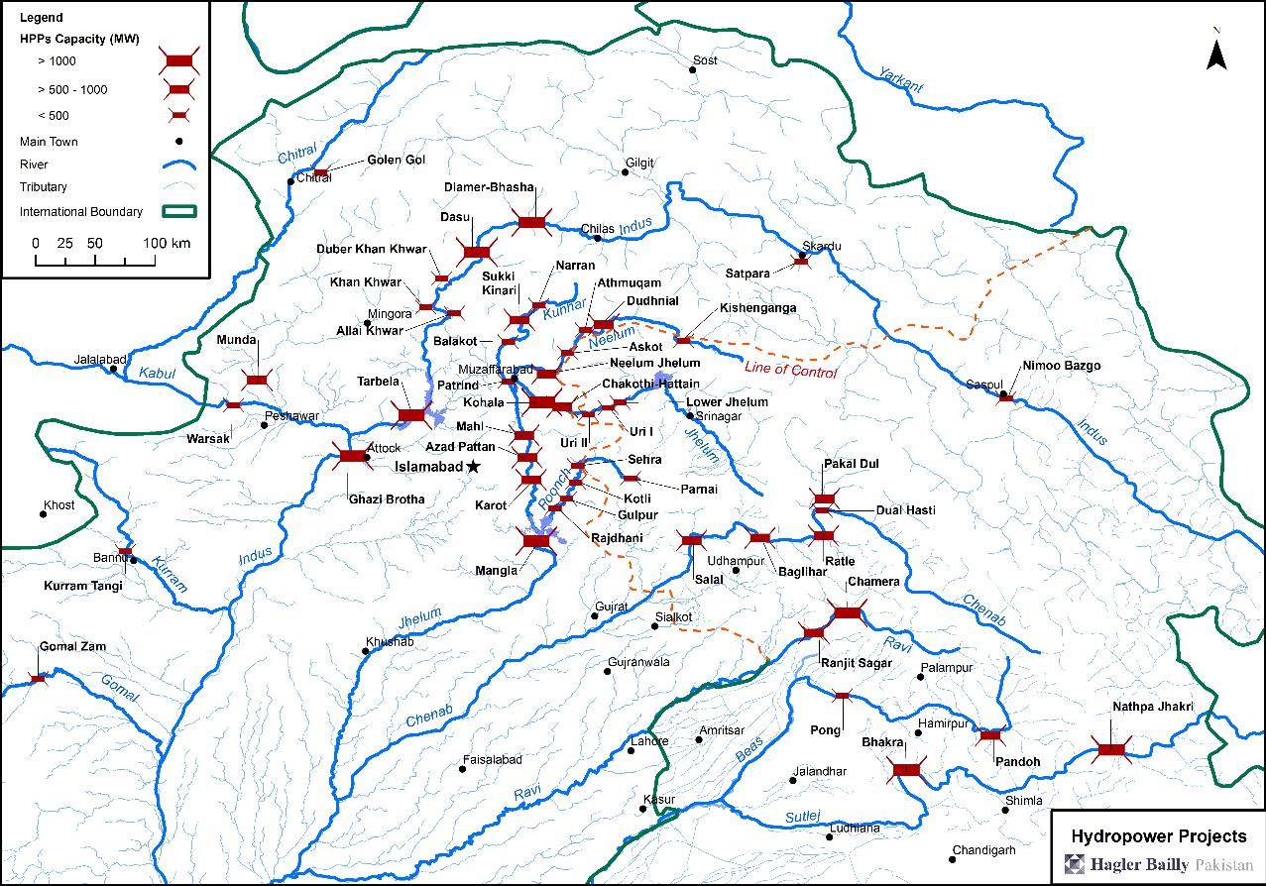
Hydropower Developments in Indus Basin

Slide 3
Environmental Considerations in Hydropower Development – Lessons from Kishenganga Case
In Kishenganga Case decision, the Court of Arbitration established under the Indus Water Treaty concluded that:
Hydro-electric projects must be planned, built and operated with environmental sustainability in mind
There no disagreement between the Parties that the maintenance of a minimum flow is required for environmental protection
The Court acknowledges India’s point that the environmental sensitivity that Pakistan urges in these proceedings does not match Pakistan’s own historical practices
Court’s ultimate decision on the minimum flow is informed by a deep awareness of the critical importance (and shortage) of electricity in both India and Pakistan. Meaningful development in this area need not be at odds with careful consideration of environmental effects
Having obtained a dispensation for environmental flow, Pakistan has had to critically examine its approach to environmental management in hydropower developments to avoid an accusation of ‘double standards’ in future

Slide 4
Challenges in Moving Towards Sustainability in Hydropower Development in the Region
The governments and developers:
Entrust basin wide planning to engineers who view the river as a source of electrical energy, where every foot of drop in elevation has to be utilized
Run into environmental issues when all the designs and agreements are done, and the of the course of the project is sealed
Ask environmental specialists to make their assessments fit the designs, and see them as ‘spoilers’ or necessary evils
Expect owners to finance environmental costs out of their profits
The people view the rivers as a free resource for:
Harvesting of fish
Extraction of sediments for construction
Extraction of water
Dumping of effluents and solid waste

Slide 5
Examples of Outcomes
As a result of hydropower developments:
Large projects at the lower ends of sub-basins such as Tarbela and Mangla Dams have isolated the mountain river ecosystems from those in the plains resulting in loss of diversity in both
Cascades of hydropower projects such as those in the Jhelum River are set to wipe out migratory fish species
However, major damage is done by people, even if the dams are not there:
The ancient and historic Soan River near Rawalpindi had more than 35 fish species about forty years back, about five remain now that can survive in polluted waters
River beds are being mined for sand and gravel, destroying habitats
All is fair to catch fish, be it explosives, large gill nets, fine mesh nets, and poisons
River ecology is likely to be irreversibly damaged whether or not the dams are built and operated

Slide 6
The Gulpur HPP Case

Slide 7
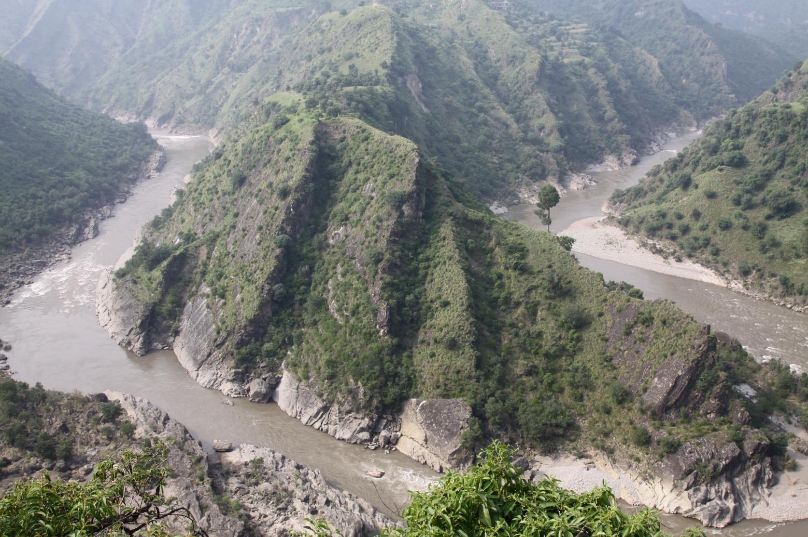

Slide 8
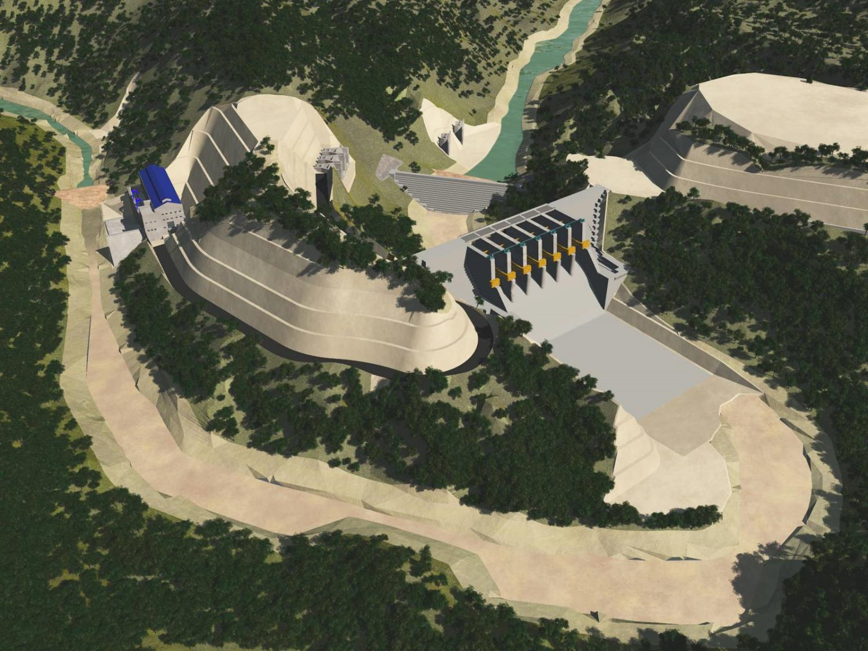
Diversion Tunnels
Cofferdam
Powerhouse
Intake
Weir and Spillway
Stilling Basin

Slide 10
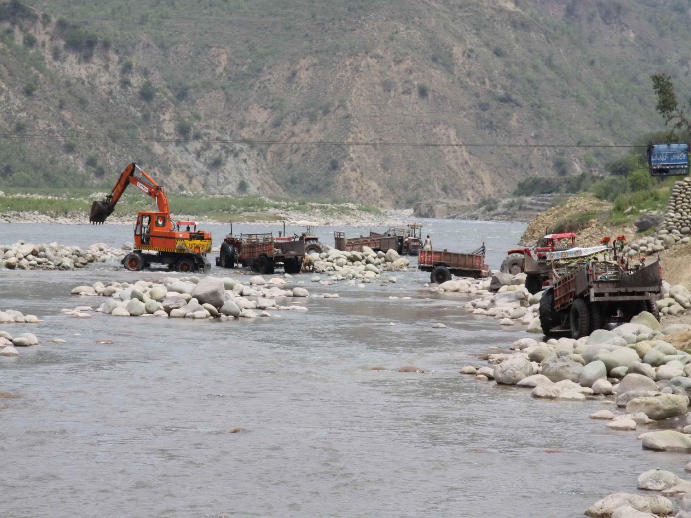

Slide 11
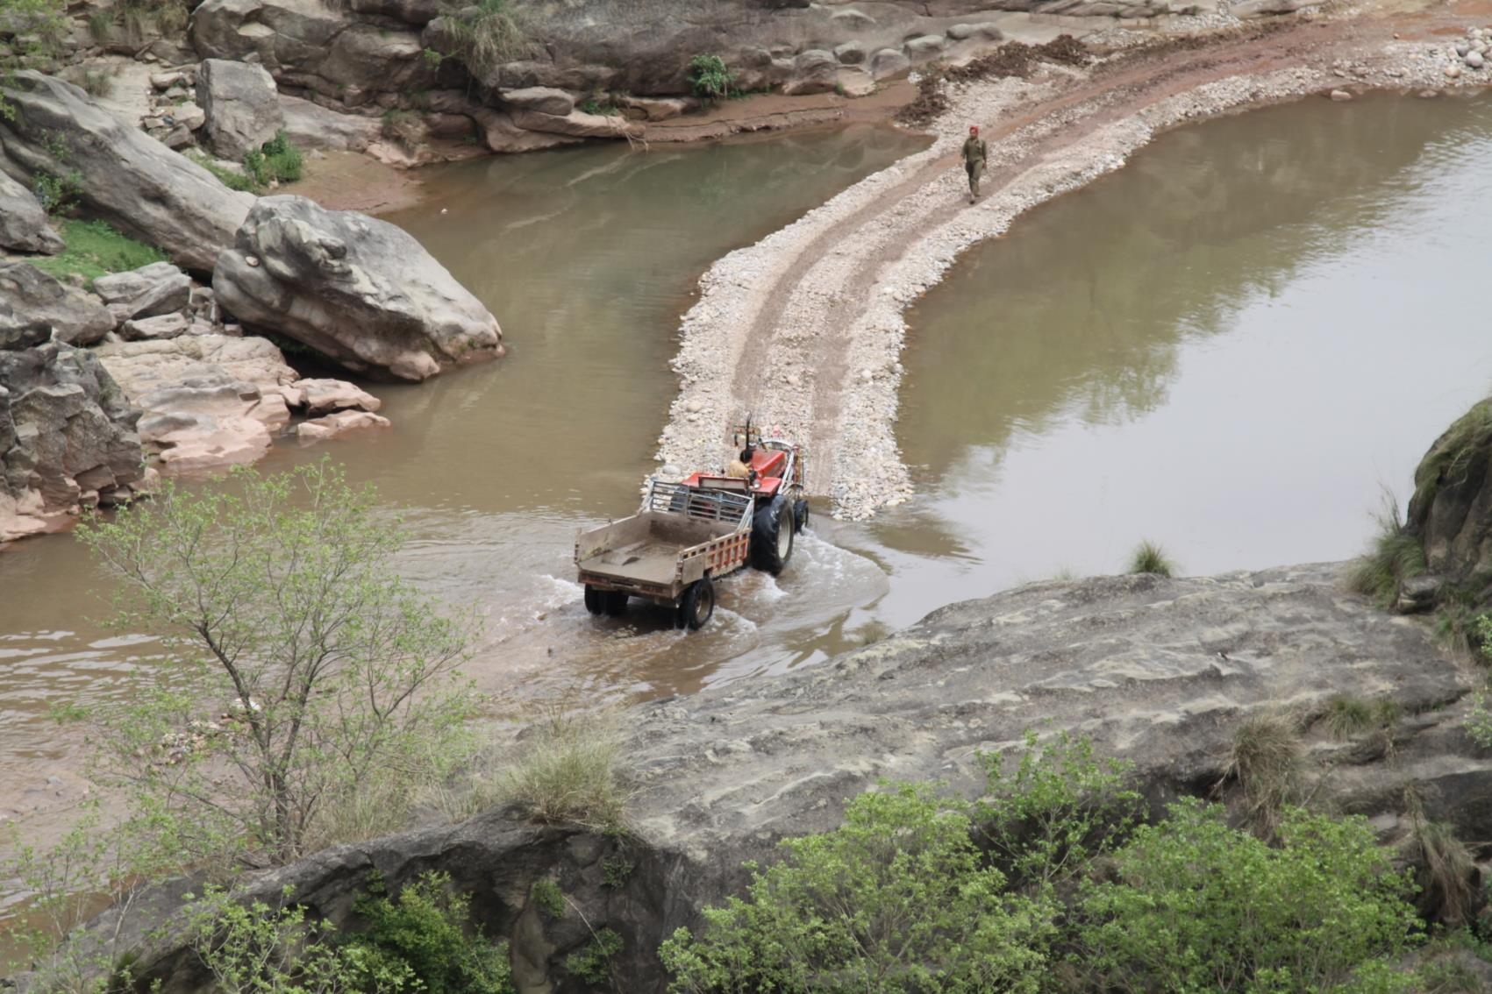

Slide 12
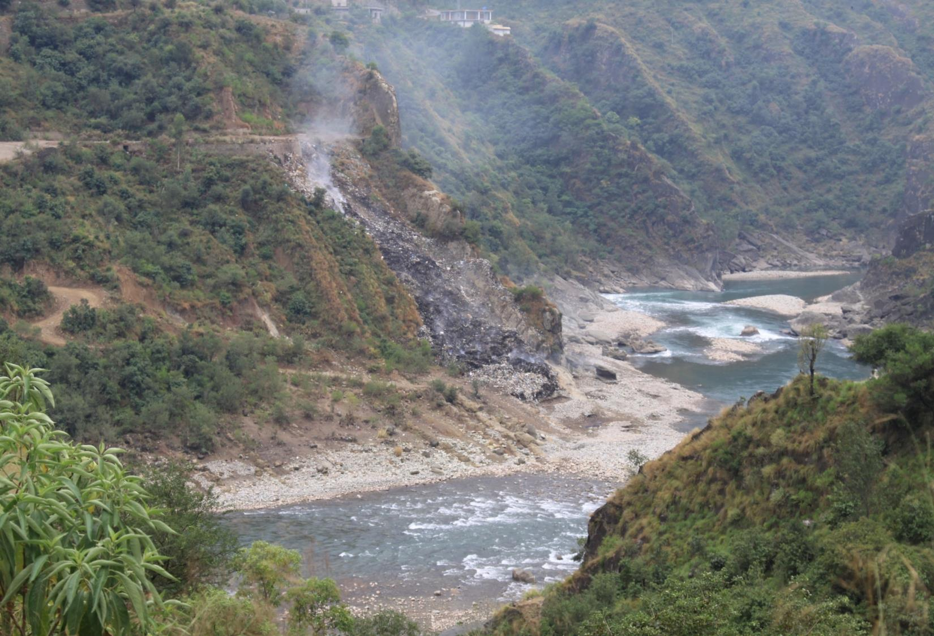

Slide 13
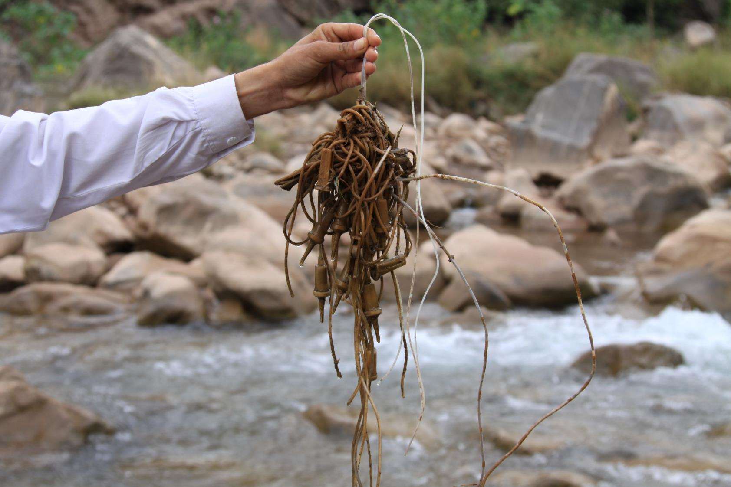

Slide 14
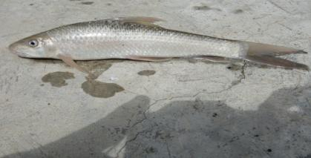
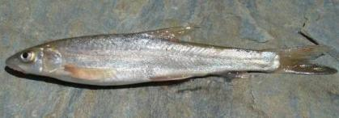
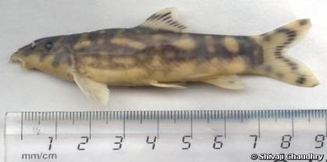
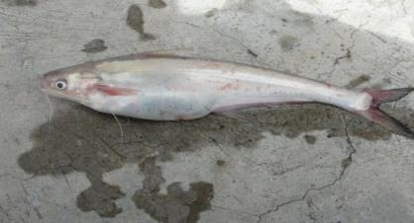
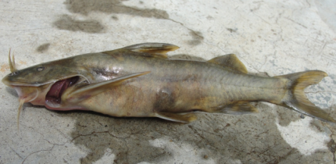
Indicator Fish Species Species
Tor putitora
Labeo dyocheilus
Schizothorax plagiostomus
Botia rostrata
Clupisoma garua
Glyptothorax kashmirensis

Slide 15
The Challenge
Wildlife legislation required ‘betterment of the park’ to approve actions and activities normally prohibited in a national park.
ADB and IFC as lenders required ‘net gain’ in biodiversity in Critical Habitat, in this case triggered by national park, Endangered Mahaseer, and Critically Endangered Kashmir Catfish.

Slide 16
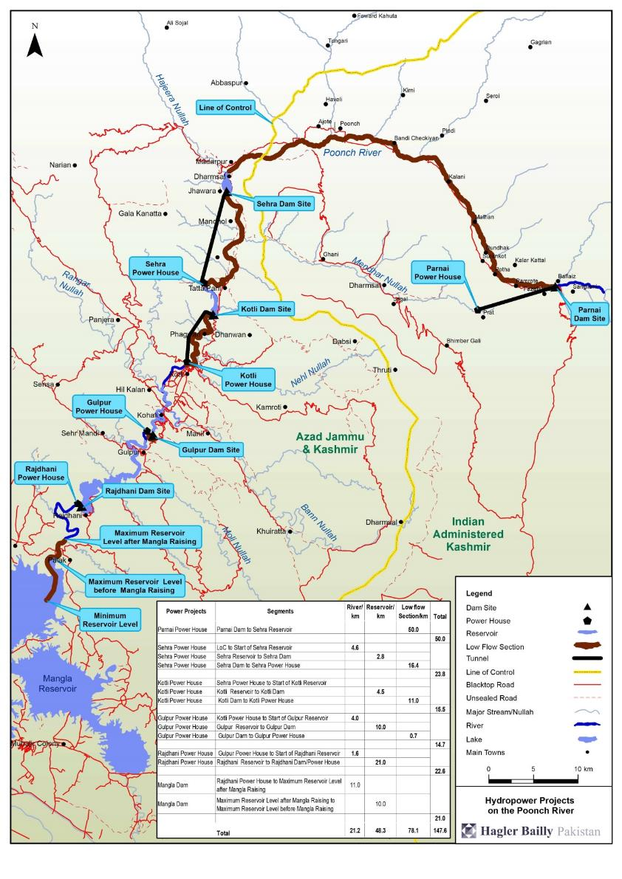

Slide 17
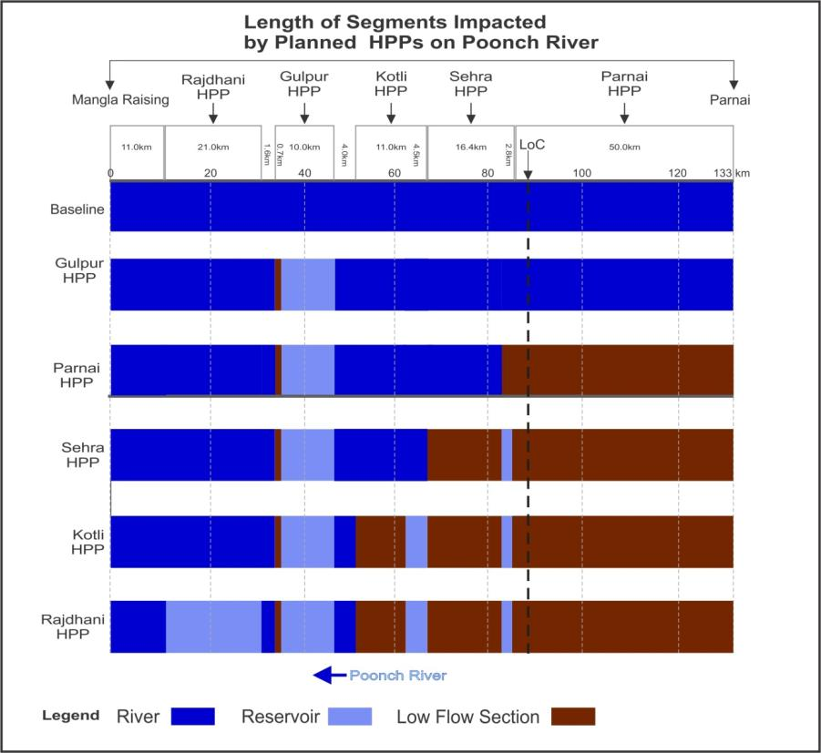

Slide 18
Critical Issues: Cumulative Impacts of Projects
Irrespective of the environmental design of the individual projects, in combination the projects planned on the river will have a detrimental and irreversible impact on the ecology of Poonch River. The wildlife department approved the project with the condition that all future projects will have to prove net gain in biodiversity in the national park.

Slide 19
The Strategy
Environmental management must focus on both flow related pressures created by dams, and non-flow pressures created by people
The consumers of electricity must pay for management of these pressures, whether in the form of higher tariffs due to higher releases for environment, non-peaking operations, or management of non-flow pressures
The electricity regulator should allow for these costs in capex and opex of the tariff
Implementation will be managed by the owner through contracts with third parties
A Biodiversity Management Plan (BMP) will be prepared to define actions required, roles and responsibilities, and M&E mechanisms
The owner will enter into an agreement with government to implement the BMP, the provision for which will be made in the Implementation Agreement for the power project

Slide 20
The Business Model for Sustainability

Slide 21
Signing of Agreement Between the Government and Project Owner

Slide 23
Handing Over of Vehicles to Implementation Organization

Slide 27
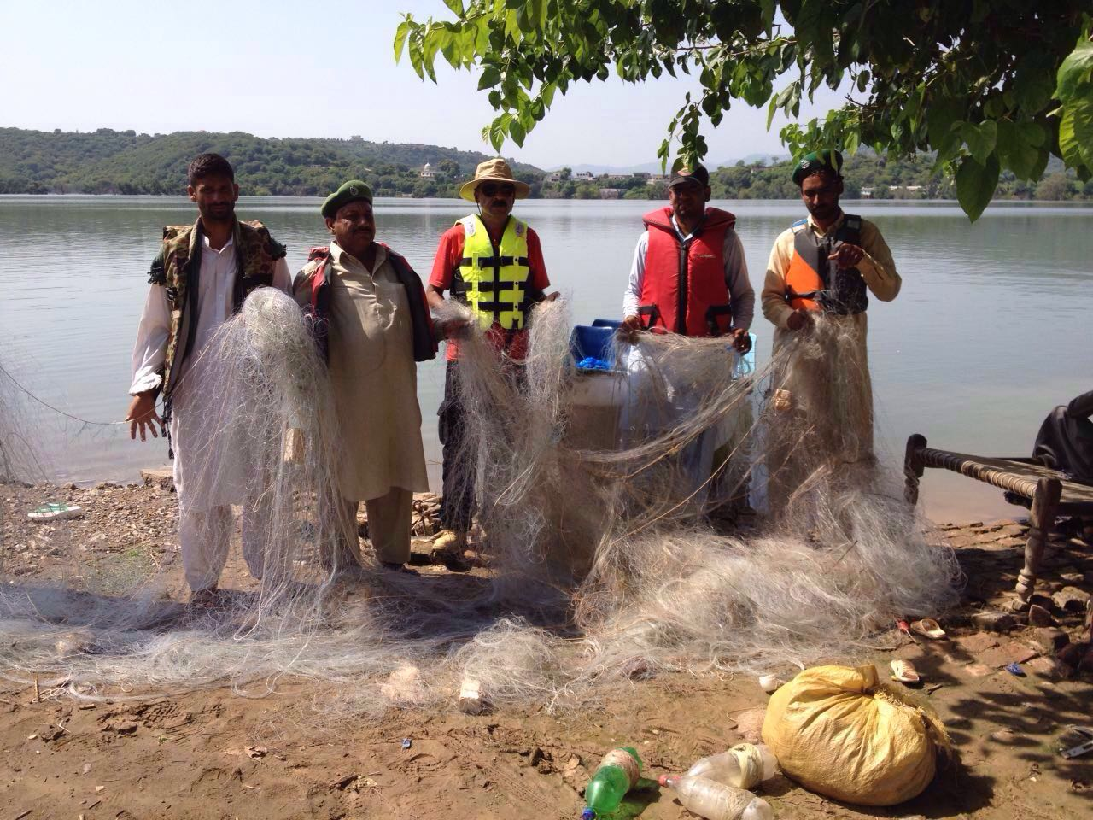

Slide 31
Monitoring and Evaluation

Slide 34
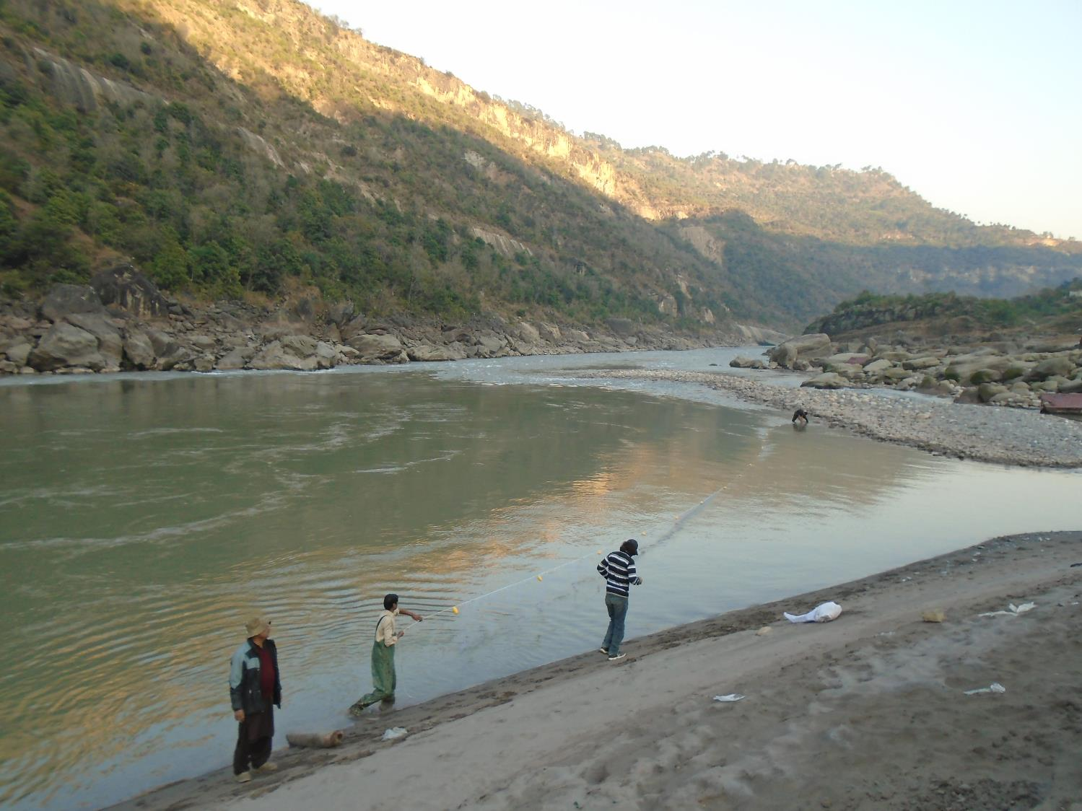

Slide 38
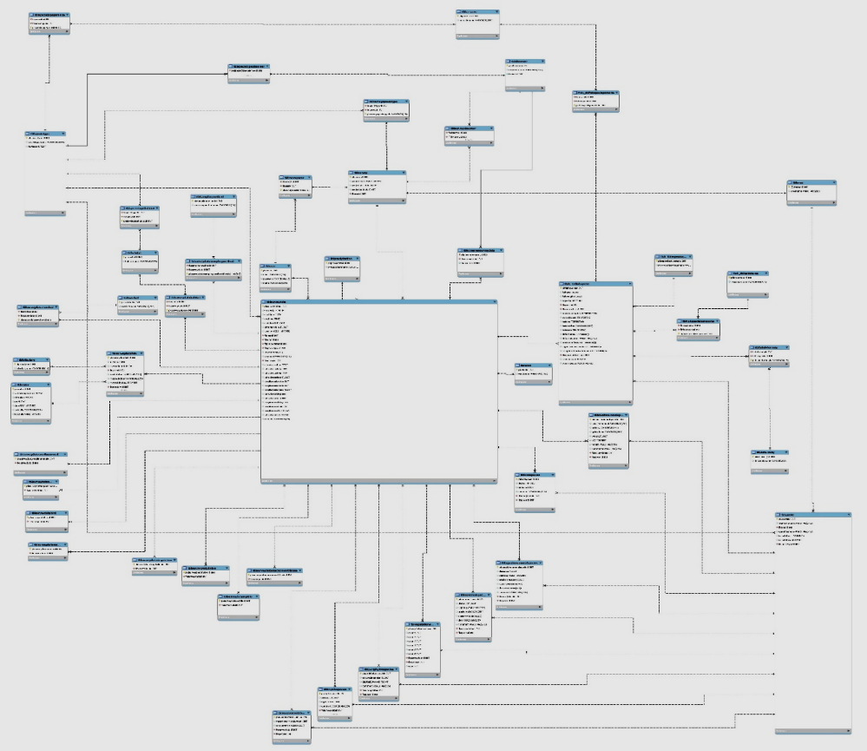
Relational Database

Slide 39
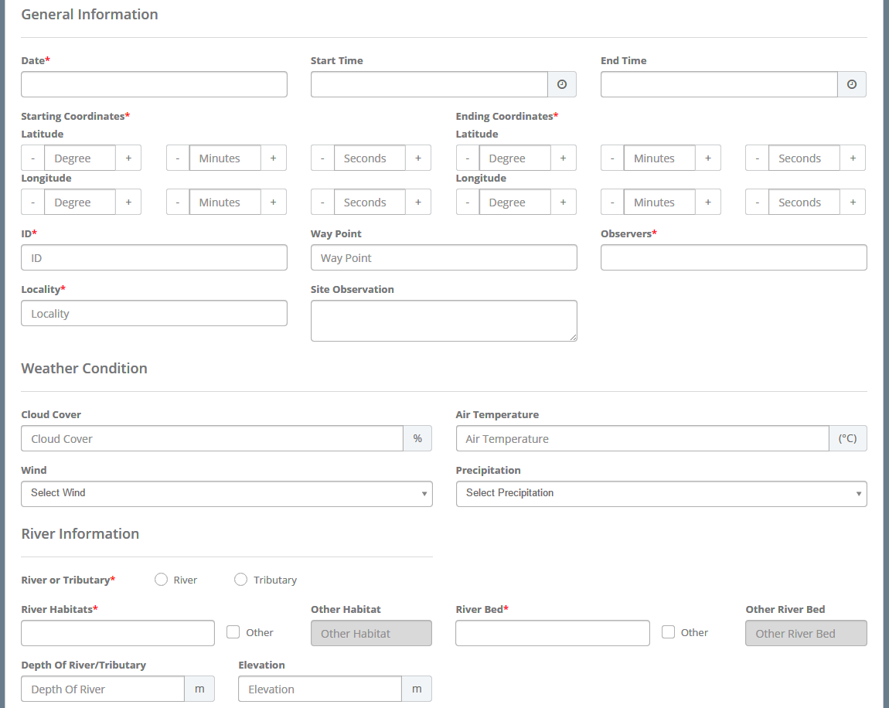
Online Data Collection Form

Slide 40
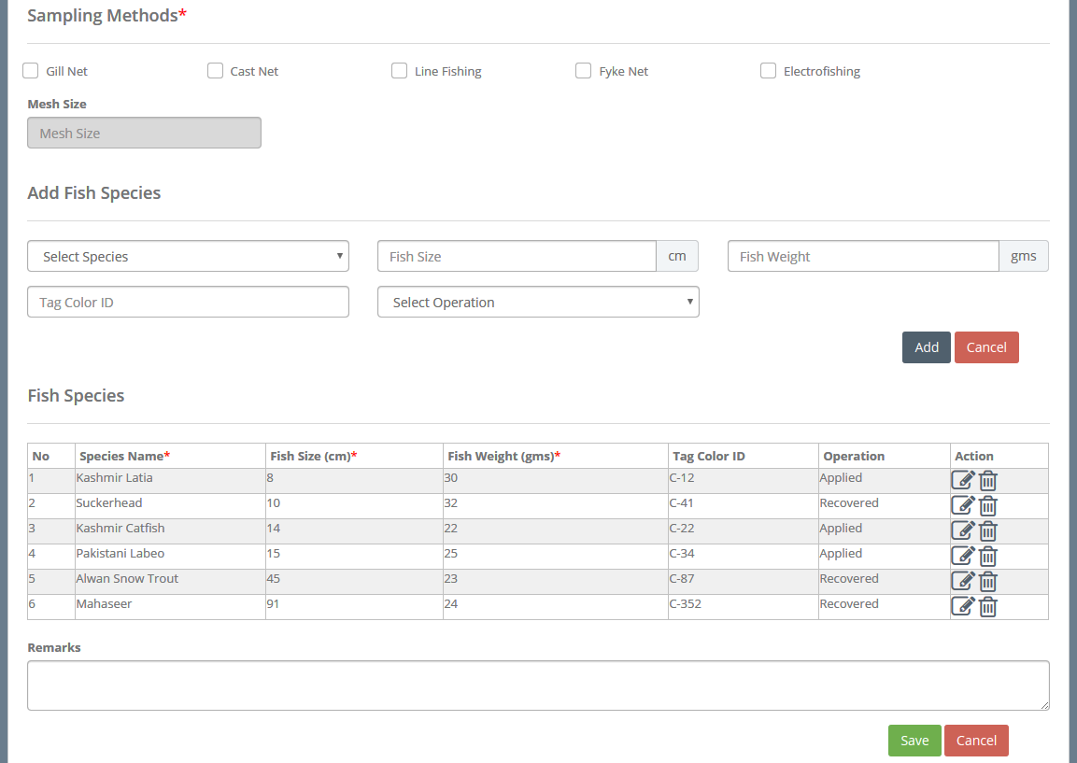
Online Data Collection Form

Slide 41
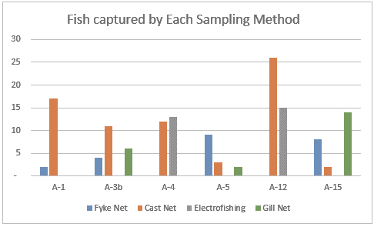
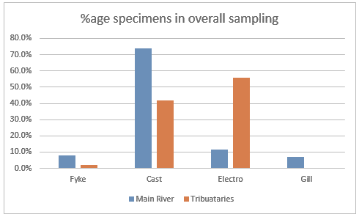
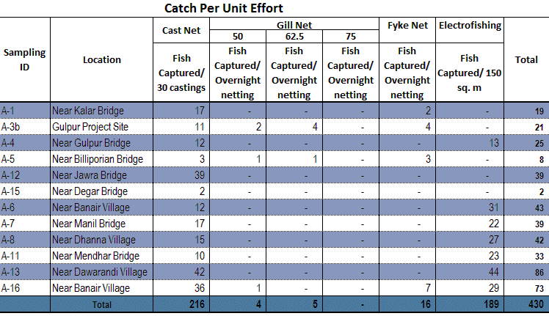
Sample Output/Report

Slide 42
The Way Forward
Replication of the business model being tested in Gulpur Project is already in an advance stages of finalization for a 760 MW and a 1124 MW project on Jhelum River
Documentation on the process is available on ADB and IFC websites
The monitoring data collected will be placed on the web, and will be accessible to managers and researchers
In the Court’s view in Kishenganga decision, the appropriate mechanism for the exchange of data and for the monitoring of the Parties’ uses on tributaries of the Indus River is the Permanent Indus Commission
However, the managers and researchers on both sides of the border can work together to improve management practices and to understand river ecosystems and impacts of uses on them
Fish don’t carry passports, and cyberspace is freely available for communication

