Slide 1
Wet Tropics Major Integrated Project
BRISBANE, AUSTRALIA | 18 - 20 SEPTEMBER 2017
MANAGED BY

Slide 2
Who am I and why am I here?
Not for profit NRM organisation for the Wet Tropics, Far North Queensland
Terrain promote sustainable use of land and waterways, protects environmental values and supports healthy, productive and viable communities and industries
We work at a whole of landscape scale, from the paddock to the reef
Facilitator, broker, coordinator - Why?

Slide 3
2017 Scientific Consensus Statement
Key Great Barrier Reef ecosystems continue to be in poor condition.
Due to the collective impact of land run-off, coastal development, extreme weather events and climate change impacts.
Sediments, nutrients and pesticides are the three biggest pollutants that affect the health of the Great Barrier Reef.
Progress towards the water quality targets has been slow and the present trajectory suggests these targets will not be met

Slide 4
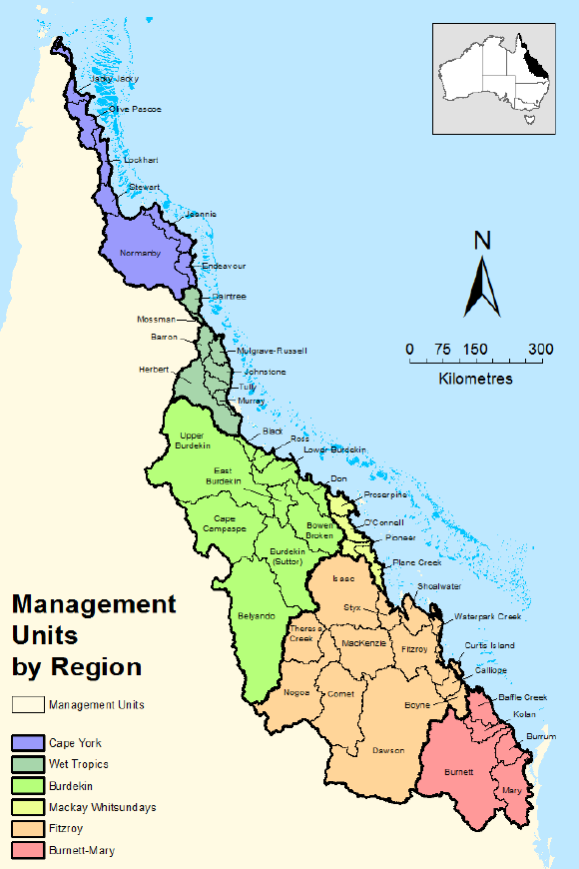
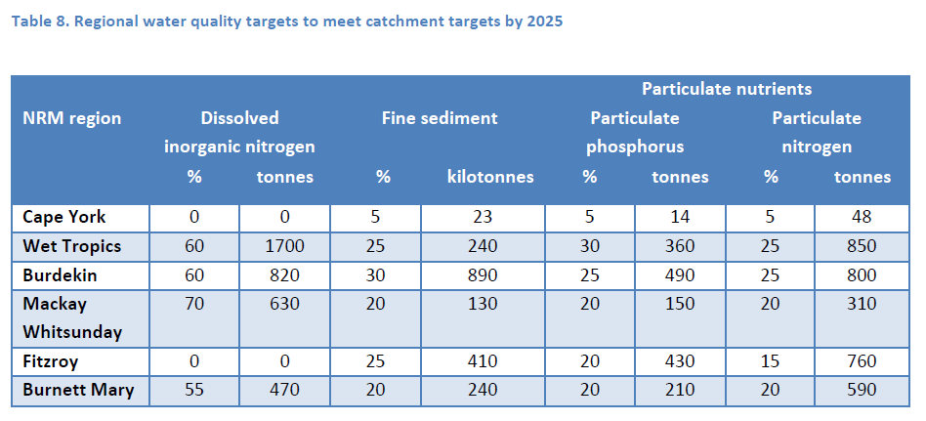
5 % of total GBR catchment area
46% DIN load, 30% Nitrogen load
15% total suspended sediment load
5 of the 8 Wet Tropics basins in top 10 DIN risk
4 of the 8 Wet Tropics basins in top 10 pesticides risk

Slide 5
CANEGROWERS Cairns Region
CANEGROWERS Herbert River
CANEGROWERS Innisfail
CANEGROWERS Mossman
CANEGROWERS Tully
CANEGROWERS Tablelands
Mossman Ag Services
SRA
Australian Cane Farmers Association (ACFA)
Herbert Cane Productivity Services Ltd (HCPSL)
Tully Cane Productivity Services Ltd (TCPSL)
MSF Sugar Limited
Tully Sugar Limited
Australian Banana Growers’ Council
Alluvium
Association of Marine Park Tourism Operators (AMPTO)
Australian Institute of Marine Science (AIMS)
Australian Wetlands Consultants Ltd
Behaviour Innovation
Cassowary Coast Regional Council
Cassowary Coast River Improvement Trust
C2O - Jane Waterhouse
Commonwealth Scientific and Industrial Research Organisation (CSIRO)
Community Matters
Eberhard Consulting
Far North Queensland Regional Organisation of Councils (FNQROC)
Girringun Aboriginal Corporation
GreenCollar
Greening Australia
Griffith University
Healthy Waterways and Catchments
Interchange
James Cook University
Johnstone Region Landcare Group
Johnstone River Catchment Management Association (JRCMA)
Mamu Aboriginal Corporation
Mulgrave Landcare and Catchment Group Inc. (MLCG)
O2 group
Queensland Water and Land Carers (QWALC)
Reef Rainforest & Research Centre (RRRC)
Rob Lait & Associates (John Armour)
Sugar Research Australia (SRA)
University of New England (UNE)
University of Southern Queensland (USQ)
Verterra
Wet Tropics Management Authority (WTMA)

Slide 6
Major Integrated Project 101
To test combinations of actions across all catchment activities to meet Reef water quality targets.
To develop a local design to meet local conditions and circumstances.
To reduce the level of nutrients and pesticides reaching the Great Barrier Reef from the Tully and Johnstone River Basins.
To integrate water quality solutions across all activities in the basins with a focus on farm practice and increase effectiveness.
Funded by Queensland Government, delivered by Wet Tropics Consortium

Slide 7
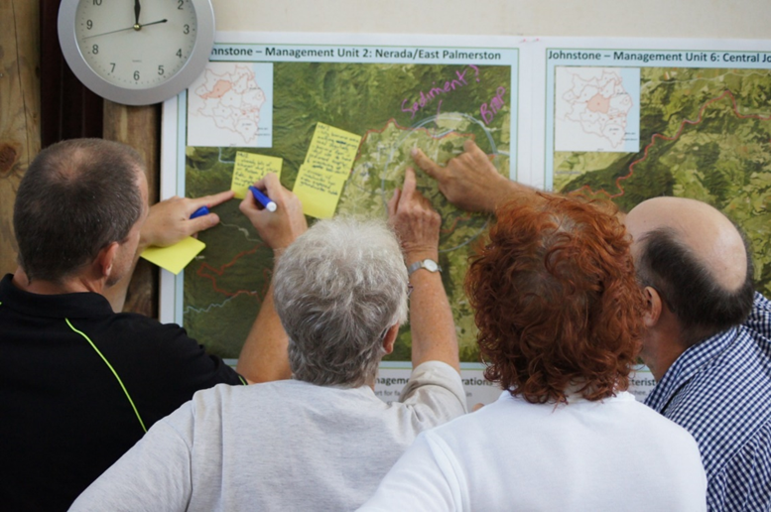
550 ideas generated
Change in landholder capacity to positively influence outcomes
Grass roots and community driven
Place based planning
New models of Collaborative Governance

Slide 8
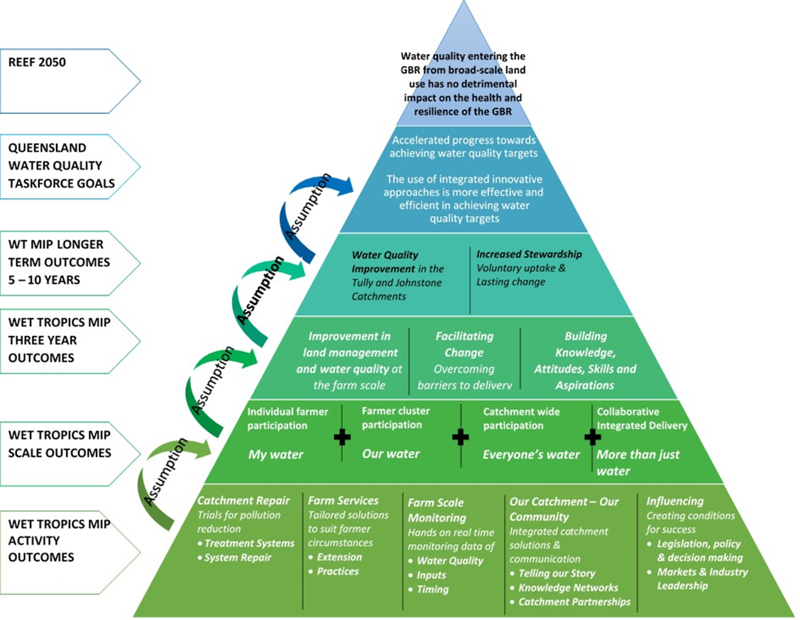
The strategic priority is to deliver enduring sustainable land management that also benefits local communities.

Slide 9
Successfully managed a complex and challenging process in a collaborative way
WTMIP design had generated a strong sense of shared ownership and commitment
Excellent participation was achieved
Innovative design process, guided by Project Panel, effective engagement of consortia and facilitation by Terrain
This is a significant achievement given the highly participatory, institutionally complex and experimental nature of the process and tight timeframes.
Exemplary and world class

Slide 10
