Slide 1


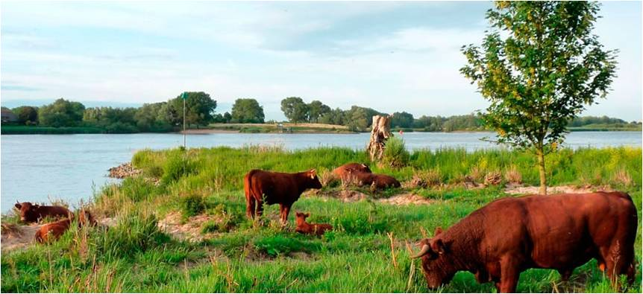

  Experience The River Waal
  - Johan Kaspers, Experience Agent
BRISBANE, AUSTRALIA | 18 - 20 SEPTEMBER 2017
MANAGED BY

Slide 2
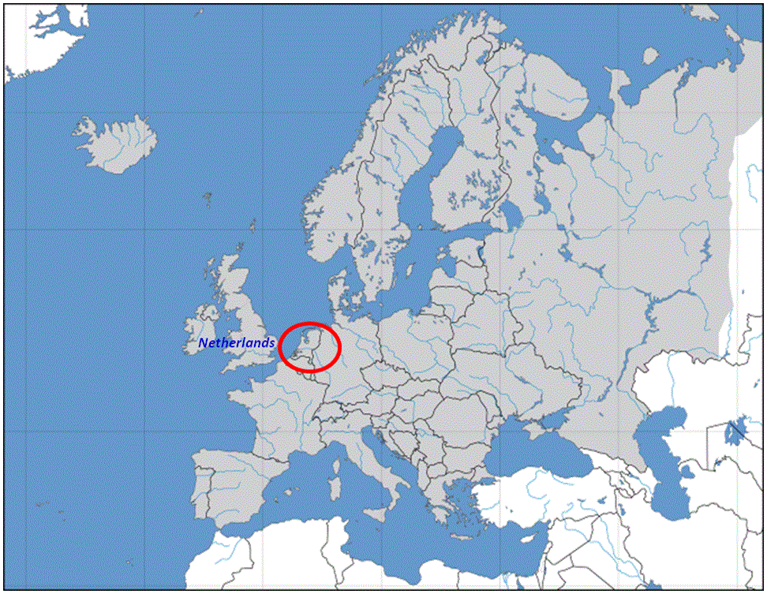
BRISBANE, AUSTRALIA | 18 - 20 SEPTEMBER 2017
MANAGED BY

Slide 3
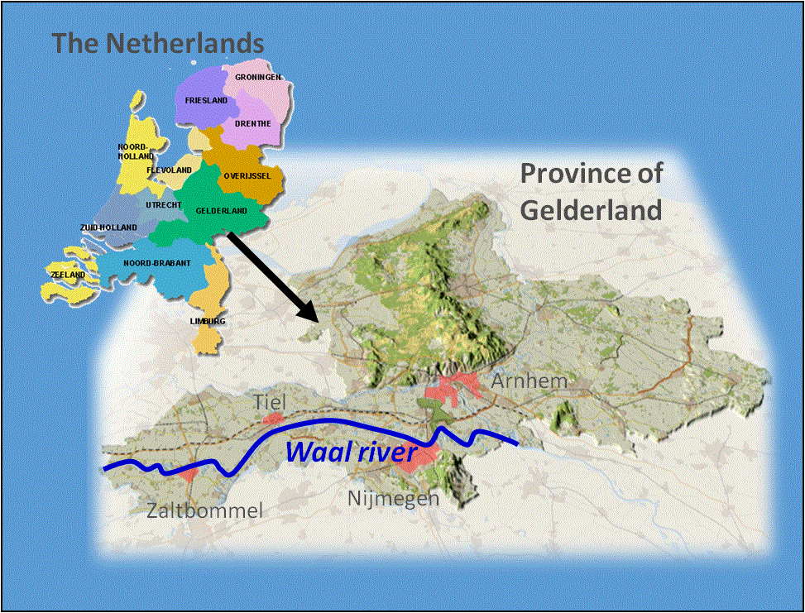
BRISBANE, AUSTRALIA | 18 - 20 SEPTEMBER 2017
MANAGED BY

Slide 4
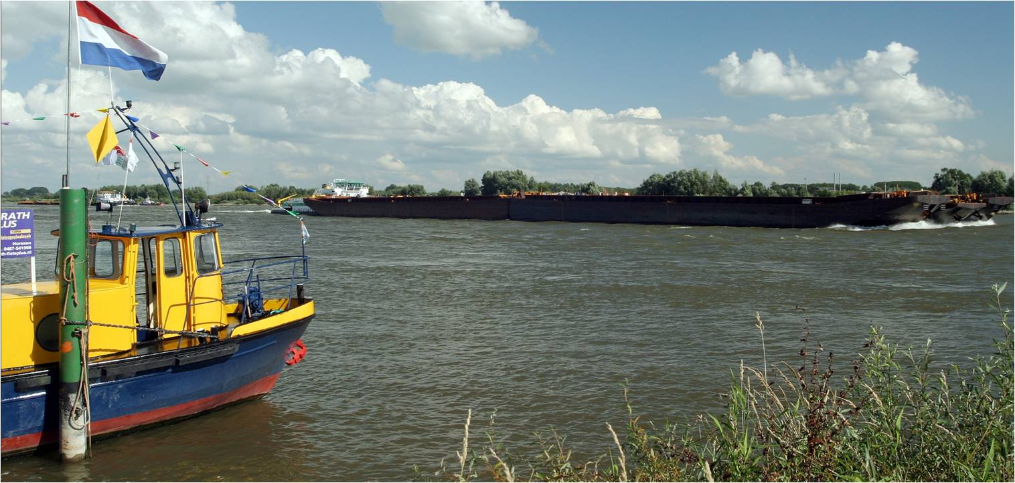

* Stretch of the river Rhine
* Dynamic, strong river
* 165.000 ships passing p/y
BRISBANE, AUSTRALIA | 18 - 20 SEPTEMBER 2017
MANAGED BY

Slide 5
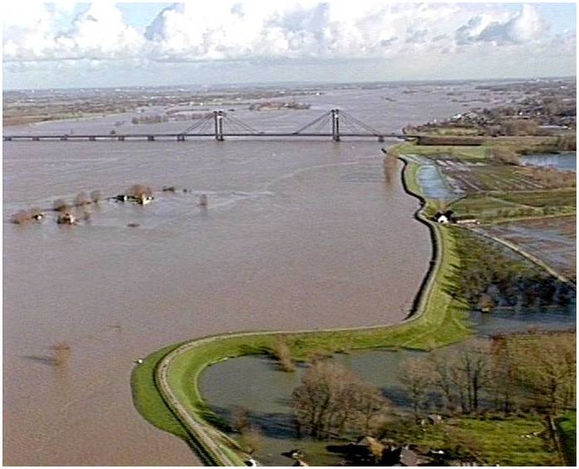
Floods in 1993 and 1995
Discharge in 2015: 16.000 m³/sec
13.500 hectares of flood plains
Discharge in 2100: 18.000 m³/sec
BRISBANE, AUSTRALIA | 18 - 20 SEPTEMBER 2017
MANAGED BY

Slide 6
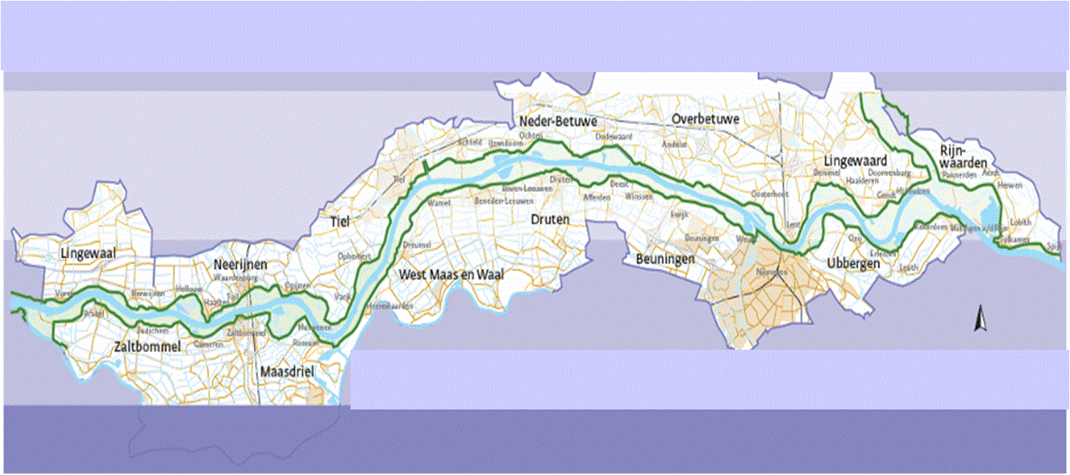
500.000 inhabitants
80 kilometers long
15 municipalities
BRISBANE, AUSTRALIA | 18 - 20 SEPTEMBER 2017
MANAGED BY

Slide 7
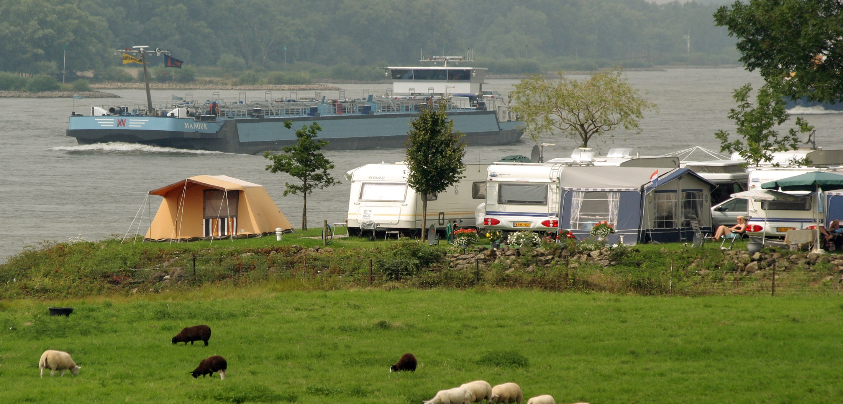
Government organizations
& Land owners and NGOs
& Local business and people
* Water safety
* Nature development
* Tourism and recreation
BRISBANE, AUSTRALIA | 18 - 20 SEPTEMBER 2017
MANAGED BY

Slide 8
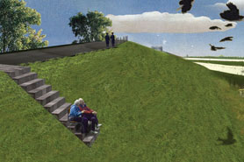
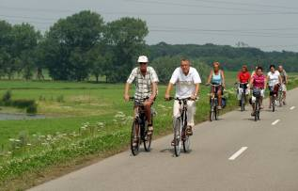
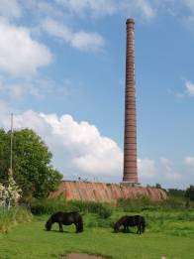
Experience The Waal – Aims :
  Enhance awareness
    Improve opportunities
        Invest in communities
          Increase cooperation
BRISBANE, AUSTRALIA | 18 - 20 SEPTEMBER 2017
MANAGED BY

Slide 9
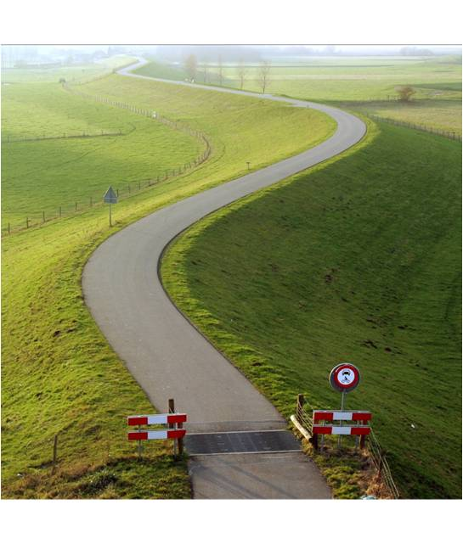
Experience The Waal – Road to success :
  Infrastructure
  2. Experience Agent
  3. Community of Practice
  4. Subsidies for initiatives
BRISBANE, AUSTRALIA | 18 - 20 SEPTEMBER 2017
MANAGED BY

Slide 10
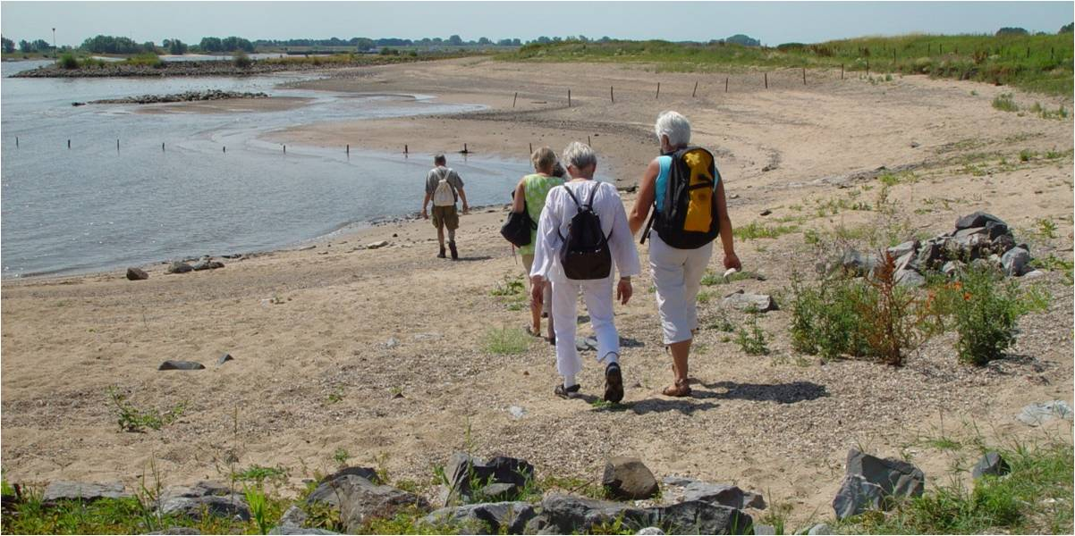
1. Infrastructure:
  * Walking and cycling routes
  * Hiking The Waal route
  * Points of Experience
BRISBANE, AUSTRALIA | 18 - 20 SEPTEMBER 2017
MANAGED BY

Slide 11
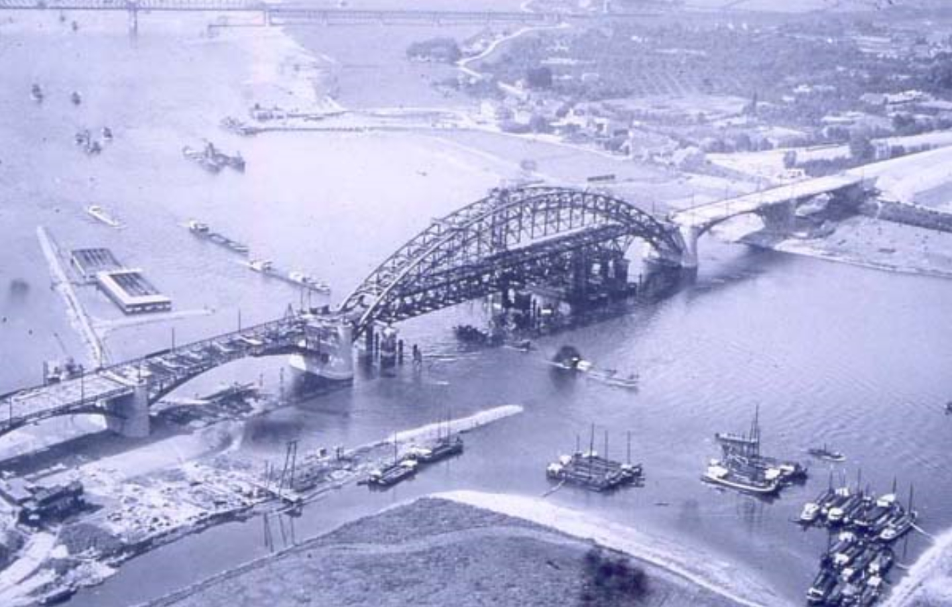
2. Experience Agent:
  * Advice initiatives
  * Connecting people
  * Guidance subsidies
BRISBANE, AUSTRALIA | 18 - 20 SEPTEMBER 2017
MANAGED BY

Slide 12
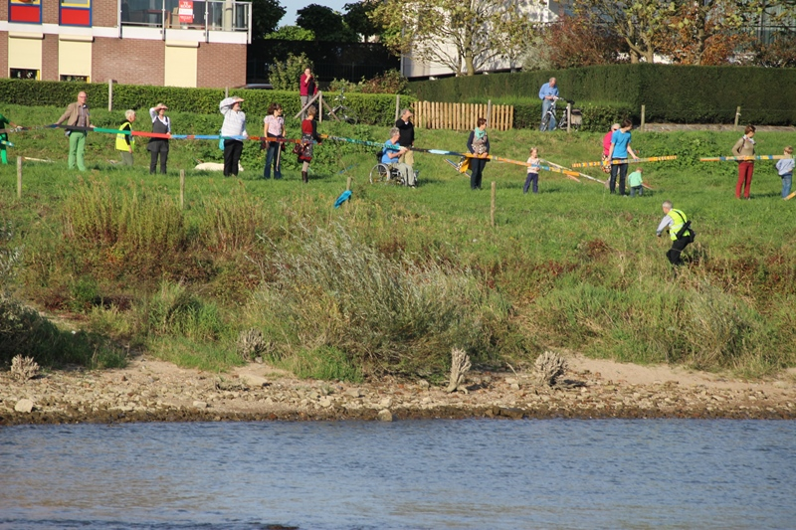
3. Community of Practice:
  * Cooperation along the river
  * Exchange and align
  * Develop ideas
BRISBANE, AUSTRALIA | 18 - 20 SEPTEMBER 2017
MANAGED BY

Slide 13
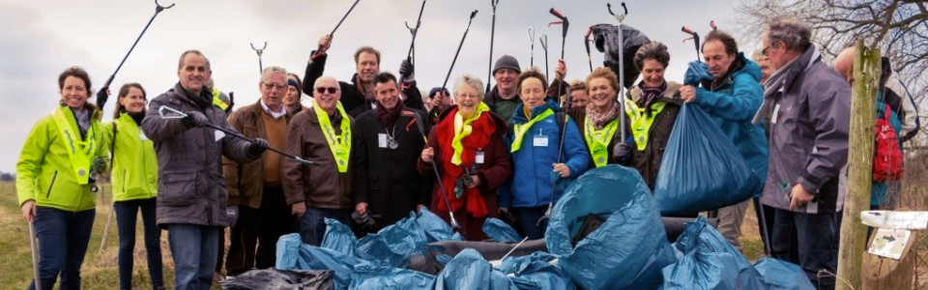
4. Subsidies:
  * Activities and events
  * Enhancing cooperation
  * Points of Experience
BRISBANE, AUSTRALIA | 18 - 20 SEPTEMBER 2017
MANAGED BY

Slide 14
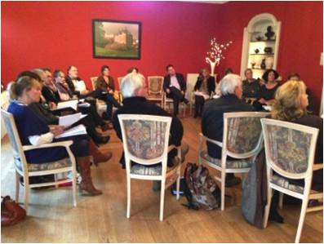
2012
2013
2014
2015
2016
2017
  Kick off, Sep’12
    Workshops, Winter ‘12 / ’13
        A lot of energy
        Many, many ideas
        Immediate network
BRISBANE, AUSTRALIA | 18 - 20 SEPTEMBER 2017
MANAGED BY

Slide 15
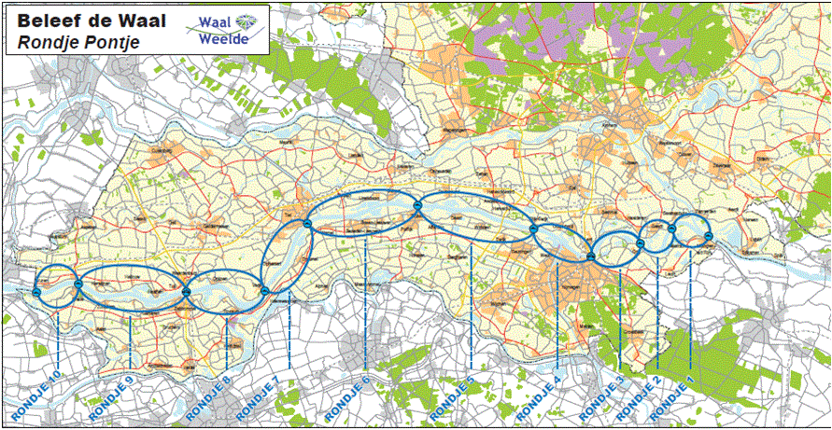
2012
2013
2014
2015
2016
2017
  Kick off, Sep’12
    Workshops, Winter ‘12 / ‘13
        Experience Agent & Start of CoP, Sep’13
Ferry Merry Cooperation
BRISBANE, AUSTRALIA | 18 - 20 SEPTEMBER 2017
MANAGED BY

Slide 16
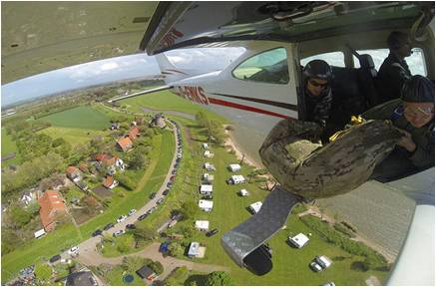
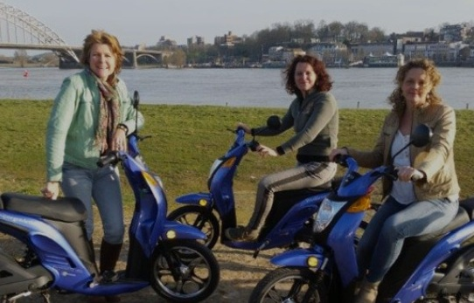
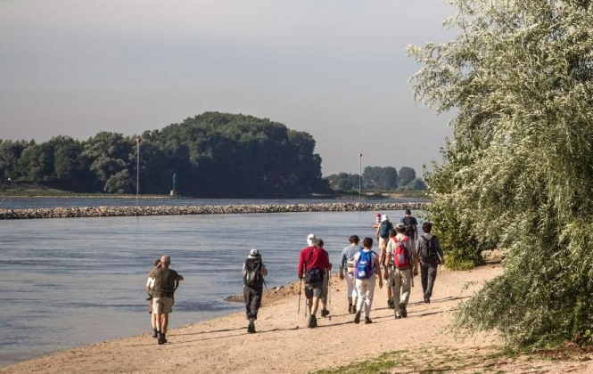
2012
2013
2014
2015
2016
2017
  Kick off, Sep’12
    Workshops, Winter ‘12 / ‘13
        Experience Agent &
        Start of CoP, Sep’13
              First Events, May’14
BRISBANE, AUSTRALIA | 18 - 20 SEPTEMBER 2017
MANAGED BY

Slide 17



Every year > 13 projects
  Events
  Activities
  Routes
With the help from the
Experience Agent and
the special subsidies
BRISBANE, AUSTRALIA | 18 - 20 SEPTEMBER 2017
MANAGED BY

Slide 18
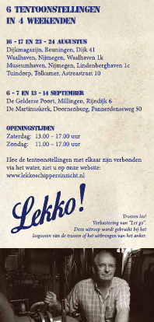
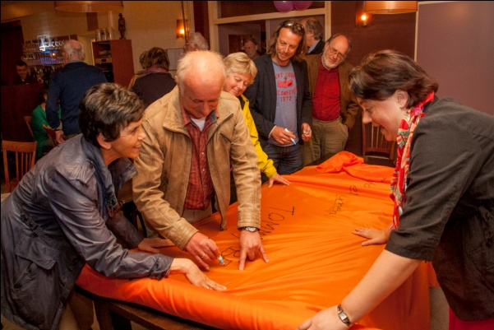


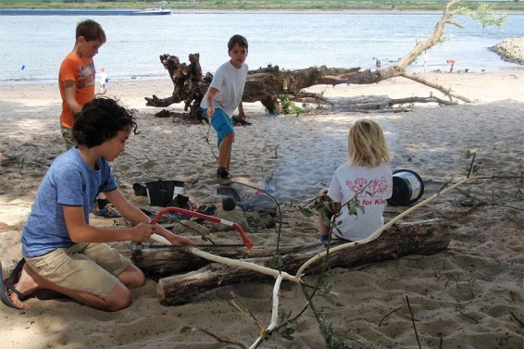
Community projects
BRISBANE, AUSTRALIA | 18 - 20 SEPTEMBER 2017
MANAGED BY

Slide 19
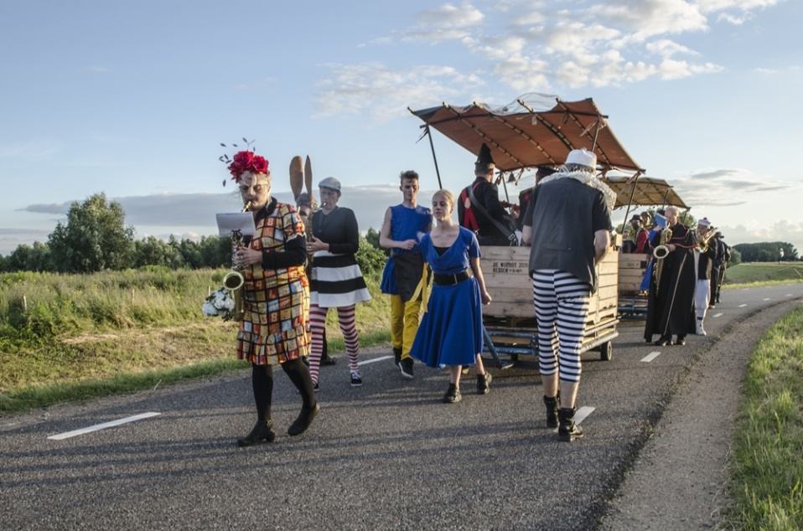
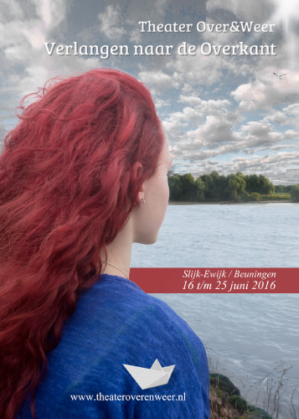
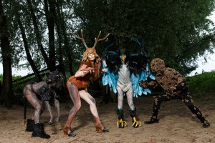

Open air theatre
and exhibitions
BRISBANE, AUSTRALIA | 18 - 20 SEPTEMBER 2017
MANAGED BY

Slide 20
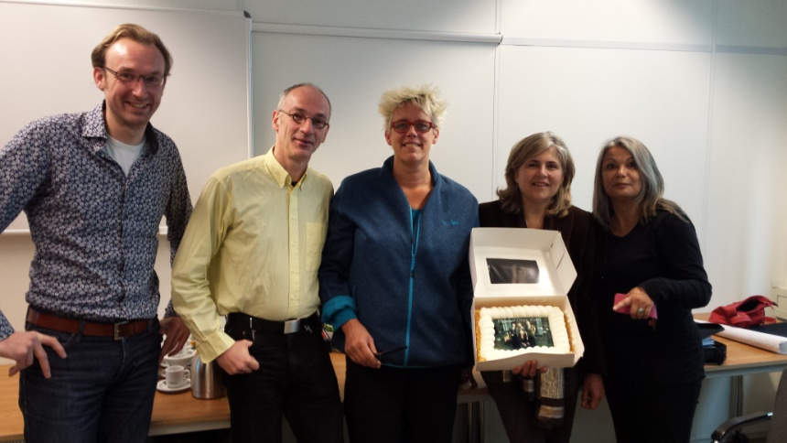

2012
2013
2014
2015
2016
2017
  Kick off, Sep’12
    Workshops, Winter ‘12 / ‘13
        Experience Agent &
        Start of CoP, Sep’13
              First Events, May’14
    Our Waal, Spring’15
BRISBANE, AUSTRALIA | 18 - 20 SEPTEMBER 2017
MANAGED BY

Slide 21

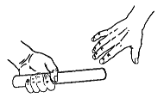
2012
2013
2014
2015
2016
2017
  Kick off, Sep’12
    Workshops, Winter ‘12 / ‘13
        Experience Agent &
        Start of CoP, Sep’13
              First Events, May’14
    Our Waal, Spring’15
        Transfer of tasks, Dec’17
BRISBANE, AUSTRALIA | 18 - 20 SEPTEMBER 2017
MANAGED BY

Slide 22


    Kick off & workshops – 100%
        Experience Agent & CoP – 100%
              Subsidies Events etc. – 50%
2012
2013
2014
2015
2016
2017
      Our Waal – 40%
            Transfer – 0%
BRISBANE, AUSTRALIA | 18 - 20 SEPTEMBER 2017
MANAGED BY

Slide 23
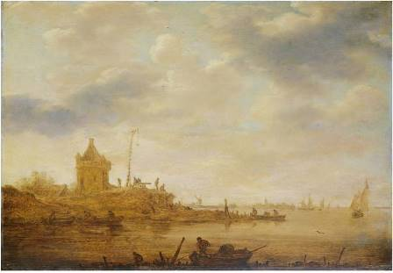
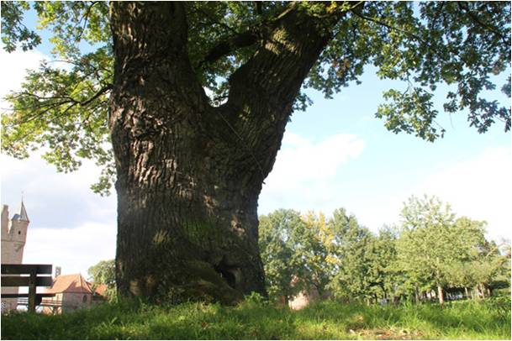
Strategy Our Waal
History
Landscape
Keep everyone connected and built more content for tourism
BRISBANE, AUSTRALIA | 18 - 20 SEPTEMBER 2017
MANAGED BY

Slide 24
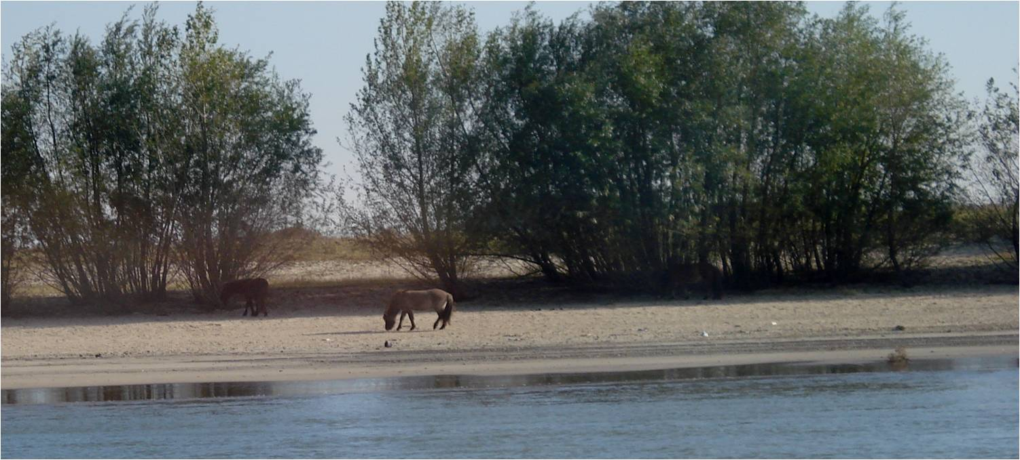
Community of >100 people connected
More than 200 organizations involved
50 plus events, routes, activities etc.
Results of
Experience
The Waal
More content & network to follow
BRISBANE, AUSTRALIA | 18 - 20 SEPTEMBER 2017
MANAGED BY

Slide 25
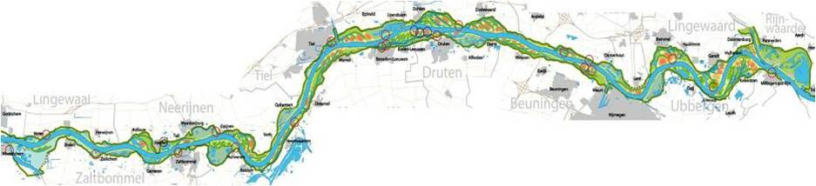
Impulse in liveability
Rich & strong cooperation
Effects of
Experience
The Waal
Stronger bond with stakeholders
More support river interventions
BRISBANE, AUSTRALIA | 18 - 20 SEPTEMBER 2017
MANAGED BY

Slide 26
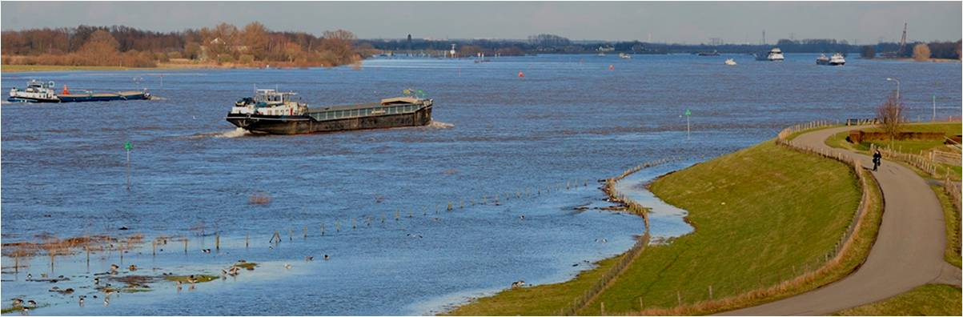
Reach out to the community
Be able to support initiative
Let them do a bit of steering
Key learnings of Experience
The Waal
Experience The IJssel,
The Apeldoorn Canal
BRISBANE, AUSTRALIA | 18 - 20 SEPTEMBER 2017
MANAGED BY

Slide 27

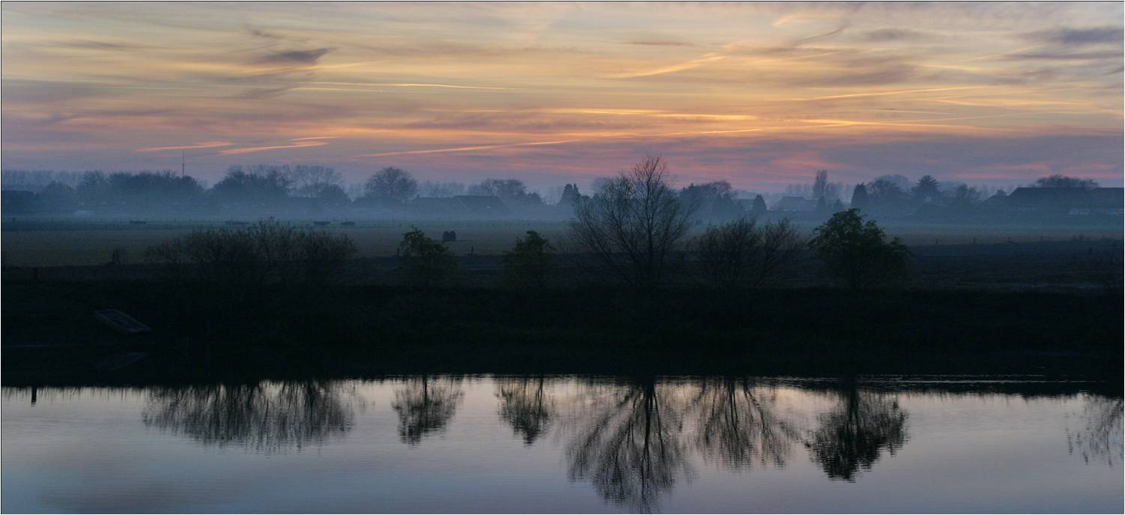
  Experience The River Waal -
  Thank you for your attention!
  Johan Kaspers, 0031-613517163
  kaspers@brederodeadvies.nl
BRISBANE, AUSTRALIA | 18 - 20 SEPTEMBER 2017
MANAGED BY

