Slide 1
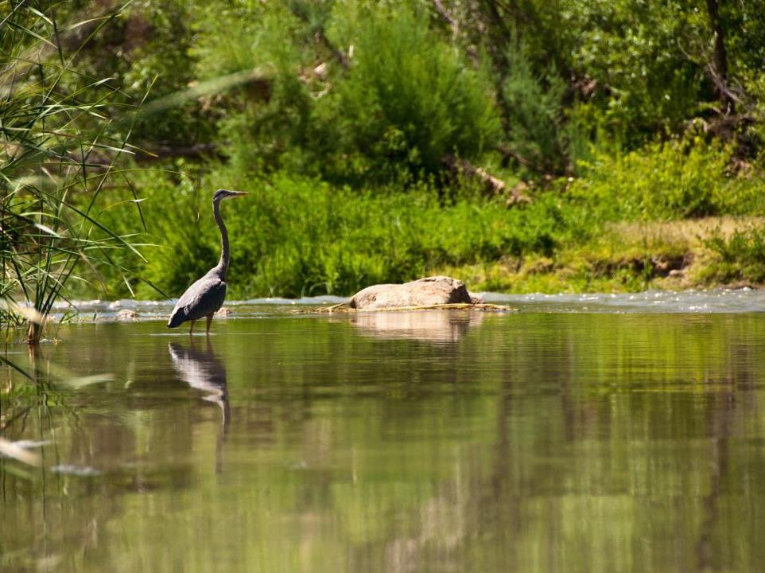
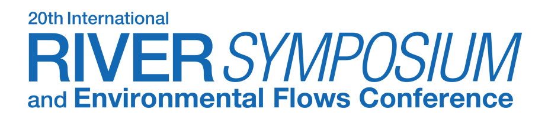
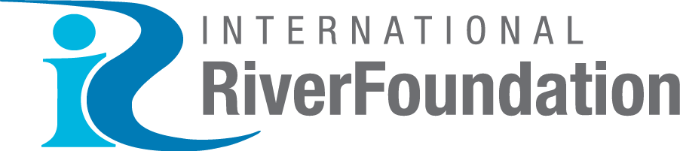
Verde River
Flow Restoration Initiative
Colorado River Program
Kimberly Schonek
The Nature Conservancy
BRISBANE, AUSTRALIA | 18 - 20 SEPTEMBER 2017
MANAGED BY

Slide 2
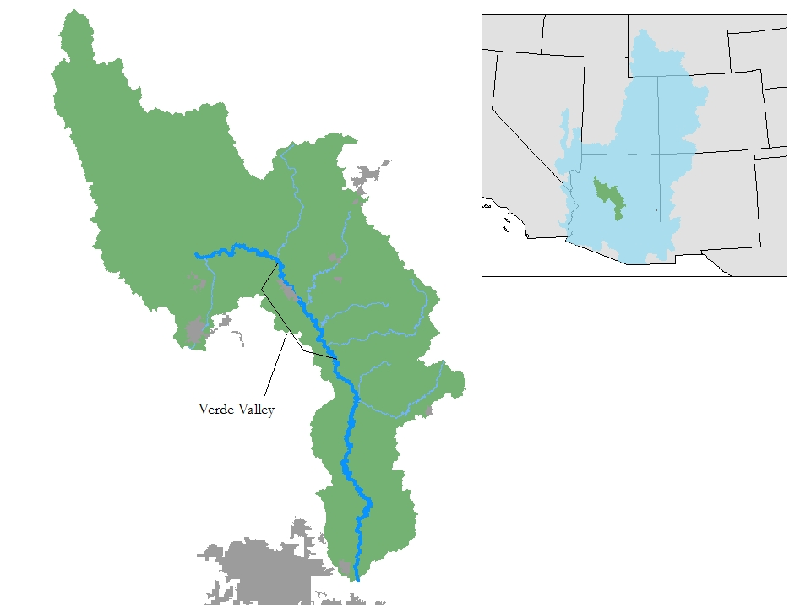
Verde River Watershed
One of 26 of the state’s 38 groundwater basins forecasted to have more demand than supply within 2 decades
Surface flows are highly impacted by groundwater and surface water diversions
Supplies surface water to one of the five largest metro areas in the country
Drinking water supply for one of the fastest growing counties in rural Arizona
Notes:
The Arizona’s Water Resources Development Commission forecasts that by 2035, municipal demands will exceed supplies in 26 of the state’s 38 groundwater basins.

Slide 3
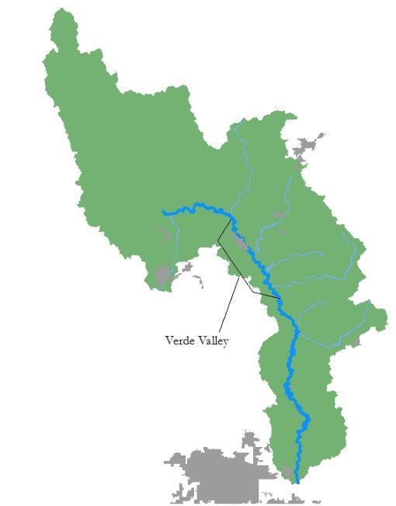

Notes:
The Arizona’s Water Resources Development Commission forecasts that by 2035, municipal demands will exceed supplies in 26 of the state’s 38 groundwater basins.

Slide 4
Drought
Groundwater Pumping
Climate Change
Notes:
The Arizona’s Water Resources Development Commission forecasts that by 2035, municipal demands will exceed supplies in 26 of the state’s 38 groundwater basins.

Slide 5
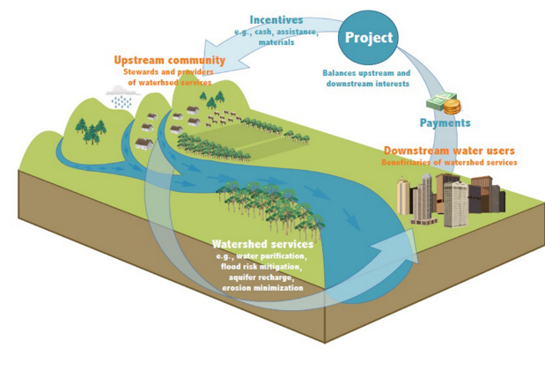
Salt and Verde Rivers Water Fund
      Cost Effective
      Measurable Results
      Cooperation between rural and urban
Notes:
A way for communities to invest in river friendly projects upstream to improve the quality and quantity of river flow

Slide 6
Achieving Goals
There’s a plan……
Enabling Infrastructure
  Must be able to control diversions
  By-pass saved water
Satisfied downstream users
  All users are fully satisfied
  Downstream users do not need “saved” water
Market Transactions
  Fallowing agreements
  Diversion reduction agreements
  Mitigate new uses
Flowing River
  Less consumptive use
  More water in critical reaches

Slide 7
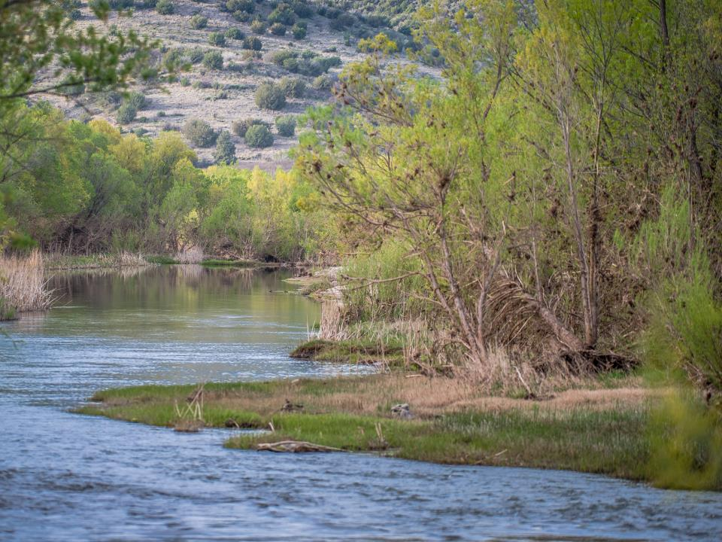
Collaborative Projects with Multiple Benefits

Slide 8
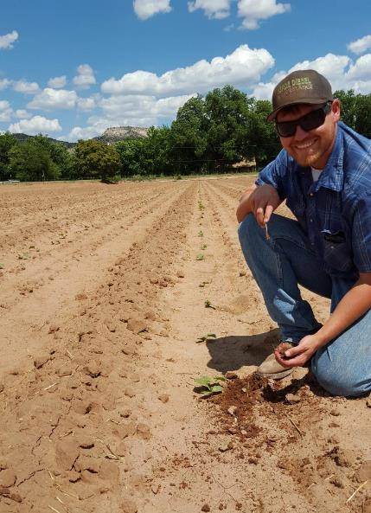
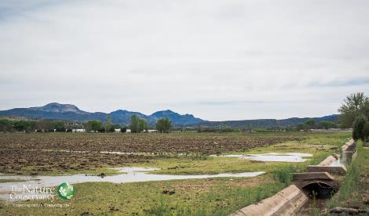
Irrigation Infrastructure

Slide 9
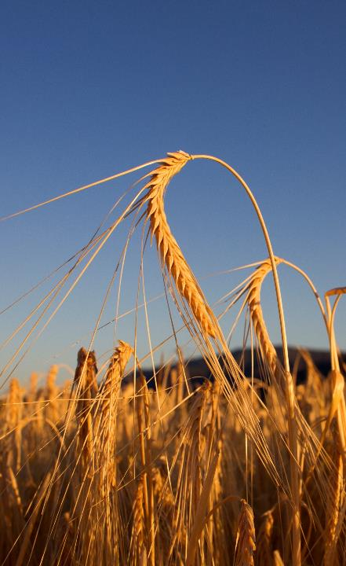
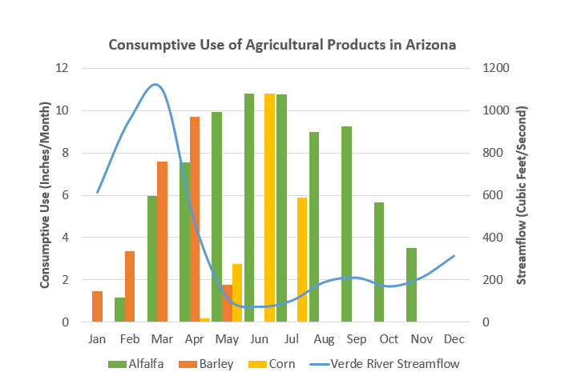
Crop Conversion
Low Water Use

Slide 10
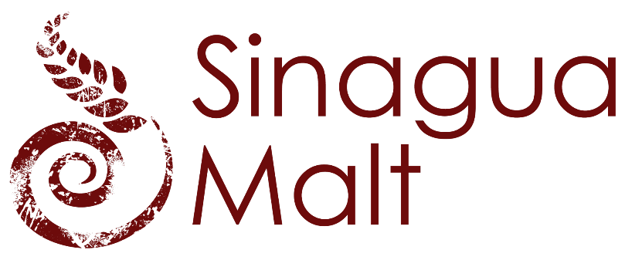
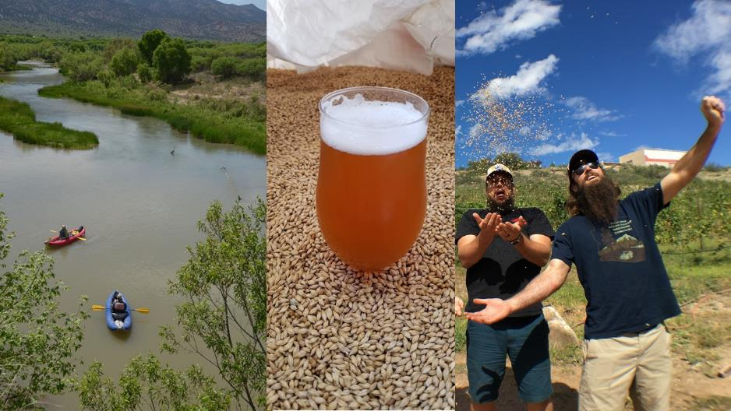

Slide 11
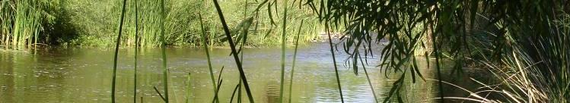
Lessons Learned
Thank you
Strong and diverse partnerships
Creative problem solving
Mutual benefits

Slide 12
Success Stories
Thank you
More than $1M in Corporate Funding
$3M in federal funding
Increased flow in 20 miles of river
More than 62 M gallons of water left instream in 2017
Strong foundation for on-going projects

