Slide 1
What does inclusive Integrated Water Resources Management look like?
Notes:
While an awareness of the importance of inclusion and gender equality within water management has increased in recent decades, much work remains to effectively embed inclusive policies and practices by the sector. Gender equality can be seen as one key dimension an inclusive approach – where no group is marginalised or excluded systematically. Sustainable Development Goal 6 to “ensure access to clean water and sanitation for all” requires explicit attention to gender equality and inclusion.
The Global Water Partnership (GWP) identified a serious need to analyse gaps and opportunities in the mainstreaming of gender equality in integrated water resources management (IWRM). To identify, explore, and begin to resolve these gaps, In 2017 the GWP commissioned the Institute for Sustainable Futures from the University of Technology Sydney to conduct a study investigating gender equality and inclusion efforts within IWRM at a range of scales (global, regional, national and local), including government, CSOs, private sector and multilateral organisations. Following a comprehensive gender analysis of water resources management literature and issues, and interviews with 15 global water management and gender equality leaders, the project brought influencers together in a high level meeting to deliberate and support the development of a major think piece. This presentation summarises the findings of the study, including an outline of clear and practical actions that all water governance sector stakeholders can take into their own organisations to champion inclusive IWRM – with a focus on driving gender equality.
The GWP is an intergovernmental organisation established in 1996 to support countries in their efforts to implement a more equitable and sustainable management of their water resources. The network spans 13 regions with more than 3,000 institutional partners in 158 countries.

Slide 2
Dublin Principles 1992
‘Women play a central part in the provision, management and safeguarding of water
This pivotal role of women as providers and users of water and guardians of the living environment has seldom been reflected in institutional arrangements for the development and management of water resources.
Acceptance and implementation of this principle requires positive policies to address women's specific needs and to equip and empower women to participate at all levels in water resources programmes, including decision-making and implementation, in ways defined by them.’
Principle No. 1: water resources demands a holistic approach
Principle No. 2: participatory approaches
Principle No. 3: Women play a central part
Principle No. 4: Water has an economic value
Notes:
Principle No. 1: water resources demands a holistic approach
Fresh water is a finite and vulnerable resource, essential to sustain life, development and the environment
Since water sustains life, effective management of water resources demands a holistic approach, linking social and economic development with protection of natural ecosystems. Effective management links land and water uses across the whole of a catchment area or ground water aquifer.
Principle No. 2: participatory approaches
Water development and management should be based on a participatory approach, involving users, planners and policy-makers at all levels
The participatory approach involves raising awareness of the importance of water among policy-makers and the general public. It means that decisions are taken at the lowest appropriate level, with full public consultation and involvement of users in the planning and implementation of water projects.
Principle No. 3: Women play a central part
Women play a central part in the provision, management and safeguarding of water
This pivotal role of women as providers and users of water and guardians of the living environment has seldom been reflected in institutional arrangements for the development and management of water resources. Acceptance and implementation of this principle requires positive policies to address women's specific needs and to equip and empower women to participate at all levels In water resources programmes, including decision-making and implementation, in ways defined by them.
Principle No. 4: Water has an economic value
Water has an economic value in all its competing uses and should be recognized as an economic good
Within this principle, it is vital to recognize first the basic right of all human beings to have access to clean water and sanitation at an affordable price. Past failure to recognize the economic value of water has led to wasteful and environmentally damaging uses of the resource. Managing water as an economic good is an important way of achieving efficient and equitable use, and of encouraging conservation and protection of water resources.

Slide 3
Examples of the benefits of inclusion
Research across 15 countries showed that water supply projects designed and run with the full participation of women (compared with non- or partial participation) were more sustainable (Gross et al., 2000).
Closing the gender gap (through equal access to assets such as land and water, inputs such as seeds and fertiliser, and training) would increase yields on women-run farms by 20–30 percent which could reduce the number of hungry people in the world by 12–17 percent (FAO, 2011; World Bank, 2017a).

Slide 4
So where are we now?
25 years after the Dublin Principles
Women = 43 percent + of the agricultural labour force globally, yet ownership of and access to land and water resources is not equal to that of men (de Jong et al., 2012).
The laws or customs in 102 countries still deny women the same land access rights as men (OECD, 2014, p. 9).
Women and marginalised people are often excluded from water management decisions

Slide 5
So where are we now?
Increasing understanding of gender and inclusion issues in WASH and development interventions more broadly (less action in WRM)
International acceptance of the economic and social benefits of reducing inequalities
Lot’s of strategies and studies! (not so many success stories or evidence of significant action or adequate resourcing of strategies)

Slide 6
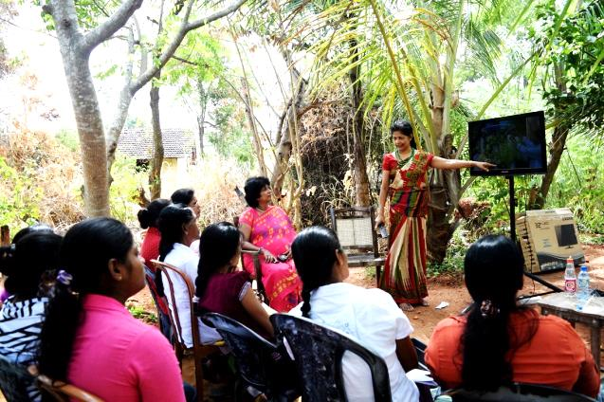
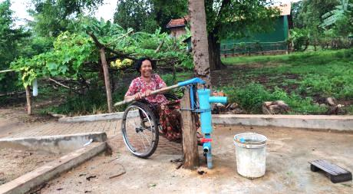
Thousands of local level initiatives
Image source: Women for Water Partnership, Footprints network

Slide 7
Scope: Focused primarily on water resources management issues (SDG 6.3 – 6.6)
Methodology: 39 people were consulted from 25 leading organisations in water governance, water management, gender equality, and inclusion policy and practice.
Outcome: Action Piece makes recommendations against four key action areas…..

Slide 8
Four principles for inclusive water resources management
Institutional practice, commitment and leadership on advancing gender equality and inclusion
Quality gender and inclusion analysis that informs design
Meaningful and inclusive participation in decision making and partnerships
Address unequal access and control of resources

Slide 9
1. Leadership
Institutional practice, commitment and leadership on advancing gender equality and inclusion

Slide 10
2. Gender Analysis
Quality gender and inclusion analysis that informs design

Slide 11
3. Meaningful participation
Meaningful and inclusive participation in decision making and partnerships

Slide 12
4. Resources
Address unequal access and control of resources

Slide 13
1. Pre-design phase: Quality gender and inclusion analysis
5. Feed monitoring outcomes into program adaptation processes
Design
Implement
Monitor
4. Monitor activities to see if they are achieving practical and strategic outcomes for marginalised people and groups.
2. Design gender mainstreamed and targeted approaches into the initiative
3. Implement approaches in partnership with women’s organisations and gender expertise

Slide 14
Monitor

Slide 15
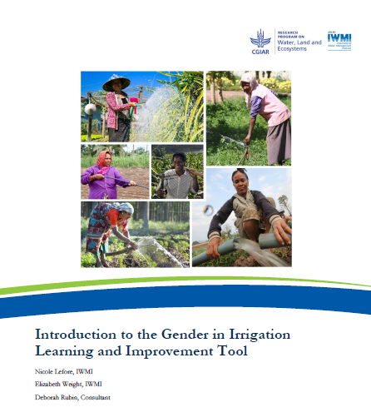
Monitor
Source: IWMI & CGIAR
Notes:
http://www.iwmi.cgiar.org/Publications/Other/training_materials/gender_in_irrigation_learning_and_improvement_tool.pdf

Slide 16
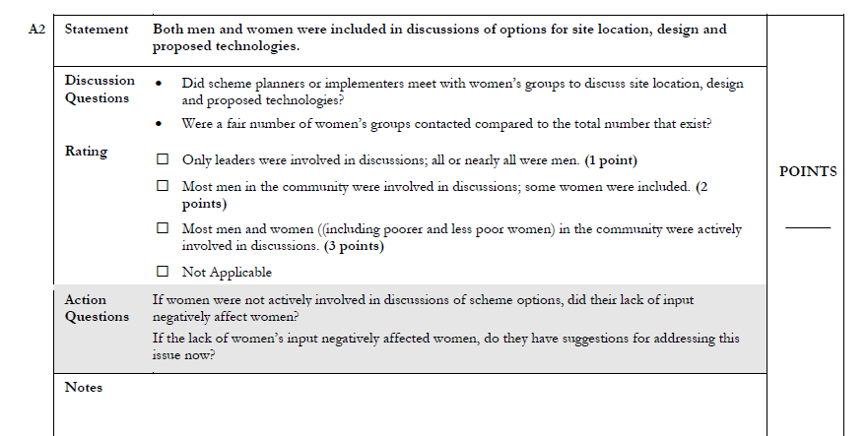
Monitor

Slide 17
Four principles for inclusive water resources management
Leadership
Gender analysis
Meaningful participation
Resources

Slide 18
Action area 1: Institutional leadership and commitment
Make gender equality and inclusion a core business goal
Global Water Partnership: Action Piece
Action area 2: Gender and inclusion analysis that drives change
Conduct gender and inclusion analysis at all levels
Action area 3: Meaningful and inclusive participation in decision- making and partnerships
Adopt a ‘nothing about them without them’ approach
Action area 4: Equal access to and control of resources
Create a level playing field with respect to access to and control of resources
isf.uts.edu.au

Slide 19
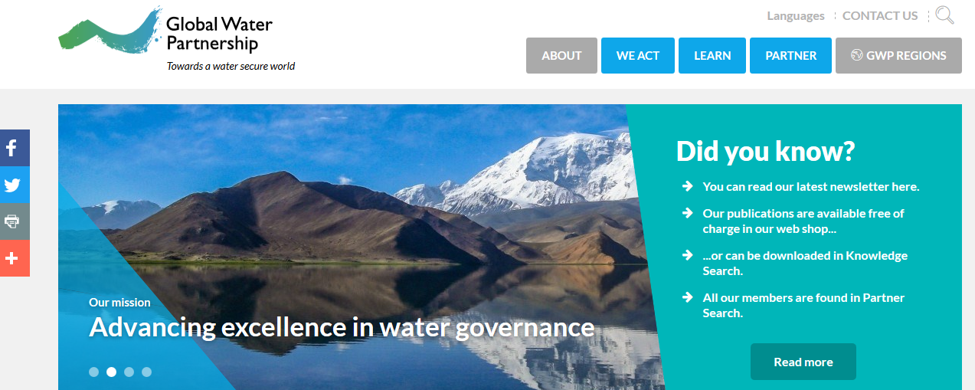
More info…. www.gwp.org
Melita Grant
@MelitaGrant
Melita.Grant@uts.edu.au

