Slide 1
Environment & Waterways Alliance:
a model of engagement
BRISBANE, AUSTRALIA | 18 - 20 SEPTEMBER 2017
MANAGED BY

Slide 2
18 Member Councils
BRISBANE, AUSTRALIA | 18 - 20 SEPTEMBER 2017
MANAGED BY

Slide 3
Mission Statement: To be an active partnership of Councils across the Central West of NSW, engaging all tiers of Government and our Communities, contributing to the protection and enhancement of the environmental, social, economic and cultural condition of our part of the world
Priorities:
Land
Biodiversity
Water & Waterways
People & Communities
Towards Sustainability
Council Capacity
BRISBANE, AUSTRALIA | 18 - 20 SEPTEMBER 2017
MANAGED BY

Slide 4
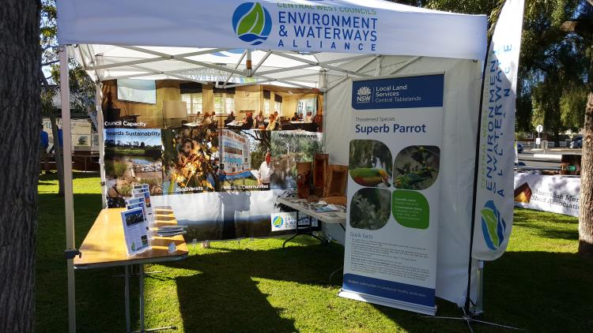
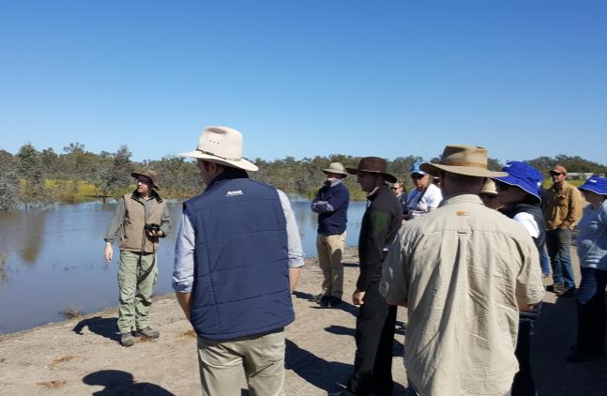
Alliance Meetings with guest speakers - Quarterly
Displays and information at environmental events
Field Trips – Macquarie Marshes 2016
BRISBANE, AUSTRALIA | 18 - 20 SEPTEMBER 2017
MANAGED BY

Slide 5
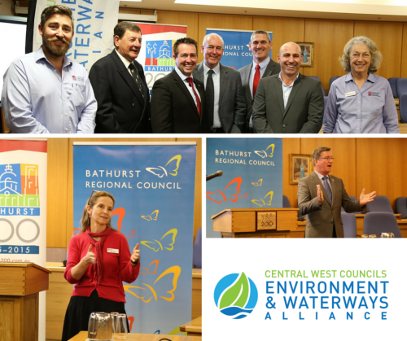
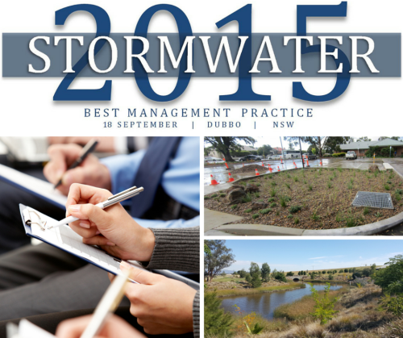
5 Year Plan and Alliance Website Launch
Stormwater 2015 Conference
Hollows for Habitat Forums
BRISBANE, AUSTRALIA | 18 - 20 SEPTEMBER 2017
MANAGED BY

Slide 6
BRISBANE, AUSTRALIA | 18 - 20 SEPTEMBER 2017
MANAGED BY

Slide 7
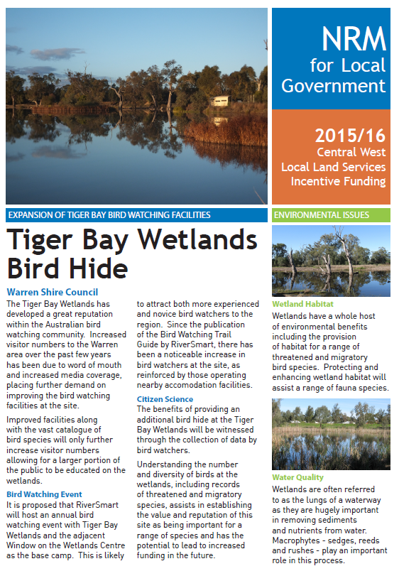
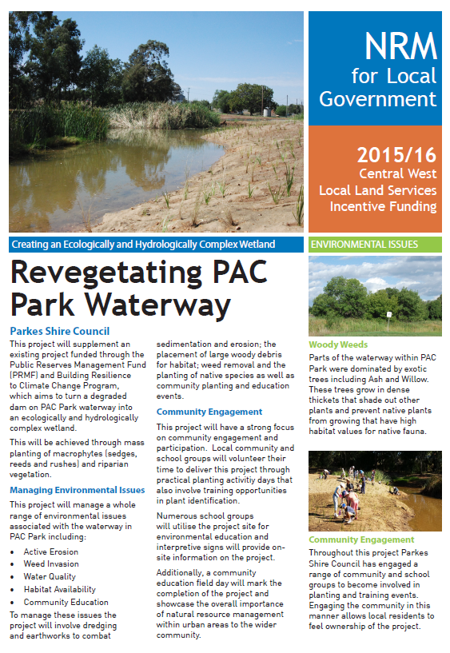
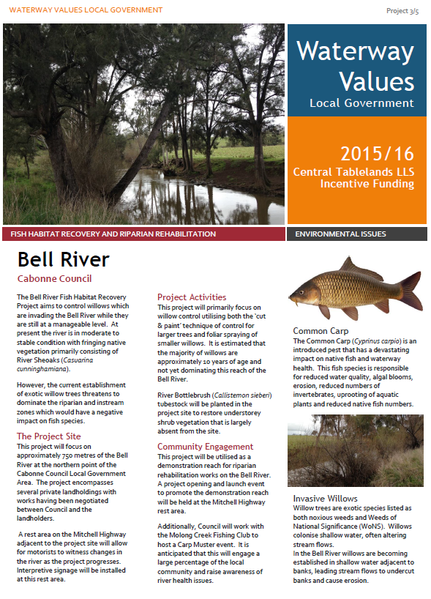
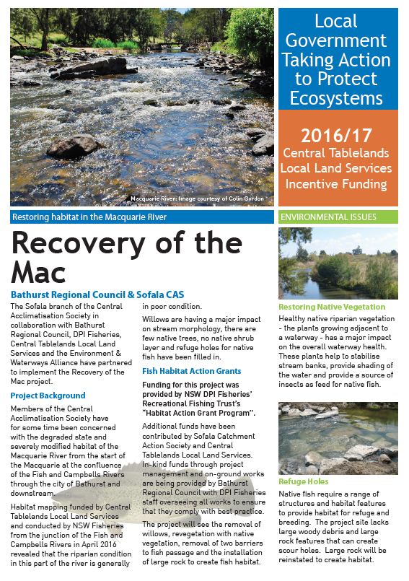
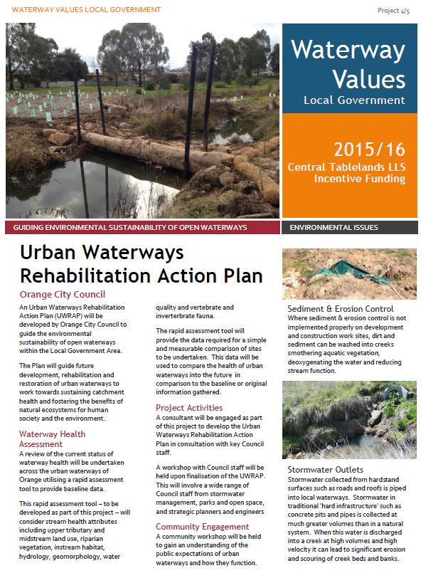
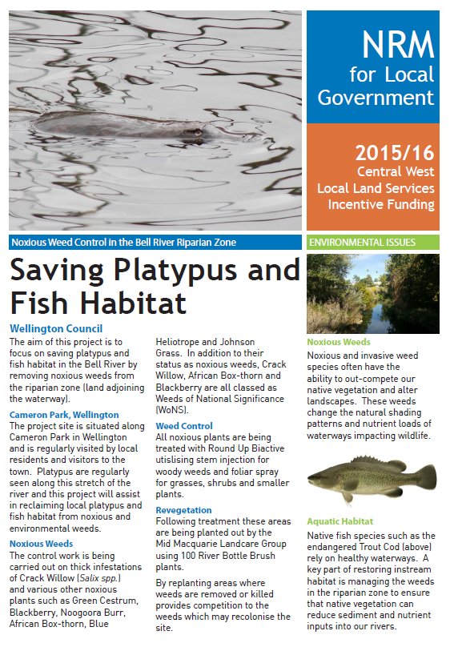
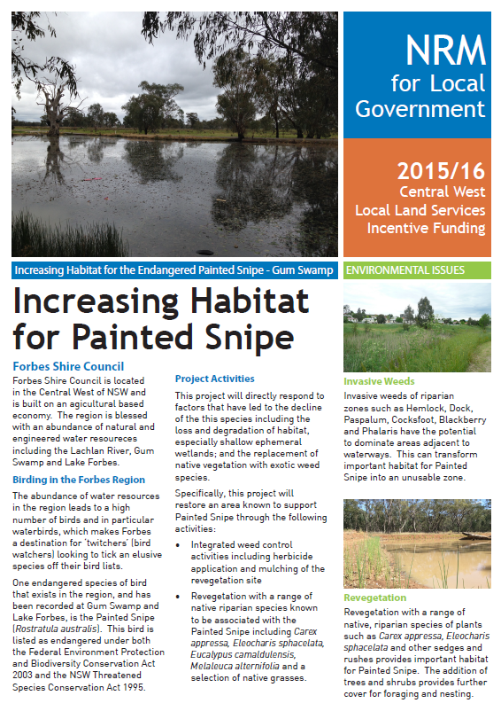
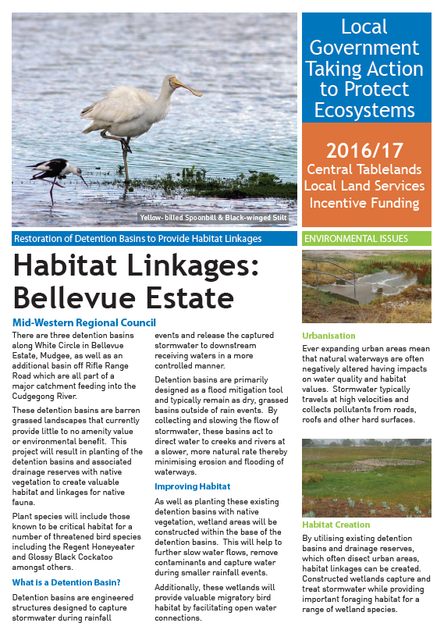
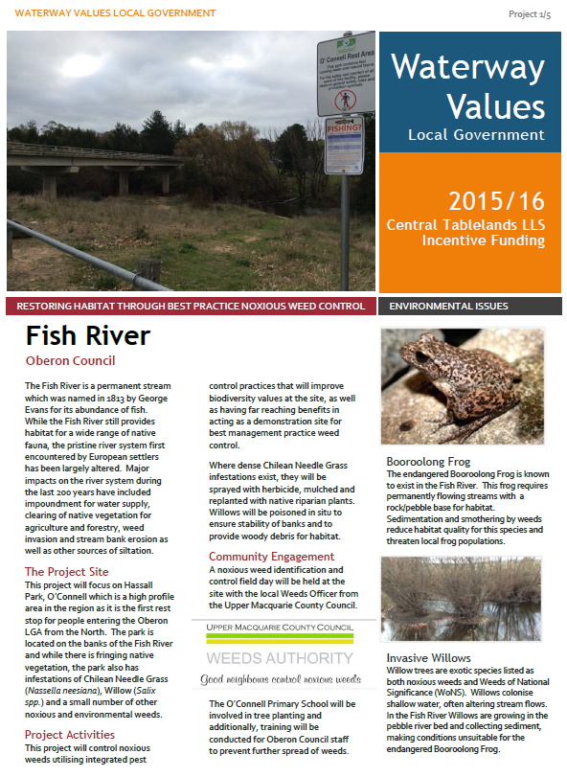
BRISBANE, AUSTRALIA | 18 - 20 SEPTEMBER 2017
MANAGED BY

Slide 8
Mick Callan
Project Support Officer
Environment & Waterways Alliance
mick.callan@lls.nsw.gov.au
BRISBANE, AUSTRALIA | 18 - 20 SEPTEMBER 2017
MANAGED BY

