Slide 1

Notes:
Firstly want to introduce the Peter Cullen Trust…….
The Trust is an independent and apolitical organisation with the mission: Bridging Science, People and the Environment. It was founded in 2009 with a commitment to carry on the legacy of the late Professor Peter Cullen who is remembered for his superb ability to synthesise and communicate complex ideas, to a broad audience in a way that enabled influential decision-makers to work together and take action. The aim of the Trust is to support a new generation of scientists, practitioners and policy makers who were not just experts in water management, but were able to work across the complex interactions between water, climate, food and energy.
To achieve this the Trust:
Running activities, lectures and events to strengthen the understanding between science, policy and stakeholders in water system management
Supports a vibrant network of Fellows to continue their development and exchange ideas and debate on important water management issues
Builds capacity in water leadership through its highly regarded leadership programs

Slide 2
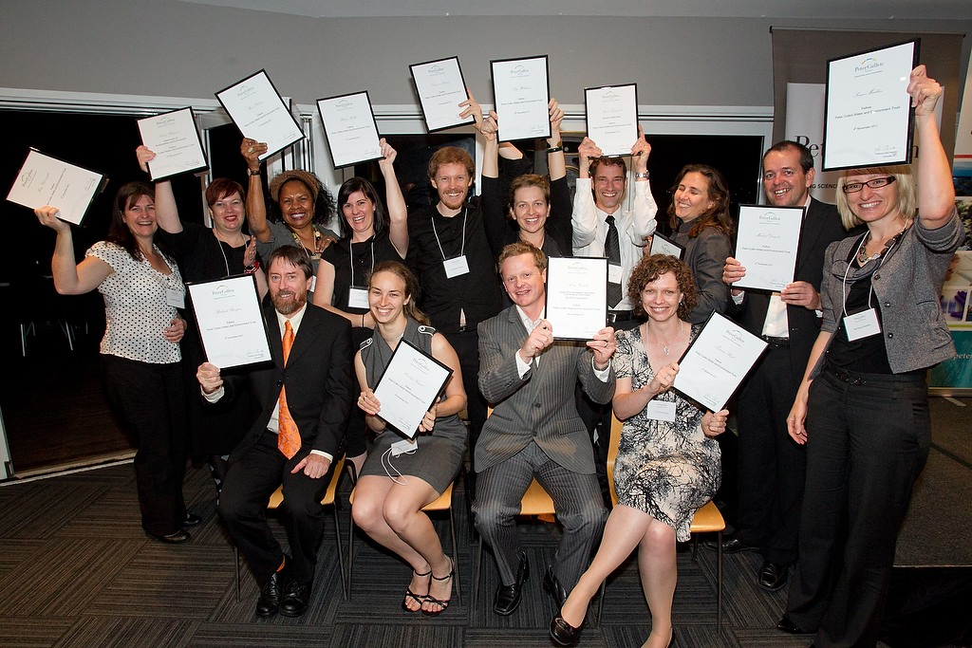
LEADERSHIP
Science to Policy Leadership Program
“I have changed profoundly during this course. I look forward to influencing water policy for as long as I am able”
2012 Program Graduate
Notes:
The leadership training programs is the foundation program of the Peter Cullen Trust and is run in Australian each year for emerging leaders in the water & environment sector.
It is highly competitive and is targeted at mid-career rising stars who are highly skilled and motivated. The program combines interactive experiential learning that challenges participants to stretch themselves beyond their current boundaries and brings high profile speakers to share their own experiences. The program provides common experiences for the group, but learning is individualised and through the program participants are encouraged to identify and focus on their leadership strengths and weaknesses (with strategies for improvement) in their workplace.
Participants (including myself) undergo quite a transformation during the program and are given the tools and confidence to ‘speak for the rivers’ with clarity and credibility to influence important water management issues.
On successfully completing a leadership program, the participants are awarded Fellowships of the Peter Cullen Trust. There are now 122 Fellows, linked across Australia in a network, staying connected, offering mutual support and ongoing professional development.

Slide 3

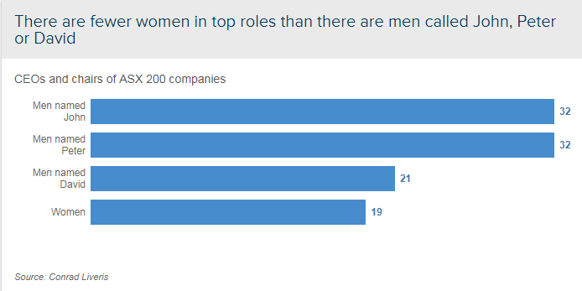
WOMEN IN LEADERSHIP
Currently only 1 in 20 leaders in the Victorian water and catchments sector are female
Notes:
Challenges facing women in water sector in Australia….. Recognising this varies globally where water is considered ‘women’s business’ yet women are well under represented in decision-making.
Women working in the water and catchments sector in Victoria. Currently only 1 in 20 leaders in this sector are female. While Australia is a great place to be a professional woman compared to many other countries, if you look at our statistics on female leadership, we’ve clearly still got a long way to go. According to the Workplace Gender Equality Agency women make up only: 12% of chair positions; 17.3% of CEO’s; 26.1% key management personnel; 27.8% other executives / general managers; 31.7% senior managers, and 39.8% other managers. Australia women are pursuing education at a greater rate than men but from the time they start working their salaries are 4% lower than men’s starting salaries. This increases to a difference of 18.8% (~$15,000) between full-time working men and women, adding up over a lifetime to $700,000 less on average.

Slide 4
WOMEN IN WATER
Leadership Program
A transformational program designed to create long-term impact and change for women in the water and catchment management sector
Notes:
The Women in Water Leadership program is based on the Science-to-Policy Leadership Program and has been developed at the request of the Department of Environment, Land, Water and Planning (DELWP) which wants to increase diversity in Victoria’s water workplaces. Dr Sarina Loo who is a fellow from the 2010 leadership program, was instrumental in getting this program up and running. Sarina is currently working as the Co-Executive Officer of the Victorian Environmental Water Holder in a job-share position.
The Women in Water leadership program was first run last year with a cohort of highly skilled, intelligent and motivated women who were chosen from their sponsoring organisations in the sector who have shown the potential for leadership. As with the Science-to-Policy Leadership program, the women were pulled out of their comfort zones and asked to reflect on what it takes to be a leader in the water sector. There were some interesting insights with 3 key challenges identified as confronting Women in advancing through leadership positions in the Australian water sector……..

Slide 5
WORKING WITH WOMEN
“one of the hardest and most important lessons I’ve had to learn is how to work with other women in leadership positions, as I have mostly worked with men”
Notes:
This is something that was raised which was something that many women I have spoken to hadn’t given a great deal of thought to previously. Many women in high level positions are typically working alongside men and therefore were not used to working alongside women. There were also shared experiences that in those instances that they were working alongside women, that these relationships were not usually supportive and could be in fact quite competitive, vying against each other for that ‘one place’ for women on boards and senior leadership positions.
This seems to be an important reflection from the program that is rarely spoken about but would need to be addressed in organisations to help support the next generation of women leaders in our industry.

Slide 6
RECOGNISING IMPOSTER SYNDROME
“I realised that sometimes I suffer from imposter syndrome and that even though outwardly I seem confident it is really not the case – but it should be”
Notes:
Another common reflection from participants was recognition of suffering from the ‘imposter syndrome’ with many of the women lacking confidence in their abilities and feeling they didn’t deserve their success and would be found out as frauds. Studies have found that imposter syndrome is not a uniquely female problem, but it is interesting how it came out as a unique theme to the Women in Water leadership program. This feeling could come from working in an engineering field when you have an environmental scientist background or other ‘softer science’ background or finding that you are losing yourself working in a position that doesn’t reflect your values.
On reflection, participants of the Women in Water leadership program found their inner confidence, strengthened their resolve on what was important to them and understood that there were in fact good enough!

Slide 7
RETURNING TO WORK
“I was flippant, I dominated, I rushed, I got frustrated, I lost confidence, I cried, and my family suffered the most”
Notes:
Balancing family and career can be difficult. Typically our work week is based on a long established pattern of working 5 days a week. Many women returning from having children are finding it difficult to, or unwilling to work within this construct and therefore feel they are missing out on leadership roles because of it. It does appear uncommon to see leadership roles available as part time roles.
Again, participants of the program realised the importance of being true to their values and what they can achieve and asking for support when needed. I also feel that the industry is changing and flexible working arrangements are becoming more common, and hopefully this will be transcend to leadership roles. An example of this is Sarina Loo’s flexible working arrangement as an executive officer at the Victorian Environmental Water Holder which allowed her to work part-time when she returned from maternity leave.

Slide 8
HOW THE PROGRAM IS EMPOWERING WOMEN
”I am more confident in my ability to lead and more focused in how to use this for positive change.”
“I realised that my true strength lies in my ability to make connections and build strong relationships with people, and that this can actually achieve great outcomes and it’s a real positive thing and that this is not just the soft stuff.”
Authentic leadership
Understanding personal values
Self-awareness
Importance of personal connections
Showing your vulnerabilities
Confidence
Notes:
Participants from the 2016 Women in Leadership program came together this year to reflect on the program. Overall there were some common learnings and experiences shared by the women:
Self-awareness and understanding where their true leadership strengths lay
Understanding the importance of authentic leadership
Self-awareness and understanding where their true leadership strengths lay
Having a sense of the bigger picture and their personal values
Having a connected and supportive network
Being open, vulnerable and free to express your true self
Confidence and knowing they are good enough

Slide 9
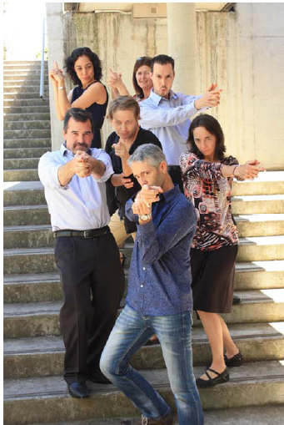
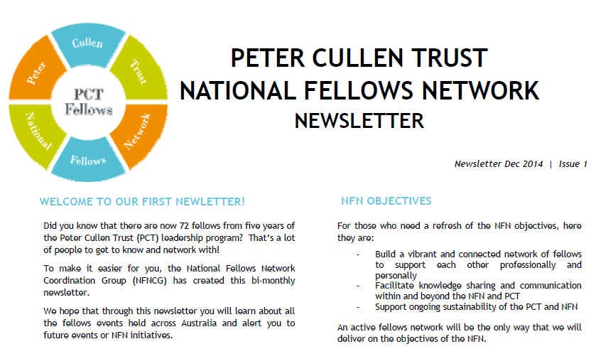
NFN COORDINATING GROUP
CONNECTIONS AND NETWORKING
KEEP IN TOUCH…..
Notes:
A special connection is created between the participants during the program, creating a safe and trusted environment where participants are able to share stories in a safe and trusted environment.
The Trust also supports all Fellows with offerings of mentoring and automatic membershipin the PCT National Fellows Network. This network provides opportunities for Fellows to meet for various social and networking events as well as collaborating on projects and activities such as speaking at conferences like this and publishing articles. An e newsletter is sent out regularly, providing updates on fellows and work in the water industry. The network also functions as a community of practice across various parts of the water sector, including Government, corporate, NGO's, community, legal, farming, consulting, utilities and academia.

Slide 10
Women in Water
Leadership Program
Thank you ☺
Notes:
The leadership programs are both being run again this year, with the Victorian Government again partly funding the Women in Water leadership program in Victoria. It would be great to get this program up and running in other states to help support women in the water industry.

