Slide 1
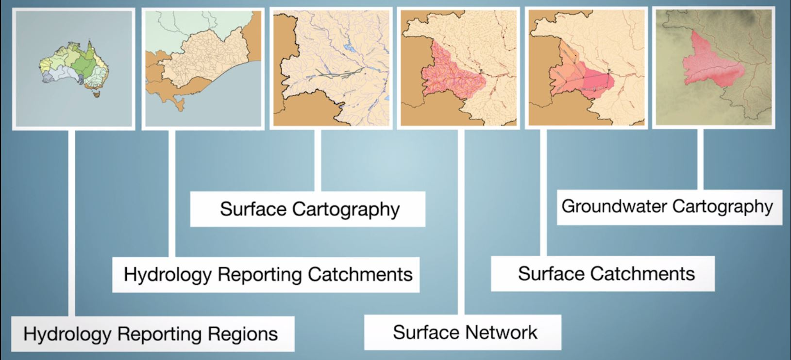
Creating stream gauging station catchment areas and streamflow routing networks using the Geofabric
Matthew Brooks, Geofabric Project Manager, Bureau of Meteorology
BRISBANE, AUSTRALIA | 18 - 20 SEPTEMBER 2017
MANAGED BY

Slide 2
Geofabric Presentation Overview
Key Geofabric Functionality
Geofabric Toolset
Geofabric Use Case Studies
Bureau Hydrology Reference Station (HRS) & Australian Water Resource Assessment Landscape (AWRA-L) Modelling Catchments
Bureau Australian Water Resource Assessment River (AWRA-R) Modelling Catchments and Streamflow Routing
Northern Territory Dept. of Land Resource Management (DLRM) Delineation of Gauging Catchments
Geofabric Version 3 Products
BRISBANE, AUSTRALIA | 18 - 20 SEPTEMBER 2017
MANAGED BY
Notes:
Case studies mostly show catchments for Gauging station features, but these could equally be for water asset features such as wetlands.

Slide 3
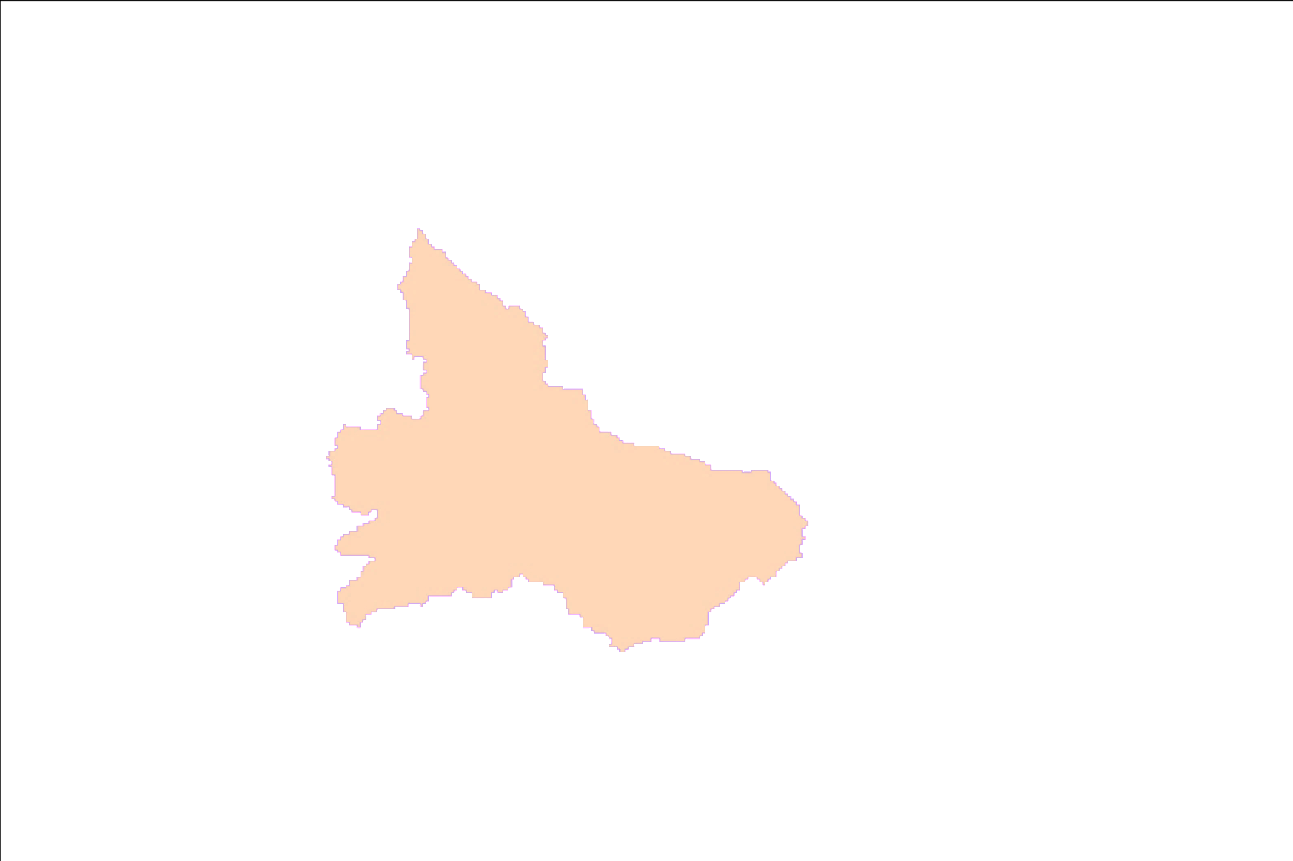
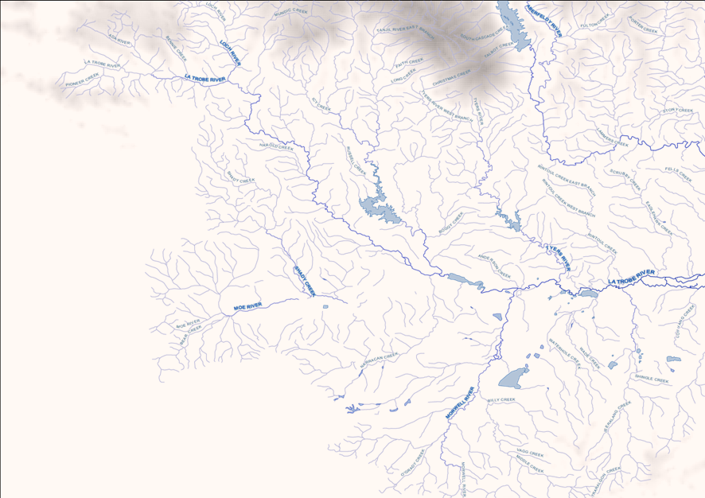
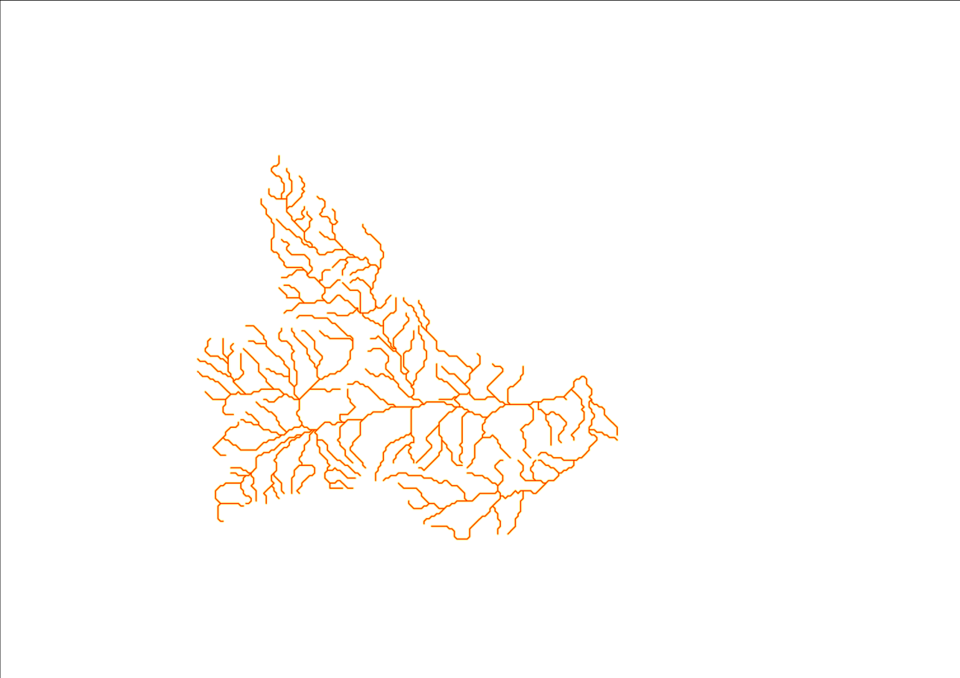
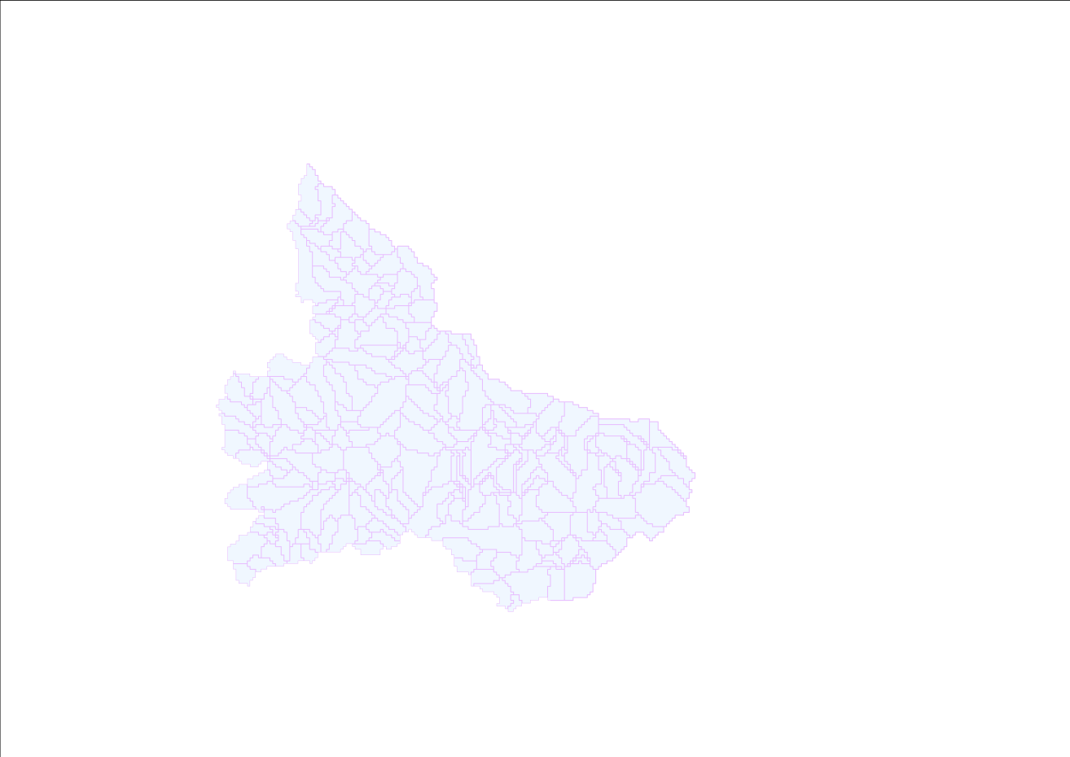
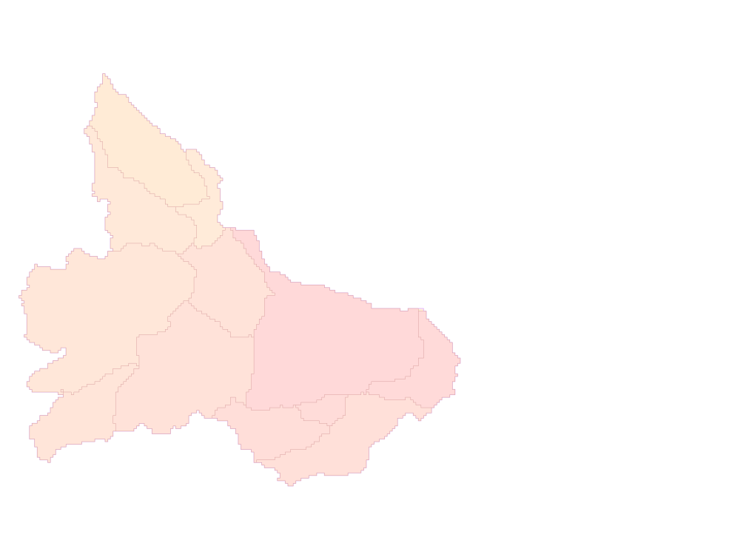
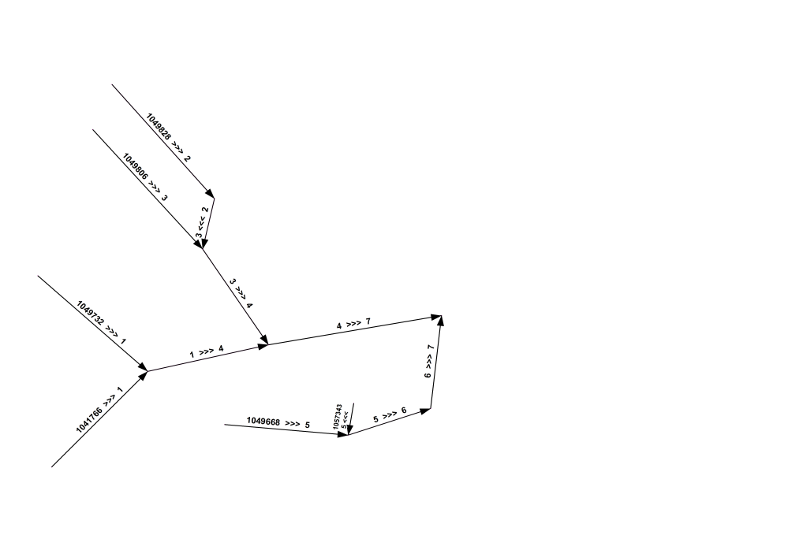
Geofabric Key Functionality
Key Geofabric Functionality
Trace the connected & flow directed stream network upstream or downstream
Find related catchments
Derive total contributing catchment area
Or sub-catchments & linked network
BRISBANE, AUSTRALIA | 18 - 20 SEPTEMBER 2017
MANAGED BY

Slide 4
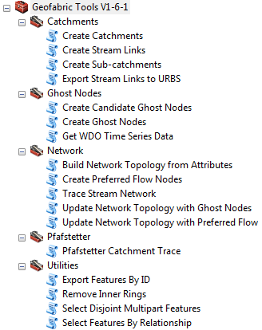
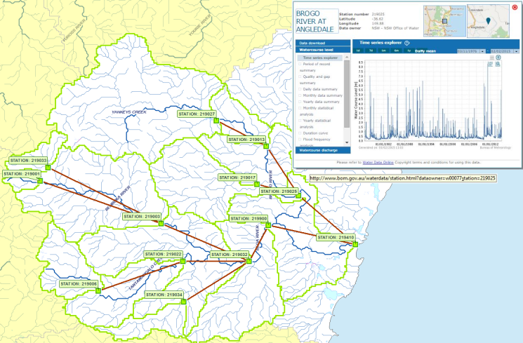
Geofabric Toolset - Key Functionality
Supports workflows commonly performed by hydrologists for multiple sites
Create nodes on streams from users points
Derive upstream catchments or sub- catchments from selected nodes of interest
Create sub-catchment stream links
Bulk download stream gauge time series data
BRISBANE, AUSTRALIA | 18 - 20 SEPTEMBER 2017
MANAGED BY
Notes:
Creates catchments for multiple points of interest, Node Link networks & download of WDO times series data
Delineation of sub-catchments and associated node link networks for use in surface water modelling
ArcGIS toolbox of 17 script tools that supports workflows commonly performed by hydrologists.
Creates catchments or sub catchments from any inputted or selected points of interest, along with associated simplified node link stream networks. Bega Sample area using 13 Geofabric Monitoring Point Ghost Nodes to create reach sub-catchments and associated links.
Facilitates bulk processing,
storage of hydrological decision made (such as preferred flow through complex anabranching drainage networks)
,ensuring repeatability and efficient updates to complex networks when required, eg addition or removal of Nodes
Also enables bulk download of Water Data Online time series observations data when used with Geofabric monitoring point features.
Originally developed in-house to delineate gauging station catchments.
Designed for use with Geofabric products, but will work with similarly structured data.
Supporting tutorial and extensive tool help in ArcGIS.
Updated toolset and quick guide soon to be released.

Slide 5
Case Study – Bureau AWRA-L and HRS Catchments
Australian Water Resource Assessment Landscape (AWRA-L) model Geofabric v2 catchments
807 shortlisted station catchments compared against alternately sourced catchment boundaries, reviewed 89 with variance > 5%
After review and update of station locations and catchments, 15 (~2%) required editing of catchment boundaries in low relief areas
589 currently used in the AWRA-L model
Hydrologic Reference Stations (HRS) Geofabric v2 catchments
222 high quality monitoring stations, reviewed against historical catchment area figures and proximity to stream junctions
Updated station locations and catchments
BRISBANE, AUSTRALIA | 18 - 20 SEPTEMBER 2017
MANAGED BY
Notes:
AWRA-L modelling currently uses 589 unimpaired catchments (295 for calibration and 294 for validation)
– Reduced numbers from shortlist, with removal of larger catchments and nested sub-catchments - identified that these require stream routing. Work underway to incorporate routing into AWRA-L modelling.
-15 required minor editing, as v2 Geofabric catchments based on the 9 sec DEM didn't provide the spatial resolution required in these low relief areas
HRS -222 high quality monitoring station sites used for identifying long-term trends in streamflow variability, across contrasting hydro-climatic regions
-Main objective is to allow for detection and attribution of long-term streamflow variability and change

Slide 6
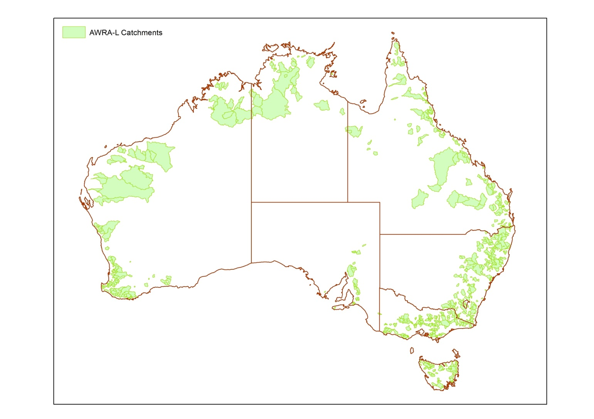
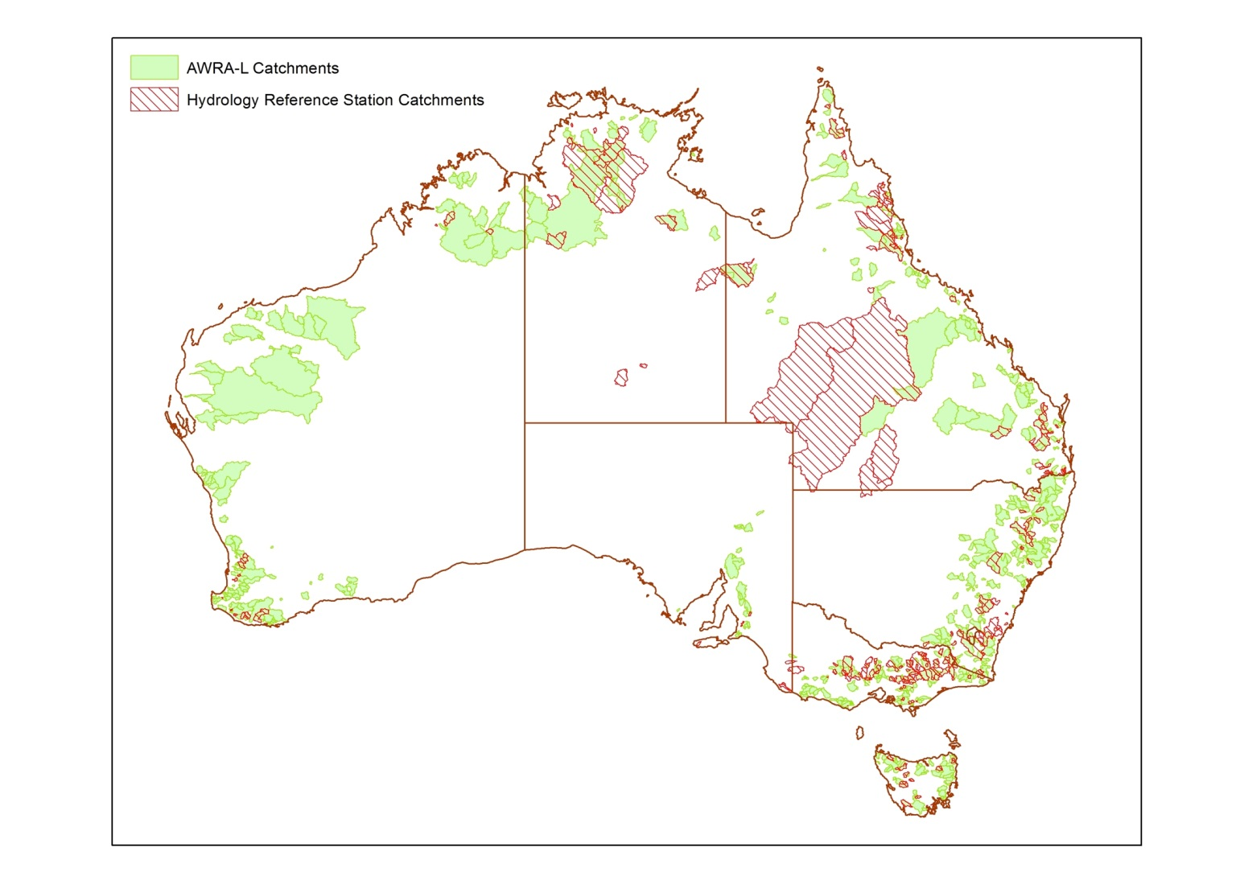
Case Study – Bureau AWRA-L and HRS Catchments
BRISBANE, AUSTRALIA | 18 - 20 SEPTEMBER 2017
MANAGED BY
Notes:
(AWRA-L) Australian Water Resources Assessment – Landscape,
(EHP) Extended Hydrological Prediction Hydrology Reference Stations
-

Slide 7
Case Study – Bureau AWRA-L and HRS Catchments Learnings
Toolset station stream name matching improves station locations
Wide variance of accuracy in historical catchment area figures, beneficial in identifying priority station catchments for review
Review required, prioritising stations with conflicting catchments areas, no stream name match, or multiple stream name matches
Most updates correcting station locations near stream junctions
Document reviews undertaken to facilitate reuse by others
Geofabric v2.1.1 includes monitoring station ghost nodes, with station location confidence levels and review notes
Improvements in v3 catchments in lower relief areas
BRISBANE, AUSTRALIA | 18 - 20 SEPTEMBER 2017
MANAGED BY
Notes:
When creating nodes on Geofabric network streams, wherever possible use toolset station stream name matching to improve station locations
Wide variance of accuracy in historical catchment area figures, beneficial for comparison to identify possible problematic catchments to review
Also useful to prioritise review of catchments based on toolset created node attribution, such as where there is no name match, or multiple name matches, particularly in the absence of historical catchment area figures
Review should be undertaken with supporting data, including imagery
Document review undertaken to improve confidence in reuse by others
Geofabric v2 includes a supporting monitoring station ghost node dataset, which includes station location confidence levels and review comments

Slide 8
Case Study – Bureau AWRA-R Catchments and Streamflow Routing
Australian Water Resource Assessment River (AWRA-R) model Geofabric v2 catchments and streamflow routing
751 river sub-catchments and associated routing across 5 regions
Resource intensive manual review and update was required for modelling sub-catchment boundaries in the Murray-Darling Basin (MDB), with its complex anabranching stream drainage network and thousands of sinks
10 of 489 (~2%) MDB sub-catchments edited where v2 Geofabric catchments didn’t provide required resolution in low relief areas
BRISBANE, AUSTRALIA | 18 - 20 SEPTEMBER 2017
MANAGED BY
Notes:
AWRA –R Catchments 741 across 5 Regions
MDB 489 – 8 overlapping with Canberra
Canberra 36
Perth 59
SEQ 65
Melb 92
Australian Water Resource Assessment Modelling System (AWRAMS)
https://www.researchgate.net/publication/280055539_A_New_Integrated_Continental_Hydrological_Simulation_System_An_overview_of_the_Australian_Water_Resource_Assessment_Modelling_System_AWRAMS
https://www.researchgate.net/publication/287508478_Australian_Water_Resources_Assessment_Modelling_System_AWRAMS-informing_water_resources_assessment_and_national_water_accounting
https://www.researchgate.net/publication/280055539_A_New_Integrated_Continental_Hydrological_Simulation_System_An_overview_of_the_Australian_Water_Resource_Assessment_Modelling_System_AWRAMS

Slide 9
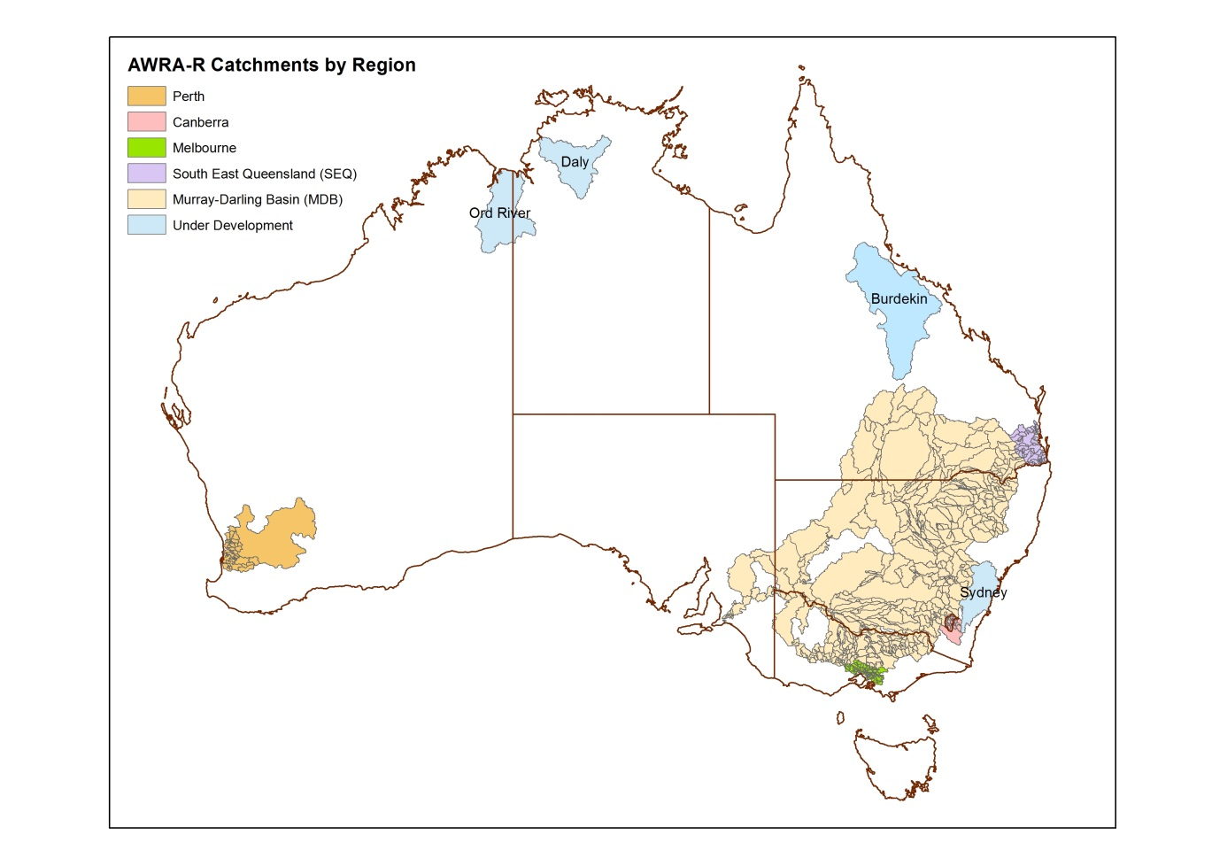
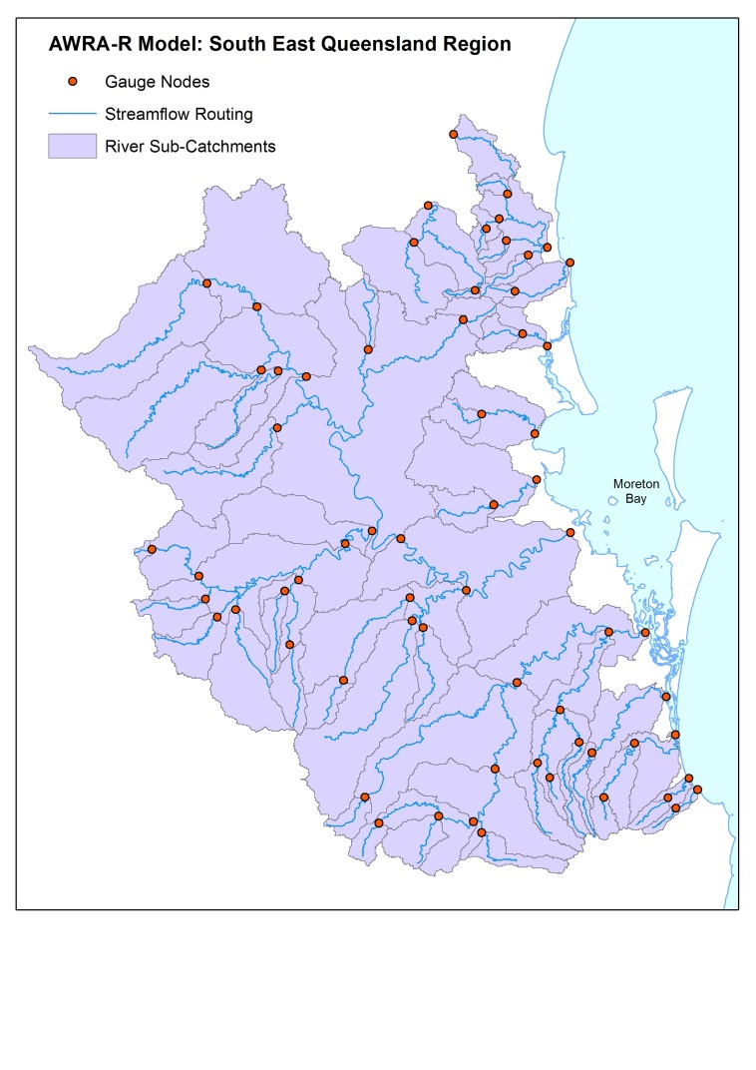
Case Study – Bureau AWRA-R Catchments and Streamflow Routing
BRISBANE, AUSTRALIA | 18 - 20 SEPTEMBER 2017
MANAGED BY
Notes:
AWRA –R Catchments 741 across 5 Regions
MDB 489 – 8 overlapping with Canberra
Canberra 36
Perth 59
SEQ 65
Melb 92
Australian Water Resource Assessment Modelling System (AWRAMS)
https://www.researchgate.net/publication/287508478_Australian_Water_Resources_Assessment_Modelling_System_AWRAMS-informing_water_resources_assessment_and_national_water_accounting
https://www.researchgate.net/publication/280055539_A_New_Integrated_Continental_Hydrological_Simulation_System_An_overview_of_the_Australian_Water_Resource_Assessment_Modelling_System_AWRAMS

Slide 10
Case Study – Bureau AWRA-R Catchments and Streamflow Routing - Learnings
Significant changes to gauge nodes in the MDB resulted in the need to recreate, manually review and update catchments and routing from scratch
Identified need to capture hydrological decision, enabling repeatability and efficient updates to complex anabranching drainage networks
Further tools developed, utilising preferred flow node attribution at bifurcation points, capturing attribution for reuse
Improved resolution of v3 catchment boundaries in problematic MDB low relief areas
V3 catchments include additional attribution that mimics DEM filling of sinks, enabling automated inclusion of these areas to streams they potentially contribute flow to if filled
BRISBANE, AUSTRALIA | 18 - 20 SEPTEMBER 2017
MANAGED BY
Notes:
Store hydrological decision made (such as preferred flow through complex divergent drainage networks), ensuring repeatability and efficient updates to complex networks when required eg:(addition or removal of nodes, changes to preferred flow)
(In divergent flow areas, initial set of sub-catchments might not be what you're expecting.
Preferred flow tool (advanced) can be used to control network traceability through divergent nodes.
Preferred flow automatically initialised using Geofabric attribution (can be adjusted manually).
Information stored allowing for repeatability.

Slide 11
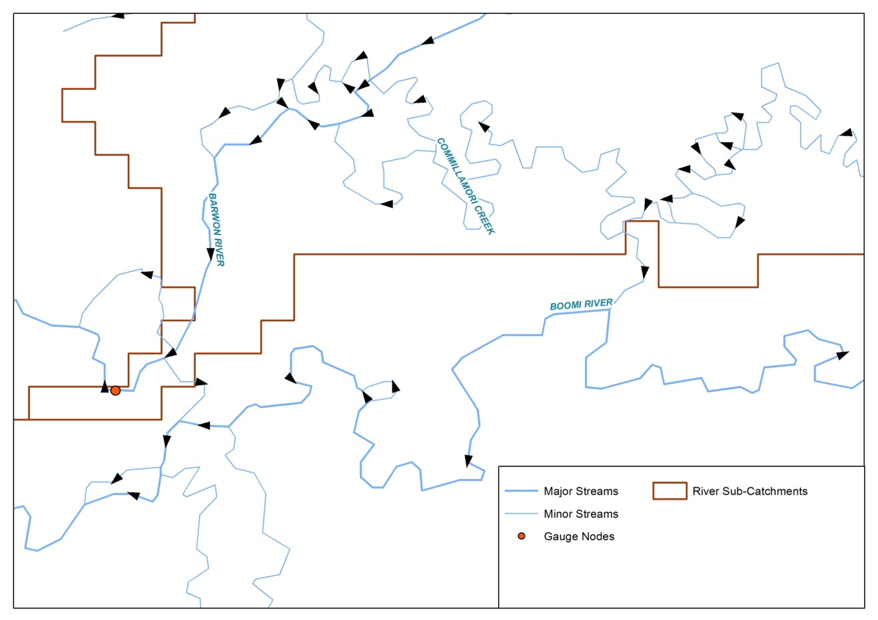
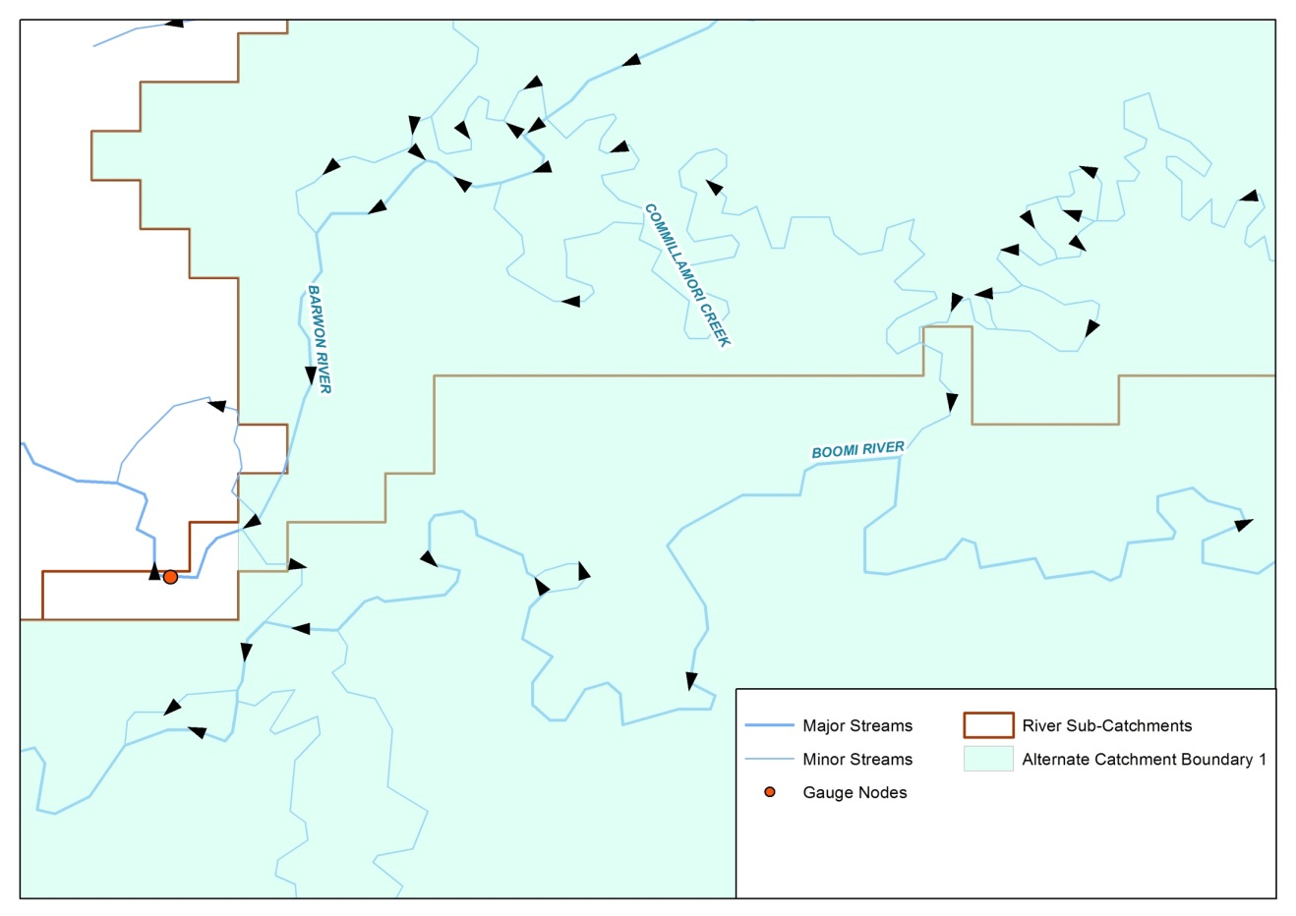
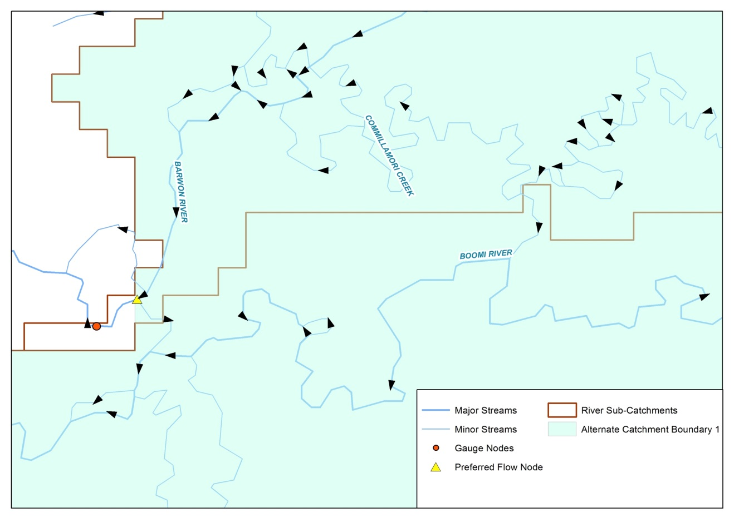
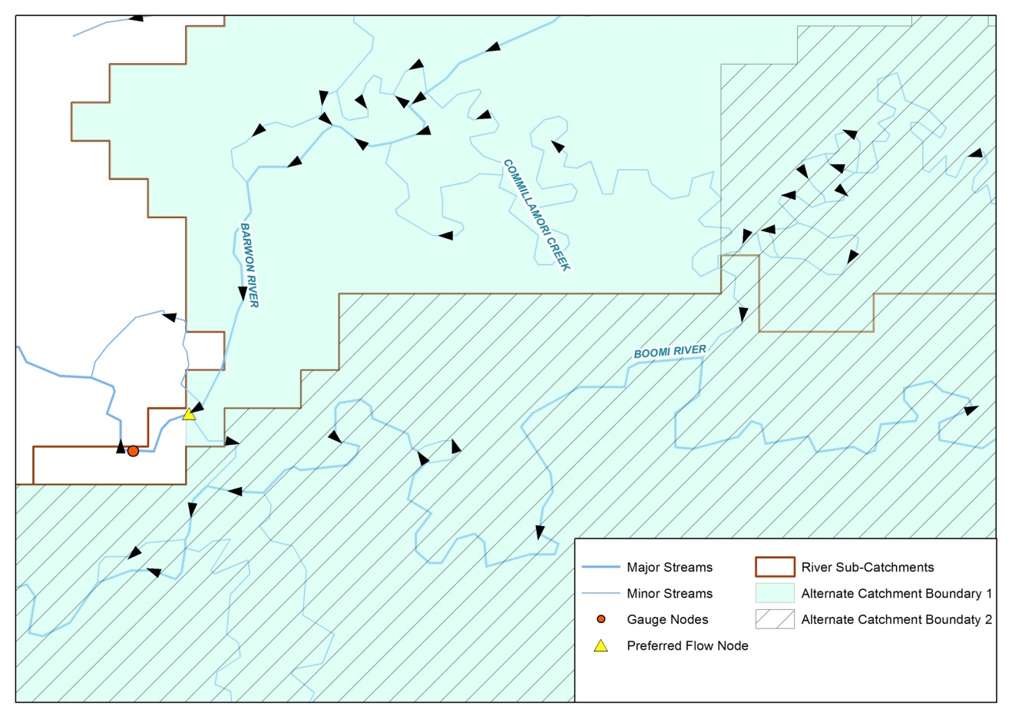
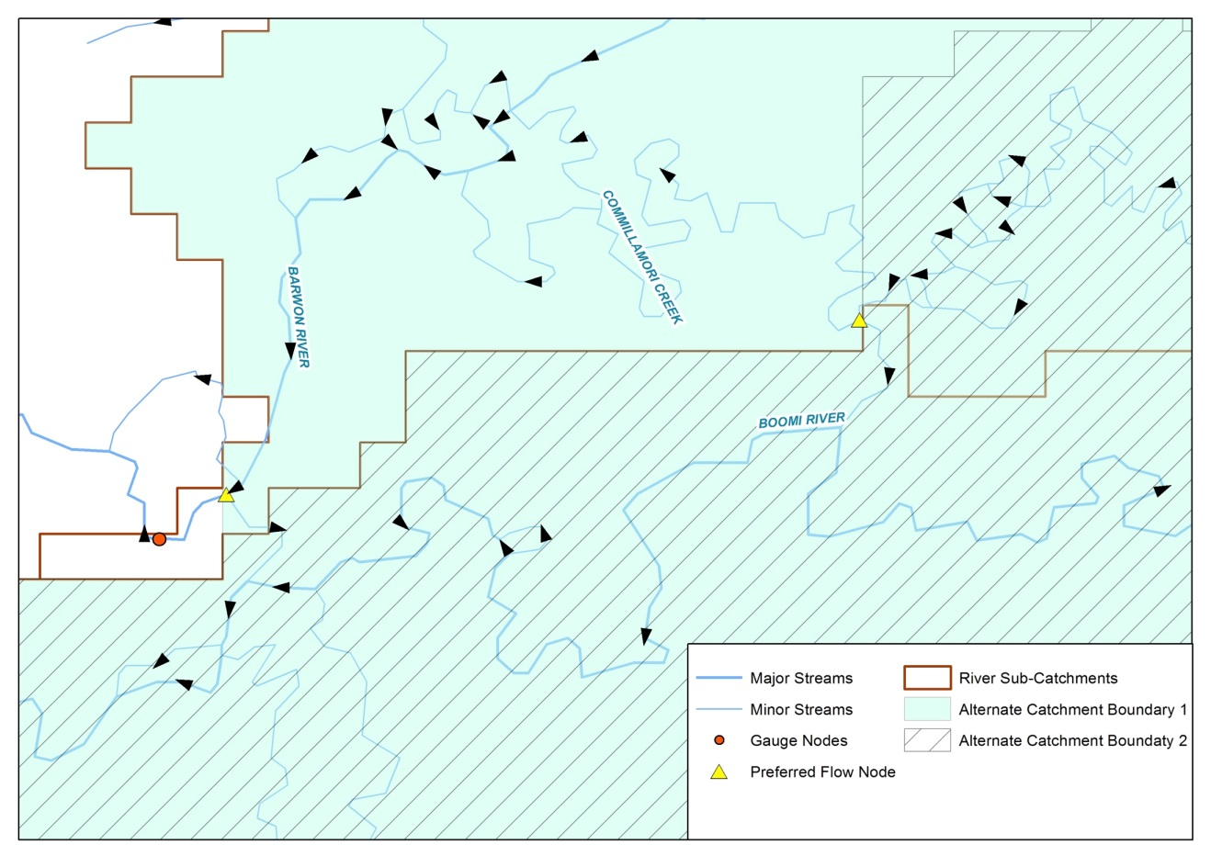
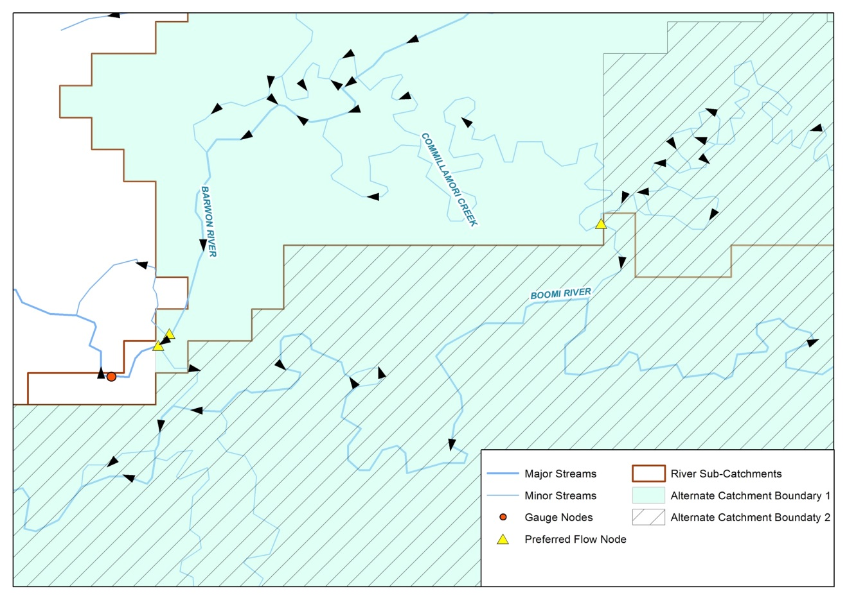
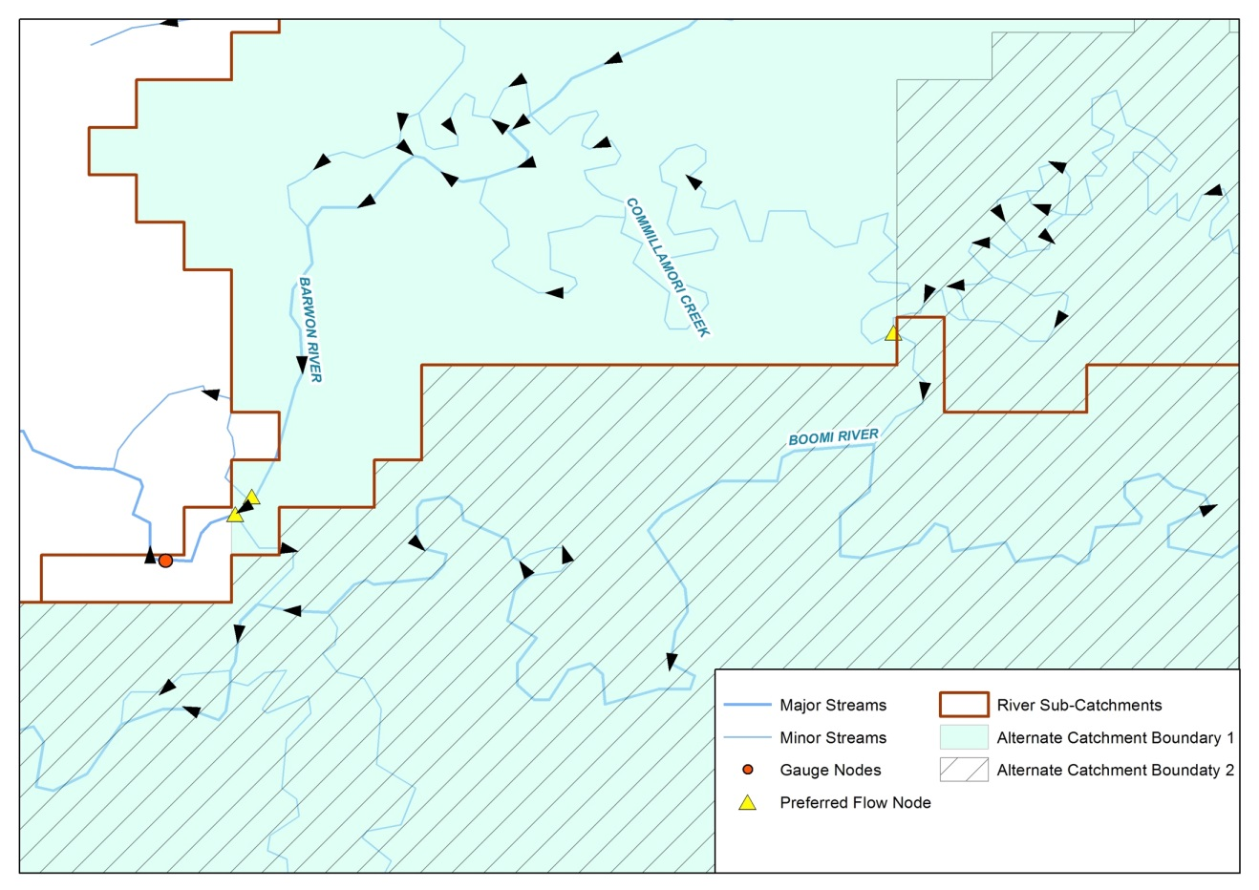
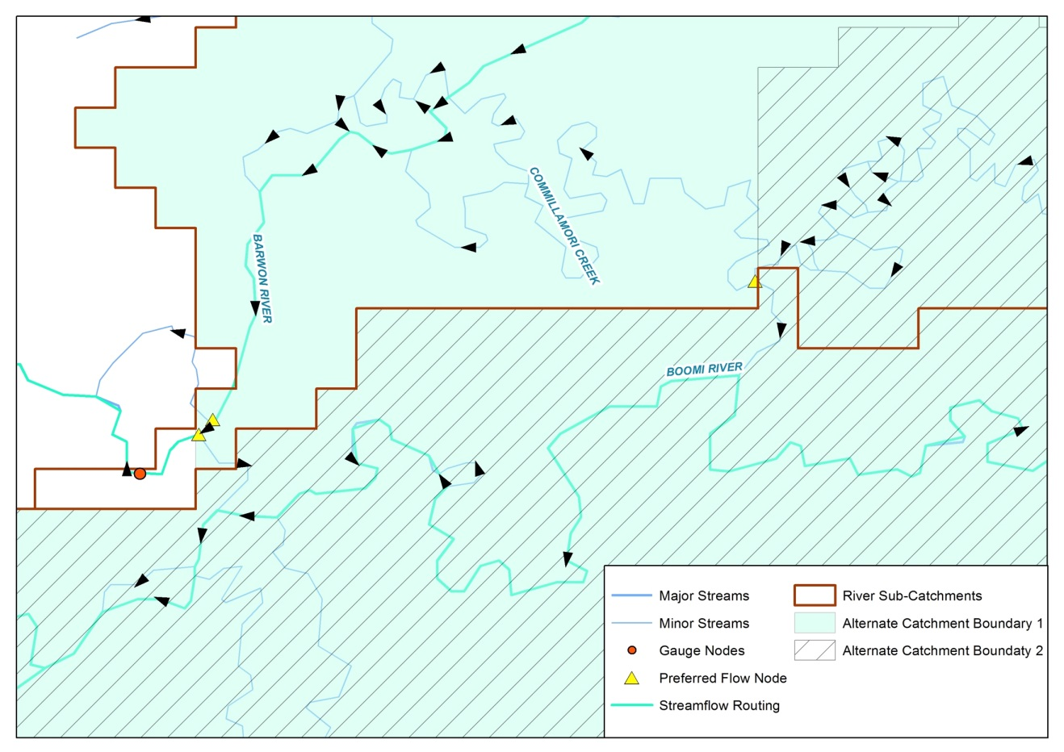
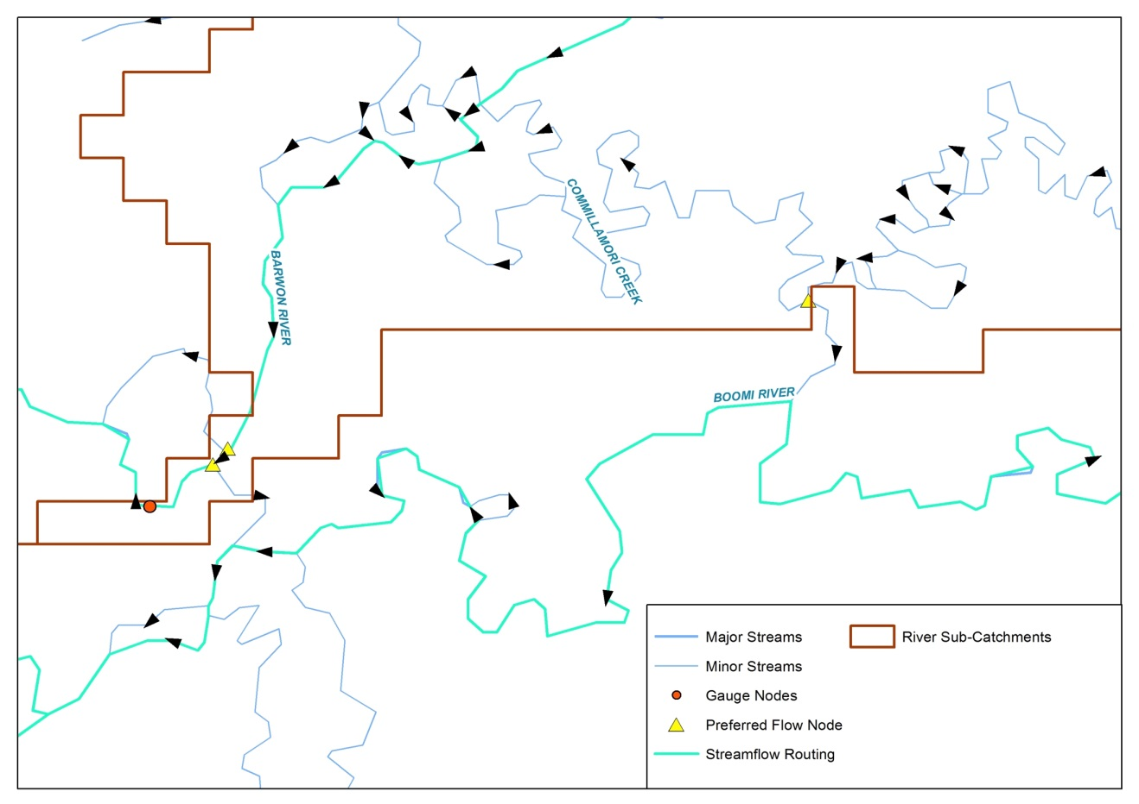
Case Study – Bureau AWRA-R Catchments and Streamflow Routing
BRISBANE, AUSTRALIA | 18 - 20 SEPTEMBER 2017
MANAGED BY
Notes:
Processing of catchments capturing hydrological decisions made
(In divergent flow areas, initial set of sub-catchments might not be what you're expecting.
Preferred flow tool (advanced) can be used to control network traceability through divergent nodes.
Preferred flow automatically initialised using Geofabric attribution (can be adjusted manually).
Information stored allowing for repeatability.)

Slide 12
Case study - NT DLRM Gauging Catchments
Northern Territory Dept. of Land Resource Management evaluated Geofabric version 2 data and the Geofabric toolset to delineate catchments for gauging stations for entry into their Hydstra system
Study area around Darwin, compared Geofabric results against catchment areas derived by experienced hydrographers, and 1:50,000 topographic maps
Acknowledgement to Corey Baird, NT Dept. of Land Resource Management
BRISBANE, AUSTRALIA | 18 - 20 SEPTEMBER 2017
MANAGED BY

Slide 13
Case study - NT DLRM Gauging Catchments Results
132 input Gauges, Geofabric successfully created 116 catchments
Identified a number of errors in pre-existing values in Hydstra
Excelled at calculating area values for small-medium catchments (1-2,000 km² ) and gauges close to Darwin
V2 Geofabric has limited, though still workable application for urban /built up areas, large catchments (>2,000 km² ), and remote areas
Provides consistent results, proved a workable, time efficient and transparent alternative for calculating catchment boundaries
BRISBANE, AUSTRALIA | 18 - 20 SEPTEMBER 2017
MANAGED BY
Notes:
132 input Gauges, Geofabric successfully created 116 catchments. Most of the 16 fell outside the toolsets stream search radius, which can be set by the users
Identified a number of erroneous catchment areas values in Hydstra and provided good alternative values
Excelled at calculating area values for small-medium catchments (1-2,000 km²) and gauges close to Darwin
Current Versions 2 Geofabric has limited, though still workable application for urban and built up areas, large catchments (>2,000 km²), and remote areas
Geofabric provides consistent results, proved a workable, time efficient and transparent alternative for calculating catchment boundaries.

Slide 14
Case study - NT DLRM Gauging Catchments Challenges and Learnings
Inconsistencies in v2 Geofabric data likely to be remedied in updated version 3
Multiple tools with many parameters, created ArcMap Model workflow to streamline catchment creation process
Some gauge locations placed on the wrong stream segment, should use automated name match or area logic
Validation procedures are necessary by hydrologists, on both inputs and results
BRISBANE, AUSTRALIA | 18 - 20 SEPTEMBER 2017
MANAGED BY
Notes:
Inconsistencies in Geofabric data likely to be remedied in updated version, with V3 based on higher resolution DEM data which should improve catchment delineation in larger catchments, low relief and remote areas
Multiple tools with many parameters to enter, built an ArcMap Model to streamline the catchment creation process.
Some gauge locations placed on wrong stream segment, particularly an issue around significant stream junctions where gauge location either Downstream or Upstream of the junction can dramatically change the catchment area result
Should use automated name match logic in the toolset, or area value logic if an existing value is available
Problematic input data and results should undergo manual checking by hydrologists - visualisation of the Geofabric results against 1:50,000 topographic maps greatly assists results validation.

Slide 15
Geofabric Version 3 Products
Improved map features and 1 second DEM, greatly improving catchment boundaries that better reflect reality
Contracted catchment product includes important monitoring stations
4 of 13 drainage divisions publicly available
Remaining 9 to be finalised this year
Challenge with hundreds of thousands of sinks in the DEM and aggregation of multi-jurisdictional mapped features
Significant resources in reviewing important monitoring stations
Partnership with Geoscience Australia and the Australian National University Fenner School of Environment & Society
BRISBANE, AUSTRALIA | 18 - 20 SEPTEMBER 2017
MANAGED BY
Notes:
Improved spatial resolution of map features (Multi Jurisdictional) and 1 second DEM | V1 & 2 Geofabric based on GA 1:250K mapped features and 9 second DEM, ~30m grids Vs ~250m
Greatly improved catchment boundaries that better reflect reality
Iteratively processing, validating, testing and releasing V3 drainage divisions products, with completion of a national extent this year

Slide 16
Summary
Functionality -Tracing stream flow directions and creating contributing catchment areas
Base level catchments can be customised to meet users requirements
Toolset facilitates efficient bulk processing to create customised catchments and networks, providing consistency and repeatability
Version 3 (V3) Geofabric data has improved catchments based on the 1 second DEM, and value added attribution
All Creative Commons
Web Feature and Map services also available
BRISBANE, AUSTRALIA | 18 - 20 SEPTEMBER 2017
MANAGED BY
Notes:
Stream flow direction with subsequent stream and catchment connectivity functionality enables stream tracing and identification of contributing catchment areas, no need to process DEM data.
Provides base level catchments which users can customise to create catchment areas that meet there unique business requirements.
Toolset facilitates bulk processing, is efficient, consistent, repeatable and can be customised for the users workflow requirements.
Version 3 Geofabric data has improved mapped features and is based on a 1 second DEM, providing improved Catchments.
Bureau Geofabric products are Creative Commons
Web Map and Web Feature services also available

Slide 17
Thank you
Get involved, let us know your interest in the Geofabric, become a V3 Beta Tester
Questions?
Geofabric Email : AHGF@bom.gov.au
Geofabric Website : www.bom.gov.au/water/geofabric
HRS Website : http://www.bom.gov.au/water/hrs/
AWRA Modelling System paper : https://www.researchgate.net/publication/287508478_Australian_Water_Resources_Assessment_Modelling_System_AWRAMS-informing_water_resources_assessment_and_national_water_accounting
BRISBANE, AUSTRALIA | 18 - 20 SEPTEMBER 2017
MANAGED BY

