Slide 1
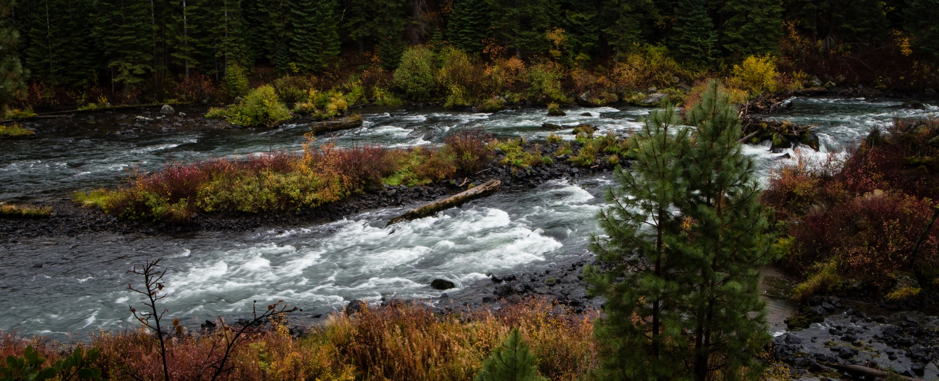
Place your
logo here
Environmental Flow Restoration: A Compelling Story. Keep It Simple
Marisa Hossick, Deschutes River Conservancy
Bend, Oregon, USA
marisa@deschutesriver.org @deschutesriver
BRISBANE, AUSTRALIA | 18 - 20 SEPTEMBER 2017
MANAGED BY

Slide 2
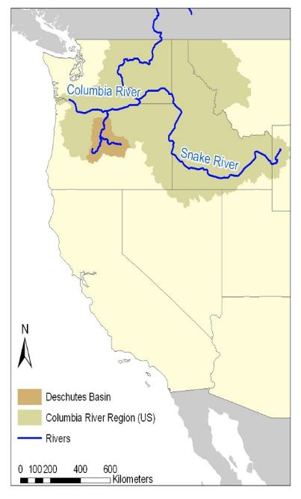
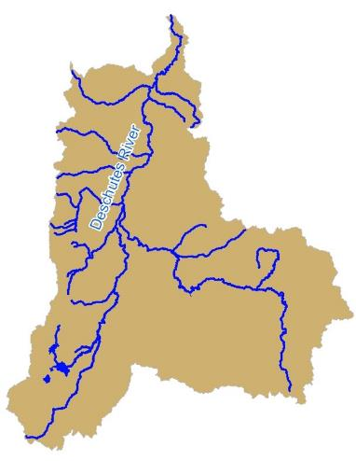
Place your
logo here
The Deschutes Basin
Central Oregon
BRISBANE, AUSTRALIA | 18 - 20 SEPTEMBER 2017
MANAGED BY
Notes:
Hi! Thanks for being here. Marisa Hossick. Deschutes River Conservancy Bend, Oregon on the West Coast of the United States. I have been the Outreach Manager for over 7 years
At our organization, we work in the Deschutes River Basin which runs through the arid lands of Oregon’s High Desert.

Slide 3
Place your
logo here
5 Steps To Go From Technical to INSPIRING
Identify why you do what you do
Find your storytellers
Translate, translate, translate
Who cares?
What should they do about it?
BRISBANE, AUSTRALIA | 18 - 20 SEPTEMBER 2017
MANAGED BY
Notes:
Today I’m going to talk to you about changing the way we relay information to the general public. We work in very technical fields and for the most part, our language we speak is very technical. It’s full of acronyms, rates of flow, measurements of volume, water law etc.
I come from a non-technical background and being at the DRC for the past 7 years has been an on the job education in all things water. Because of my background, I know what it’s like to sit in a room hearing highly technical talk and looking for inspiration.

Slide 4
Why change?
At the Deschutes River Conservancy, we restore streamflow and improve water quality in the Deschutes Basin.
We do this through a collaborative, multi-stakeholder board,
devising innovative, consensus-based solutions for flow restoration.
Notes:
I’m guessing a lot of your messaging looks a little like this. We have a wonderfully concise and focused mission statement that is easy to understand. It tells you what we do. This next sentences tells you how we do it. This is pretty standard messaging, but to really make an impact, we need to go a little further.

Slide 5
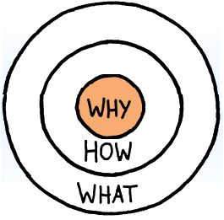
Place your
logo here
Why change?
Simon Sinek’s Golden Circle from his book, “Start with the Why”.
BRISBANE, AUSTRALIA | 18 - 20 SEPTEMBER 2017
MANAGED BY
Notes:
WHAT: Every company or organization knows WHAT they do. No matter the industry, everyone can easily describe the products and services offered. Enter the mission statement.
HOW: Some companies or organizations know HOW they do WHAT they do. They can explain how their organization, method, program, or product is different.
WHY: Very few companies or organizations can give you a clear picture of WHY they do WHAT they do. This isn’t about RESULTS, this is about your PURPOSE, CAUSE of BELIEF. Why does your organization exist? Why do you get out of bed every morning? And WHY should anyone care?

Slide 6
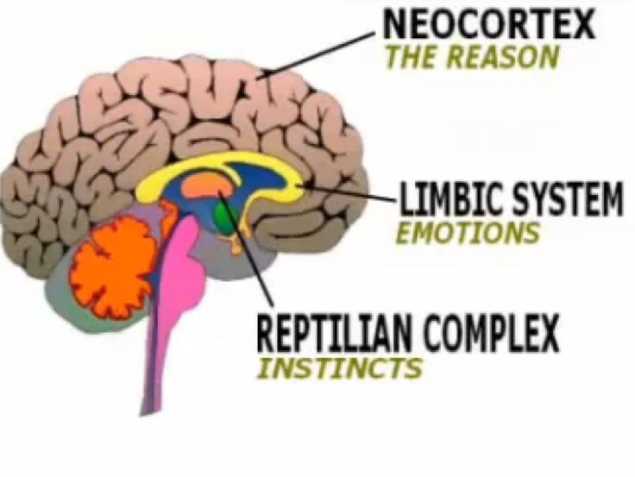
Place your
logo here
Biology says:
BRISBANE, AUSTRALIA | 18 - 20 SEPTEMBER 2017
MANAGED BY
Notes:
When an organization helps us understand WHY they do what they do and that resonates for us, we will go out of our way to support them. When they represent values that are important to us, we feel like we belong to part of something.
The Neocortex is the part of our brain responsible for analytical thought and language. The is our facts and figures receptor. It does not, however drive behavior.
The Limbic brain is responsible for feelings, such as trust and loyalty. This is the area of our brain that’s responsible for decision making. It has no capacity for language. Your ‘gut decisions’ come from the limbic brain.
If you make somebody feel something, they will change their behavior. (Limbic Brain)
The part of the brain that controls decision making, doesn’t control language.
(Limbic Brain)
Hitting people with facts and figures will not inspire people to be a part of what you do.
(Neo cortex)

Slide 7
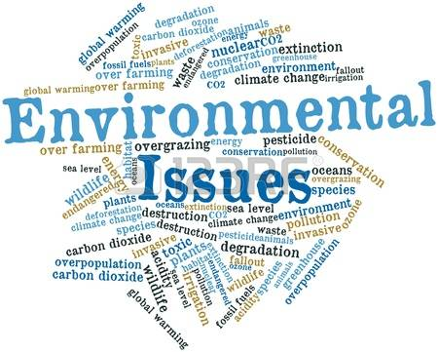
Why is this distinction important?
Notes:
Why does this matter? In a news environment of monsters storms, millennium droughts, epic floods, out-of-control wildfires and, of course, climate change, these reports of river restoration and other great work can fall on deaf and numb ears.
Most environmental news is so huge and not close enough to home. It feels far away and scary and there are so many other concerns in our lives that we tend to just numb out.
Presenting a compelling story about restoring a local river is something that people can wrap their head around. It’s something that has a personal impact and is accessible for people. Seeing small good changes in our own back yard.

Slide 8
Place your
logo here
?
Why do we do what we do?
BRISBANE, AUSTRALIA | 18 - 20 SEPTEMBER 2017
MANAGED BY
Notes:
So, why do we do what we do?

Slide 9
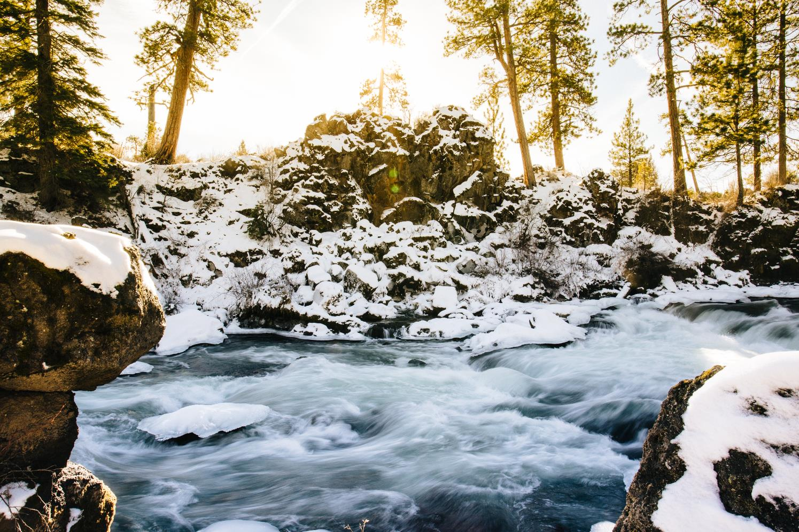
Because
Nature
Matters
Place your
logo here

Slide 10
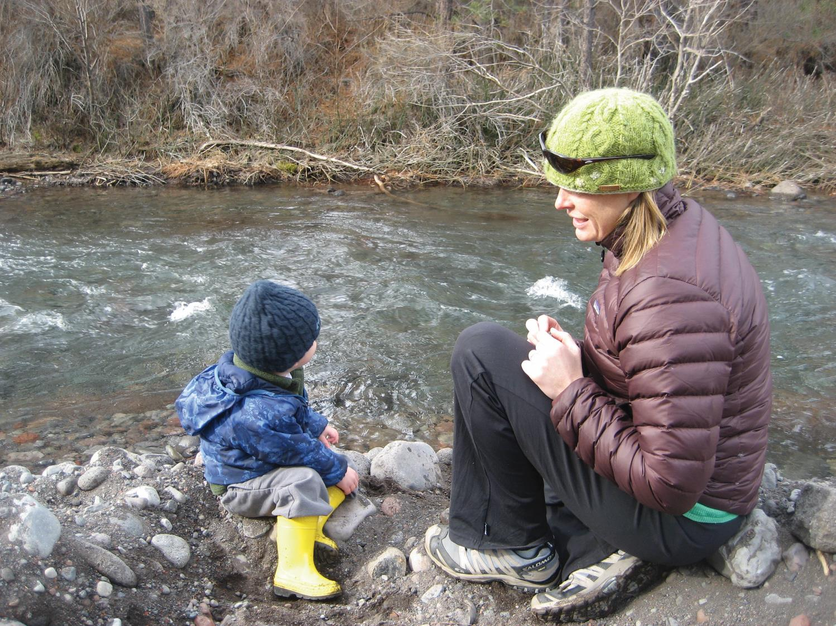
Place your
logo here
Because we want our children
to live in a beautiful, abundant, natural world.
BRISBANE, AUSTRALIA | 18 - 20 SEPTEMBER 2017
MANAGED BY

Slide 11
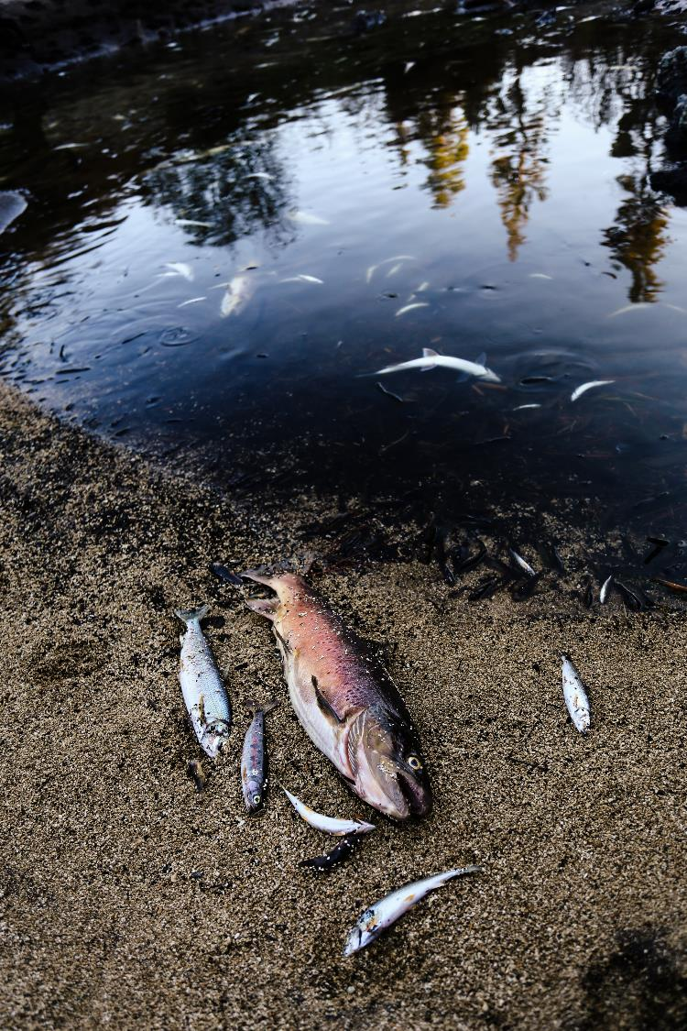
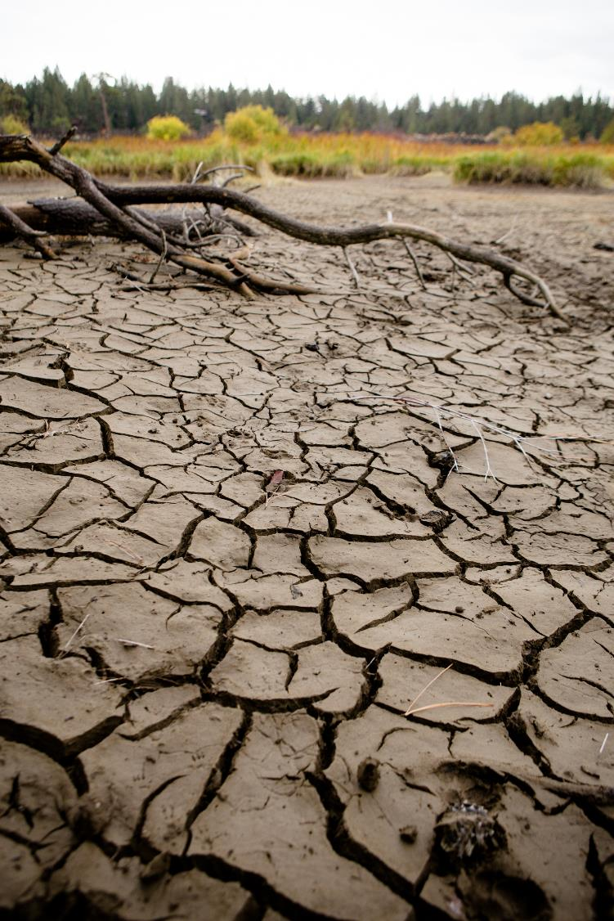
And we need to fix what we’ve broken…

Slide 12
Why: The Deschutes River is broken. By working together we can heal this river and ensure there is enough water for our community moving into the future.
How: We work collaboratively with local stakeholders to create long-term restoration strategies that work for fish, farms and families.
What: We restore streamflow and improve water quality in the Deschutes Basin.

Slide 13
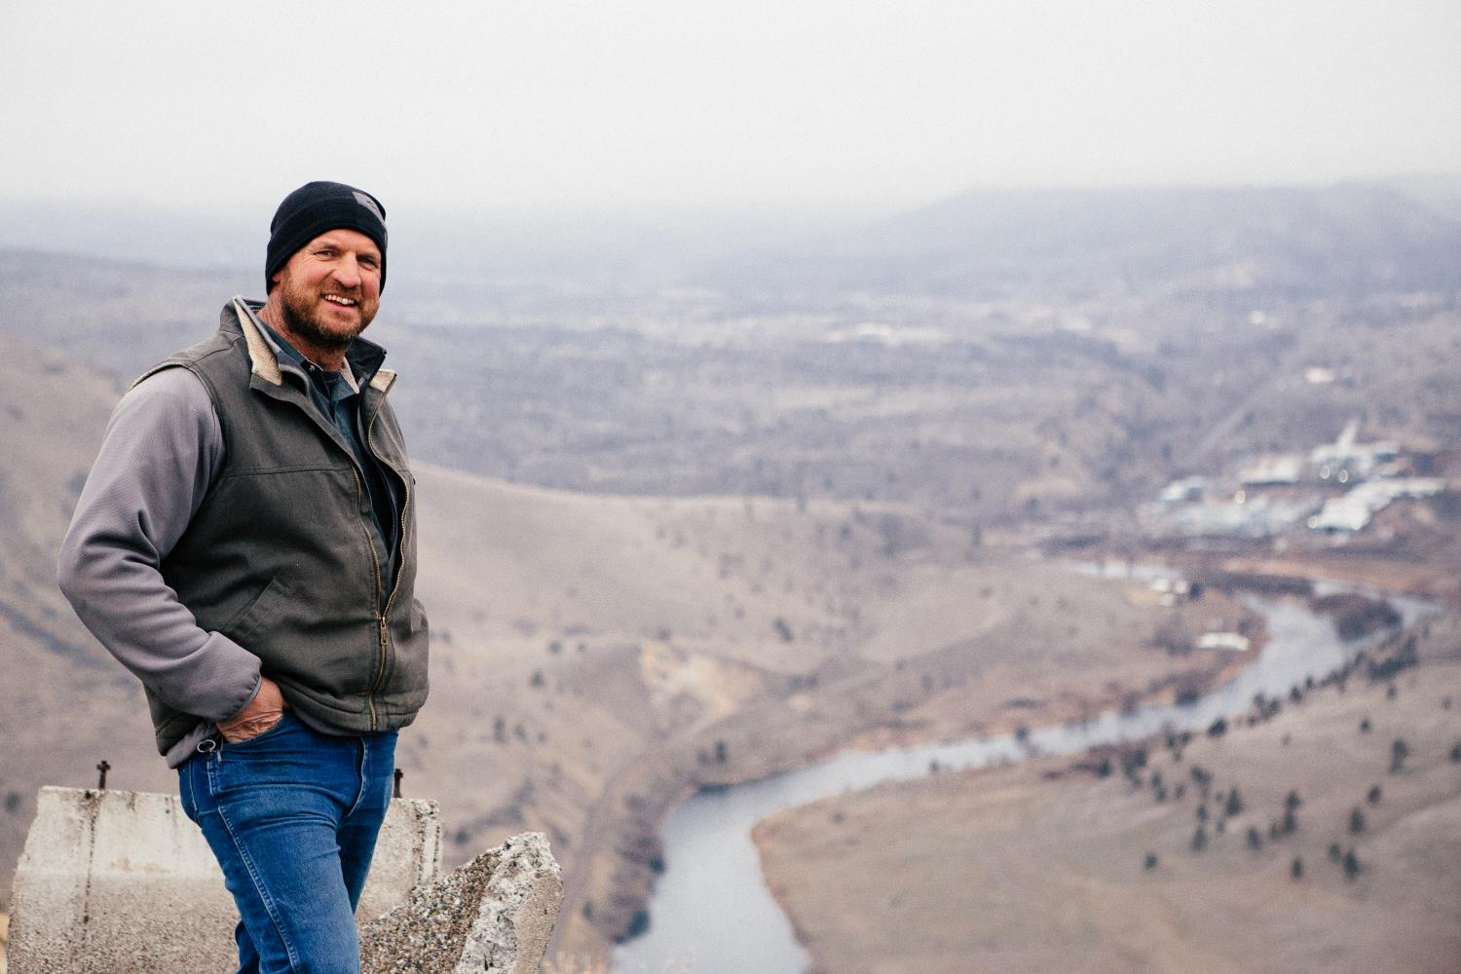
Find your storytellers
Notes:
Why tell stories? 65% of our daily conversations are made up of some sort of narrative. Neuroscience research reports that our brains are naturally wired to receive and remember every human experience within the structure of a story. Storytelling is the creation of mental images and emotions. When done well, storytelling will evoke emotions ranging from empathy to anger. This will galvanize your donors and supporters to take action on behalf of your cause.
Who are the personalities in your work that can help tell your story?

Slide 14
Find your storytellers

Slide 15
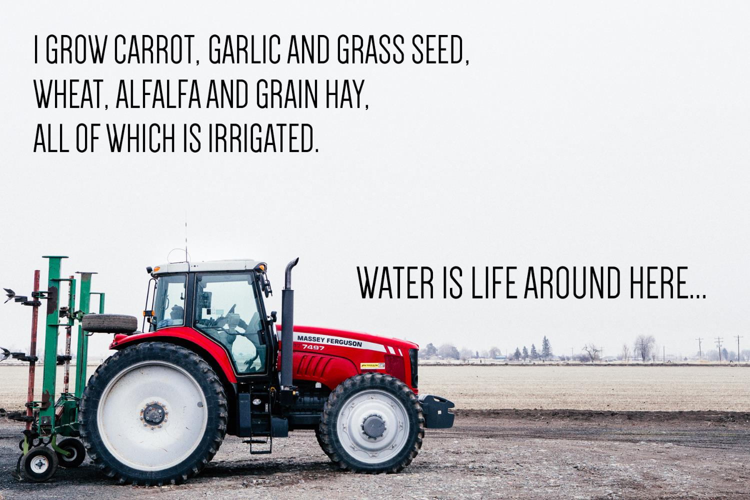
Find your storytellers

Slide 16
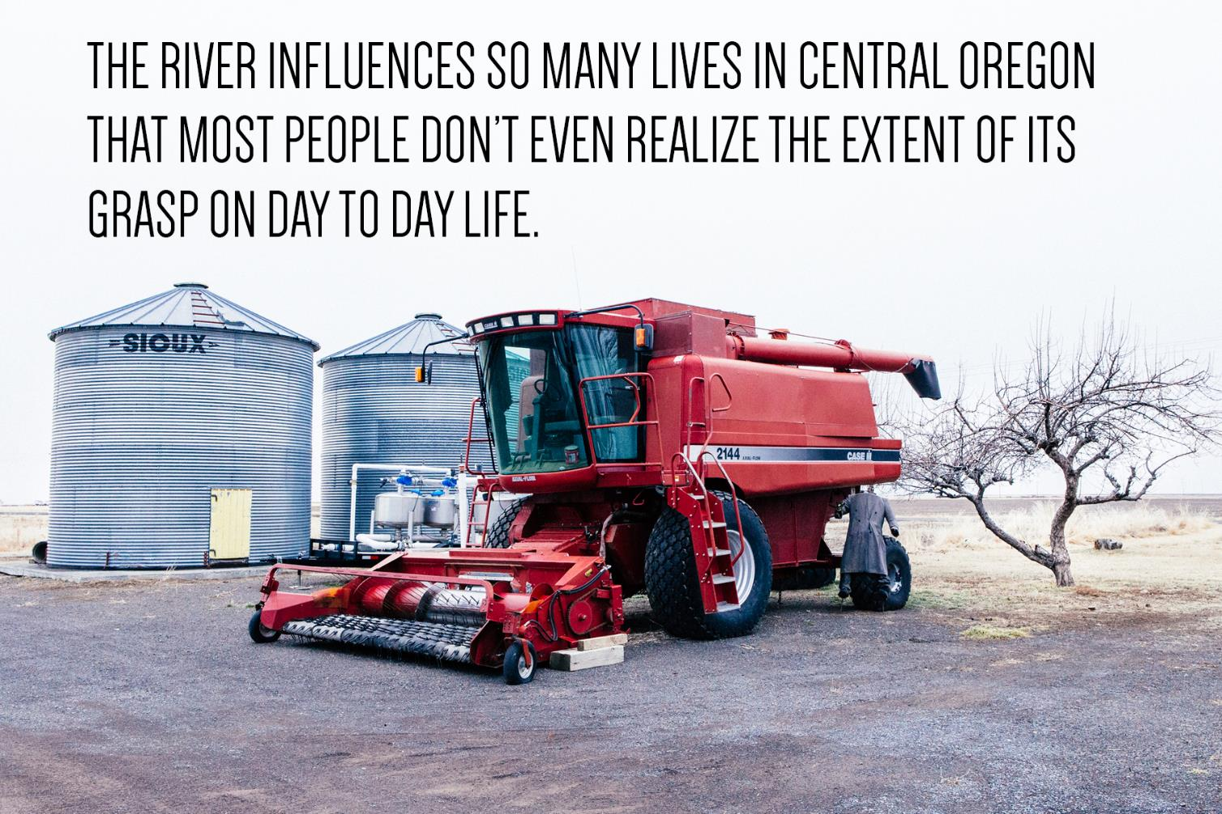
Find your storytellers

Slide 17
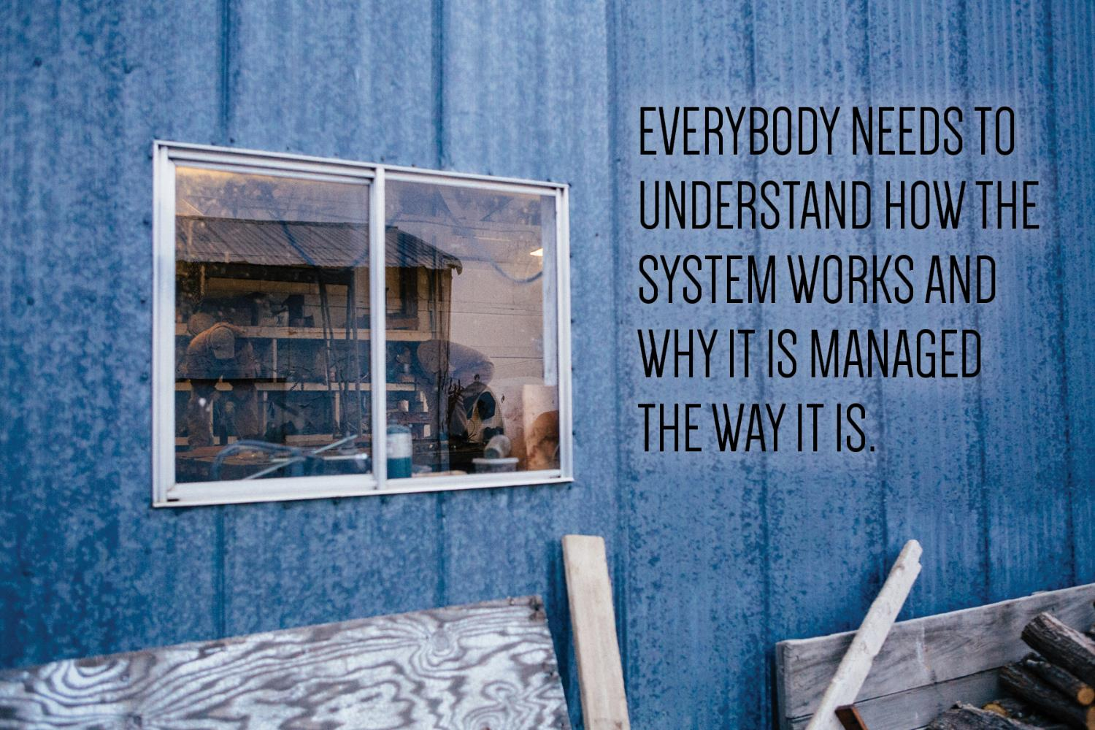

Slide 18
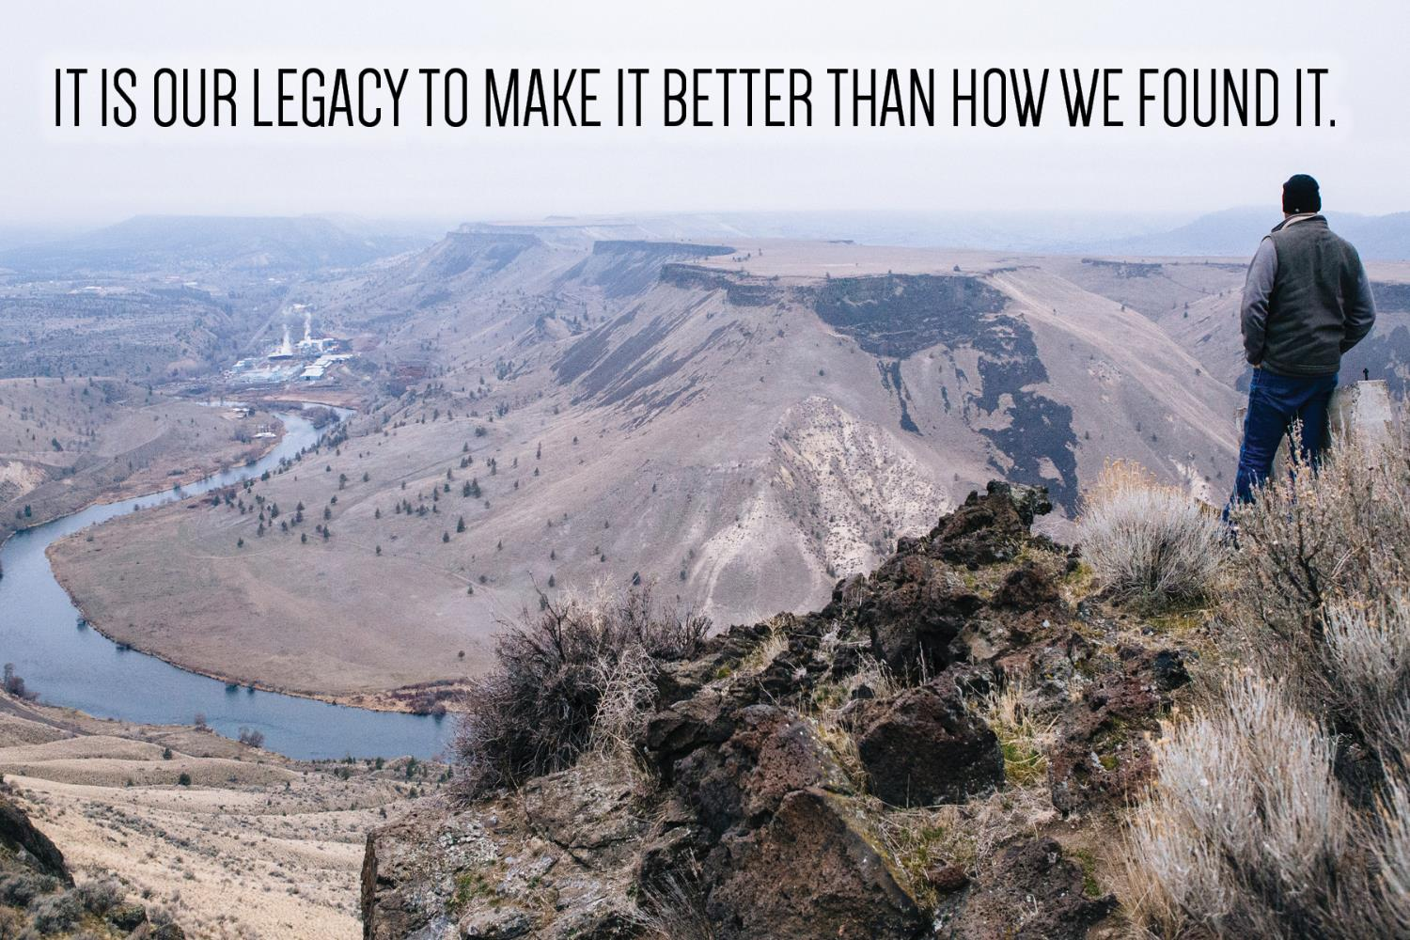

Slide 19
Place your
logo here
Translate. Translate. Translate!
BRISBANE, AUSTRALIA | 18 - 20 SEPTEMBER 2017
MANAGED BY
Notes:
Make sure you’re speaking the right language to the right audience. Develop a sense of fluency in different ways of telling the story. Among more informed people, bringing them technically driven information is great. When you are in an outreach, social media, newsletter or any other situation that relates to the general public, use broad picture ideas. Use analogies. Paint pictures for them. Find the percentage decrease instead of how much the rate of flow has dropped. Using a sentence like “the river drops by 98%” is more visually effective than saying flows go from 2000 cubic feet per second to 20 cubic feet per second.

Slide 20
Notes:
Is the information you are trying to relate actually interesting to your audience? Really think about this.
What are the values of your audience and how can you tell your story in a way that is relatable?
5 ways you can create content that makes people care is to
Let your passion for what your doing shine through
Tap into their emotional connection
Use stories
Let them know they are part of something bigger
Appreciate them

Slide 21
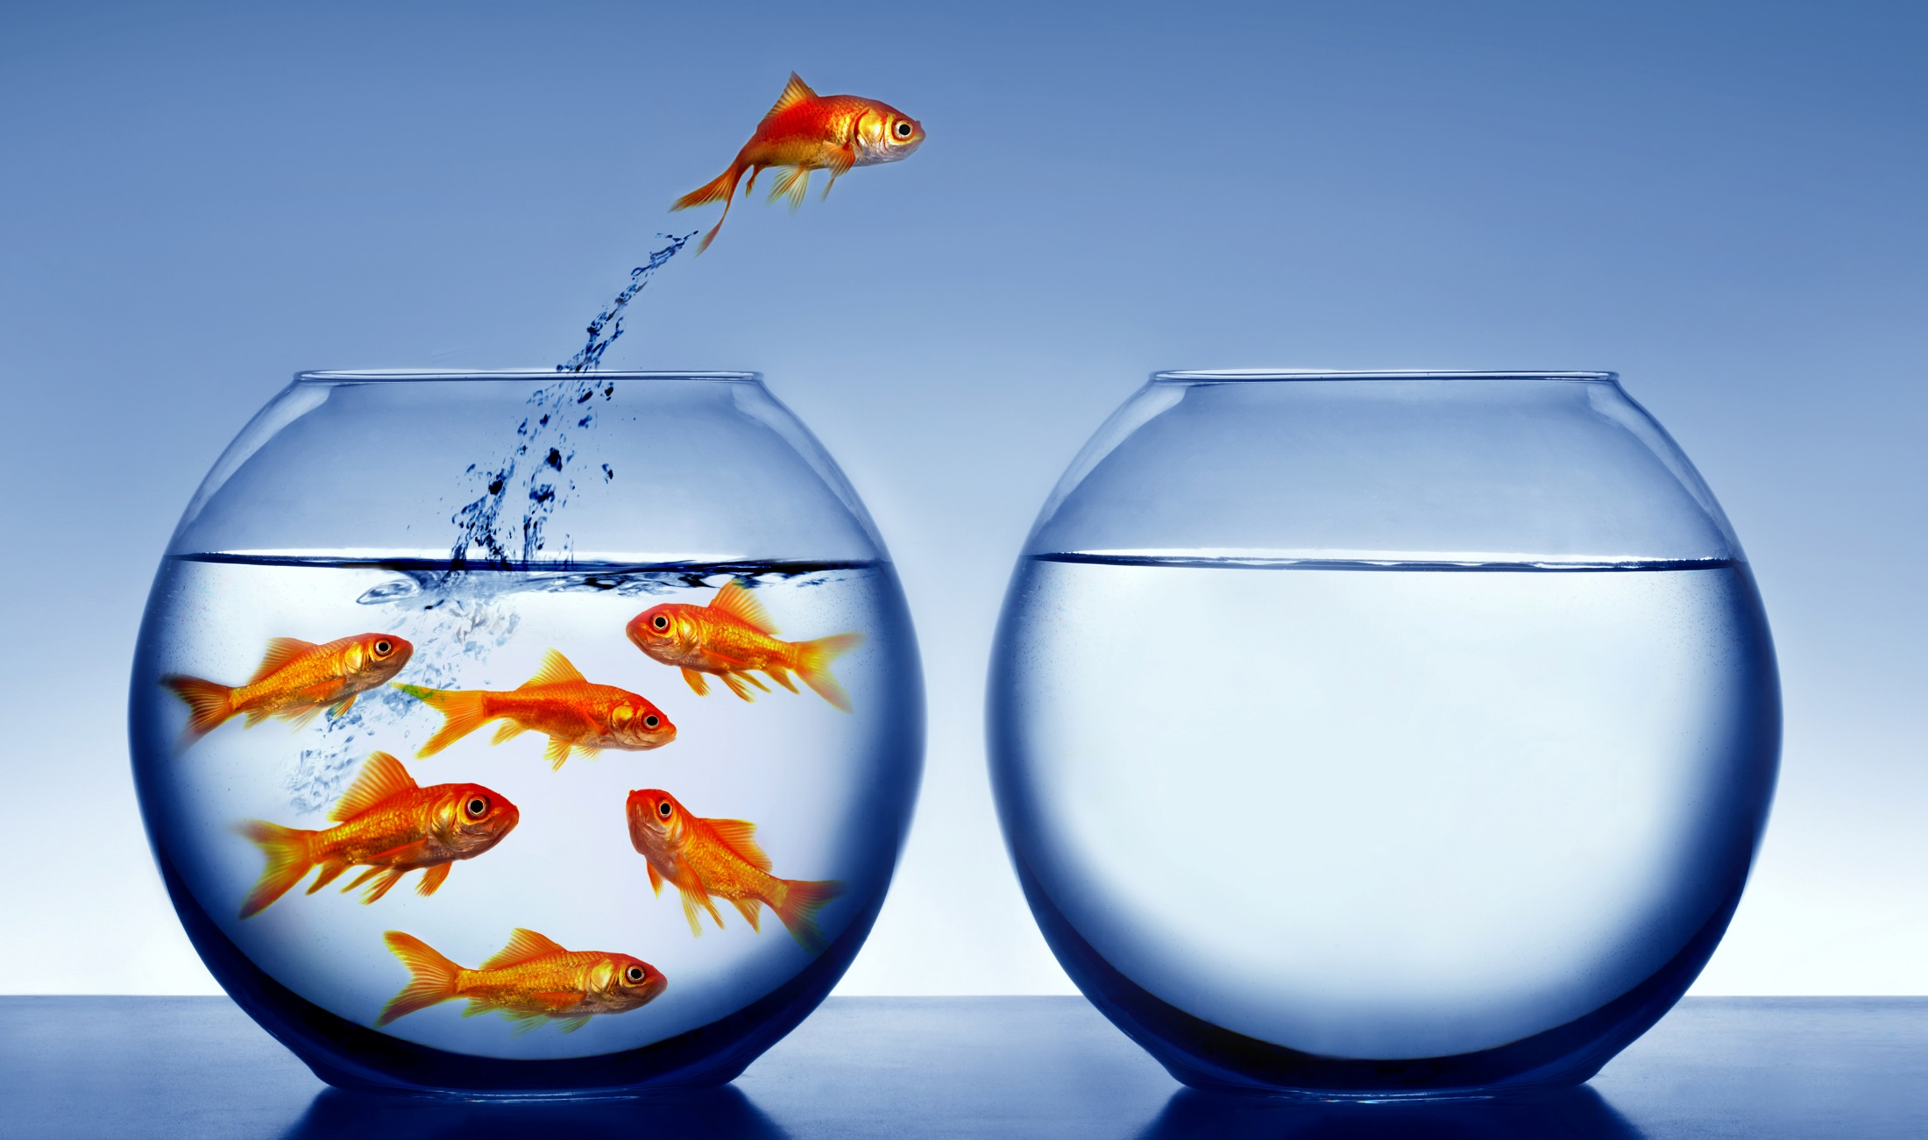
What do you want them to do about it?
Notes:
What is your call to action? What leap in behavior do you want them to make after they hear what you have to say?
Do you want them to give you money? Use less water? Vote a certain way? Plant trees? Volunteer their time? Make sure you have a clearly defined, easy to understand action that you would like them to take. This can be a complex process to go through, but will make or break your communications efforts.

Slide 22
Place your
logo here
5 Steps to Go From Technical to INSPIRING
Identify why you do what you do
Find your storytellers
Translate, translate, translate
Who cares?
What should they do about it?
BRISBANE, AUSTRALIA | 18 - 20 SEPTEMBER 2017
MANAGED BY
Notes:
So, we’ve talked about starting with WHY you do what you do
We’ve talked about storytelling
Speaking the right language to the right person
Getting people to care
And getting people to take action.

Slide 23
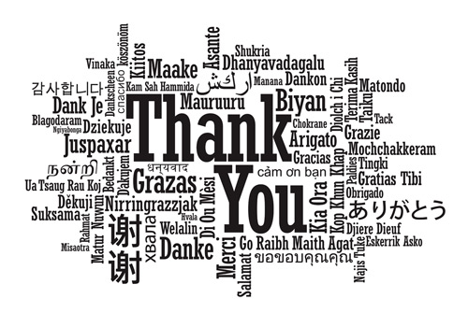
Place your
logo here
Marisa Hossick, Deschutes River Conservancy
Bend, Oregon, USA
marisa@deschutesriver.org @deschutesriver
BRISBANE, AUSTRALIA | 18 - 20 SEPTEMBER 2017
MANAGED BY

