Slide 1
Place your
logo here
How to build a WQIP when there is no perceived water quality problem?
Developing a WQIP for the Mount Lofty Ranges, South Australia
Stephen Packer
Environment Protection Authority,
South Australia
BRISBANE, AUSTRALIA | 18 - 20 SEPTEMBER 2017
MANAGED BY

Slide 2
A correspondent to the Observer of Adelaide on the 25 May 1843 wrote:
“It does appear strange to me that no steps are as yet taken to supply the town with cleaner water. It would be hard indeed to persuade me that the Torrens water is at all wholesome, if sheep washing with tobacco, tanning hides and so forth, are allowed on its banks….But besides all this, the cows, goats, bullocks and horses kept in town are taken to the old bridge to water and to wash….”(Whitelock et al 2000).
BRISBANE, AUSTRALIA | 18 - 20 SEPTEMBER 2017
MANAGED BY

Slide 3
In 1957 newspapers published letters from ‘horrified’ residents informing their fellow citizens that sheep were allowed to graze in the South Para catchment area. There were also departmental reports to the Public Works Parliamentary Standing Committee of ‘disturbing’ sewage conditions’ at Lobethal and Gumeracha (Hammerton 1986 ).
BRISBANE, AUSTRALIA | 18 - 20 SEPTEMBER 2017
MANAGED BY

Slide 4
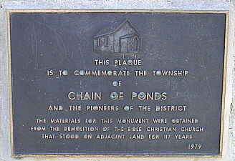
An extreme example was the township of Chain of Ponds, founded in 1850. In response to possible sewage contamination concerns for the Millbrook Reservoir in 1977 it was decided to buy up all the property and remove the township. The population was forced to sell their houses so they could be demolished, the last family leaving in 1981 (Sunday Mail 2010).
Source: Flinders Ranges Research http://www.southaustralianhistory.com.au/chainofponds.htm
BRISBANE, AUSTRALIA | 18 - 20 SEPTEMBER 2017
MANAGED BY

Slide 5
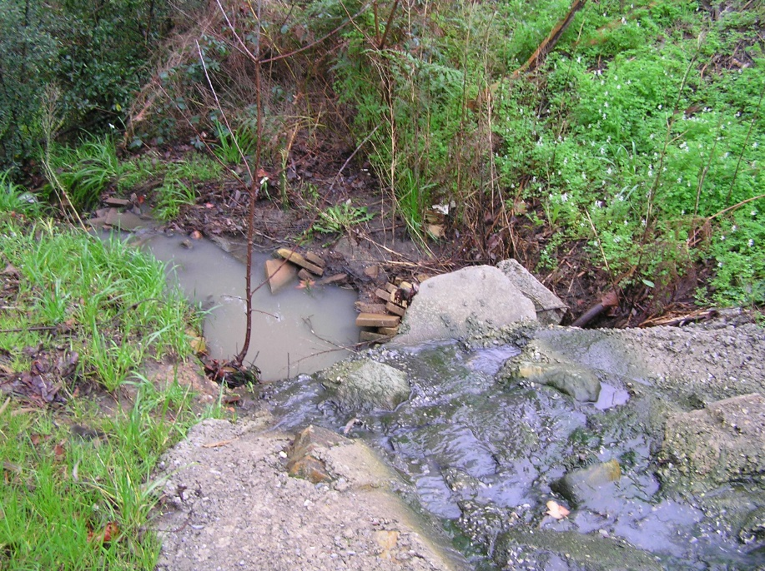
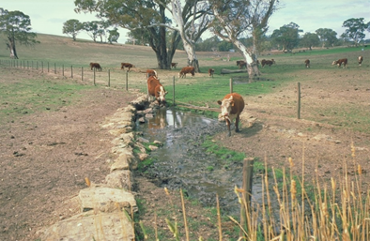
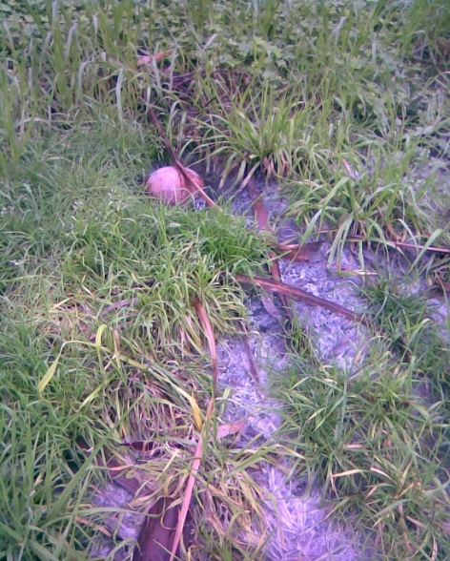
BRISBANE, AUSTRALIA | 18 - 20 SEPTEMBER 2017
MANAGED BY

Slide 6
How do we build a WQIP if there is no perceived problem?
How do we define water quality?
Is it a number?
Is it a look, a visual definition?
Is it a cost, $$ to treat
Is it an environmental value not met?
BRISBANE, AUSTRALIA | 18 - 20 SEPTEMBER 2017
MANAGED BY
Notes:
One suggestion is don’t start something this complex without having everyone in agreement. It is like asking a question without already knowing the answer.
You must have a driver for a major project, something that engages everyone, residents, industry and government where all want to see change and can understand what is affecting water quality.
Presenting data like the AECRs does not inspire people to change behaviour

Slide 7
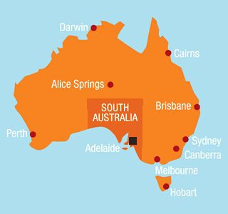
Where is the Mount Lofty Ranges Watershed?
BRISBANE, AUSTRALIA | 18 - 20 SEPTEMBER 2017
MANAGED BY

Slide 8
BRISBANE, AUSTRALIA | 18 - 20 SEPTEMBER 2017
MANAGED BY
Notes:
Four main pollutants
2 rivers, many creeks, hundreds of mapped watercourses
5-6 main pollutant sources
Many unique aquatic ecosystems
10 councils
4 or more government agencies with vested interests
6 community/environmental values
Multiple industries
Grazing, horticulture, viticulture, vegetables, dairy
Many small towns
Major tourism destinations,
Marketed as clean and green
Over 180 catchments
Over 50000 residents
And supplies 60% of Adelaide's drinking water

Slide 9
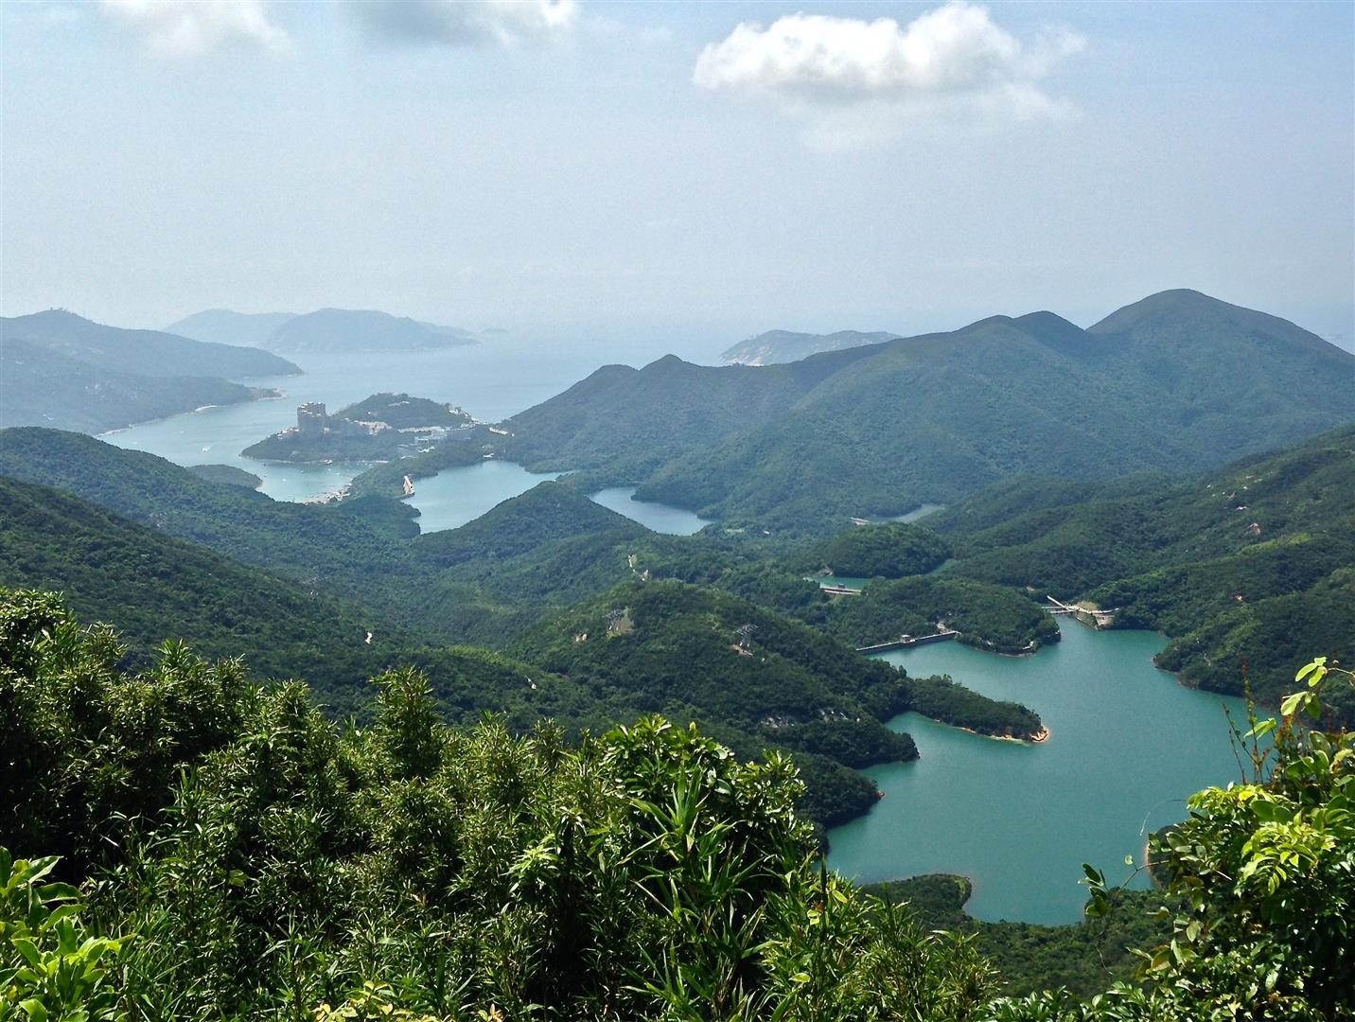
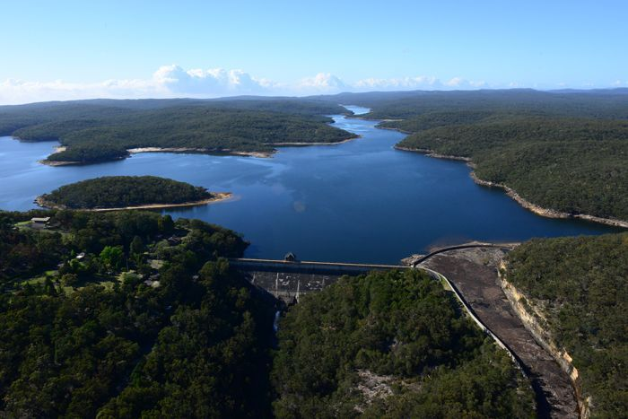
BRISBANE, AUSTRALIA | 18 - 20 SEPTEMBER 2017
MANAGED BY
Notes:
How does it compare to other city catchments
Why is it different to other places?
Melbourne
Sydney
Perth
Hong Kong

Slide 10
What are the drivers to improve WQ?
Drinking water?
Aquatic Ecosystems?
Cultural and spiritual?
Other EV’s?
It took the 2006-2009 drought.
BRISBANE, AUSTRALIA | 18 - 20 SEPTEMBER 2017
MANAGED BY
Notes:
– You would think pretty obvious and considering the history shown here a pretty easy sell. But not.
One of the challenges is that our drinking water supplier has done a good job of ensuring nobody gets sick through Crypto or Giardia and we have never had a boiled water notice. Thanks to the WQ scare in Sydney in 1998 a big effort was made to improve treatment to ensure that didn’t happen.
As for Aquatic Ecosystems, I think we have just gotten used to the state of water as it is. Maybe there aren’t any iconic species to inspire a public outcry and so WQ has not received the recognition it should have.
Other EV’s have also been OK and none challenged to need improvement.
Water quality and security recognised as an issue during drought 2006-2009 with Water for Good
And so a WQIP was born.

Slide 11
Why do we say it is poor water quality?
Monitoring as part of the MERI for NRM called AECRs or Aquatic Ecosystem Condition Reports. A combination of water chemistry and ecological condition
This sampling and monitoring showed that only 17% were good or better, so 83% are fair, poor or very poor.
But still there is a challenge for some groups to accept that water quality in the MLR is poor and unlikely to get better on its own.
BRISBANE, AUSTRALIA | 18 - 20 SEPTEMBER 2017
MANAGED BY
Notes:
For 30 years prior to 2007 we used water quality chemistry but this just went up and down on a yearly cycle with no trend showing. Water chemistry monitoring could show a difference on a daily basis depending on flows.
So we adopted a method for defining water quality using ecosystems, gain and loss of native species and introduced species with water chemistry data.
Apparently a number is needed to confirm water quality but we don’t know what that number is. Obviously when the level of N or P or salt is > ADWG or other EV standards then that water is likely to not be good but the same nutrient number could be low if it is consumed by algae so a number does not tell the story.

Slide 12
How do we develop a WQIP faced with these barriers?
Over 70% of NRM budget spent on land management, education and capacity building
Implied water quality improvement
Consultation and engagement
Provide focus for funding and efforts
Recognise industry as part of community and recognise limitations of what can be achieved
Eg never be pristine
Some groups can only do a little
BRISBANE, AUSTRALIA | 18 - 20 SEPTEMBER 2017
MANAGED BY

Slide 13
The Mount Lofty Ranges Watershed Water Quality Improvement Plan – MLRWWQIP - is being released as a web document with industry support, government agency endorsement and hopefully Australian Government funding to deliver actions.
BRISBANE, AUSTRALIA | 18 - 20 SEPTEMBER 2017
MANAGED BY

