Slide 1
Place your
logo here
Basin Planning in the Upper Deschutes River: Rebalancing water use in a changing climate
Kate Fitzpatrick
Deschutes River Conservancy
Bend, Oregon, United States
kate@deschutesriver.org
www.deschutesriver.org
BRISBANE, AUSTRALIA | 18 - 20 SEPTEMBER 2017
MANAGED BY
Notes:
Themes to highlight:
basin-scale integrated solutions for instream and out of stream uses
Diverse stakeholder inclusion and management of process
Interdependencies
Climate analysis
Scales from largest-scale(big movements of water) to smallest (how/where/when)

Slide 2
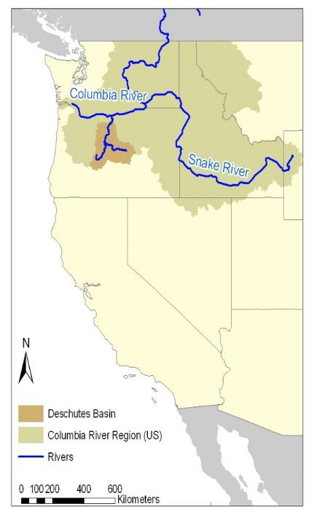
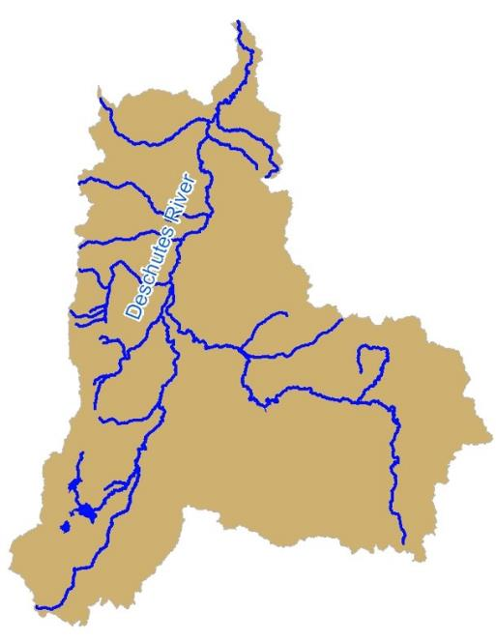
Place your
logo here
How do we meet current and future water needs?
17,222 km²
BRISBANE, AUSTRALIA | 18 - 20 SEPTEMBER 2017
MANAGED BY

Slide 3
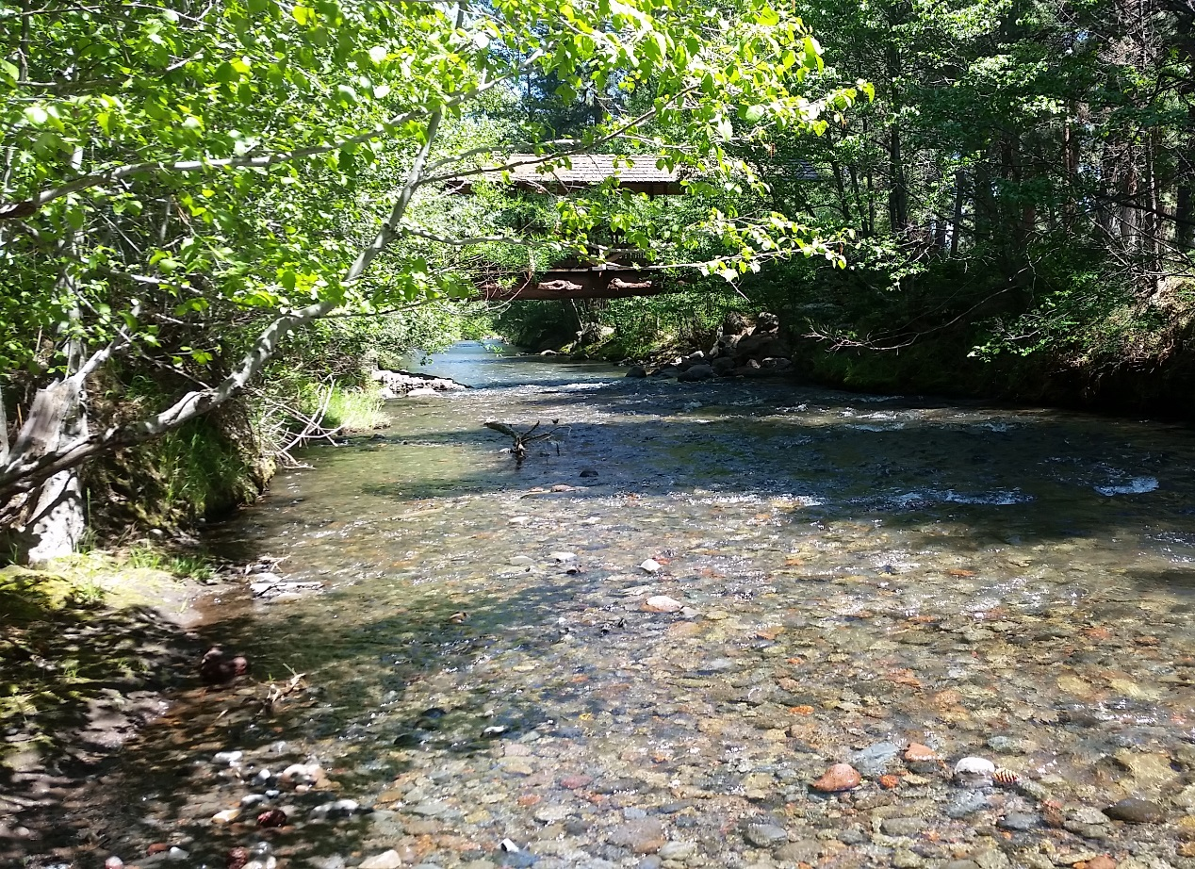
Why a Basin Study?
Place your
logo here
1992: Formation of Deschutes River Conservancy
Strong History of Collaboration & Progress
Wicked Problems Remain: Upper Deschutes River
Need to take coordinated planning up a notch
BRISBANE, AUSTRALIA | 18 - 20 SEPTEMBER 2017
MANAGED BY

Slide 4
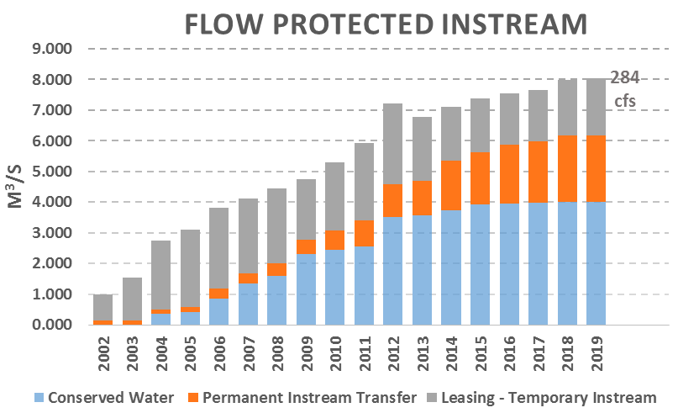

Slide 5
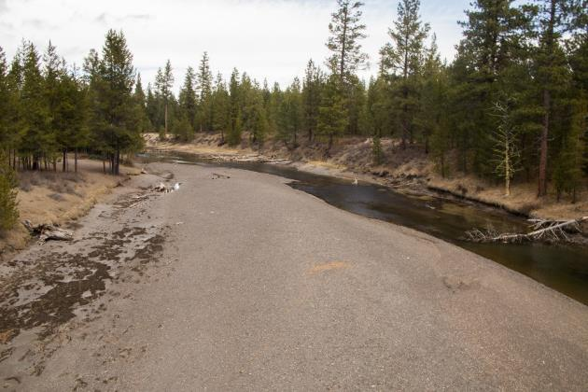
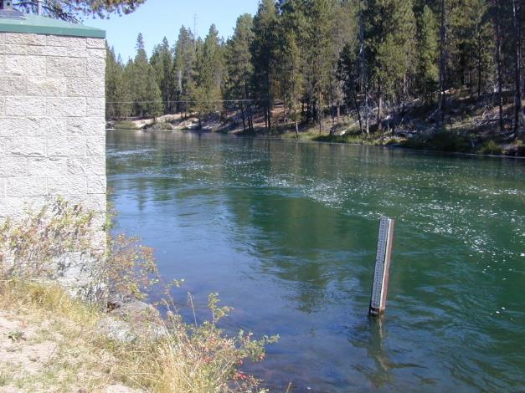
Place your
logo here
Upper Deschutes
Low Winter Flows
Upper Deschutes
High Summer Flows
BRISBANE, AUSTRALIA | 18 - 20 SEPTEMBER 2017

Slide 7
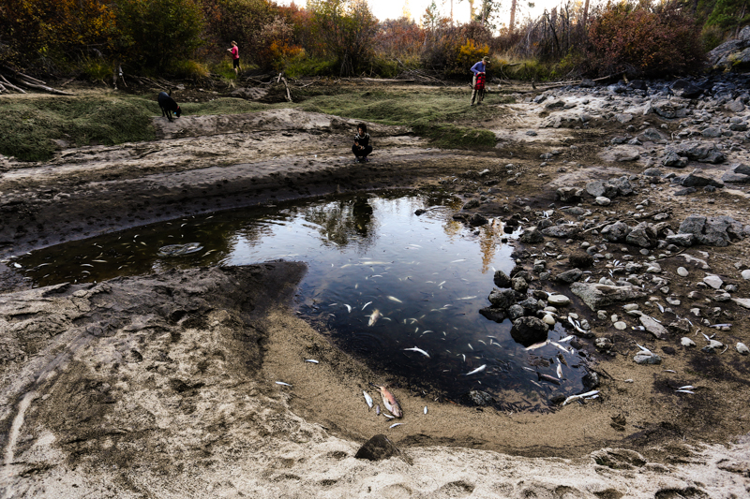

Slide 8
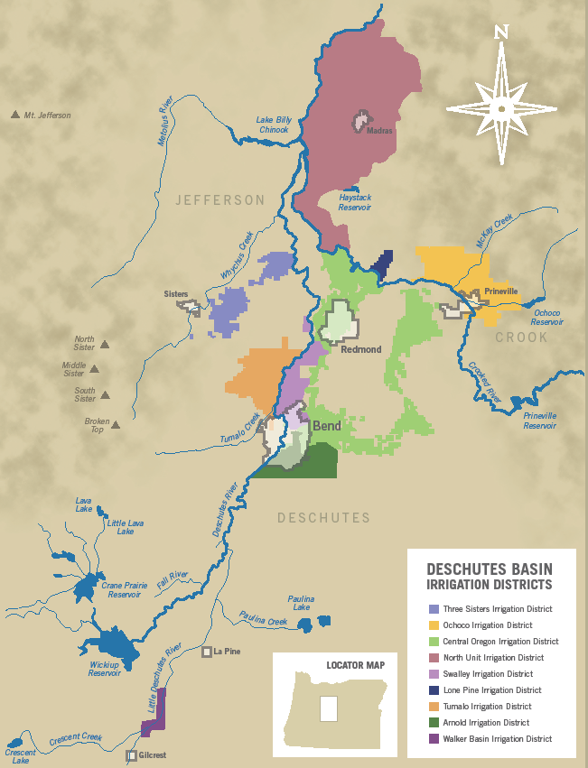
Place your
logo here
The need for integrated solutions
8 Irrigation Districts
5 Reservoirs
5 Cities
Dewatered streams
All chasing the same water

Slide 9
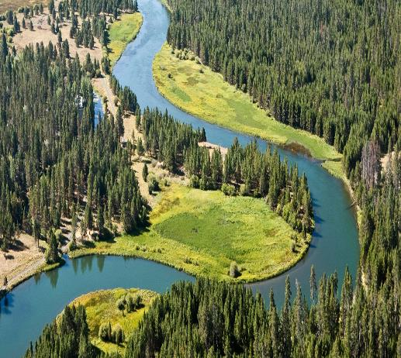
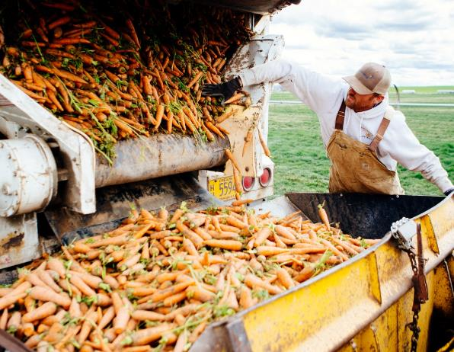
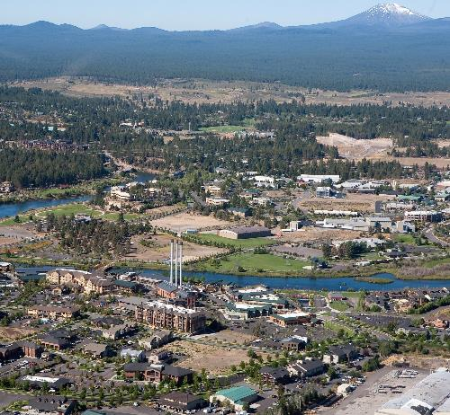
Place your
logo here

Slide 10
Basin Study Work Group
Central Oregon Irrigation District
North Unit Irrigation District
Arnold Irrigation District
Swalley Irrigation District
Lone Pine Irrigation District
Tumalo Irrigation District
Ochoco Irrigation District
Three Sisters Irrigation District
City of Bend
Avion
City of Madras
City of Redmond
City of LaPine
City of Prineville
USDA Forest Service
Department of Environmental Quality
US Fish and Wildlife Service
Confederated Tribes of Warm Springs
Deschutes County
Coalition for the Deschutes
Crooked River Watershed Council
Upper Deschutes Watershed Council
Sunriver Anglers
Central Oregon Flyfishers
Deschutes River Conservancy
Trout Unlimited
Native Reintroduction Network
Bureau of Reclamation
Oregon Water Resources Department
Oregon Land and Water Alliance
Oregon Department of Agriculture
Deschutes Soil and Water Conservation District
Portland General Electric
WaterWatch
Deschutes Water Alliance
Bend Paddle Trail Alliance

Slide 11
Objectives of Basin Study
Analyze water supply and demand, incorporating climate change projections
Analyze how existing operations will perform, how demands will be met
Develop options to address water imbalances
Analyze effectiveness, cost, environmental impact, risk, stakeholder response, and other attributes of identified options
Notes:
Basics of where our water supply comes from. Most falls as snowpack in the cascades. A lot seeps into the ground as groundwater. Variable across the basin; drier as you go east. The crooked basin is more of a snowmelt-driven system.

Slide 12
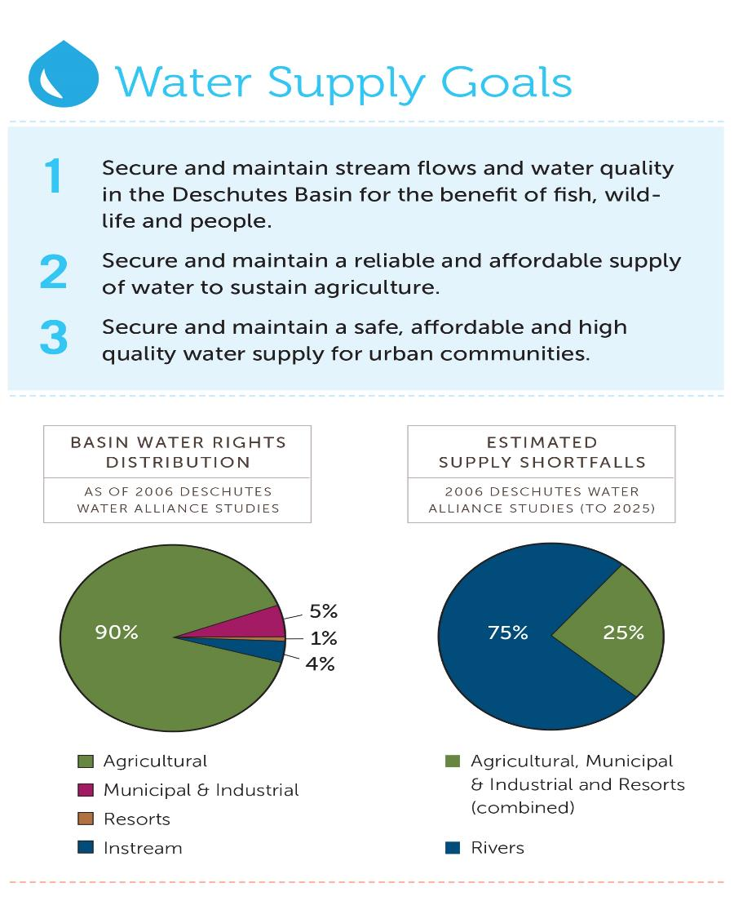

Slide 13
Basin Study - Overview
Storage Assessment
Existing
Future
Historic Climate
Climate Change Models
Water Use
Water Rights
Groundwater/Surface Water Model
Reservoir Optimization
Water Resource Model
Water Cons Assessment
Impacts
Water Resource Alternatives
BSWG Workshop
Inflow Forecasting
Other
Multi-Criteria Evaluation
Policy, Legal,
Socio-Economic
Middle D Ecological
BSWG Workshop
BSWG Workshop
Crooked Ecological
Develop Scenarios
Upper D Ecological
Whychus Ecological
Recommendations and Implementation Plan
Notes:
Not supposed to be absorbed, just shows study structure.

Slide 14
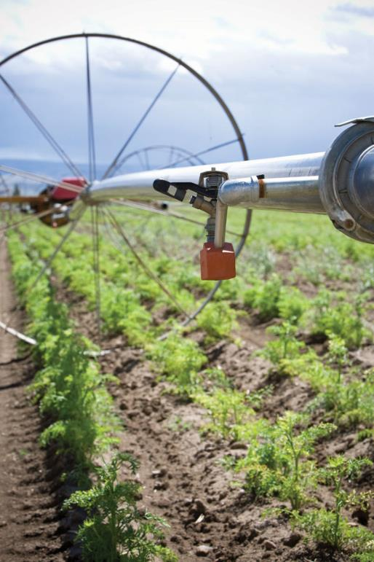
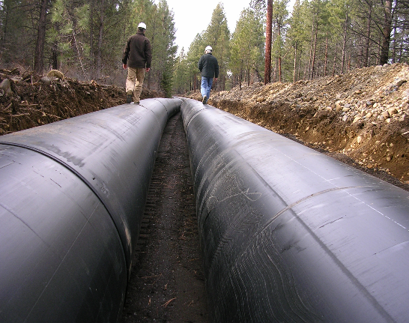
Solutions Development
Irrigation Efficiency
Piping/lining canals
On-farm efficiency
Increased measurement

Slide 15
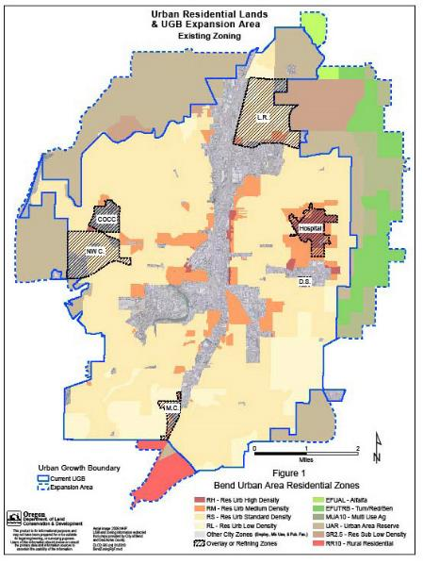
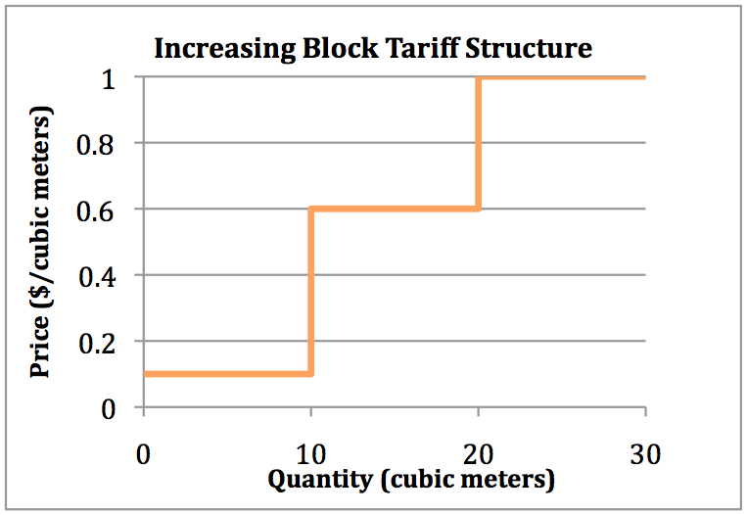
Solutions Development
Market Tools
Trading water between farmers and to rivers-old and new programs
Volumetric water pricing

Slide 16
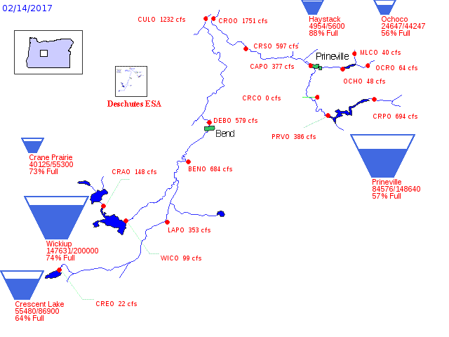
Solutions Development
Optimizing Storage

Slide 17
Integrated Basin Solutions
NUID: 1913
Generating water supply & getting it where it needs to go
A unique case of prior appropriation not serving farmers or rivers
Legal/policy implications
COID: 1900
Notes:
Walk through a sample scenario

Slide 18
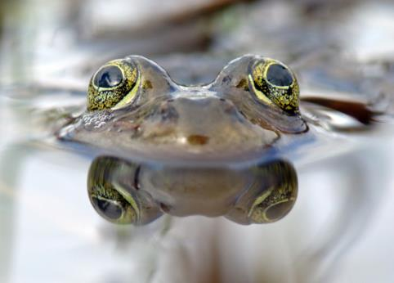
Place your
logo here
Lessons Learned
Strengths: inclusive, collaborative, creative, integrative
comprehensive, long-term
A little bit of “heat” increased commitment & pace of change
BUT, complex interplay b/w litigation, regulation and collaboration
Bend Bulletin
Published Feb. 7, 2016 at 12:01AM
Lawsuits over spotted frog worry farmers
Jefferson County growers fear the loss of
irrigation water

Slide 19
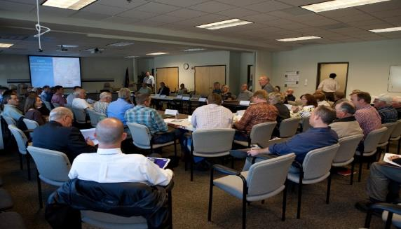
Place your
logo here
Challenges
Time-intensive: any way to accelerate collaborative planning?
Need for innovation and flexibility in institutional water management systems
Need for assurances alongside flexibility, adaptability
Irrigator preferences versus COST EFFECTIVENESS
Agreement and implementation

Slide 20
Place your
logo here
Supported by: Bureau of Reclamation, Oregon Water Resources Department, National Fish and Wildlife Foundation Columbia Basin Water Transactions Program, Oregon Community Foundation, Meyer Memorial Trust, Oregon Watershed Enhancement Board, Pelton Fund, Bella Vista Foundation
BRISBANE, AUSTRALIA | 18 - 20 SEPTEMBER 2017
MANAGED BY

