Slide 1
Introduction to Our Water Ways
A team initiative by the Rivers and Ranges Community Leadership Program

Slide 2
Esteemed colleagues and waders in water issues. I am happy to be here, to learn of new ideas that are trickling through to those of us on the foreshores of the 20th International Riversymposium and environmental Flows Conference.
Before I introduce our water ways project. Let me ask you some questions
Why are the glaciers melting?
What causes global warming?
What is causing the increase of CO2 in our atmosphere?
Which of the following absorbs more CO2 from the atmosphere?
warm water, cold water, trees, grasses, lichen or algae
I’m afraid I don’t have the answers to all of these questions but with 7.5 billion people on the planet, I trust there will be some who do have the answers. If not now, then soon.
What can we do. Now?
We can raise awareness of the issues, because in a school nearby there may be a child who will soon come up with the answers, and some solutions.

Slide 3
Last year a group of community leaders from the Rivers and Ranges Shire in Victoria, began a project called “Our Water Ways". We received sponsorship from ‘The Hugh Williamson Foundation’ and with that we developed a resource to be used in schools to raise awareness of water issues in our region.
We used information from ‘Aquaprint -A community vision for water reform’, produced in June 2016 by environment Victoria.
The first of the 9 key steps identified following community consultation was “community education for water literacy” So we chose to base our project on increasing water literacy among school students.
To help us to develop the resource we worked with the teachers and children from grades 4,5&6 of St Andrews Primary school which is situated in the foothills of the Yarra Ranges area not far from Melbourne
The children already had a very good knowledge of how to conserve water by being frugal with its use and they were aware of some of the causes of water pollution.
We gauged the children's knowledge before and after the delivery of the project to gain insight into its effectiveness.
This is our project.

Slide 4
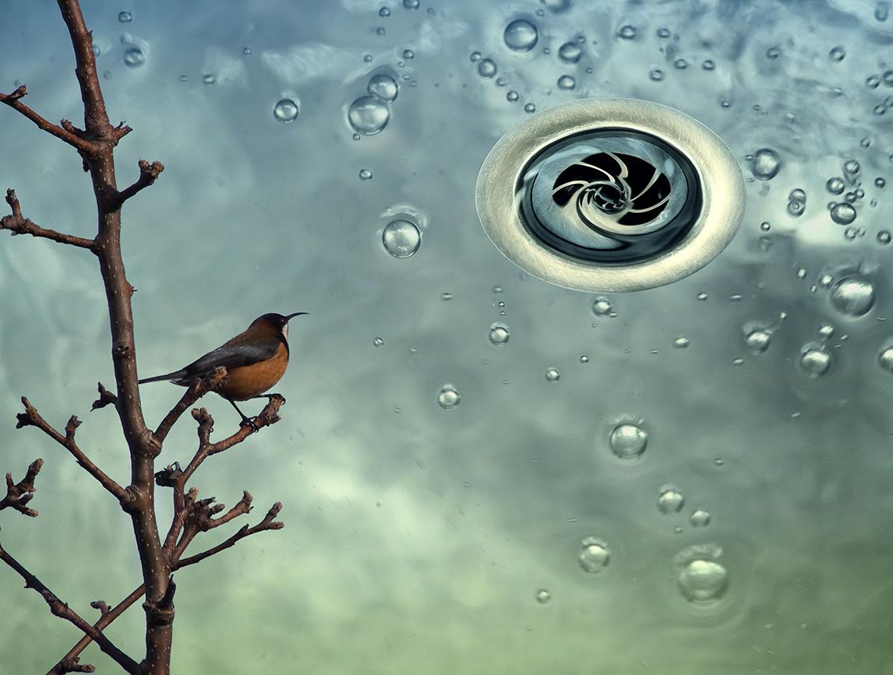
Our Water Ways
2016 Rivers and Ranges Community Leadership Program
Photography by Karena Goldfinch

Slide 5
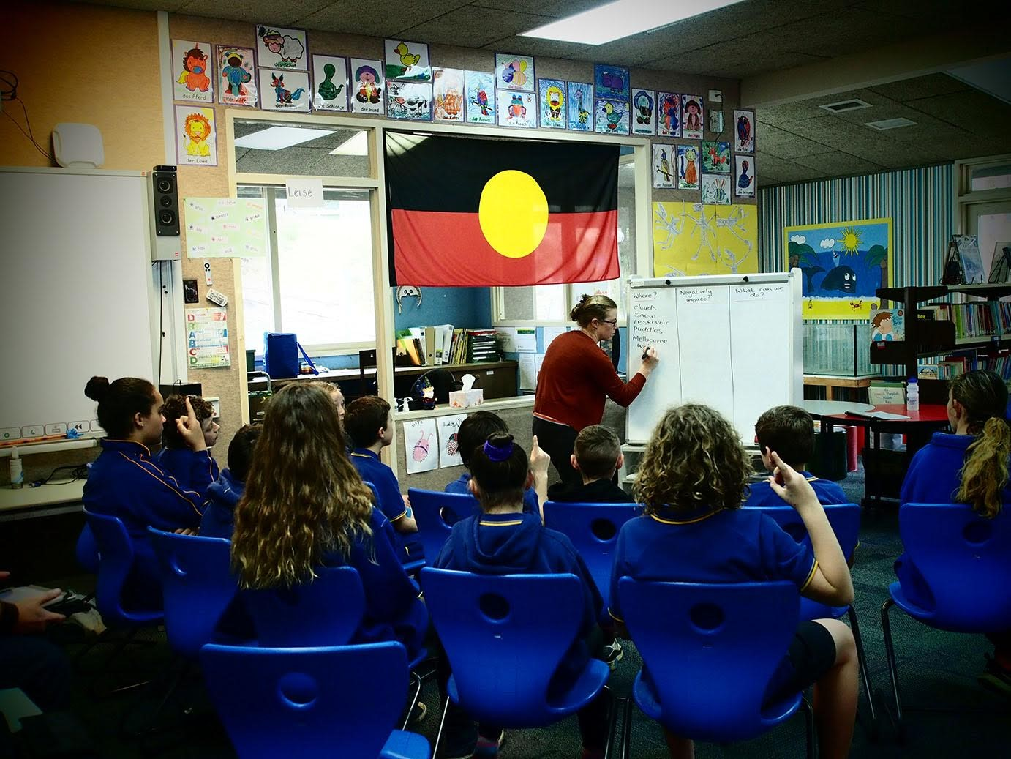
First we asked the students what they already knew about water e.g. Where it came from and how we use it

Slide 6
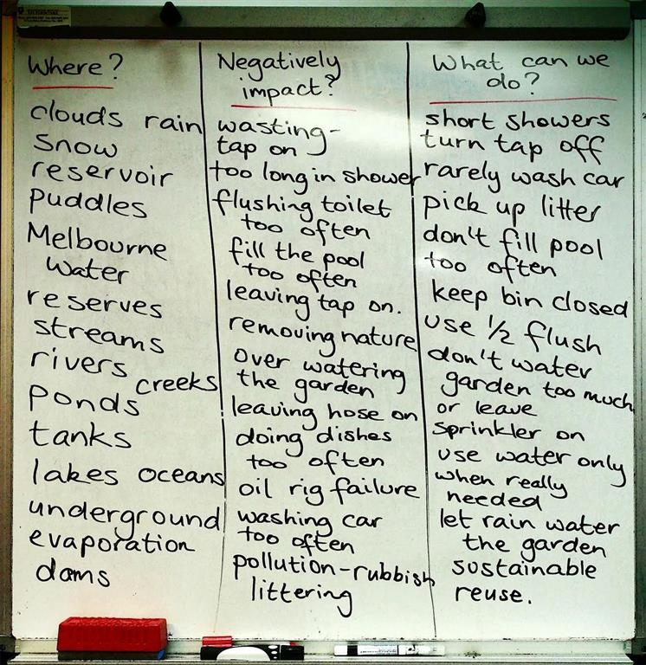

Slide 7
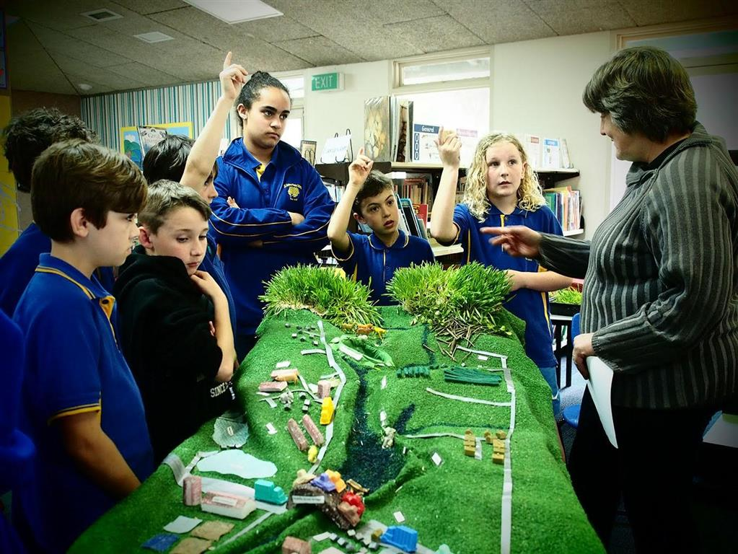
We took the children on a journey from mountains to sea, to learn what happens to water as it travels through different environments.

Slide 8
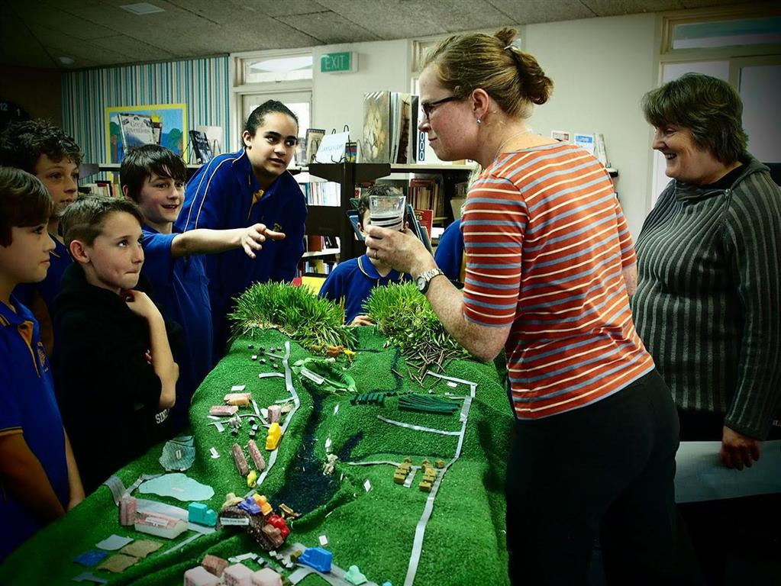
We took “water samples” at strategic locations to see what contaminants had entered the waterway and why.

Slide 9
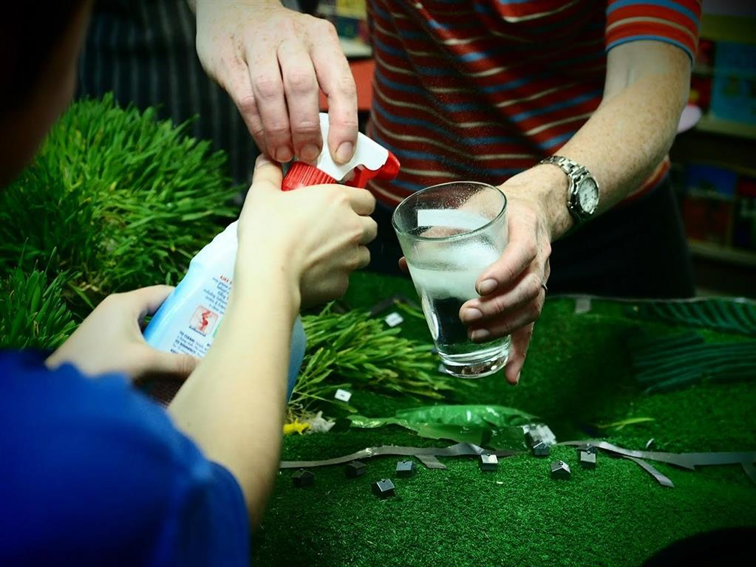
The children added contaminants like household cleaning products, petro chemicals, poo, farm chemicals and dirt.

Slide 10
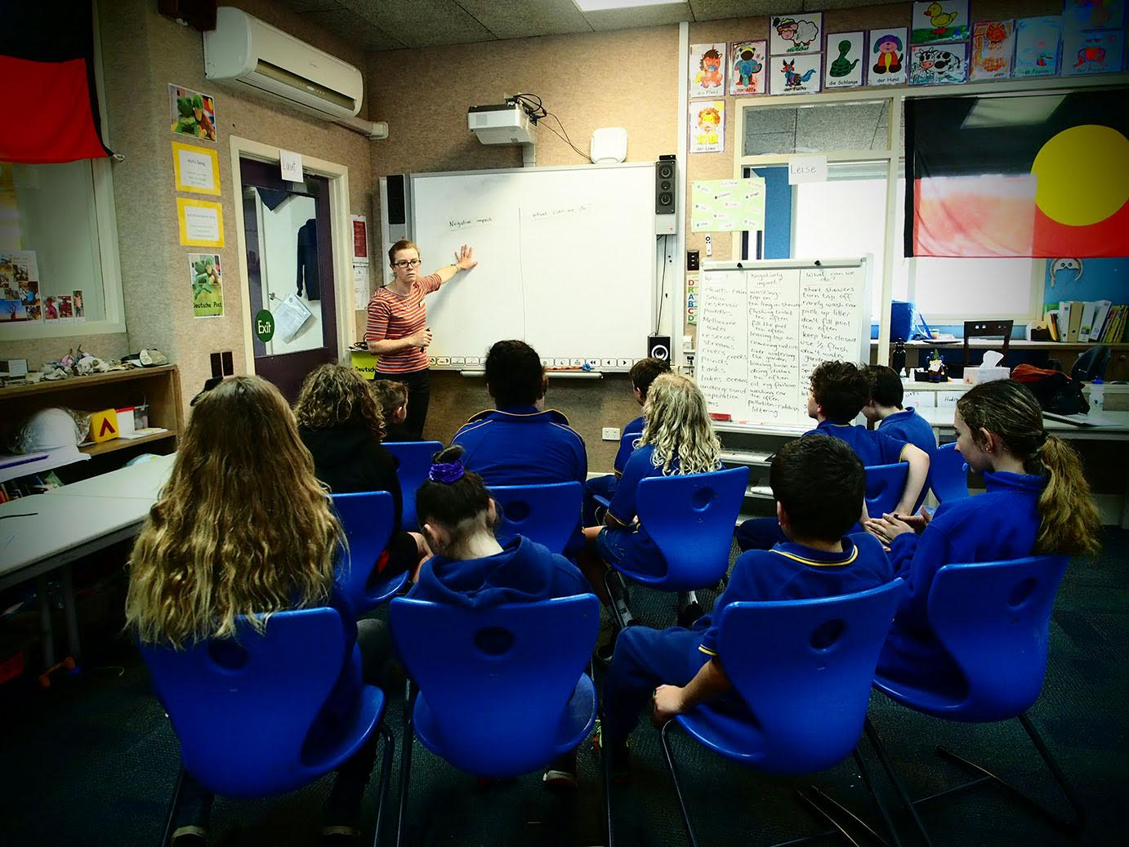
Negative
impacts
What can we do
We did a second assessment to gauge what the students had learned. The students had gained a broader understanding of the many problems encountered in our waterways and we discussed solutions to some of them.

Slide 11
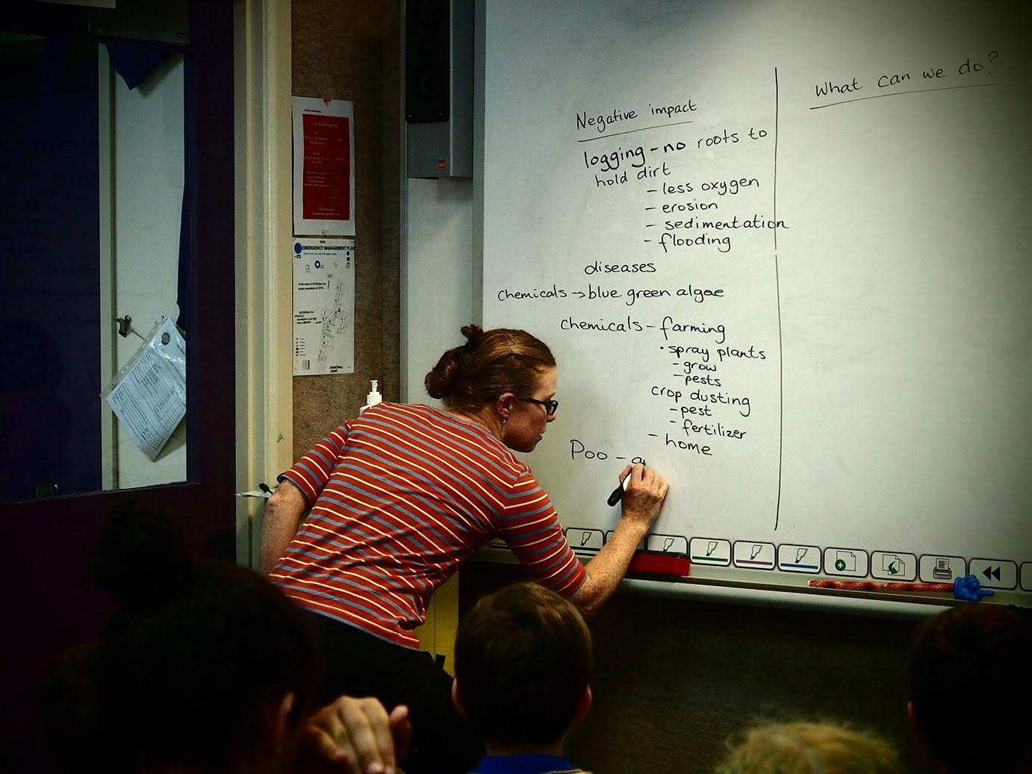
Here’s a snapshot of some of the problems the students learned about while following the water journey on our water ways model

Slide 12
The journey of water
Grey clouds in the sky are heavy with rain
It falls to the earth on thirsty terrain
Some falls in the forest, some falls on the field
The plants are all grateful and increase their yield
Rivulets form and run down into creeks
From forests that flourish on ranges and peaks
Soil creatures rejoice, all nature gives thanks
Reservoirs fill as do lakes, dams and tanks
Puddles are many and frogs lay their eggs
Toddlers in gumboots splash rain up their legs
Umbrellas pop up to keep our clothes dry
But our water’s in crisis. Let me explain why
Our great forests are felled, the ranges lay bare
There’s nothing to hold the soaking rain there
The soil can’t absorb it there’s no humus left
A vital component of which it’s bereft
It rushes in torrents down the hillside
And gauges scars in the land in its wild downhill ride
To the creeks and rivers the rainwater goes tumbling
It’s barely contained, river banks start crumbling
Gone are the tree roots that once held them in place
Angry and turgid the flood picks up pace.
I’m sure you can guess what the outcome will be
What makes this happen? Read on and you’ll see
Our disappearing forests are the lungs of the earth
They prevent climate change, but now there’s a dearth
We can expect more floods, fires and weather events
Increased temperatures and droughts. A bleak future presents
Now let’s go back in our journey to where rain fell on farms
On crops and on pasture on livestock and barns
What changes occurred there that should cause concern
Let’s investigate thoroughly so we can learn
On the journey through farmland many poisons were met
On the leaves, grass and soil, and once they were wet
The poisons washed into the water and ran
Into the waterways of the cities of man.
Poisons in farming have some “time saving” features
But they’re toxic to microbial life and soil creatures
Are farmers to blame for this state of affairs?
In the case of pollution is the fault solely theirs?
Let’s look at our contribution, though to us it seems small
Aren’t we greenies, conservationists and vegans after all
As long as water comes out when we turn on the tap
We don’t care to know more or to look at a map
To see the journey of water and how it got there
We live in the city, why should we care?
We bathe in it, wash with it and do all our cleaning
Our plants and our lawns with grey water are greening.
Our cleaning compounds and chemical “stuff”
Gurgle down plug holes, it seems we can’t get enough
Adverts promised more clean for less effort, in less time as well
So we have more free time, but what didn’t they tell?
In our quest for more time and cleaning with ease
Was it mentioned that pollution causes disease
As our wash water disappears down the drain
Do we remember that it was once rain?
Would we drink it now, I doubt we would dare
But fish in the creek do when it ends up there
They haven’t much choice, nor do the frogs
As they struggle to survive in the swamps and the bogs
It’s easy to point and blame pollution on others
But we are in this together we are all brothers
Soil creatures, livestock, fish, frogs and us
All suffer together, now let us discuss
Are our dilemmas caused by nature or man, you decide
Could we manage land better, who’ll be our guide?
Politics, economics, convenience, science
To live in harmony with nature we must form an alliance
A stronger connection is what we all need
Connection with nature, disconnection from greed
Let us start with the air the water and ground
What things can we do to turn all this around?
We read the children a poem “The journey of Water” which we hoped would inspire them to do some great artwork with cyanotype prints of drawings (Cyanotype is a very early form of photography which uses two chemicals and exposure to sunlight to make a negative of the drawing)

Slide 13
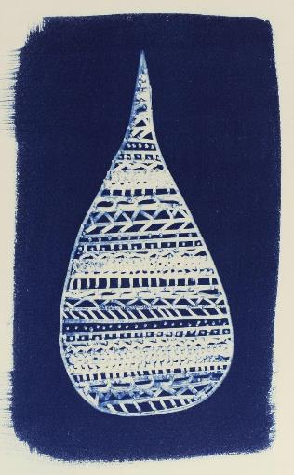
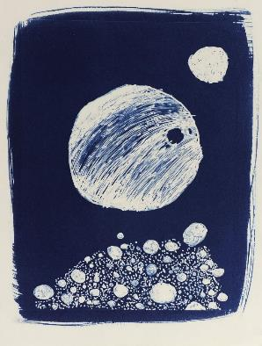
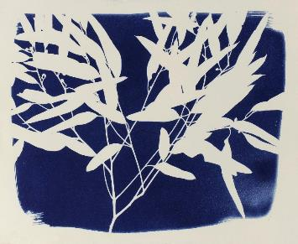
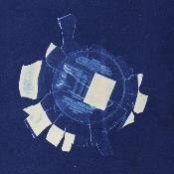
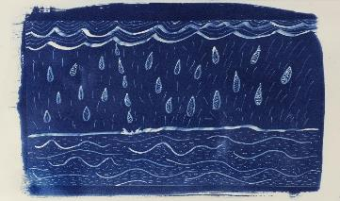
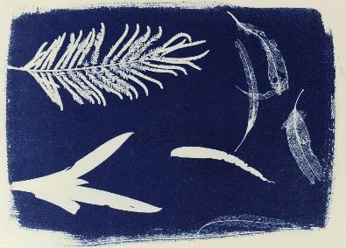
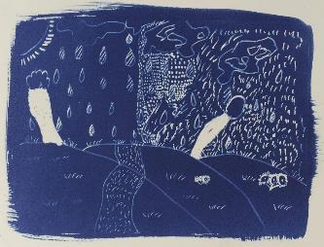
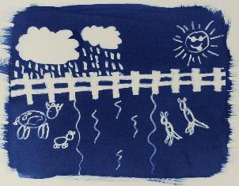

Slide 14
We made a book which included the poem “The journey of water”.
We used the children's artwork to illustrate the poem.
We included some of the photos of our school visit in the book and some ideas and exercises to help children to understand how our use of water impacts the waterways.
Our aim is to promote this book as a tool that can be used by schools to aid in the education of children. We believe that raising awareness of the way each of us, individually, uses (or misuses) water will help us to take better care of this precious resource.

Slide 15
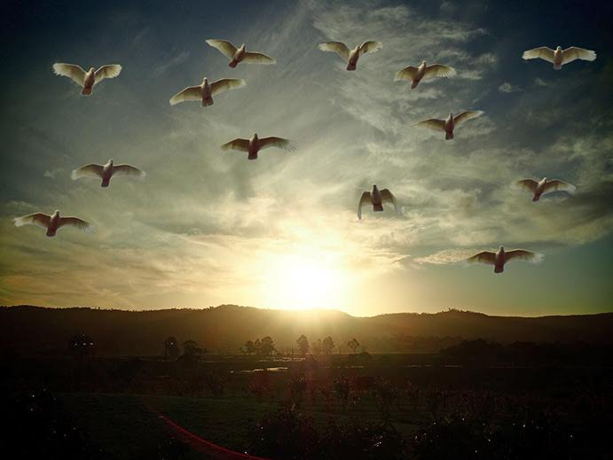
We would like to thank; The principal and teachers of St Andrews Primary School. The students of St Andrews Primary School. The Hugh Williamson Foundation for sponsoring our project The Rivers and Ranges Community Leadership Program for giving us this opportunity. The 20th International Riversymposium and environmental flows Conference.

