Slide 1

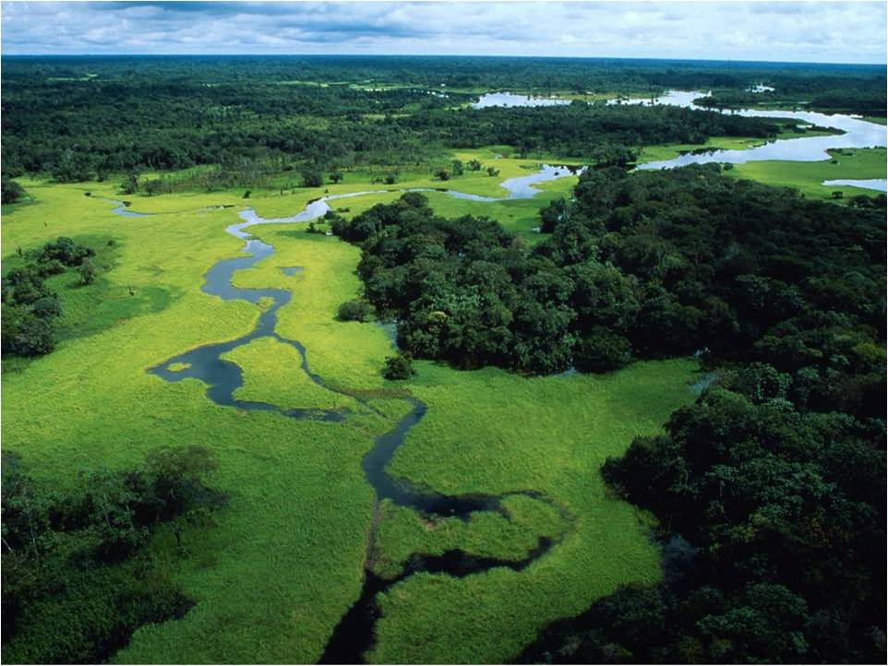

GIWP
New approaches to river basin management for sustainable development in China
A global collaboration
General Institute of Water Resources and Hydropower Planning and Design, Ministry of Water Resources, P. R. China (GIWP) &
World Wide Fund for Nature (WWF)
BRISBANE, AUSTRALIA | 18 - 20 SEPTEMBER 2017
MANAGED BY
Notes:
On behalf of General Institute of Water Resources and Hydropower Planning and Design, Ministry of Water Resources, China, I am very glad to be here to shares progress in China's integrated basin planning process in recent years, and the challenges and opportunities for this progress.
Mr. Dave Tickner from WWF, our partner to facing the challenges will cover the later part of the presentation to shares insights gleaned from an ongoing collaboration between our institute and WWF.
China faces profound river management challenges. As its economy evolves, public expectations of eco-environmental quality shift, how should the country's policy makers and planners make the most of its rivers and associated water resources as well as protect them? Integrated river basin plans are a key instrument for addressing this question.

Slide 2
GIWP
China river-basin planning
General planning formulated for developing, utilizing, saving and protecting water resources, and preventing and controlling water disasters, according to requirements of socio-economic development as well as status quo of development and utilization of water resources.
People’s Republic of China Water Act
BRISBANE, AUSTRALIA | 18 - 20 SEPTEMBER 2017
MANAGED BY
Notes:
Water Act 2002

Slide 3
GIWP
China river-basin planning General Orientation
A programmatic document to coordinate river-basin and regional socio-economic development, sustainable utilization of water resources and eco-environmental protection
An important basis for harnessing rivers, preventing and controlling water disasters, comprehensively developing and utilizing water resources, and protecting water ecology and environment
An important basis for the government to strengthen macro-control and social management, and to provide public service
BRISBANE, AUSTRALIA | 18 - 20 SEPTEMBER 2017
MANAGED BY
Notes:
From the definition of river basin planning and multiple year of practice
Function of river-basin planning
- plays an important role in promoting reasonable adjustment of economic structure and industrial layout, supporting and guaranteeing socio-economic development， and improvement of ecological environment
- Coordinate water relations among different regions, balance interests among stakeholders, identify right relations involving water affairs, adjust imbalance among different regions, and promote regional harmonious development
- Carefully analyze and demonstrate important water projects and their construction schemes which affect overall river basins, and this guarantees that water projects construction will be orderly implemented and project benefits will be effectively exerted
- Formulate policies and management system framework for river-basin development, utilization and protection, lay foundation for integrated river-basin management, and promote river-basin benign development through strengthening system regulations and policy adjustment measurements for water affairs

Slide 4
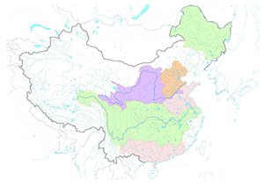
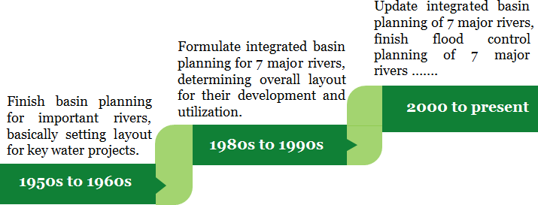
GIWP
China river-basin planning History
Yellow River
Yangtze River
Notes:
While river management has an ancient history in China, in the second half of the twentieth century China’s river basin planning has experienced the following three stages:
• From the 1950s to 1960s, the first round of river basin planning was carried out, with a focus on river regulation and management, disaster prevention and mitigation. This laid the foundations for the basic layout of major water projects in China’s large river basins.
• In the 1980s, the second round of river basin planning emphasized integrated water resources development. Considerations of water resources protection and management were reinforced. Overall layout of 7 major rivers were developed at this stage.
• At the beginning of the 21st century, the third round of river basin planning was conducted based on the core philosophy of harmonious development between human and nature. The emphasis was on maintaining river health and ensuring sustainable development of water resources. More attention was paid to the role of river basin planning in social management.
The National Integrated Water Resources Planning ——The first national-level strategic planning of water resources in China
Updating of the Integrated Planning of seven major river basins ——made overall arrangement on development and protection of the river basins for next 20 years up to 2030

Slide 5
GIWP
China river-basin planning History
1st round with a focus on river regulation and management, disaster prevention and mitigation. This laid the foundations for the basic layout of major water projects in China’s large river basins.
2nd round emphasized integrated water resources development. Considerations of water resources protection and management were reinforced. Overall layout of 7 major rivers were developed at this stage.
3rd round based on the core philosophy of harmony between human and nature. The emphasis was on maintaining river health and ensuring sustainable development of water resources. More attention was paid to the role of river basin planning in social management.
Notes:
• From the 1950s to 1960s, the first round of river basin planning was carried out, with a focus on river regulation and management, disaster prevention and mitigation. This laid the foundations for the basic layout of major water projects in China’s large river basins.
• In the 1980s, the second round of river basin planning emphasized integrated water resources development. Considerations of water resources protection and management were reinforced. Overall layout of 7 major rivers were developed at this stage.
• At the beginning of the 21st century, the third round of river basin planning was conducted based on the core philosophy of harmonious development between human and nature. The emphasis was on maintaining river health and ensuring sustainable development of water resources. More attention was paid to the role of river basin planning in social management.
The National Integrated Water Resources Planning ——The first national-level strategic planning of water resources in China
Updating of the Integrated Planning of seven major river basins ——made overall arrangement on development and protection of the river basins for next 20 years up to 2030

Slide 6
GIWP
China river-basin planning Thoughts evolution
2000s
1990s
Guarantee river-basin sustainable development
1980s
Enhancing integrated water resources management
Resource development & utilization
1950s
Mitigating flood & water-logging disasters
BRISBANE, AUSTRALIA | 18 - 20 SEPTEMBER 2017
MANAGED BY
Notes:
- With main planning thought of emergency treatment of disaster problems, aiming to recovery of production and stabilization of social life
- Continuously improve flood-control ability, and simultaneously intensify development and utilization of water resources, emphasizing planning thoughts of systematic harness and development of river basins and pay attention to construction arrangement of water projects for resources development and utilization
- Emphasize characteristics of integrity and strategic nature of river-basin planning, and pay attention to linkage and coordination between river-basin planning and other plannings such as land use planning, socio-economic development planning, etc.
- Planning thought changes from engineering planning orientated to resource and environment planning, and simultaneously emphasize construction and management. Pay more attention to sustainable socio-economic development and protection and improvement of ecological environment

Slide 7
GIWP
China river-basin planning Thoughts evolution
1950’s - With main planning thought of emergency treatment of disaster problems, aiming to recovery of production and stabilization of social life
1980’s - Continuously improve flood-control ability, and simultaneously intensify development and utilization of water resources, emphasizing planning thoughts of systematic harness and development of river basins and pay attention to construction arrangement of water projects for resources development and utilization
1990’s - Emphasize characteristics of integrity and strategic nature of river-basin planning, and pay attention to linkage and coordination between river-basin planning and other plannings such as land use planning, socio-economic development planning, etc.
2000’s - Change from engineering planning orientated to resource and environment planning, and simultaneously emphasize construction and management. Pay more attention to sustainable socio-economic development and protection and improvement of ecological environment

Slide 8
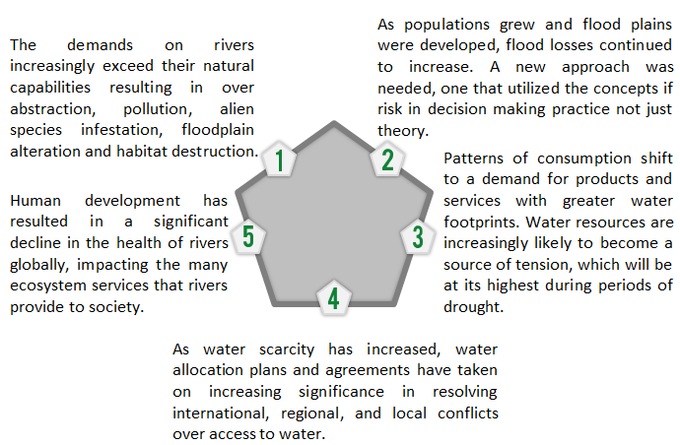
GIWP
China river-basin planning Challenges

Slide 9
GIWP-WWF cooperation Impacts
New concepts and approaches in national practices of river management, which provided good reference and directive significance for river basin master planning in China.
Developed national technical codes based on the above guidelines as recommended standards for integrated & professional basin planning and revision in rivers, will eventually affect river management practice across China.
Influenced government policy with more integrated thinking.
Water allocation skills have been applied in 53 main rivers in China, and river restoration has been conducted in 28 rivers.
The topics of the cooperation have become government priorities leading to huge investment.
Notes:
In order to improve the capacity of integrated river management in China, cooperation between WWF-GIWP has been ongoing since 2010 with fruitful outputs. These include a series of guidelines related to river management, as well as meaningful achievements and significant outcomes in river management in China, such as:
Code for river basin planning in 2015
Code for water resources planning 2014

Slide 10
GIWP
Code for river basin planning (SL201-2015)
Main contents
Overall Planning
Flood Control Planning
Water-logging Control Planning
Water Resources Planning
Water Saving Planning
Urban-rural Water Supply Planning
Navigation Planning
Surface Water Resources Protection Planning
Groundwater Protection Planning
Aquatic Ecological Protection and Rehabilitation Planning
Soil and Water Conservation Planning
River Channel and Estuary Regulation Planning
Key Water Project Planning
Integrated Basin Management Planning
New!
Notes:
The code was revised from the code of river basin planning (1997), with the new content of:
water resources protection instead of water quality protection,
aquatic ecology protection and restoration including securing E-flow requirements, protecting and restoring key habitat & important wetland & sensitive ecoregion, aquatic ecological monitoring
integrated basin management instead of basin water resources management
which were all highlighted in our guidelines

Slide 11
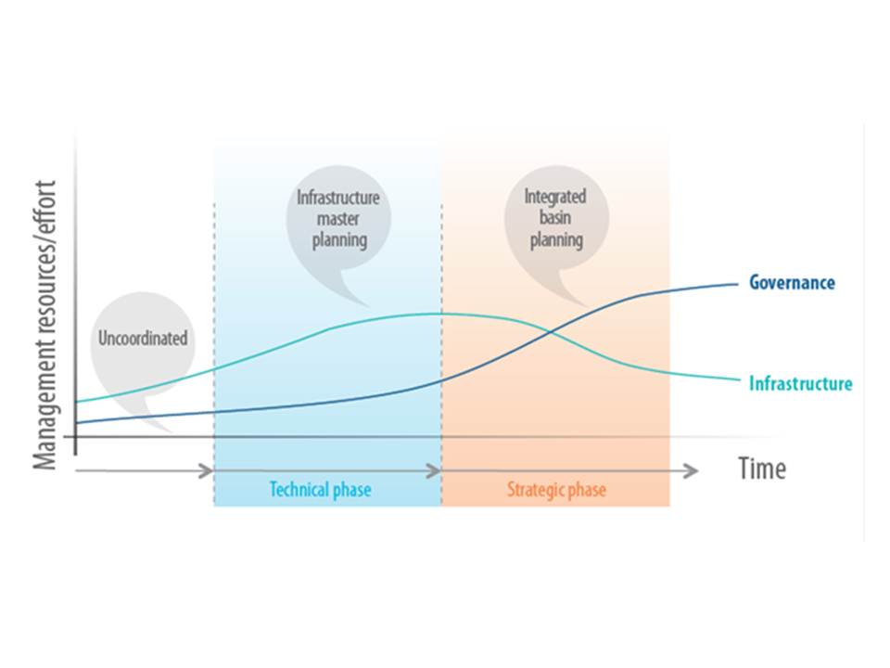
GIWP
An era of strategic water management?
BRISBANE, AUSTRALIA | 18 - 20 SEPTEMBER 2017
MANAGED BY

Slide 12

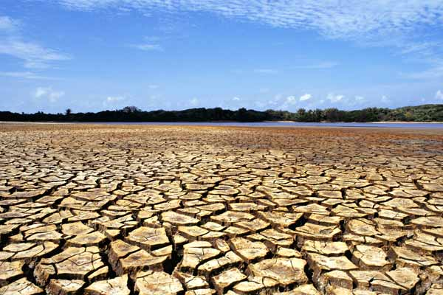
GIWP
Elements of a strategic approach
Outcome-led
Addresses context
Understanding of hydro-ecological functions & socio-economic systems
Considers complexity, risk & uncertainty
BRISBANE, AUSTRALIA | 18 - 20 SEPTEMBER 2017
MANAGED BY

Slide 13
GIWP
Project aims
To support review & revision of Water management frameworks in China
To promote strategic approaches globally
BRISBANE, AUSTRALIA | 18 - 20 SEPTEMBER 2017
MANAGED BY

Slide 14
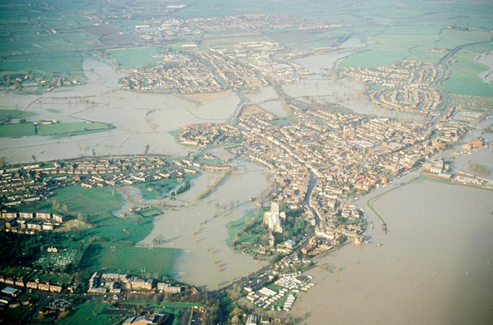
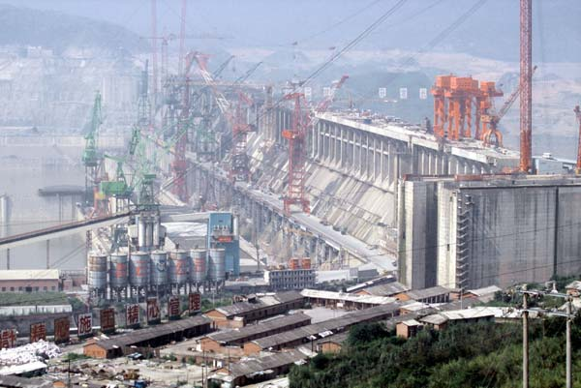
GIWP
Scope
Phase I (2009-2013):
Basin Planning
Flood Risk
Water Allocation
Phase II (2013-2016):
Drought risk
River restoration
BRISBANE, AUSTRALIA | 18 - 20 SEPTEMBER 2017
MANAGED BY

Slide 15
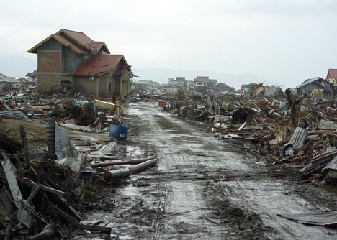
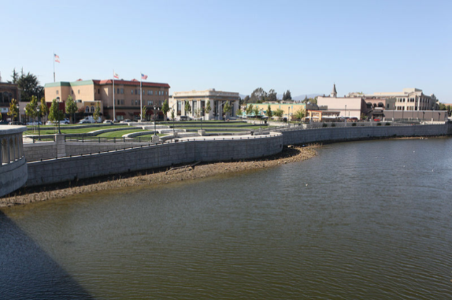
GIWP
Approach
Case studies
Distil emerging challenges & lessons
Expert workshops – Chinese & international teams
Develop framework – principles, procedures & approaches
Peer review
Document & disseminate
BRISBANE, AUSTRALIA | 18 - 20 SEPTEMBER 2017
MANAGED BY

Slide 16

GIWP
CASE STUDY LOCATIONS
BRISBANE, AUSTRALIA | 18 - 20 SEPTEMBER 2017
MANAGED BY
Notes:
More than 30 case studies from 6 continents

Slide 17
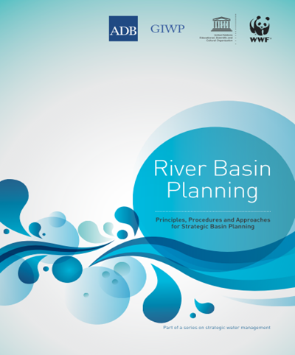
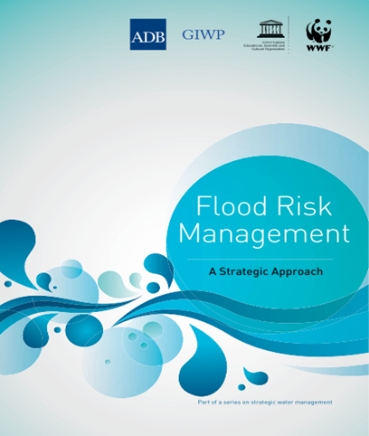
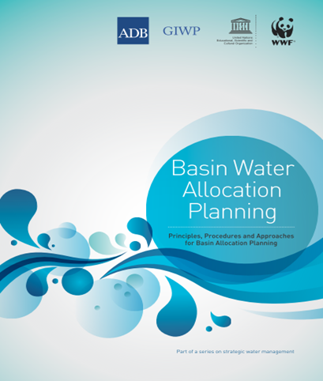

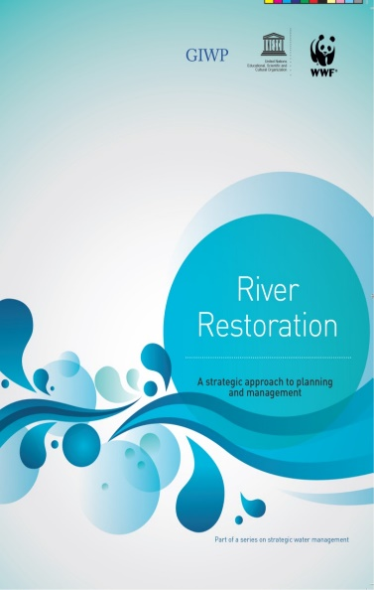
GIWP
Book series
New !
Available free to download from UNESCO library (www.unesco.org/ulis/)
Or contact: Dave Tickner, dtickner@wwf.org.uk
BRISBANE, AUSTRALIA | 18 - 20 SEPTEMBER 2017
MANAGED BY

Slide 18
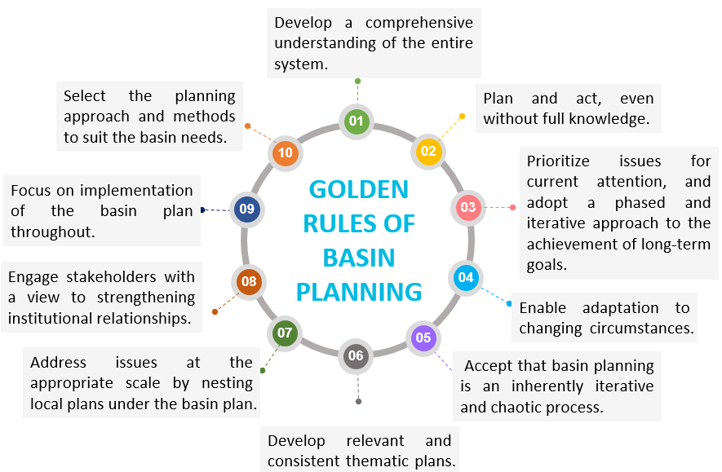
Golden Rules of Basin Planning
GIWP

Slide 19

GIWP
Phase III cooperation
Spatial planning & water resource planning
Groundwater management
Green and Grey Water infrastructure planning
…..
Coming !
BRISBANE, AUSTRALIA | 18 - 20 SEPTEMBER 2017
MANAGED BY

Slide 20
GIWP
Thank You！
Ying Tian 147911198@qq.com
Dave Tickner DTickner@wwf.org.uk
BRISBANE, AUSTRALIA | 18 - 20 SEPTEMBER 2017
MANAGED BY

