Slide 1


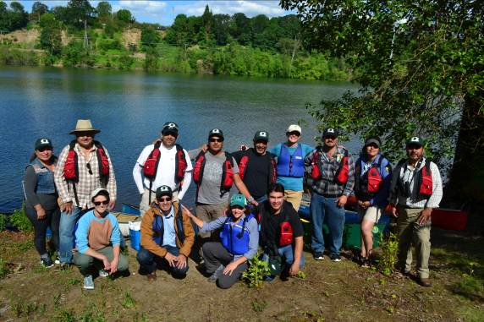

Opportunities for Cross-Cultural Exchange in Twinning
Tara Davis, Contractor, Willamette River Initiative, Oregon, USA
Co-Presenters, Agustin Madrigal Bulnes and Rosario Franco
BRISBANE, AUSTRALIA | 18 - 20 SEPTEMBER 2017
MANAGED BY

Slide 2
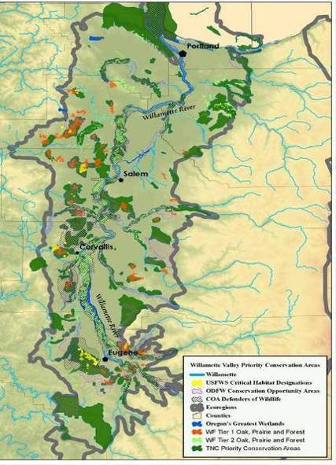
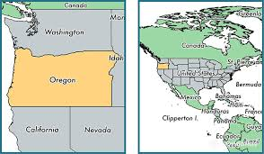
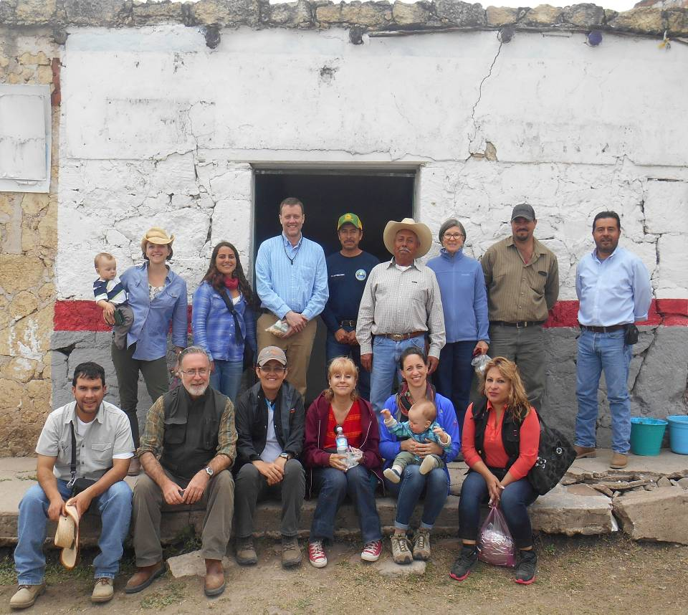
Background- Willamette/Laja Twinning
Willamette River Initiative (WRI) in NW Oregon forms with over 2 dozen conservation partners and several state and private funders in 2008.
Willamette River Initiative wins Thiess International Riverprize in 2012.
Twinning Partner Selection in 2013
  Maritsa River, Bulgaria
  Rio Valdivia, Southern Chile
  Rio Laja, Central Mexico
BRISBANE, AUSTRALIA | 18 - 20 SEPTEMBER 2017
MANAGED BY

Slide 3
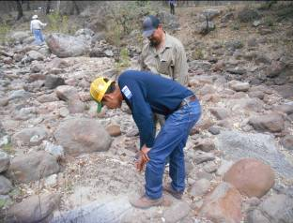
Similar Challenges, Different Treatments
Aggrading streambeds & floodplain connectivity
  Large wood verses rock
Riparian and floodplain reforestation
  Semi-arid species vs. temperate PNW
Stream bank stabilization
  Willows or other streamback veg
Livestock exculsion
  Fencing: artificial vs. biological materials
Oak forest restoration and regeneration
BRISBANE, AUSTRALIA | 18 - 20 SEPTEMBER 2017
MANAGED BY

Slide 4
Willamette Partners
7 Watershed Councils
Benton Soil SWCD
Cascade Pacific RC&D
Willamette Riverkeeper
Friends of Buford Park
Greenbelt Land Trust
McKenzie Land Trust
The Nature Conservancy
Oregon Parks & Recreation Dpt
US Geological Survey
University of Oregon, and Oregon State University
Willamette Partnership
Bonneville Environmental Foundation
Primary Activities
Stakeholder-Driven Watershed Restoration
Advocacy & Water Quality
Community Engagement & Education
Land Protection/Conservation
Research & Monitoring
Laja Partners
Comisión Nacional de Forestal
Salvemos al Rio Laja
Cuerpos de Concervación
Caminos del Agua
Amigos de la Presa
Audubon Society of Mexico
El Charco del Ingenio
Instituto de Ecologia
Universidades múltiples (US/Canada/Mexico)
Comición Nacional del Agua

Slide 5
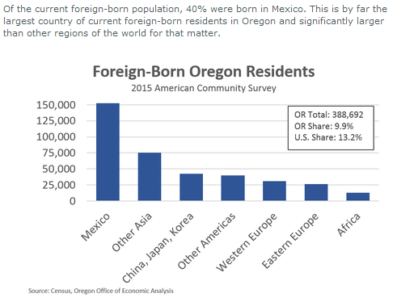
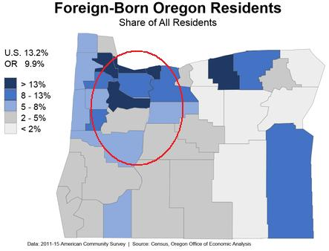
Willamette-Laja Cultural Connections
BRISBANE, AUSTRALIA | 18 - 20 SEPTEMBER 2017
MANAGED BY

Slide 6
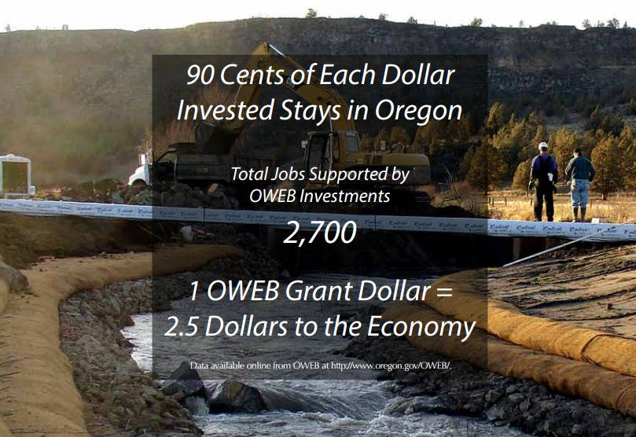
Notes:
Every million invested in habitat and clean water creates 15-20 jobs
Project managers and council staff
Engineering and construction companies
Plant nurseries
Rentals, equipment, fuel
Calapooia ED experience… Over a million dollar annual budget, and my highest paid contractor, over 150-200K/year was a planting company that employs Mexican immigrants, upwards
Largest project materials invoice for native plants, 30-40 Mexican immigrants. $80-150,000

Slide 9
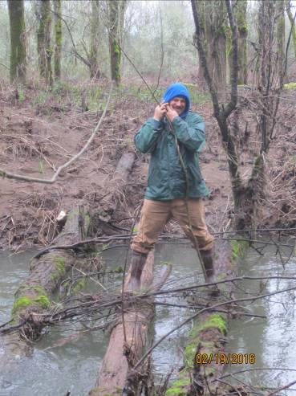
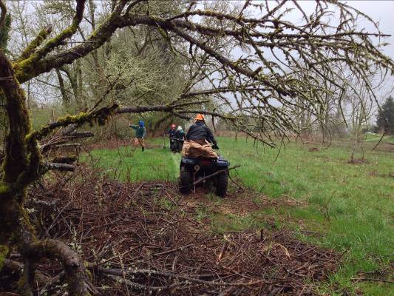
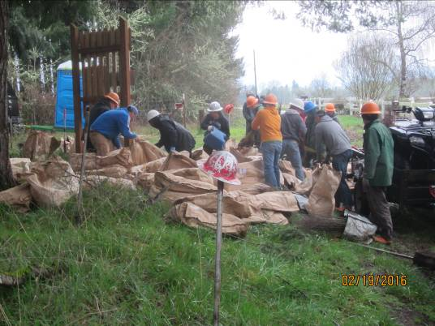
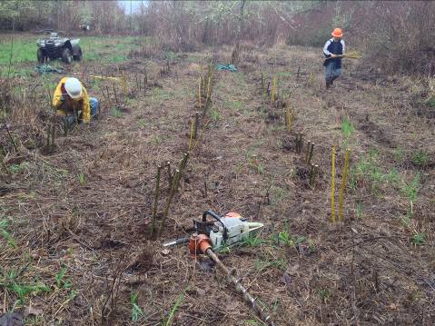
Immigrant Labor Force
Rosario Photos…
BRISBANE, AUSTRALIA | 18 - 20 SEPTEMBER 2017
MANAGED BY
Notes:
This one contractor, albeit the largest reforestation company working with Willamette partners, installs over a million bare root/year throughout restoration projects up and down the valley, and performs wetland restoration and forest fire work during the summer.
Silent heroes of restoration in Oregon, and the Willamette.
Engaging, but through employment, not with whole families, or with direct education and involvement.

Slide 10
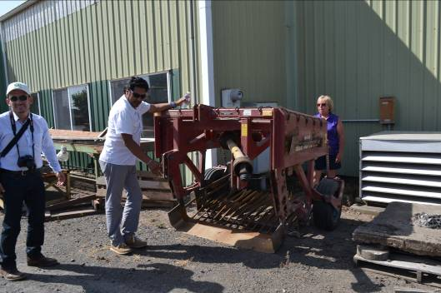
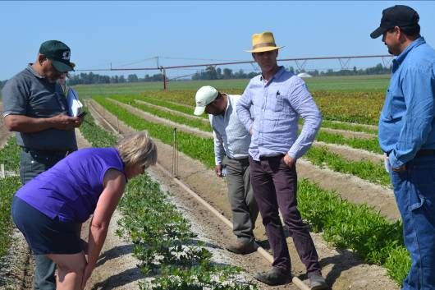
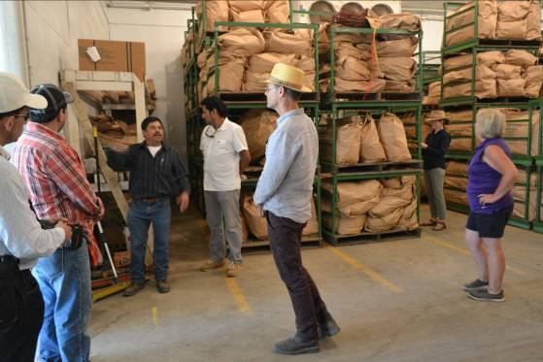
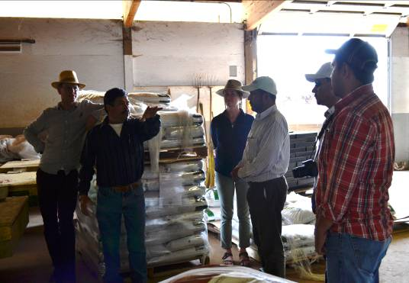
BRISBANE, AUSTRALIA | 18 - 20 SEPTEMBER 2017
MANAGED BY

Slide 11
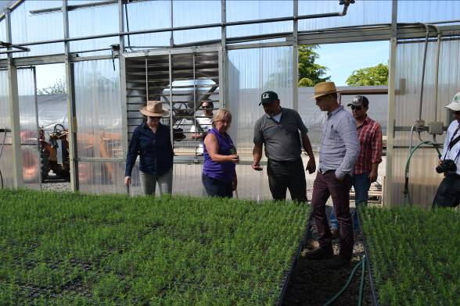
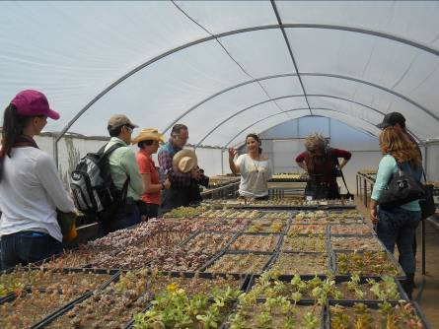
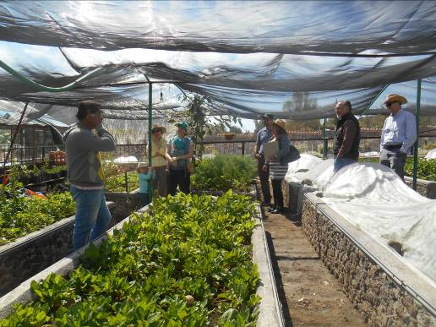
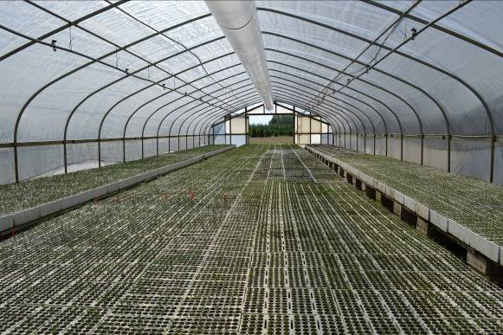
BRISBANE, AUSTRALIA | 18 - 20 SEPTEMBER 2017
MANAGED BY

Slide 12
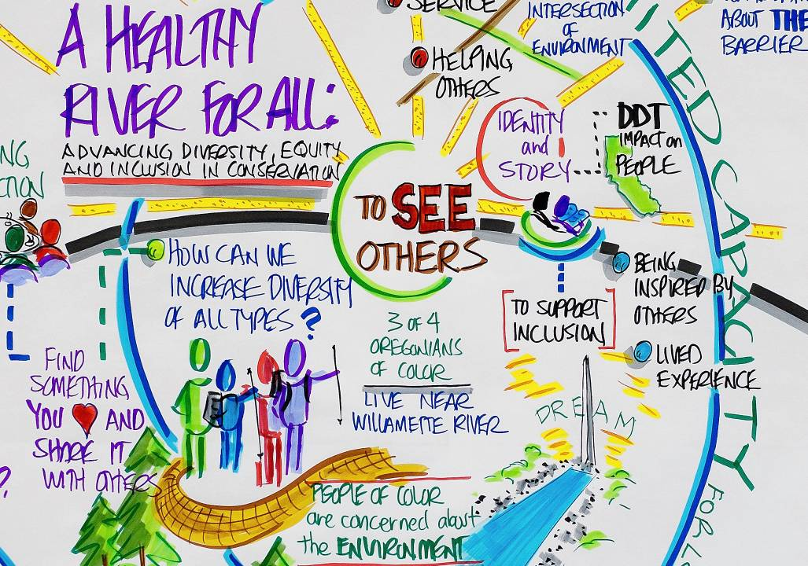
BRISBANE, AUSTRALIA | 18 - 20 SEPTEMBER 2017
MANAGED BY
Notes:
Pretty painting, with powerful words… creating at recent december 2016 conference by 300+ willamette conservation groups. 9 years later, into the WRI, we are JUST NOW looking at DIE, and inclusion of WHOLE communities.
Want to start engaging…but, where do you start, when your entire organizational make-up is caucasion? Vulerability, uncomfortable consversation to begin.
Safe route first…organizational DIE audits, staff and board trainings, local demographics research.
Laja can help us begin to engage with communities of color and obviously immigrant and Mexican American community.

Slide 13
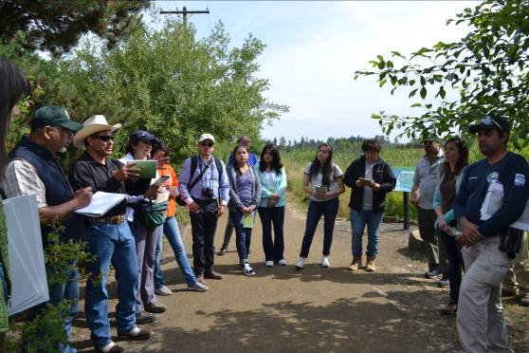
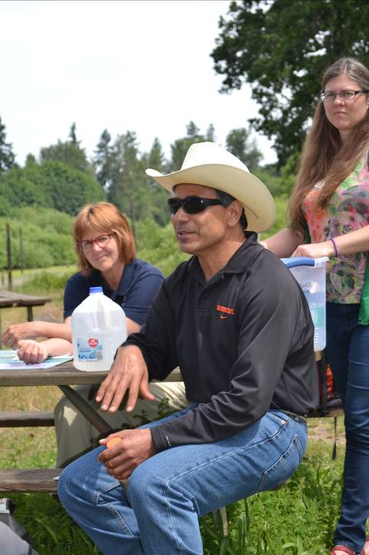
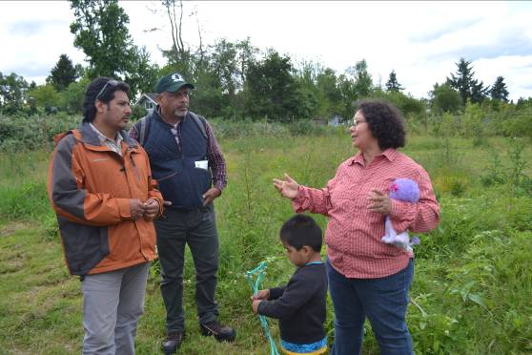
BRISBANE, AUSTRALIA | 18 - 20 SEPTEMBER 2017
MANAGED BY
Notes:
So HOW do you begin to connect this Mexican diaspera… create meaningful cross-boarder relationships? The first way with through YOUTH.
Exchanges… recent exchange to the willamette… photo, 6 Mexican partners, and several 1st and 2nd generation Mexican Americans.
And the platform we intend to use is…..drumroll…

Slide 14
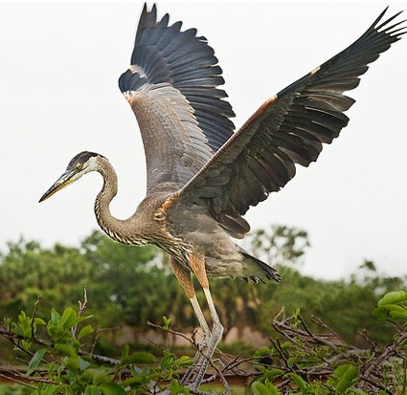
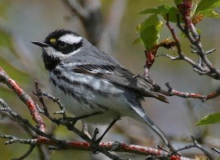
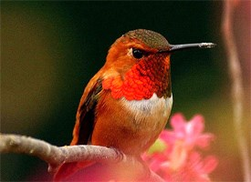
Great Blue Heron
Black-throated Gray Warbler
Rufous Hummingbird
Source: The Cornell Lab of Ornithology
http://www.allaboutbirds.org
BRISBANE, AUSTRALIA | 18 - 20 SEPTEMBER 2017
MANAGED BY
Notes:
Charasmatic
Embolic
Easy for community engagement
Representative of three habitats
Known to exist with relatively stable populations in both basins, warbler on decline

Slide 15
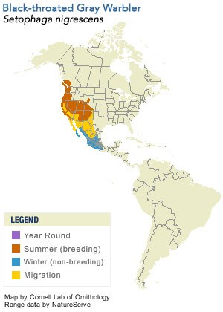
Twinning Project Next Steps
Final development of “Laja Initiative”, a collective impact model like the Willamette’s; complete conservation strategy using advanced GIS analysis of project locations and priorities.
Fundraise for this international partnership based on a foundation of shared migratory species that will ultimately increase public value for the environment and draw attention to protection and restoration in our watersheds.
Institutionalize the twinning partnership by developing communication mechanisms such as “eBird” linking the basins’ communities.
BRISBANE, AUSTRALIA | 18 - 20 SEPTEMBER 2017

Slide 16
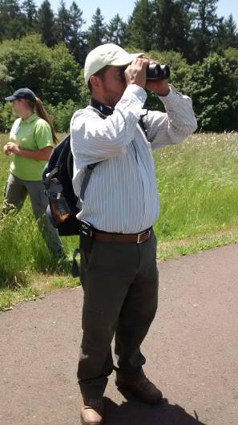
Twinning Project Next Steps
Develop an advanced monitoring framework that incorporates citizen science; develop training materials for local communities in both basins to observe specific migratory species.
Diversification of conservation movement in the Willamette Valley
  Integrate the Laja partnership into “Diversity, Inclusion and Equity” forums for conservation organizations.
Latino Youth Engagement in the Willamette and Laja based on citizen science; student leadership exchange for shared values in conservation.
BRISBANE, AUSTRALIA | 18 - 20 SEPTEMBER 2017
MANAGED BY

Slide 17


THANK YOU!!
Co-Presenters, Advisors, and Funders:
Rosario Franco, Agustin Madrigal Bulnes,
Josh Ellsworth, Arturo García Lozano,
Meyer Memorial Trust, International River Foundation
BRISBANE, AUSTRALIA | 18 - 20 SEPTEMBER 2017
MANAGED BY

