Slide 1
Twinning Success Story – Working Toward an Integrated Watershed Management Plan for the Ayuquila-Armeria River Basin (Mexico)
Brian R. Kemp
GM – Conservation Lands
Lake Simcoe Region
Conservation Authority
Ontario, Canada
Tania Román Guzmán
Biologist
Ayuquila-Armeria
Watershed Commission
Colima, Mexico

Slide 2
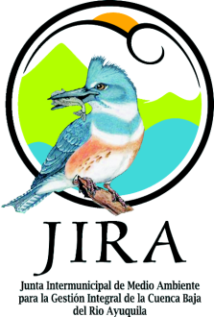

PRESENTATION OVERVIEW
Twinning Project
Ayuquila-Armeria River Basin
Project Missions
Lessons Learned
Where Do We Go From Here

Slide 3
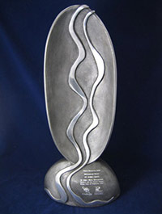
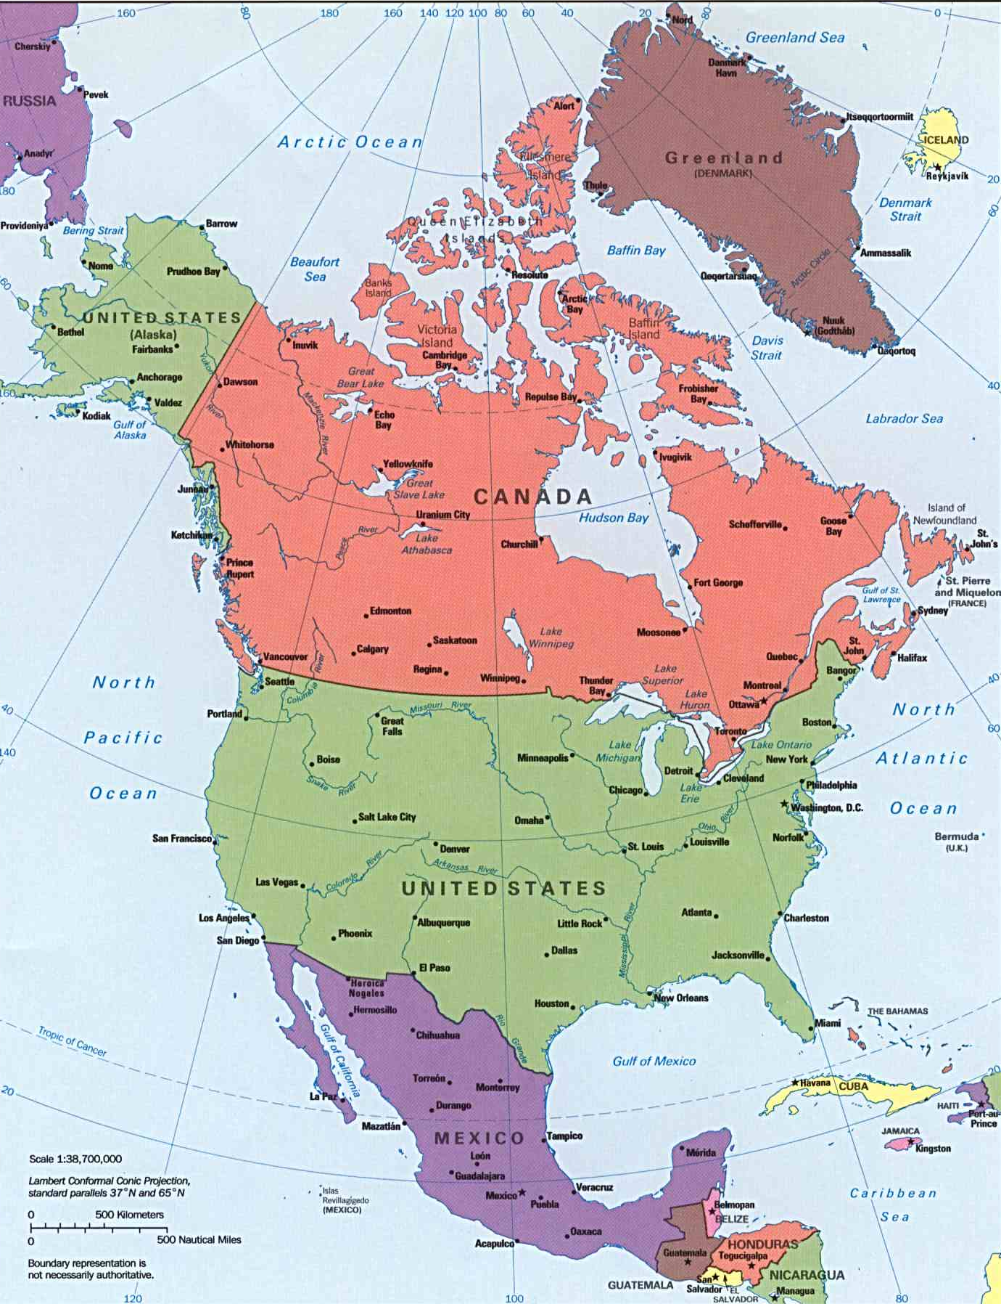
Twinning Project Overview
2009 - LSRCA won the International RiverFoundation’s (IRF) Thiess
International Riverprize for water
management excellence.
Provided an opportunity to "twin", or partner, with a developing country
2010 - LSRCA’s Board of Directors, with the approval of the International RiverFoundation, announced JIRA (representing the Ayuquila River in Mexico) as our twinning partner.
2013 – Partnership expanded . . . University of Guadalajara and Ayuquila-Armeria Watershed Commission
Notes:
2009 - LSRCA won the International RiverFoundation’s (IRF) Thiess International Riverprize for water management excellence.
Provided us with an opportunity to "twin", or partner, with a developing country, sharing expertise in the areas of watershed management, flood control, public participation, forestry, recreation and general environmental management.
2010 - LSRCA’s Board of Directors, with the approval of the International RiverFoundation, announced JIRA (representing the Ayuquila River in Mexico) as our twinning partner.
2013 – Partnership expanded . . . University of Guadalajara and Ayuquila-Armeria Watershed Commission joined with LSRCA and JIRA

Slide 4
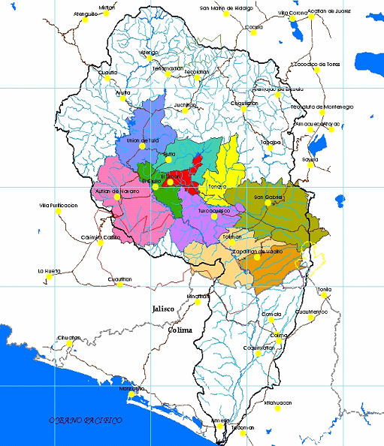
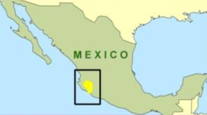
Ayuquila-Armeria River Basin
Close to 10,000 sq. km. in size
Ayuquila River and Tuxcacuesco River join to form the Armeria River
Combined river lengths – 294 km
3 large dams provide water to irrigate 54,000 hectares of farmland in Jalisco and Colima
22 municipalities within two states (Jalisco and Colima)
Over 550,000 people reside in the watershed
Notes:
The Ayquila-Armeria River system is one of the most important river systems in western Mexico. With a basin area of 9803 km2 and length of 294 km, it crosses the two states of Jalisco and Colima and consists of three sub-basins: the Ayuquila River, the Tuxcacuexco River and the Armeria River (see Figure 3.5). The Ayuqila River rises in the upper basin converging with the Tuxcacuexco to form the Armeria River, which flows south discharging into the Pacific Ocean (Montero et al 2006). Approximately 550,000 people live in the basin within 22 municipalities. It also contains five protected natural areas, a high diversity of native and threatened species and three large dams at Tacotan, Trigomil and Corcovado (UNU 2008). These dams provide irrigation to 54,000 has of farmland in Jalisco and Colima.
The Ayuquila-Armería flows for a total of 294 km before reaching the Pacific Ocean. The river begins with the Ayutla River originating in the Sierras of Cacoma and Quila. This segment runs for 100 km until forming the Ayuquila River at the Tacotán dam. After 15 km, the Ayuquila encounters another dam, the Trigomil. The river continues for 20 km until the Corcovado diversion dam where most of the water is diverted from the river to be used for the irrigation of the agricultural valley of Autlán and El Grullo. Beyond this valley, the river creates 70 km of the northern boundary of the Sierra de Manantlán Biosphere Reserve (SMBR). At the eastern edge of the SMBR, the Ayuquila River joins with the Tuxcacuesco River to form the Armería River for the last 135 km before draining into the Pacific Ocean (Mercado-Silva 2001).

Slide 5
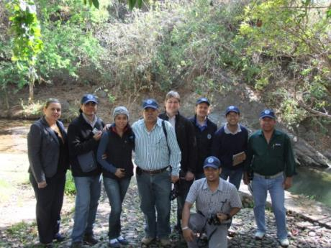
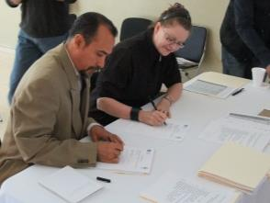
Mission 1 Overview – Project Definition
December 2011
Project Definition Mission focused on four areas:
Governance;
Water Quality Improvement/Wastewater Treatment;
Stewardship; and
Education.
Achievements included:
Visited the river basin to assess the watershed;
Exchanged information and knowledge on watersheds and programs;
Documented and evaluated the watershed and work completed by JIRA;
Defined and assessed the twinning project and its purpose;
Facilitated a workshop on the project goals, deliverables, outcomes, responsibilities and budget; and
Prepared for Mission 2

Slide 6
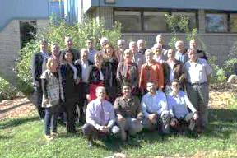
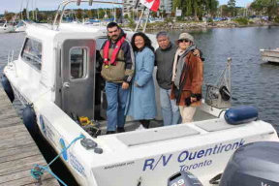
Mission 2 Overview – Knowledge Building
September 2012
Knowledge Building Mission focused on “hands on” learning based on three days of touring the Lake Simcoe watershed and taking part in workshops regarding strategic planning and watershed management plan development.
Recommendations included:
An Integrated Watershed Management Plan should be developed including; strategic plan, annual operating plans and a component on public engagement
Monitoring gauges and a monitoring/measurements program be established
LSRCA and JIRA should expand its Twinning Partnership by early 2013 to include the University and the Commission through a revised Letter of Intent to Partner.
Mission 3 to focus on building capacity – focus on water monitoring network and restoration initiatives

Slide 7
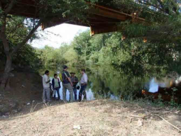
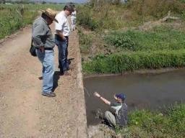
Mission 3 Overview – Capacity Building
Phase I – April 2013
Prior to Mission 3 the partnership was formally expanded and the vision updated:
LSRCA, JIRA, CUCSUR and the Watershed Commission of the Ayuquila-Armeria River are committed to partner to promote integrated watershed management in the Ayuquila-Armeria River Basin by developing twinning programs that will meet desired objectives and inspire positive
social and environmental change in both countries.
Key accomplishments included:
Focused workshop sessions on developing a watershed plan, reviewing the current monitoring program, identifying restoration opportunities and reviewing current communication programs;
Presenting the new partnership to JIRA Board of Directors with representatives from the University and AAWC;
Visiting monitoring network sites and potential restoration projects;
Visiting a major erosion site in Tapalpa; and
Preparing for Phase II of the Mission.

Slide 8
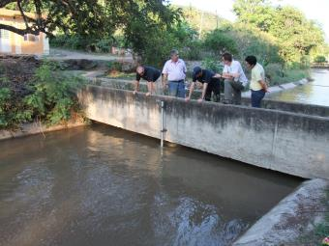
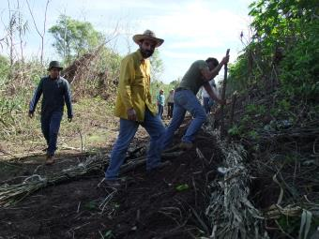
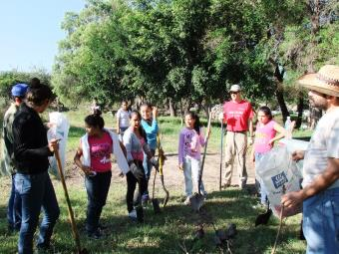
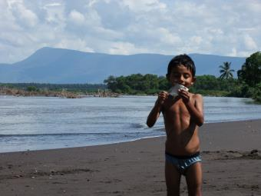
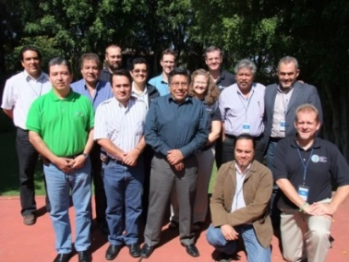
Mission 3 Overview – Capacity Building
Phase II – November 2013
A team of 5 LSRCA staff arrived on November 3rd to establish a Monitoring, Measuring and Mitigation Pilot Program:
Tour of basin from Colima to Autlán
65 linear metres of river bank restored
Erosion site repaired
6 monitoring stations installed
1 weather station installed
Workshops conducted
Tree planting with the community
Successful meeting with Federal, State and local water agency representatives.

Slide 9
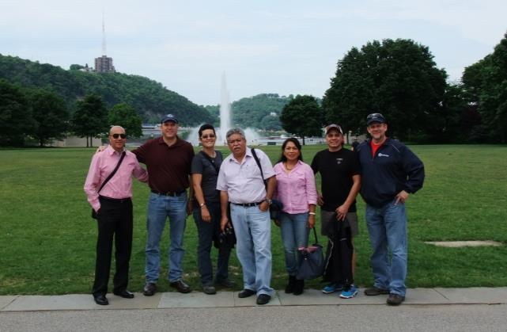
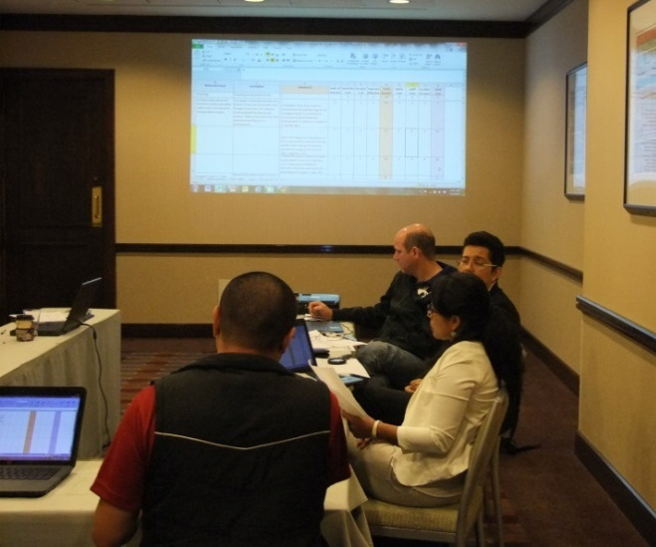
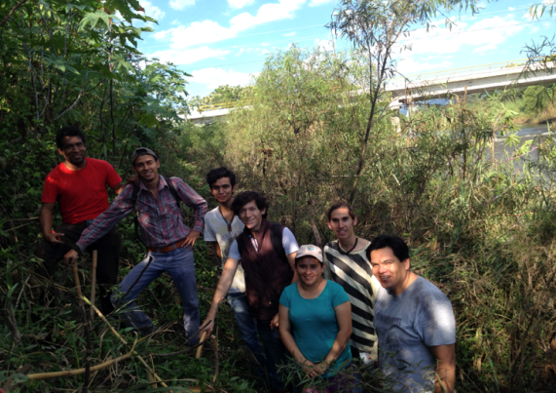
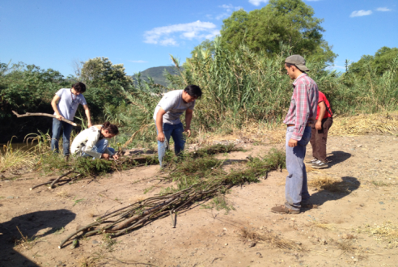
Mission 4 – Integrated Project Planning
Attended River Rally 2014 and 2015 with representatives from JIRA, UDG and AAWC.
Opportunity to learn about other international projects focused on watershed protection initiatives, network with other river advocates, and take part in workshops.
Worked together on developing an integrated strategic plan for watershed management for the Ayuquila-Armeria River Basin.
Continued restoration activities along Ayuquila River near El Grullo.

Slide 10
Integrated Project Planning – Our Approach
Identify the Issues
Rank Impact
What Is Currently Being Done
Gaps/Solutions
Cost / Benefit of Implementing Solution(s)
Prioritized Issues
Develop Detailed Plans (5 W’s)

Slide 11
Mission 4 – Integrated Project Planning
JIRA, UDG and AAWC continue to refine implementation priorities in consultation with basin stakeholders
  Leading to development of an integrated watershed management plan for Ayuquila-Armeria River Basin
  Confirming what needs to be done, by who and by when
How Are We Doing?
  18 priorities have been identified for the Basin
  8 are underway – making some positive gains

Slide 12
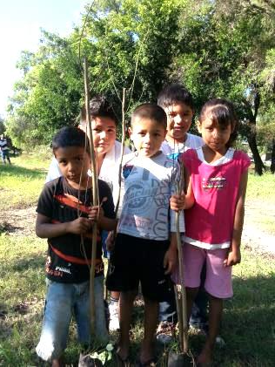
Where Do We Go From Here . . .
  Finalize draft of Implementation Plan for the Ayuquila -Armería
  River Basin (IPAARB) 2018-2021 - September 2017
  Partner workshop(s) to seek input into implementation plan
  November – December 2017
  Final Implementation Plan – December 2017
  Include actions within the Integrated Management Plan of the
  Watershed Council for Centro Pacifico
  Continue to build local and regional community partnerships.
  Monitor success of pilot projects and share the success.
  Build database of environmental measures.
  Expand environmental monitoring network to support the need for continued action.
  Begin to develop a watershed report card and share stories of success.
  Show that the Ayuquila-Armeria River Basin model can be used to showcase itself as a National, North American and International model for cooperation and environmental restoration.

Slide 13
Lessons Learned – A Poem
Each watershed is different and through the water tell us her history.
The knowledge is inside. Science and local knowledge can help us to discover it.
Big rivers always start with little streams, every drop of social participation counts.
Rivers have slow and rapid flows, we need to keep eyes and ears open to change the course.
Like rivers, we must focus on a principal course. As water, we need to be patient and persevere.
Watershed management is not in a straight line, has meanders and cycles.
When we get to the end, we need to start again from the top to the bottom,
Our management plans are dynamic and evolve.
The basins are very ancient, the humans start to walk in.
Water unites, the watershed converge,
Let’s do this for our river basins around the world to keep them healthy and alive.

Slide 14
THANK YOU
GRACIAS

