Slide 1





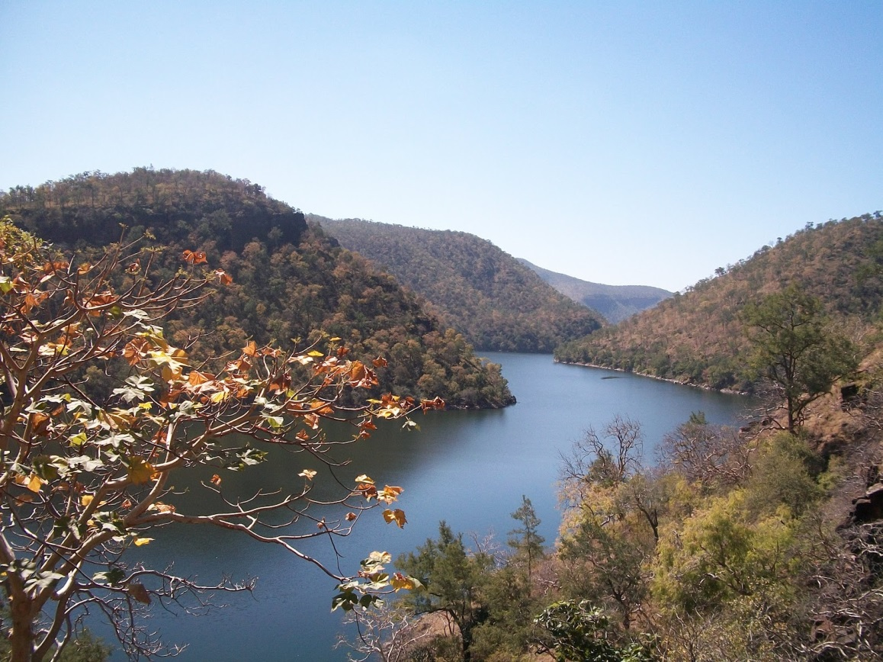
River Basin Planning – Drawing on the Australian Experience to Inform Basin Planning in India
Authors: David Winfield, Melita Grant, David Harriss, Tony Weber and Ajay Pradhan.
Notes:
Authors: David Winfield^{1,2}, Melita Grant^{1,3}, Tony Weber^{1,2}, David Harriss^{1,4}, and Ajay Pradhan⁵.

Slide 2
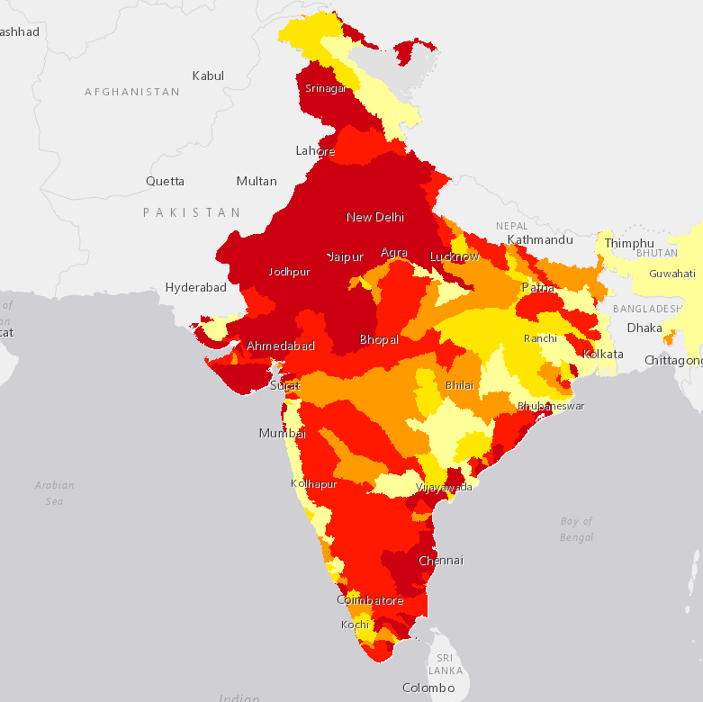
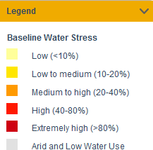
Water Stress in India
Source: http://indiawatertool.in/ June 2017
Notes:
Baseline water stress - India

Slide 3
Are there lessons that can be drawn from the Australian experience?
Australian experience
Manage water stress
Water sharing and allocation
Pollution control
Water reform journey
Integrated river basin planning
Engagement
BRISBANE, AUSTRALIA | 18 - 20 SEPTEMBER 2017
Notes:
The Government of India (GoI) has commenced a significant investment in river basin planning (RBP) with an initial focus on obtaining and sharing water data through the National Hydrology Program (NHP) III. It is important to contextualise this initial focus on data within broader RBP objectives. In 2016 the Government of India (GoI) identified that a review of RBP policy and regulatory frameworks was needed, to identify opportunities and approaches for India. The GoI requested support from the Australian Water Partnership (AWP) to undertake the review and to develop a User Guide for RBP in India.
Quote source: http://projects.worldbank.org/P152698/?lang=en&tab=financial

Slide 4
Key similarities
Legal context for water
Key differences
Population size and density
Climate
Variable hydrology
Importance of agriculture
Socio-economics
Urban growth rate
Food security
Agriculture structure
High water stress
Context comparison
Notes:
Comparison of the Indian and Australian context – Describes some of the similarities and differences of the Indian and Australian contexts and the impact this may have on basin planning. Concludes that the Indian and Australian contexts have clear differences, but in the area of water management there are also many similarities in legal, bio-physical and agricultural dependencies, which make the exchange of knowledge and lessons in basin planning beneficial for both.
Similarities include:
Legal context – Both countries have a constitutional assignment of water management to the states, with the national government role covering issues of national significance.
Climate – Both countries cover a broad range of climate zones including subtropical, mountainous, semi-arid and arid.
Highly variable hydrology – Rivers in both countrieshave highly variable flows both temporally – between months, years and decades – and spatially.
Importance of agriculture in river basin management – Almost 70% of India’s population lives in rural areas and relies on agriculture for its livelihood (WB, 2014). In the Murray-Darling Basin, 10% of people are employed in the agriculture sector (compared to 2.7% nationally) and 35% to 40% of the total gross value of Australia’s agricultural production is produced in the Basin (ABS, 2006).
Key differences to be considered when drawing lessons from the Australian experience include:
Population size and density – The population density of India is 382 persons/km² (NITI 2001) whilst in Australia it is 3.1 persons/km² (ABS, 2016) and in the Murray-Darling Basin it is 1.19 persons/km² (ABS, 2006). The vast differences in population size and density impact on a range of issues including resource use, resource accessibility, water quality and planning processes.
Socio-economic context – India is ranked by the World Bank as a lower middle income country with rapidly increasing GDP (US$2.1 trillion in 2015), whereas Australia is ranked as a high income country (World Bank, 2016). This difference impacts on issues such as pricing water, infrastructure development and planning processes.
Urban growth – While both countries are experiencing rapid urban growth, the pace of growth is much greater in India and limited resources for infrastructure mean that the consequences of urban growth for water demand and water pollution are greater.
Food security and structure of agriculture – Food security is a key issue for India, whereas for Australia, the predominantly higher incomes allows price rises and imports to compensate for fluctuations in domestic production. In India, agriculture is predominantly carried out by many small-scale farmers, whereas Australia’s agriculture has restructured over the last 2-3 decades and is predominantly the domain of large agribusinesses.

Slide 5
Supporting basin planning under the NHP III
National Hydrology Project III
Improve the extent, quality, and accessibility of water resources information and strengthen the capacity of targeted water resources management institutions in India
A) Water Resources Data Acquisition System
B) Water Resources Information System
C )Water Resources Operations and Planning
D) Institutional Capacity Enhancement
Support for river basin planning
Develop a guide for basin planning in India
Australian Water Partnership
BRISBANE, AUSTRALIA | 18 - 20 SEPTEMBER 2017
MANAGED BY
Notes:
The Government of India (GoI) has commenced a significant investment in river basin planning (RBP) with an initial focus on obtaining and sharing water data through the National Hydrology Program (NHP) III. It is important to contextualise this initial focus on data within broader RBP objectives. In 2016 the Government of India (GoI) identified that a review of RBP policy and regulatory frameworks was needed, to identify opportunities and approaches for India. The GoI requested support from the Australian Water Partnership (AWP) to undertake the review and to develop a User Guide for RBP in India.
Quote source: http://projects.worldbank.org/P152698/?lang=en&tab=financial

Slide 6
Engagement in India is essential to developing a useful guide
Review of India planning policies and processes
Draft User Guide
Consultation on draft User Guide
Completion of User Guide, dissemination and piloting
Update User Guide post-piloting
Consultation & engagement with key stakeholders in India
Notes:
The project…

Slide 7
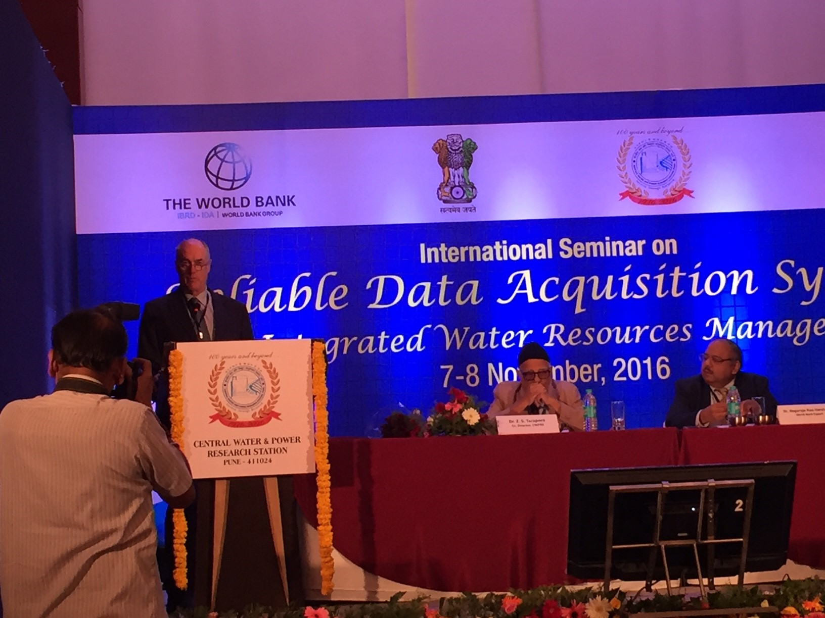
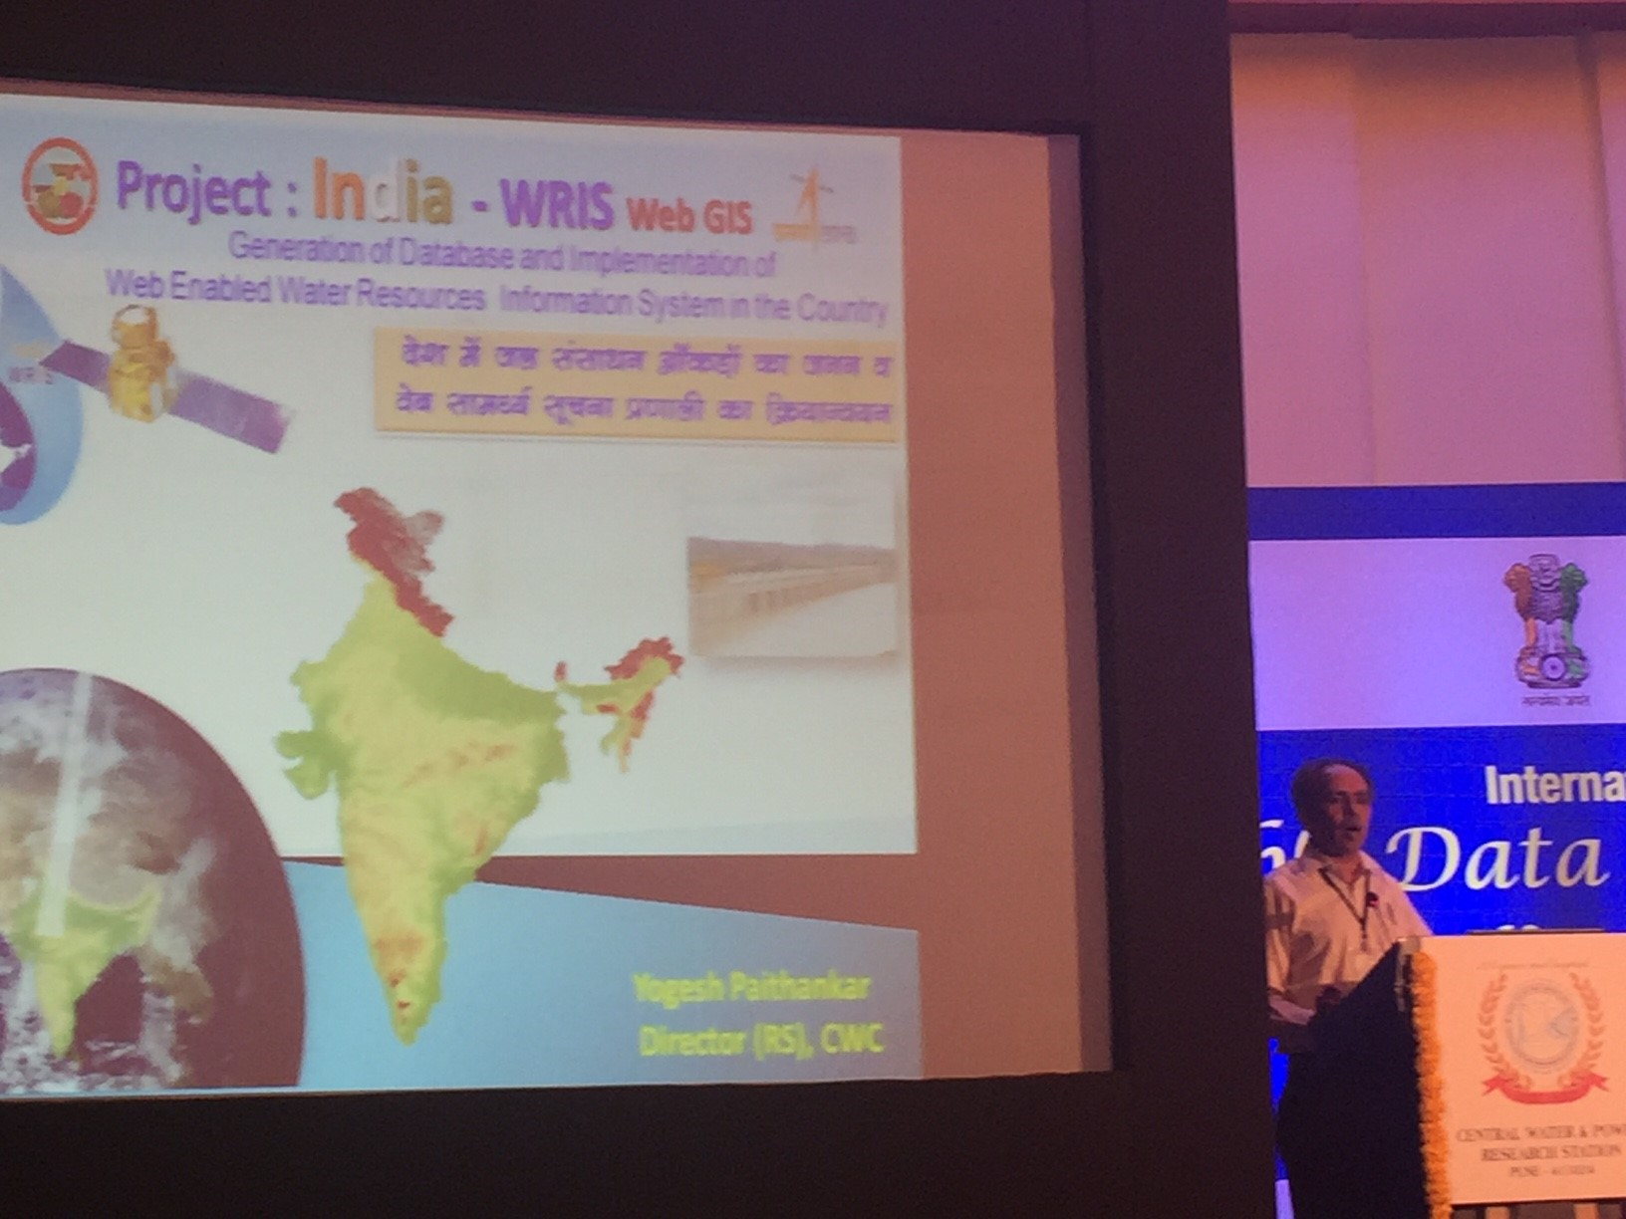
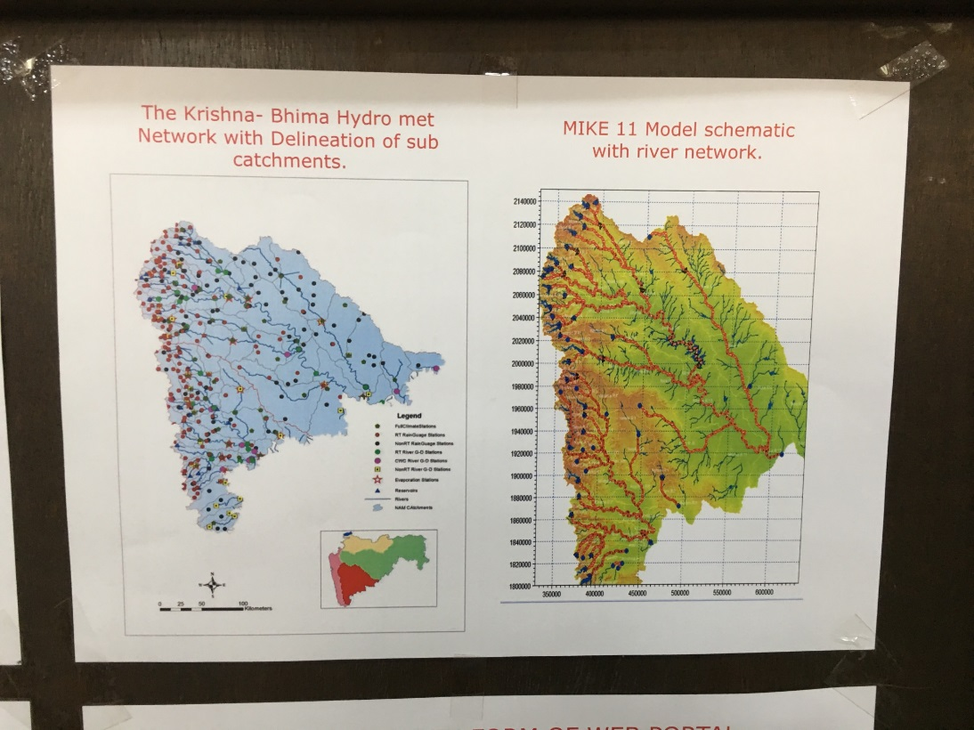

Slide 8


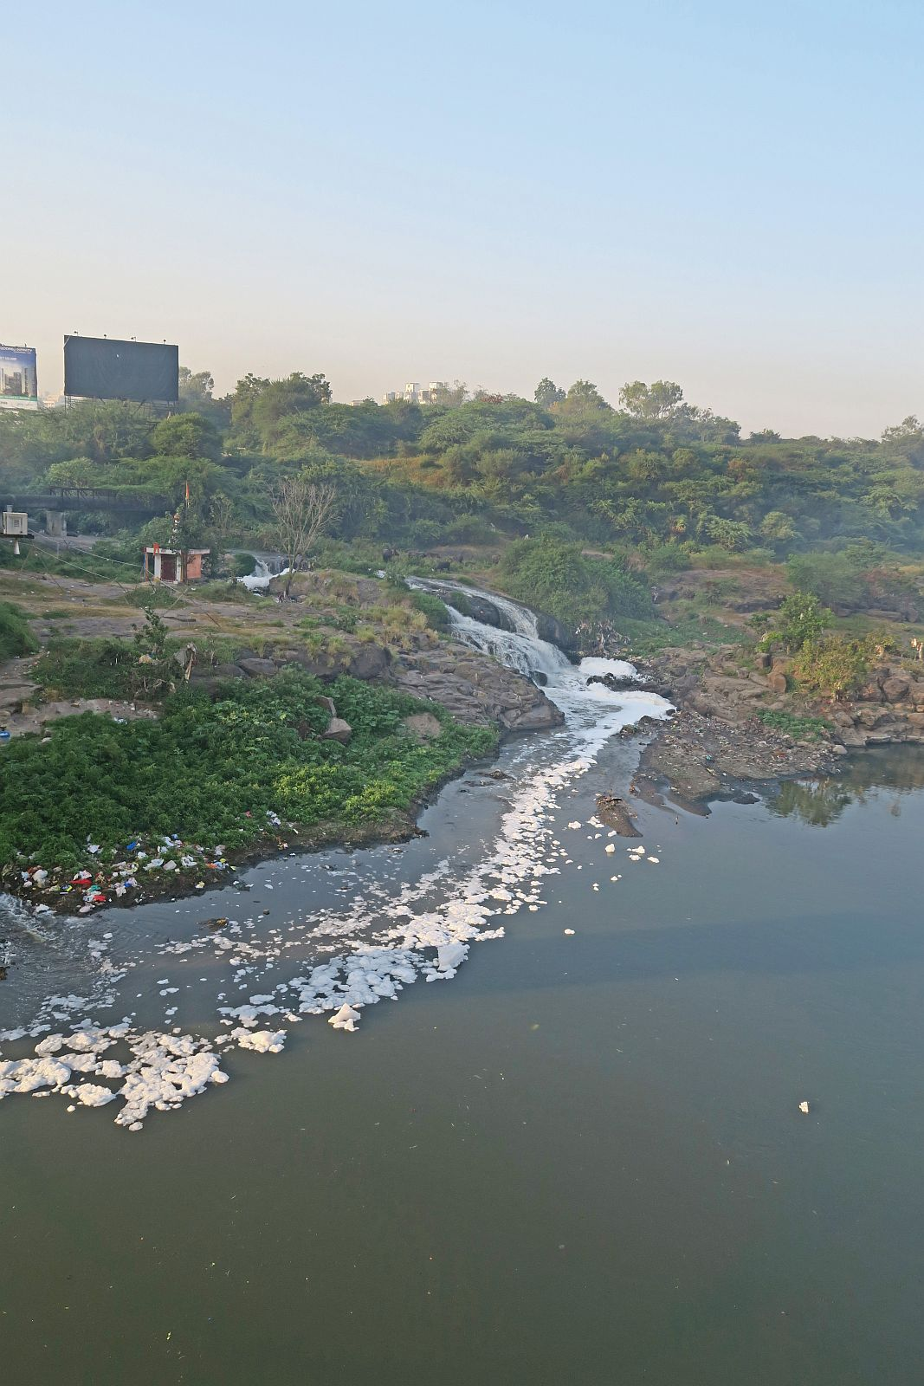


Slide 9
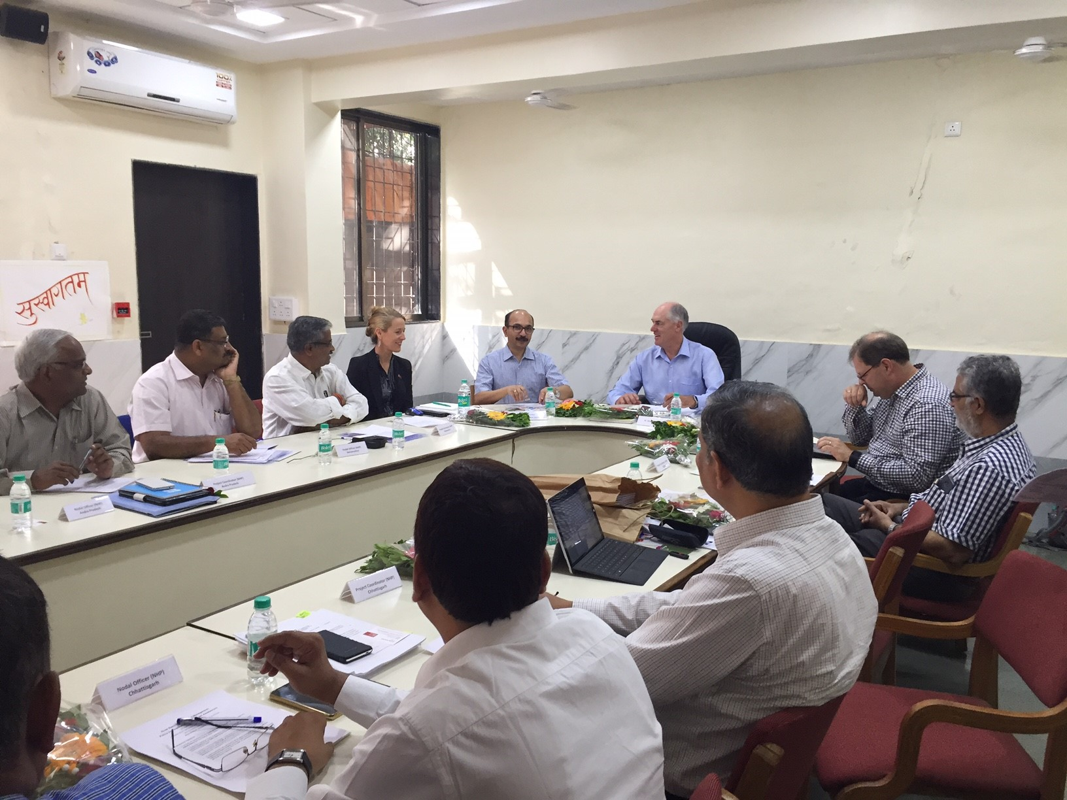

Slide 10
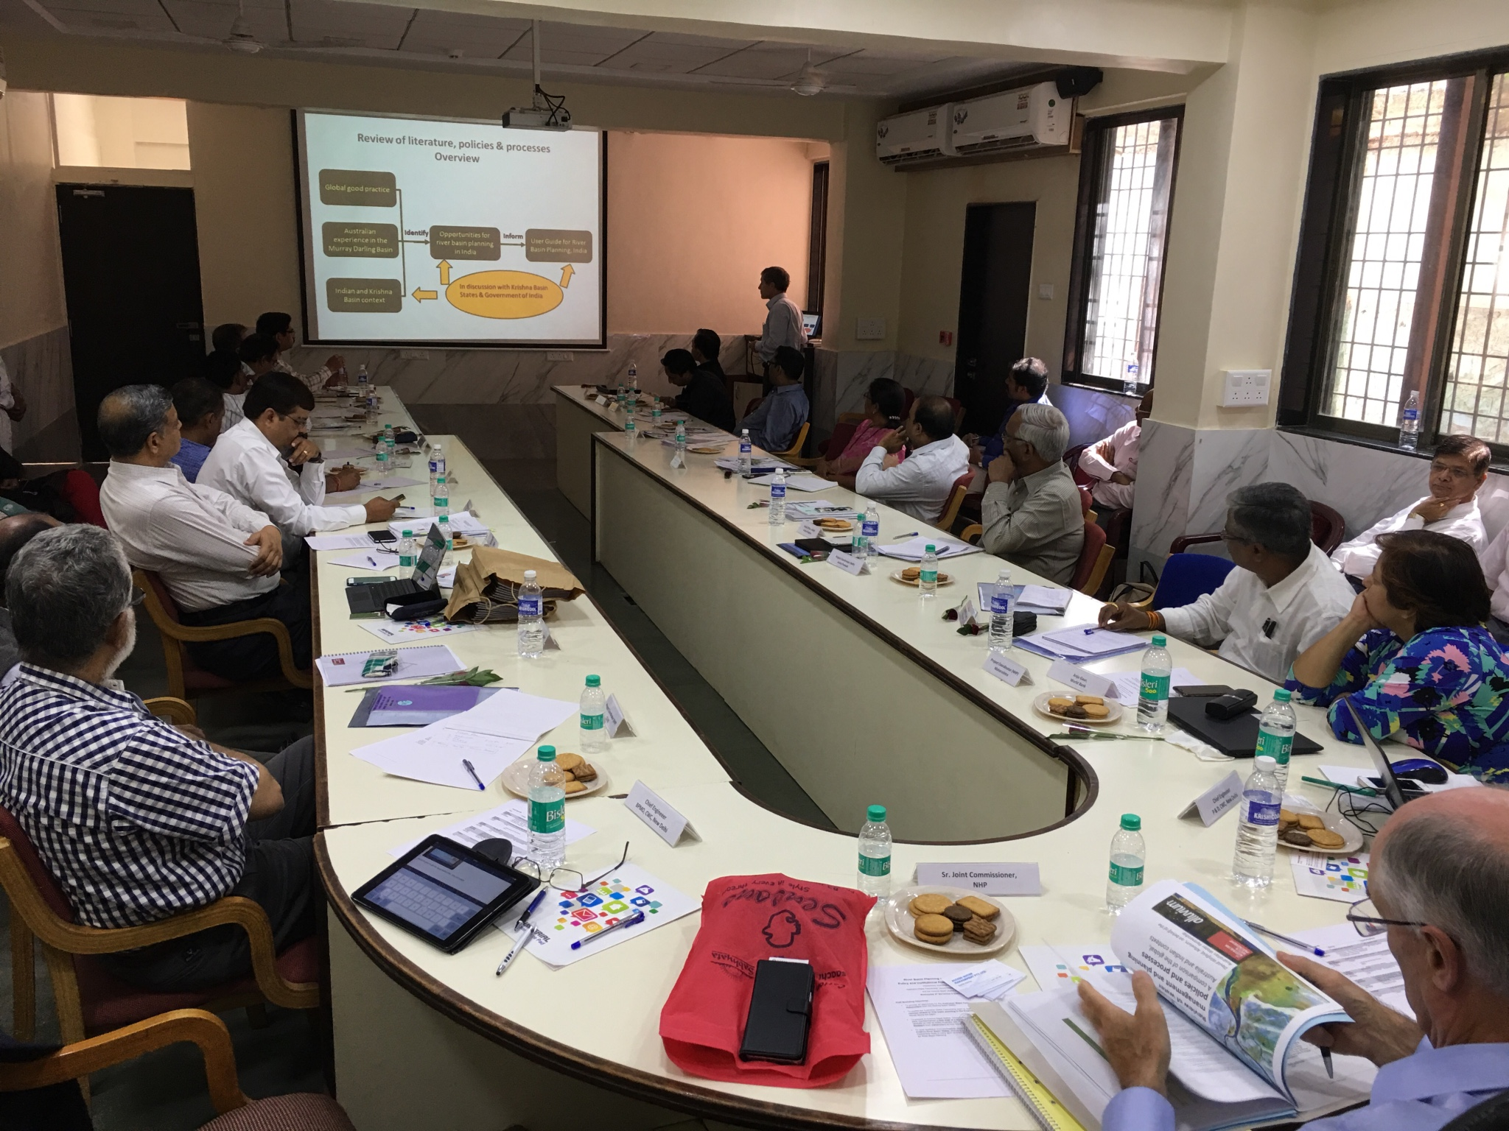

Slide 11
Content of the User Guide for River Basin Planning
Chapter | Content
Introduction | Defines basin planning concepts and compares India and Australian contexts
2. River basin planning in India – the current context | Establishes the Indian policy, legislative and institutional context
3. Enabling environment for river basin planning | Describes enabling environment for basin planning (legal, capacity, funding, engagement and institutional)
4. Basin strategies – principles and tools | Basin management strategies: system needs and defining limits to extraction; demand and supply management; operational and water quality management
5. Process for developing a river basin plan | Describes basin planning process
6. Content of a river basin plan | Outlines typical content of a basin plan
Notes:
One slide on the content of the guide
The main contents of the guide are:
Comparison of the Indian and Australian context – Describes some of the similarities and differences of the Indian and Australian contexts and the impact this may have on basin planning. Concludes that the Indian and Australian contexts have clear differences, but in the area of water management there are also many similarities in legal, bio-physical and agricultural dependencies, which make the exchange of knowledge and lessons in basin planning beneficial for both.
Context comparison
Process
Strategies and tools
Contents of a River Basin Plan

Slide 12
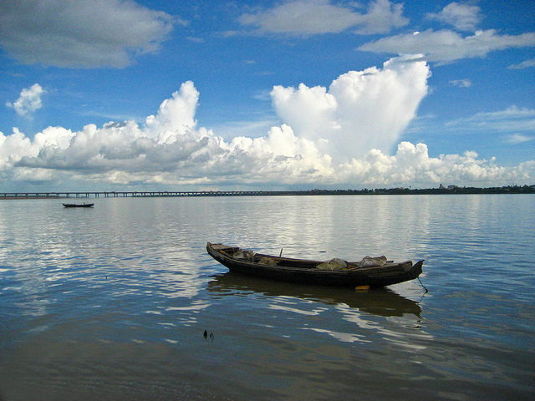
Key themes emerging for the user guide

Slide 13


Theme 1 – necessity of the enabling environment for basin planning
India- proposed National Water Framework bill
Clarify the purpose of basin planning
Define the basin planning process
Empower RBOs
Engage with stakeholders and community
Water Act 2007
State legislation
Water Act 2007
State legislation
MDBA established by Water Act
State & national water legislation
Draft National Water Framework Bill
State legislation
Draft National Water Framework Bill
State legislation
River Boards Act 1956
Draft National Water Framework Bill
Notes:
One slide on the content of the guide
The main contents of the guide are:
Comparison of the Indian and Australian context – Describes some of the similarities and differences of the Indian and Australian contexts and the impact this may have on basin planning. Concludes that the Indian and Australian contexts have clear differences, but in the area of water management there are also many similarities in legal, bio-physical and agricultural dependencies, which make the exchange of knowledge and lessons in basin planning beneficial for both.

Slide 14
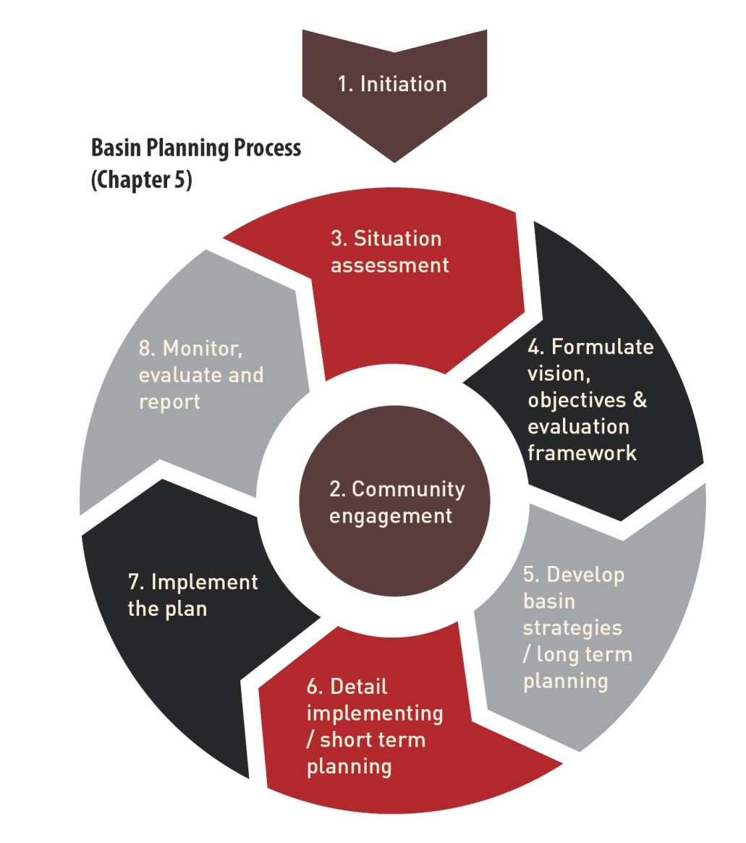
Theme 2 –Basin planning is complex and cyclical
Engagement is central
Data and modelling tools are only part of the picture
Notes:
One slide on the content of the guide
The key steps in the process are
Initiation
Community engagement
Situation Assessment
Formulate vision, objectives and evaluation framework
Develop basin strategies and long-term planning
Detail implementation and short term planning
Implementation
MER
Principles of adaptive management, ensuring continuous learning and improvement and review

Slide 15
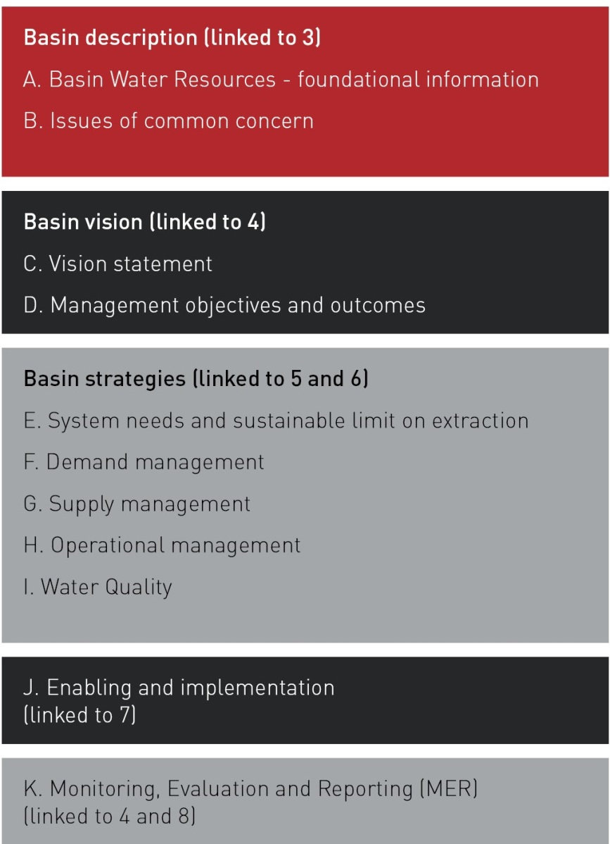
Theme 3 – Basin plans typically have five key sections

Slide 16
Theme 4 – Interacting system needs, demand management and supply management strategies

Slide 17
Theme 5 – Establishing principles for basin planning strategies
Principles
Define system flow regime
Establish agreed hierarchy of uses
Develop mechanism for allocating water (responsive to seasonal, monthly and decadal changes in climate)
Develop regulatory framework for the defined system flow regime and allocation mechanisms
Enable adaptability while providing clear and predictable rules

Slide 18
Theme 6 – Establish planning that links values and objectives to the technical issues management

Slide 19
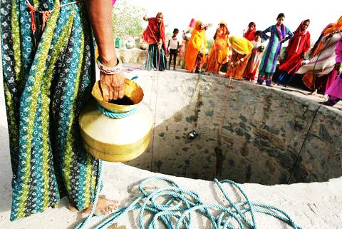
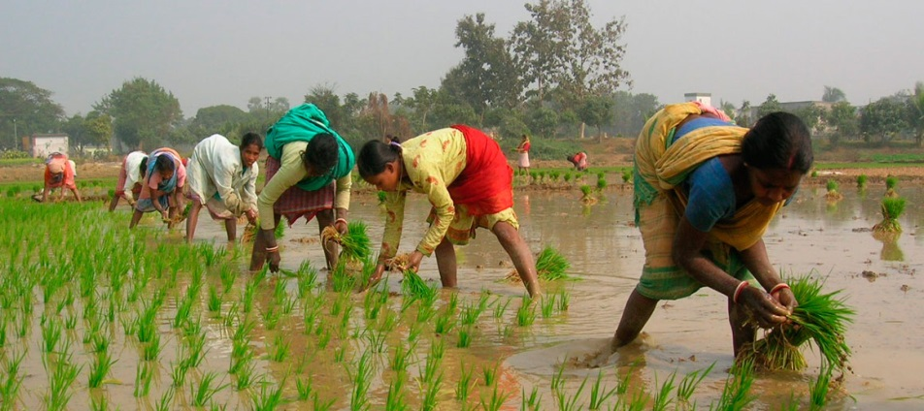
Theme 7 – Importance of gender equality and inclusion
Existing inequalities in any context affect river basin planning
Inclusive stakeholder engagement requires all voices to be incorporated – not only the most dominant and financially able
Gender mainstreaming in river basin planning can occur at four key levels:
Image source: womenfarmersofindia.org
Notes:
Incorporating gender equality and social inclusion at each step of the process is important, to ensure that people (especially the poor, low-caste, women, and people with disabilities) are not further marginalised or disadvantaged by river basin planning, water allocation and sharing decisions. Inclusion means that marginalised people are represented not only in numbers during decision making processes, but supported so that they can contribute equally and influence decisions.
Gender Equality and Social Inclusion in river basin planning
When designing a stakeholder participation strategy, it is important to consider existing inequalities and power dynamics within any given context. Inclusive strategies have been found to result in water governance interventions to be more sustainable, and able to contribute to multiple objectives relevant to sustainable development (Grant et al, 2016). The United Nations World Water Assessment Program reported in 2015 that: “No water assessment can be realistic without a gender perspective. And no decision-making is inclusive unless both women and men participate in the process”.
In many countries, there is a move of males from farming to employment in urban areas, leaving the women responsible for farm management. This is increasing female involvement in agriculture and water management.
Inclusive stakeholder engagement requires ensuring that the poor and marginalised are prioritised, in order to ensure that critical human water needs are met in any river basin planning intervention. It also requires that marginalised peoples such as women, people with disabilities, gender-discriminated peoples, and lower-caste people are involved and that their voices are incorporated into water management decision making.

Slide 20
Theme 7 – Importance of gender equality and inclusion
Inclusion plan developed with gender experts and women’s, and DPOs
Train staff in inclusive practice
Inclusive river basin planning
Disaggregated data by sex and disability status
Facilitate and enable meaningful participation
Adapted from WSP, 2010
Notes:
Gender mainstreaming is a process whereby the implications for women and men of any planned action - including legislation, policies and programs in all areas and at all levels is assessed and addressed, and gender inequalities are not perpetuated (Alston, 2014). To achieve inclusive decision-making, gender mainstreaming needs to occur at four key levels (WSP, 2010):
1)A plan for how to reduce gender inequalities through the River Basin Planning process needs to be developed with the support of gender experts including women’s organisations;
2) Staff within relevant institutions need to be trained to understand gender mainstreaming and social inclusion throughout the river basin planning project cycle;
3) When monitoring data is disaggregated by sex and disability status, better information is made available to assess the positive or negative impacts of a program on women and men, and this data can be used to inform decisions. River Basin gender monitoring should be integrated with national monitoring frameworks rather than separate/disconnected processes being created;
4) When women and marginalised citizens, including persons with a disability are included in decision-making forums, and are supported with the skills and opportunities to shape programs and services, water governance outcomes are enhanced. Multiple barriers to women’s involvement in decision-making include being time-poor due to household responsibilities, cultural barriers to women’s participation, and different education levels and opportunities. These barriers need to be revealed so that river basin planning processes and programs can be made more inclusive.

Slide 21
Some final insights
Many water management processes and strategies underway – donors need to help link these
Focus on data is just the first step (albeit important). River basin planning focuses on what you do with the data
Establishing engaged and deeply invested partners is key to success
There is value in a 2-way exchange of strategies and tools to solve water management problems (recognising we cannot directly transfer institutional structures from one context to another)
Consultation and engagement with affected industry and community is essential, but can be challenging to achieve

Slide 22

Next steps
Phase 4. | Indian water leaders visit Australia and the Murray-Darling Basin Consultation on the River Basin User Guide in India
Phase 5. | Completion of River Basin User Guide in India, dissemination and piloting
Phase 6. | Updating of River Basin User Guide post-piloting
BRISBANE, AUSTRALIA | 18 - 20 SEPTEMBER 2017
MANAGED BY

Slide 23


The Team
David Harriss – Access Water Management
David Winfield - Alluvium
Melita Grant – ISF-UTS
Tony Weber - Alluvium
Ajay Pradhan – C2S2 (presentation contributor)
BRISBANE, AUSTRALIA | 18 - 20 SEPTEMBER 2017
MANAGED BY

Slide 24
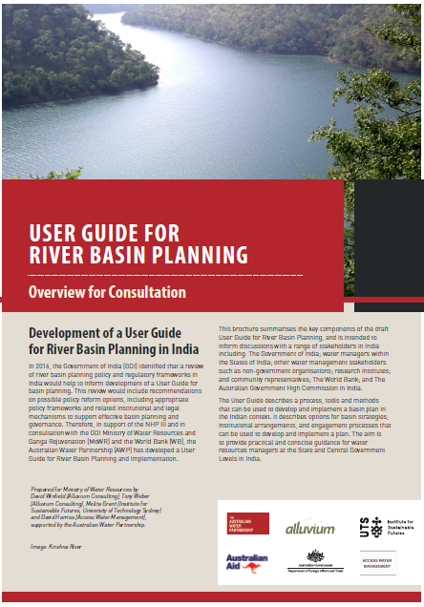
Thank you
Please call in at the AWP booth
All documents will be at
www.waterpartnership.org.au

