Slide 1
Why knowledge and learning are essential to achieving SDG6
The Civil Society Water, Sanitation and Hygiene Fund
Amanda Morgan on behalf of
Bronwyn Powell | September 2017

Slide 2
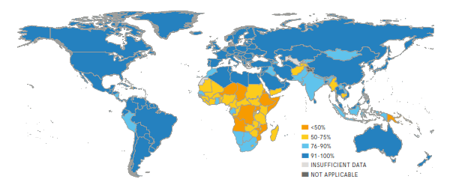
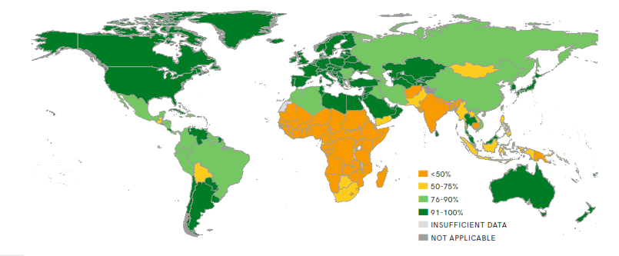
Global sanitation and water crisis
In 2015
884 million people lacked a basic water supply
2.1 billion people lacked safely managed drinking water services
In 2015
2.3 billion people lacked basic sanitation
4.5 billion people lacked safely managed sanitation services
Source: JMP (2017) Progress on Drinking Water, Sanitation and Hygiene. WHO/UNICEF

Slide 3
Source: Stockholm Resilience Centre 2016

Slide 4
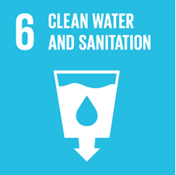
SDG6 brings together WRM and WASH
6.1.1 | Safely managed drinking water services (WHO, UNICEF)
6.2.1 | Safely managed sanitation and hygiene services (WHO, UNICEF)
6.3.1 | Wastewater safely treated** (WHO, UN-Habitat)
6.3.2 | Good ambient water quality** (UNEP)
6.4.1 | Water use efficiency** (FAO)
6.4.2 | Level of water stress* (FAO)
6.5.1 | Integrated water resources management (UNEP)
6.5.2 | Transboundary basin area with water cooperation** (UNECE, UNESCO)
6.6.1 | Water-related ecosystems** (UNEP)
6.a.1 | Water- and sanitation-related ODA that is part of a government coordinated spending plan (WHO, UNEP, OECD)
6.b.1 | Participation of local communities in water and sanitation management (WHO, UNEP, OECD)
“Ensure availability and sustainable management of water and sanitation for all”
6.1
6.1 Drinking water
6.2.1
6.6 Eco-systems
6.2
Sanitation and hygiene
6.6.1
6.a and 6.b
Cooperation and participation
6.a.1
6.b.1
6.5.2
6.5
Water Management
6.3 Waste-water and water quality
6.3.1
6.5.1
6.4
Water use and scarcity
6.3.2
6.4.2
6.4.1
Source: UN Water & WHO 2017

Slide 5
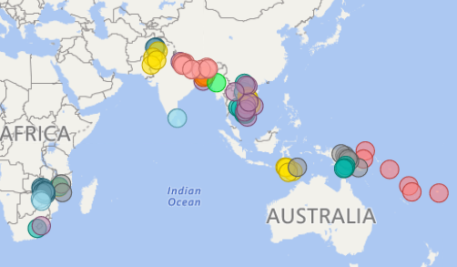
The Civil Society Water, Sanitation and Hygiene (CS WASH) Fund
29 projects, 19 countries, 13 Civil Society Organisations (CSOs)

Slide 6
CS WASH: Holistic Approach
Water
Sanitation
Knowledge and learning
Environment, climate change and disaster risk reduction
Gender and social inclusion
Hygiene

Slide 7
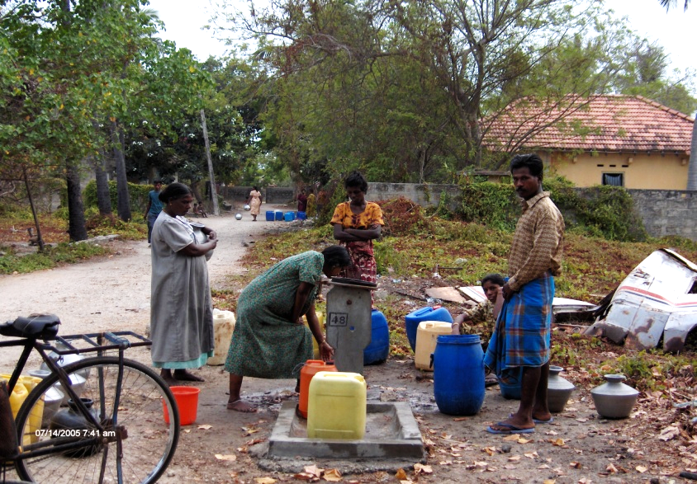
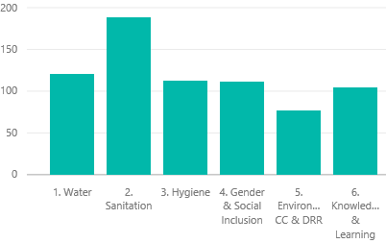
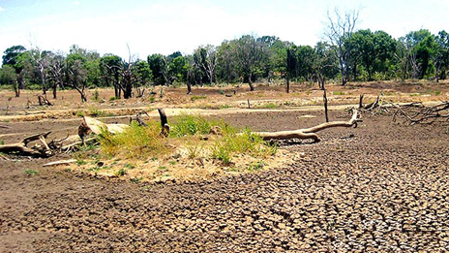
CSO project areas by area of emphasis
Photos: Drought in Jaffna, Sri Lanka 2017. World Vision Lanka
Source: CS WASH Fund
Monitoring and Evaluation Review Panel

Slide 9
Of all the knowledge products, none are on climate change adaptation and disaster risk reduction
No. public outputs (public reports, learning briefs, fact sheets, manuals, learning events)
Source: CS WASH Fund
Monitoring and Evaluation Review Panel

Slide 10
Significant emergencies and climatic events: Opportunities for learning
Earthquake 2015 – Nepal
Drought 2016 - PNG
Flood 2017 – Nepal, Bangladesh
Floods 2015 - Malawi
Flooding / Drought 2017 – Sri Lanka
Cyclones 2015, 2016 - Vanuatu

Slide 11
Impacts of flooding in Malawi
In Mulanje District latrine coverage dropped significantly (from 84% to 35%) as a result of 2015 floods
Ref: Plan (2016)

Slide 12
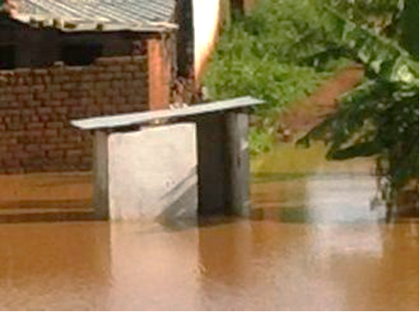
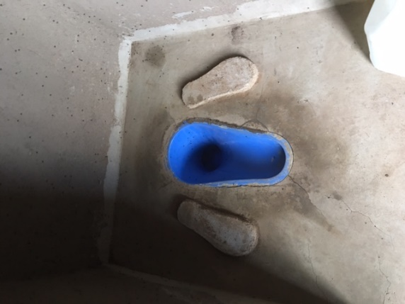
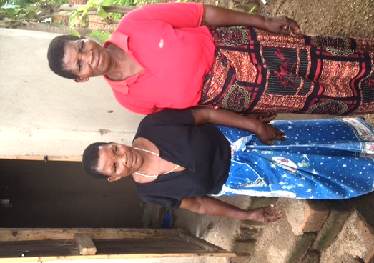
Post flood latrine survey
Assessment of latrine survival
Traditional pit latrines with any of the following had a higher survival rate:
pit lining (woven or bricks) and durable timber for slab
water proof roofing
long eaves overhang (>300mm)
constructed on higher grounds
Modest pit diameter (<2m)
Photos: Plan International

Slide 13
Lessons and remaining challenges
Integrating lessons across SDG6, WASH and water security/DRR/climate change
SDG6 focus on safely managed requires greater effort on quality, not just quantity
Knowledge and learning remains critical: the SDGs raise the bar and we must continue to collect and share data to meet this challenge
Integration between water security and WASH remains an area of challenge, particularly ‘building back better’
Cross-sectoral coordination is essential

Slide 14
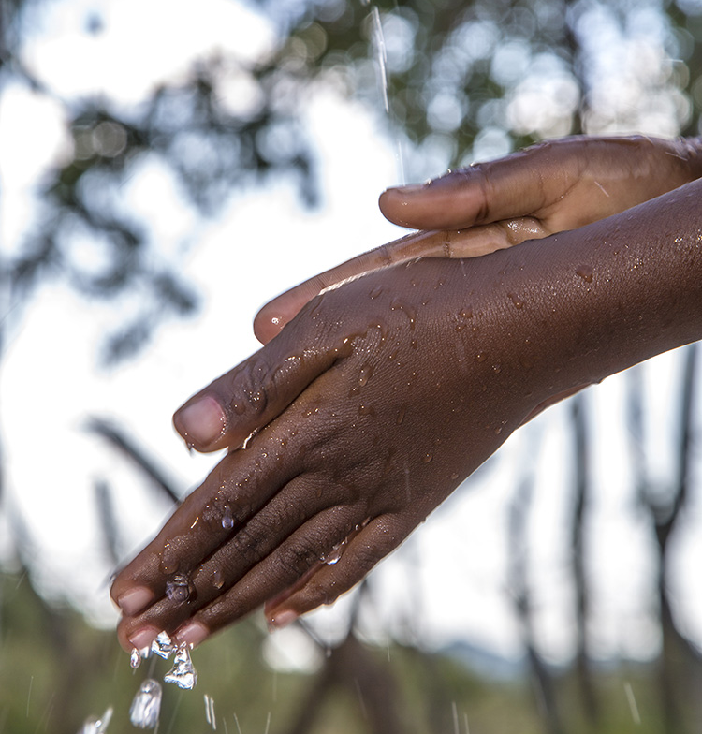
Thank you
www.cswashfund.org
#CSWASHFund

