Slide 1
Prioritising soil conservation and water quality issues for the Waikato River and Waipā River Restoration Strategy, New Zealand.
Reece Hill^{1,2}, Dan Borman^{1,2} and Tane Desmond¹
¹ Waikato Regional Council
² Landsystems Limited
BRISBANE, AUSTRALIA | 18 - 20 SEPTEMBER 2017
MANAGED BY

Slide 2
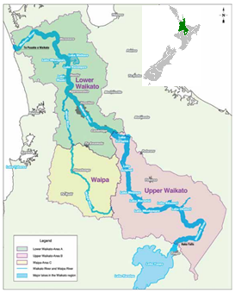
About the Restoration Strategy
The Restoration Strategy covers the Waikato and Waipā River Catchments as defined by several Treaty of Waitangi Iwi Settlement Acts.
Through the Treaty settlements, around $6m NZD are available annually to fund river related improvements in the Waikato and Waipā River Catchments.
The Restoration Strategy will guide the funding of projects to ensure they address priority areas and issues.
This presentation focusses on the science component of the strategy that identifies priority areas for addressing land based issues and the impact of mitigations.
BRISBANE, AUSTRALIA | 18 - 20 SEPTEMBER 2017
MANAGED BY

Slide 3
Overview
Science contribution
Methods – the GIS framework
Results and findings
Lessons learned
BRISBANE, AUSTRALIA | 18 - 20 SEPTEMBER 2017
MANAGED BY

Slide 4
Science contribution
To develop an easy to interpret spatial approach and outputs for identifying and prioritising soil conservation issues across sub-catchments.
The information will inform the restoration strategy process.
Including:
Where soil conservation issues are greatest.
The range of mitigations being used on the ground.
Where mitigations can be placed.
An estimate of the cost for mitigations by sub-catchment.
An estimate of likely the sediment reductions if mitigations are implemented.
BRISBANE, AUSTRALIA | 18 - 20 SEPTEMBER 2017
MANAGED BY

Slide 5
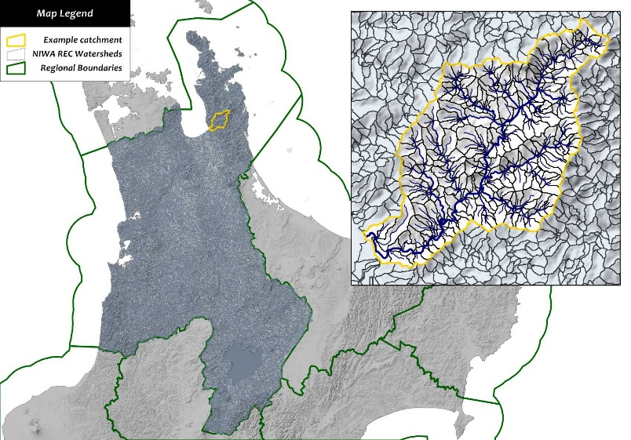
Science contribution
Based on previously developed GIS-based framework
Using available model data
Erosion and sediment generation
Land use intensity
Vegetation cover
A broader approach
Land focussed – mitigate the issues on the land
A relative picture across sub-catchments
Hydrologically connected and scalable
Getting the best from different models
BRISBANE, AUSTRALIA | 18 - 20 SEPTEMBER 2017
MANAGED BY

Slide 6
Issues – multiple model data and ranking
Hillslope erosion and sediment model data
Landuse and landcover model data
Streambank erosion and sediment model data
Mitigations – spatially match issues
Stabilise landslides on pasture
Plantation forests on pasture
Retire pasture
Sediment traps
Riparian planting
Riparian fencing
Estimates – spatially match mitigations
Mitigation costs and sediment reductions
BRISBANE, AUSTRALIA | 18 - 20 SEPTEMBER 2017
MANAGED BY

Slide 7
Issues
Hillslope erosion and sediment model data
Landuse and landcover model data
Streambank erosion and sediment model data
Multiple model data was normalised to combine
Watershed scores - area weighted lengths and areas of issues.
Sub-catchment scores – sum of watershed scores weighted by sub-catchment area
Sub-catchments ranked by issue scores
BRISBANE, AUSTRALIA | 18 - 20 SEPTEMBER 2017
MANAGED BY

Slide 8
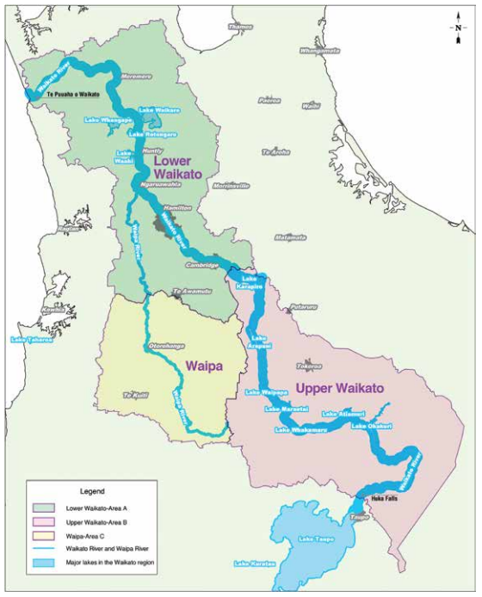
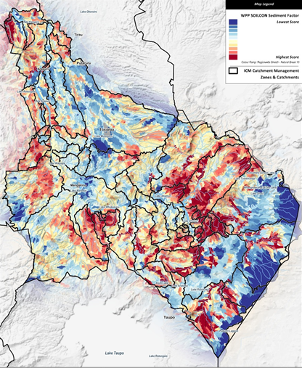
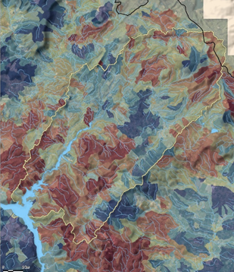
Issues – Upper Waikato sub-catchment sediment
BRISBANE, AUSTRALIA | 18 - 20 SEPTEMBER 2017
MANAGED BY

Slide 9
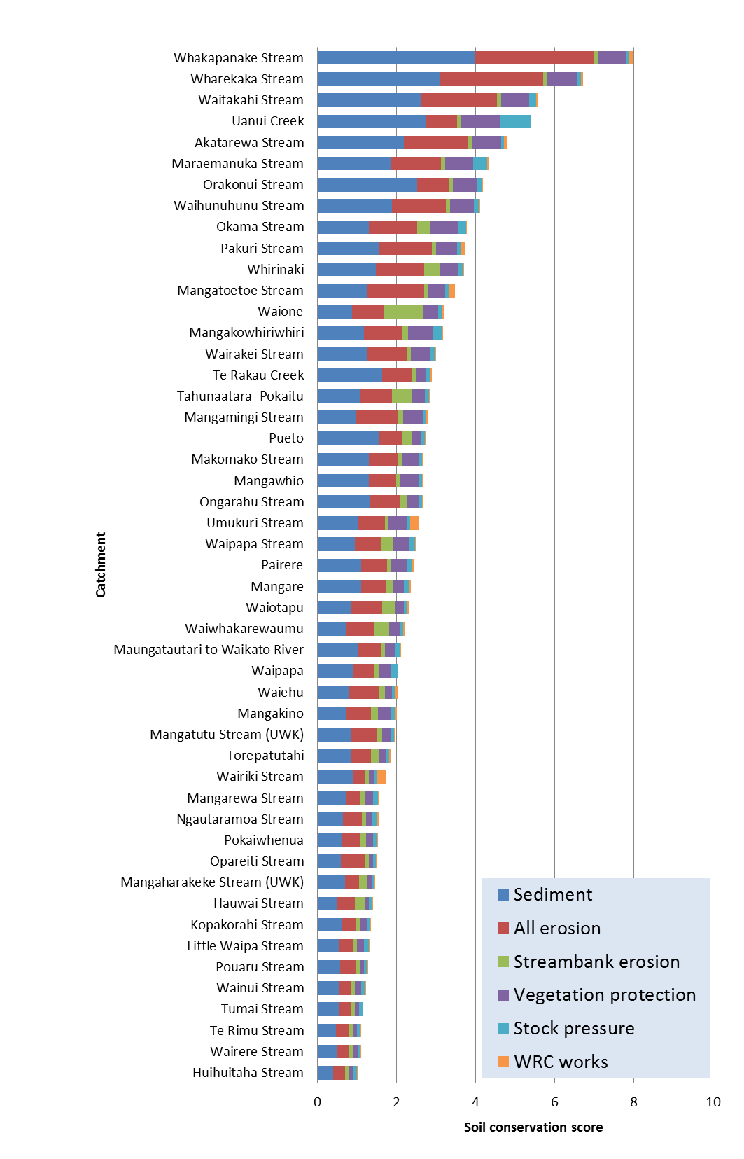
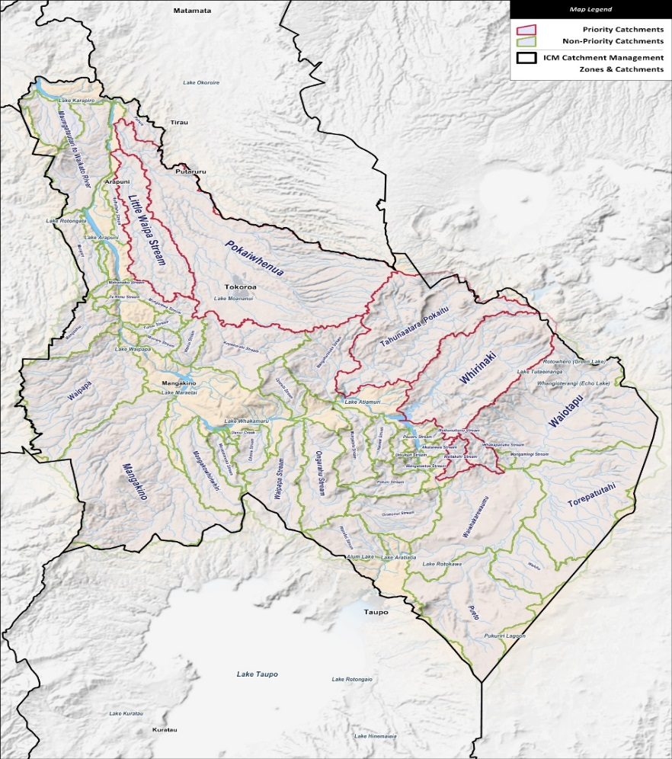
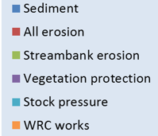
Ranking sub-catchments issues
BRISBANE, AUSTRALIA | 18 - 20 SEPTEMBER 2017
MANAGED BY

Slide 10
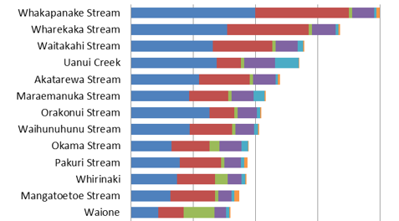
Ranking sub-catchments issues
BRISBANE, AUSTRALIA | 18 - 20 SEPTEMBER 2017
MANAGED BY

Slide 11
Mitigations
Stabilise landslides on pasture
Plantation forests on pasture
Retire pasture
Sediment traps
Riparian planting
Riparian fencing
Mitigations varied across the Waikato catchment.
Reality tested with land management staff workshops.
Specific mitigations imposed on the land identified as having issues.
BRISBANE, AUSTRALIA | 18 - 20 SEPTEMBER 2017
MANAGED BY

Slide 12
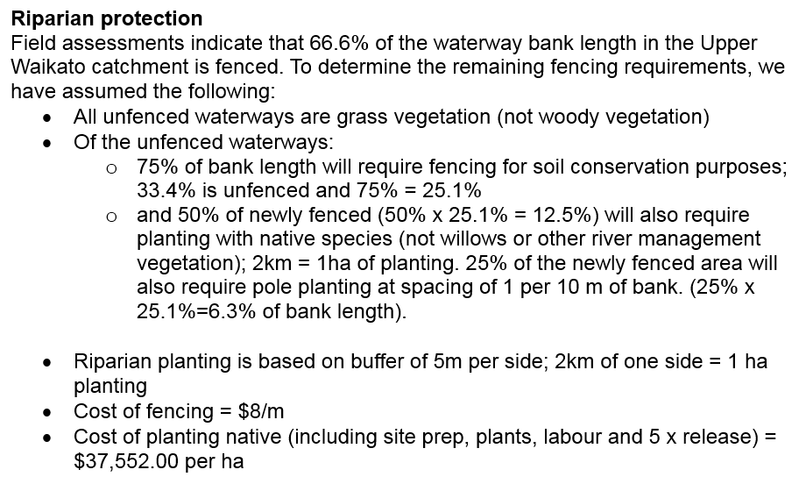
Mitigation – streambank example
BRISBANE, AUSTRALIA | 18 - 20 SEPTEMBER 2017
MANAGED BY

Slide 13
Mitigation – streambank example
Fencing completed
BRISBANE, AUSTRALIA | 18 - 20 SEPTEMBER 2017
MANAGED BY

Slide 14
Mitigation – streambank example
Fencing required
Planting required
BRISBANE, AUSTRALIA | 18 - 20 SEPTEMBER 2017
MANAGED BY

Slide 15
Mitigation – streambank example
Costs
BRISBANE, AUSTRALIA | 18 - 20 SEPTEMBER 2017
MANAGED BY

Slide 16
Estimates
Mitigation costs and sediment reductions
Cost estimates aggregated for sub-catchments.
Sediment reduction estimates for each mitigation were imposed on watersheds and aggregated for sub-catchments.
Available literature was used to estimate reductions.
A range of maps, graphs and data tables was useful to show the estimates across the sub-catchments.
BRISBANE, AUSTRALIA | 18 - 20 SEPTEMBER 2017
MANAGED BY

Slide 17
Whirinaki sub-catchment | Estimates
 | Mitigation cost | Sediment reduction | Sediment reduction | Reduction cost / ton
Hillslope | $20.8 m | 52% | 2325 t/yr | $9000/t
Streambank | $2.2 m | 8% | 320 t/yr | $6900/t
Total | $23.0 m | 19% | 2645 t/yr | $8700/t
BRISBANE, AUSTRALIA | 18 - 20 SEPTEMBER 2017
MANAGED BY

Slide 18
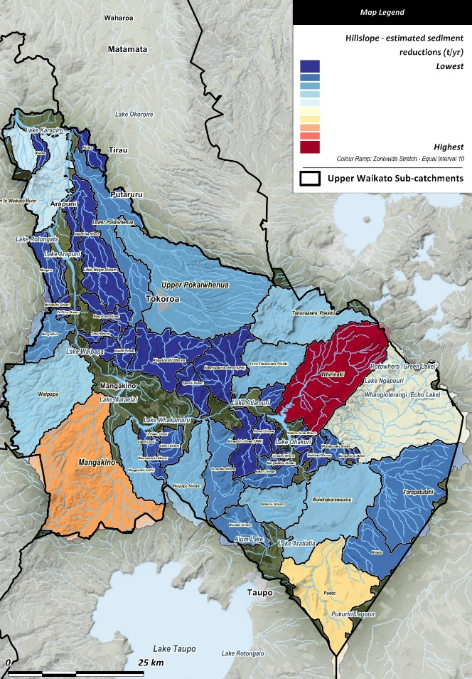
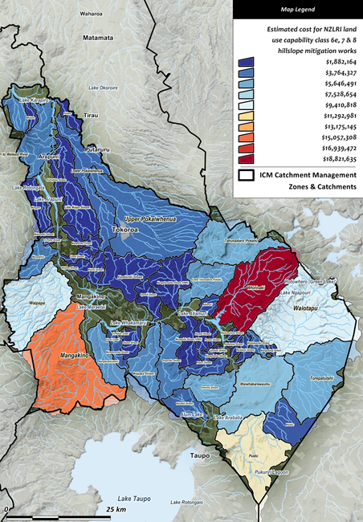
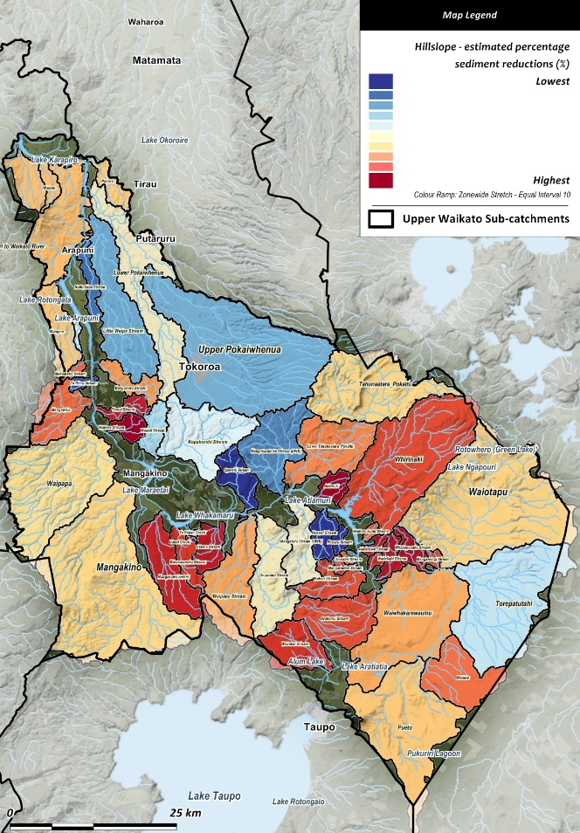
Upper Waikato sub-catchments - hillslope sediment
Reductions (t/yr)
Costs ($)
Reductions (%)
BRISBANE, AUSTRALIA | 18 - 20 SEPTEMBER 2017
MANAGED BY

Slide 19
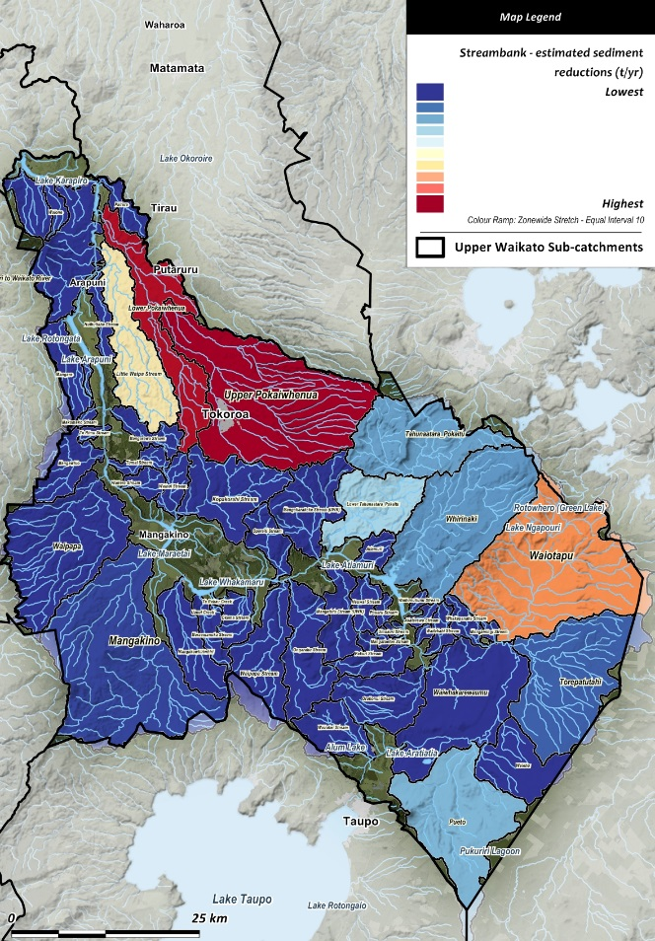
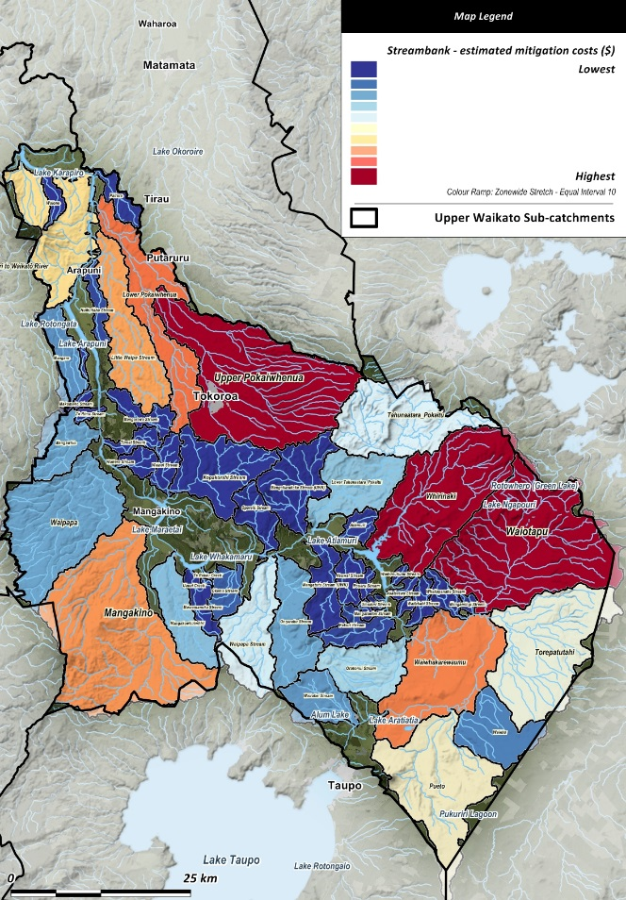
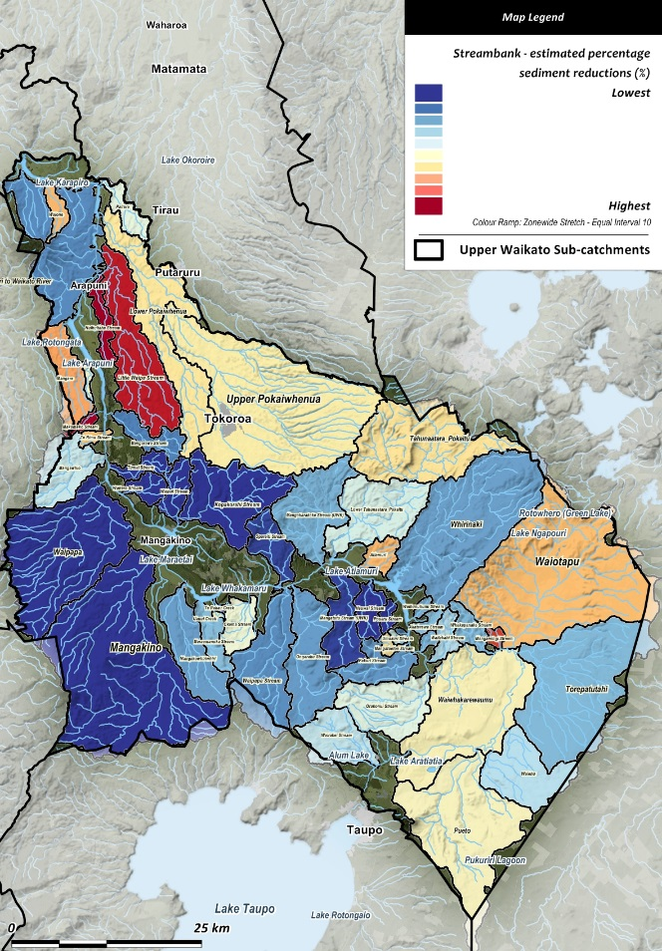
Upper Waikato sub-catchments - streambank sediment
Reductions (t/yr)
Costs ($)
Reductions (%)
BRISBANE, AUSTRALIA | 18 - 20 SEPTEMBER 2017
MANAGED BY

Slide 20
Application success
A range of model derived spatial data were combined in a meaningful way to inform the restoration strategy.
Provided a clear and realistic overview of relative sub-catchment land related issues, estimates of mitigation costs, and likely sediment reductions.
The visual and spatial outputs were well received by a wide ranging audience.
The approach was very flexible and could be updated in quick response to requested changes.
BRISBANE, AUSTRALIA | 18 - 20 SEPTEMBER 2017
MANAGED BY

Slide 21
Lessons learned
Science information from multiple models can be made accessible to a broad audience.
A spatial and visual approach assisted information uptake.
Compromises are required for the GIS based mitigations.
Science was essential but one of many consideration when prioritising sub-catchments for funding.
Iterative process and full involvement of “on-the-ground” land managers was an essential requirement for success.
BRISBANE, AUSTRALIA | 18 - 20 SEPTEMBER 2017
MANAGED BY

Slide 22
Acknowledgements
My Co-authors.
Technical Advisory Group members.
Waikato Regional Council and DairyNZ.
Restoration Strategy team at Envirostrat.
The INFFER team.
Landsystems Limited for funding my attendance.
Thank you
BRISBANE, AUSTRALIA | 18 - 20 SEPTEMBER 2017
MANAGED BY

