Slide 1
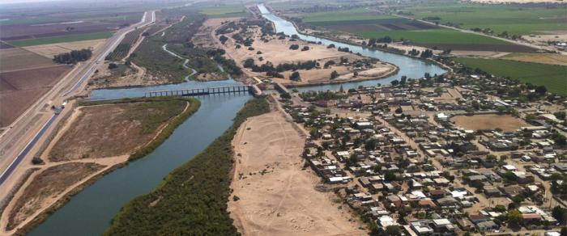
The social dimensions of Colorado River flow restoration: Insights for water policy at the U.S.-México border
Dr. Carlos A. de la Parra, El Colegio de la Frontera Norte, Tijuana, Baja California, México
Dr. Eloise Kendy, The Nature Conservancy, Helena, Montana, USA
BRISBANE, AUSTRALIA | 18 - 20 SEPTEMBER 2017
MANAGED BY
Notes:
Tuesday at 1:30 pm
This is the view from US south into MX.

Slide 2
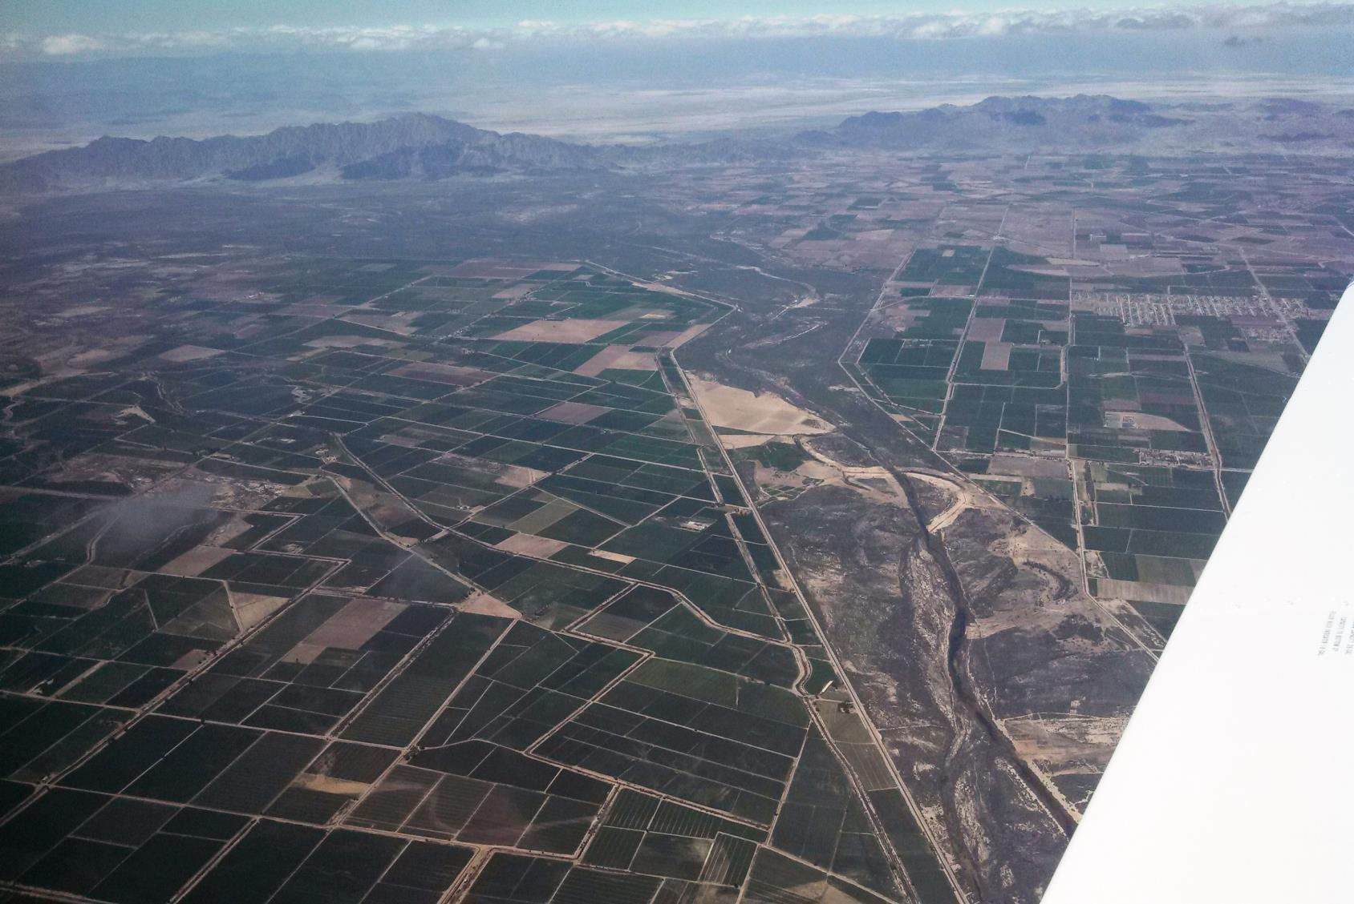
Notes:
This is the view further downstream. Most of the delta is now irrigated farmland. The last remaining piece of the “wild” delta is confined between levees and consists mostly of invasive tamarisk and bare ground.

Slide 3
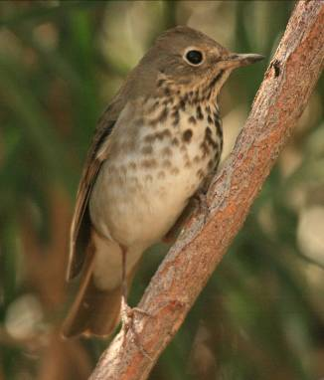
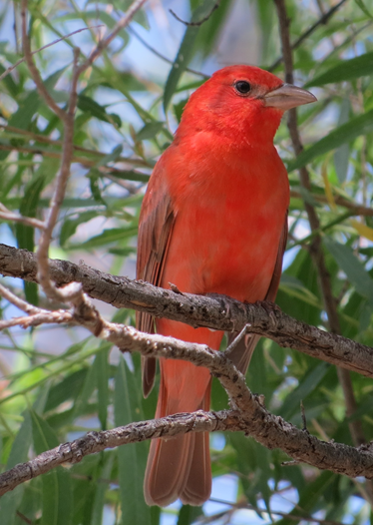
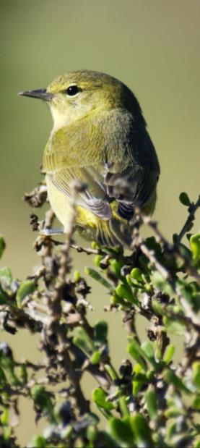
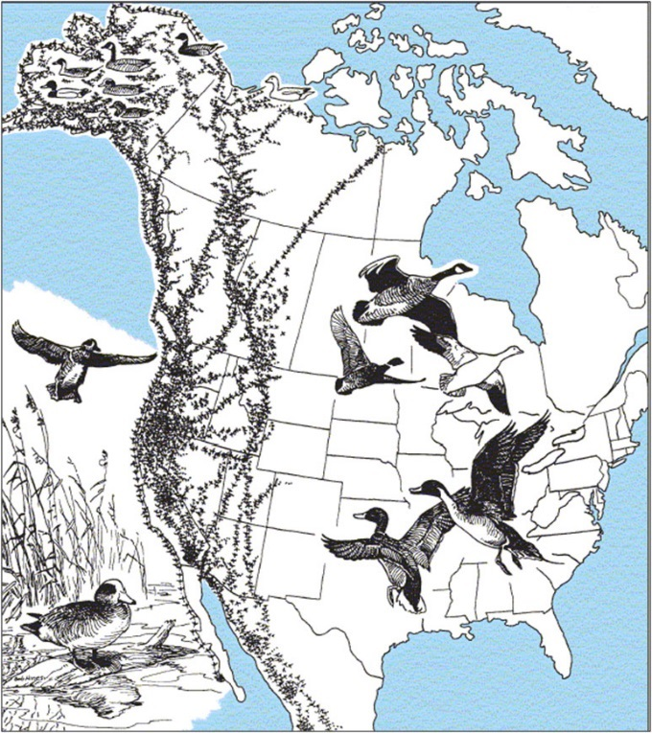
Minute 319
Pulse flow 130 Mm³ (105,000 acre-feet)
Base flows 65 Mm³ (53,000 acre-feet)
Primary objective: germinate native plants to restore riparian habitat
Swainson’s thrush, Osvel Hinijosa
Pacific-slope flycatcher, Osvel Hinojosa
Summer tanager, Peter Warren
Pacific Flyway
Notes:
Emulate the ecological functions of historical floods – scour old vegetation, deposit fresh sediment, germinate seeds, and maintain sufficient moisture for the seedling roots to reach the water table.

Slide 4
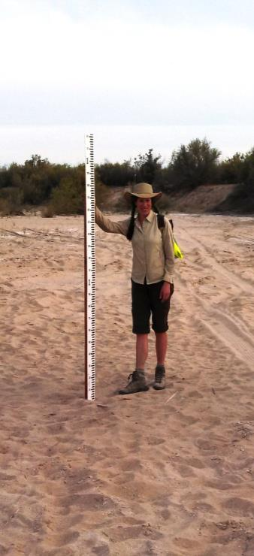
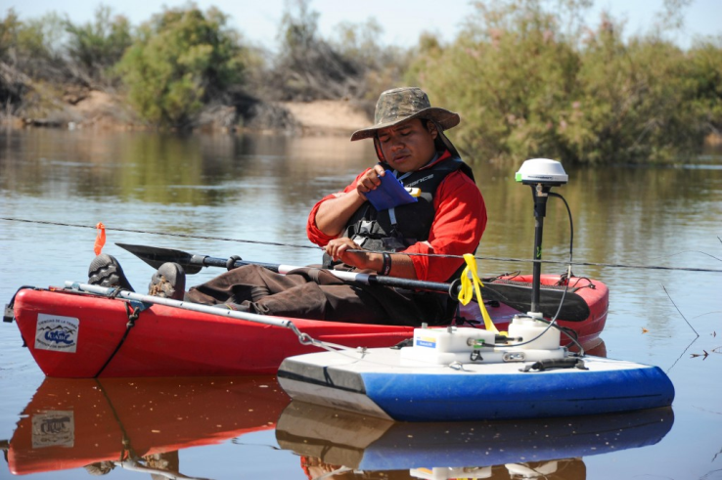
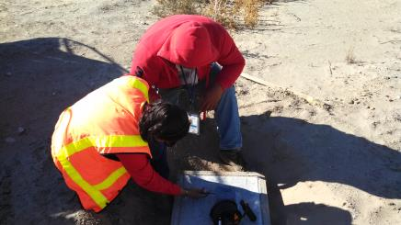
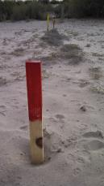
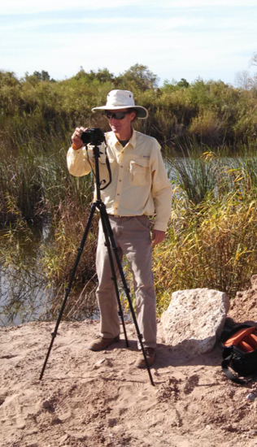
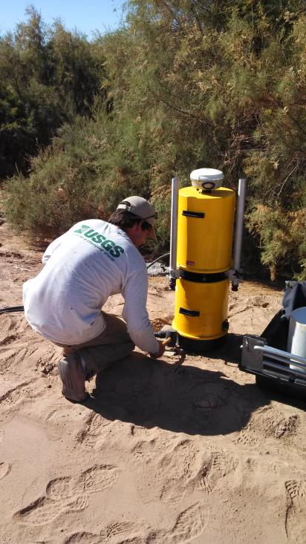
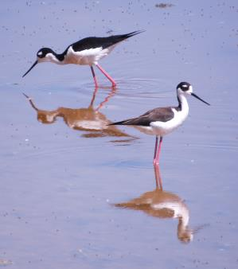
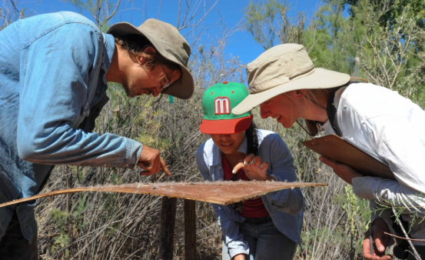
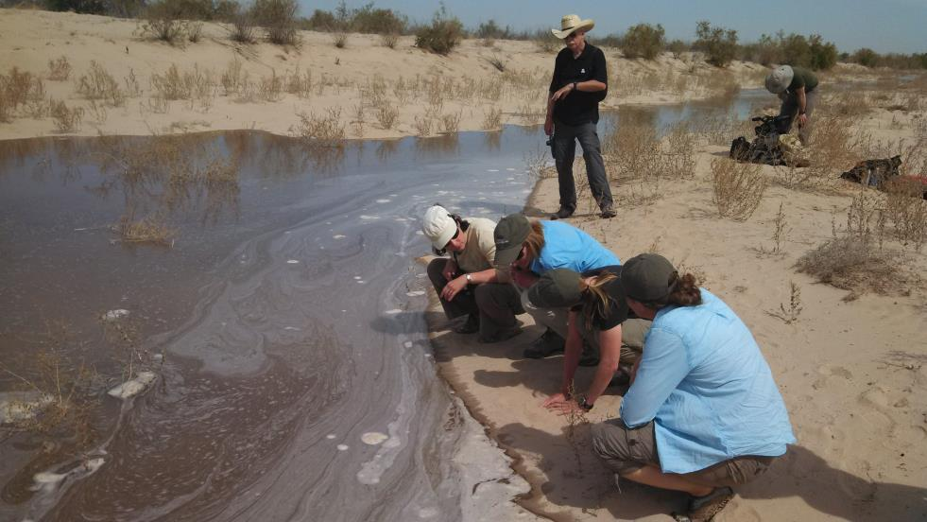
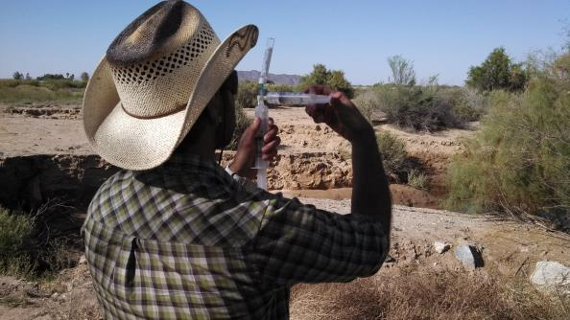
Notes:
Accordingly, the Minute funded extensive scientific monitoring of hydrologic and ecological responses to the pulse flow. But there were no plans to monitor the social responses.
Erick Lundgren with the U.S. Geological Survey and Emma Fajardo and Karen Schlatter (right) with the Sonoran Institute count cottonwood, willow and other seeds that have dispersed and fallen onto their sticky monitoring palate. Photo by Cheryl Zook/National Geographic
Graduate student Edgar Carrera patiently crosses the Colorado River to measure its rate of flow as it reclaims its channel in the delta. Photo by Cheryl Zook/National Geographic

Slide 5
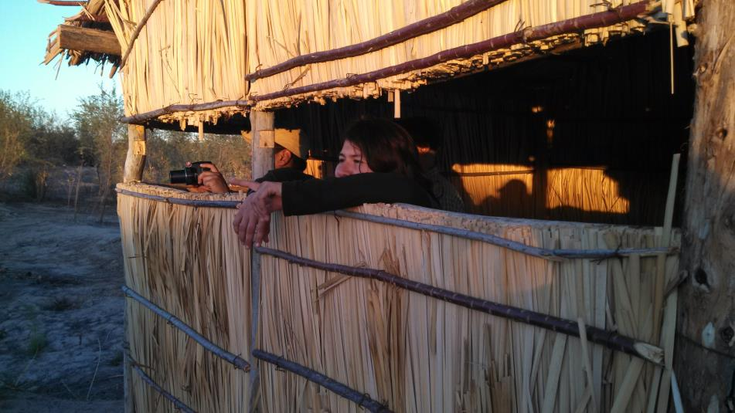
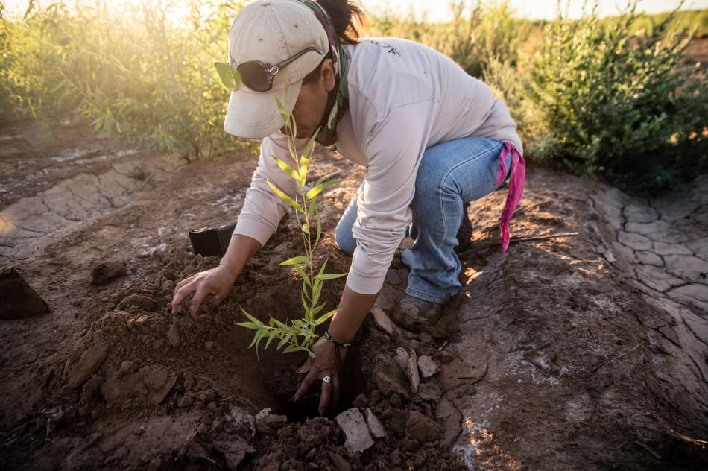
Non-environmental beneficiaries of Minute 319
Economic activity associated with ecological restoration
Birdwatching and ecotourism
Border security improvement due to invasive plant clearing
Reconnecting people to the river
Notes:
2007 study results. Carlos – who did this study? Did I translate the results OK?
Ecological restoration includes local employment and economic activity associated with building and staffing native plant nurseries, producing native plants and seeds for local and regional use, restoring habitat on the ground – clearing tamarisk, contouring land surfaces, building access roads, planting seedlings, irrigating vegetation, managing water deliveries, weeding, and more.

Slide 6
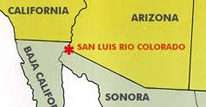
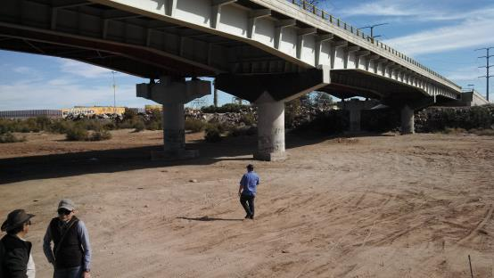
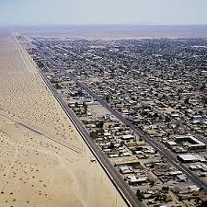
Opportunity: Understand social perceptions in San Lius Rio Colorado (population 160,000)
©E. Kendy, TNC 34 km / 22 mi below Morelos
Notes:
San Luis has very few amenities. People have to drive ___ km to the Gulf of California to go swimming.

Slide 7
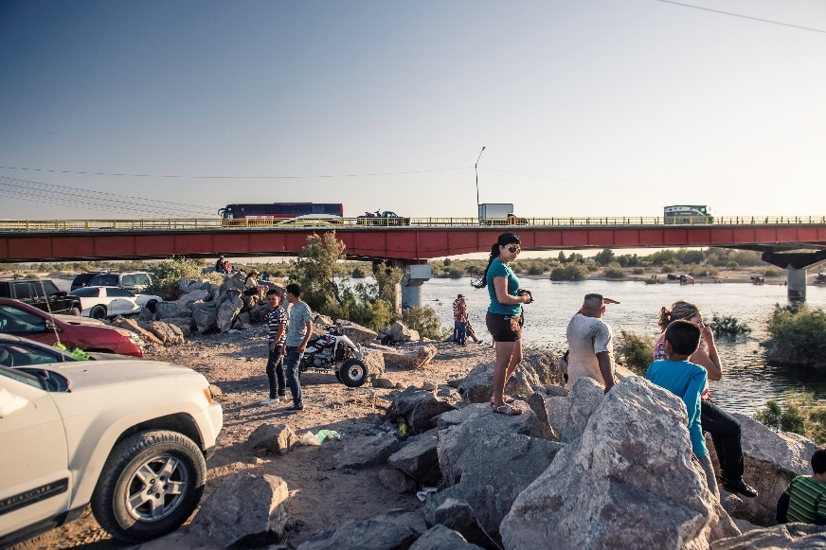
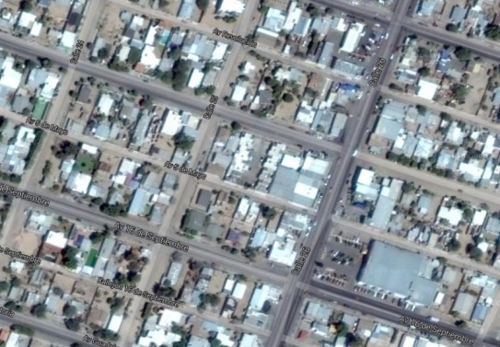
TOTAL SURVEYED: 701
101 along the riverbank
(April 7 – 19, 2014)
600 in their homes
(May 2014)
©Nick Hall, TNC
4% estimation error, 95% confidence level

Slide 8
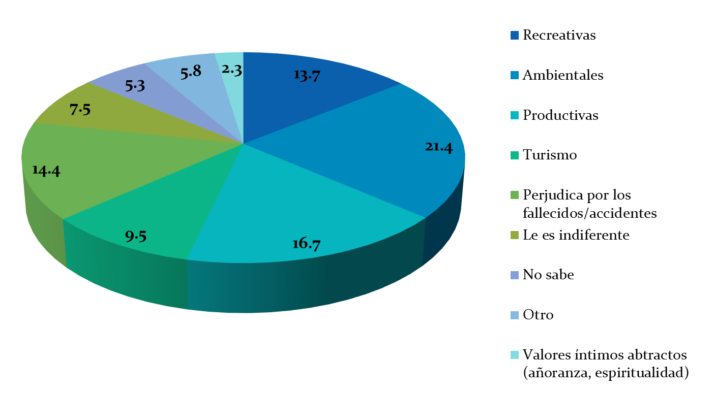
What does the river mean to the people?
Along the river
Recreation
Environment
Production
Tourism
Danger
Indifferent
Don’t know
Other
Abstract values
In the households
Notes:
Top 4 are recreation, envt, production, and tourism

Slide 9
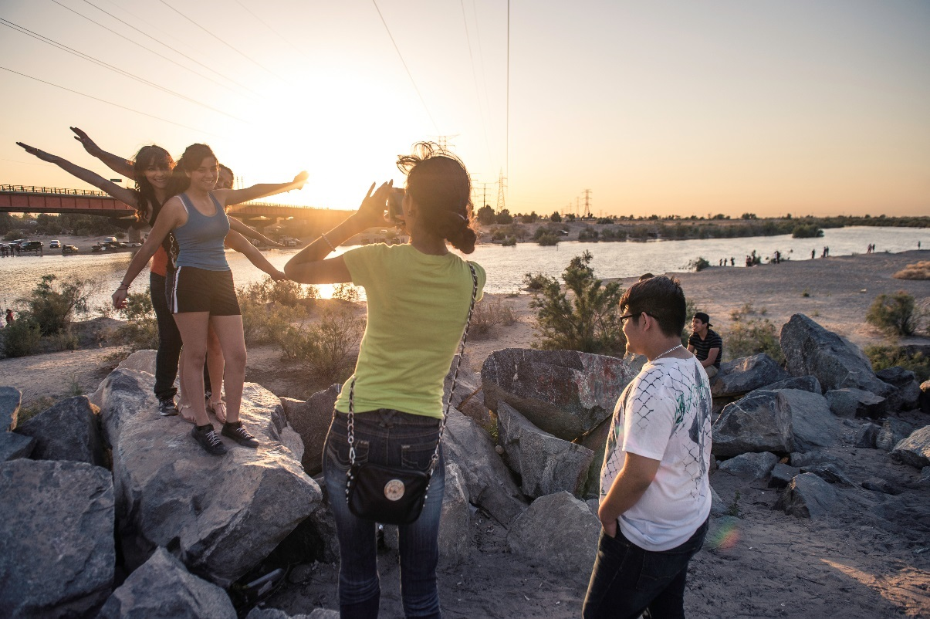
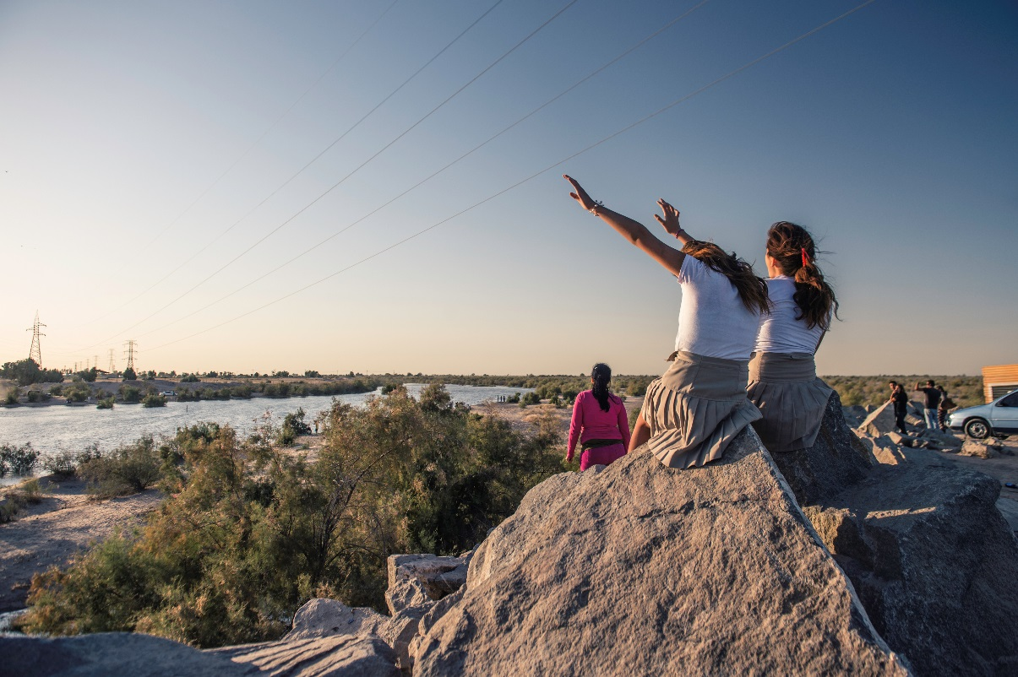
“Families can come and enjoy themselves”
“To conserve nature”… “A river without water isn’t a river”
“It’s filling up the aquifer”
“This helps the farmers because we’ve had a long drought”
“There will be work for the fishermen and the region’s ecology, which has been lost.”
“A tourist draw for San Luis”
© Nick Hall for TNC

Slide 10
How did you learn that the river had water?
Along the river
TV
Radio
Newspaper
Internet
Family, friends
Saw it
In the households
En los hogares
TV
Radio
Newspaper
Internet
Family, friends
Saw it
86.7% of the people in the households knew that the river had water in it.

Slide 11
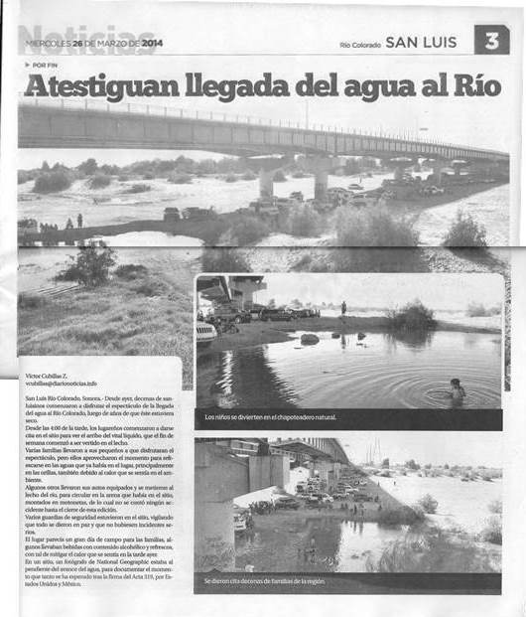
Notes:
Flowing! (They) w
itness the arrival of the water to the River. The local newspaper covered the pulse flow, both before and during.

Slide 12
Do you know why there’s water in the river?
1 Mexican government decision
2 US government decision
3 Problem with the dam
4 Binational agreement
5 Environmental groups’ success
6 Other
7 Don’t know
Along the river
Percent
En los hogares
In the households
1 2 3 4 5 6 7
Percent
1 2 3 4 5 6 7

Slide 13
What do you think about there being water in the river?
Along the river
En el río
In the households
En los hogares
Percent
Like Don’t like or indifferent
Percent
Like Don’t like or indifferent

Slide 14
Support according to socioeconomic status
What do you think about there being water in the river?
Along the river
En el río
Like
Don’t like or indifferent
In the households
En los hogares
Percent
High Medium Low
Socioeconomic condition
Percent
High Medium Low

Slide 15
Awareness according to socioeconomic condition
Did you know that the Colorado River had water for the past few weeks?
Percent
Yes
No
High Medium Low
Socioeconomic condition
Notes:
According to the logistic regression model, there is a statistically significant relationship between awareness and socioeconomic conditions. Specifically, 73% of awareness is determined by socioeconomic condition. Socioeconomic condition was determined by the surveyors based on the conditions of the respondents’ homes.

Slide 16
Logistic regression model
Support
Awareness
But how to mobilize that support?
Notes:
Tried to correlate awareness (did you know that there’s been water in the river for the past few weeks?) and sympathy (how do you feel about there being water in the river?) with age, gender, educational level, and socioeconomic condition.

Slide 17
Insights for Water Policy
Awareness support
Advocacy coalition of scientists, NGOs, and government agencies got Minute 319 passed without local awareness.
But lack of local awareness hindered implemenation.
Local support for the pulse flow contritubed to the successful negotiation of the successor Minute.
Local support is equally critical for successful implementation.
Local social perceptions have binational impacts.
Notes:
Generally, higher socioeconomic status means better access to information, which led to greater awareness of the pulse flow. But regardless of economic condition, whoever knew about the pulse flow supported it. People who were blindsided by it didn’t really appreciate it.
Advocacy coalition of scientists, government agencies, and NGOs got Minute 319 passed. But without local support in Mexico, its implementation was hindered. The survey revealed that most local people didn’t even realize that the pulse flow was part of Minute 319. Local water management agency staff turnover meant that commitments were not kept (baseflow deliveries, data reporting, science funding) and conflicting actions were pursued (Mexicali and Tijuana water allocations). We attribute these implementation problems to lack of awareness and therefore lack of support for the Minute. The negotiations excluded local communities. Had local people been informed from the onset and kept informed throughout the Minute, then they would have advocated strongly for compliance. Clearly, they want to see more water in the river. But to this day they are largely uninformed about the impacts of other local water management decisions on the ability to bring water back to the river.
Results of this survey showing across-the-board local support for the pulse flow contributed to successful negotiation for its successor. But just as importantly, the survey results suggest that local support is critical for successful implementation of the Minute.
Conclusion: local social perceptions have binational impacts.

Slide 18
Extra slides

Slide 19
Support according to gender
What do you think about there being water in the river?
¿Qué opina que haya llegado el agua al Río Colorado?
Along the river
En el río
Like
Don’t like or indifferent
Percent
In the households
En los hogares
Male Female
Percent
Male Female

Slide 20
Awareness according to educational level
¿Sabía usted que el río Colorado tuvo agua las últimas semanas?
Did you know that the Colorado River had water for the past few weeks?
Yes
No
Percent
1-6 7-9 10-12 13+ 0 No response
Years of education

Slide 21
What determines awareness?
Variables in the Equation
 |  | B | S.E. | Wald | df | Sig. | Exp(B)
Step 1ª | Socioeconomic condition | .730 | .146 | 25.057 | 1 | .000 | 2.075
 | Age group | .294 | .138 | 4.563 | 1 | .033 | 1.342
a. Variable(s) entered on step 1: Socioeconomic condition, age group
RESULT
Socioeconomic condition | El OR  al doble conforme la condición socioeconómica
Age group | El OR  aprox. 34% conforme aumenta el grupo de edad

Slide 22
What determines support?
Variables in the Equation
 |  | B | S.E. | Wald | df | Sig. | Exp(B)
Step 1ª | Awareness | 1.590 | .236 | 45.521 | 1 | .000 | 4.904
 | Gender | .653 | .202 | 10.388 | 1 | .001 | 1.921
 | Socioeconomic condition | -.217 | .110 | 3.936 | 1 | .047 | .805
a. Variable(s) entered on step 1: Awareness, gender, socioeconomic condition
RESULT
Awareness | If they knew that the river had water in the past few weeks, el OR  4.9 times compared to if they didn’t know
Gender | Men 1.9 times compared to women
Socioeconomic condition | El OR  aprox 19.5% increases with? Socioeconomic condition

Slide 23
Insights for Water Policy
Is local/social a part of binational?
The new governance of the river:
From 7 US States + Mexico > Advocacy coalition
Expanded river governance
Central government > state and local government
Water management, environment > social
It’s important to estimate the dividends of extending governance, the advocacy coalition before Minute 32x
Notes:
Generally, higher socioeconomic status means better access to information, which led to greater awareness of the pulse flow. But regardless of economic condition, whoever knew about the pulse flow supported it.

Slide 24
Support according to awareness
What do you think about there being water in the river?
En los hogares
In the households
Percent
Yes
No
I like it
Notes:
Logistic regression modeling confirms that knowing about the pulse flow is the single most important determinant of whether the respondent supports the pulse flow. The relationship is stronger than the relationship between socioeconomic status and awareness.

Slide 25
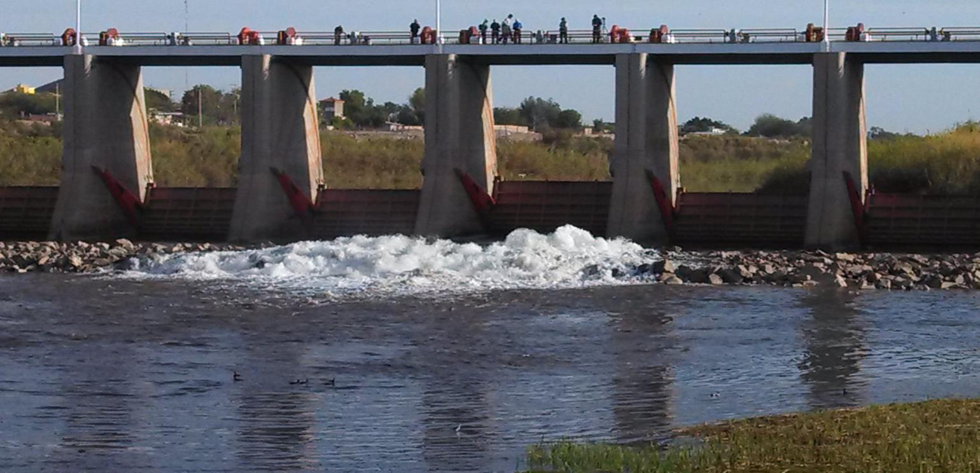
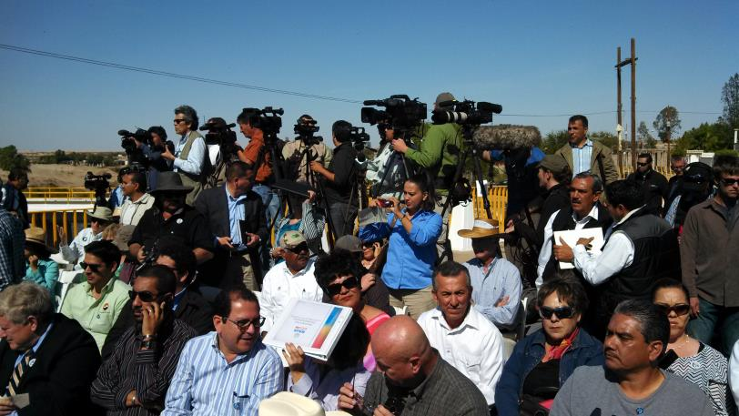
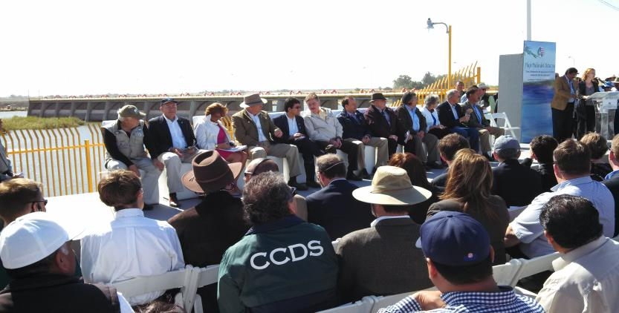
Notes:
The pulse flow was released, to great aplomb.
Gaston Luken Aguilar, ProNatura
Michael L. Connor serves as Deputy Secretary of the U.S. Department of the Interior (under Sally Jewell, Secretary)
Anne Castle, Assistant Secretary

