Slide 1



Effect of catchment disturbance on river health in two agricultural catchments in Sri Lanka.
J.M.C.K Jayawardhana¹, W.D.T.M Gunawardhana ¹, E.P.N Udayakumara¹, M. Westbrooke²
¹Department of Natural Resources, Faculty of Applied Sciences, Sabaragamuwa University of Sri Lanka
² Centre for Environmental Management, Faculty of Science and Technology, Federation University Australia, Office Y147/Y Building/Mt. Helen Campus, Ballarat, Australia
BRISBANE, AUSTRALIA | 18 - 20 SEPTEMBER 2017
MANAGED BY

Slide 2
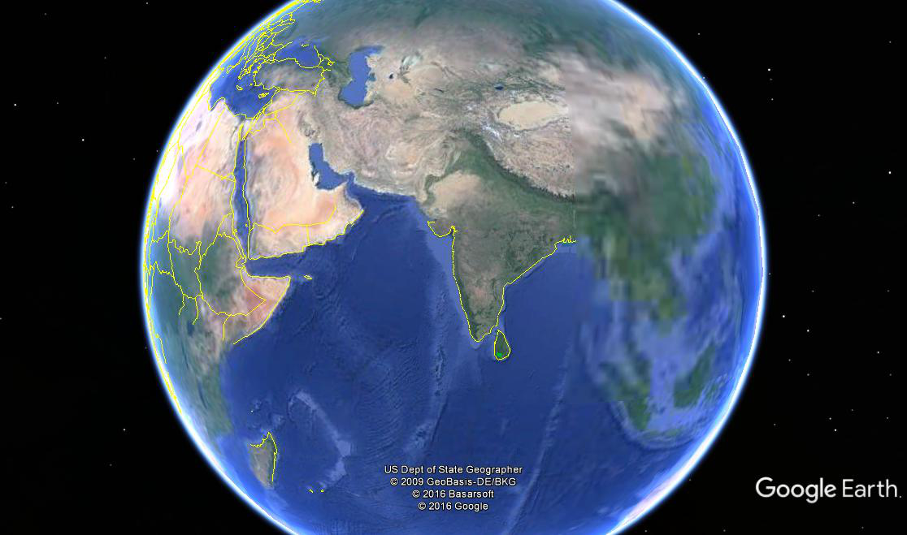
Sri Lanka
BRISBANE, AUSTRALIA | 18 - 20 SEPTEMBER 2017
MANAGED BY

Slide 3
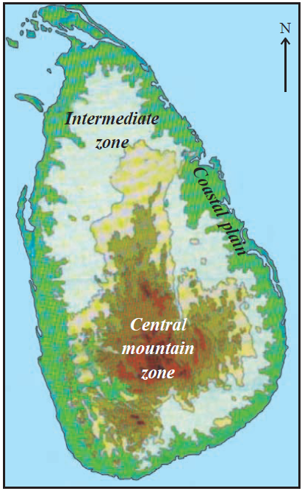
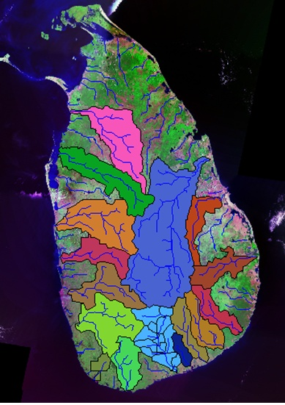
Topography of Sri Lanka
MANAGED BY
BRISBANE, AUSTRALIA | 18 - 20 SEPTEMBER 2017

Slide 4
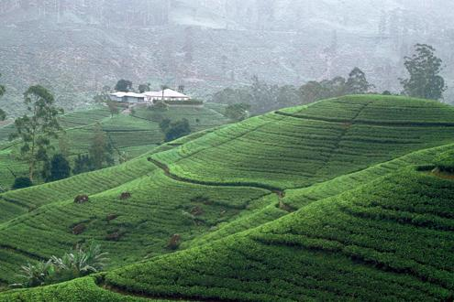
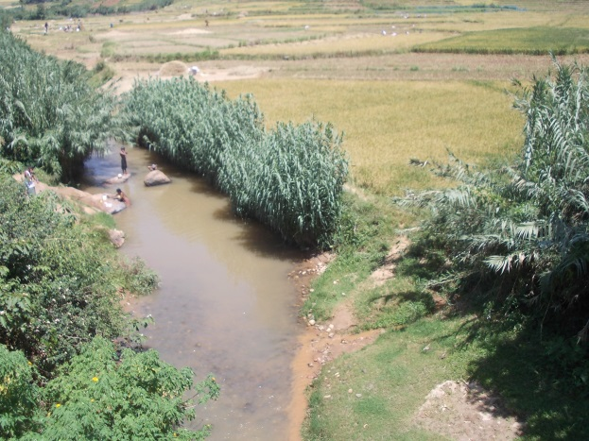
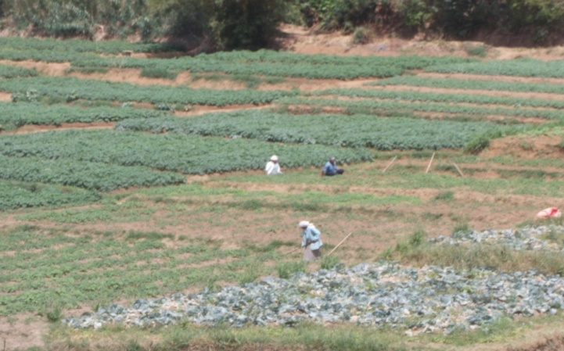
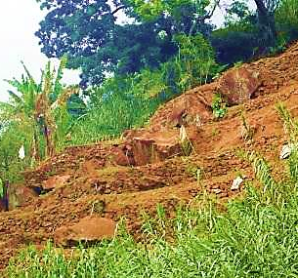
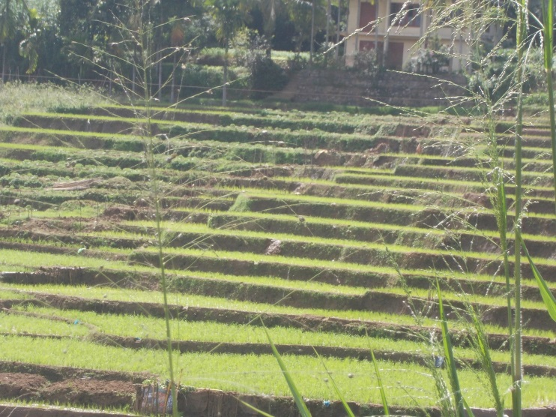
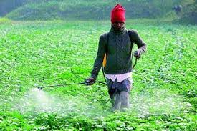
LAND USE OF UPPER CATCHMENTS
BRISBANE, AUSTRALIA | 18 - 20 SEPTEMBER 2017
MANAGED BY

Slide 5
Catchment impacts on rivers and tools of impact assessment……
Land cover and land use impact on river health?
Spatial scale?
(Aguiar et al., 2009; Richards et al., 1996; Marzin et al.,2013; Johnson et al., 2007)
Responses
River health
Physical Habitat quality
Riparian Quality Index (RQI)
Channel Quality Index (CQI)
Water Quality
pH, conductivity, Nitrate, Nitrite, Phosphate,
Ammonia, TDS, TSS
Biological Indicators
Species Richness
EPT taxa
%Chironomidae
BRISBANE, AUSTRALIA | 18 - 20 SEPTEMBER 2017
MANAGED BY

Slide 6
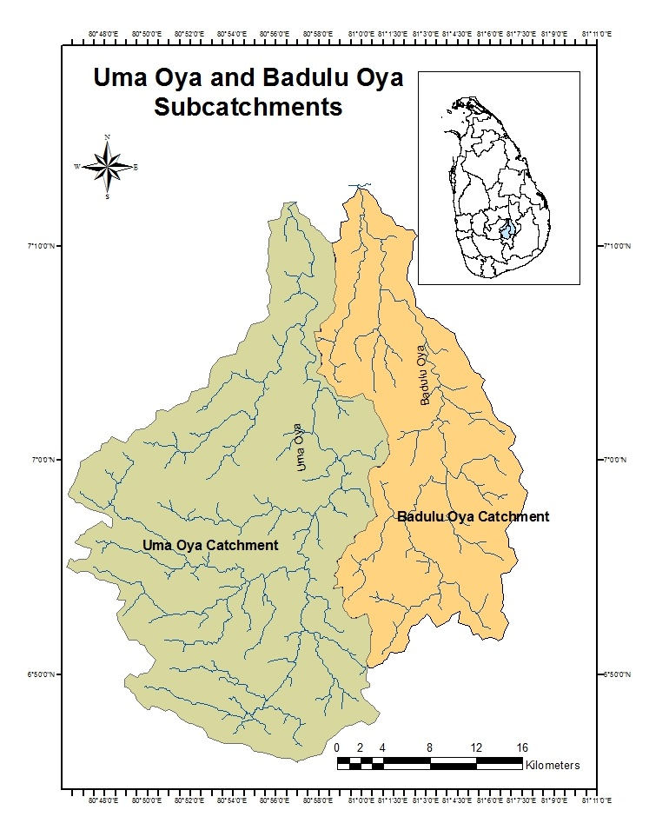
How the catchment landuse affect river health of Uma oya & Badulu oya?
Stream Health?
- Physical Habitat Quality
- Water Quality
- Bio indicators
At which spatial
scales?
BRISBANE, AUSTRALIA | 18 - 20 SEPTEMBER 2017
MANAGED BY

Slide 7
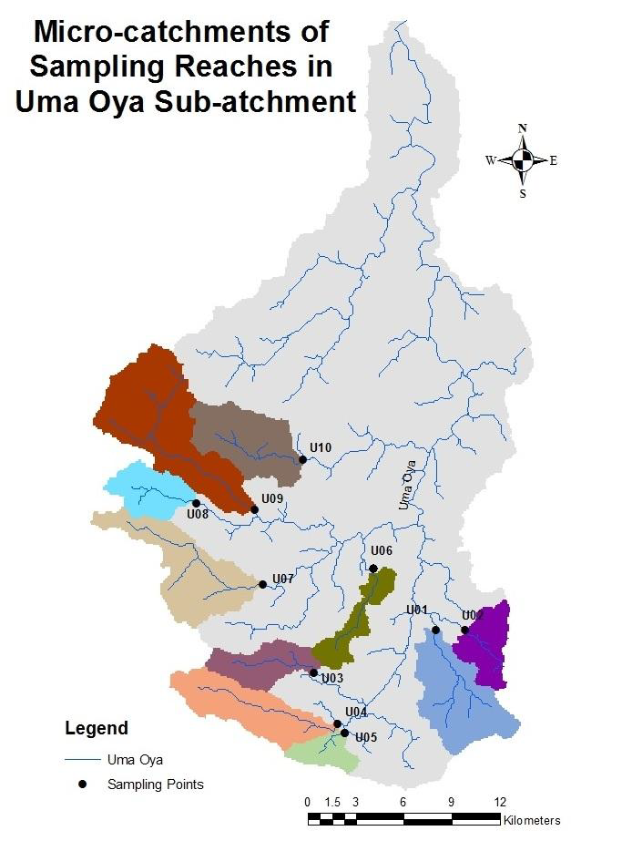
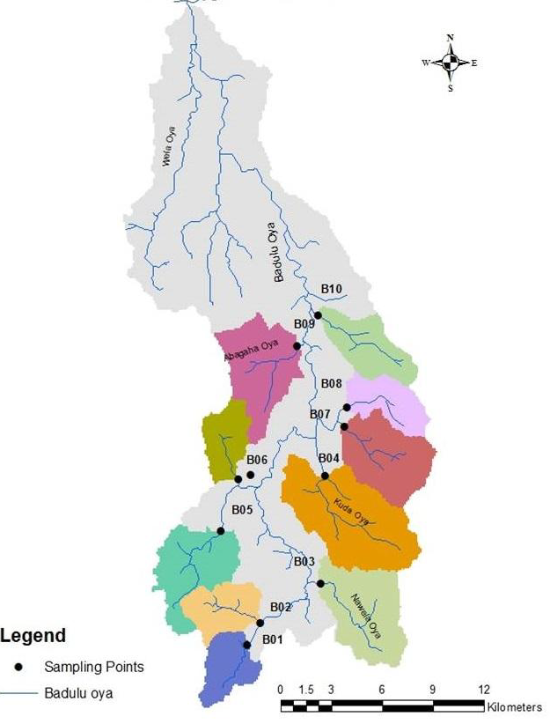
Micro-catchments of Badulu oya
BRISBANE, AUSTRALIA | 18 - 20 SEPTEMBER 2017
MANAGED BY

Slide 8
Land cover
quantification
Catchment scale
Riparian corridor
Site scale (200m
upstream)
300m
Catchment
Catchment
300m
Riparian corridor
Riparian corridor
200m
Quantification of land cover using ArcGIS 9.1
Sampling site
BRISBANE, AUSTRALIA | 18 - 20 SEPTEMBER 2017
MANAGED BY

Slide 9
Physical Habitat Quality Assessment
Riparian Quality Index (RQI)
Channel physical Habitat Quality Index (CQI)
[Rapid Bio Assessment Protocol for use in streams and wadeable rivers (Barbour et al., 1999)]
Riparian Quality Index (RQI) | Channel Physical Habitat Quality Index (CQI)
Riparian vegetation zone width % overhead canopy Riparian composition (% woody/ trees/ grass/ bare) Riparian continuity | % Cobble Velocity Embeddedness Bank/ Channel alteration Sediment deposition Riffle characteristics Condition of the stream (% Eroded) Bank vegetation
BRISBANE, AUSTRALIA | 18 - 20 SEPTEMBER 2017
MANAGED BY

Slide 10
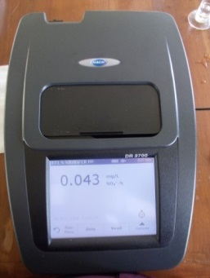
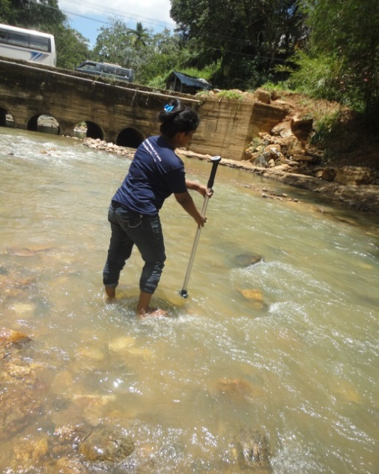
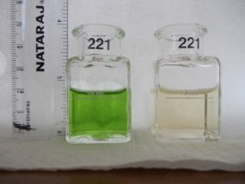
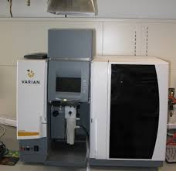
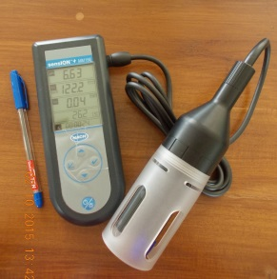
Water quality Analysis
On-site Measurements
Water flow Flow meter (Global Water FP111) Temperature pH Conductivity Multiparameter Salinity (HACH sensION MM156) TDS
Laboratory Measurements
Nitrate-N Spectrophotometer Nitrite-N (HACH DR2700) Ammonical-N Phosphate Sulphate DO BOD5
Winkler’s Method
Heavy Metals
Atomic Absorption
Spectrophotometer(AAS)
(Varian AA240FS)

Slide 11
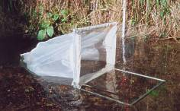
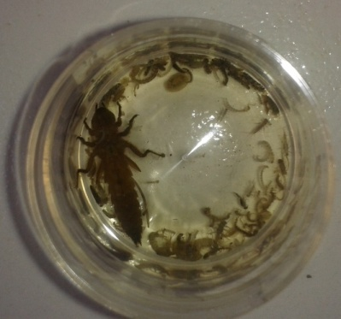
Biological parameters
Macroinvertebrates sampling and analysis
Macroinvertebrate
family richness
% EPT taxa
% Chironomidae
Shannon Diversity
Index (SDI)
BRISBANE, AUSTRALIA | 18 - 20 SEPTEMBER 2017
MANAGED BY

Slide 12
Analysis
Effect of catchment land cover on river physical, chemical and biological attributes
Principal Component analysis (PCA)
Pearson’s correlation test
BRISBANE, AUSTRALIA | 18 - 20 SEPTEMBER 2017
MANAGED BY

Slide 13
RESULTS
PCA analysis

Slide 14
Pearson’s correlation between % forest cover and water quality variables
 | Temp | pH | Cond | TS | TDS | TSS | BOD | NO₃-N | NO₂-N | NH₄-N | PO₄-P | SO4- | CQI | RQI
%Cat. Forest | -.370** | .018 | -.186** | -.219** | -.198** | -.149* | -.108 | -.057 | -.228** | -.172* | .006 | -.152* | .265** | .414**
%Rip. Forest | -.260** | .233** | -.061 | -.196** | -.071 | -.179** | -.071 | -.123 | -.235** | -.172* | -.002 | -.301** | .379** | .512**
%200m. Forest | -.056 | .360** | .027 | -.228** | .026 | -.255** | -.132* | -.242** | -.312** | -.189* | -.055 | -.338** | .815** | .822**
**. Correlation is significant at the 0.01 level
*. Correlation is significant at the 0.05 level
BRISBANE, AUSTRALIA | 18 - 20 SEPTEMBER 2017
MANAGED BY

Slide 15
% Forest cover

Slide 16
Pearson’s correlation between % forest cover (catchment/riparian corridor/site scale ) and biotic indices
 | Family Richnesss | % EPT | % Chironomidae | SDI
%Cat.forest | .207 | .150 | -.220 | -.006
% Riparian forest | .346** | .081 | -.112 | .192
% 200m forest | .607** | .061 | -.220 | .507**
BRISBANE, AUSTRALIA | 18 - 20 SEPTEMBER 2017
MANAGED BY

Slide 18
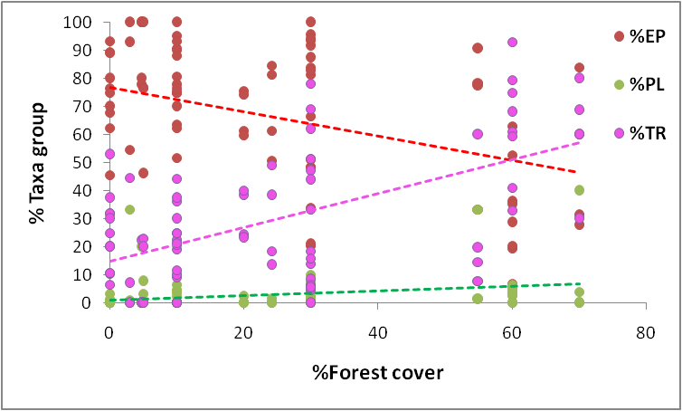
Why %EPT does not respond to forest cover change?

Slide 19
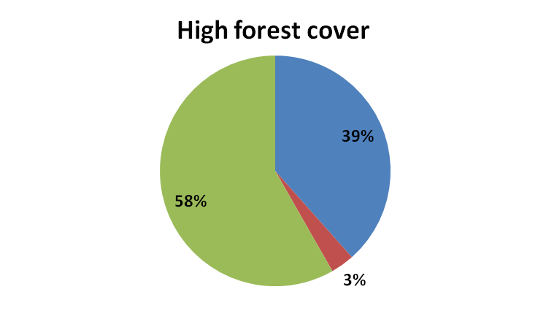
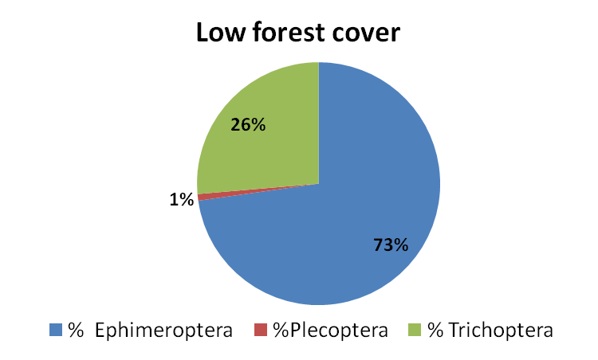
Why %EPT does not respond to forest cover change?

Slide 20
Conclusion
Catchment Forest cover at all spatial scales tested, improved the stream physical habitat quality, water quality and stream’s resilience to natural forces.
Riparian and site scale forest cover had a more pronounced impact on biological matrices.
The findings of the study suggest that land use impacts on river health could be better predicted when appropriate spatial arrangement of land cover is considered.
BRISBANE, AUSTRALIA | 18 - 20 SEPTEMBER 2017
MANAGED BY

Slide 21
Conclusion
River physical habitat quality indices & selected biological indices in conjunction with chemical water quality proved to be effective in assessing river health and possible tools for the future river health assessment programmes in Sri Lanka.
BRISBANE, AUSTRALIA | 18 - 20 SEPTEMBER 2017
MANAGED BY

Slide 22
Acknowledgement
National Research Council of Sri Lanka Grant No: 13-160
BRISBANE, AUSTRALIA | 18 - 20 SEPTEMBER 2017
MANAGED BY

Slide 23
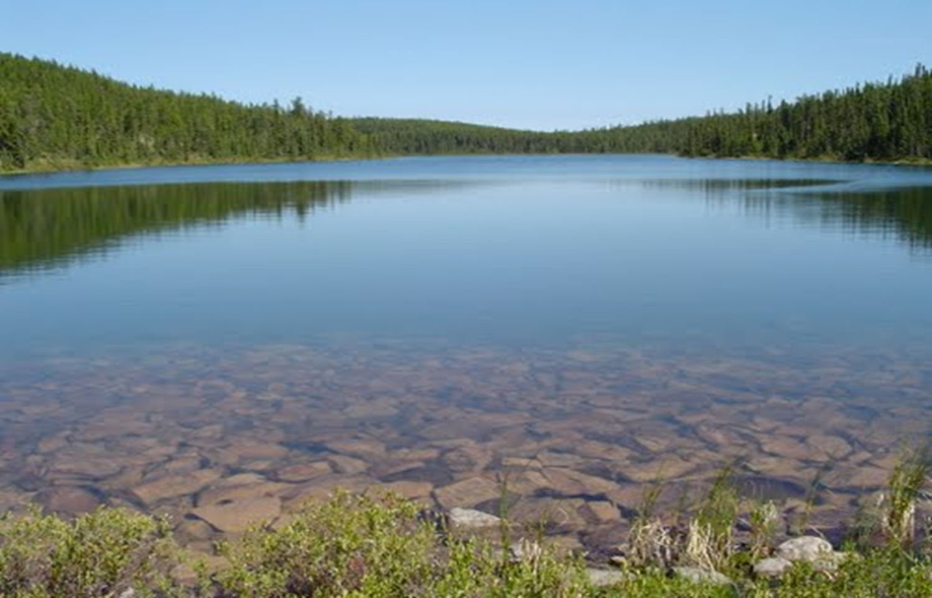

BRISBANE, AUSTRALIA | 18 - 20 SEPTEMBER 2017
MANAGED BY

