Slide 1


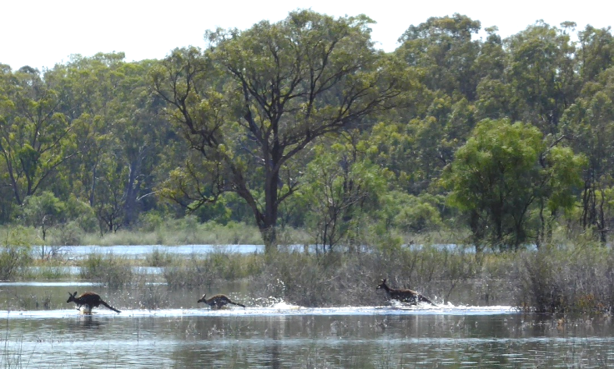

When the river runs high:
Two case studies illustrating how an environmental water program responds to a high river
Natalie Stalenberg, Program Manager Water for Nature
BRISBANE, AUSTRALIA | 18 - 20 SEPTEMBER 2017
MANAGED BY
Notes:
Acknowledge Traditional Owners past and present, and their continuing connection with the land we meet on today.
Acknowledge:
Anne Jensen
Ian Atkinson
I am not an ecologist or hydrologist.

Slide 2
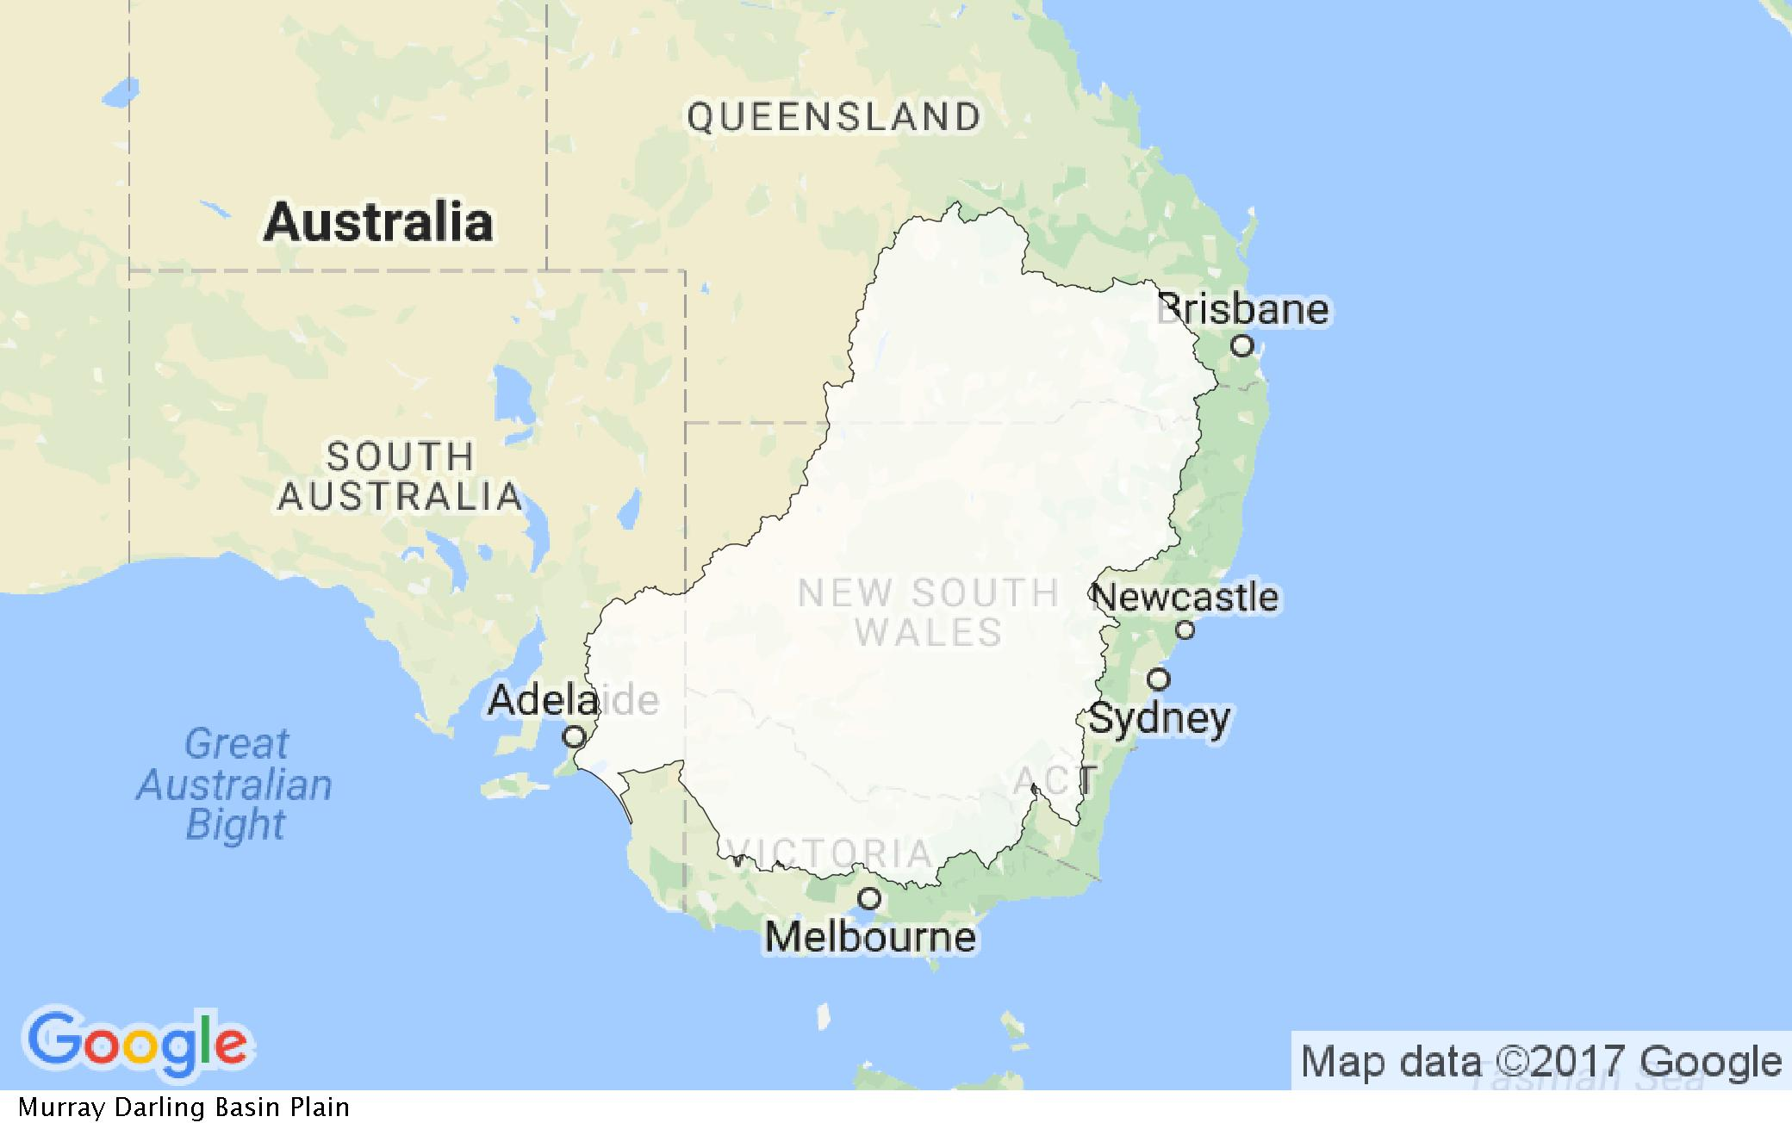
Murray-Darling Basin

Slide 3
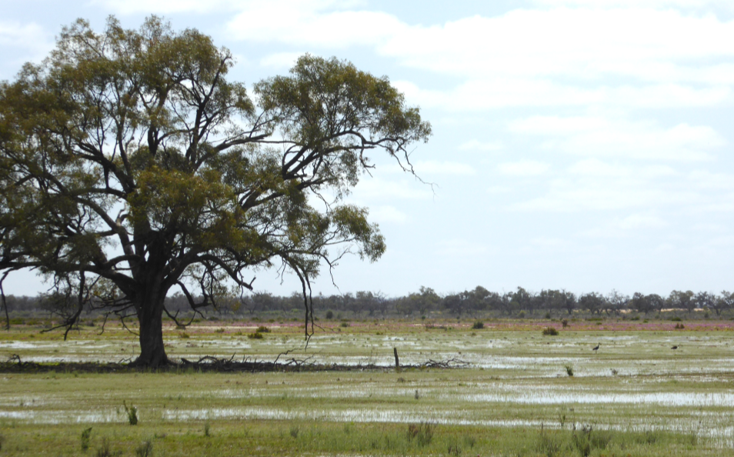
SA River Murray Valley – boasts 1100 wetlands and floodplains
Government agencies – focus on icon sites and big projects
Nature Foundation SA’s Water for Nature program:
Work with community & focus on smaller sites
Focus on mainly native vegetation i.e. Black box Eucalyptus largiflorens and river red gum Eucalyptus camaldulensis
Focuses on sustaining benefits of past natural floods
Partnership with Commonwealth Environmental Water Holder
We have delivered 6.22 Gigalitres since 2013
Notes:
Nature Foundation SA is an environmental charity – 36 years old - came about from a recognition that governments alone cannot save, protect or restore all of nature
The Water for Nature program adopts this same attitude
We work with local landholders on private land, but also some local and state government sites
Started in 2008 during the millennium drought when we purchased a small 34 ML of water to water trees at Hogwash Bend
Focus on native vegetation – river red gum, black box trees and lignum shrublands
2012 Agreement with Commonwealth Environmental Water Holder to deliver up to 10 Gigalitres per year of environmental water
Since 2013 we have delivered 6.22 Gigalitres – or 6.22 billion litres of environmental water to around 50 sites

Slide 4
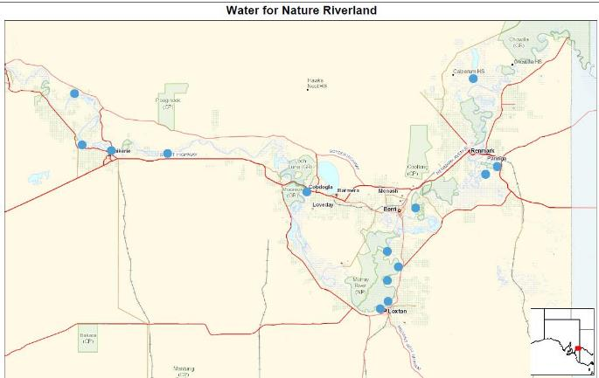
Notes:
Riverland sites
Locks and weirs along sections all along the river – that means the river cannot run its natural course or to its natural extent
Our sites rarely get wet unless you physically pump water to them
Each site has a water regime based on its objectives and the needs of those objectives – those objectives help in meeting the broader and higher level Murray Darling Basin Plan environmental objectives and the objectives of the CEWH

Slide 5
2016 High River
In June 2016, we planned to deliver up to 6,440 megalitres of water for use across 50 sites
River Murray of 95,000 ML at the SA border in December 2016.
Many watering sites naturally inundated, or access restricted due to water covering tracks and culverts
Total environmental water delivered 1,657.26 ML to 16 sites in the SA River Murray Valley.
Notes:
In June 2016 no one was expecting a flood and South Australian irrigators had a reduced water allocation. It wasn’t until September that we realised that we may end up with more rainfall in the Murray-Darling Basin than expected, and that good flows were expected for SA. Irrigators ended up with 100% allocation, and many of our lower wetlands were naturally inundated.
However, after much uncertainty it turned out to be a short lived high river – not really a flood in SA as it was in parts of the eastern states
It was a very dynamic time – and our program was required to adapt to it.
Our program when from 6.5 Gigalitres across 50 sites to 1.6 Gigalitres to 16 sites
This about adaptivity!

Slide 6
When there is a high river / flood - some wetlands and floodplains higher up in the river system may still miss out – we adopt a ‘natural cues’ approach and target these ones to get water to stressed native trees and wetlands.
River channel
Natural high river flows 80-90,000 Megalitres a day
Diagram adapted from Department Water, Land and Biodiversity Conservation (SA)
Notes:
Why water at all during a high river?
Take advantage of the flood to get water to higher sites
Prolong the benefits of the high river event
Extend the reach of the high river

Slide 7
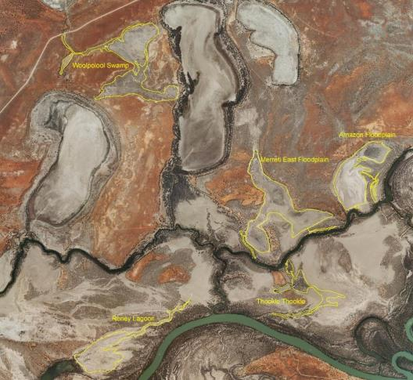


Case study 1: Woolpolool Swamp
An ephemeral swamp that had not flooded since the 1980s.
Objectives:
  water fringing black box trees,
  replenish the freshwater lens,
  flush accumulated salt and
  provide a temporary wetland for waterbirds and frogs.
Lake Meretti
Lake Woolpolool
Murray River
Notes:
Partner with Australian Landscape Trust
This site wasn’t initially on our list to water in 2016-17 but in adapting to the high river we realised we could get water to it and give it its first decent drink since the 1980s.
Note where the site is and the distance from the river (about 3km ) – naturally the swamp was connected to the lakes on either side.
We had approximately 2-3 weeks to mobilise the site
State and commonwealth government approvals
Assess the environmental objectives
Assess the logistics

Slide 8
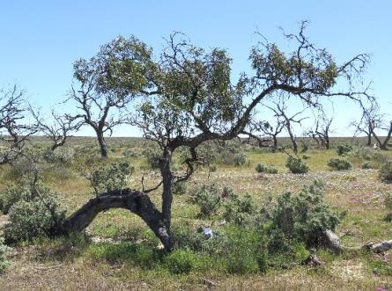
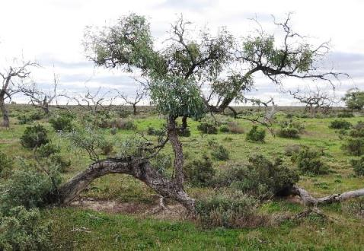
BEFORE AFTER
574.40 Megalitres environmental water delivered in December 2016
Result: Some trees showed good improvement others showed only increased flowering, while some trees showed no improvement at all. This has been a valuable exercise for assessing effect of e-watering on trees in different locations.
Notes:
Had planned to deliver 2000 ML to the site, but the high river cut off access to the water pump – so 574 ML
It’s a bit early to make a full assessment on the environmental response, given the trees have had a long time without water – but some trees have shown a response with extra foliage and flowering, and some trees have not shown any improvement. Maybe differences in where the trees are getting water from in terms of groundwater, or salinity
So this is a watch and see site

Slide 9


Case study 2: Lyrup Lagoon
Lyrup Lagoon lies at the upstream end of the Gurra Gurra wetlands complex, which covers 3000 ha of floodplain between Lyrup and Bookpurnong.
Objectives to water May-June 2017:
  Prolong benefits of high river
  Habitat for waterbirds
  Freshening of saline lagoon
  Prime site for spring/summer natural event or follow up watering
River Murray
Lyrup Lagoon
Notes:
This site did get water at the peak of the high river for a short period of time, the lagoon filled and then started to recede.
We wanted to prolong the benefits of that high river – or piggy back onto it to top up the lagoon.
Acting in partnership with Central Irrigation Trust, we use irrigation infrastructure to deliver Commonwealth environmental water to the site. The network of existing pipes is enabling us to deliver water to sites we wouldn’t normally be able to get to.
We watered Lyrup Lagoon in May-June 2017 to prime the lagoon for spring/summer natural event or follow up watering.

Slide 10
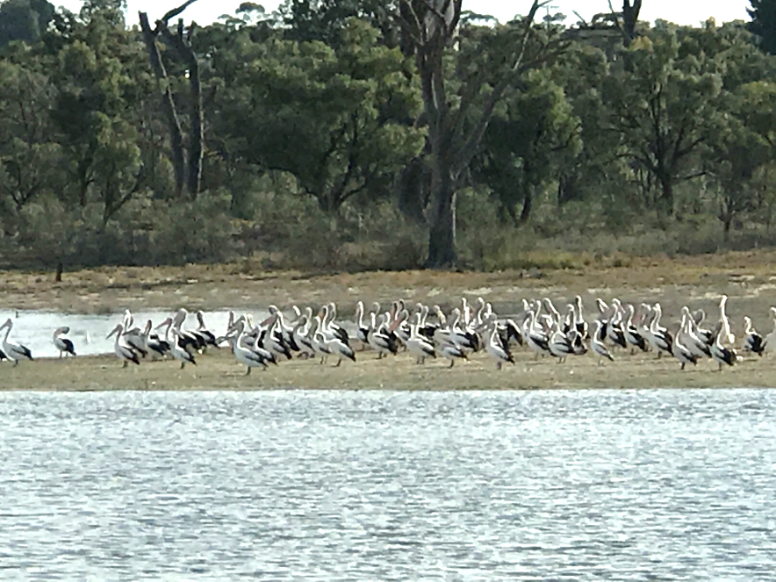
Results:
Salinity readings were taken by CIT staff at Lyrup Lagoon towards the end of the priming event. Readings show a significant freshening of the lagoon itself, with readings at Tortoise Crossing within normal range for this site.
Pumping ceased at 110 ML of the expected 150ML goal so as to prevent water covering a nearby culvert
Notes:
We ended up delivering 110 ML into the lagoon.
hundreds of waterbirds were observed at the lagoon during May and June. Including pelicans, grey teal, and welcome swallows.
Salinity readings:
Water flowing in at the outlet was 369 EC
200m south of outlet was 7,980 EC
Approximately half way to Tortoise crossing 8,890 EC
At Tortoise crossing 14,230 E
(Electrical conductivity – intensity of dissolved salts in the water)

Slide 11
Challenges
Predicting the extent, timing and duration of the high river and the impact on potential watering sites
Logistical issues:
  Landholder permission (public or private)
  Government approvals for new sites
  Heavy equipment
  River peaks and then retreats quickly
  Inundation of third-party roads etc
Monitoring watering events to prevent loss of access to locals

Slide 12
Solutions
Working with local community organisations and irrigators:
  Local knowledge & people networks
  Use existing infrastructure
Seeking technical advice from government
High rivers can provide opportunities to water higher and thirsty sites with good ecological benefits
Pays to develop a ‘library’ of watering sites for a dry, moderate, wet year
Notes:
Now have a draft five year environmental watering strategy – that Dr Anne Jense has helped us to develop.
This means that in future years as the river changes we can adapt to it a lot quicker and a lot easier by simply identifying which our sites we should water as conditions change. Much like a library of books, we can select which book we want take off the shelf. (not my analogy)

Slide 13





Partners/Sponsors
Thank you

