Slide 1





Assessing the impacts on water supply:
Modelling, economic analysis and community engagement to support a decision for variable environmental flows in Hawkesbury-Nepean River in Sydney
Dr Simon Fane
Judy Birrell
BRISBANE, AUSTRALIA | 18 - 20 SEPTEMBER 2017
MANAGED BY

Slide 2
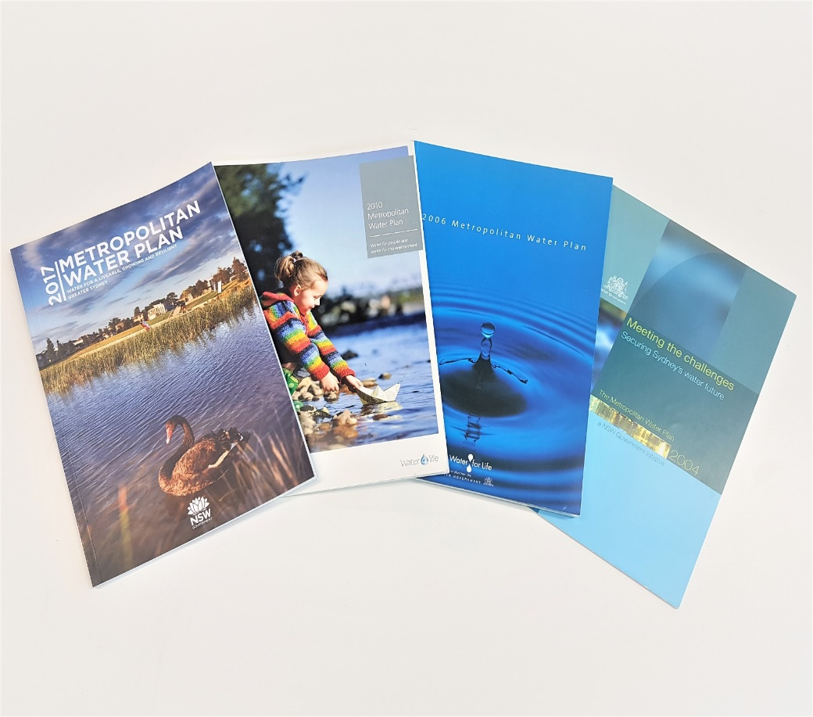
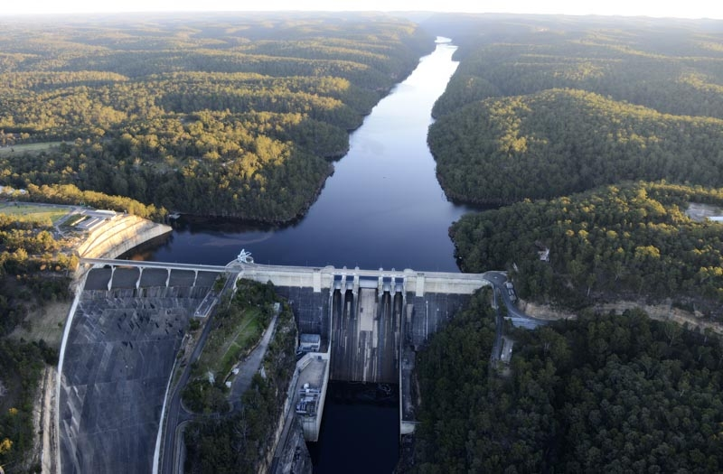
Metropolitan Water Plan - NSW Government plan to secure water for people and environment of Greater Sydney
2017 Plan - decision to introduce new variable e-flows from Warragamba Dam, which provides 80% of city’s supply
Decision supported by:
hydro-economic optimisation
benefit cost analysis
findings from community engagement
BRISBANE, AUSTRALIA | 18 - 20 SEPTEMBER 2017
MANAGED BY
Notes:
Background
The Metropolitan Water Plan is the NSW Government’s plan to ensure sufficient water to meet the needs of the people and environment of Greater Sydney.
Greater Sydney covers Sydney and Illawarra – currently 5M
MWP was first developed in 2004 and the recent 2017 Plan is the fourth iteration.
Previous MWPs have seen introduction of e-flows from all significant dams in supply system except the largest – Warragamba Dam which supplies over 80% of city’s supply
By 2009 variable e-flows were occurring at all dams expect Warragamba Dam.
The 2017 MWP includes a decision to release variable environmental flows (e-flows) from Warragamba Dam.
Because of significance of Warragamba Dam – e-flows decision needed to be supported by evidence of value of releasing flows.
Involve significant:
- hydro-economic analysis and optimisation to minimise costs of e-flows
- cost-benefit analysis
- community consultation

Slide 3
MetroNet Model – Generates Pareto Fronts
Reference Case
With E-flow
Feasible Solution Space
(Supply, PVs)
Feasible Solutions
True Pareto Front
Notes:
Objective Function
Minimise Total PVs (of Opex & Capex)
Maximise supply (yield)
Constraints set for security and reliability
Shows the soln space of all possible portfolios
Shows the true pareto front of all those portfolios that are optional ie least cost for a given demand
Shows what the model finds – a very close approximation of optional but not optimal
Shows a different condition or scenario in this case with eflows
Key point is that each point on a curve is a full portfolio optimised for that demand
Results for:
Reference case
Warragamba e-flows – 90/10
Warragamba FSL at current level & reduced by 5m & 12m
At the same time

Slide 4
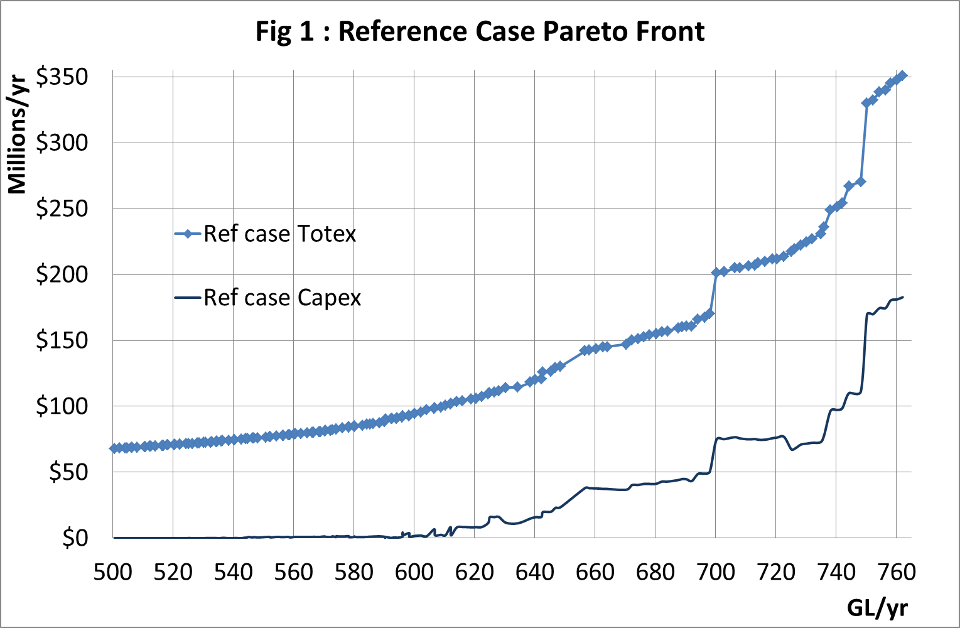
Hydro-economic optimisation
BRISBANE, AUSTRALIA | 18 - 20 SEPTEMBER 2017
MANAGED BY

Slide 5
Hydro-economic optimisation
- Each point is full portfolio with different options & triggers
BRISBANE, AUSTRALIA | 18 - 20 SEPTEMBER 2017
MANAGED BY

Slide 6
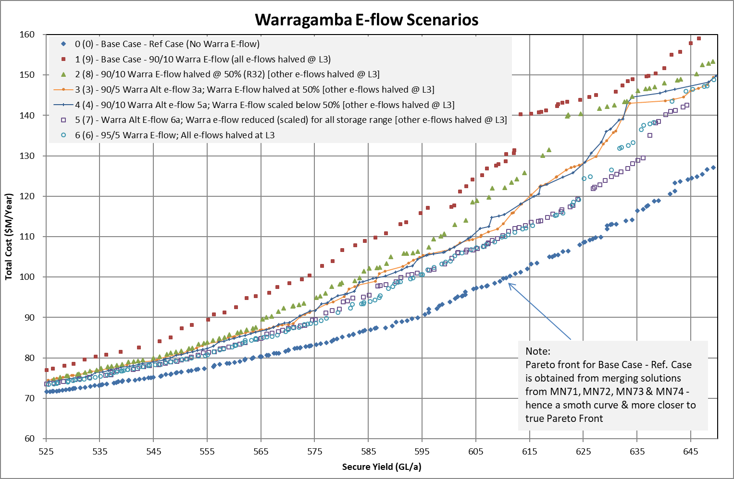
Fig 2:
BRISBANE, AUSTRALIA | 18 - 20 SEPTEMBER 2017
MANAGED BY

Slide 7
Fig 2:
Current demand
$14 M/yr in at 595GL/a
$8 M/yr in at 575GL/a
$5 M/yr in at 555GL/a
BRISBANE, AUSTRALIA | 18 - 20 SEPTEMBER 2017
MANAGED BY

Slide 8
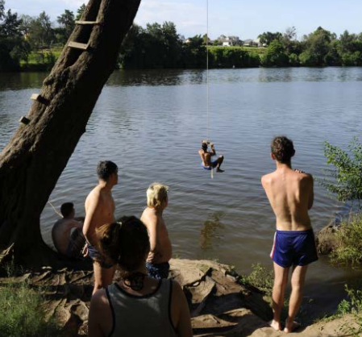
2017 Metropolitan Water Plan
Benefits
Benefits of e-flows were determined by:
  River length suitable for swimming
  Time to catch a bass
  River length free of floating weeds
Costs
Costs of e-flows were determined by:
  Infrastructure
  Reduction in water supply yield
  Increased time in water restrictions
  Increased likelihood of a new drought supply
  Bringing forward the need for supply augmentation
  Increased frequency of and longer run times of the Sydney Desal Plant
  Increased frequency and duration of Shoalhaven transfers
Future demand was uncertain – chose a range of demand forecasts including low, business as usual and high demand
BRISBANE, AUSTRALIA | 18 - 20 SEPTEMBER 2017
MANAGED BY

Slide 9
Benefit cost analysis
Benefits from willingness-to-pay ($ value) for river health
Minus the costs of e-flow infrastructure
Metronet optimisation, then minimised the supply-side costs across demand range:
  Lost yield
  Water restrictions - willingness-to-pay ($ value)
  Emergency drought supplies
  Supply augmentation
  Running desal plant or Shoalhaven transfers, including GHG
  Preferred e-flow option had a BCR of 4.0 for BAU demand forecast used in Metro Water Plan
BRISBANE, AUSTRALIA | 18 - 20 SEPTEMBER 2017
MANAGED BY

Slide 10

2017 MWP - community engagement and social research
Activities included:
deliberative-style community workshops
futures forum
sentiment monitor surveys and online focus groups
stakeholder workshops, briefings and targeted meetings
socio-economic research
BRISBANE, AUSTRALIA | 18 - 20 SEPTEMBER 2017
MANAGED BY
Notes:
Alongside the modelling, economic and other technical studies, we also undertook a number of engagement activities with the community and stakeholders to better understand their views and preferences around Warragamba e-flows and river health more generally. The engagement on the e-flows was one aspect of a broader engagement strategy around the Metropolitan Water Plan for greater Sydney.
Our engagement activities were spread across a range of platforms including deliberative style community workshops – where we provided the community with information on a range of water related issues and then sought their input into key decisions to be made as part of the MWP, sentiment monitor surveys to track the community’s views on water security and river health issues and a futures forum where we asked the community for their vision for water in Sydney in 50 years time.
These activities were complemented by socio economic research in the form of a travel cost survey at popular river sites to quantify the value that river users placed on a healthy river, and a choice modelling study to quantify how much the community was willing to pay to maintain or improve river health in the Hawkesbury-Nepean River. We also undertook targeted stakeholder engagement with river users and local community groups.
This engagement served to increase awareness of: e-flows and river health in the lower Hawkesbury-Nepean River area; e-flows in the broader context of the NSW Government’s approach to river management; and the relationship between Warragamba e-flows and water security as part of the development of the Metropolitan Water Plan.

Slide 11
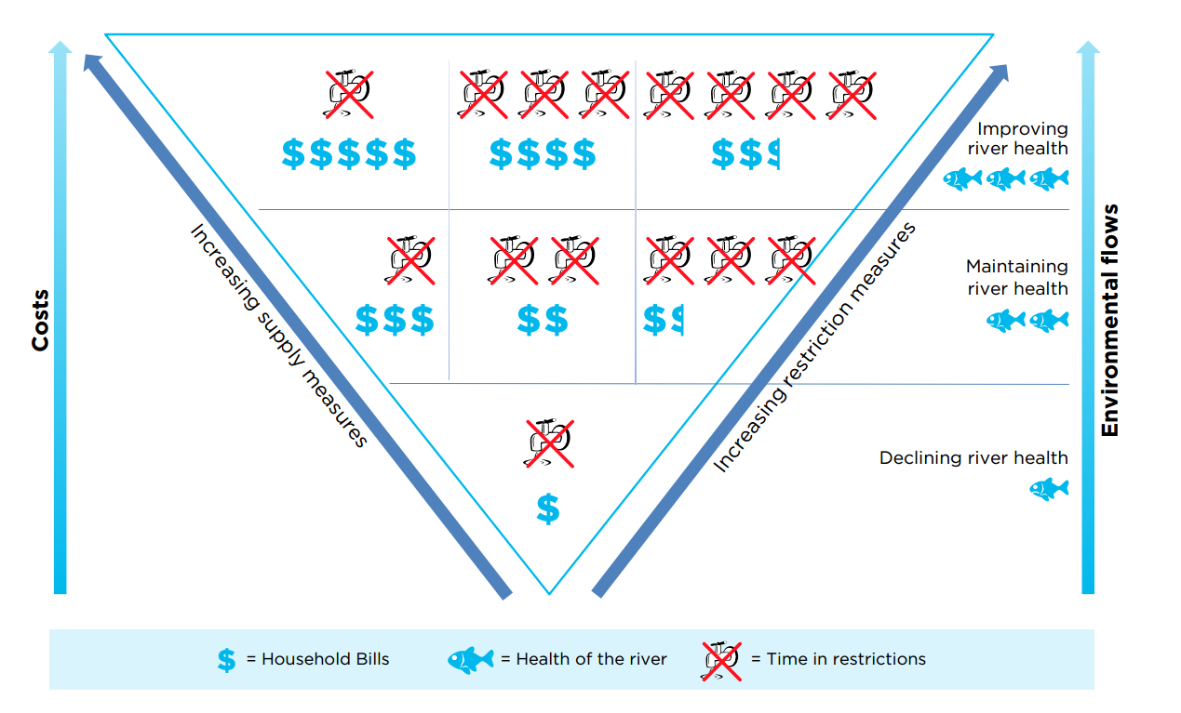
Community engagement: Trade off between River Health, Bills and Water Restrictions
SD
BRISBANE, AUSTRALIA | 18 - 20 SEPTEMBER 2017
MANAGED BY
Notes:
I’d like to give you an example of one of the activities we undertook during our last series of workshops with the community.
At this workshop – which we ran in seven different regions of greater Sydney – we asked the community to be water planners for the night. They had to consider the inherent trade offs between long term water security for the region, the use of water restrictions to manage demand, the health of the Hawkesbury-Nepean River and cost impacts on their water bills.
Workshop participants were asked to consider an example scenario as shown in the diagram where the release of e-flows from Warragamba Dam impacts the amount of water available for drinking water supply, which could mean more frequent water restrictions (to reduce demand) or it may increase the likelihood of an increased use of supply measures (to mitigate water security issues), resulting in higher water bills.
Participants were encouraged to think about the level of river health they viewed as acceptable, while contemplating the required supply and demand balance to achieve that particular level of river health.
So – if you look at the top right hand corner of the triangle – this would be where you would get the highest level of river health, but would effectively pay for it through more severe water restrictions, and some additional costs on your water bills.
Conversely in the top right corner, you will still get a high level of river health, but would pay for it through the need to bring on new supply measures, rather than more stringent water restrictions.
Each of the segments in the diagram requires a trade off between river health, restrictions and additional costs on water bills.

Slide 12
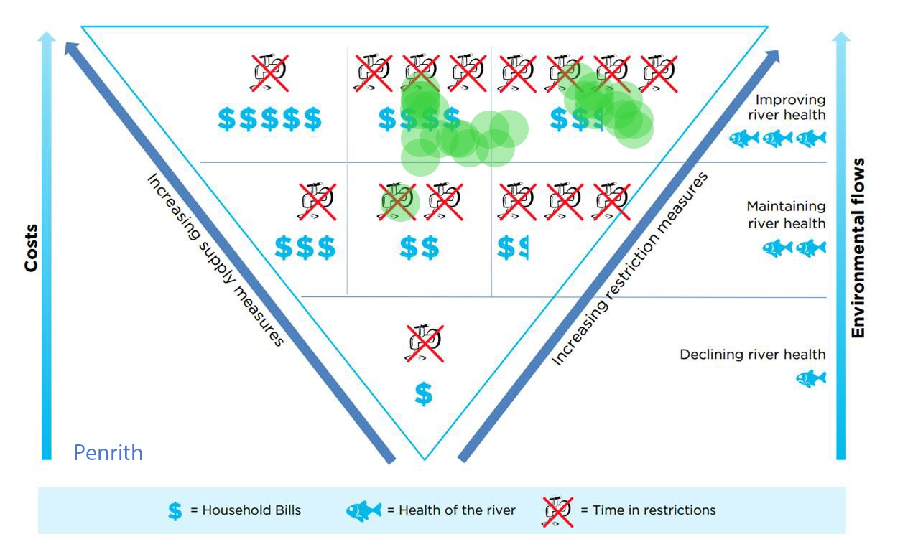
Results: Penrith next to the river
SD
BRISBANE, AUSTRALIA | 18 - 20 SEPTEMBER 2017
MANAGED BY
Notes:
We asked each workshop participant to place a green sticky dot on the segment that they felt best represented their preference for managing the inherent trade offs between water supply, river health, water restrictions and bill impacts.
This shows the results from the Penrith workshop.
Penrith is an inland city on the fringe of the Sydney basin. It is located on the Hawkesbury-Nepean River XX (ASK HELEN) km downstream from Warragamba Dam. The river is used for boating, swimming and fishing and the river banks are popular with local residents for recreation and relaxation. The river is a highly valued community asset.
As you can see, the Penrith workshop participants showed strong support for improving the health of the river even if this means higher household bills and increasing the time spent in restrictions. Participants showed a preference to trade off e-flows for time in restrictions in preference to increasing water supplies with higher bill impacts.

Slide 13
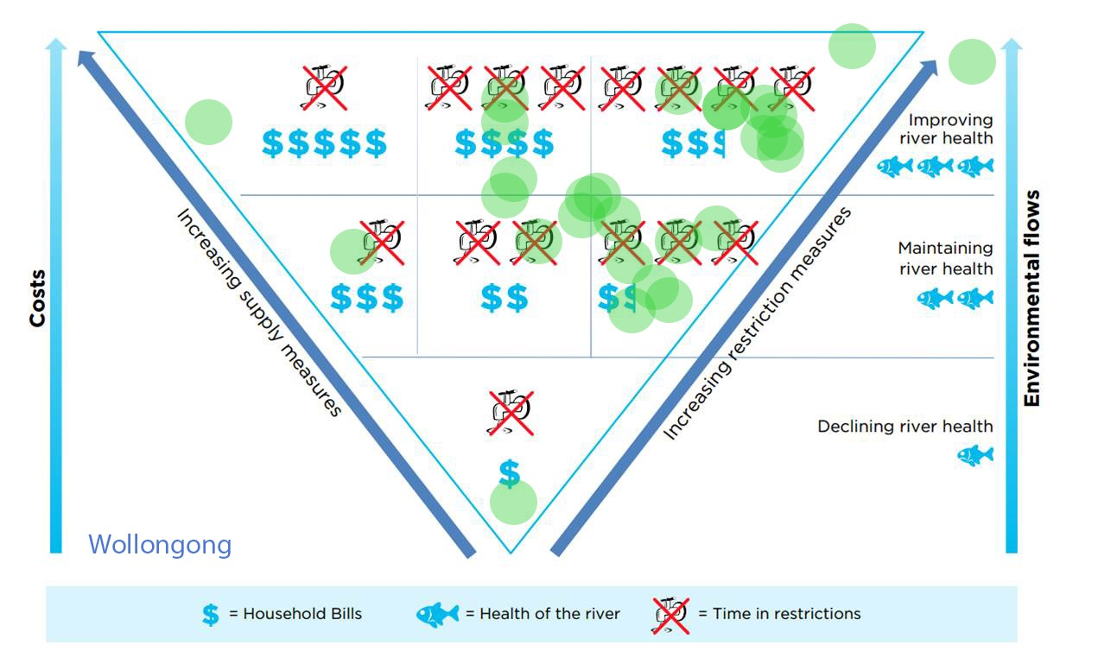
Results: Wollongong far from river
SD
BRISBANE, AUSTRALIA | 18 - 20 SEPTEMBER 2017
MANAGED BY
Notes:
As a comparison, workshop participants in Wollongong – which is located on the coast south of the Sydney metropolitan area and with very little association with the Hawkesbury-Nepean catchment.
Not as strong a support for improving river health, however the majority of participants wanted to see river health at least maintained, while others were keen to see an improvement. Again a majority were ok with an increase in water bills but preferred to ‘pay’ for e-flows through more time in restrictions rather than increasing supply.

Slide 14
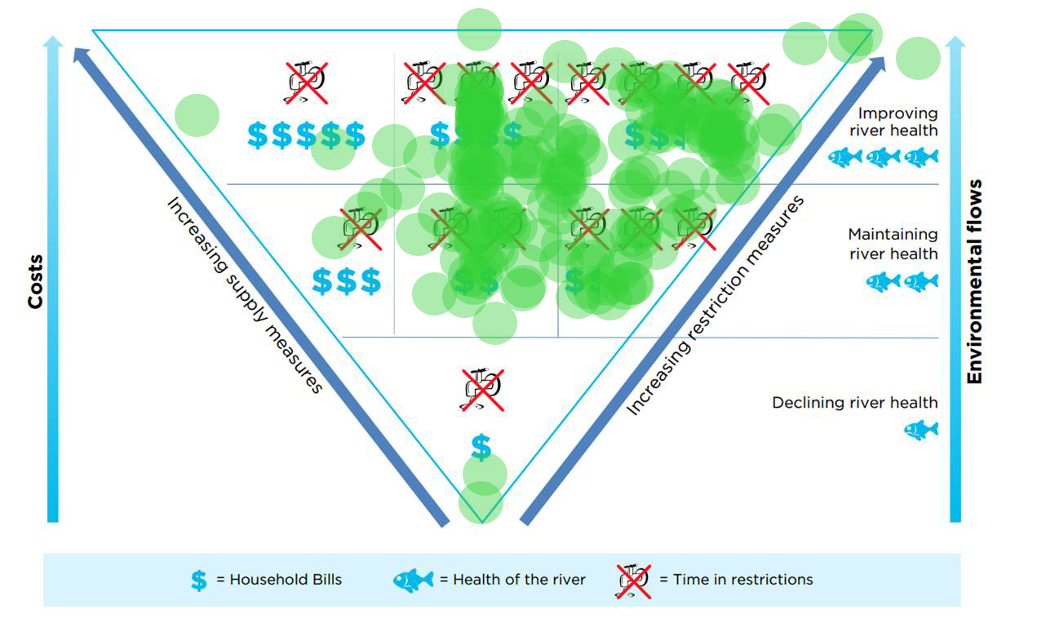
Results: all 7 locations
BRISBANE, AUSTRALIA | 18 - 20 SEPTEMBER 2017
MANAGED BY
Notes:
The results from all 7 locations throughout the region showed that participants strongly supported the introduction of an e-flow from Warragamba Dam, specifically: 60 per cent of participants supported e-flows at volumes sufficient to improve river health and 39 per cent of participants supported e-flows at volumes sufficient to maintain river health.
Findings in relation to specific ‘trade-offs’ indicated that participants supported the introduction of e-flows from Warragamba Dam even if it meant higher household bills and/or more time in water restrictions.
These results were consistent with the findings from other engagement and social research activities.
The key finding of the willingness to pay study was that 90 per cent of households were willing to pay higher household bills for river health improvements.
The travel cost survey of river users confirmed the river’s importance to the community (particularly to local users), its many recreational uses, and its contribution to societal wellbeing more broadly.
The annual sentiment monitor surveys also showed consistent support for protecting the health of the Hawkesbury-Nepean River, with the majority of respondents indicating its importance to them. Specifically, e-flows as a measure to improve river health received strong support over the past three annual sentiment monitor surveys.
The engagement results were presented alongside the results of our modelling and economic studies – and provided a robust evidence base for government decision making. Work is now underway to introduce variable e-flows from Warragamba Dam including infrastructure changes, refining the final rules and putting in place pre and post release monitoring programs.

Slide 15
Conclusions
Model identified optimal solutions that minimised ‘cost’/ impact of e-flows on supply system
Allowed comparison of many e-flows options across wide demand range – BCA can account for uncertainty and revised forecasts
Provided insight into how the supply system would need to adapt over time with e-flows
Benefit cost analysis with all costs and key +/- externalities was positive for preferred option
Engagement highlighted trade-offs between supply, social costs & river condition – findings showed strong support for introducing e-flows to maintain/ improve Hawkesbury-Nepean River
BRISBANE, AUSTRALIA | 18 - 20 SEPTEMBER 2017
MANAGED BY

