Slide 1
WOMEN IN RIVER SCHOOL:
WOMEN INFORMAL EDUCATION FOR SUSTAINABLE RIVER DEVELOPMENT
Sari Darmasiwi¹, Surani Hasanati²,
Niken Nur Widyakusuma³
¹Faculty of Biology, Universitas Gadjah Mada, INDONESIA
²Faculty of Geography, Universitas Gadjah Mada, INDONESIA
³Faculty of Pharmacy, Universitas Gadjah Mada, INDONESIA
BRISBANE, AUSTRALIA | 18 - 20 SEPTEMBER 2017
MANAGED BY

Slide 2
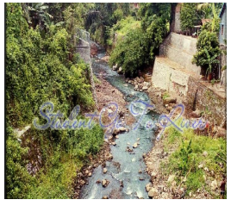
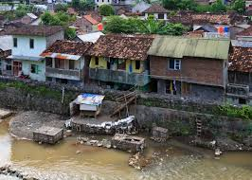
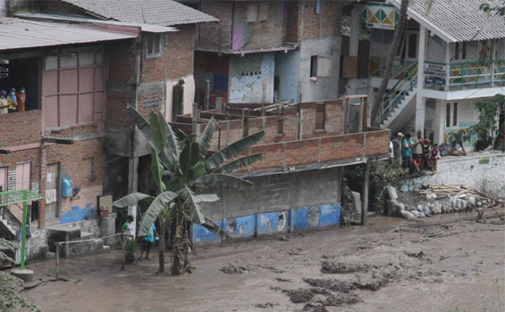
PROGRAM BACKGROUNDS
Code River, Yogyakarta plays vital role in Yogyakarta water source
Many people come from low socio-economic status live in Code river fringe
Most of them are jobless and low-educated people. Thus, their knowledge on environment and health are still limited
It may create more problem for the RIVER ENVIRONMENT e.g. poverty, river slum
Need education stimulation for the river community
Woman community targetted :“RAISING WOMAN COMMUNITY AWARENES” as trigger for bigger change!
Srikandi Sungai Indonesia or so-called-“Women in River” movement tried to make informal educational program named Indonesian Women in River School

Slide 3
BACKGROUND POLICY
Implementation of Education for Sustainable Development (ESD) : combining the three pillars of ESD (health, environment, economy creative) with Sustainable Development Goals (SDGs)
Three Ends Ministry of Women Empowerment Indonesia:
End Violence Against Women and Children
End Human Trafficking
End Barriers To Economic Justice

Slide 4
OBJECTIVES
To implement ESD in Indonesia, by targeting women who live in river fringe of Code River, Yogyakarta by giving them educational skills “women in river school” related with health knowledge

Slide 5
METHOD
TRAINING OF TRAINER :
WOMEN CREATION IN KAMPONG
Transferring knowledge about how to recycle waste, how to make traditional herbal drink, and fermented drink.

Slide 6
RESULTS
Educational skills were participatory driven by the community
It opened insights for the women community in Code River fringe about the importance of environment and health knowledge as well as driven creative ideas for the community to make economic and ecological sustainability for river ecosystem

Slide 7
ENVIRONMENT
Ecobrick

Slide 8
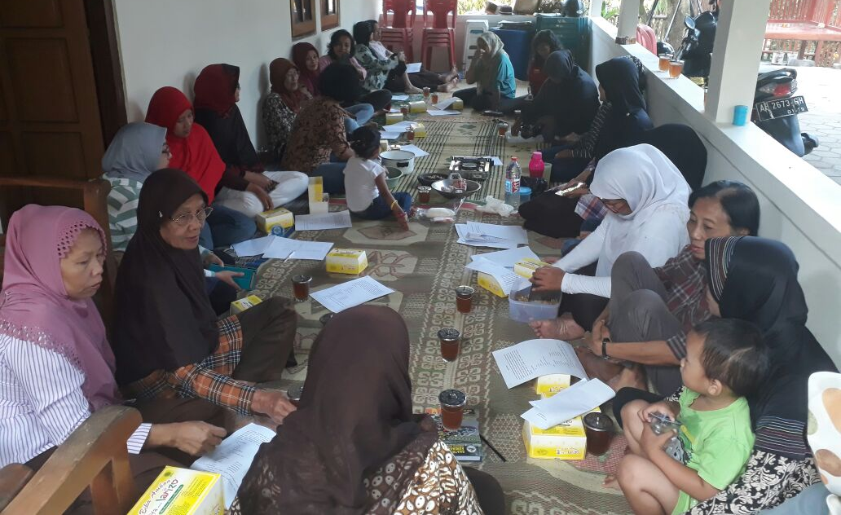
HEALTH
Making
Herbal drink

Slide 9
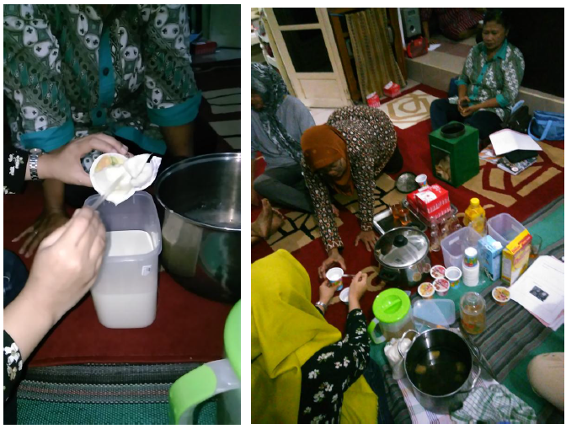
ECONOMY CREATIVE
Making
Fermented drink (yoghurt)

Slide 11
CONCLUSION
Indonesian Women in River School is embracing the world policy with ESD and SDGs as well as HeForShe Campaign
Indonesian Women in River School also embraces the national policy that is Three Ends Policy

Slide 12
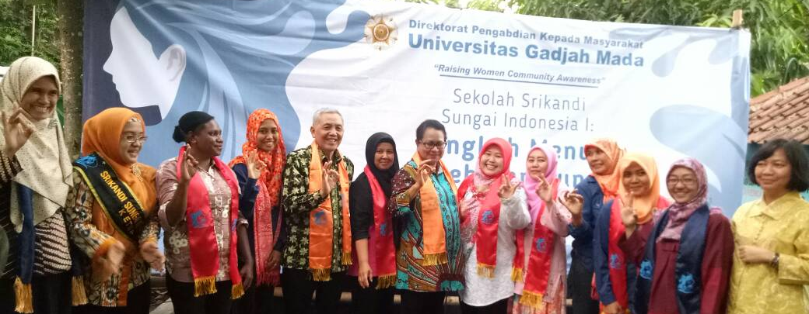
THANKS TO :
Faculty of Biology, Pharmacy and Geography Universitas Gadjah Mada, Yogyakarta, INDONESIA
Indonesian Ministry of Woman Empowerment and Child Protection
Srikandi Sungai Indonesia (Indonesian Woman in River)
Women's and Community Empowerment Bodies, Yogyakarta, INDONESIA

