Slide 1
ASSESSMENT OF ENVIRONMENTAL FLOWS FOR THE TAPI RIVER BASIN, INDIA
P. V. Timbadiya, Ph.D.
Assistant Professor in Water Resources Engineering
Department of Civil Engineering
S. V. National Institute of Technology – Surat, Gujarat, India
BRISBANE, AUSTRALIA | 18 - 20 SEPTEMBER 2017
MANAGED BY

Slide 2
Outline of the presentation
Introduction
Study Area and Data Collection
Methodology
Results and Discussion
Conclusions
BRISBANE, AUSTRALIA | 18 - 20 SEPTEMBER 2017
MANAGED BY

Slide 3
Introduction
Water is generally used for diverse purposes such as irrigation, power generation, drinking and sanitation and industrial use.
The assessment of water requirements of freshwater-dependent ecosystems is a challenging task considering the complexity of the physical processes and interactions between the components of the ecosystem (Smakhtin and Anputhas, 2006)
Environmental requirements of the rivers are defined as a suite of flow discharges of certain magnitude, timing, frequency and duration.
These flows ensure a flow regime capable of sustaining a complex set of aquatic habitats and ecosystem processes and are often referred as ‘environmental flows’ or ‘environmental water requirements’.
BRISBANE, AUSTRALIA | 18 - 20 SEPTEMBER 2017
MANAGED BY

Slide 4
Introduction
Environmental flow (EF) plays important role in protecting bio-diversity.
In the developing country such as India estimation of EF is still at primary level.
India faces numerous water related challenges including increasing water shortages and competing water demand between different sectors and states.
Vast spatio-temporal variability of monsoon is another challenge.
The National River Linking Project (NRLP) has been proposed by Government of India which envisages transferring the water from the river basins of North & East viz., Ganga, Brahmaputra and Meghna to the basins of South & West.
BRISBANE, AUSTRALIA | 18 - 20 SEPTEMBER 2017
MANAGED BY

Slide 5
Introduction
Spatial variation in mean annual precipitation across India ranges from about 100 mm in western Rajasthan to more than 2500 mm in Northeastern region to a maximum of 11,000 mm near Cherrapunji.
Source: commons.wikimedia.org
BRISBANE, AUSTRALIA | 18 - 20 SEPTEMBER 2017
MANAGED BY

Slide 6
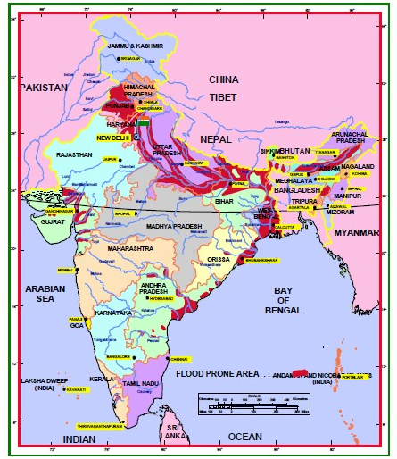
Introduction
The major flood prone regions are Punjab, Haryana, most of the Gangetic plains including Uttar Pradesh, North Bihar and West Bengal, the Brahmaputra valley, coastal Andhra Pradesh and Orissa, and South Gujarat.
Source: nihroorkee.gov.in
BRISBANE, AUSTRALIA | 18 - 20 SEPTEMBER 2017
MANAGED BY

Slide 7
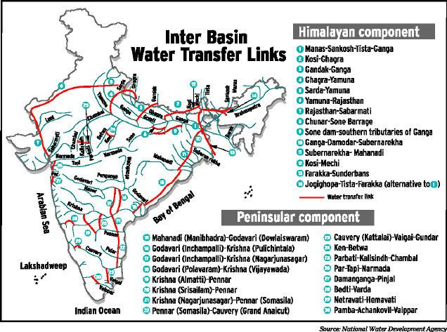
Introduction
15 major river
45 medium
120 minor
Number of ephemeral streams
Success ????
Source: indiawaterportal.org
BRISBANE, AUSTRALIA | 18 - 20 SEPTEMBER 2017
MANAGED BY

Slide 8
Introduction
The National Commission for Integrated Water Resources Development Plan project 2% of the total national water requirement as EF.
It is estimated as 10 km³ and 20 km³ for year 2025 and 2050 without specifying its geographical location and any scientific basis.
Also, basin specific study on EF has not been carried out yest except for Brahmaputra basin.
The initial estimate of Environment Flow for the Tapi River has been estimated.
BRISBANE, AUSTRALIA | 18 - 20 SEPTEMBER 2017
MANAGED BY

Slide 9
Study Area and Data Collection
Tapi River Basin
Area: 65,145 km²
Mean annual runoff: 14.9 BMC
Tapi River length: 724 km
Minor, Medium and Major Hydraulic Structures on Tapi River
BRISBANE, AUSTRALIA | 18 - 20 SEPTEMBER 2017
MANAGED BY

Slide 10
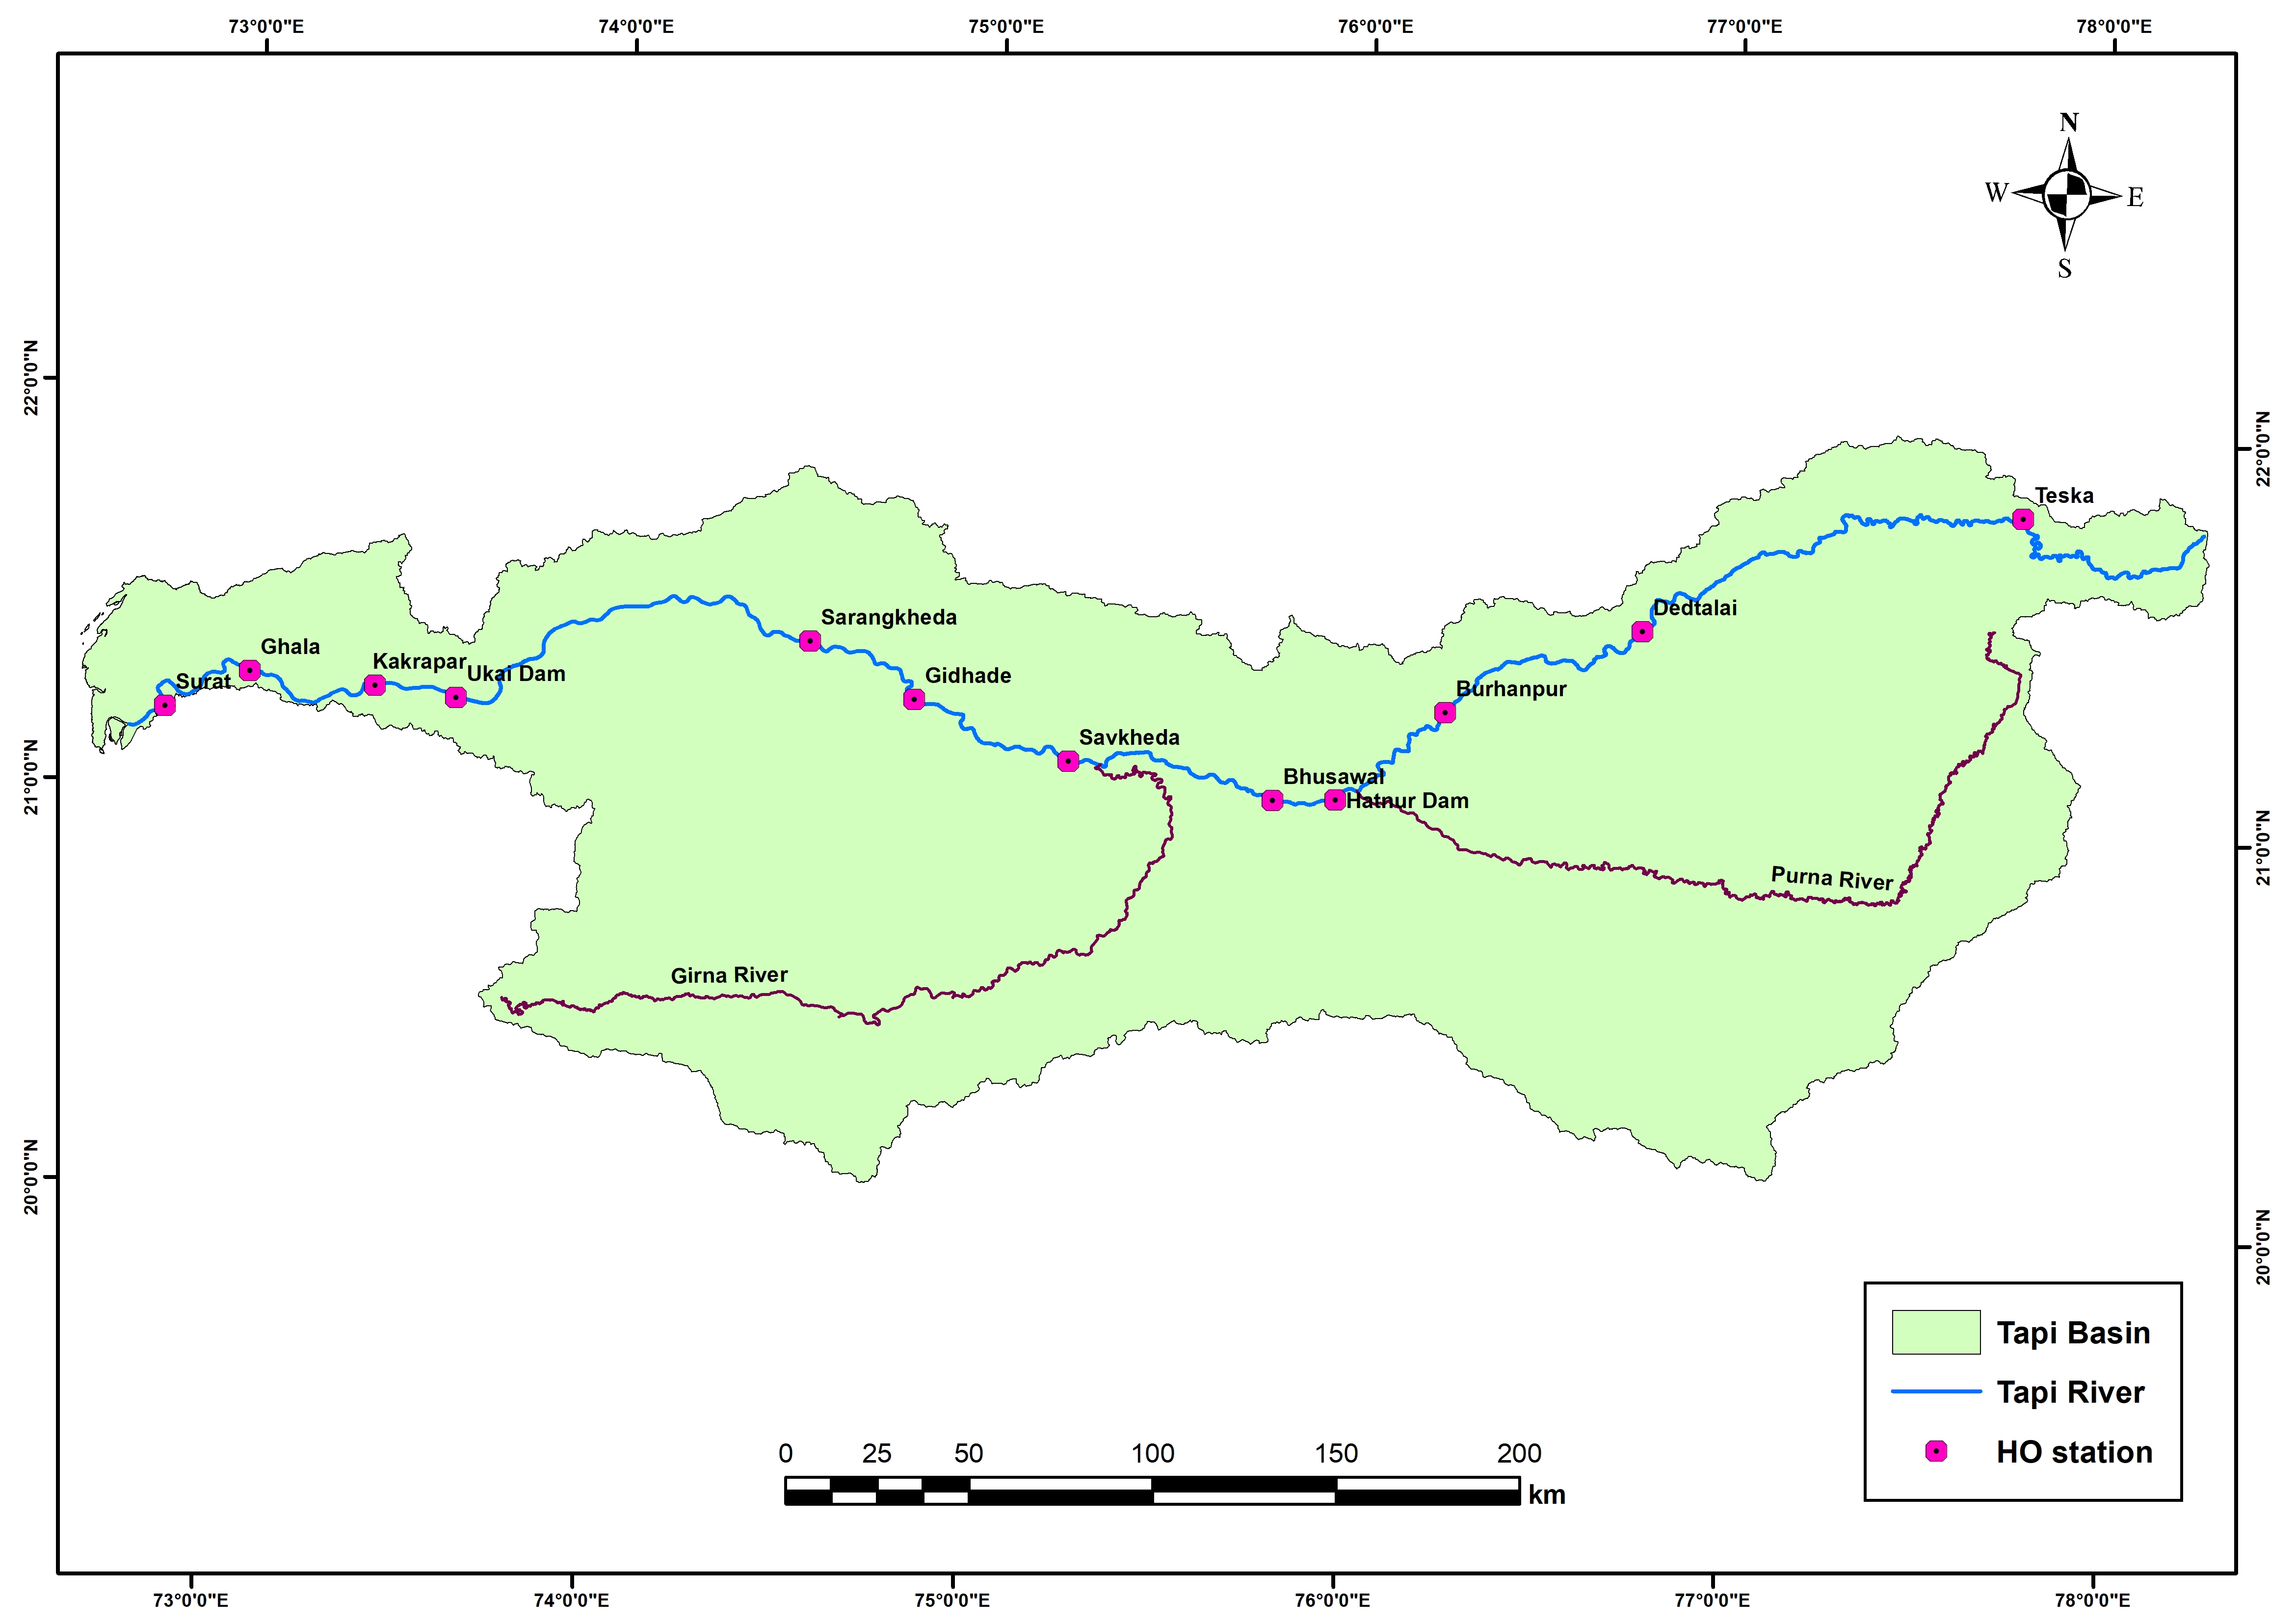
Study Area and Data Collection
Hydro observation sites on Tapi River
Dedtalai
Burhanpur
Bhusaval
Gidhade
Savkheda
Sarangkheda
Ghala
Hydro observation sites on Tapi River
BRISBANE, AUSTRALIA | 18 - 20 SEPTEMBER 2017
MANAGED BY

Slide 11
Methodology
Detailed assessment based on primarily holistic approach
Rapid assessment based on analysis of hydrological time series.
The global flow environmental flow calculator developed by IWMI, Sri Lanka and Water System Analysis Group of University of Hampshire, USA which is based on natural hydrological variability.
Observed flow data converted to monthly flow data at particular gauging station to compute actual mean annual runoff (MAR).
Flow duration curve for entire range of probabilities of occurrence has been computed.
BRISBANE, AUSTRALIA | 18 - 20 SEPTEMBER 2017
MANAGED BY

Slide 12
Environmental Management Classes (EMC)
Classes A & B
Unmodified and largely natural conditions
Where no or limited modification is present
Class C
Modified river ecosystems
The modifications are such that they generally have not affected the ecosystem integrity
Class D
Largely modified ecosystems
Considerable modification from the natural state where the sensitive biota is reduced in number and extent
Classes E & F
Seriously and critically modified ecosystems
Most ecosystem’s functions and services are lost
BRISBANE, AUSTRALIA | 18 - 20 SEPTEMBER 2017
MANAGED BY

Slide 13
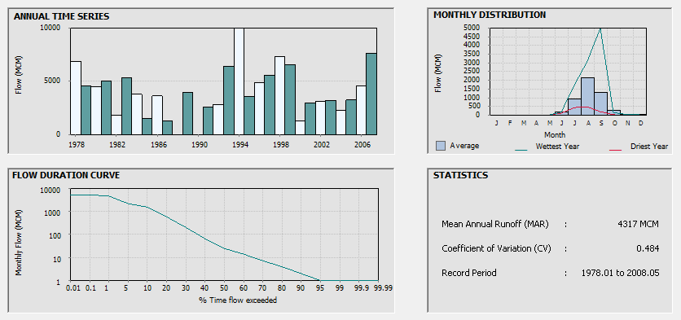
Results and Discussions
Burhanpur
BRISBANE, AUSTRALIA | 18 - 20 SEPTEMBER 2017
MANAGED BY

Slide 14
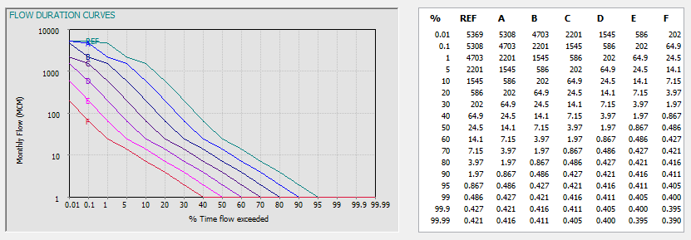
Results and Discussions
Burhanpur
Flow Duration Curves with EMC
BRISBANE, AUSTRALIA | 18 - 20 SEPTEMBER 2017
MANAGED BY

Slide 15
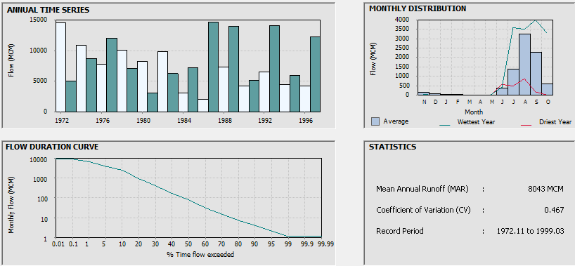
Results and Discussions
Savkheda
BRISBANE, AUSTRALIA | 18 - 20 SEPTEMBER 2017
MANAGED BY

Slide 16
Results and Discussions
Savkheda
Flow Duration Curves with EMC
BRISBANE, AUSTRALIA | 18 - 20 SEPTEMBER 2017
MANAGED BY

Slide 17
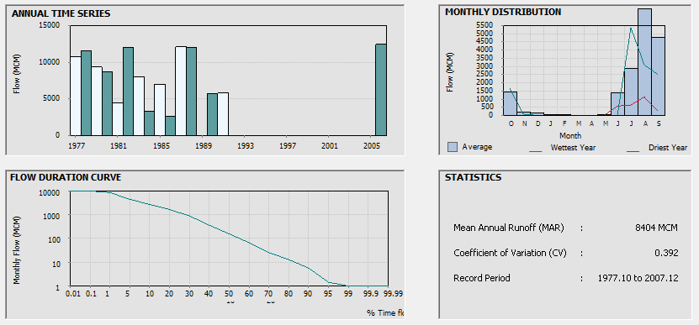
Results and Discussions
Sarangkheda
BRISBANE, AUSTRALIA | 18 - 20 SEPTEMBER 2017
MANAGED BY

Slide 18
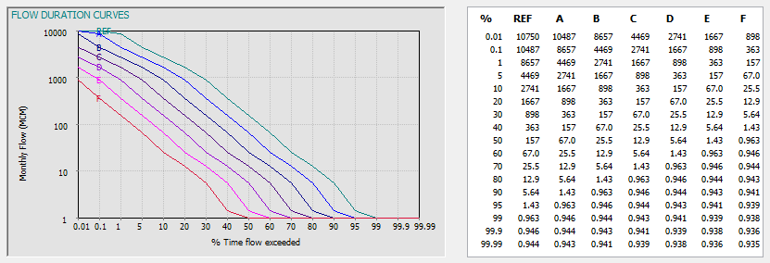
Results and Discussions
Sarangkheda
Flow Duration Curves with EMC
BRISBANE, AUSTRALIA | 18 - 20 SEPTEMBER 2017
MANAGED BY

Slide 19
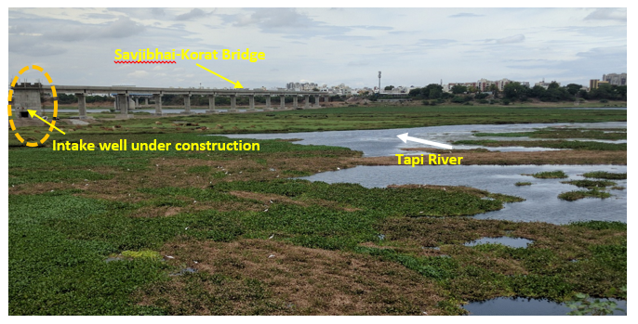
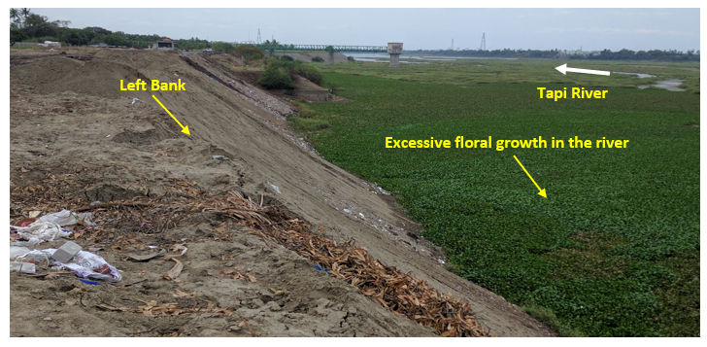
Eutrophication in Tapi River
BRISBANE, AUSTRALIA | 18 - 20 SEPTEMBER 2017
MANAGED BY

Slide 20
Conclusions
Actual mean annual runoff at Burhanpur, Savkheda and Saragkheda is 4317, 8043 and 8404 MCM.
Required MAR for natural management of the Tapi river is 50.1%, 52.2% and 56.1 % of actual MAR respectively Burhanpur, Savkheda and Saragkheda station.
If MAR fall below 0.7%, 1.6% and 1.4% of actual MAR respectively Burhanpur, Savkheda and Saragkheda station, then river will reach to the critically modified state at that location and hence, total natual habitant and biota will lost.
BRISBANE, AUSTRALIA | 18 - 20 SEPTEMBER 2017
MANAGED BY

Slide 21
Acknowledgment
Centre of Excellence on Water Resources and Flood Management at SVNIT Surat for providing data and other support
BRISBANE, AUSTRALIA | 18 - 20 SEPTEMBER 2017
MANAGED BY

Slide 22
Thank You
BRISBANE, AUSTRALIA | 18 - 20 SEPTEMBER 2017
MANAGED BY

