Slide 1


A retrospective of 20 years of environmental water management in the Snowy Mountains, Australia:
Key factors for river rehabilitation success.
Simon Williams
Blackfish Consulting
Andrew Nolan
Snowy Hydro Limited
James Pirozzi
Snowy Hydro Limited
BRISBANE, AUSTRALIA | 18 - 20 SEPTEMBER 2017
MANAGED BY

Slide 2
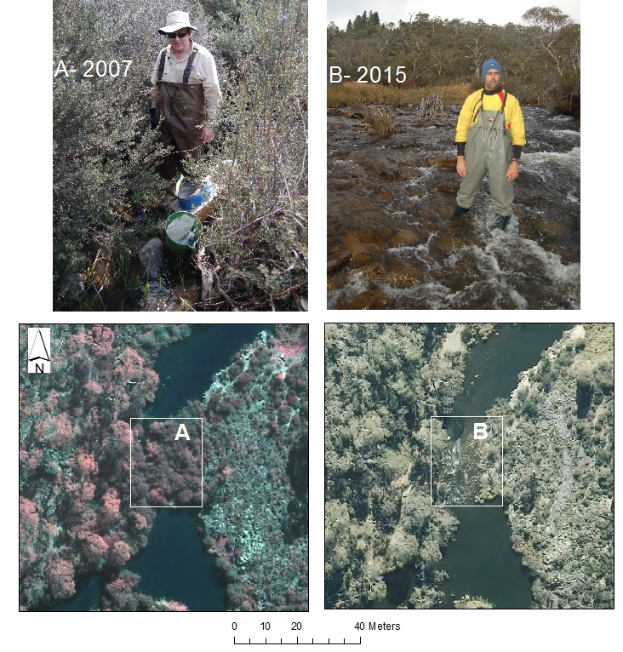
Aim
To look back at 20 years of water reform in the Snowy Mountains, Australia.
To comment on the need to look at basal level ecology in e-flow management.
To identify some key factors for river rehabilitation success.
Change in riffle condition in the Snowy River, Jindabyne Gorge, (A) 2007- (B) 2015, attributable to environmental flows.
Images of the same location within a cobble riffle.

Slide 3
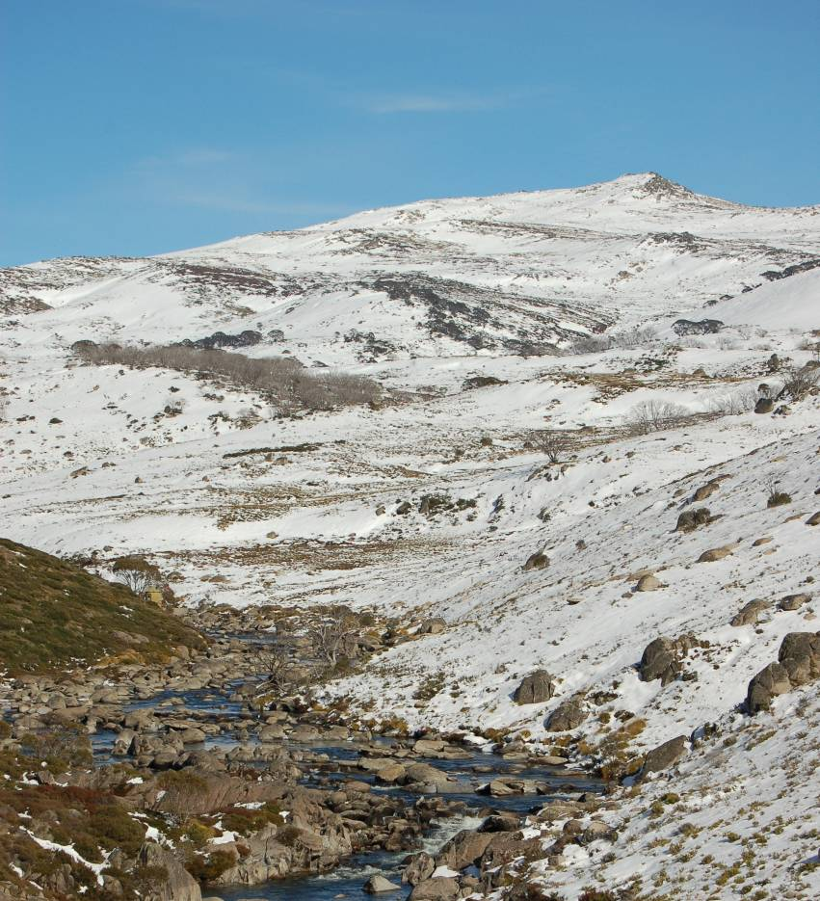
Snowy Water Initiative (SWI)
Public concerns regarding the status of the Snowy Montane Rivers (i.e. Snowy, Murrumbidgee and Murray).
Snowy Water Inquiry established in mid 1990s to review impacts of Snowy Mountains Hydro-electric Scheme.
Various legal instruments developed to provide governance arrangements to implement the reform.
  Snowy Water Inquiry Water Implementation Deed 2002
  Snowy Corporatisation Act 1997.
  Snowy Water Management Licence 2011.
  Various other deeds and agreements.
Established the first major water recovery program in Australia (i.e. ~280GL).
  Water recovered in Murray and Murrumbidgee catchments via water savings projects.
  No net impacts on water users.
Implementation programs
  Snowy Flows (i.e. planning, science, management)
  Infrastructure upgrades
  Instream habitat and riparian management
  Cultural water management
The unregulated Snowy River above Guthega Dam.

Slide 4
Key SWI environmental water reform requirements
The major environmental flow releases to the Snowy Mountains “Increased Flows”
River Murray (70 GL)
Snowy Mountain Rivers ( 117.8 GL)
    Murrumbidgee (30% MANF)
    Goodradigbee
    Geehi
    Upper Snowy
      Guthega
      Island Bend
Snowy River (212 GL)
    Snowy River d/s Jindabyne (21% MANF)
      Focus of talk
Snowy (SRIF), Snowy Montane (SMRIF) and River Murray (RMIF) Increased Flows

Slide 5
The Snowy Mountains Scheme and its hydrological impact on the Snowy River
The Scheme diverts approximately 1,130 GLy⁻¹ west to the Murray-Darling Basin.
Between 1967 and 2002:
Provision of 24 MLd⁻¹ minimum flow (Stage 0).
Affected all components of the flow regime in the upper Snowy River.
  Mean Annual Natural Flow (MANF)
    1% @ Jindabyne (Upper)
    4% @ Dalgety (Upper)
    65% @ Jarrahmond (Lower)
  Reduced daily and seasonal flow variability.
  Loss of large flows generated by spring snowmelt or catchment rainfall .
Loss of chemical cues associated with connectivity to the upper catchment via snowmelt and rainfall runoff.
222012

Slide 6




Hydrology and the period of maximum water diversion, 1967 to 2002.
Daily discharge (MLd⁻¹) (A) time series & (B) probability of exceedance (%) for the Snowy River at Dalgety (222026) for natural (grey) and observed (black).
A
unregulated snow melt river
regulated snow melt river
Discharge (MLd⁻¹)
Year
B
Water diverted to MD Basin
The change in river benthos condition associated with river regulation
  increased fine silt and attached filamentous green algae.
  loss of habitat availability and nutrient translocation sites.
Probability of exceedance (%)

Slide 7
The need to understand the previous hydrology to develop a new flow regime
Role of tributaries
Four hydrological types in the tributaries of the Snowy River catchment.
Provision of basal resources.
Release mechanism
High Intra- annular variability
Duration of peak events
typically ~ 1day
Historical annual flood
20,000 MLd⁻¹
Mean daily discharge
> 4,000 MLd⁻¹
Spillway
Bi-modal seasonal high flow signal
(primary spring, and
secondary winter)
Spring snow melt
(Seasonally predictable
high magnitude,
Long recession)
Intra-annular flood
(>1,000 MLd⁻¹)
Autumn and Summer low flows
Cone
Valves
Tributary
Mean daily discharge (MLd⁻¹) Snowy River at Dalgety, 1998 to 2016.
Natural discharge (grey),
Snowy River Increased Flows (black)
(Williams et al. A.)

Slide 8
How do you make the most of the available environmental water?
How do you improve the hydrology of a montane river when its not possible to meet any of the pre- regulation hydrological metrics with 212 Gly⁻¹ or 21% of the Mean Annual Natural Flow (MANF)?
The primary rehabilitation objective:
“Create a smaller, but healthier montane river.”
Mowamba Thredbo
Min 12,725 71,142
Mean 31,127 164,400
Max 65,928 232,230
Probability of exceedance (%) of total annual discharge volumes for two reference rivers in the Snowy Mountains, 1985-2016.
(Williams et al. A.)

Slide 9
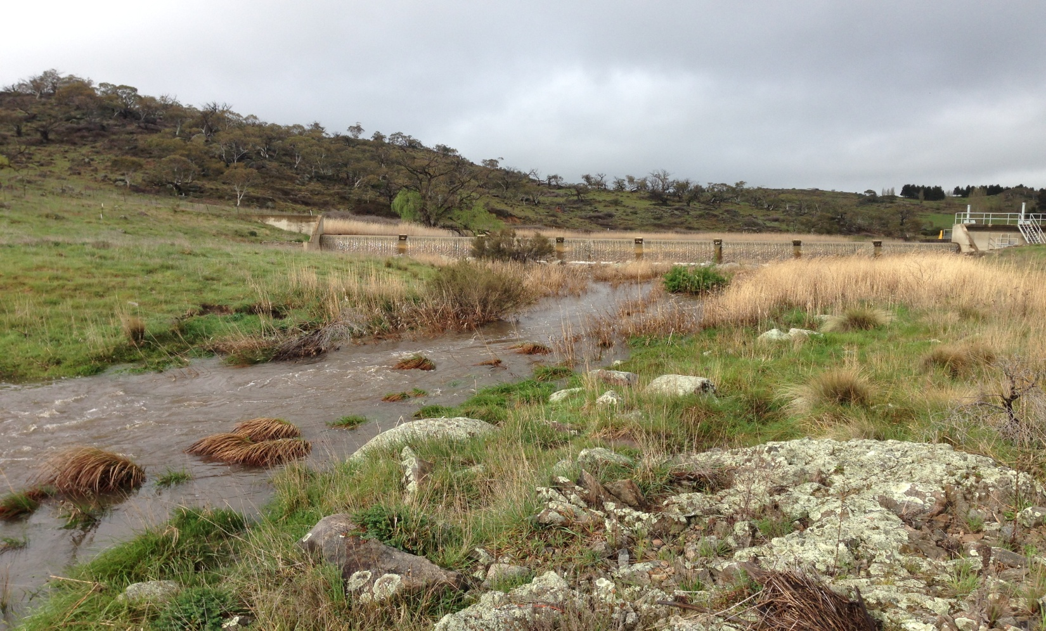
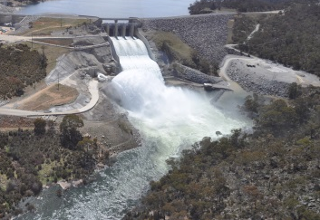
Stage 1: Tributary Releases (TR), 2002-2006
      Transparent releases from a small montane river, (i.e. ~4% of MANF).
Stage 2: Default Monthly Setting (DMS), 2006-2009
  Fixed monthly percentage of the annual allocation, (i.e. ~4% of MANF).
Stage 3: Building Block Method (BBM), 2009-2013
  Daily targets set on the perceived needs of a sub-set of ecological attributes, (i.e. ~15% of MANF).
Stage 4: Reference River (RR) & tributary releases (TR), 2013-2016.
  Daily and hourly targets set on hydrology of a reference montane river with similar yield as available environmental water. Represents ~15% of MANF.
  Complementary tributary release in autumn low flows (deliver basal resources).
Environmental water strategies in the Snowy River: 2002-03 to 2015-16.
Montane tributary release (TR)
Dam release (DMS, BBM, RR)

Slide 10
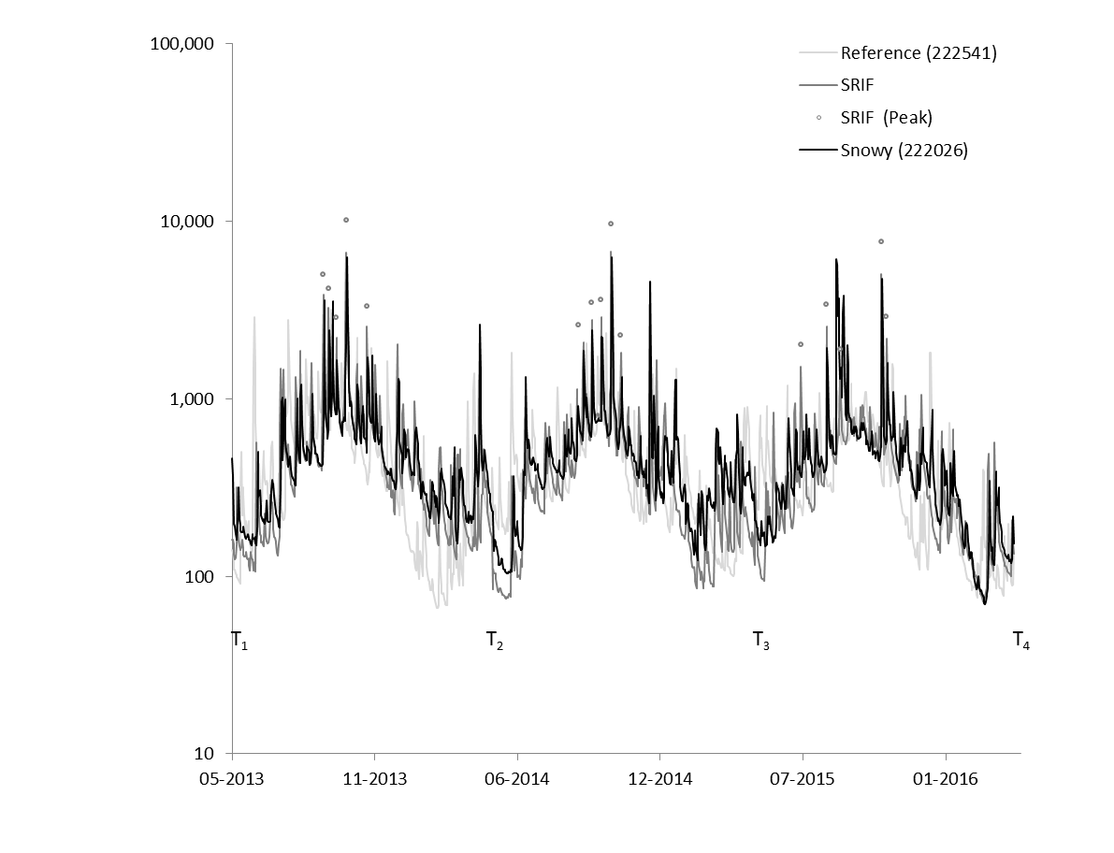
Comparison of the SRIF release strategies: (a) Minimum flow (Stage 0), (b) tributary release (Stage 1), (c) default monthly settings (stage 2),(d) Building Blocks (Stage 3) and (e) hydrological flow scaling, 1998-2016.
Discharge (MLd⁻¹)
Peak flows
Tributary flows
(Williams et al. A.)

Slide 11
Principal co-ordinates analysis (PCO) of the 56 RAP hydrological metrics in the Upper Snowy River, 1998-2016. Vectors >0.9 correlation
Regulated river
Reference river
Reference River
Regulated River
Coefficient
of variation
Mean Duration
of High Spell
Building Blocks
Minimum
Flow
Total
volume
Constancy
i
ii
Tributary
Monthly
Average
Reference River
i Mean magnitude of rise and fall
ii No. of high and low spells
Mean rate of rise and fall
Mean daily flow
(Williams et al. A.)

Slide 12
The use of the Building Block Methodology (BBM) and the need to consider a-typical hydrological signals, Snowy River, 2010-11.
1- Simplified winter signal, with no complex rainfall signals.
2- Peak flow timing, not aligned to seasonal high flows. Rate of fall high.
3- Similar changes in magnitude, frequency and duration of base flows
4- Rate of rise slower, rate of fall faster. A seasonal autumn high flow.
(Williams et al. A.)

Slide 13
Environmental water, river processes, and basal resources.
River discharge is a key ecological process.
Why has there been such a dearth of discussion about habitat, processes and basal ecology in environmental flow management?
Basal level responses historically overlooked for tertiary level responses, i.e. birds and fish.
Accessing basal resource stores and the resulting energy flow is a key consideration for e-water management.
Confined (Montane)
T1
T2
T= Tributary
Floodplain (Lowland)
T1
T2
Using e-water to create “hot spots” and “hot moments”.
Conceptual model of chemical spiralling and processes in a (i) confined river and (ii) a floodplain river.
Modified from NILSSON, C. & SVEDMARK, M. Environnemental Management (2002) 30: 468. doi:10.1007/s00267-002-2735-2

Slide 14
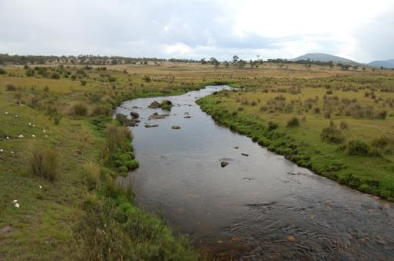
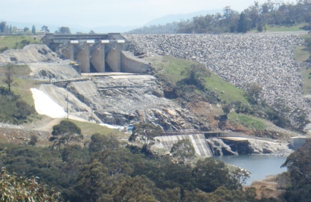
The composition of environmental water is important
Natural events
Dam water
Positive relationship between discharge and DOC
Tributaries provide connectivity to headwater basal resource stores
Highly complex DOC
Negative / no relationship between discharge and DOC
Limited connectivity to basal resource stores.
Less complex- inert DOC
DOC (mgL⁻¹)
Discharge (m³s⁻¹)
(Rohlfs et al. 2015)
14

Slide 15
Response of key basal resources in a confined montane river
Two models for delivery of basal resources.
Headwater tributaries deliver
DOC and Dsi.
TN and TP
Appropriate thermal regime
Managed releases deliver
In-channel delivery of TN and TP via disturbance of benthos.
Relationship between TSS and TP & TN using managed releases
(Williams et al. B)

Slide 16
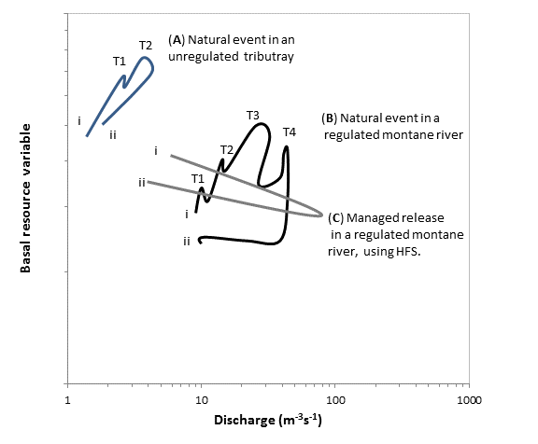
Conceptual model of the response of key basal resources (DOC, and DSi) during (A) natural event in a small tributary (B) a natural event in a regulated river and (c) a managed release using RR in a regulated montane river.
(c) managed releases in a regulated montane river using RR.
i and ii indicate the start and conclusion of high flow event.
T1 – T4 indicates tributary contributions during the catchment generated event.
Define this acronym somewhere in the text.
(Williams et al. B)

Slide 17
Likelihood of release strategy method (L-Low, M-Mid, H-High) achieving flow and WQ metric class in the Snowy River.
Metric |  | Release strategy method
 | Minimum flow | Tributary release | Monthly average | Building Blocks | Reference River
Volume | L | L-M | H | H | H
Magnitude | L | L | L | H | H
Duration | L | H | L | M | H
Timing | L | H | L | L | M
Variability | L | M | L | L | H
Rates of change | L | M | L | L-M | H
Composition | L | H | L | L | L
(Williams et al. A)

Slide 18
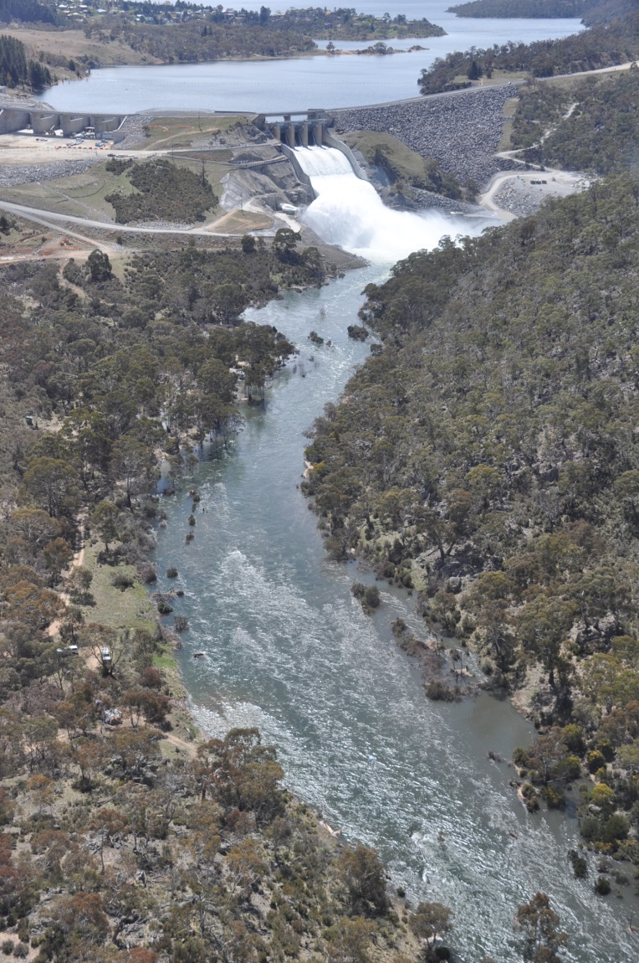
Key e-water learnings in the Snowy River
River hydrology
Minimum flows alone are insufficient to protect river processes and sustain river health.
The use of default monthly settings provide limited discharge variability, and does not optimise the available water. Highly inefficient.
The use of BBM and the focus on a few objectives (i.e. iconic/ rare taxa) may lead to atypical hydrological patterns.
The use of reference rivers (RR) produce more complex natural hydrological characteristics.
The use of RR and increased hourly peak flow rates allows higher discharge thresholds to be achieved and regular achievement of physical flow thresholds (i.e. sediment scour).

Slide 19
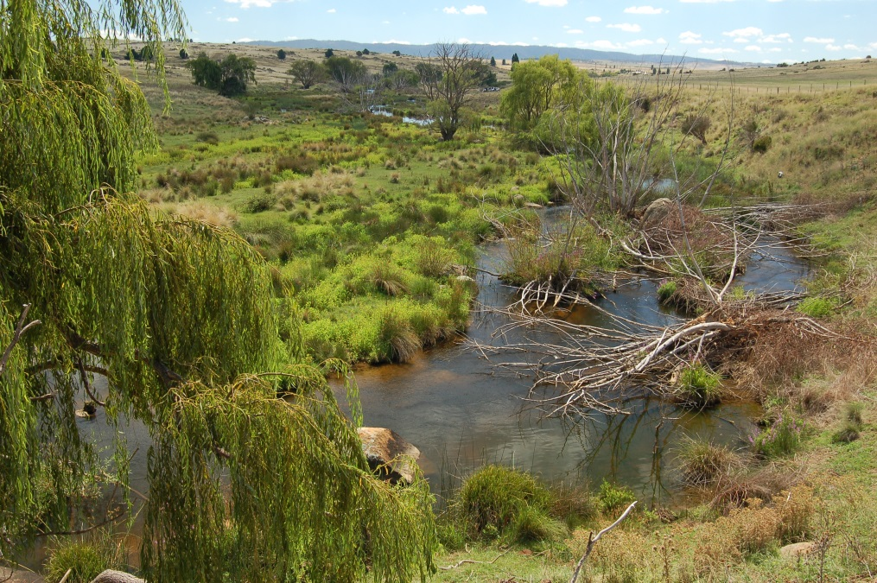
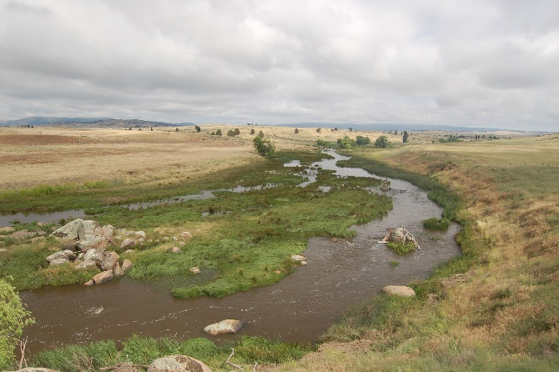
Key e-water learnings in the Snowy River:
River processes
The composition of held water in major reservoirs will not provide all of the ecological outcomes sought, particularly basal resources. Regardless of dam delivery method.
Tributaries can provide complementary ecological processes, provision of (i) basal resources and bio-chemical hot moments and (ii) appropriate thermal regimes with lower volumes of water.
Habitat improvement is required to complement the environmental water. If the perquisite habitat conditions are not met, then outcomes likely to be limited with the application of e-water.
Riparian management is a critical component to improving habitat condition and maximising the benefits of the ewater.
Focus on flow based river processes, rather than terrestrial based biodiversity management frameworks.
2006
2014
Snowy R @ Dalgety, showing changes in
channel morphology and vegetation

Slide 20
What do you do when you have a small volume of environmental water?
Flow rehabilitation strategy should recognise, the following:
Its not always possible to meet defined/desired hydrological metrics. Environmental gains can occur even without the large allocations (i.e. 15% of MANF). Take the wins and use it to build social capital.
Make the most of what we have using an experimental release framework. Scientific assumptions can be wrong. Trial by doing.
Build a case for a future, but informed discussion. Science will not necessarily engender change management. People have to be ready to receive and accept information.
Cultural water management requires (i) recognition, (ii) representation and (iii) responsibilities. We need to change our thinking about our roles.
Policies can constrain the development of strong relationships. Allow flexibility for collaborative adaptive change not prescriptive change.
Strong relationships will allow cultural change. Bring everyone along for the ride. River rehabilitation will take decades.

Slide 22
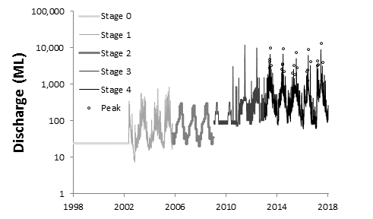
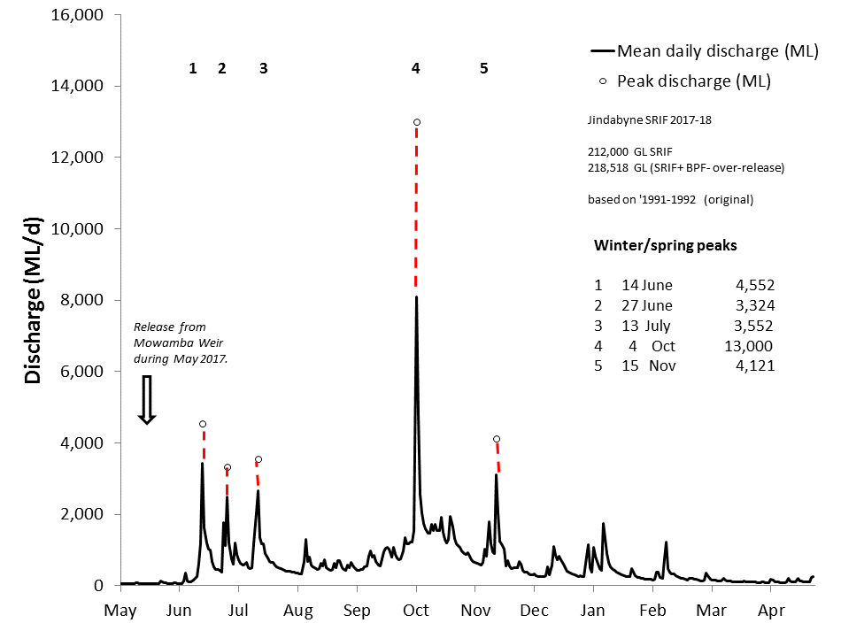
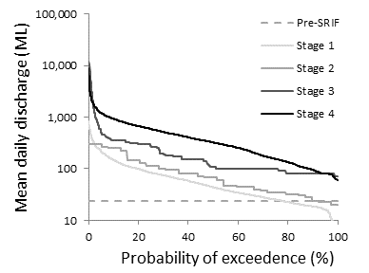
Evolution of a modified montane river flow regime.
Mean daily discharge (MLd⁻¹) targets for the Snowy River below Jindabyne, 2017-18.
Note: hourly discharge targets (ML) expressed in red.
(Williams et al.)

Slide 23
Changes in mean (95%CL) annual discharge (MLy⁻¹) by e-water method
Upper Snowy
Mid Snowy
Lower Snowy
Minimum
Tributary
Monthly
BBM
Reference

Slide 24
Changes in mean daily monthly discharge in the Reference river (222541), SRIF target and the regulated river (222026), for each stage of SRIF, 1/5/1998 to 30/4/2016.
Min.
Reference – Thredbo River (222541)
SRIF
Regulated - Snowy River @ Dalgety (222026)
Stage 1
Tributary
BBM
Discharge (MLd⁻¹)
DMS
Reference
Month
Month

Slide 25
Changes in mean (95%CL) daily discharge (MLd⁻¹) by environmental water method .
Upper Snowy
Mid Snowy
Lower Snowy
Minimum
Tributary
Monthly
BBM
Reference

Slide 26
Comparison of SRIF target mean (95%CL) daily discharge (MLd⁻¹) high flow metrics (a) magnitude, (b) duration and (c) timing for the five largest events for stage, 1998-2016.
Magnitude
Duration
Duration
Stage
0 Minimum flow
Tributary release
Monthly setting
BBM
Reference river
Timing
Minimum
Tributary
Monthly
BBM
Reference

Slide 27
Changes in mean daily monthly discharge in the Reference river (222541), and the regulated Snowy River (222013), for (i) Minimum releases and (ii) Reference River releases.
Reference – Thredbo River
SRIF targets
Regulated - Snowy River (mid)
Minimum release
Reference River
Month
Month

Slide 28
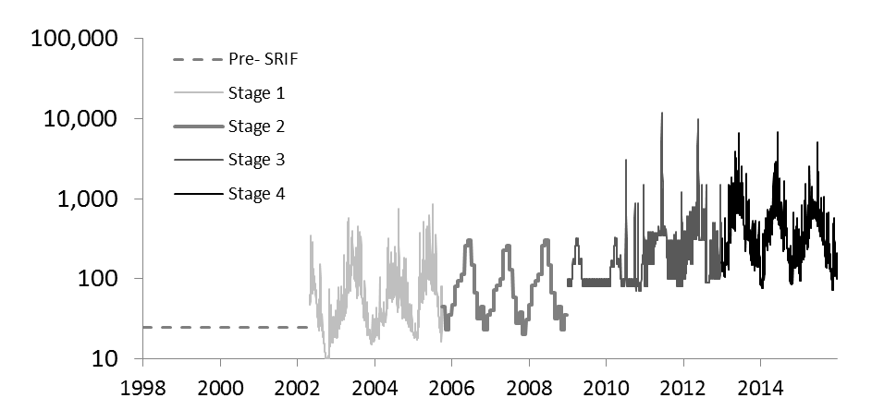
Changes in daily mean discharge probability of exceedance for each flow stage, 1/5/1998 to 30/4/2016.
Snowy River
Unregulated tributaries
Upper
Snowy
Mean daily discharge (MLd⁻¹)
Mid
Snowy
Probability of exceedance (%)

Slide 29
Basal resources.
Conceptual model of hydrological and basal level responses for different peak flow event types in a montane river.
(Williams et al. B)
Event type | Hydrological |  | Basal resource
 |  | DOC, Dsi, and EC | Benefits | Limitations
Natural event in small unregulated montane tributary. | Relatively simple hydrological signal. Moderate magnitude, short duration event. | Positive clockwise hysteresis (simple). High concentrations. | Provision of higher concentrations of complex DOC and Dsi, and macro-nutrients. | Limited achievement of flow magnitude targets achieved in regulated river.
Natural events in a large regulated montane river. | Complex hydrological event. High magnitude, short duration event with multiple peaks associated with tributary inputs. | Positive clockwise hysteresis pattern. Complex pattern attributed to multiple tributary contributions. Moderate concentrations. | Provision of moderate concentrations of complex DOC and Dsi, and macro-nutrients, via a complex signal attributable to tributary inputs. | Minor dilution of basal resources.
Managed high flows (Building Block Method- BBM) in a montane regulated river. | Simple hydrological signal. High magnitude and peak duration longer than natural. | Neutral or negative clockwise hysteresis. Low concentrations. | The limited basal resource stores in the regulated river are accessed. | Less complex hydrological signal. Dilution of DOC and DSi. Uses more water than HFS.
Managed high flows (Hydrological Flow scaling-HFS) in a montane regulated river. | Simple hydrological signal. High magnitude, and peak duration equivalent to natural. | Neutral or negative clockwise hysteresis. Low concentrations. | The limited basal resource stores in the regulated river are accessed, using less water than the BBM. | Less complex hydrological signal. Dilution of DOC and DSi.

