Slide 1








Modelling environmental flows in
Source River System models
Dr Ingrid Takken
Murray-Darling Basin Authority
Project partners:
BRISBANE, AUSTRALIA | 18 - 20 SEPTEMBER 2017
MANAGED BY
Notes:
Today, I am presenting a project on the development of Source software functionality to be able to model environmental flows.
This is a collaborative project:
eWater is developing the software functionality (+ software developers)
The project is funded by MDBA, OEH, CEWO and Vic DELWP
Various people from these and other stakeholder organisations are providing input to this project

Slide 2

Hydrological Models
Hydrological models have been used in the Murray-Darling Basin for more than 50 years, to help understand, plan and manage water resources.
Source is Australia's National Hydrological Modelling Platform
MDBA and State governments are rolling out its application
BRISBANE, AUSTRALIA | 18 - 20 SEPTEMBER 2017
MANAGED BY
Notes:
River system models have been used to inform key water management policies across the MDB for over 50 years.
In 2008 Governments decided to develop Source (software) as the National Hydrological modelling platform.
Currently, there are 24 individual river system models used across the Murray-Darling Basin, developed and used by MDBA and States.
These models are using different method and software, and have reached their use-by date. They are based on outdated software and struggle to meet the need for 21st century water resource management.
To overcome these issues, MDBA and Commonwealth and States governments have supported and funded the development of Source, as the national hydrological modelling platform.
Source has been developed by eWater between 2005 and 2012.
MDBA and Basin State governments are now rolling out its application, developing new models in Source to ultimately replace the models currently used for water resource planning.

Slide 3
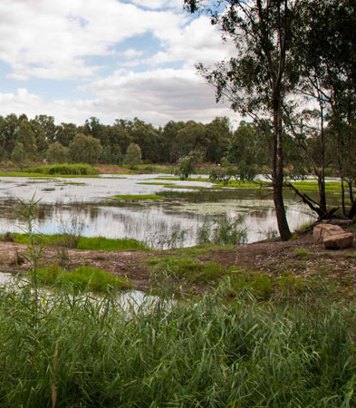
Need for functionality to model environmental water
Over 2000 GL of water recovered across the Murray-Darling Basin
Resides in portfolios with large variety of entitlements, held by Commonwealth and States
Requires careful planning, coordination and delivery
Improved and better integrated modelling capability is required to support environmental water management
BRISBANE, AUSTRALIA | 18 - 20 SEPTEMBER 2017
MANAGED BY
Notes:
Environmental water is now an important component of the river systems in the Murray-Darling basin:
Currently, over 2000 GL of water has been recovered across the Basin.
The water resides e-water portfolios held by the Commonwealth and Basin States. The Living Murray program and other smaller programs also have their own holdings.
The portfolios comprise a large number and variety of water entitlements.
To achieve the best environmental outcomes (locally and across the Basin), the use of this environmental water needs to be carefully planned, coordinated (between water holders) and delivered.
It is important that water resource models can be used by MDBA, State governments and environmental water holders to assist with the planning and delivery of environmental water:
Models should be able to help analyse the best way to use and prioritise environmental water across the system, and to assess environmental outcomes as well as any impacts on other water users.
Current models do not have the functionality to do this.
While current models represent existing environmental flow rules, ability is still limited. For example, environmental water demands for modelling scenarios supporting the development of the Basin Plan, were developed using separate tools outside of models (which would not allow proper accounting and feedback mechanisms to be considered).
To be able to support environmental watering well, the models need capacity to simulate environmental flows based on similar principles used by environmental water planners/holders.
So, there is a need for improved and better integrated modelling capability to support environmental water management in the future.

Slide 4
Project Objective
Develop Environmental Flow functionality in Source that will enable modelling of environmental flows, so that benefits and impacts of different environmental flow scenarios can be assessed
BRISBANE, AUSTRALIA | 18 - 20 SEPTEMBER 2017
MANAGED BY
Notes:
This objective of this project is to develop environmental flow functionality in Source to realise a fit-for-purpose modelling framework for water resources planning and management.
This functionality will allows modellers to set-up/configure models to test relevant environmental watering scenarios, so that the environmental benefits and impacts of different environmental flow scenarios can be tested and evaluated.

Slide 5





Project Methods
Collaboration between environmental water holders and planning organisations to compile and prioritise user requirements
Development of conceptual model based on user requirements
Implementation of functionality in Source software
Software testing
Documentation and training
BRISBANE, AUSTRALIA | 18 - 20 SEPTEMBER 2017
MANAGED BY
Notes:
To develop a clear understanding of the needs of potential users and beneficiaries of the software and models, information was gathered through several workshops and consultation meetings, with our project partners (OEH, CEWO, DELWP) and a number of other environmental water holders and planning organizations (VEWH, DPI Water, SA DEWNR, Melbourne Water) .
This resulted in a long wish list of functionality / capabilities the models should be able to provide.
These user requirements have been compiled and prioritised (in agreement with the partners) and have informed the development of the conceptual model for the functionality, which is currently being implemented by eWater software developers.
In parallel with software development, MDBA is testing the software, using examples of flow requirements and rules provided by project partners. Hereto, simple test models are developed, but testing will also be done using the Source Murray Model.
In addition, this project will provide training to modelling staff at MDBA and partner organisations to support wider application of Source models in environmental planning and delivery.

Slide 6
Key user requirements
Ability to:
generate environmental flow demands based on specified watering actions
allow planning and prioritisation of many different water needs at a site and between sites
coordinate environmental releases along the river
represent environmental entitlements and portfolios, and set priorities for use
coordinate water delivery from specified portfolios
account for environmental water use
BRISBANE, AUSTRALIA | 18 - 20 SEPTEMBER 2017
MANAGED BY
Notes:
We have compiled and prioritized a list of more than 100 detailed user requirements.
In general, the majority of environmental flow sharing rules that currently exist in major jurisdictional water sharing plans should be able to be represented with the proposed core functionality. The new functionality will also need to address management of environmental entitlements across a range of sites and for different purposes.
This would require ability to:
generate environmental flow demands based on specified watering actions
represent environmental entitlements and portfolios, and set priorities for use
coordinate water delivery from specified portfolios
allow planning and prioritisation of many different water needs at a site and between sites
coordinate environmental releases along the river
account for environmental water use

Slide 7
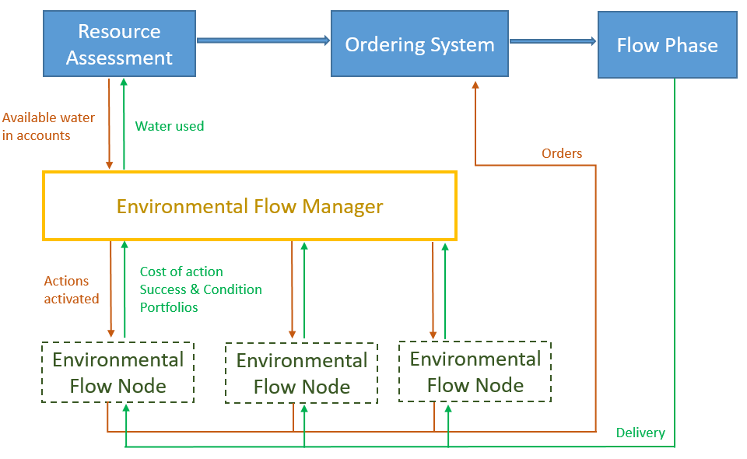
Conceptual model
Notes:
We have developed a conceptual model that should provide the modeller with enough tools and flexibility to represent environmental water management in their systems.
The environmental flow functionality will have two main components that interact with each other and the existing functionality available in Source.
The Environmental Flow Node is located at the site and determines water needs for that site based on user specified env watering actions.
The flow node creates the orders (in the ordering phase) and keeps track of flows being delivered.
The Environmental Flow Manager is an overarching manager that includes functionality to prioritise and roster environmental demands, and account for use from different types of water entitlements and portfolios.
The flow manager is informed by the resource assessment, which keeps track of water allocated to the environmental accounts.
The manager also uses information from the flow node, on the watering needs at the site.
The manager prioritises the environmental flow demands, and informs the node on which actions to target.

Slide 8
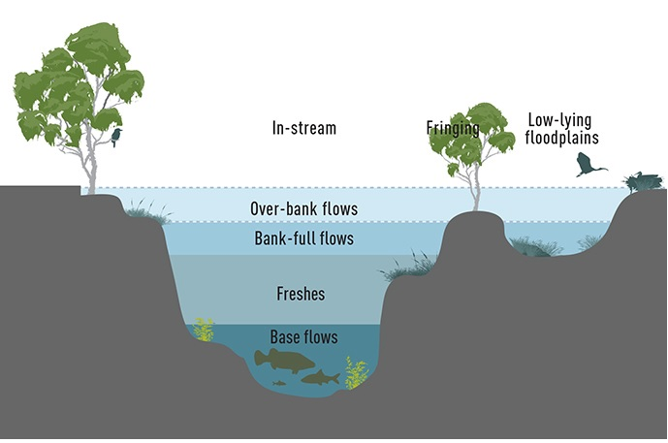
Environmental flow demands at a site
Desired flow regime
BRISBANE, AUSTRALIA | 18 - 20 SEPTEMBER 2017
MANAGED BY
Notes:
Environmental flow targets at a site are generally based on a desired flow regime.
A flow regime consist of different types of flows, which occur more or less frequently and have specific ecological functions, e.g:
Baseflows are low flows that provide long term drought refuges – like the minimum flows that usually occur throughout the year
Freshes are small in channel events (that allow fish movement, redistribute food, provide water for riverside plants) – these flows may occur frequently, e.g. several times per year
Bank full and Overbank flows (recharge wetlands, water floodplain vegetation and connect the floodplain to the river) may occur once in several years
Environmental water managers specify a number of desired environmental watering actions representing different parts of the flow regime at a site.
Such actions can be configured at the environmental flow node.

Slide 9
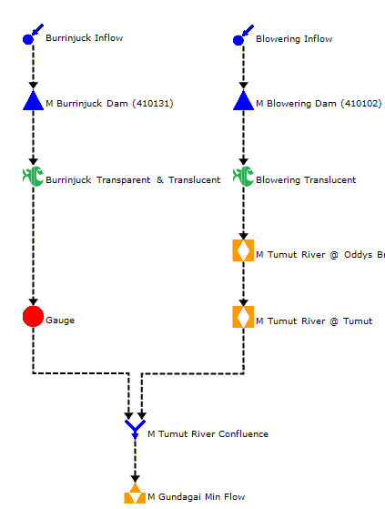
Environmental flow node:
Sits at specific site in flow network
The actions can be configured as:
  Minimum flow
  Translucency flow
  Flood/Fresh flow
    Target, season, duration, timing, triggers etc
Creates demands and orders based on desired flow actions
Keeps track of success and condition
BRISBANE, AUSTRALIA | 18 - 20 SEPTEMBER 2017
MANAGED BY
Notes:
The EFN sits at specific location in the network (Fish icon)
Three different types of actions or water requirements can be specified:
Minimum flows (certain minim flow required for specified period, e.g. baseflow)
Translucency flow, which require a percentage of dam inflows to be released – typically specified as a percentage of a reference flow
Fresh and flood flow, based on desired flow target, season, duration, timing (frequency) and triggers for commencement ( & rates of rise and fall etc).
The node will create the demands and orders, based on user specified actions.
It also tracks success for the actions (both natural and man made) and the condition of the asset associated with the actions.

Slide 10
How is planning and Prioritisation done?
Water Availa-bility
Environmental Water Demand
Very High
High
Moderate
Low
Very Low
Very Low
Low
Moderate
High
Very High
http://www.environment.gov.au/system/files/resources/a854e5b5-6368-4859-b020-d71c7ff5990a/files/portfolio-mgt-plan-approach-planning-2016-17.pdf
Notes:
Many actions can be determined at many sites along the system.
How do environmental water planners prioritise between the various environmental watering actions?
Priorities for the type of actions to be targeted in the season are set based on environmental demand and water availability
e.g. if it has been dry and the need for water is high, while water availability is low – actions would be targeted to avoid damage and provide drought refuge
If it has been wet and water needs are low, water may be carried over, or large events may be targeted opportunistically.
This slide shows a planning matrix provided by CEWO, showing how they undertake planning.
It is based on two factors:
The first is water need – this is based on antecedent conditions (history of watering at the site) that determine the conditions of the asset
The second is water availability to meet demands - the current water availability in the storage (and hence accounts) and the water availability outlook.
These two factors determine the overall purpose of Commonwealth environmental water management:
For example, if it has been dry and the water need is high, but water availability is still low – then watering actions would be selected in order to ‘avoiding damage’ and provide drought refuges
If a lot of water is available, high flows events may be targeted and or water may be carried over for use the next year.
The software should be able to represent such a decision making framework.

Slide 11
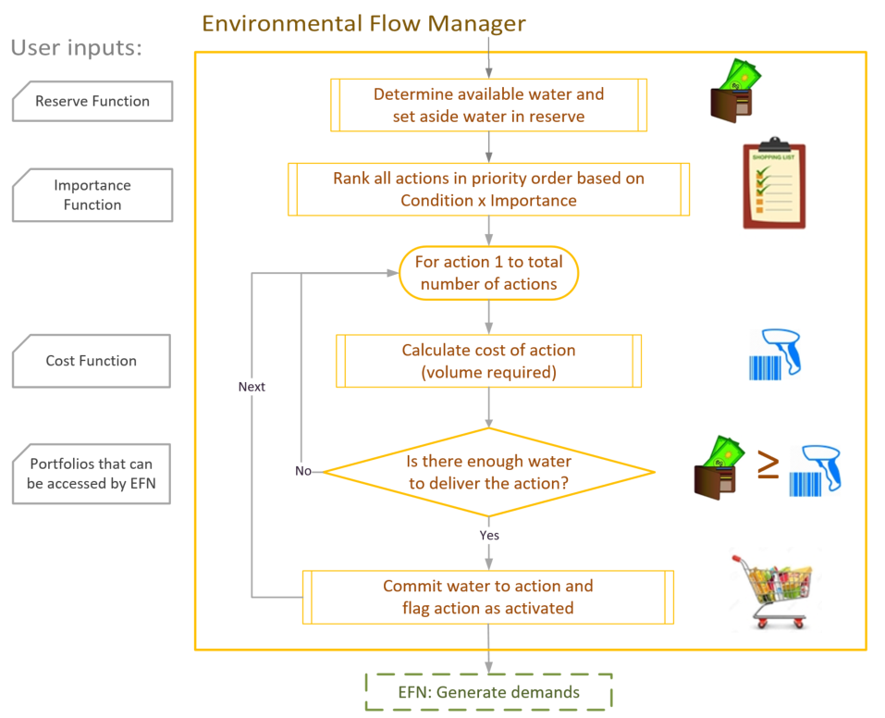
Environmental Flow Manager: Planning and prioritising
Notes:
This flow chart represents the functionality at the EFM that prioritises and activates actions based on a purchasing style conceptual model (the ‘shopping trolley’ model)
The environmental flow manager keeps track of entitlement portfolios, and the water allocated to the entitlements in the portfolio.
The user can specify a reserve function for each entitlement, to determine how much water may need to be set aside for use later in the season, or for carryover to next season
Based on this, the manager determines the water available – i.e. the money in the wallet
The EFM prioritizes all actions based on the condition of the asset multiplied by a user defined importance weighting.
The condition (score) is tracked by the environmental flow node, and determines water need.
The importance weighting is calculated using a user defined function. The importance function can include water availability in the system, as well as functions determining dependencies on other flow actions. It is through configuration of the importance function, that the user has a lot of flexibility to represent how actions are prioritized and coordinated.
This results in a shopping list that has the items listed in priority order.
The Environmental Flow Manager will then step through the prioritized list of actions and will determine whether there is sufficient water available to meet the action, i.e. can I afford the action?
The cost for the action is calculated based on a user specified cost function. (The price of the item)
The manager compares the cost of the action (ie. the volume of water required to deliver the action) to the available water in the portfolio(s) that can be accessed by the action.
If affordable – the manger will activate/flag the action and will decrease the amount available for other actions (set aside the money).
Accounts are not debited until after a managed target response is executed (i.e. actual payment is not made until after delivery)

Slide 12
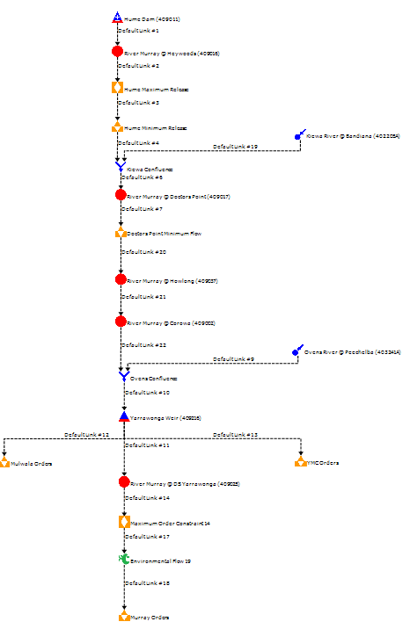
Hume
Preliminary Results
Flood/Fresh rule example @ Yarrawonga:
Spring Overbank Flow | Rule specifications
Frequency | All years
Trigger Flow | 40,000 ML/d
Timing window to commence event | July to October
Target flow at Yarra DS | 40,000 ML/d
Duration | 20 days
Yarrawonga
Env. Flow Node
Notes:
Currently the EFN functionality is largely complete, but still being tested and improved. He flow manager is still under development.
So, I will only show a small example of results from the EFN.
To test a flow rule downstream of Yarrawonga, a test model of the upper Murray was set up (see figure)
The flow node is located below Yarrawonga weir
The specified flow action represents a ‘high flow extent’ action
Spring overbank flows to water wetlands and floodplain forests, mobilise carbon and nutrients from floodplains to support riverine productivity, and help mitigate black water risks in subsequent smaller floods.
It is desired every year – between July and October
Should be triggered when a flow of 40,000 ML/d occurs and should maintain flow at that level for 20 days

Slide 13
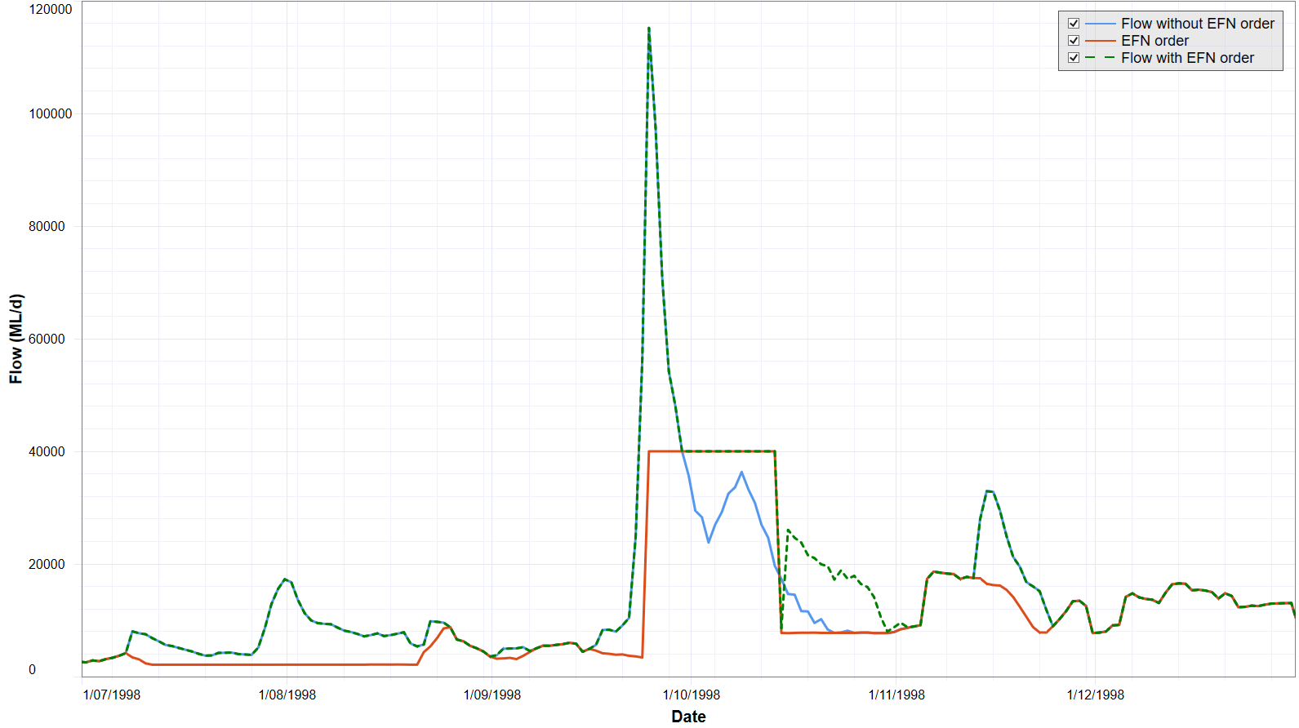
Results: Flow at Yarrawonga
BRISBANE, AUSTRALIA | 18 - 20 SEPTEMBER 2017
MANAGED BY
Notes:
Blue line shows flow in river without the EFN demand
Red is the order created by the EFN, which starts day after flow threshold of 40,000 ML/d has been reached, and continues for 20 days (no rise and fall modelled)
Green is resulting flow
The ordering interacts with all other functionality, so that the node would not order flows above constraints specified in the model. When the node is a long way away from the storage, it need to consider travel time and make orders a month beforehand – this makes some of this very complex.
Note: You can also see how it interacts with other functionality in the system.
I have not specified a rate of rise and fall, but Hume Dam would have rules on how fats releases can be reduced (6-inch rule) – therefore Hume releases more. The first day after the event, flow at Yarrawonga is low because the weir is reregulating flows from Hume, but after a day Yarrawonga weir starts spilling.

Slide 14
Conclusions
Environment is now a major water user and has a significant portfolio of entitlements
Current water resource models have no functionality to represent current complexity of environmental flow management
Source functionality developed under this project will allow representation of environmental water planning, delivery and accounting and will be a valuable tool to support environmental water planning and river operations in the future
BRISBANE, AUSTRALIA | 18 - 20 SEPTEMBER 2017
MANAGED BY
Notes:
Environment is now a major water user and has a significant portfolio of entitlements
Current water resource models have no functionality to represent current complexity of environmental flow management
Source functionality developed under this project will allow representation of environmental water planning, delivery and accounting and will be a valuable tool to support environmental water planning and river operations in the future
Collaboration through this project has been a good opportunity for environmental water holders and planners to work together and share ideas.
We are at the start of a long and exiting journey

Slide 15
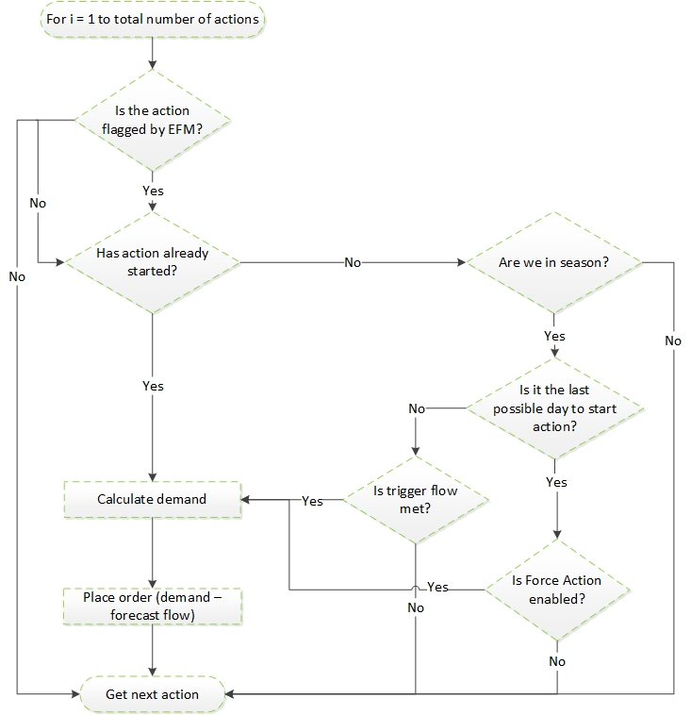
Environmental Flow Node:
Ordering

