Slide 1
Overturning aqua nullius: Securing Indigenous Water Rights in Australia
“Water is the basis for our songs and our culture. We have been looking after our waterholes and rivers for thousands of years. We have respect because we know that if you don’t treat it right many things can happen. This is the lesson that we need to make other people learn.”
Walmajarri Senior Lawman Joe Brown
BRISBANE, AUSTRALIA | 18 - 20 SEPTEMBER 2017
MANAGED BY

Slide 2
Overturning aqua nullius: Securing Indigenous Water Rights in Australia
Aboriginal health is integral in any national dialogue on Aboriginal water rights and interests.
There is an interrelationship between access to natural resources, such as clean drinking water, the enjoyment of good health and maintaining traditional laws & culture.
BRISBANE, AUSTRALIA | 18 - 20 SEPTEMBER 2017
MANAGED BY

Slide 3
Overturning aqua nullius: Securing Indigenous Water Rights in Australia
Aboriginal Peoples in Australia are the First Peoples.
We are not stakeholders or a minority or special interest group;
We are inherently connected to Australia’s lands, waters, resources and all that is tangible & intangible;
We are knowledge holders of science and ecology.
BRISBANE, AUSTRALIA | 18 - 20 SEPTEMBER 2017
MANAGED BY

Slide 4
Overturning aqua nullius: Securing Indigenous Water Rights in Australia
The Indigenous rule of law(s)
Indigenous laws regulate:
All relationships with waterscapes and landscapes and the use & extraction of resources.
Indigenous laws inform:
Water management, the use and access of water, social & cultural obligations.
Land and water is inseparable & not divisible.
BRISBANE, AUSTRALIA | 18 - 20 SEPTEMBER 2017
MANAGED BY

Slide 5
Overturning aqua nullius: Securing Indigenous Water Rights in Australia
Aboriginal identity is connected to water – basins, rivers, creeks, soaks, estuaries …
Environmental Flows compete with:
Cultural Flows compete with:
Over-allocation
Historic self-interest
Fluctuating policy & laws
Commercial water use
Aboriginal water use
Environmental policies
Historic exclusion, over-allocations and Colonial laws
All water users
Government policies
BRISBANE, AUSTRALIA | 18 - 20 SEPTEMBER 2017
MANAGED BY

Slide 6
Overturning aqua nullius: Securing Indigenous Water Rights in Australia
The ‘western’ conception of water
“Water is power, and those who control the flow of water in time and space can exercise this power in various ways”.
UN Water Report 2006
BRISBANE, AUSTRALIA | 18 - 20 SEPTEMBER 2017
MANAGED BY

Slide 7
Overturning aqua nullius: Securing Indigenous Water Rights in Australia
Indigenous Peoples in Australia are yet to have Constitutional Protections & Treaty Rights
Aboriginal Wealth
Aboriginal Health
56% between $200 - $799
59% renting compared to 29% national average
81% not in Sec. Education
51% employed
3x more likely to be Sole Parent
Cashless Welfare Card
Life expectancy is 20 years less than national average
Premature mortality
Median age is 21
Only 4% reach 65
Homelessness 14x higher
BRISBANE, AUSTRALIA | 18 - 20 SEPTEMBER 2017
MANAGED BY

Slide 8
Overturning aqua nullius: Securing Indigenous Water Rights in Australia
Three clauses in the National Water Initiative for Indigenous Australians
cl. 52 (1) & (ii) “water planning wherever possible … wherever they can be developed”
cl. 53 “will take into account … the possible existence of native title”
cl. 54 “water allocated to NT holders … will be accounted for”
no meaningful recognition of water requirements
discretionary language
no legal certainty for economic & non-economic water use
BRISBANE, AUSTRALIA | 18 - 20 SEPTEMBER 2017
MANAGED BY

Slide 9
Overturning aqua nullius: Securing Indigenous Water Rights in Australia
Human Rights for Saltwater & Freshwater
Lens of human rights
UNDRIP Art. 25 “right to maintain & strengthen … water”
UNDRIP Art. 26 “right to own, develop, control & use … water
UNDRIP Art. 29 “recognition of cultural & IP … traditions …”
Incorporation of human rights into NWI and domestic water regimes
Increase substantive water rights
Include Aboriginal ontological frameworks in water policy & law
Constitutional Recognition
BRISBANE, AUSTRALIA | 18 - 20 SEPTEMBER 2017
MANAGED BY

Slide 10
Overturning aqua nullius: Securing Indigenous Water Rights in Australia
Aboriginal language is the conduit for water knowledge, rights & interests
No solutions in MDB Plans to address the ‘unfettered discretion’ in bureaucracy and over-allocation of water
Water Amendment Act 2008 includes Indigenous peoples as stakeholder
NWI Blueprint did not include Indigenous water rights’ interests
No penalties for States & Territories under NWI on non-compliance of Indigenous water needs
BRISBANE, AUSTRALIA | 18 - 20 SEPTEMBER 2017
MANAGED BY

Slide 11
Overturning aqua nullius: Securing Indigenous Water Rights in Australia
Australia: The need for national water reform
Reserved Water Rights regime allocated for Aboriginal communities to develop economic capacity and intergenerational prosperity
The Aboriginal Water Holder:
with a capacity to trade Aboriginal water holdings on the open market; and
the capacity to buy and sell water between Aboriginal water holders
BRISBANE, AUSTRALIA | 18 - 20 SEPTEMBER 2017
MANAGED BY

Slide 12
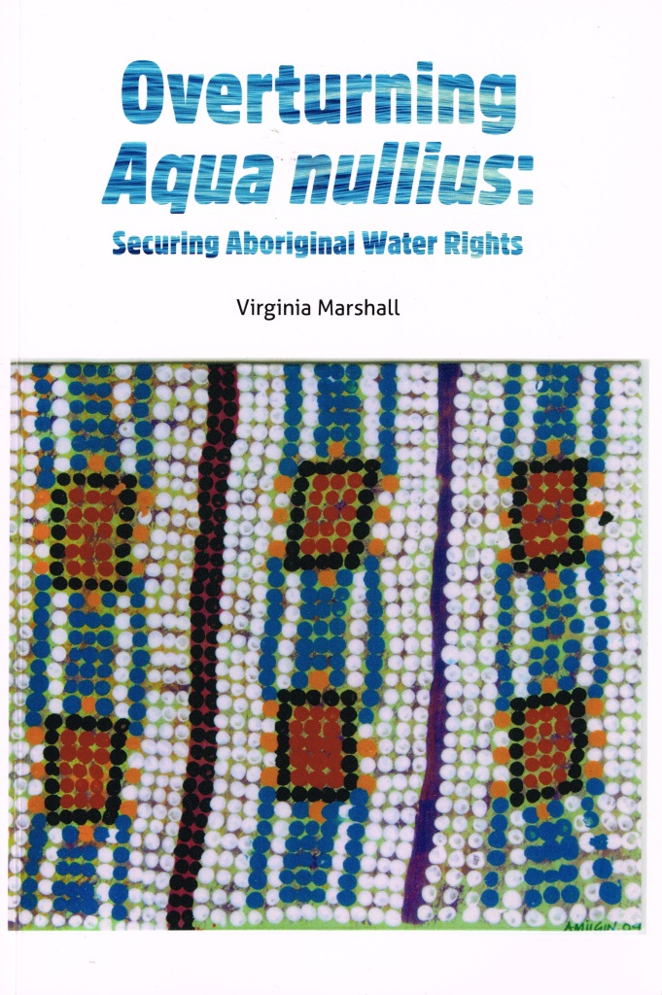
Overturning aqua nullius: Securing Indigenous Water Rights in Australia
“Just as the Australian Law Reform Commission report of 1986 may have expedited the arrival of land rights for Australia’s indigenous peoples, so I believe Dr Marshall’s book will influence the future of water rights as they affect Aboriginal and other indigenous peoples in Australia. Looked at from the perspective of history, we are definitely on a path to correct the injustices and silences of the past. Dr Marshall can be proud of the contribution she has made to the rights of her people by writing this book. Its impact is now a challenge before all Australians.”
The Hon Michael Kirby AC CMG
Published by Aboriginal Studies Press, Canberra, Feb 2017 RRP $39.95
BRISBANE, AUSTRALIA | 18 - 20 SEPTEMBER 2017
MANAGED BY

