Slide 1
International actors and transboundary water governance;
the case of the Ganges-Brahmaputra problemshed
Paula Hanasz
Australian National University
BRISBANE, AUSTRALIA | 18 - 20 SEPTEMBER 2017
MANAGED BY

Slide 2
Agenda
What is the Ganges-Brahmaputra problemshed?
What are the threats it faces?
How are third parties trying to prevent and resolve transboundary water conflicts here?
What effect are these approaches having?

Slide 3
Ganges-Brahmaputra-Meghna basin
Notes:
The problemshed is Nepal, Bhutan, India and Bangladesh, i.e., the whole GBM minus China. This is because only a small portion of the GBM flow comes from Chinese territory, and the main transboundary governance issues happen between Nepal, Bhutan, Bangladesh, and India. I’m also not going to talk specifically about the Meghna because although it is hydrologically part of the wider basin, it is not specifically of international concern.

Slide 4
Water security in this problemshed (1)
The usual suspects:
Vast, poor, and crowded
Rapid population growth = increasing demand for food/energy/water
Effects of climate change
Transboundary disputes over:
Hydropower production
Flood ‘control’
Water sharing agreements

Slide 5
Water security in this problemshed (2)
Context-specific threats and challenges
History of conflict and distrust
Weak regionalism
Zero-sum attitudes to water sharing
Securitisation of water
Improved water governance is not a priority for India, Nepal, Bhutan and Bangladesh

Slide 6
How are threats being addressed?
Third parties = international organisations, aid donors, especially World Bank
Theory of change: good governance increases cooperation between riparian states and decreases conflict
South Asia Water Initiative favours:
Negotiating benefit sharing outcomes
Facilitating Track II dialogue

Slide 7
But these approaches…
Ignore power asymmetry between riparian states
Do not address historical grievances
Are not increasing relative importance of transboundary water governance on political agendas of riparian states

Slide 8
So what?
Context is everything
No one actor or one approach can mitigate or resolve transboundary water conflicts
Benefit sharing and Track II dialogue alone are not enough…
…but they are still part of the puzzle of transboundary water conflict and cooperation

Slide 9
Paula.Hanasz@anu.edu.au
@paulahanasz

Slide 10
Australia’s leading Public Policy School Crawford School of Public Policy
www.crawford.anu.edu.au
www.crawford.anu.edu.au

Slide 11
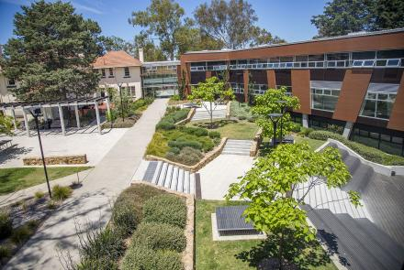
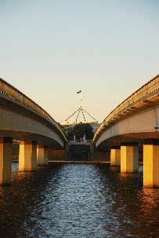
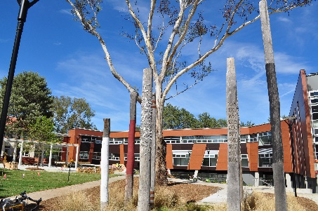
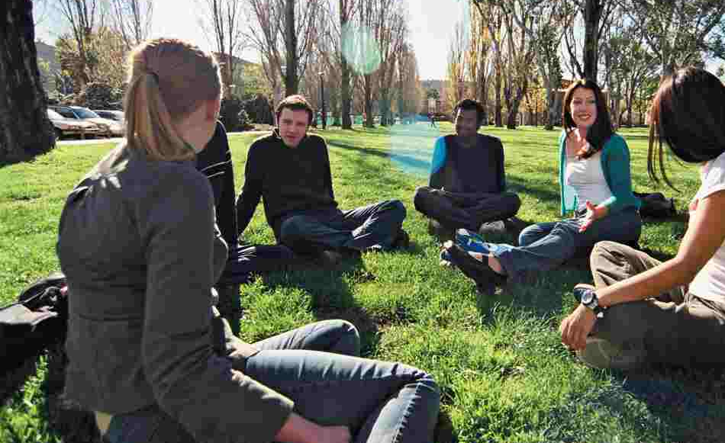
Crawford School of Public Policy Graduate Degrees
Economics
Master of International & Development Economics
Master of Environmental & Resource Economics
Governance
Master of Public Policy (specialised MPP’s in Development Policy, International Policy, Economic Policy, Social Policy, Policy Analysis)
Master of Public Administration
Master of National Security Policy
Resources, Environment & Development
Master of Climate Change
Master of Environmental Management & Development
PhDs
Short Executive Training
For more information www.crawford.anu.edu.au
CRICOS 00120C

