Slide 1
The role of River Basin Organizations in sustainable management of river basins: case studies from around the world.
Frederick Bouckaert
PhD Candidate
School of Earth and Environmental Sciences
University of Queensland
BRISBANE, AUSTRALIA | 18 - 20 SEPTEMBER 2017
MANAGED BY

Slide 2
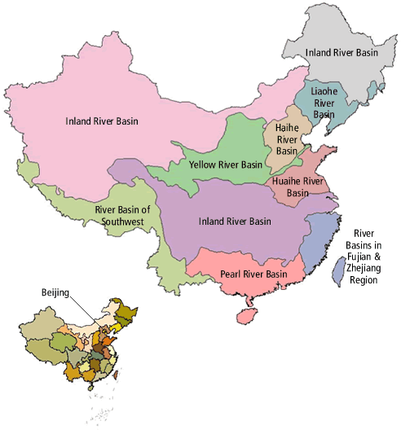
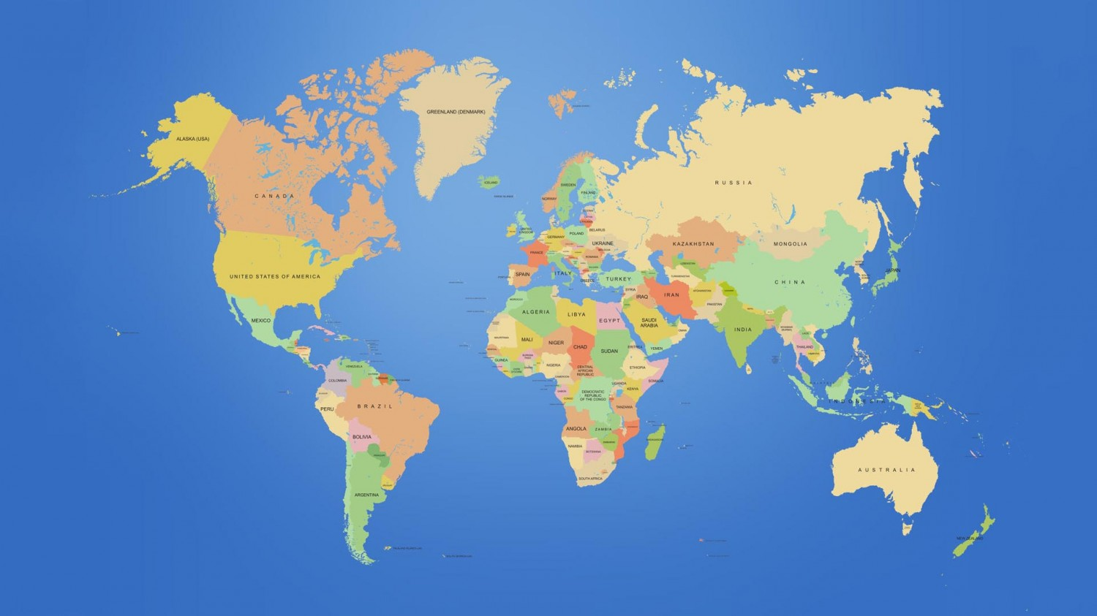
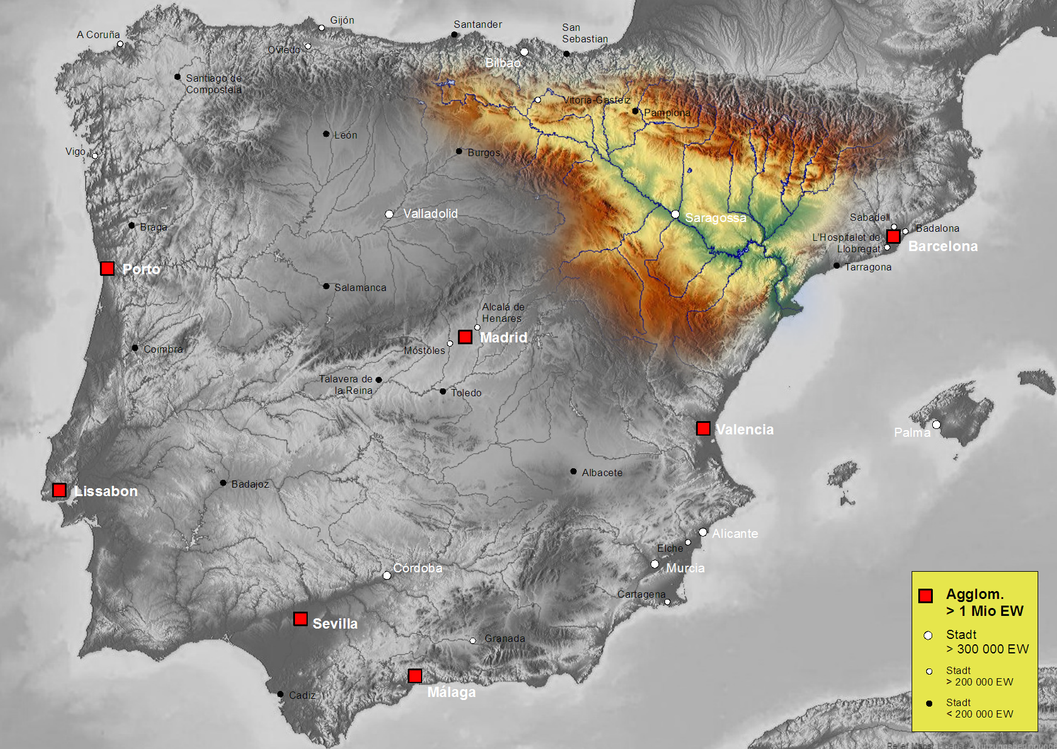
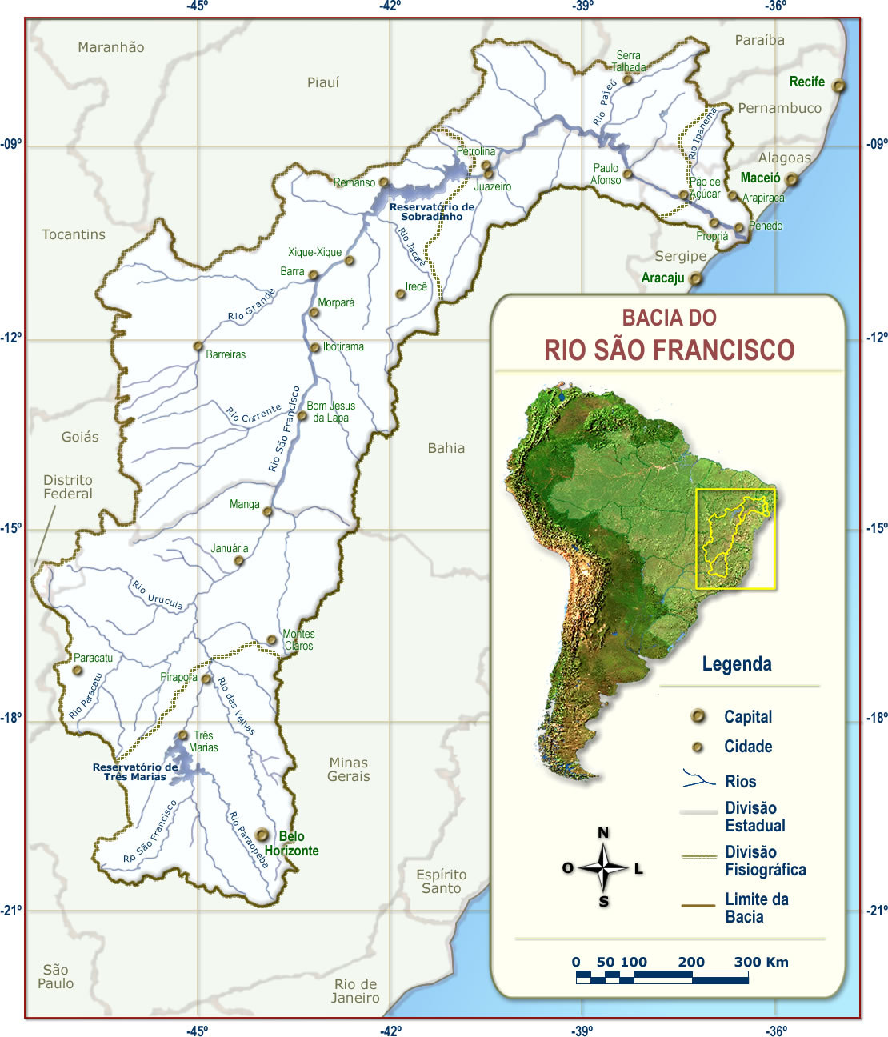
Introduction: governance and management of river basins
The problem of sustainable management
Management framework
Diagnostics: indicators and targets
Capacity profiles
Examples from three case studies:
Yellow River Basin, China
Ebro River Basin, Spain
São Francisco River Basin, Brazil
Summary and conclusions
References & Acknowledgments
O u t l i n e
BRISBANE, AUSTRALIA | 18 - 20 SEPTEMBER 2017
MANAGED BY

Slide 3
Introduction: Governance and management of river basins
Emerging threats:
Overallocation
Changes in hydrology and water quality
Degradation of freshwater ecosystems
Stakeholder conflicts (overt and covert)
Land use change
Climate change
Governance of river basins made up of generic and context specific characteristics
Sustainable water management:
Water security and flood management
Ecosystem services security
BRISBANE, AUSTRALIA | 18 - 20 SEPTEMBER 2017
MANAGED BY

Slide 4
Key Research Question
How can we integrate governance performance with biophysical/ecosystem outcome objectives?
Key components of a proposed conceptual framework
Process: A Theory of Change framework, to guide capacity and target setting at different spatial scales and progress from short term to long term objectives
Performance indicators: A diagnostic framework, to profile governance output capacity and targets, and socio-ecological outcome capacity and targets, with ability to link both profiles and track progress.
BRISBANE, AUSTRALIA | 18 - 20 SEPTEMBER 2017
MANAGED BY

Slide 5
Management framework: providing water and ecosystem services security
Objectives | Activities | Outcomes | Assumptions
Evaluating (long term outcomes) | Monitoring and Evaluation Implementation and alignment with international policy frameworks | (Independent) evaluation Revised Basin Management Plan Renewal of commitments | Long term objectives and indicators remain relevant Forecasts and models reflect real feedback loops
Implementing (intermediate outcomes) | Implementation of management activities Adaptive management | Interim evaluation of intermediate outcomes | Obligations by all stakeholder parties fulfilled
Defining targets (prototyping) (immediate outcomes) | Determine priorities Quantifying management targets and objectives Stakeholder consultations | Prototype Basin Management plan | Agreement reached on prototype
Determining capacity (influential) | Data and knowledge acquisition | Knowledge inventory | Data sharing Sufficient resources
Foundational activities | Governance institutions Stakeholder representation at three spatial scales: reach, catchment, basin | Governance framework System conceptual framework | Stakeholder representation Constructive engagement
4
3
Basin planning : strategic long term to specific measures
2
1
0
BRISBANE, AUSTRALIA | 18 - 20 SEPTEMBER 2017
MANAGED BY

Slide 6
Diagnostics, indicators and targets
External drivers and governance settings
Water allocation
Hydrological connectivity
Provisioning of habitat
Water security
Security of tenure
Connectivity
Strength
Formalisation
Clarity of roles
Transparency
RBO and IWRM
Governance capacity (outputs)
Transformation of material
Erosion and deposition
Nutrient cycling
Carbon
Shipping transport
Heterogeneity
Biodiversity
ES accounting
Rare spp & ecosystems
Diversity of stakeholders
Learning
Adaptive management
Triple loop learning
Generate and share information
Evaluation
Structuring
Modularity
Self-organising capacity
Accountability
Data sharing
Targets
Flexibility
Adaptive mgt.
Recruitment
Pathways and adequate flows
Hydraulic regimes
Dispersal mechanisms
Invasive species
Steering
Authority
Regulatory power
Legal mechanisms
Economic incentives
Ecosystem capacity (outcomes)
River Basin settings
BRISBANE, AUSTRALIA | 18 - 20 SEPTEMBER 2017 hello
MANAGED BY

Slide 7
Capacity profiles
Outputs
Outcomes
1 very poor
2 poor
3 moderate
4 good
5 very good
transformation
of material
heterogeneity
recruitment and dispersal
condition
Year 2
Governance
Year 1
Basin 2
Biophysical condition
Basin 1
BRISBANE, AUSTRALIA | 18 - 20 SEPTEMBER 2017
governance
MANAGED BY

Slide 8
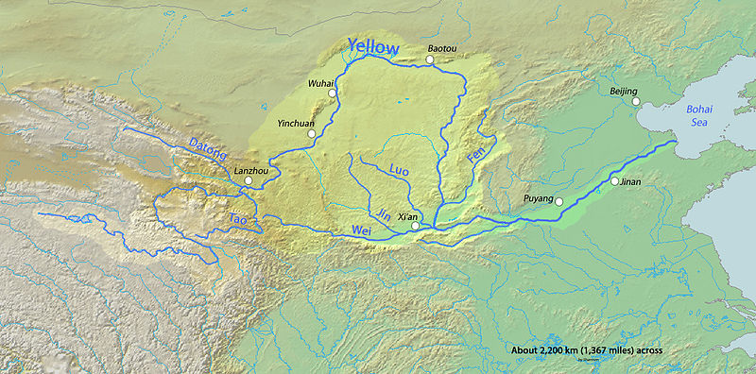
Yellow River Basin
Upper reach:
1.Bayenkala mountains to Langzhou 56% run-off
2. Langzhou to Gobi desert (evaporation>> precipitation)
5400km 9% of population, 17% of agriculture
Middle reach: Loess Plateau: huge sediment loads
Rapid development changes:
Demand exceeds water supply
Accelerated waste water discharge (local industrial development
Need for environmental flows in the lower delta
Flood mitigation (erosion control and management of sediment deposition)
South-north water transfer
Lower reach: suspended river channel; high population, wetlands
BRISBANE, AUSTRALIA | 18 - 20 SEPTEMBER 2017
MANAGED BY

Slide 9
Yellow River Basin
Example: target improved water allocation, to:
Avoid river closure
Allocate some water for end of system environmental flows
Minimize volumes needed in south-north water transfer
We need to focus on improving:
Stakeholder connectivity: strength in collaboration, transparency and clarity of roles
Structuring: accountability and data sharing
Steering: regulatory power and legal mechanisms
Step 2
Step 1
BRISBANE, AUSTRALIA | 18 - 20 SEPTEMBER 2017
MANAGED BY

Slide 10
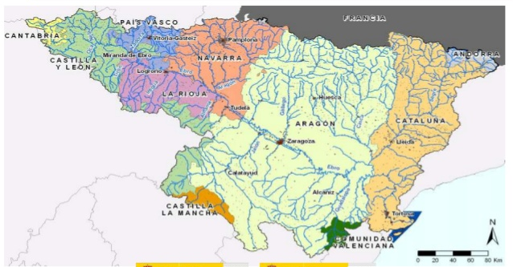
Ebro River Basin
Longest river in Spain: 928 km
Catchment: 85,550 km2
Annual discharge: 14,623hm3
Mean annual flow: 423 m3/s
Highly variable climate with five different regions
Several provinces requiring National governance and EU compliance
Strong top-down complex regulatory approach; stakeholder engagement enshrined in law.
Second Basin Plan 2014
Water transfer plans reason for water conflicts between provinces and national government; RBO is being challenged
BRISBANE, AUSTRALIA | 18 - 20 SEPTEMBER 2017
MANAGED BY

Slide 11
Ebro Basin
Example: water allocation is driven by groundwater connectivity in this case. To improve sustainable management, we need to consider improving stakeholder connectivity:
Improving collaboration strength by restoring trust
Through greater transparency (reducing institutional complexity?)
improving clarity of roles and responsibilities (for water allocation planning)
BRISBANE, AUSTRALIA | 18 - 20 SEPTEMBER 2017
MANAGED BY

Slide 12
São Francisco River Basin
Length: 2,830 km
Catchment: 641,000 km²
55 million inhabitants, largest river entirely in Brazil
Mean annual flow: 2,943 m³/s
Transfer of São Francisco River is a large-scale interbasin transfer to the states of Cerea, Rio Grande do Norte, Paraiba and Pernambuco.
Legal stakeholder representation, but…
Decision-making process is challenged: power imbalance
BRISBANE, AUSTRALIA | 18 - 20 SEPTEMBER 2017
MANAGED BY

Slide 13
São Francisco Basin
Example: water allocation (security and tenure) for small landholders becomes priority objective. In order to improve this, two governance dimensions need to be addressed:
Structuring:
Accountability of government decision making
Modularity: decentralizing means less emphasis on technical, command & control approach
Connectivity:
Greater strength in collaboration through developing trust
Improving transparency also engenders trust
BRISBANE, AUSTRALIA | 18 - 20 SEPTEMBER 2017
MANAGED BY

Slide 14
Summary and conclusions
Preliminary analysis suggests that considering governance indicators in function of biophysical outcome indicators can offer an integrated approach for navigating towards sustainable outcomes
Sub-indicators will need to be refined to reflect contextual objectives, increasing confidence in capacity and target scores. This needs to be done with stakeholder involvement.
Further work is needed to quantify governance scores, by using social network analysis.
Semi-structured interviews will be used to analyze governance profiles and obtain self-assessment inputs into this analysis.
BRISBANE, AUSTRALIA | 18 - 20 SEPTEMBER 2017
MANAGED BY

Slide 15
Thank you. Questions?
Acknowledgments to:
University of Queensland for research support
My advisory panel:
Associate Professor Yongping Wei, School of Earth and Environmental Sciences, University of Queensland
Professor Karen Hussey, Global Change Institute, University of Queensland
Associate Professor Jamie Pittock, Fenner School of Environment, Australian National University
BRISBANE, AUSTRALIA | 18 - 20 SEPTEMBER 2017
MANAGED BY

