Slide 1
Creating a public-private relationship in the Lake Simcoe watershed
Robert Baldwin, General Manager, Planning & Development Lake Simcoe Region Conservation Authority Newmarket, Ontario, Canada
Cheryl Shindruk, Executive Vice President
Shauna Dudding, Senior Vice President Friday Harbour Resort
Geranium Markham, Ontario, Canada
BRISBANE, AUSTRALIA | 18 - 20 SEPTEMBER 2017
MANAGED BY

Slide 2
A story of change…
Conservation Authority
Independent government agency
Environmental and Hazard Regulator
2009 Thiess International RiverPrize Recipient
Geranium
Master planned community developer & builder for 40+ years
Building Industry and Land Development Association’s Home Builder of the Year
Developer of Friday Harbour Resort
BRISBANE, AUSTRALIA | 18 - 20 SEPTEMBER 2017
MANAGED BY
Notes:
Introduce us..
Here to tell a brief story of how together we changed to culture and process
Broke away from the traditional regulator vs. developer

Slide 3
The location for this story…
Lake Simcoe
~500,000 pop.
Water supply and wastewater
High recreation
Ecological value
Significant growth pressure
BRISBANE, AUSTRALIA | 18 - 20 SEPTEMBER 2017
MANAGED BY
Notes:
Wtaershed is the fastest growing

Slide 4
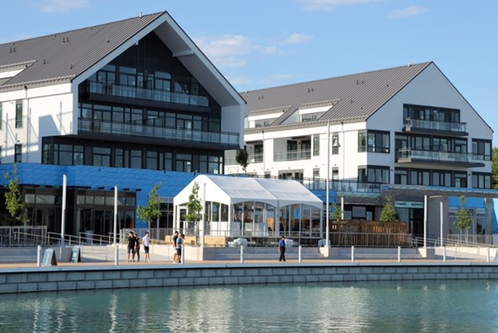
The Catalyst for Change…
Friday Harbour
Redev of 50-year old degraded marina
600-acre master planned resort
18-hole Championship golf course
200 acre nature preserve; 7.5km trail system
Marina-based Village
2,000 units, incl 400 hotel suites
1,000 slip marina
Commercial, Conference, Performing Arts uses
Multi-Activity Beach Area
$2.5B capital investment
BRISBANE, AUSTRALIA | 18 - 20 SEPTEMBER 2017
MANAGED BY
Notes:
Cheryl – Catalyst for Change
2001/2002 plan for redevelopment of an old degraded 110-acre marina, single use site, on private services
600-acre mixed use, four-season resort development on modern water and wastewater services extended to the site….
opportunity to provide sanitary services to 1700 existing homes in area….environmental benefit to the lake.
Pedestrian-oriented, recreation-based community…..golf, boating, hiking, fishing,
[80k sf. Commercial uses…shops, restaurants etc; 50k sf Conference facilities]

Slide 5
What drove need for change…
Project scale & magnitude
Environmental significance of Lake Simcoe
Engaged community – both for and strongly opposed
Recognition that existing regulatory approach was inadequate
Senior leadership from both parties wanted and needed a positive outcome
Socially, environmentally, politically
BRISBANE, AUSTRALIA | 18 - 20 SEPTEMBER 2017
MANAGED BY
Notes:
Cheryl –
FH was a large complex development, with many parts, on a sensitive water body.
Lake Simcoe was under stress due to phosphorus levels.
Community groups in the watershed were engaged in initiatives to protect/enhance water quality; opposed to development and especially FH.
Other groups supported the development for its recreational and community development benefits.
Existing/traditional approach was an us v. them; rules-based approach; checklist approach; submit; comment; resubmit; etc
Regulator vs developer. Public-vs-private fight; win-lose proposition;
Our team consisted of highly qualified scientists – limnologists, marine engineers, ecologists, civil engineers, planners etc
Senior leadership at CA and Geranium saw the creative potential to embrace a new approach based on Science, Collaboration, Innovation to achieve socially valued outcomes. (win-win-win). We were a lake-based development. This beautiful water resource would be our lifeblood. We needed to get this right.
We challenged ourselves to uncouple development and environmental degradation. Water Resource must be protected and economic benefits generated for the Town, Region and Province.
Substantial economic benefits – jobs both during construction and at build out; on-site jobs and spin-off jobs; BP fees; Dev. Charges; property taxes.
At build-out: $190 million annual spending by visitors, resort owners in local & regional economy. $30 million annual revenue to all levels of govt.

Slide 6
Engagement & Transparency
Continuous and Comprehensive Dialogue
Multi-Agency Round Tables
Week-long design charrette at outset was first in watershed
Early identification of opportunities and constraints
Principle-based
Exploration of Solutions
BRISBANE, AUSTRALIA | 18 - 20 SEPTEMBER 2017
MANAGED BY
Notes:
Cheryl – consultation since 2002 design charrettes; first in our watershed; involved all agencies including
Opportunities and constraints on table in day 1, and discussing resolutions, innovations
Wanted to get away from the old model of sending a box of reports, which would be circulated to numerous review bodies, waiting for them to be reviewed; waiting to receive the many questions that would undoubtedly come; responding with volumes of material in reply; and repeat until no more questions.
Then move on to the next set of more detailed approvals needed and start process over again.
Very inefficient (lethargic?), insular, linear thinking, silo-based approach.
By engaging early and often, with full transparency between agencies and stakeholders, could unleash the critical thinking potential of the process; dialogue fostered the establishments of principles which then allowed for a robust exploration of solutions.

Slide 7
Focus on outcomes…
Establish collective agreement on “desired” outcomes
Watershed objectives
Measurable Indicators
Collaborative assessment to achieve and enhance performance
BRISBANE, AUSTRALIA | 18 - 20 SEPTEMBER 2017
MANAGED BY
Notes:
Shauna –
Socially valued outcomes – how we go from social opposition to agreement to acceptance to implementation
Embracing the project when initially - 5 stages of mourning
Establish principles, and then let the details fall based on direction from principles and objectives
Net Zero phosphorous development
Adaptive management in the face of paralysis by analysis – Resilience to climate change, etc.
Fully integrated development concept

Slide 8
Science versus Fake News…
Fake news and rumors spread like invasive species and can have the same effect
Science and facts are critical
Early engagement and agreement on requirements
Communicate science in open and approachable environment
BRISBANE, AUSTRALIA | 18 - 20 SEPTEMBER 2017
MANAGED BY
Notes:
Not rely on the public perception, science should rule the day
Science, collaboration and innovation – lessons learned
Communicating science in a comprehensive manner – reachable, respectful, clear translation,
Fake news can only be combated with science and engagement (early engagement!), dialogue to get to mutual understanding on POV, don’t necessarily have to agree

Slide 9
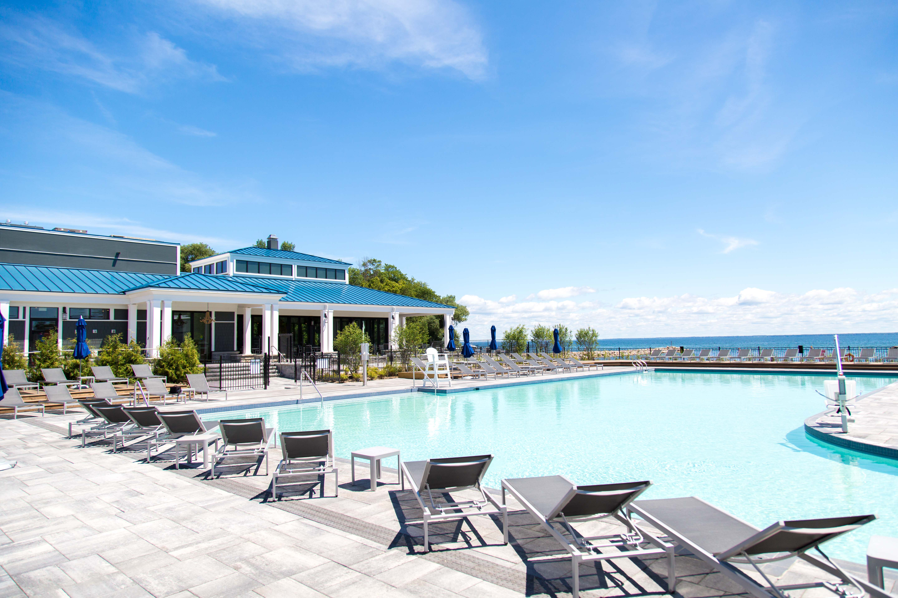
The next chapter…
Education
Kids Camps
Conservation Foundation partnership
Homeowner engagement
Adaptive Management
Informs future development
Create knowledge database
Performance Monitoring
Knowledge Transfer
Development Industry
Municipalities
Provincial Ministries
NGO’s, community groups
Other Conservation Authorities
BRISBANE, AUSTRALIA | 18 - 20 SEPTEMBER 2017
MANAGED BY
Notes:
Knowledge transfer – to other Conservation Authorities, municipalities, developers (local to Reginoal, Provincial, Federal and to other development industry)
NGO’s,
Transfer of approach, Design charettes

Slide 10
Top 5 Takeaways
Transparency, Open Dialogue & Collaboration
Embrace Innovation & Ideas
Focus on Outcomes
Celebrate Successes
Collective Ownership
BRISBANE, AUSTRALIA | 18 - 20 SEPTEMBER 2017
MANAGED BY
Notes:
Rob
Courage of CA

Slide 11
“Fight for Minimums or Partner for Maximums”
BRISBANE, AUSTRALIA | 18 - 20 SEPTEMBER 2017
MANAGED BY
Notes:
Full partnership

Slide 12
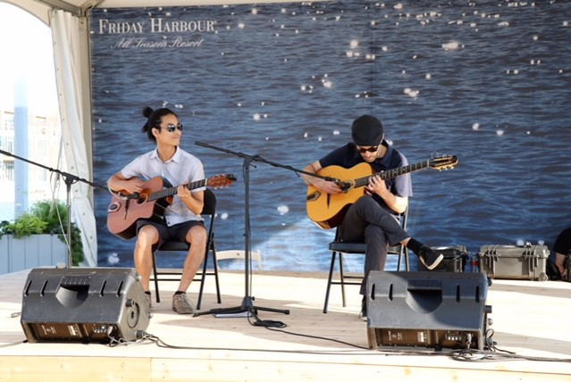
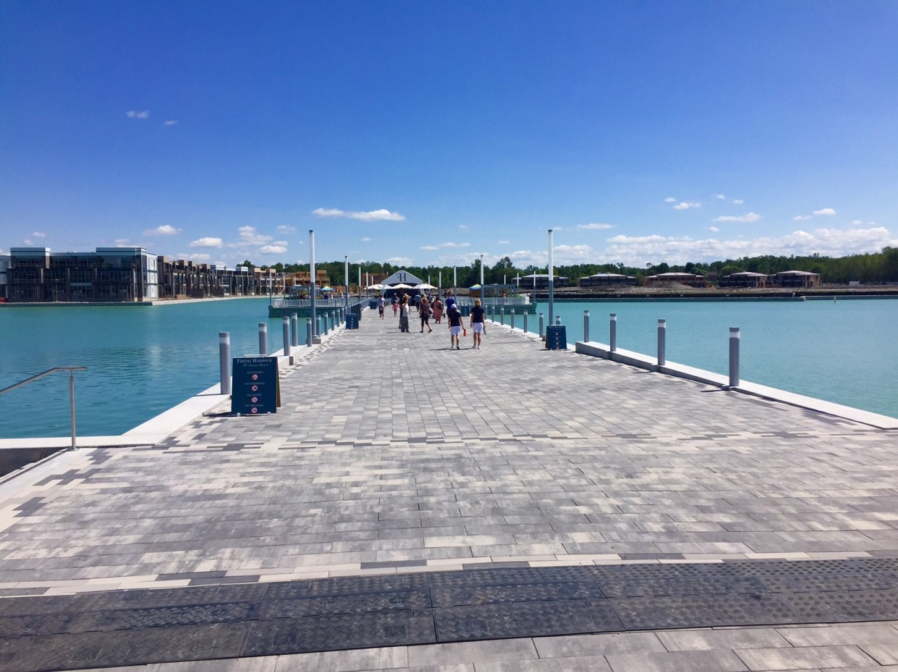
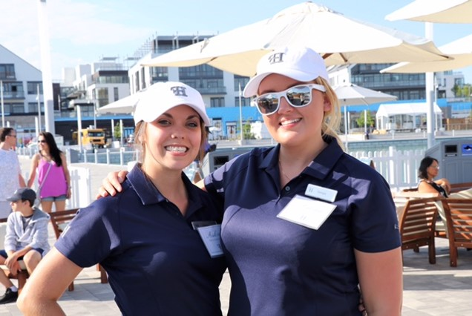
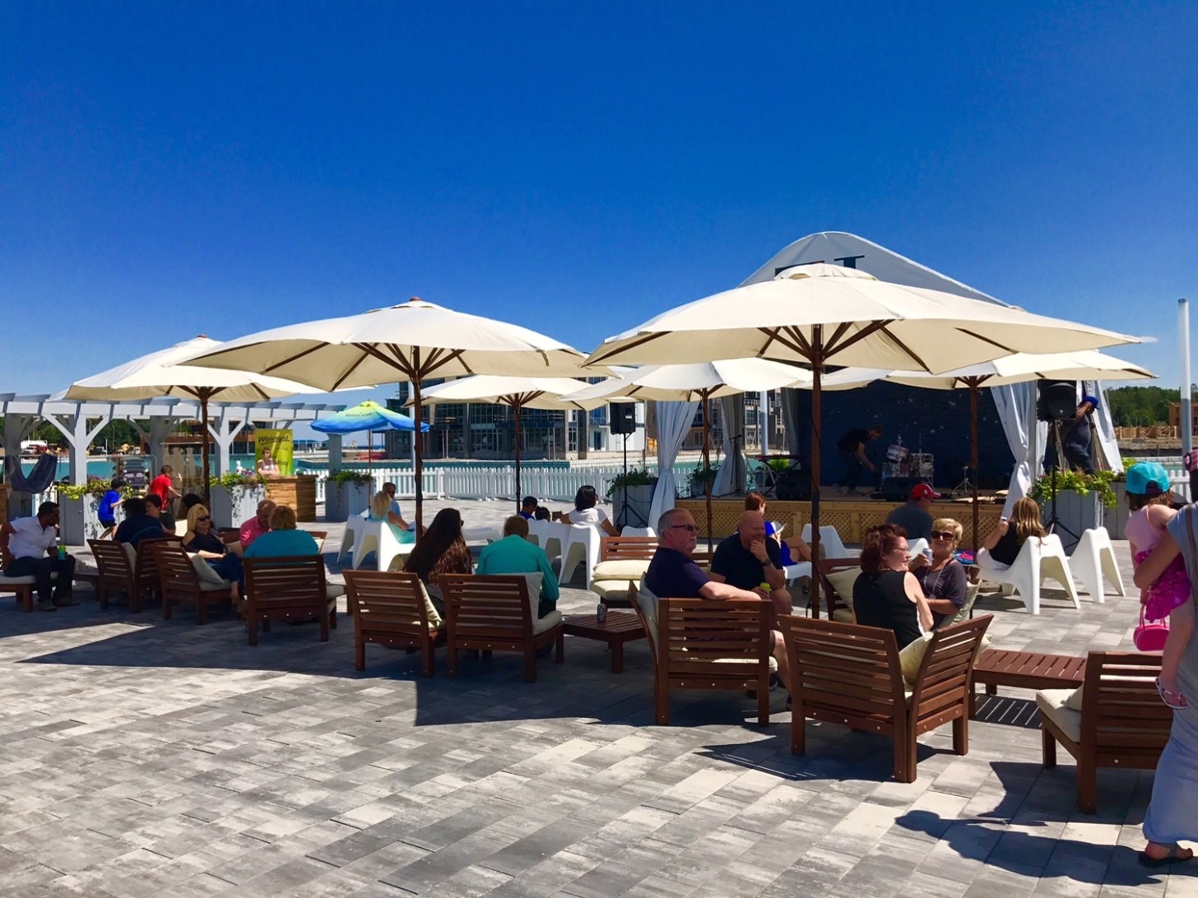
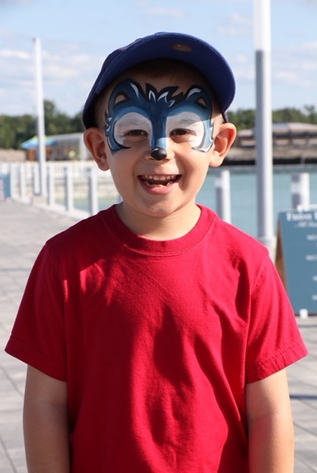
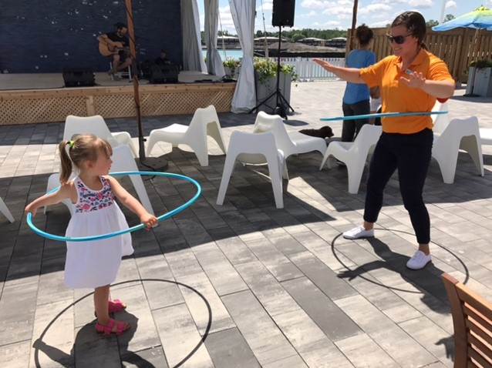
BRISBANE, AUSTRALIA | 18 - 20 SEPTEMBER 2017
MANAGED BY

Slide 13
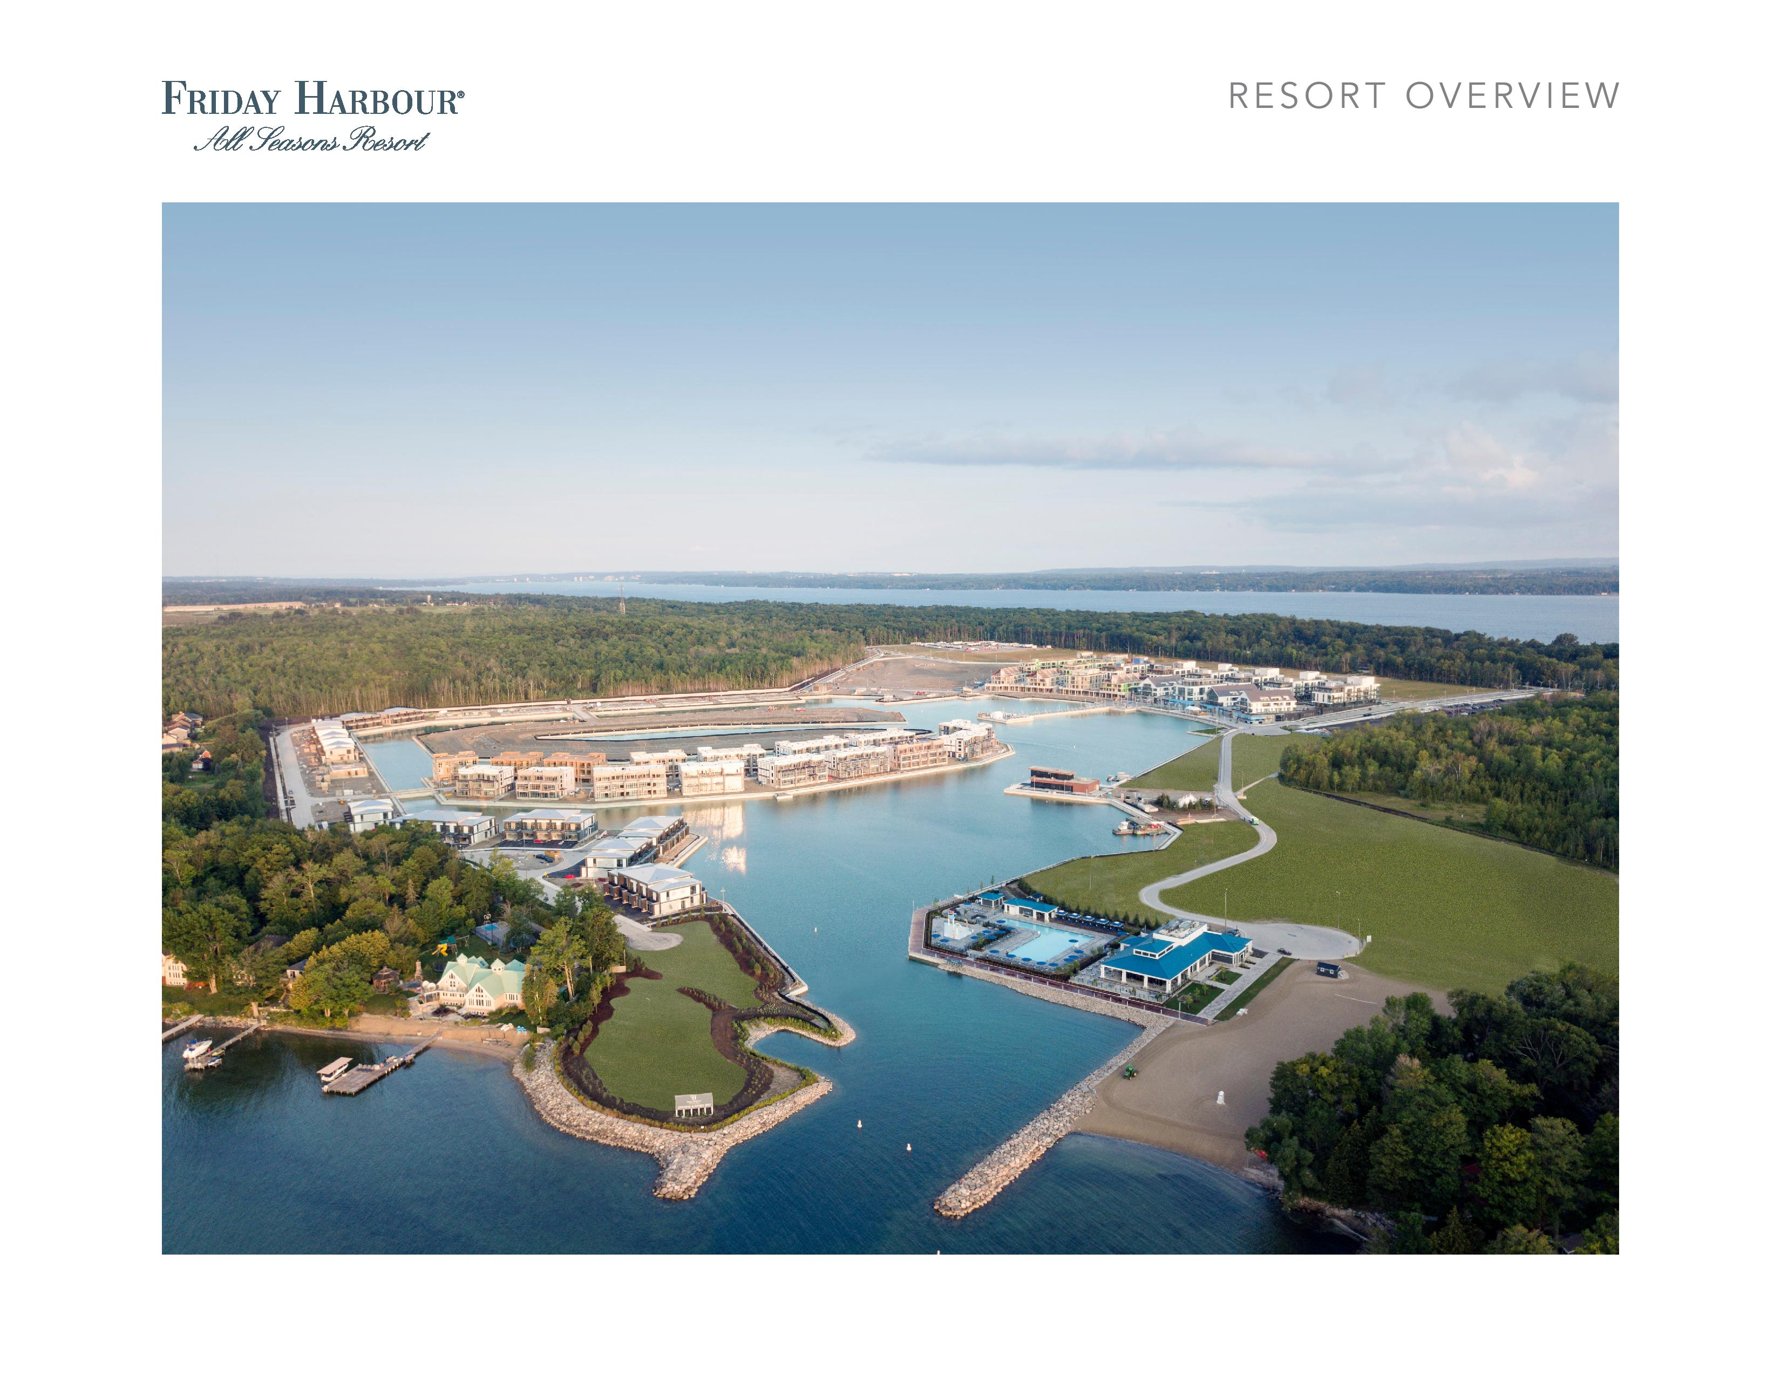
BRISBANE, AUSTRALIA | 18 - 20 SEPTEMBER 2017
MANAGED BY

