Slide 1
CAPACITY BUILDING FOR YOUNG WATER PROFESSIONALS (YWP)
EXPERIENCE SHARING FROM SRI LANKA
CHATHURA SANJEEWA W.G.
KUSUM ATHUKORALA
RUWAN LIYANAGE
BRISBANE, AUSTRALIA | 18 - 20 SEPTEMBER 2017
MANAGED BY

Slide 2
CONTENTS
Introduction
YWPs
Problems associated with Water Sector & YWP’s role
Active engagement of YWP
Issues faced by YWPs
Lessons Learnt
BRISBANE, AUSTRALIA | 18 - 20 SEPTEMBER 2017
MANAGED BY

Slide 3
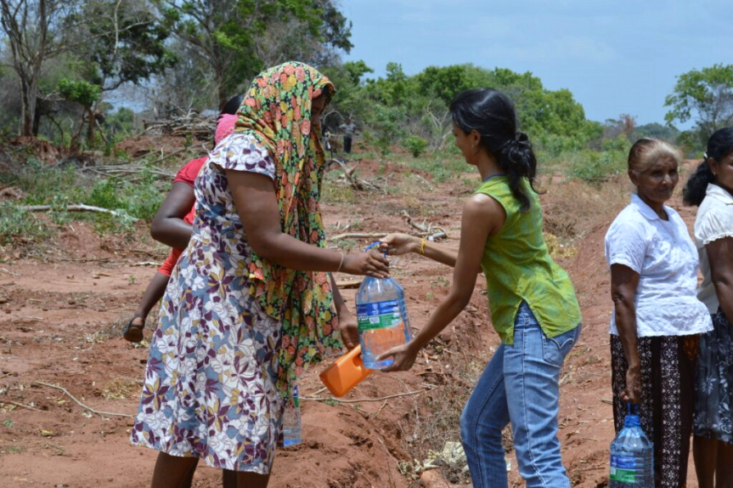
INTRODUCTION
According to the World Bank (2015), access to improved water sources are;
91% for the Global population
96% in Sri Lanka
94% in India
91% in Pakistan
87% in Bangladesh
BRISBANE, AUSTRALIA | 18 - 20 SEPTEMBER 2017
MANAGED BY

Slide 4
INTRODUCTION
Water is the reinforcement of life and development
Water is becoming a more and more scarce resource day by day
Sustainable use of water is essential for the betterment of the society
To achieve SDGs looking after “clean water and sanitation” is important
BRISBANE, AUSTRALIA | 18 - 20 SEPTEMBER 2017
MANAGED BY

Slide 5
WHAT CAN YWPs DO?
WHO ARE YWPs?
BRISBANE, AUSTRALIA | 18 - 20 SEPTEMBER 2017
MANAGED BY

Slide 6
YOUNG WATER PROFESSIONALS ARE...
In-charge of future water sector
Professionals working in the water sector and below 35 years (including Water, Irrigation, Environmental Engineers, Administrators working in water related sectors, Sociologists, Chemists, Private sector & Active NGO professionals, Doctors, PHI, Accountants, Agricultural officers, Researchers, etc.)
YWPs has a vital role as one of the main stakeholders in water management as well as in achieving Sri Lanka Water Vision 2025
BRISBANE, AUSTRALIA | 18 - 20 SEPTEMBER 2017
MANAGED BY

Slide 7
BEING READY TO THE FUTURE…
Challenges in near and mid-term future for the water sector are clear
Accordingly there is a role to be played by senior water professionals to strengthen future intellectual assets of the country
Make sure YWPs are represented and heard in
Policy & Decision Making Processes
Advocacy
Management, Financing, O&M
Research & Documentation
-A Place For Everyone And Everyone In Their Place-
BRISBANE, AUSTRALIA | 18 - 20 SEPTEMBER 2017
MANAGED BY

Slide 8
BRISBANE, AUSTRALIA | 18 - 20 SEPTEMBER 2017
MANAGED BY

Slide 9
PROBLEMS ASSOCIATED WITH WATER SECTOR & YWP’S ROLE
Water & Population Explosion
Water & Climate Change
Water & Catchments
Water & Disaster Management
Water Quality Emergencies
Water & Sanitation
Viyadiguna water source (1930s)
BRISBANE, AUSTRALIA | 18 - 20 SEPTEMBER 2017
MANAGED BY

Slide 10
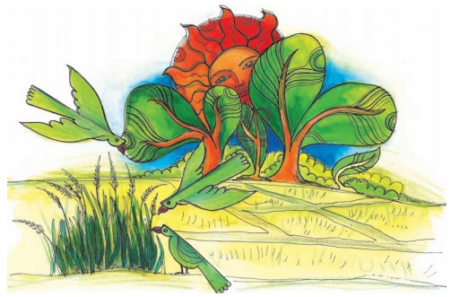
PROBLEMS ASSOCIATED WITH WATER SECTOR & YWP’S ROLE
Water & Awareness creation
Water & Traditional knowledge
Water economy & Financial assistance
Usage of New Technology
Gender Friendly Working Place?
BRISBANE, AUSTRALIA | 18 - 20 SEPTEMBER 2017
MANAGED BY

Slide 11
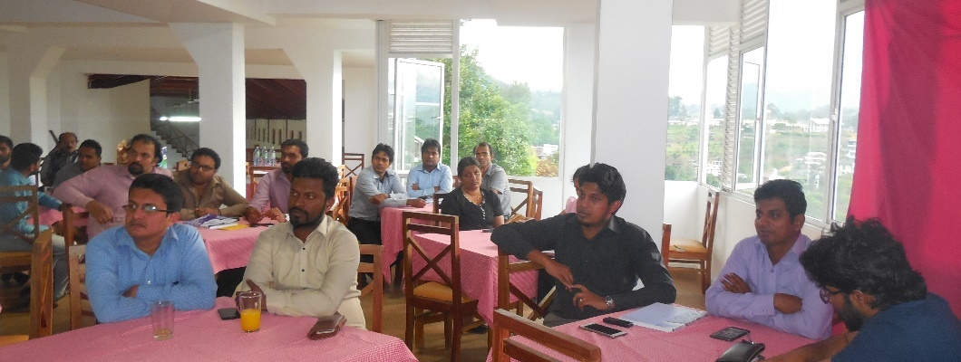
ACTIVE ENGAGEMENT OF YWP
Partnership in action : With collaboration with SLWP and IESL (Uva) YWPs Uva group formulation
IWRM capacity building program and lectures on GIS
BRISBANE, AUSTRALIA | 18 - 20 SEPTEMBER 2017
MANAGED BY

Slide 12
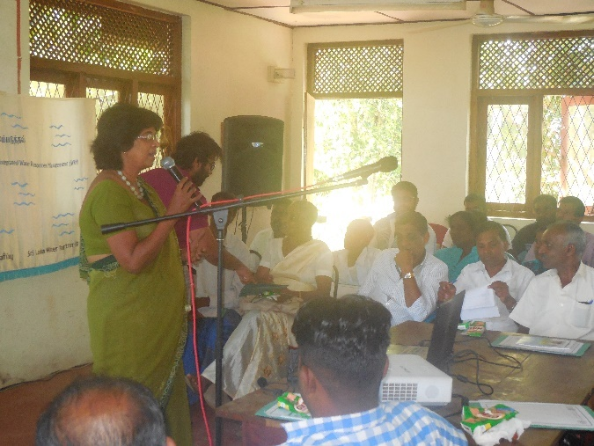
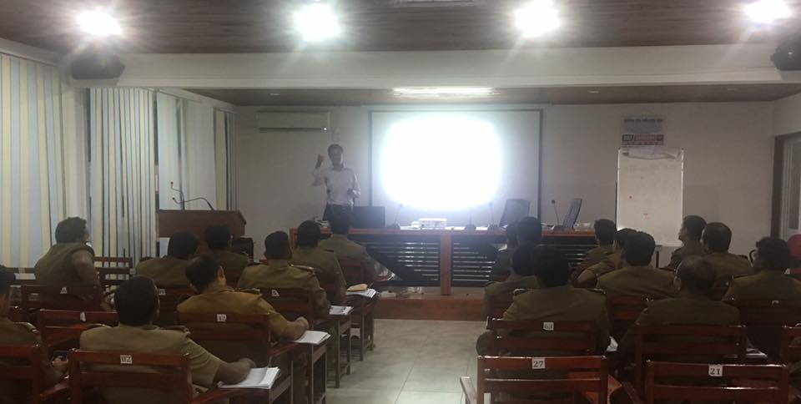
ACTIVE ENGAGEMENT OF YWP
Climate Change Adaptation programs for CBOs
Programs for Estate Sector
WSP workshops for Health officers
BRISBANE, AUSTRALIA | 18 - 20 SEPTEMBER 2017
MANAGED BY

Slide 13
ACTIVE ENGAGEMENT OF YWP
Climate Change Adaptation programs for CBOs
Programs for Estate Sector
WSP workshops for Health officers
BRISBANE, AUSTRALIA | 18 - 20 SEPTEMBER 2017
MANAGED BY

Slide 14
ACTIVE ENGAGEMENT OF YWP
Youth watch groups formulation in Aranayaka
Social media is being used as tool for networking
SLWP YWP program was expanded with a webinar conducted with technical support from TransformationFirst.Asia which brought together YWP opinions
BRISBANE, AUSTRALIA | 18 - 20 SEPTEMBER 2017
MANAGED BY

Slide 15
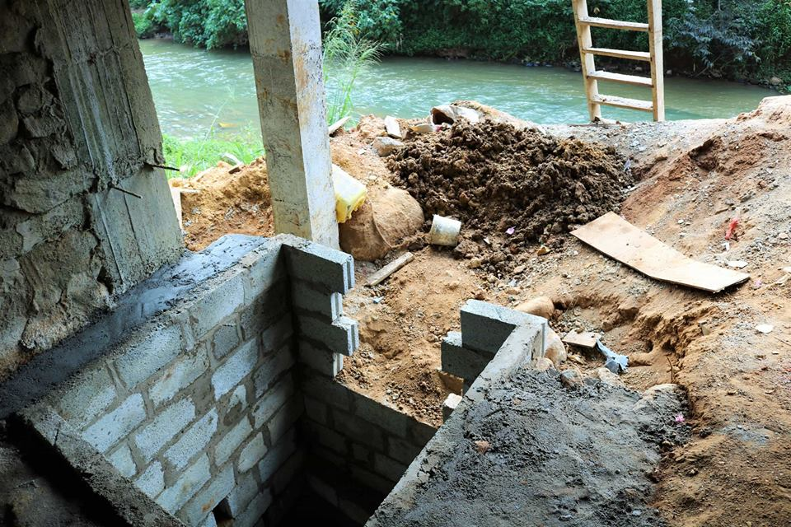
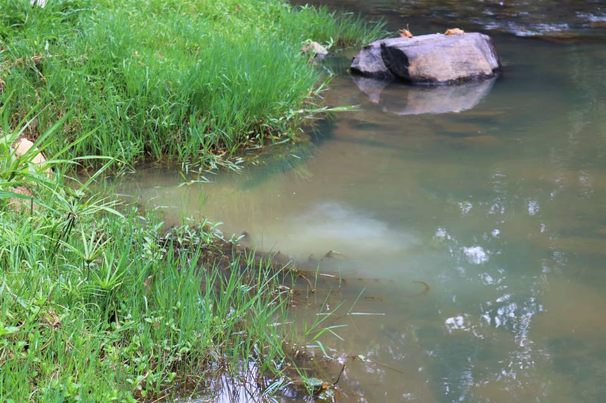
ACTIVE ENGAGEMENT OF YWP
Tree plantation programs
Transect walks: Informing administrators about the people and locations where water deterioration taken place
BRISBANE, AUSTRALIA | 18 - 20 SEPTEMBER 2017
MANAGED BY

Slide 16
ISSUES FACED BY YWPs
Mainly in Government institutes: time consuming traditional procedures
You are still junior, so you have to listen all from your seniors​
Hard to find talented resource persons to organize and give responsibility
Gender discrimination
Priority for opinions are given based on age not knowledge
Resistance for new ideas or proposals
BRISBANE, AUSTRALIA | 18 - 20 SEPTEMBER 2017
MANAGED BY

Slide 17
ISSUES FACED BY YWPs
Issues when collecting people
Lack of recognition: dealing with other institutes or officers
Time constraints for effective training programs
Busy age: specially for women
Time required to prepare educational qualifications: commitment to work?
BRISBANE, AUSTRALIA | 18 - 20 SEPTEMBER 2017
MANAGED BY

Slide 18
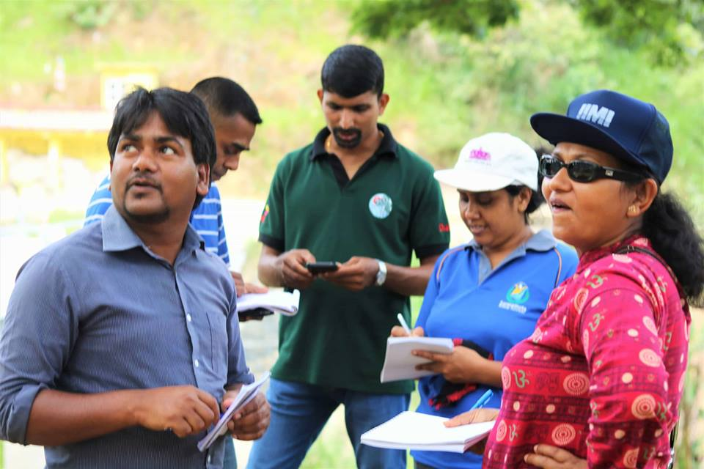
LESSONS LEARNT
Coordination & Partnership : To be stable even in the shaking ground
In the means of both Process oriented approach and Results oriented approach
One of the dimensions of the partnership: having a common vision
BRISBANE, AUSTRALIA | 18 - 20 SEPTEMBER 2017
MANAGED BY

Slide 19
LESSONS LEARNT
Systematic sharing of best practices
Respect for the principle of subsidiarity
The humanitarian imperative
National level framework for YWPs
Communicate with Global level
BRISBANE, AUSTRALIA | 18 - 20 SEPTEMBER 2017
MANAGED BY

Slide 20
We, the people in a society who talk about environmental sustainability, who act for sustainability, who destroy the environment and create a world which needs sustainability.
Environment Day is yesterday, today and tomorrow.
Transect walk along Badulu Oya –
Thank you !
BRISBANE, AUSTRALIA | 18 - 20 SEPTEMBER 2017
MANAGED BY

