Slide 1
Basin-scale Environmental Watering:
Five years as the CEWH
David Papps
Commonwealth Environmental Water Holder
BRISBANE, AUSTRALIA | 18 - 20 SEPTEMBER 2017
MANAGED BY

Slide 2
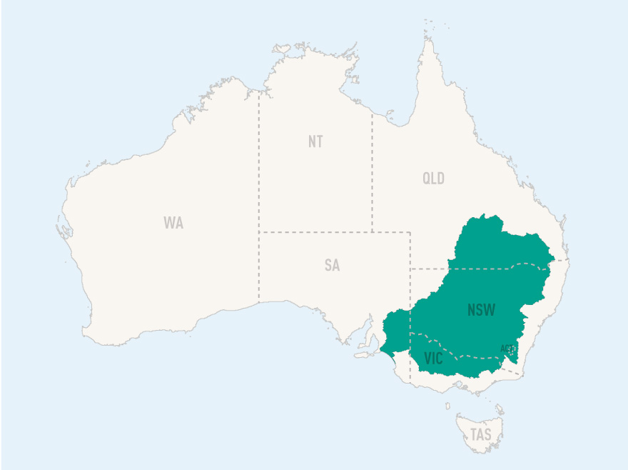
Established under The Water Act 2007, the Commonwealth Environmental Water Holder manages water to protect and restore the Basin’s environment
16 endangered mammals
45+ Aboriginal nations
35 endangered birds
Diverse population
46 species of native fish
14% of Australia’s landmass
Over 30,000 wetlands, 16 Ramsar listed
$6.9 billion = gross value of irrigated agricultural production
(2014-15)
40% of Australia’s farms
65% of Australia’s irrigated farming
Notes:
Water Act 2007
Act within and meet statutory requirements to maximise environmental outcomes
Protect and restore environmental assets – rivers, floodplains and wetlands
Alongside a prosperous agricultural powerhouse

Slide 3
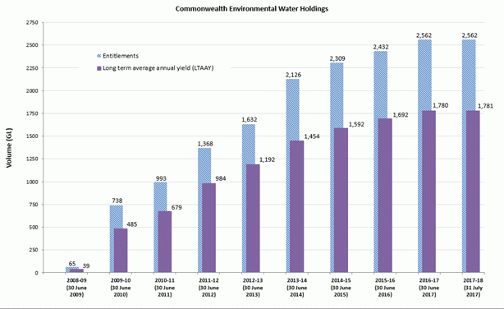
Manager of a significant and growing volume How much? 2750GL (but…) About $3.4 billion public asset
Notes:
Talk to slide
As at 31 July 2017, the Commonwealth environmental water holdings total 2,562,429 megalitres of registered entitlements with a Long term average annual yield of 1,780,592 megalitres.

Slide 4
Complex and controversial
80 entitlement types
5* States
17 Basin Plan regions
Politically/Socially “nuanced”
Notes:
The graph shows water availability and water use as at 30 June each year from 2008-09 to 2016-17, and as at 31 July for 2017-18.
As at 31 July 2017, over 7,277 gigalitres of Commonwealth environmental water has been delivered to rivers, wetlands and floodplains of the Murray-Darling Basin.

Slide 5
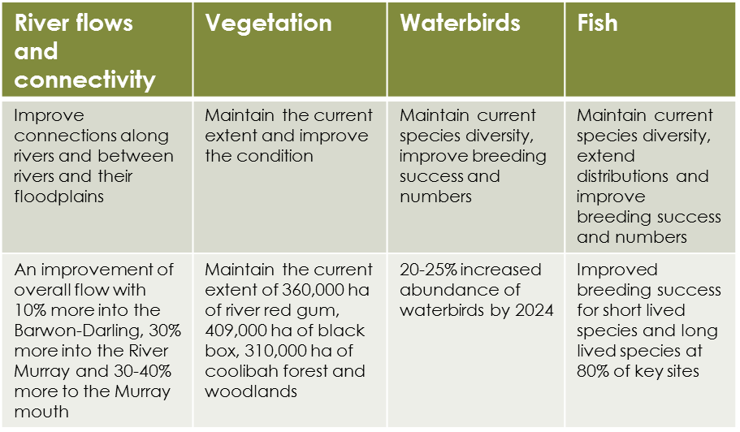
What are we trying to achieve?
Basin-wide environmental watering strategy
Four high-level outcomes
Multiple specific, measurable targets
Notes:
These four ecological outcomes are:
River flows and connectivity
Vegetation
Waterbirds
Fish
Intro to next slide: So how does the Commonwealth Environmental Water Office’s approach to environmental water delivery aim to achieve these outcomes?

Slide 6
Our approach to environmental water management uses latest science, local knowledge and partnerships Natural floods; planned ewater; operational flows
Notes:
Talk to slide through CEWO feedback loop for the planning, implementation and review of environmental watering actions.
The planning, delivering and monitoring of Commonwealth environmental water is helping to build knowledge about the best way to get positive outcomes, based on what works and what doesn’t work.

Slide 7
Three choices…
 | Use it | Deliver water to meet identified environmental demands
 | Hold it | Carry water over for use in the next water year (‘carryover’)
 | Trade it | Trade (sell or buy) water for equal or greater environmental benefit or invest in environmental activities
Notes:
In addition to using environmental water, the Commonwealth Environmental Water Holder may: Hold on to the water and carry it over for use in the next water year – this is referred to as ‘carryover’, or Trade - sell or buy water - for equal or greater environmental benefit.
There is also an option to investment the proceeds of allocation trade on environmental activities, where certain criteria are met. You can comment on our discussion paper for our proposed Investment Framework by going to our website and having your say before 30 November 2017.

Slide 8
Natural cues inform planning, management & monitoring
EXTENDED DRY
WET TO DRY
MODERATE OR AVERAGE
WET FOLLOWING DRY
EXTENDED WET
Notes:
The management of Commonwealth environmental water is driven by two key factors:
Demand:
Watering needs are considered on the basis of ecological condition, wetting and drying cycles and the time since last watering.
We also plan for ‘in case of emergency – water here’ events such as waterbird breeding and hypoxic black water events
Water availability (supply):
The amount of water we have to use during a year can limit the scope of watering actions and environmental outcomes.
Commonwealth environmental water is subject to fees and charges and receives the same allocations as equivalent entitlements held for consumptive use.
We do this sort of planning annually for each catchment
Intro to next slide: so, how do we adapt our planning and management when the unexpected happens?

Slide 9
Monitoring + Evaluation
Linked to Plan and Strategy Outcomes Framework
Monitoring ecological responses to environmental watering
Complementing monitoring by MDBA and States
Independent, expert and transparent evaluation
Continuous improvement and innovation
Notes:
Commonwealth environmental watering is part of long-term Basin Plan reform. This means that in some areas, results will take many years to fully emerge. Nonetheless early monitoring is showing progress.
Some examples from the Murray and Murrumbidgee catchments include:
Murray
Fish:
In May 2015, juvenile Murray Cod were detected in the Lower River Murray - were very had been found in this reach for the previous decade - which makes the finding an excellent indication of improving river health.
In October and November 2015, Golden Perch and critically endangered Silver Perch spawned in the Mid Murray in response to environmental flows, with juvenile Silver Perch being found in the Edward-Wakool system.
Other environmental outcomes were also achieved for waterbirds, floodplain vegetation communities and the export of millions of tonnes of salt through the Murray Mouth.
Murrumbidgee River System
Fish: Repeat Golden Perch and Silver Perch spawning along the river channel between November and December 2014.
Other environmental outcomes also achieved included watering wetlands and floodplains to improve vegetation condition and support the breeding of water birds.
Intro to next slide: This next slide shows another great example of the kind of ecological outcomes that environmental water can support.

Slide 10
Localism: building a social licence
Being a good neighbour
Engagement and participation not just consultation
Accessing and utilising local knowledge and experience – what we heard and what we did with it
Getting to know people and communities – respect and trust
Active partnerships (managed devolution) – doing more with local organisations such as Aboriginal groups and irrigation trusts.
Regional staff (and everyone else getting out and about)
Demonstrating outcomes, especially locally
Notes:
. . . we are bringing the community and our partners on a journey. We are building a social licence through encouraging people to participate both in the actions, monitoring and outcomes, wherever possible. We are planning and then executing and really seeing the results!
Our Local Engagement Officers play a critical role in this engagement process, including sharing the results of monitoring and evaluation with landholders and the broader community is a critical part of engaging locally.

Slide 11
The journey so far…
More than 7300GL delivered since 2008-9
Coordinated water events between catchments over large spatial scales
Monitoring and evaluation demonstrates significant results
mitigating blackwater
positive fish outcomes over lifecycles
supported natural water bird breeding
native vegetation recovery
connecting rivers, wetlands and floodplains
improving water quality
Notes:
. . . BUT in the mean time we are kicking goals!
Speak to slide
Intro to next slide: We are fostering a culture of continuous improvement and innovation in the Office and we are looking to the future.

Slide 12
What is necessary to grow success?
Building social licence 2.0 – trust; credibility; support
Political support at all levels
Resist tinkering with the architecture
Think in ecological timeframes
Expand and improve monitoring and evaluation and thence contemporary best practice in adaptive management

Slide 13
What is necessary to grow success?
Basin States do what they promised – key rule changes; fix big constraints; cultural change (Animal Farm)
Improve management of ewater in unregulated systems – more science and innovation
Groundwater – what, where and how?
Greater focus on water quality
Integrated catchment management (as if we wanted it to work)

Slide 14
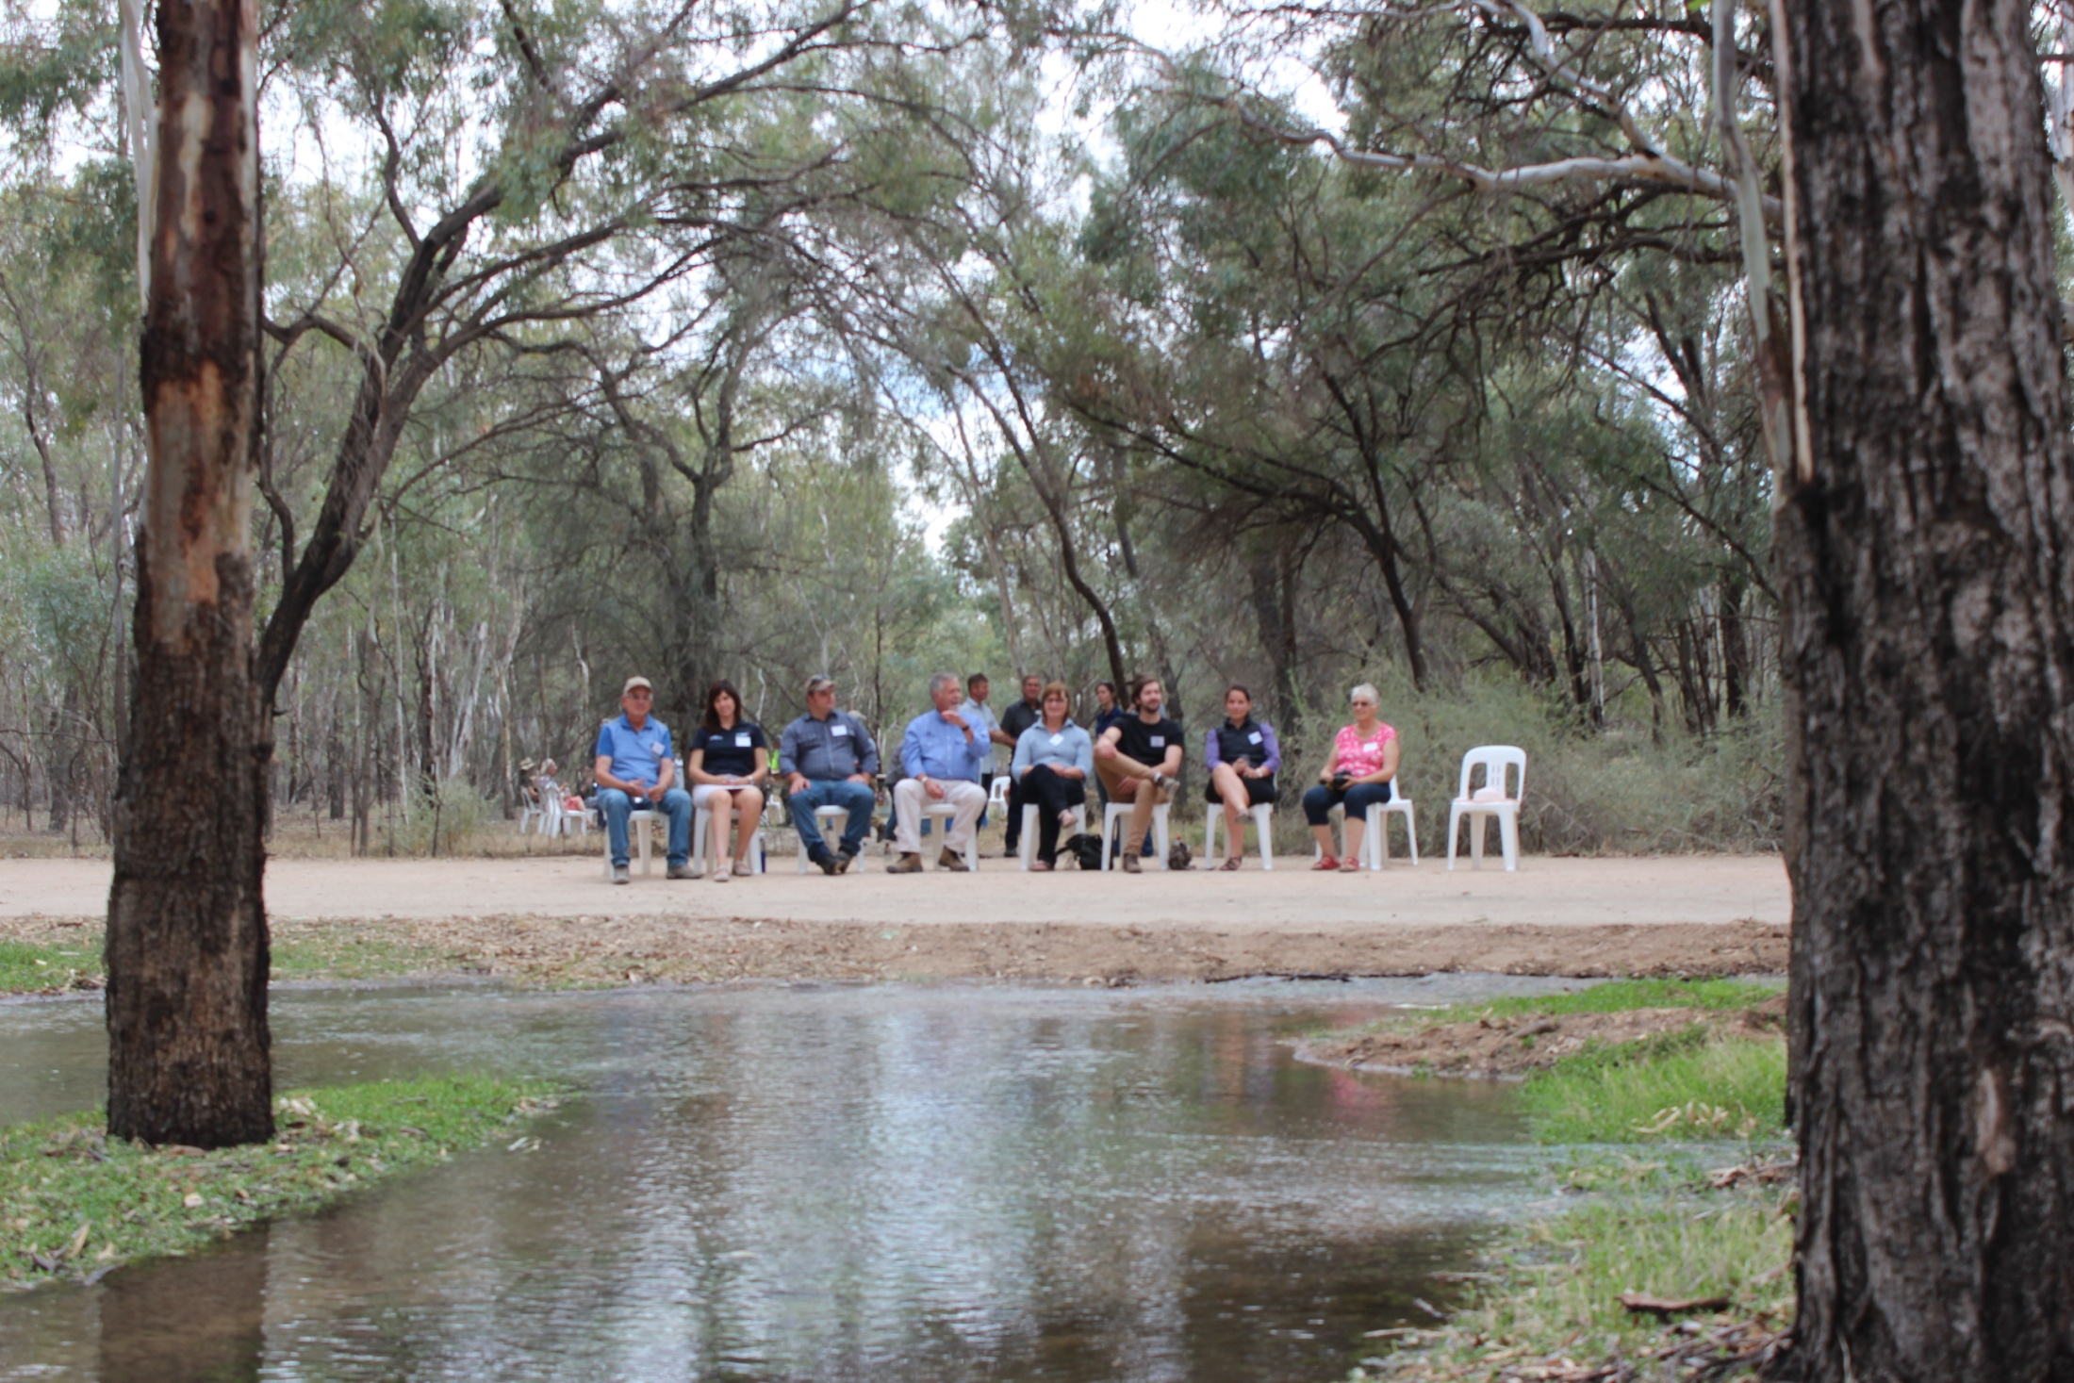
Questions?
We welcome feedback
ewater@environment.gov.au http://www.environment.gov.au/water/cewo
Follow us on twitter: @the CEWH

