Slide 1





Flows, habitat, connectivity and cooperation:
Place your
logo here
recovering native fish in northern Victoria
Phil Slessar and Mark Toomey
BRISBANE, AUSTRALIA | 18 - 20 SEPTEMBER 2017
MANAGED BY

Slide 2
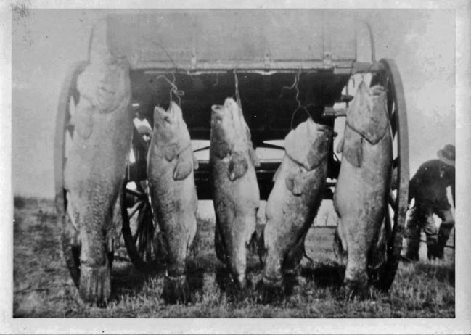
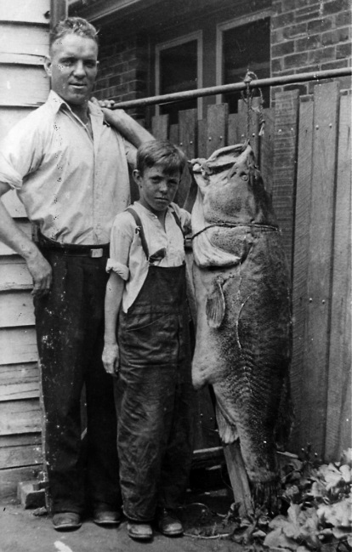
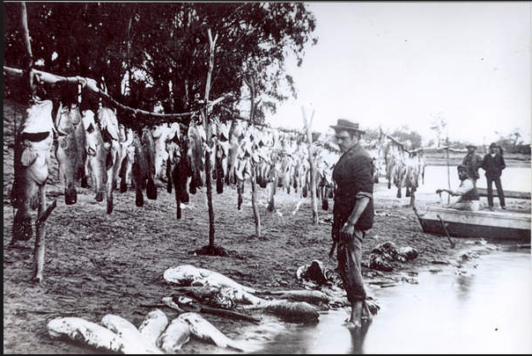
What once was
Historically there were huge numbers of large bodied fish

Slide 3
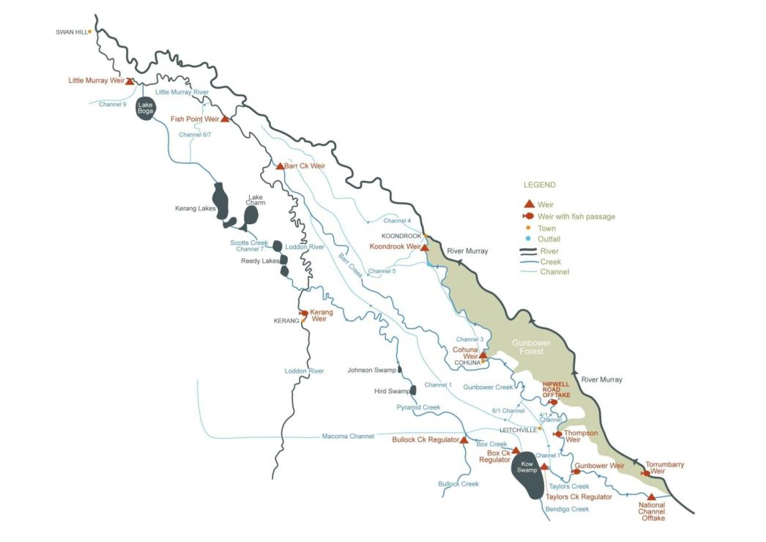

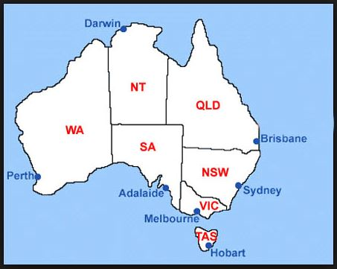
Where is the highway?
Lower Loddon River
Murray River
Little Murray River
Gunbower Forest
and Creek
Pyramid Creek
Notes:
Integrated management to rehabilitate native fish populations
Improve connectivity- fish ways
Improve habitat - large wood, deep pools and riparian vegetation (including fencing and weed control)
Improve flow management – environmental water and consumptive water en-route

Slide 4
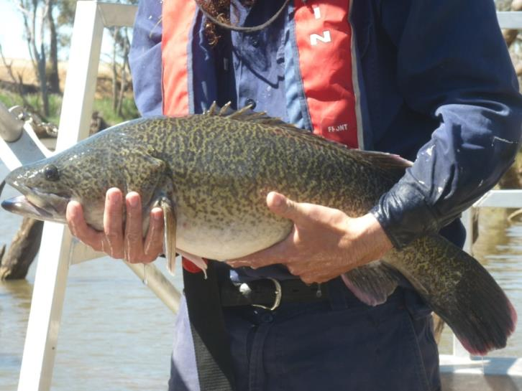
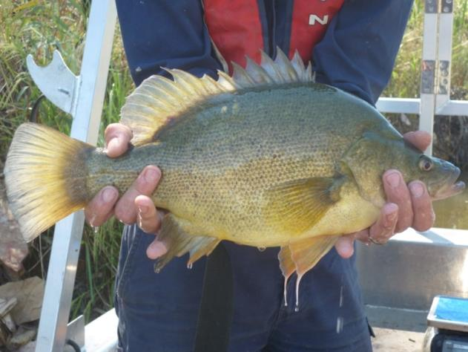
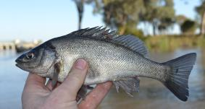
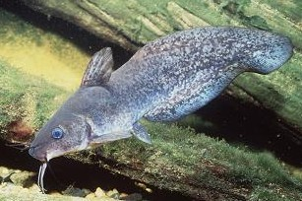
Golden perch
Murray cod
Silver perch
Catfish

Slide 5
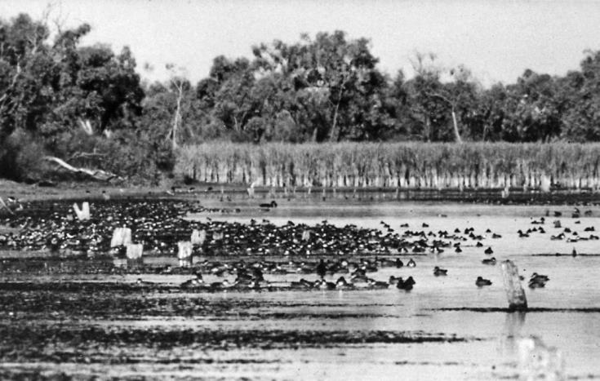
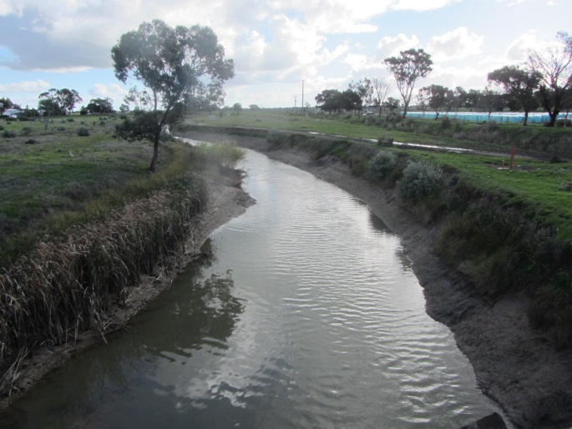
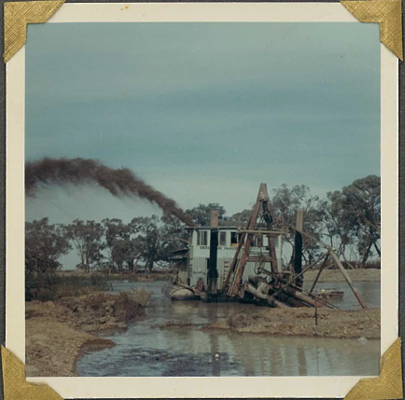
Why has it changed?
System heavily modified
  Channelisation
  De-snagging, clearing
  Obstructions
  Water regime
10% of pre-settlement populations
Pyramid Ck pre dredging
Dredging in Pyramid Ck, 1968
Pyramid Ck, 2017
Notes:
Channelised – increased channel capacity
Clearing, de-snagging increased hydraulic efficiency
Obstructions – regulating structures
Altered water regimes – irrigation
Huge impact on native fish migration patterns
Large bodied native fish populations declined
Populations isolated
Historic pathways disrupted
Habitat decline

Slide 6
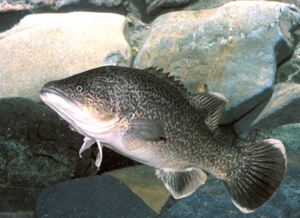
Native Fish Recovery Plan –
Gunbower Creek, Pyramid Creek & lower Loddon River
Addressing three essential ingredients for healthy native fish populations
Habitat
Flow
Connectivity
Notes:
The Plan sets out our recipe for success. It draws on experience from other projects across the Murray Darling Basin and the world.
The Plan highlights the three key ingredients for success.
FLOW, CONNECTIVITY and HABITAT
So many rehab projects focus on just one element – but you won’t achieve your goal of self sustaining diverse native fish populations by doing this.
Often dealt with separately in environmental projects EG. Koondrook weir has fishway, but no flow and the habitat upstream is poor – not going to have fish recovery.
This recovery plan sets out strategic on-ground actions that address all three issues – key to success

Slide 7
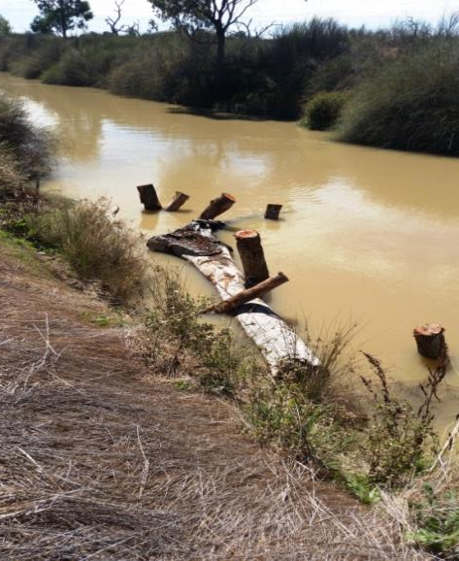
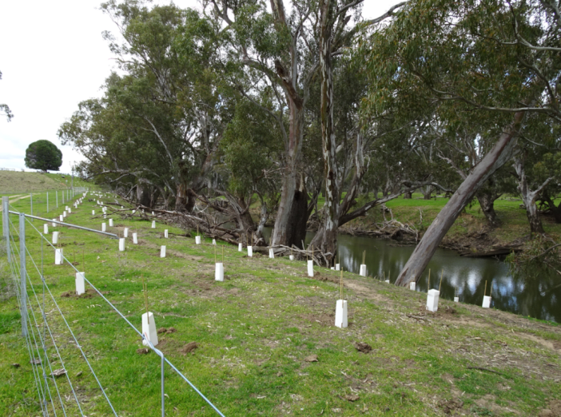
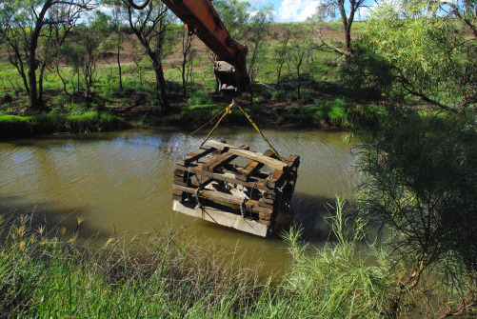
Habitat
Fencing and revegetation
Snag piles
Fish ‘hotels’
Notes:
Reinstatement of snag piles
Rehabilitating Pyramid Creek
Revegetation of river banks and fencing
Shade, bank stability, source of LWH
Managing threats
Screens on irrigation channels and pumps
First time in Australia
Long term socio-economic benefits
Improved opportunities for recreational fishing, tourism and local industry

Slide 8
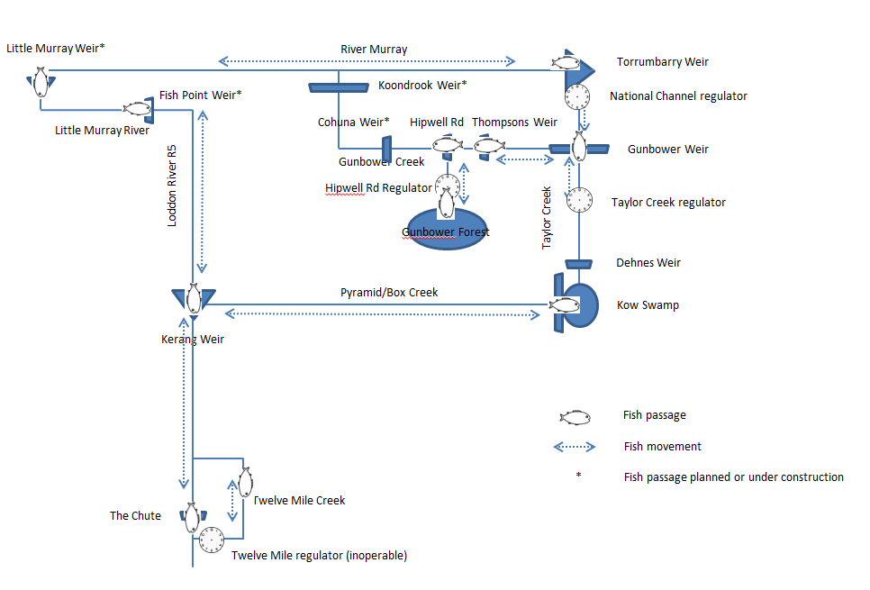
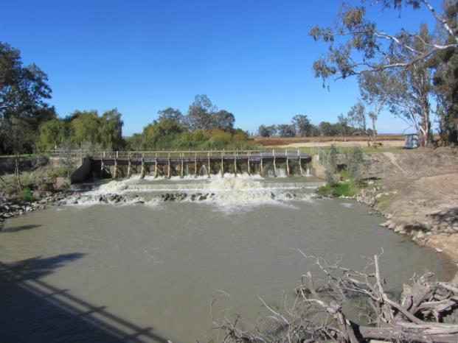
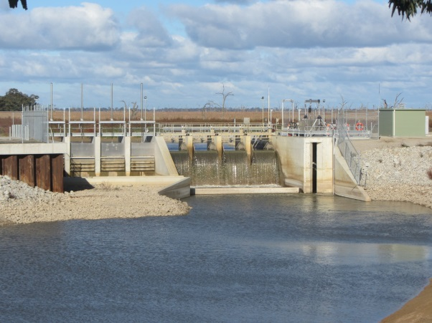
Connectivity & movement
Fish lock structure

Slide 9
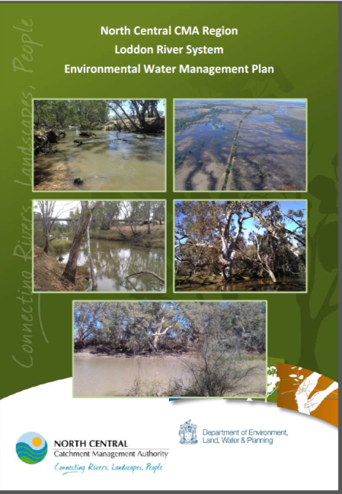
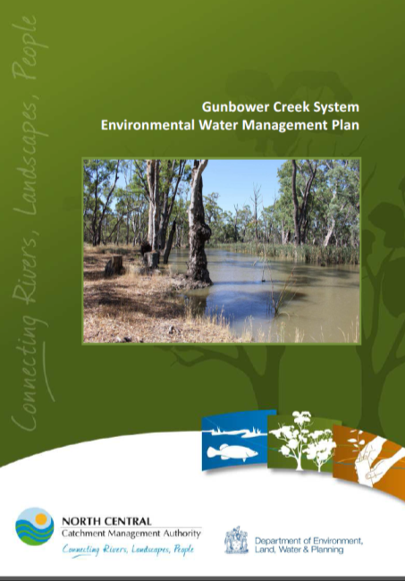
Flow
Environmental Water Management Plans (EWMPs)
  10 year planning horizon
  Inform annual planning
  Working within the irrigation system
Notes:
EWMPs developed in 2014/15. These will be used to inform the annual seasonal watering process.

Slide 10
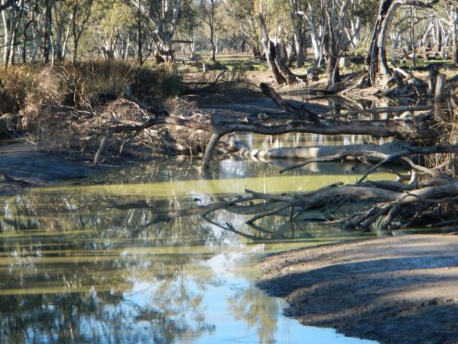
Pyramid and Gunbower Creeks
Seasonally inverted flows
  Irrigation water delivered from spring to autumn (“irrigation season”)
  Cease to flow, habitat elements exposed at the wrong times
Environmental flows can piggy-back on consumptive water to smooth out the hydrograph

Slide 11
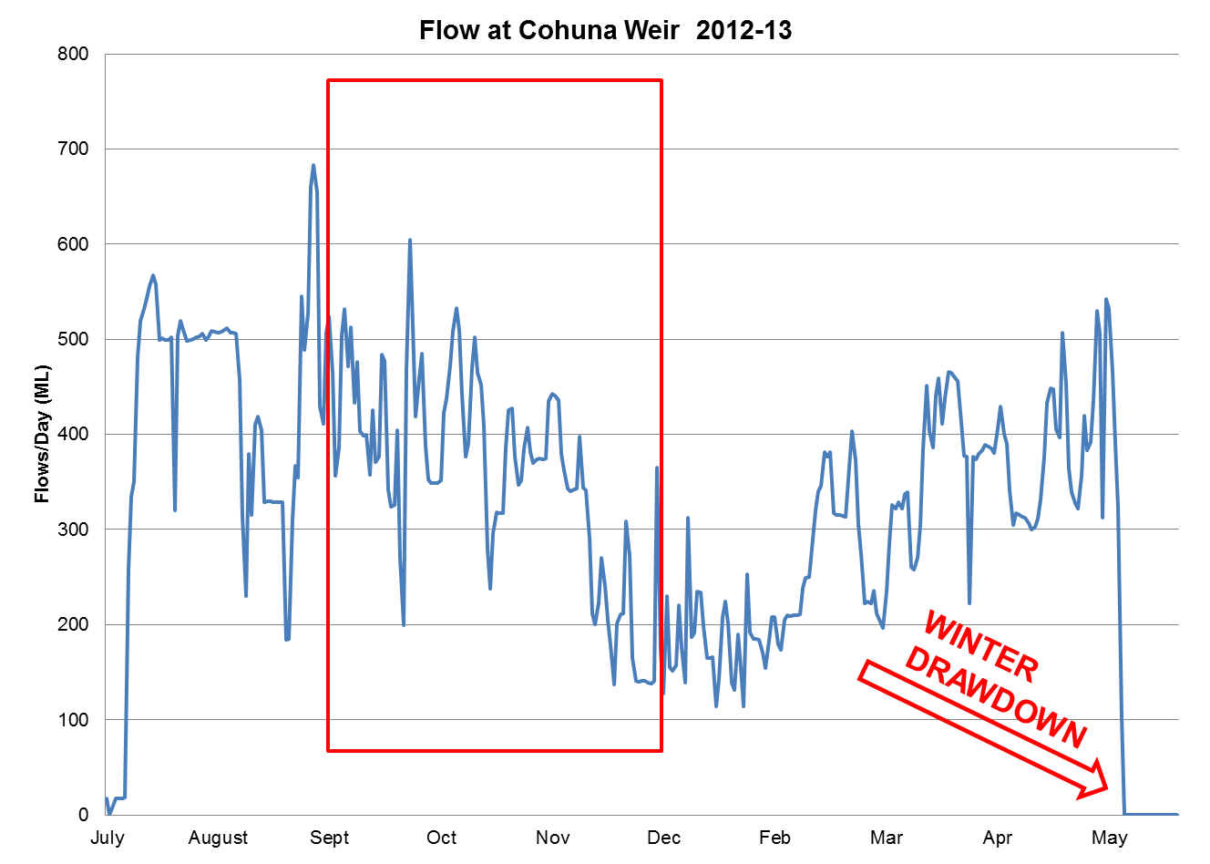
Hydrology without environmental water
Rapid and extreme flow and water level fluctuations

Slide 12
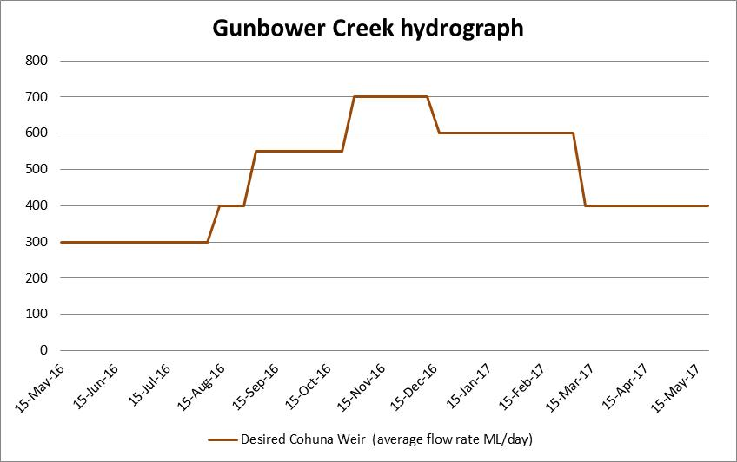
Spawning and survival fish hydrograph
Larval survival
Movement & mating
Spawning/ nesting
Over winter survival
Over winter survival
Monitoring shows Murray cod age cohorts corresponding to the delivery of the hydrograph

Slide 13
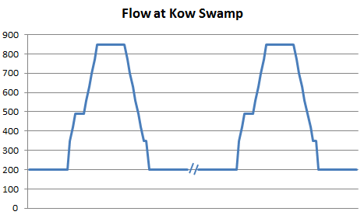
Migration fish hydrograph
Movement & breeding
Maintain adequate water depth for survival
Movement & dispersal
Spring
Autumn

Slide 14
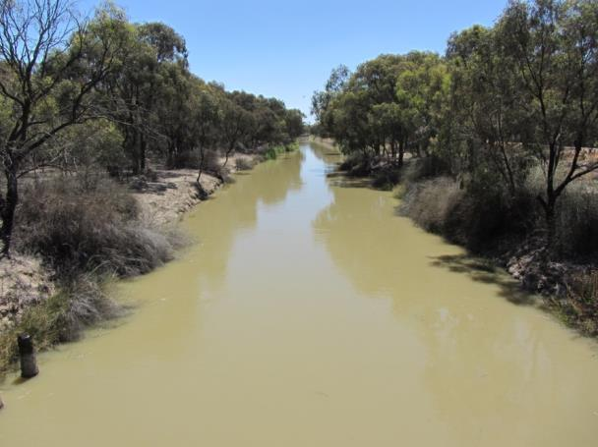
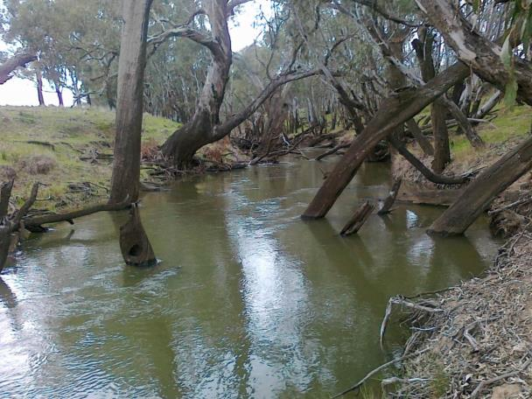



Loddon River-Pyramid Creek environmental flow
Pyramid Creek
Loddon River
Notes:
Im Mark from VEWH, here to talk about an environmental flow delivered in the Loddon River / Pyramid Creek in April 2017
This could not be achieved without cooperation and cordination of many partners and for this flow they are:

Slide 15
Where is the highway?
Murray River
Kerang Weir
Loddon River
Pyramid Creek
Notes:
Purpose of the flow to deliver a flow of 700 ML /day x 10 days at Kerang weir to attract fish from the Murray River into the Loddon River and the Pyramid Creek
Flow regime based on evidence from ARI that fish will migrate at 900 ML day, but this flow a bit more than we’d prefer to deliver so want to test at a lower rate and get ARI track and trap tagged fish to demonstrate that fish will move and navigate the varioius fishways in the system

Slide 16
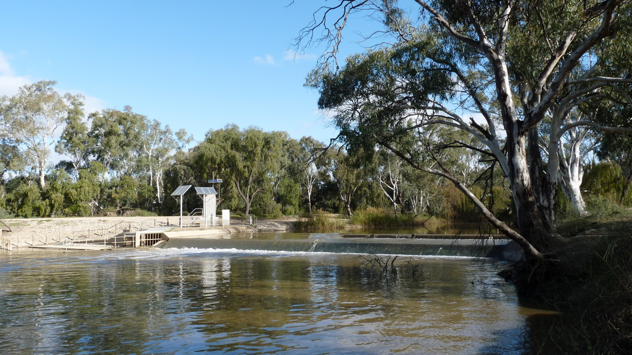
Kerang Weir
Notes:
Kerang Weir photo for scale

Slide 17
Challenges and opportunities
Flow coordination and water supply
Third party impacts
Metering and water accounting
Notes:
Highlight 4 key areas that create challenges and opportunities:
Flow coordination and water supply
Storage management and IA operations
Third party impacts
Water accounting

Slide 18
Murray River
Loddon River
Sheepwash Creek
National channel
Kerang Weir
Washpen Creek
Pyramid Creek
Kerang Lakes
Kow Swamp
Loddon River
Upper Loddon River storages
Notes:
Water supplied from two systems Loddon and Murray:
Kerang weir is a fixed crest weir and so water is dellvered to fill and spill the weir, therefore timing is critical and the long and variable travel times of several days from each system is a challenge to meet the target flow
In Loddon system VEWH and CEWH environmental water used
In Pyramid Creek consumptive available to customers in the Torrumbarry IA was used
This is water supplied from the Murray River into Kow swamp, then delivered to customers that divert fromPyramid Creek
It is also water supplied to Kerang Lakes to meet customer demands
The primary purpose of this system is irrigation. Irrigation demands may increase or decrease at any time and on a daily basis,. If irrigation demand increases, then water earmarked for delivery to environment is redirected to irrigators which would compromise the environmental flow at Kerang Weir of 700 ML day.
To mitigate this risk, in the lead up to the flow GMW created a buffer in Kerang Lakes, i.e. held it higher level then normally required to limit the risk or volume shortfalls in supplying the environmental flow

Slide 19
Flow at Kerang Weir
Weir filling
Notes:
Began with a period of weir poll filling in early April using water from the Loddon River and Pyramid Creek

Slide 20
Flow at Kerang Weir
Magnitude exceeded, duration achieved
Weir filling
Notes:
Achieved and slightly exceeded the required hydrograph of 700 x 10 in mid April
During this time there was a lack irrigation demands and supply from Pyramid Creek was not impacted

Slide 21
Flow at Kerang Weir
Ramp down not achieved
Magnitude exceeded, duration achieved
Weir filling
Notes:
However in some ways the lack of irrigation demand was a little too favourable
Reason for the lack of demand was because during the event there was significant rainfall forecast and on one day there was rainfall of 44 mm in the district (lots for this area)
This effectively ceasedirrigation demands and meant the preferred ramp down of flows at Kerang Weir was not achieved
This also impacted storage operations managed by GMW

Slide 22
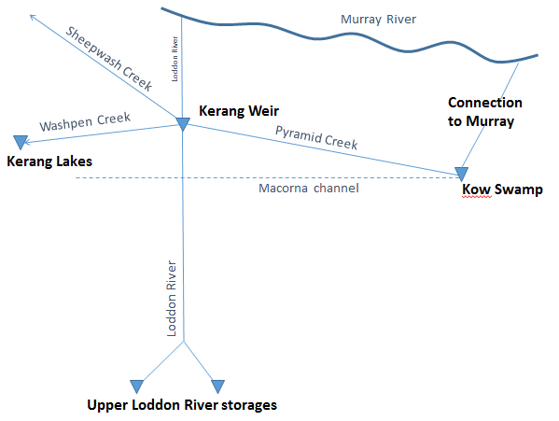
Third party impacts
Notes:
It is state government policy in Victoria, and VEWH policy to not inundate private land without landholders consent
Flow landholders on the Loddon Riiver there is no agreement with landhoolders and channel capacity about 450 ML/day, therefore flow from Loddon system could not exceed 450 ML//day
Flows exceeding 700 ML/day at Kerang Weir can cause spill from Kerang weir into distributary - Sheepwash Creek. Attained landholder consent and NCCMA, VEWH and GMW entered into a deed of agreement for watering private land
DS Kerang weir GMW notified customers of higher than normal flows so they could move pumping infrastructure if need be

Slide 23
Metering and water accounting
Notes:
The last challenge was meting and water accounting
The overall discharge for the event at Kerang weir was over 10,000 ML
You can see that e water use from Loddon was 5,000 and Pyramid just 927
This was the water that was deemed against e water accounts

Slide 24
Metering and water accounting
- 4,445 ML
Notes:
However the numbers don’t add up! And this is due to innovative accounting in the Pyramid Creek system
As I’ve explained, in this system water was not directly used from VEWH or CEWH accounts, but instead there was extra consumptive water delivered to achieve the flow at Kerang Weir
Once the water passed Kerang Weir it could be accounted as a return flow to the Murray River for GMW
As such, an arrangement was made that VEWH would only be debited an amount of water equal to the losses associated with delivery of extra consumptive water in Pyramid Creek
Under this arrangement VEWH was required to underwrite the full demand from Pyramid Creek (which was 8,000 ML) in case the information used to account the system losses was not accurate
However this did not eventuate and VEWH were only attributed 924 ML

Slide 25
Learnings
Plan as early as possible
Avoid delivering late in the irrigation season
Improve gauging data for accurate water accounting
Notes:
Plan early to avoid surprises and make as many contingnencies as possible
Avoid delivering late in the irrigation season to limit risks too GMW system operations
Continually improve our measurement of flows so that the most favourable accounting method can be used without impacting other users

Slide 26
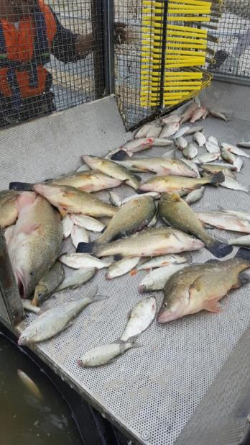
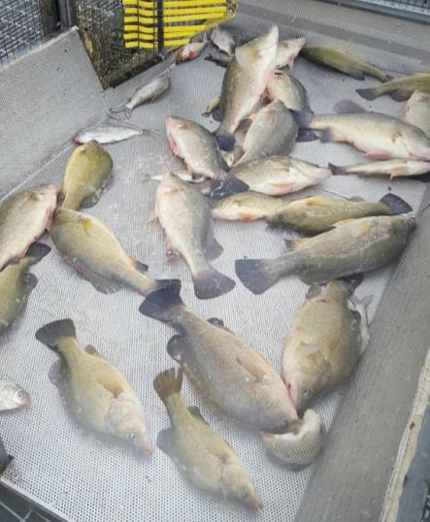
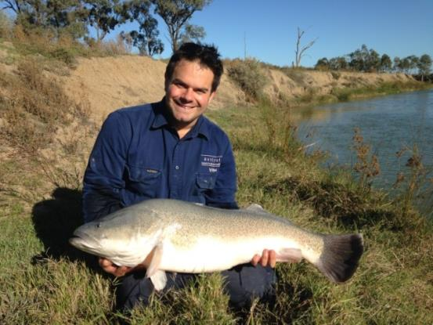
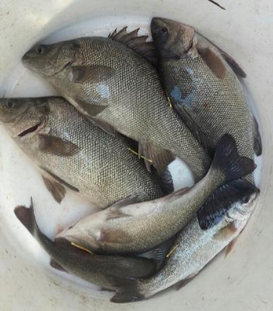
Environmental outcomes
Large bodied:
  Silver perch, golden perch, Murray cod, bony bream
  Many silver perch after flow – not previously observed
Small bodied:
  Carp gudgeon, Australian smelt, unspecked hardyhead and Murray-Darling rainbowfish
Notes:
Photos taken of monitoring outcomes – flow magnitude was successful at 700 ML/day
Large and small bodied fish movement
Will repeat this in the coming weeks for fish migration in spring

Slide 27
Contacts
Phil Slessar
North Central Catchment Management Authority
phil.slessar@nccma.vic.gov.au
Mark Toomey
Victorian Environmental Water Holder
mark.toomey@vewh.vic.gov.au

