Slide 1




Making every drop count
Optimising outcomes through coordination
Place your
logo here
BRISBANE, AUSTRALIA | 18 - 20 SEPTEMBER 2017
MANAGED BY

Slide 2
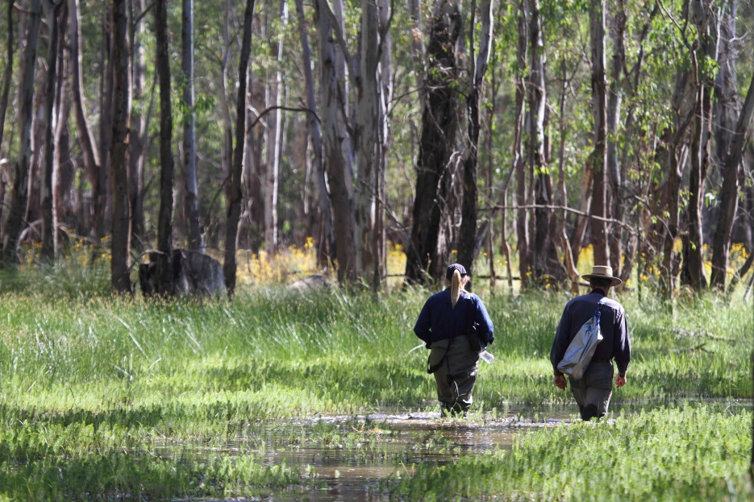
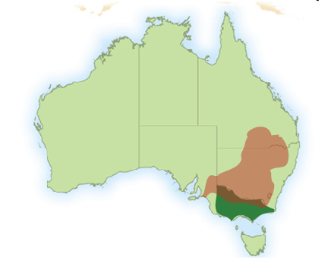
Outline
Environmental water in the context of a regulated river
Making every drop count
  Coordinated releases
  Return flows
  Consumptive water en route
Coordination is key
Bringing it all together
Gunbower Forest bird monitoring, North Central CMA
Notes:
Examples from deliveries in 2014-15

Slide 3
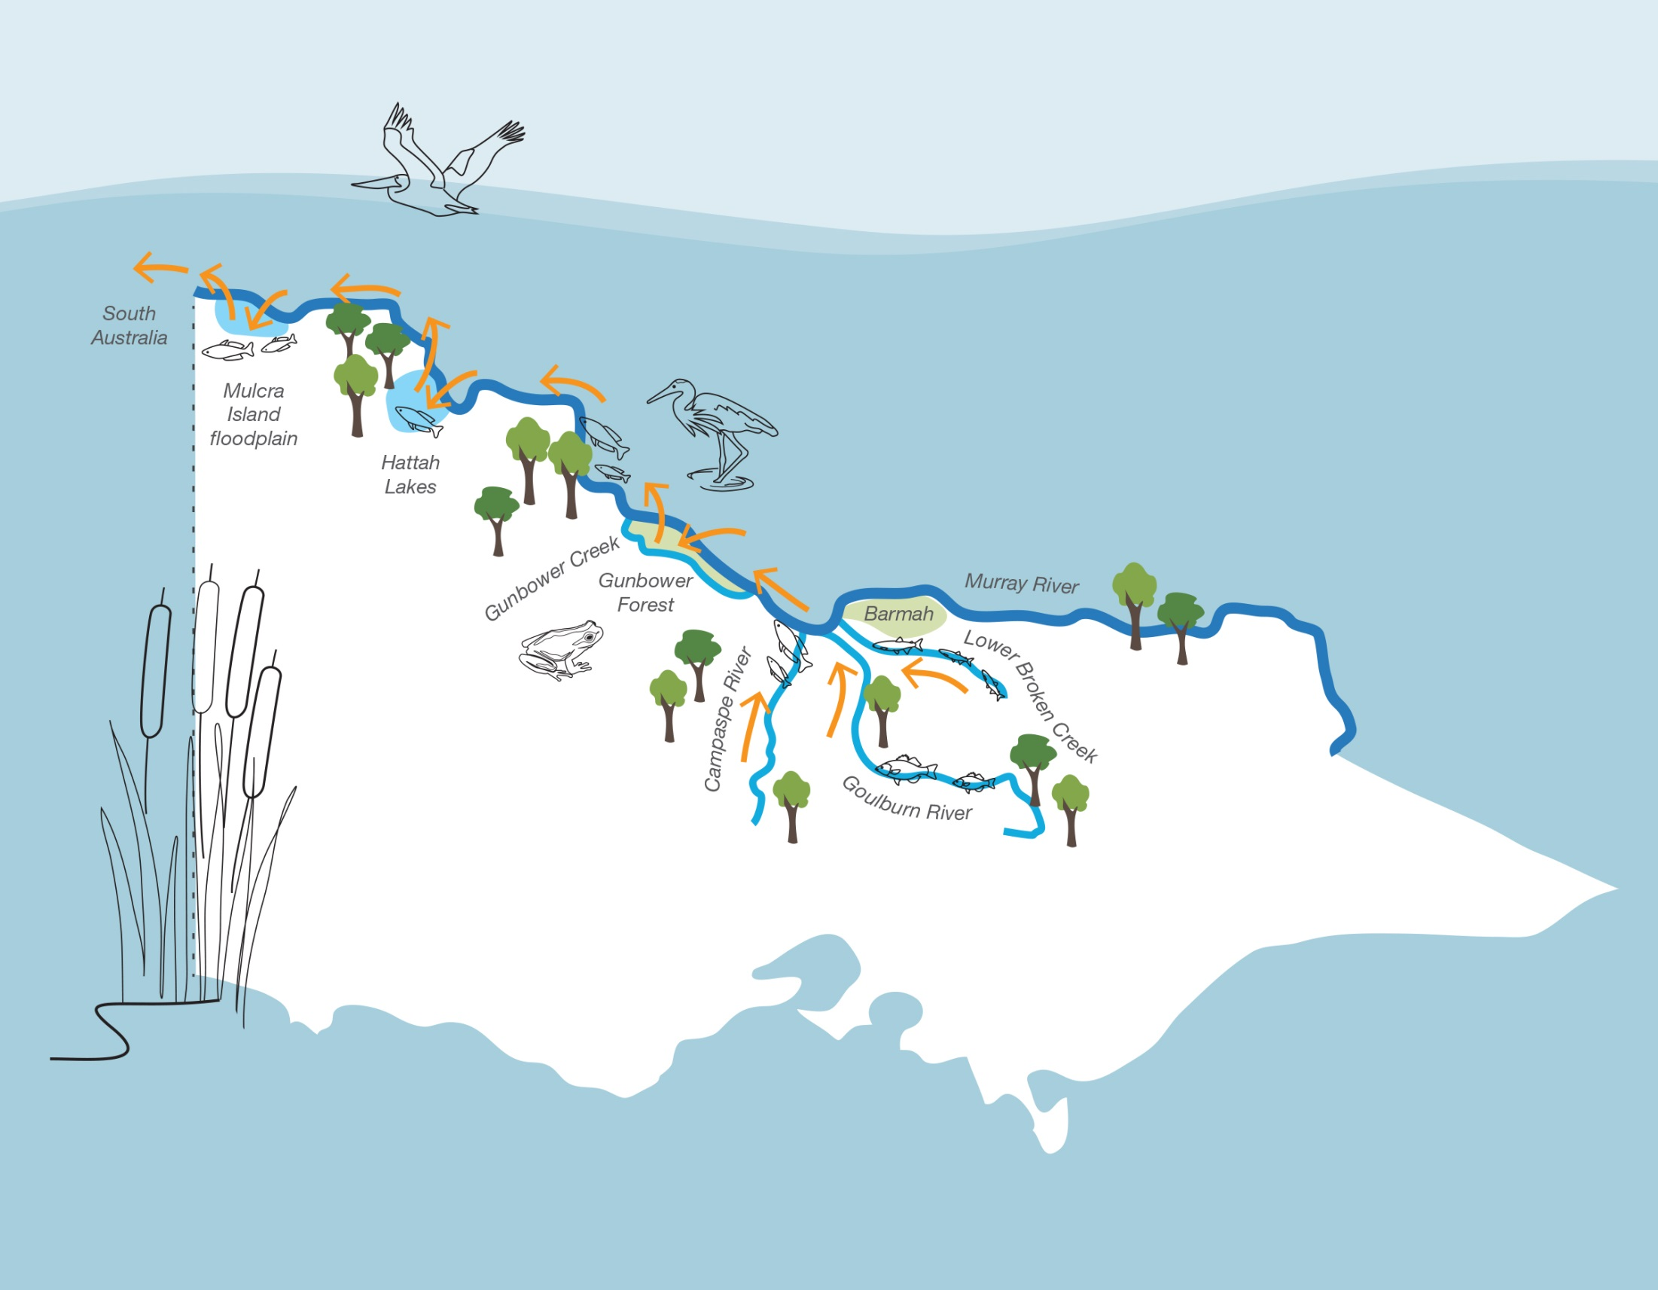
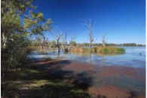
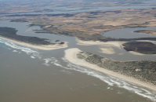
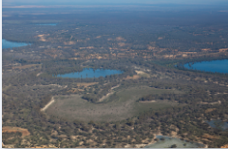
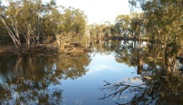
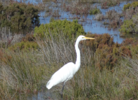
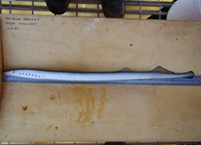
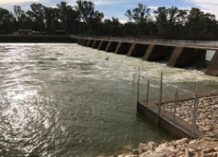
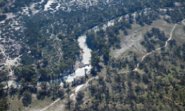
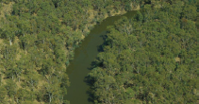
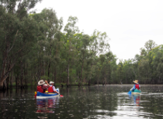
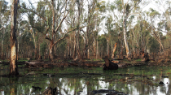
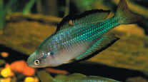
Hattah Lakes
Lower Broken Creek
South Australia
Murray River
Mulcra Island
Goulburn River
Gunbower Creek
Campaspe River
Gunbower Forest
Notes:
Overview:
Photo credits: Mallee CMA (Hattah, Mulcra); North Central CMA (Gunbower); MDBA (Rainbowfish); GBCMA (Goulburn River; Lower Broken Creek); VEWH (Murray River)

Slide 4
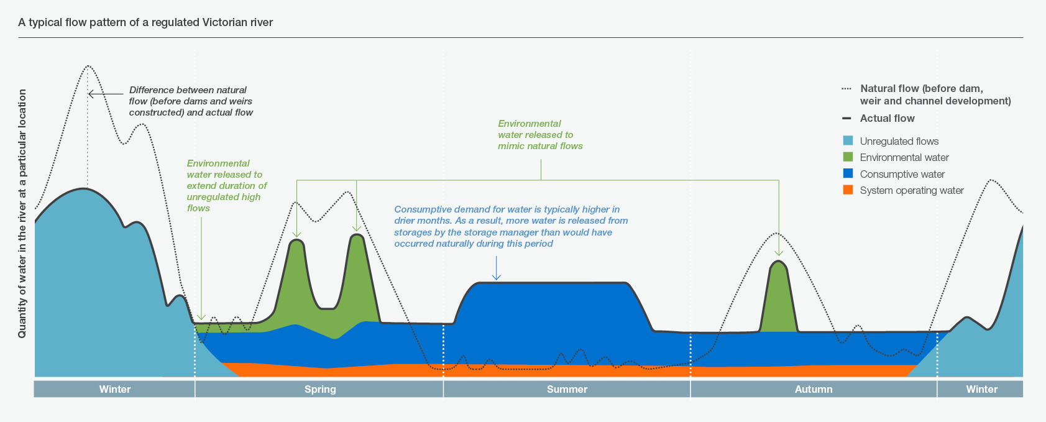
A ‘typical’ northern Victorian river
Natural flow
(pre-regulation)
System operating water
Unregulated flows
Consumptive water
Environmental water
Notes:
Environmental water is only one type of water in a river or wetland system
Unregulated flows: occur naturally in a waterway, generally after heavy rainfall, including when storages spill.
Environmental water: owned by environmental water holders, held in storages and actively released at a time and rate designed to provide environmental outcomes. Otherwise known as ‘held environmental water’ or ‘managed environmental water’.
Consumptive water: owned by water corporations or private entitlement holders, held in storages and actively released to meet domestic, stock, town, industry and irrigation needs.
System operating water: managed by storage managers, generally held in storages and actively released to ensure the system can deliver consumptive water, managed environmental water and water to meet other needs.
Storage managers are not only responsible for environmental water delivery. They also release water for other purposes, including consumptive water to supply towns, industry and irrigation or system operating water to ensure the river has enough flow to be able to deliver environmental or consumptive water. As such, storage managers have a big responsibility to balance the needs of all water users.

Slide 5
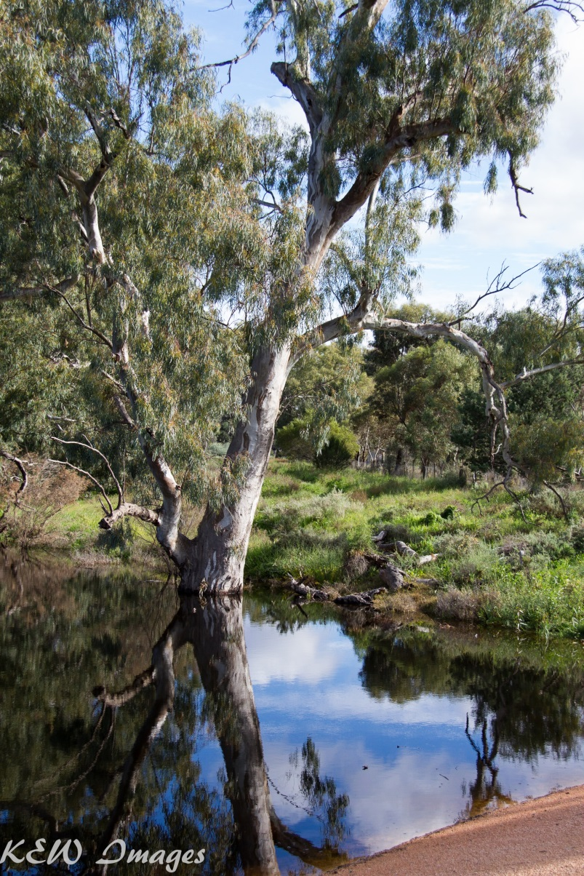
Making every drop count
Highly connected and regulated
One release of water can contribute to or achieve several environmental targets in different locations
Achieved through:
  use of consumptive water en route
  coordination with consumptive releases
  use of return flows
Hattah Lakes, Kerry Whitelegg
Notes:
Draw predominantly on northern Victorian examples, however these tools are utilised in many systems in southern and western Victoria
Multiple benefits - optimising use of environmental water
Efficient use of water – the driver for establishing these provisions was to assist in reducing the volume of water required to be purchased for the environment to meet demands (use same water at multiple locations = less water)

Slide 6










Coordination is key
Scientists
&
Community
Notes:
Waterway/site managers - River Operators - Accounting/trade - E-water holders - Land Managers - Technical experts

Slide 7
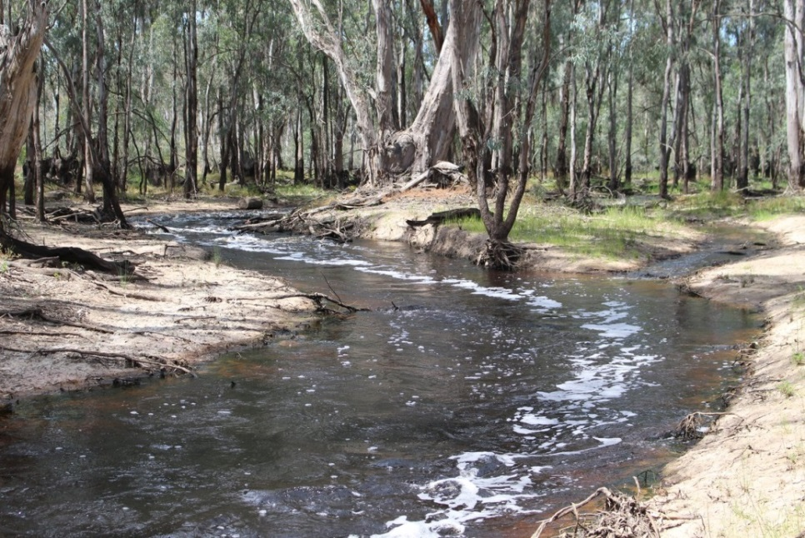
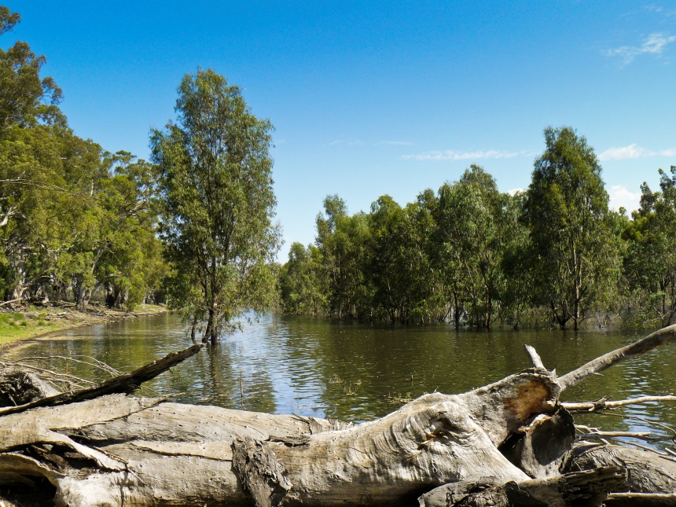
Consumptive water en route
Storage managers release water for consumptive demands downstream
  sometimes its possible to divert this water on the way
  or deliver in a way that meets environmental needs
Environmental water is used to account for losses
Gunbower Forest outfall, North Central CMA
Mulcra Island, Mallee CMA

Slide 8
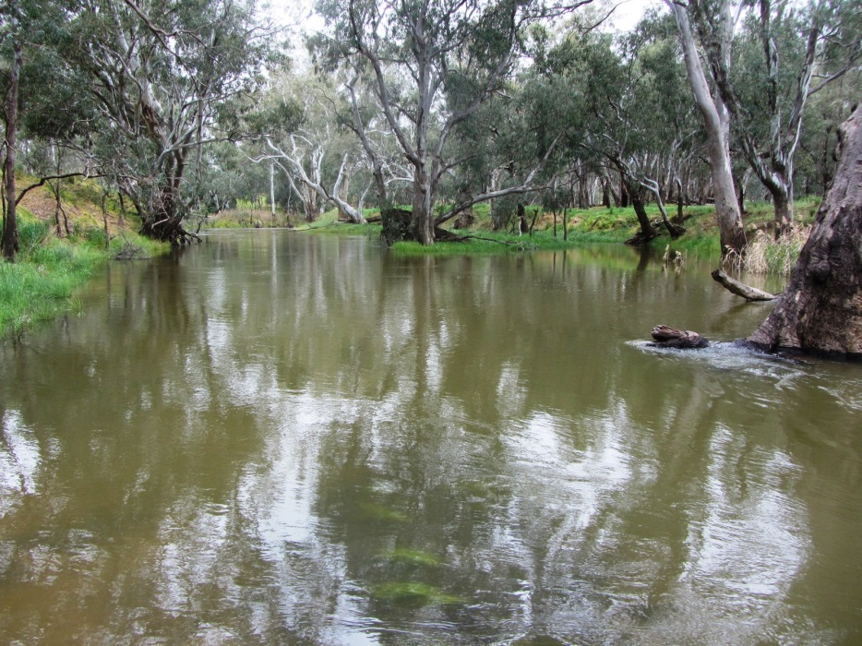
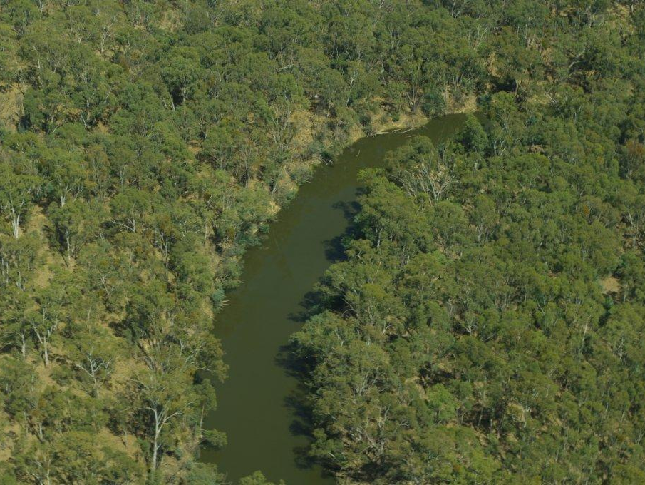
Coordinated releases
Combining environmental and consumptive releases, and unregulated flows, to achieve greater results
  ‘Piggy-backing’
Campaspe River at Runnymede, North Central CMA
Goulburn River at Mooroopna, Goulburn Broken CMA
Notes:
Piggy-backing
Adding environmental water on top of planned consumptive releases to achieve larger flows, such as freshes to trigger fish spawning
It may not have been possible to deliver these flows otherwise due to the significant volumes of water required to achieve the events
>> Goulburn and Campaspe spring freshes were coordinated with consumptive water to achieve desired flow rates, which resulted in sucessful spawning of Golden Perch in the Goulburn system, and helped to boost native fish populations in the Campaspe, where an increase in numbers of Golden Perch and Murray-Darling Rainbowfish was detected

Slide 9
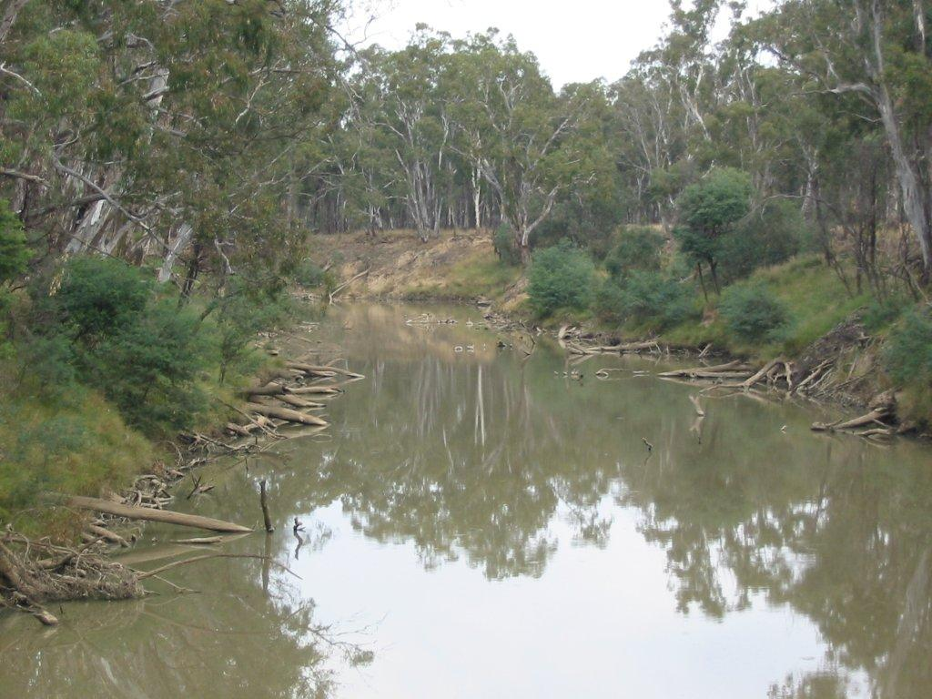
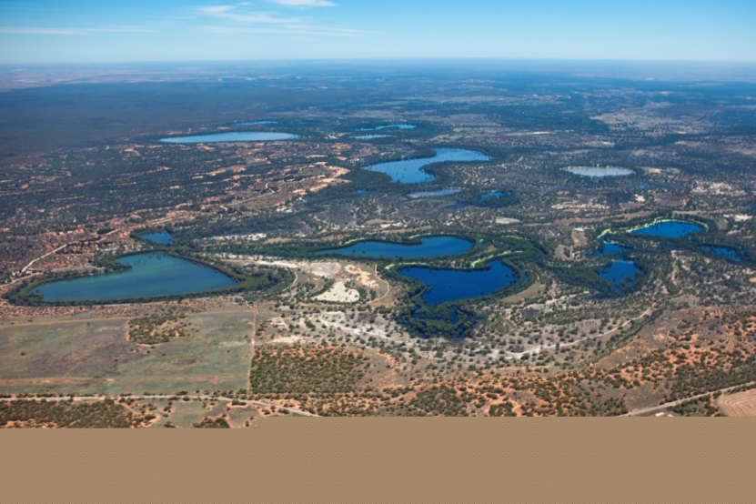

Return flows
Water is used in one system, then re-credited and used again further downstream
Lower Lakes, Coorong and Murray Mouth
Goulburn River at Hurricane Bend, Photo: Keith Ward
Hattah Lakes, Photo Mallee CMA

Slide 10
284 GL
South Australia
17 GL
Hattah Lakes
Inundated 6,100 ha floodplain
76 GL environmental use
29 GL
39 GL
Lower Broken Creek
34 GL environmental use/loss
20 GL return flows
24 GL
29 GL return flow recredit
39 GL return flow recredit
River Murray
24 GL environmental use
Mulcra Island
Inundated ~440 ha floodplain
6.3 GL environmental use (losses)
24 GL return flow recredit
1 GL return flows
0.4 GL return flows
Goulburn River
309 GL of environmental use
Gunbower Creek
0.8 GL environmental use (losses)
304 GL return flow recredit
0.2 GL return flows (losses)
<0.1 GL return flows (losses)
Campaspe River
30 GL environmental use
Gunbower Forest
Inundated over 3,750 ha floodplain forest and wetlands
96 GL consumptive water delivered
37 GL environmental use (losses)
18 GL return flow recredit
Notes:
Example from 2014-15 (VEWH slides):
Implementation of return flow policy and other cooperative arrangements to deliver multiple benefits as water moves downstream
[Background: return flows policy originally introduced in Victoria in the mid-1990s for urban water corporations to claim credit for water treatment returns upstream of downstream off-takes. Introduced for environment with Living Murray water recovery measures as a way of ensuring Victorian tribs also received the benefits of water en route to icon sites in the Murray system.
Arrangements formalised through Northern Region Sustainable Water Strategy (must be measurable etc.; Resource/Storage Manager oversight). Important for achieving efficiency of water use.
How does it work in practice?
Important that it is measured (by physical meter or agreed methodology)
Supported by Victorian Water Register arrangements
Water first delivered to upstream site, measured at the end of the system, then recredited to accounts in the Murray system.
Trade was the mechanism determined to get water across the border to SA to ensure protection from extraction, re-regulation or substitution (MDBA’s requirements).

Slide 11
Hattah Lakes
Lower Broken Creek
South Australia
Murray River
Mulcra Island
Goulburn River
Gunbower Creek
Campaspe River
Gunbower Forest
Notes:
Overview:
Photo credits: Mallee CMA (Hattah, Mulcra); North Central CMA (Gunbower); MDBA (Rainbowfish); GBCMA (Goulburn River; Lower Broken Creek); VEWH (Murray River)

Slide 12
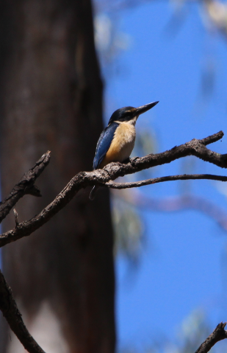
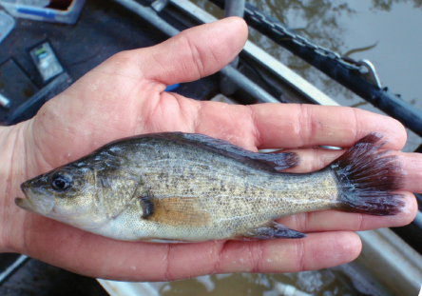
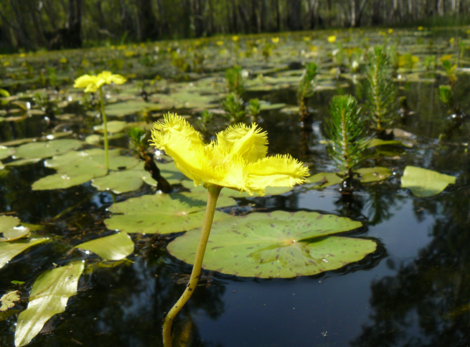
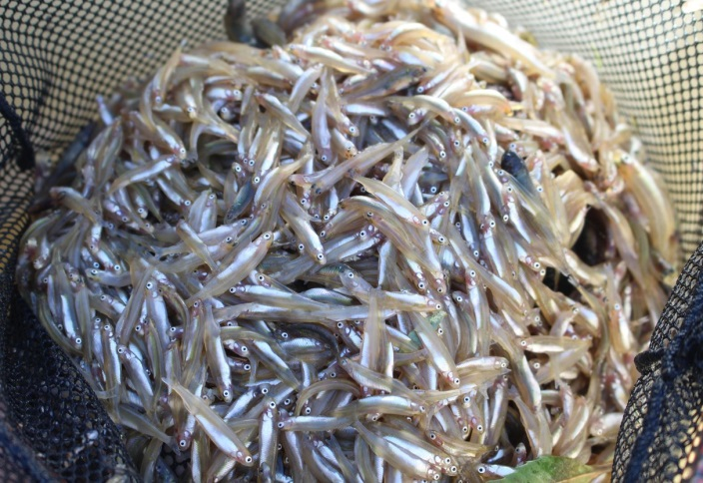
Summary
Coordination at a Basin-scale to make every drop count
Able to provide multiple environmental outcomes from the same ‘bucket’
Increasing sophistication over time – work ongoing to improve coordination and effectiveness
Notes:
Not just e-water – building on what’s in the system
Photo credits
Arthur Rylah Institute (GP)
North Central CMA (wavy marshwort), Australian smelt
Will Honybun - Kingfisher

Slide 13
Place your
logo here
Thank you
Contact:
Caitlin.Davis@vewh.vic.gov.au
BRISBANE, AUSTRALIA | 18 - 20 SEPTEMBER 2017
MANAGED BY

