Slide 1
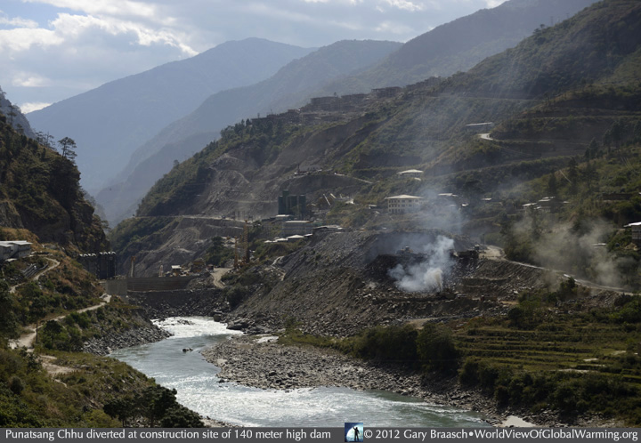
Comparative study of Environmental Impact Assessment (EIA) in Bhutan with best practices elsewhere.
Pema Dorji
Kholongchhu Hydro Energy Ltd (KHEL)
Trashi Yangtse: Bhutan
(pema.khel@gmail.com)
_____________________________
Master of Environmental Science (Water Management)
University of South Australia, Adelaide (2015-16)

Slide 2
Contents
Introduction
Review of Literature
Research Objectives & Outcomes
Research Methods
Results
Discussions
Conclusions
Recommendations
Acknowledgements
References
Additional information

Slide 3
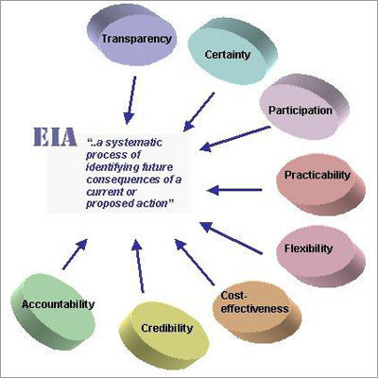
Introduction
Definition:
EIA is a process aimed at identifying and evaluating potential effects of development projects on natural and man-made environments (Wood 2003, p. 1).
1st developed in US under its National Environment Policy Act (NEPA), 1969.
An important decision making tool for any developmental project to proceed.
EIA was developed as a tool to minimize negative impacts (Kominkova 2008, p. 1329) by including mitigation measures into the approval process.

Slide 4
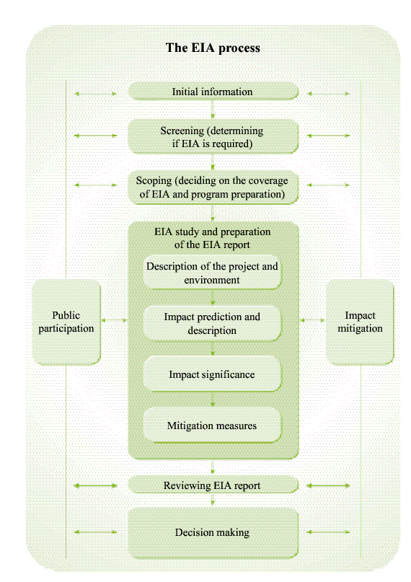
A summary of the
EIA process – the international model
Survey questions are based on this model

Slide 5
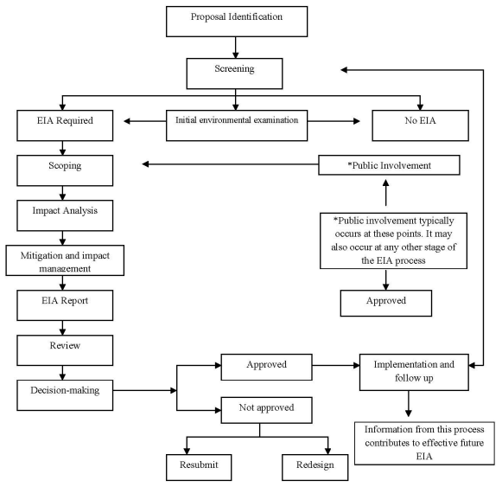
EIA Process in Bhutan
Fig. The EIA Process (NECS 2012)

Slide 6
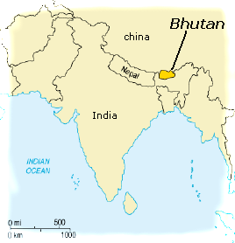
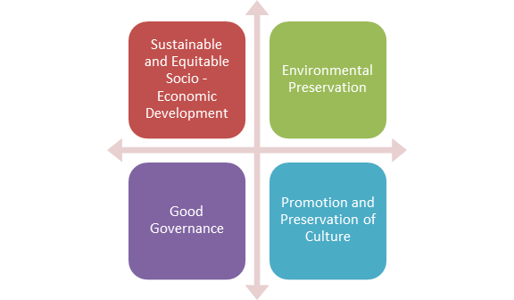
Introduction
EIA and Bhutan
Bhutan introduced EIA into the decision-making process in the 2000s:
Environment Assessment (EA) Act of 2000, & its Regulation for Environmental Clearance of Projects in 2002.
Guided by development philosophy of Gross National Happiness (GNH) - conservation of natural environmental as one of its four pillars.
Under this legislation, the applicant and project developers are mandated to conduct an Environmental Assessment.
Is iterative in nature.
GNH
BUT:
How effective is Bhutan’s EIA system, in theory and in practice?
How does Bhutan perform in decision-making process using EIA framework?

Slide 7
Review of Literature
SN | Study/ Research | Study Area | The Study | EIA Attributes | Approach/Method
1 | Clarke and Menadue (2015) | South Australia | Has looked at robustness of EIA screening systems for land-use planning. | Has investigated the adequacy of its discretionary ‘screening’ process. | Examined the screening approach through evaluation of Major Developments Directory (MMD)
2 | Wood, C (2003) | US, UK, EU, Netherlands, Canada, the Commonwealth of Australia, New Zealand and South Africa | Has done comprehensive comparative review of the EIAs. | Has looked at various EIA attributes like respective EIA legal basis, coverage of EIA systems, consideration of alternatives, screening, scoping, report preparation, review, decision making, monitoring and auditing, mitigation of impacts, consultation and participation and strategic environmental assessment. | Comparative review using certain EIA system evaluation criteria.
3 | Heinma and Põder (2010) | Estonia | Has looked at effectiveness of EIA by examining projects without EIA causing significant environmental effects and measure of EIA that has no influence on decision. | The study has focused on post EIA decisions looking specifically at documented violations of permit conditions and complaints to determine the effectiveness of EIA in minimizing significant environmental effects. | Extensive survey with e-mail distributed questionnaires to governmental agencies, developers
4 | Pölönen, Hokkanen and Jalava (2011) | Finland | Focus of effectiveness of EIA system by examining weaknesses and strengths. | Has looked at Finish legislation, screening system, quality of environmental impact statements, linkage of EIA and decision-making, public participation, and follow-ups. | Adopted surveys and document analysis to evaluate EIA practices.
5 | Clausen, Vu and Pedrono (2011) | Vietnam | Study on the EIA gap between theory and practice. | Emphasis on the policy and practice aspects of EIA with special focus on EIA inclusiveness in project cycle, capacity of EIA practitioners, screening, EIA from pre-construction to operation, meaningful public participation, EIA commitments and appraisal enforcement and harmonization of EIA requirements with best practice. | Evaluation of the EIA framework against various EIA attributes.

Slide 8
SN | Study/ Research | Study Area | The Study | EIA Attributes | Approach/Method
6 | Azri, Busiadi and Sulaiman (2013) | Gulf Cooperation Council (GCC) | Study on status of EIA legislation and comparative evaluations of EIA systems in GCC states. | Has focused on EIA legislation, EIA administration and EIA process. | Adopted descriptive assessment criteria to evaluate the comparison.
7 | Marara et al. (2011) | East African countries of Kenya, Rwanda and Tanzania | Reviews and compares condition of EIA in three countries. | Has looked at the legal, administrative and procedural frameworks. | Combination of different research approach including literature review and structured interview questionnaires to analyse different elements of analytical framework.
8 | Chen, Zhang and Ekroos (2007) | China | Comparison of China’s EIA with European Union Directive. | Study has done comprehensive comparison of China’s EIA framework with EU Directive and has also compared EIA process (scoping, reporting, review of report, decision-making, monitoring, public participation and sanctions and control). | Review of development of EIA in China and comparison with EU EIA Directive.
9 | Bassi et al. (2012) | UK and Italy | Comparative study on the management practice in construction industry. | Has looked at all EIA stages that includes screening, scoping, impact analysis, mitigation design, preparation of environmental statements, review, decision making, follow-up and public involvement. | Representative case studies, review of environmental statements and related documents and design and administration of questionnaires for key informants.
10 | Samarakoon and Rowan (2008) | Sri Lanka | Review of EIS with reference to Ecological Impact Assessment. | Has critically examined EIS and EIA documents from the national archives with particular focus on detailed ecological appraisal. | Sampling of documents, and review and evaluation using checklist of common ecological review criteria.
Notes:
The literature portrays various studies carried out on EIA. Different studies have adopted different approaches to examine EIA and have been generally conducted in order to identifying gaps, strengths, weaknesses and opportunities for improvement in different EIA stages.

Slide 9
Research Gap
However, NOT a single study done in Bhutan t0 date.
Hence, the study evaluated the structure, practice and outcomes of the EIA process in Bhutan by:
Comparing and contrasting the EIA framework with international practice;
Evaluating views of EIA practitioners in Bhutan;
Examining effectiveness of EIA.

Slide 10
Research Objectives
Aims:
To conduct a comparative study of EIA systems - international best practices.
To analyze key similarities and differences, strengths and weaknesses in EIA approaches and performance.
To assess the views of EIA practitioners - understand practical challenges and and to identify aspects that function well.
To articulate recommendations for improvement in EIA process and guideline documents.

Slide 11
Expected Outcomes
To identify link between policy implementation and practice.
To identify areas of improvement in EIA structure and system in Bhutan in relation to international standards.
To recognize aspects of EIA requiring amendments to increase its effectiveness and efficiency.

Slide 13
Research Methods
Mixed method approach - qualitative and quantitative designs were employed.
Qualitative aspect: open ended questions; comparative review of EIA documents;
Quantitative approach looked at an analysis and interpretation of data collected through online survey questionnaire.
Potentially capitalize on both traditions overcoming many shortcomings.

Slide 14
Role of Survey
Online survey using questionnaire for ‘on the ground’ data.
Collection of practical views of different stakeholders and evaluating strengths and weaknesses of the system.
The focus of the survey was on different aspects of EIA drawn from government regulations in practice.

Slide 15
Target Stakeholders & Selection of Participants
EIA system of Bhutan was examined to map stakeholders - Important institutions identified as potential stakeholders.
‘FOCUSED’ on EIA professionals.
Environmental regulators, project developers, environmental officers, project managers, EIA consultants, decision makers and project managers.
A list of some 65 (sixty five) participants identified.
email IDs and other details compiled to establish further networks and to extend more invitations.

Slide 16
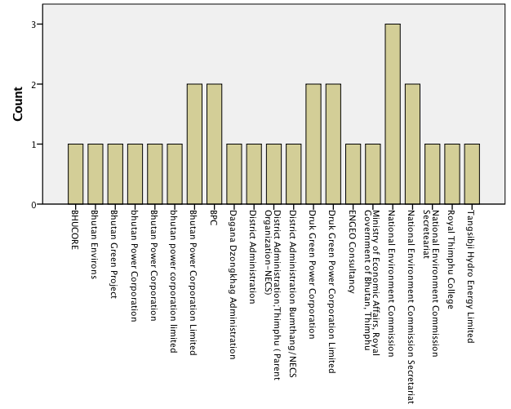
Stakeholders who participated in the survey (SPSS output)
(65 invitations, 34 responses)

Slide 17
Construction of Questionnaire
Four broad categories.
General information - such as name/nickname (optional), agency (optional), age, gender, educational qualification, EIA experience and anonymity.
About their degree of agreement or disagreement to 20 statements made regarding EIA process.
Rating of EIA process by stages.
Open-ended question regarding improvements of EIA.
Lastly, a section for other comments.

Slide 18
Distribution of Questionnaire
Excel to SurveyMonkey –
https://www.surveymonkey.com/r/EIA_Bhutan2016
Invitations sent through email.
With formal Letter of Invitation along with Participant’s Information Sheet signed by Supervisor as per UniSA Ethics Approval.
The survey on the web was initially kept open for a period of three weeks starting form from August 1, 2016 to August 20, 2016.
Was extended by additional 10 days.

Slide 19
Response rate
65 invitations, 34 responses - about 52.3% response rate.

Slide 20
Data analysis techniques (statistical analysis)
SurveyMonkey has ‘Collect Responses’ and ‘Analyze Results’ features:
Response compilation and preliminary analysis
Also presents open-ended responses in a report format
The Export feature of SurveyMonkey allows the generation of all the responses in MS Excel format.
SPSS used to conduct further analysis.
Nature of the questionnaire was mostly in categories using ratings and Likert scales, responses - categorical data.
Analysis such as descriptive (statistics) like frequency table, mode and crosstabulations were relevant and applicable.

Slide 22
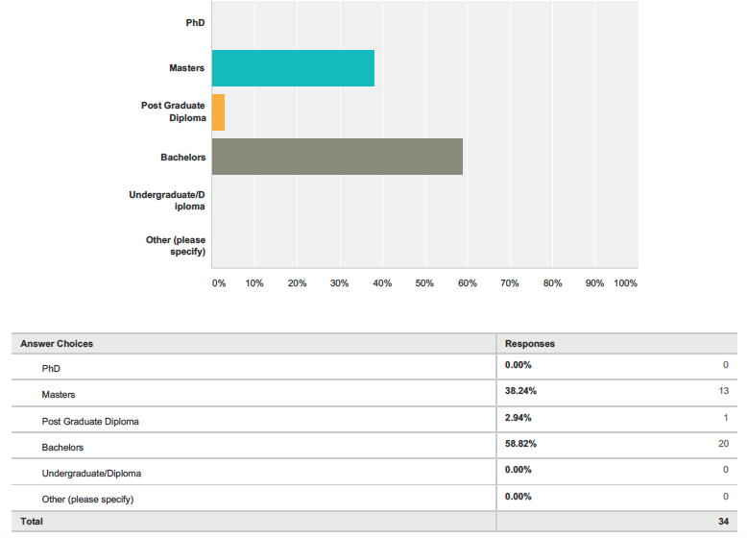
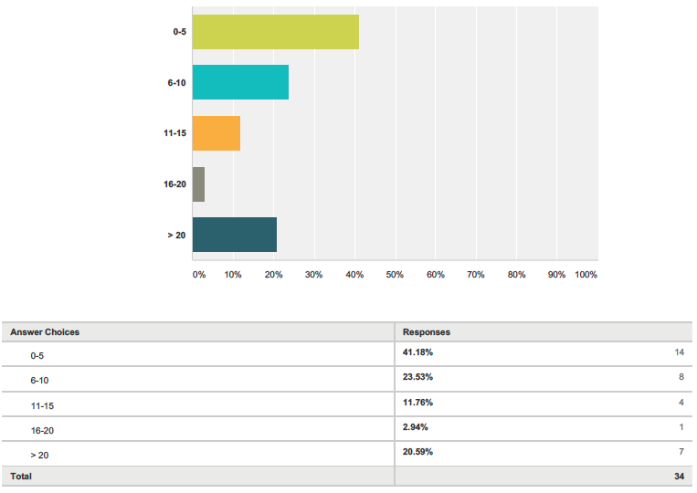
Results
Q8. “Educational Level”
Q9. “How many EIAs have you been involved with so far?”

Slide 23
Q10. “To what extend do you agree or disagree with the following statements (Please select one from the drop down list)”

Slide 24
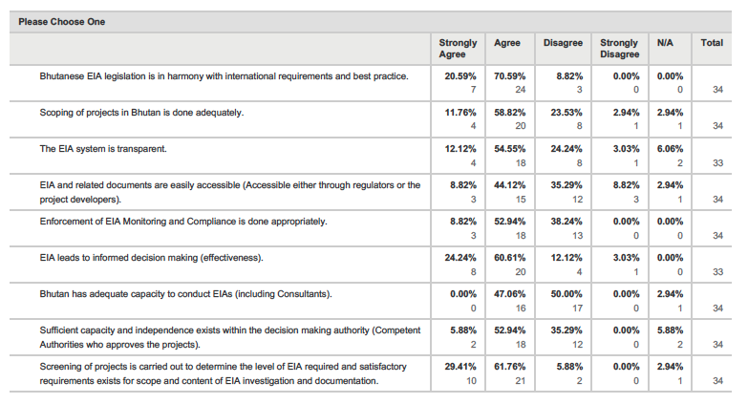
Q10. “To what extend do you agree or disagree with the following statements (Please select one from the drop down list)”

Slide 25
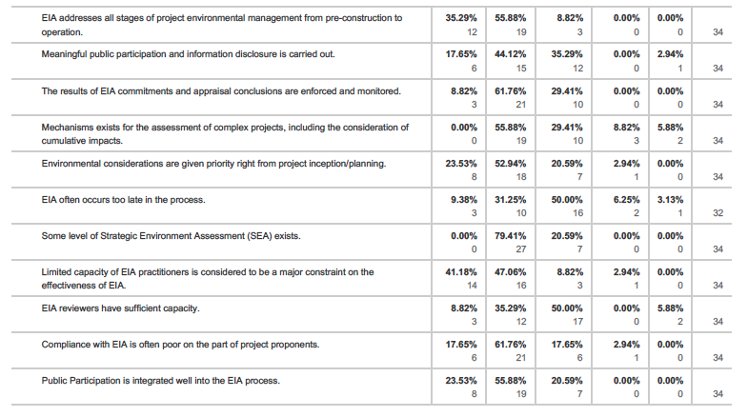
Q10. “To what extend do you agree or disagree with the following statements (Please select one from the drop down list)”

Slide 26
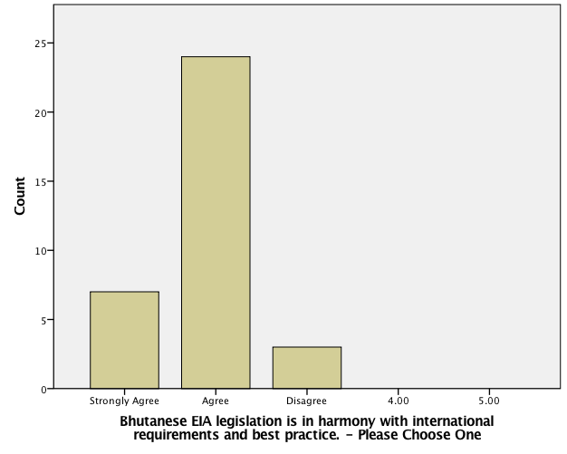
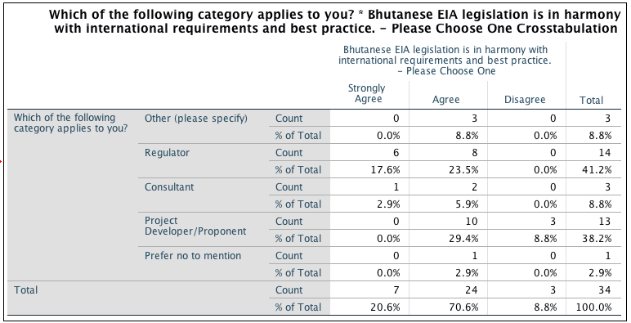
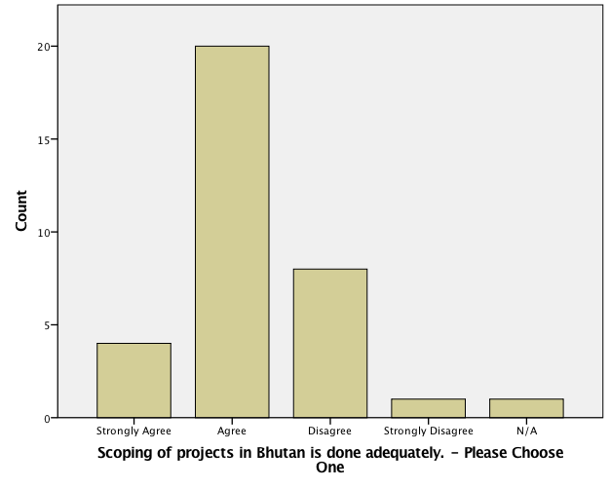
Q10. “To what extend do you agree or disagree with the following statements (Please select one from the drop down list)”
Of 70.59% who agrees, 23.5% are regulators 29.4% are project developers and 5.9% are consultants.

Slide 27
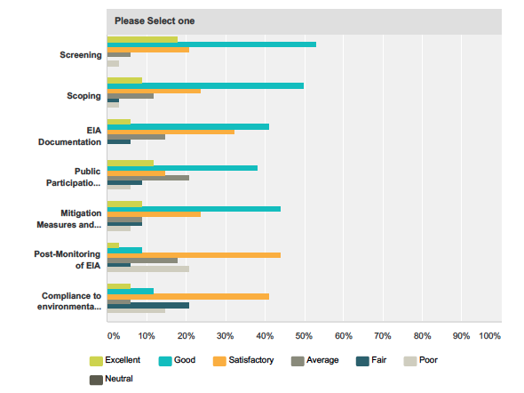
Q11. “How do you rate the following stages of EIA in Bhutan?”

Slide 28
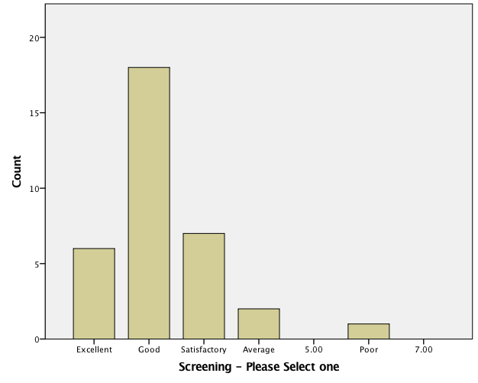
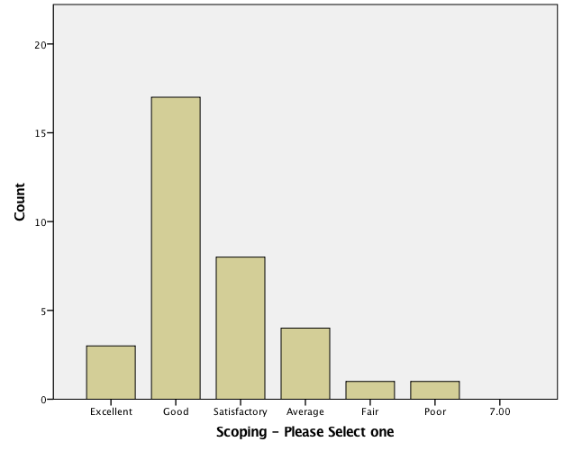
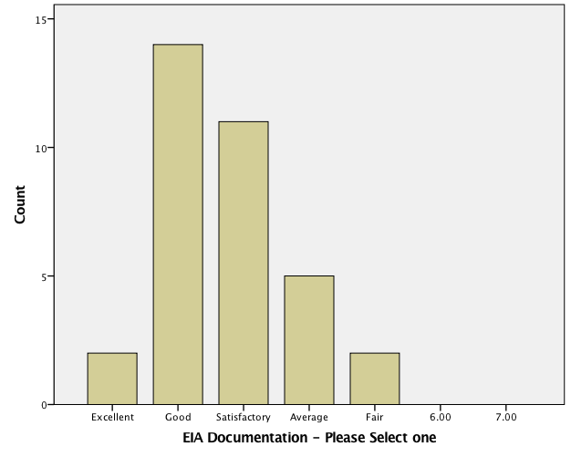
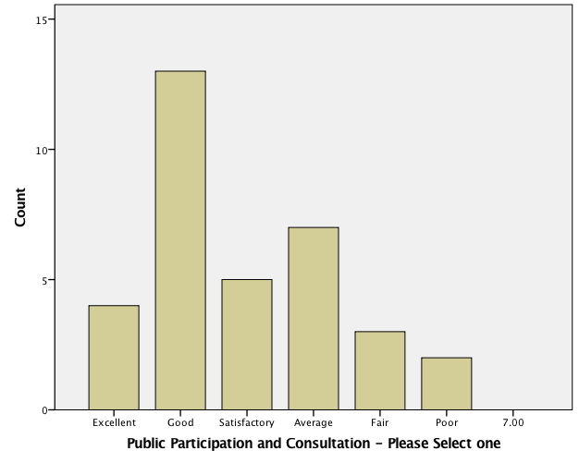
Q11. “How do you rate the following stages of EIA in Bhutan?”

Slide 29
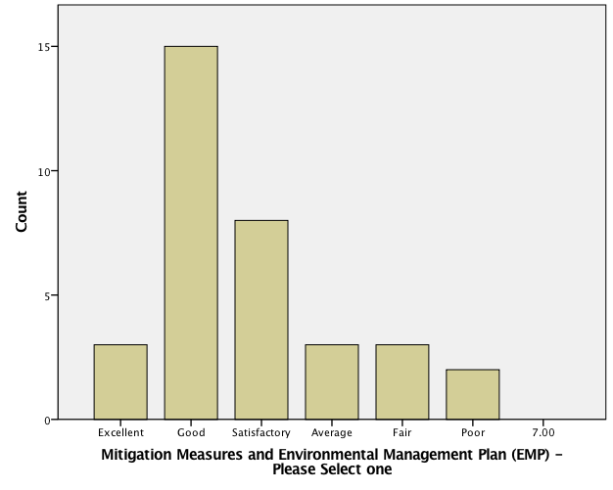
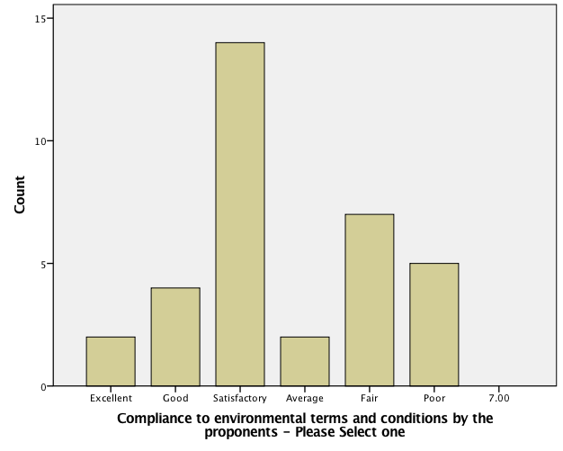
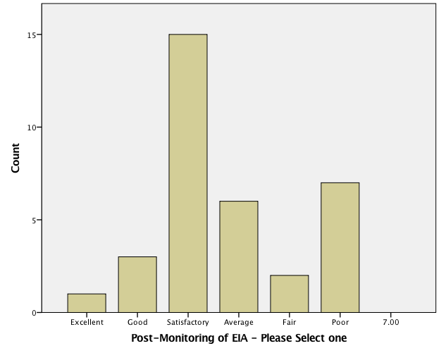
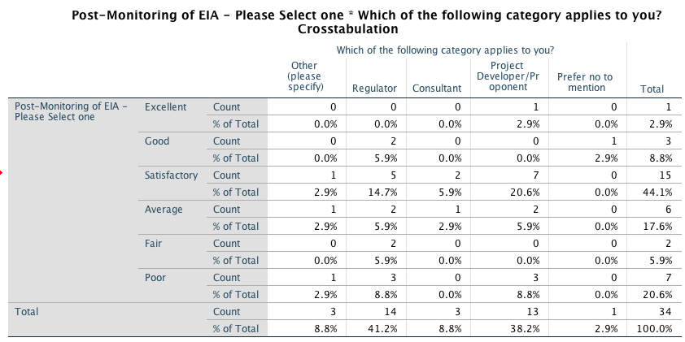
Q11. “How do you rate the following stages of EIA in Bhutan?”

Slide 30
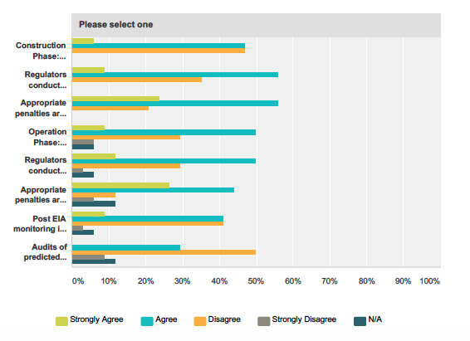
Q12. “How far do you Agree or Disagree with the followings?”

Slide 31
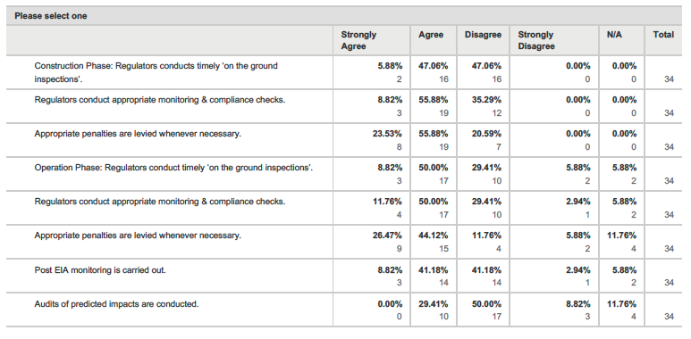
Q12. “How far do you Agree or Disagree with the followings?”

Slide 32
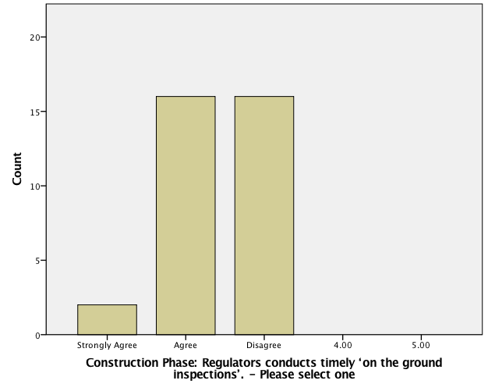
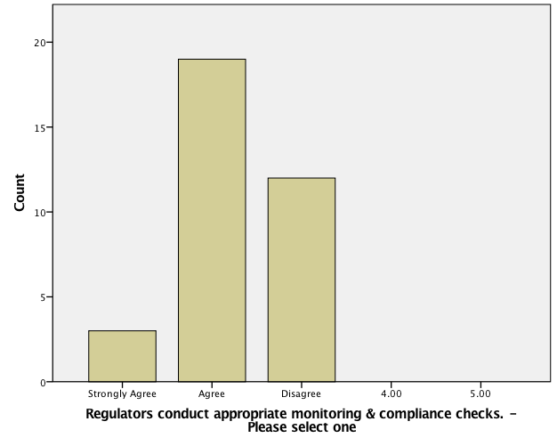
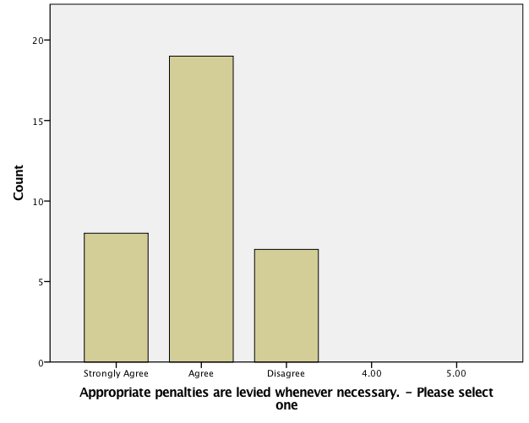
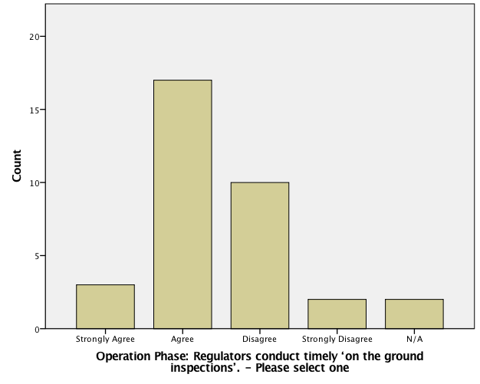
Q12. “How far do you Agree or Disagree with the followings?”

Slide 33
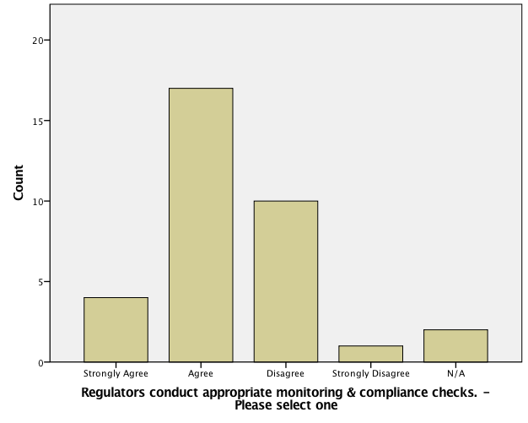
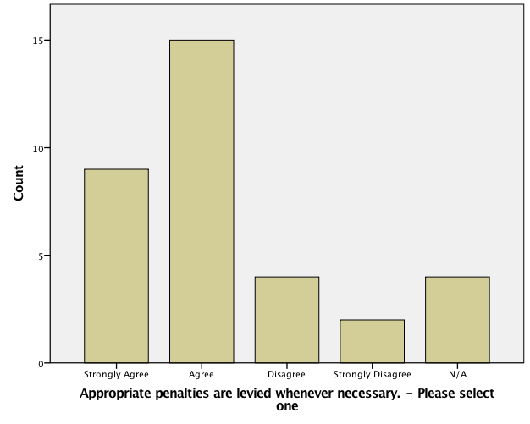
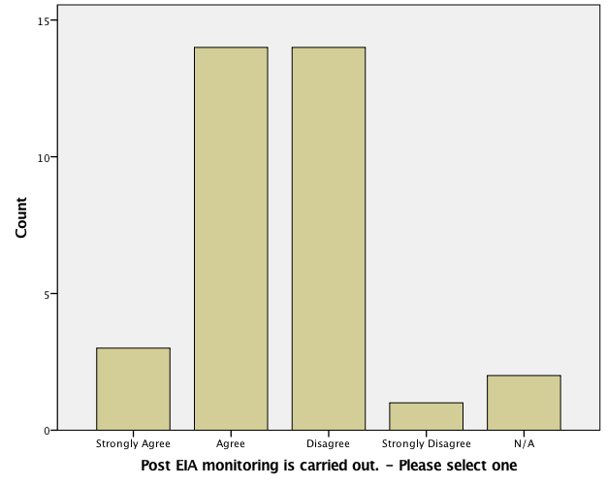
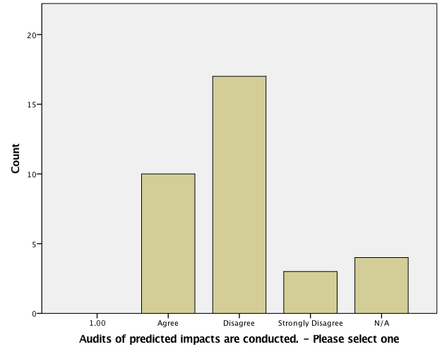
Q12. “How far do you Agree or Disagree with the followings?”

Slide 34
Q13. “How can the EIA process be improved? Please respond to any of the following you think is important”.

Slide 35
Discussions
Summary of the key aspects of the results

Slide 36
Discussion
The main survey results covered:
Respondent data and general information (profile of the respondents, experience, stakeholders and education level)
Legal and administrative aspects (SEA, transparency, best practices, informed decision making)
Screening
Scoping
EIA Documentation
Impact Prediction, Mitigation Measures and Environment Management Plans (EMP)
Monitoring and Compliance
Audit of Predicted Impacts
Public Consultation and Disclosure (EIA document accessibility, integration of EIA from beginning)
EIA Decision Making and Approval
Capacity of EIA professionals (regulators, reviewers, consultants and project developer)

Slide 37
Evaluation criteria based on Panigrahi and Amirapu (2012, p.25) and Woods (2003, p.45).
A | Legislative framework for EIA
a | Legal provisions. | Bhutan has sound legal provisions for EIA (EA Act 2000, Regulation 2002 & eight Sectorial Guidelines of 2012).
b | Legal provisions for appeal by the proponent or stakeholders against decisions. | Provisioned under Chapter IX of the Act and Section 42 of its Regulation for decisions regarding screening and EC decisions issued by NECS or CAs.
c | Legal specification of time limits for approval and appeal. | Within 30 days of the decision by NEC (Section 42.3 of Regulation 2002).
d | Legal provisions for SEA | Not mentioned in Act/Regulation. However, GNHC at national policy level looks after development policies, plans and programs where SEA of some form is being incorporated with principles of GNH and Sustainability. Environmental factor is one of the four pillars of GNH and hence environmental factor at strategic level is considered by GNHC. Also, during the survey, when respondents were asked about SEA, majority 79.41% of the respondents agreed that some form of SEA existed while only 20.59% disagreed. Moreover, in the recent development based on informal information, NECS is undertaking SEA into its policy mainstream by involving stakeholders from different sectors and ministries in Bhutan.
B | Administrative set up for EIA
a | Competent authority for EIA screening and approval. | NECS is the apex regulatory body with designated functions and powers as per the Act (Chapter V) and has delegated a list of CAs for various projects as per Annex 2 of the Regulation.
b | EIA review committee. | NECS within their functions and may consult other relevant agencies and individual experts when required.
c | Specification of responsibilities of regional authorities in the EIA process. | Have listed list of activities and projects for which CAs may screen and issue ECs (Annex 2 of Regulation).
d | Level of coordination with other planning and development agencies/departments. | Mandated as per Section 31 of the Regulation under ‘Public Consultation’.
Discussions

Slide 38
Discussion
3. Screening
Screening is the first step in EIA process - whether a project is subjected to EIA.
In Bhutan, there are list of projects/activities delegated to several CAs (Annex 2 of Regulation 2002)
The screenings in Bhutan is almost ‘prescribed’ in the regulation but for projects that are not envisaged and reflected in the list are dealt case on case basis.
‘Mandatory and discretionary’
Survey:
29.41% strongly agreed and 61.76% agreed that screenings of projects are satisfactorily carried
Rating - ‘good’ (52.94%) or ‘excellent’ (17.65%), 20.59% rated ‘satisfactory’.
A general agreement that screening process is performing well in Bhutan.
30% suggested for improvements
‘Clear delegation of authority to Competent Authorities and capacity building support to Competent Authorities’ (Respondent#8).
‘appropriate criteria and measures to screen projects and decide the level of EIA required’ (Respondent#12).
Bhutan’s screening based on IEE – no formal tests or criteria for thresholds;
Similar approach of the US - unlike the The Netherlands or UK that has criteria and threshold system;
Many of the threshold values in such threshold and criteria system were considered to be arbitrary, unclear and set too high.
A study done by Clarke and Menadue (2015) shows that screening done in South Australia, which is discretionary is not as effective as it should be for a sound EIA process.

Slide 39
Discussion
7. Monitoring and Compliance
Monitoring ensures that terms and conditions of the project approval are met and verifies compliance and performance of environmental conditions.
Survey: Performance of monitoring and compliance in Bhutan.
The view on monitoring was divided among regulators and project developers.
Of 52.94% who agreed - it was mostly regulators (26.5% regulators and 17.6% project developer) & vice versa for project developers (17.6% project developer and 11.8% regulators of total 38.24% who disagreed).
Mostly agreed (61.75% total, 26.5% regulators, 23.5% project developers) on the enforcement and monitoring of the results of EIA commitments and appraisals, and that compliance with EIA was often poor on the part of project proponents.
This portrays the weakness on compliance by the proponents.
Rating: Post-monitoring of EIA was rated ‘satisfactory’ (44.12%) and ‘average’ (17.65%).
80% responded to improvement of ‘monitoring’
Improvement of frequency and need for timely/regular monitoring for enhancement of compliance (Respondent#1, #6, #11, #14, #25, #27 and #30);
Need for monitoring guidelines for specific sectors (Respondent#4);
Need for more human resources and capacity building to conduct timely and appropriate monitoring at all levels of the project - construction & operation phases (Respondent#5, #9 #12, #13, #26 and #28).

Slide 40
Discussion
7. Monitoring and Compliance
Experiences from elsewhere:
Generally that monitoring has been the weak component of EIA in most of the countries (Jha-Thakur and Fischer (2016, p. 26).
Study carried out by Woods (2003):
Monitoring is often weak in practice in the US.
No provision for monitoring in UK .
In The Netherlands, while requirements are set in EISs, it is often ignored in practice.
Canada has extensive provision in the Act for follow up of mitigation measures through monitoring but has no mechanism for full compliance.
Commonwealth of Australia has made monitoring discretionary (Woods 2003, p.257).
Poor or no provision exists for monitoring in countries like New Zealand and South Africa.
Hence, Bhutan is no exception as monitoring is seen as the weakest stage of EIA process in most of the countries, especially in practice.

Slide 41
Discussion
9. Public Consultation and Disclosure (EIA document accessibility, integration of EIA from beginning)
Established in legal documents (Section 16 of EA Act 2000 and Chapter VI of the Regulation 2016) and in EIA process.
Survey in Bhutan:
Majority agrees that public consultation is integrated well into EIA process (23.53% strongly agree and 55.88% agree).
20.59% indicating the existence of some weakness.
If meaningful public participation and information disclosure was carried out - 44.12% agreed while 35.29% disagreed
Rating of public Participation: 11.76% - ‘excellent’, 38.24% rated ‘good’ and 20.59% rated ‘average’.
54.55% felt that EIA was transparent in Bhutan while 24.24% disagreed.
Accessibility of EIA and related documents: 44.12% felt (agree) it was accessible while 35.29% felt it was not accessible.
Bhutan has seriously taken consultation and participation into its policy mainstream and EIA process comparable to any best practices although need for improvements are still foreseen.

Slide 42
Discussion
11. Capacity of EIA professionals (regulators, reviewers, consultants and project developer)
Capacity and competence of EIA practitioners is a determining factor for success and effective implementation of EIA.
Survey:
Most of the EIA practitioners in Bhutan were young with limited EIA experience;
Capacity of consultants to conduct EIA - while 47% agreed, almost 50% said no capacity.
Sufficient capacity and independence within decision-making authorities - 52.94% agree, 35.29% feel otherwise.
50%feel that EIA reviewers don’t have sufficient capacity to conduct their duty against 35.29% of respondents who feel there is capacity.
Limited capacity of EIA practitioners has hindered the performance and effectiveness of EIA - 41.18% strongly agree, 47.06% agree and 8.8% disagree.
Hence, there is need to build capacity of EIA professionals in Bhutan for efficiency and effective implementation of EIA system.
Doberstein (2004, p. 285) argues that the lack of capacity seen in most, if not in all developing countries as EIA is newly introduced has necessitated the need for many EIA capacity building programs worldwide over the last 15 years through aid agencies. Bhutan is no exception in this regard.

Slide 44
Conclusions
The objective of this research was to make a comparative assessment of the EIA system in Bhutan and to understand its effectiveness, and how it harmonized with other international best practices
The study has attempted to investigate and analyze EIA system of Bhutan by reviewing the system currently in place and by collecting practitioner’ views.
EIA practitioners in Bhutan are composed of young pool of professionals with only few EIA experience.
Majority of the practitioners are regulators and project developers & only few consultants.
Bhutan has sound legal provisions with explicit guidance on EIA, comparable to any best practice internationally.
There was mixed opinion from respondents on the performance of screening process while scoping was found adequately done.
EIA documentation in Bhutan was similar to other practices (UK, US, Canada, etc);

Slide 45
Conclusions
Areas requiring improvements:
The quality of EIA report;
Impact assessment;
Monitoring of impacts and compliance - was weakest aspect of EIA performance in Bhutan;
Auditing of predicted impact – almost not done!
Consultation and participation is well integrated into the EIA system.
EIA in Bhutan led to informed decision-making.
Consultants, regulators and practitioners have no adequate capacity currently.

Slide 46
Future research and recommendations
This study was the first step in an attempt to understand the performance of EIA system in Bhutan.
The outcomes of this study indicate that certain aspects of EIA are poor in practice - monitoring and auditing for instance.
Appropriate to suggest future research by focusing on any aspect of EIA to understand an issue in-depth to come up with policy recommendations and interventions.
Given the type of questionnaire, only few statistical analyses were used to present the results.
Future research could tailor the surveys to allow much powerful statistical tests and analyses.
Given the advantage of sample size, future studies could look at reaching to all levels and numbers of stakeholders and make study inclusive.
Other broad potential areas of research foreseen in Bhutan:
Environmental Flows (related to water and hydropower sector), Social Impact Assessment (SIA), Strategic Environment Assessment (SEA), Cumulative Impacts and inclusion of Climatic Change in EIA studies.

Slide 47
Acknowledgement
Mr. Wil Van Deur, my supervisor for consistent support, attention, guidance, advice and inspiration. I really appreciate the time he has given to me during the course of this process.
Dr. Justin Payne, Course Coordinator and Program Director, School of Natural & Built Environments (NBE), University of South Australia for continued support and guidance.
Colleagues and friends in Bhutan, Mr. Tshering Phuntsho, Mr. Tshering Dorji and Mr. Rinchen Penjor for being the survey focal persons in Bhutan by assisting me in compiling stakeholder lists and reaching out to the survey participants.
Also to all EIA practitioners in Bhutan who have taken their invaluable time to provide views by participating into the survey.
Finally to my parents and friends for their constant help and support during this two years of study period.

Slide 48
References (1/2)
Azri, NA, Busiadi, RA & Sulaiman, H 2013, 'Evaluation of Environmental Impact Assessment (EIA) Systems in GCC States Through Performance Criteria', APCBEE Procedia, vol. 5, pp. 296-305.
Bassi, A, Howard, R, Geneletti, D & Ferrari, S 2012, 'UK and Italian EIA systems: A comparative study on management practice and performance in the construction industry', Environmental Impact Assessment Review, vol. 34, pp. 1-11.
Chen, Q, Zhang, Y & Ekroos, A 2007, 'Comparison of China's Environmental Impact Assessment (EIA) law with the European Union (EU) EIA Directive', Environ Monit Assess, vol. 132, no. 1-3, Sep, pp. 53-65.
Clarke, B & Menadue, T 2015, 'Fit for purpose? Establishing the robustness of EIA screening systems for land-use planning using a case study from South Australia', Journal of Environmental Planning and Management, vol. 59, no. 3, pp. 538-556.
Clausen, A, Vu, HH & Pedrono, M 2011, 'An evaluation of the environmental impact assessment system in Vietnam: The gap between theory and practice', Environmental Impact Assessment Review, vol. 31, no. 2, pp. 136-143.
Glasson, J & Bellanger, C 2003, 'Divergent practice in a converging system? The case of EIA in France and the UK', Environmental Impact Assessment Review, vol. 23, no. 5, pp. 605-624.
Glasson, J, Therivel, R & Chadwick, A 2005, Introduction to environmental impact assessment, 3rd edn, Routledge, New York.
Glasson, J, Therivel, R, Chadwick, A & Netlibrary, I 2005, Introduction to environmental impact assessment, 3rd edn, Routledge, London ; New York.
Gross National Happiness Commission (GNHC) 2013, ‘Eleventh Five-Year Plan, Volume I: Main Document – 2013-2018’, GNHC, Royal Government of Bhutan. Viewed April 28, 2016, <http://www.gnhc.gov.bt/wp-content/uploads/2011/04/Eleventh-Five-Year-Plan.pdf>.
GNHC 2016, ‘9th Five-Year Plan Document’, Viewed April 28, 2016, <http://www.gnhc.gov.bt/wp-content/uploads/2011/04/5yp09_main.pdf>.
GNHC 2016, ‘8th Five-Year Plan Document’, Viewed April 28, 2016, <http://www.gnhc.gov.bt/wp-content/uploads/2011/04/08fyp.pdf>.
GNHC 2016, ‘7th Five-Year Plan Document’, Viewed April 28, 2016 <http://www.gnhc.gov.bt/wp-content/uploads/2011/04/07fyp.pdf>.
Heinma, K & Põder, T 2010, 'Effectiveness of Environmental Impact Assessment system in Estonia', Environmental Impact Assessment Review, vol. 30, no. 4, pp. 272-277.
Johnson, D.E & Dagg, S 2003, ‘Achieving public participation in coastal zone environmental impact assessment’, Journal of Coastal Conservation, vol. 9, pp. 13-18.
Kominkova, D 2008, 'Environmental Impact Assessment and Application -Part 2', Ecological Engineering, pp.1329-1339.

Slide 49
References (2/2)
Kreuser, P & Hammersley, R (1999), ‘Assessing the Assessment: British Planning Authorities and the review of environmental statements’, Journal of Environmental Assessment Policy and Management, vol.1, no.3, pp.369-388.
Marara, M, Okello, N, Kuhanwa, Z, Douven, W, Beevers, L & Leentvaar, J 2011, 'The importance of context in delivering effective EIA: Case studies from East Africa', Environmental Impact Assessment Review, vol. 31, no. 3, pp. 286-296.
Morrison-Saunders, A, Annandale, D & Cappelluti, J 2001, 'Practitioner perspectives on what influences EIA quality', Impact Assessment and Project Appraisal, vol. 19, no. 4, pp. 321-325.
National Environment Commission Secreteriat (NECS) 2012, ‘Environmental Assessment Guideline for Power Transmission Line Projects’, Thimphu, Bhutan.
National Environment Commission Secreteriat (NECS) 2001, 'Regulation for the Environmental Clearance of Projects', Thimphu, Bhutan.
Nitz, T & Holland, I (2000), ‘Does Environmental Impact Assessment Facilitate Environmental Management Activities?’, Journal of Environmental Assessment Policy and Management, vol 2, no.1, pp. 1-17.
O'Faircheallaigh, C 2010, 'Public participation and environmental impact assessment: Purposes, implications, and lessons for public policy making', Environmental Impact Assessment Review, vol. 30, no. 1, pp. 19-27.
Pölönen, I, Hokkanen, P & Jalava, K 2011, 'The effectiveness of the Finnish EIA system — What works, what doesn't, and what could be improved?', Environmental Impact Assessment Review, vol. 31, no. 2, pp. 120-128.
Ross, W, Saunders, A & Marchall, R 2006, ‘Common sense in environmental impact assessment: it is not as common as it should be’, Impact Assessment and Project Appraisal, vol 24, no. 1, pp. 3-22.
Royal Government of Bhutan (RGoB) 2000, 'Environmental Assessment Act, 2000', Tashichho Dzong, Thimphu, Bhutan.
Royal Society for Protection of Nature (RSPN), 2010, Bhutan’s Natural Heritage – A Legacy of the Monarchs, Thimphu Bhutan.
Samarakoon, M & Rowan, JS 2008, 'A critical review of environmental impact statements in Sri Lanka with particular reference to ecological impact assessment', Environ Manage, vol. 41, no. 3, Mar, pp. 441-460.
Thomas, I, 1998, Environmental Impact Assessment in Australia – Theory and Practice, 2nd edn, The Federation Press, NSW.
Wood, C 2003, Environmental impact assessment: a comparative review, 2nd edn, Pearson/Prentice Hall, Harlow, England ; New York.
Zubair, L 2001, ‘Challenges for Environmental Impact Assessment in Sir Lanka’, Environmental Impact Assessment Review, vol. 21, pp. 469-478.
(Random clips and photo courtesy: Google)

Slide 50
Thank you all for your kind attention ☺

Slide 51
Additional Information

Slide 52
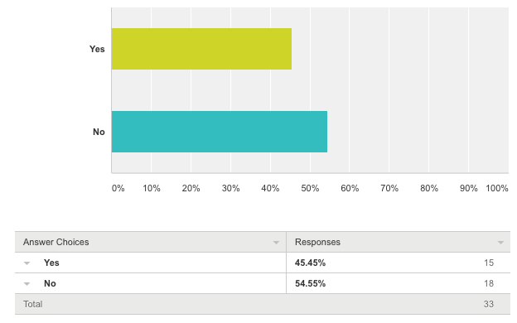
Results
Q1. “Name/Nickname ” and Q2 “Agency/Organization” - (Optional)
Of 34 respondents, 28 responded to both the questions
Q3. “Do you wish to remain anonymous?”

Slide 53
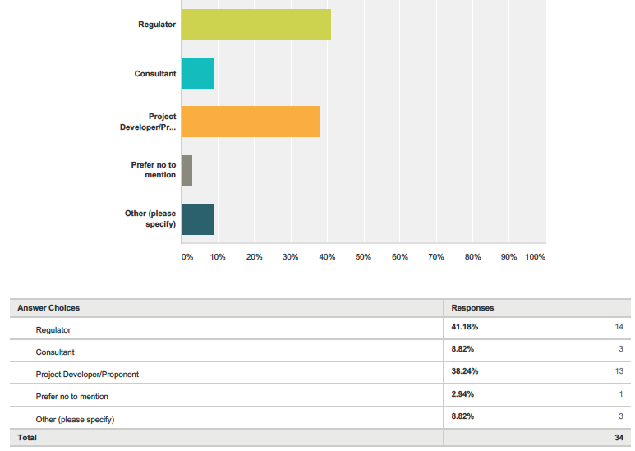
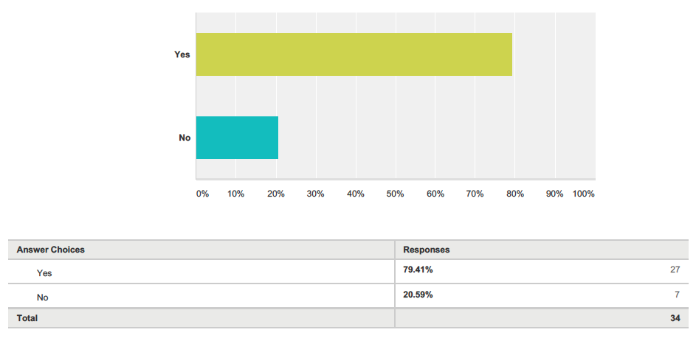
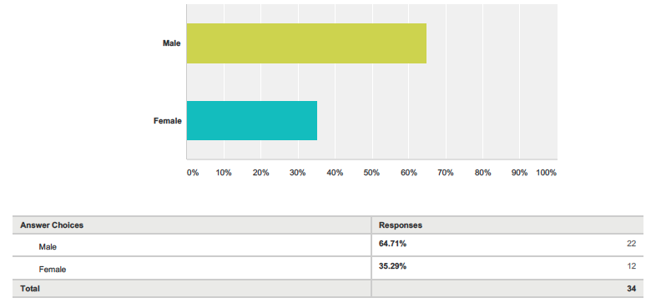
Results
Q4. “Do you wish to be contacted for further clarification, if required?” – 79.4% Yes
Q5 “Which of the following category applies to you?”
Q6. “Gender” – 64.71% male, 35.29% female

Slide 54
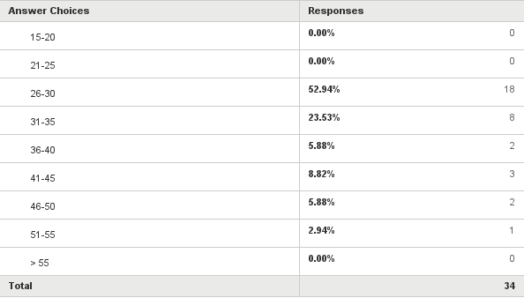
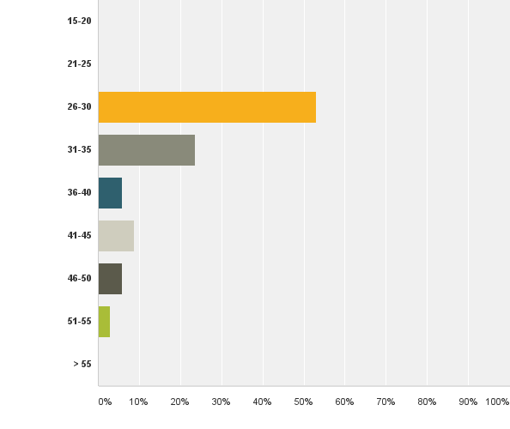
Results
Q7. “Age (Please select from the age ranges below)”

Slide 55
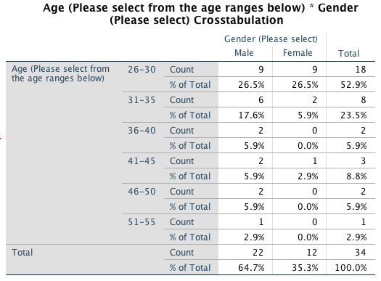
Crosstabulations (two by two frequency tables)
Age & Gender
Of nine male and female respondents (26.5%) belonged to 26-30-age bracket, while 6 male (17.6%) and two female (5.9%) respondents fell under 31-35 age brackets.
Only one male was between 51-55 years old. There was no female in that age category.

Slide 56
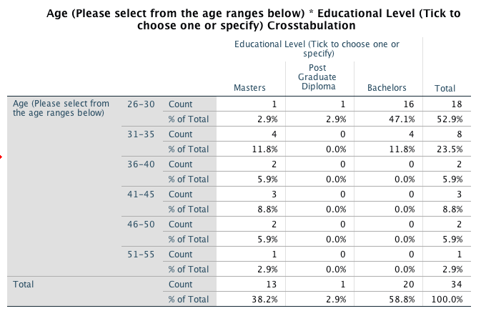
Crosstabulations (two by two frequency tables)
Age and Education Level
Of 20 respondents who have bachelor’s degree, 16 respondents (47.1%) of the total are between 26-30, representing a young group of EIA professionals.
4 respondents (11.8%) between 31- 35 years have master’s degree while another 4 respondents under same age category has bachelor’s degree.

Slide 57
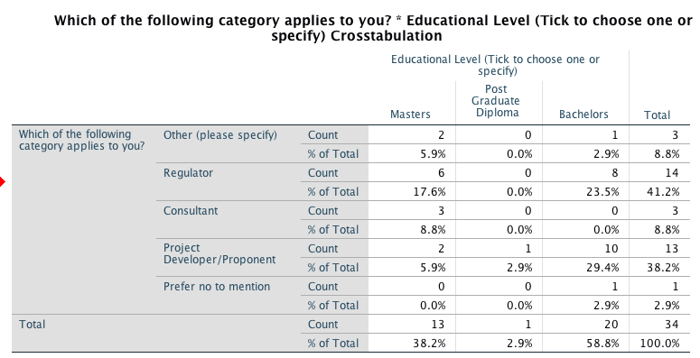
Crosstabulations (two by two frequency tables)
Occupational Category and Education Level
Six respondents with master’s degree (17.6%) and eight respondents with bachelor’s (23.5%) are regulators, while two respondents with master’s (5.9%) and 10 Respondents with bachelor’s are Project Developers (29.4%).
The lone respondent who has Post Graduate Diploma (2.9%) is a Project Developer.

Slide 58
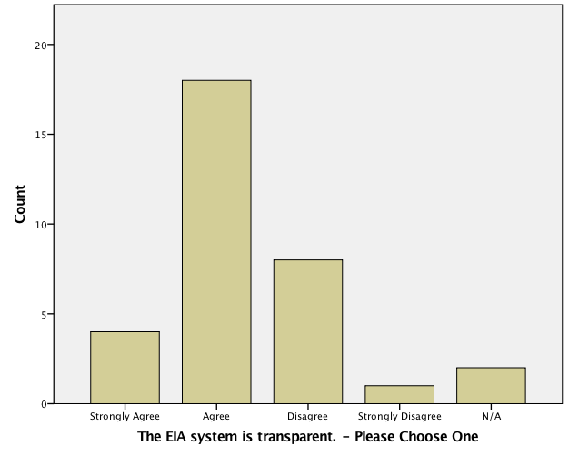
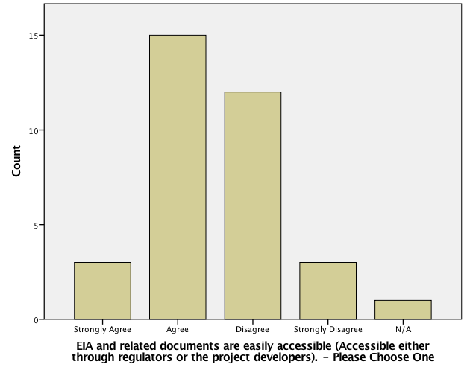
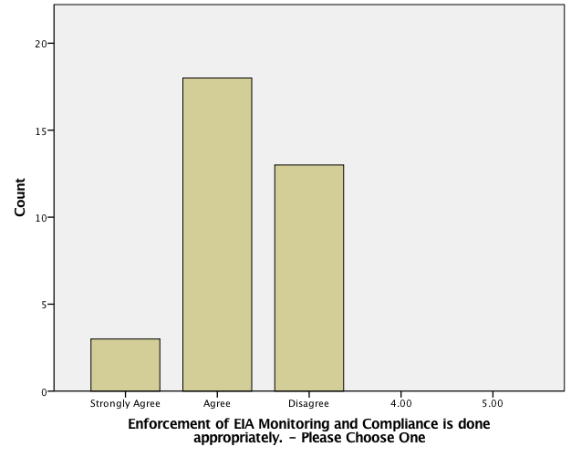
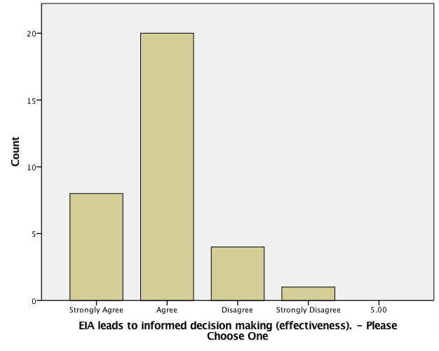
Q10. “To what extend do you agree or disagree with the following statements (Please select one from the drop down list)”

Slide 59
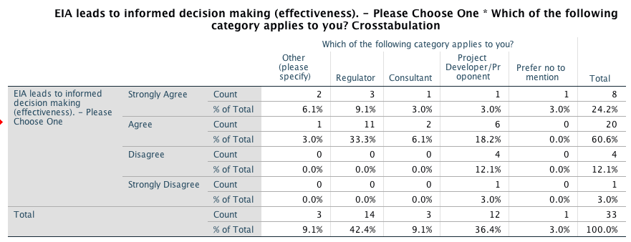
Q10. “To what extend do you agree or disagree with the following statements (Please select one from the drop down list)”
Of 60.6% who agreed, 33.3% are regulators, 18.2% are project developers while 3% are others.
Similarly, of 24.2% who strongly agree, 9.1% are regulators, 2% others and 3% each are consultant and project developer.

Slide 60
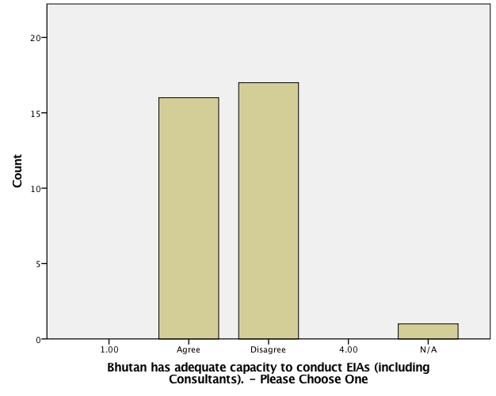
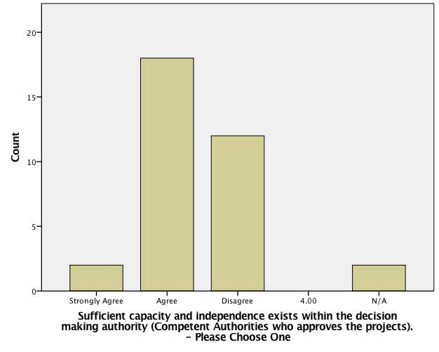
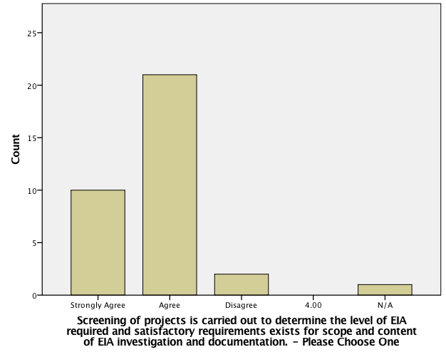
Q10. “To what extend do you agree or disagree with the following statements (Please select one from the drop down list)”

Slide 61
Q10. “To what extend do you agree or disagree with the following statements (Please select one from the drop down list)”

Slide 62
Q10. “To what extend do you agree or disagree with the following statements (Please select one from the drop down list)”

Slide 63
Q10. “To what extend do you agree or disagree with the following statements (Please select one from the drop down list)”
Of the 50% who disagree, 20.6% or seven respondents each are regulators and a project developer while one respondent (2.9%) is consultant.

Slide 64
Q10. “To what extend do you agree or disagree with the following statements (Please select one from the drop down list)”
Of 17.65% who strongly agree, 11.8% are regulators while 2.9% are the project developers. On the other hand, of another 17.65% who disagree, 11.8% are project developer and 2.9% are regulators.
Hence, regulators and project developers have an equally divided opinion on this statement.
26.5% of regulators and 17.6 % of project developers agree that public participation is well integrated into the EIA process. Moreover, 8.8% of both regulator and project proponent strongly agree to the statement.

Slide 65
Q11. “How do you rate the following stages of EIA in Bhutan?”

Slide 66
Discussion
5. EIA Documentation
EIA report as ‘face of the EIA process’ (Woods (2005, p. 176).
Bhutan - guided by ‘Environment Assessment Report Format’ (Annex 3) - can adapt to project specific issues based on ToR.
Title Page, Table of Contents, Terms of Reference, Summary, Project Description, Alternatives to the Project, Existing Environment, Assessment of Impacts, Mitigation Measures, Compliance, Response to comments and , Appendices
This checklist in conformity to other best practices such as the United States UK, The Netherlands, Canada and Commonwealth of Australia (based on (Woods 2005, p. 184-191).
Survey: EIA lead to informed decision making
60.61% agrees (and 24.24% strongly agree);
12.12% disagrees;
Rating: EIA documentation: 5.88% -‘excellent’, - 41.18% rate as ‘good’ followed by 32.35% - ‘satisfactory’.
20% feel the need for improvement.
Should not be just ‘table scoped and bogus’ (Respondent#4)
‘copying and pasting’ practiced (Respondents#5 & #7) - anti-plagiarism tools to review;
Need for capacity building (Respondent#26) to enhance the quality of reports.

Slide 67
Q11. “How do you rate the following stages of EIA in Bhutan?”

Slide 68
Discussion
Respondent data and general information (profile of the respondents, experience, stakeholders and education level)
Majority were regulators (41.2%) and project developers (38.2%).
EIA process came late into Bhutan’s policy mainstream -practitioners are still at its infancy.
Bhutan will need some more time before more experience is achieved on quality and professionalism in EIA.
2. Legal and administrative aspects (SEA, transparency, best practices, informed decision making)
Survey: whether EIA legislation was in harmony with international requirements and best practices?
Most of the respondents (70.59% - agree and 20.59% - Strongly agree)
It led to informed decision-making (60.61% agree, 24.24% strongly agree).
Was transparent (54.55% agree, 12.12% strongly agree).

Slide 69
Discussion
4. Scoping
Process of identifying the content and extent of the environmental information to be submitted to the competent authority under the EIA procedure – ToR or Frame of Reference.
In Bhutan – proponent required to prepare ToR to be endorsed by CA. (Section 29 of Regulation 2002).
Canada and The Netherlands have a formal scoping stage - developer agrees with the CA or EIA commission on the aspects EIA will.
Survey: Adequacy of Scoping?
11.76% strongly agree and 58.82% agree).
8.8% each of regulator and project developers however disagreed.
20% responded to improvement.
Rating- 8.82% - ‘excellent’, 50.00% ‘good’, 23.53% ‘satisfactory’ and 11.76% as ‘average’.
‘Scoping should be carried out in consultation with all the involved parties so that only key environmental issues can be the focus of the study (Respondent#16)’.

Slide 70
Discussion
Scoping treated differently in different countries & institutions.
NEPA 1969 silent about the scoping in almost all EIA - it was introduced only with 1978 CEQ Regulations.
US system does not have prescribed list of impacts that must be included in EISs .
Bhutan in the recent development (2012) has made this list exhaustive with introduction of eight sectorial guidelines - Bhutan in terms of such procedural guidance is hence better than the US.
Dutch EIA system has made scoping a requirement since its introduction in 1987 with detailed guideline.
Canada has made scoping mandatory under Canadian Environmental Assessment Act of 1992.
Is also a requirement in Commonwealth of Australia, but with formal consultation and public participation (Woods 2003, p. 169).

Slide 71
Discussion
6. Impact Prediction, Mitigation Measures and Environment Management Plans (EMP)
The heart of EIA process: Bhutan’s Sectorial Guidelines 2012 provide exhaustive checklist of all aspects that need to be considered during environment assessment.
Survey
36.67% of the suggested the need for improvement of the impact assessment.
need for consideration of only ‘significant’ impacts rather than including all impacts (Respondent# 3);
need for good ‘baseline data through field visits’, and ‘adequate consultations’ (Respondent#4 & #30);
use ‘scientific methods and tools ’(Respondent#4, #7 & #20);
need for ‘cumulative impacts’ (Respondent#11)
55.88% agree while 29.41% disagree - mechanism existed for assessment of complex projects including consideration of cumulative impacts.

Slide 72
Discussion
6. Impact Prediction, Mitigation Measures and Environment Management Plans (EMP)
EIA addressed environment management at all stage of project from pre-construction to operation - 35.29% strongly agreed while 55.88% agreed.
Rating of EMP: 8.82% excellent, 44.12% good and 23.53% satisfactory.
while the performance of MM and EMP is fairly doing well, improvement to meet some practical challenges is still required.
US, UK, The Netherlands, Canada, New Zealand, Commonwealth of Australia and South Africa takes impact prediction and hence mitigation measures as the central determinant of EIA process.
Mitigation has been the great strength of South Africa as per its integrated environmental management (IEM) guideline.
However generally, there is considerable scope for improvement of the mitigation measures (associated with monitoring) in all above countries with respect to improvement in practice (Woods 2003, p.274).

Slide 73
Discussion
8. Audit of Predicted Impacts
To compare the results of implementation and impact monitoring and the forecasts and commitments made earlier in EIA process.
Survey results:
reveal a weak post-monitoring and auditing practice in Bhutan.
Almost 50% disagreed that auditing of predicted impacts were conducted of which, almost 20.6% of respondents were regulators.
46.67% of respondents provided their suggestions on improvement.
‘It is in my opinion the weakest element of the whole EIA process in Bhutan. The follow up in Bhutan is only concerned with what has been already documented in EIA document. Auditing can be used as a tool to assess how effective was the EIA process and to what extent are the actual impacts comparable with the ones predicted’ (Respondent#16).
… ‘non-existent as of now’ (Respondent#25)
Elsewhere:
There appears to no standardized audit methodologies (Woods (2003, p. 243) )
In UK, auditing is not a requirement although voluntary proponent auditing is emerge and
‘environmental monitoring’ is discretionary under Environment Minister in Commonwealth of Australia (Woods 2003, p.252).

Slide 74
Discussion
9. Public Consultation and Disclosure (EIA document accessibility, integration of EIA from beginning)
50% response on the improvement:
need for working out clear procedure for public consultation and mechanism for public disclosure (Respondent#2 and #26).
, ‘…public awareness to draw realistic EMP is mandatory and availability of the documents on Public domain should be a requirement in EIA approval (Respondent#4).
Another respondent felt that there was need for regulator to web host EIA reports as practiced by other international financial institutes such as Asian Development Bank (ADB) (Respondent#11 and #7) to solicit comments and opinions from stakeholders (Respondent#25).
Bhutan has seriously taken consultation and participation into its policy mainstream and EIA process comparable to any best practices although need for improvements are still foreseen.
Countries like the US, The Netherlands, Canada and Commonwealth of Australia insists on taking consultation and participation prior to and following the EIA report publication (Woods 2003, p. 298), which is a good practice in principle.
However, in countries like UK, while consultation often take place prior to environment statement (ES), it rarely happens if scoping has been already done.

Slide 75
Discussion
10. EIA Decision Making and Approval
Ultimate purpose of EIA
Survey: EIA in Bhutan leads to informed decision-making –
24.24% strongly agree, 60.61% agree.
Therefore, this may be the strength of EIA in Bhutan since the objective of EIA is met through ability to make informed decisions.
40% responded for further improvement –
One of the main issues was on time taken by competent authorities (and other statutory clearances) to accord decision (Respondent#1, #7 and #14) and applicable time limits (Annex 1 of Regulation 2002) was too long (Respondent#6, #15 and #17). A respondent for instance stated that:
‘Regulators may abide by the timeline prescribed in the rules so that proponents do not have to waste months waiting for approval. To fast tight approval process the developer should not be allowed to make presentations separately for regulators after all stakeholder consultations’ (Respondent#11).
Elsewhere:
Comparative study of Woods (2003, p.238) when investigated on ‘Must the finding of EIA report and review be a central determinant of the decision on action’ found that most of countries like US, UK, Netherlands, Canada, Commonwealth of Australia and New Zealand only ‘partially’ met this criteria.
For instance, Woods found that in while ES was material information in UK was not necessarily a central determinant as practices varies.
However, it is to acknowledge that EIA in Bhutan influences informed decision-making at large.

