Slide 1
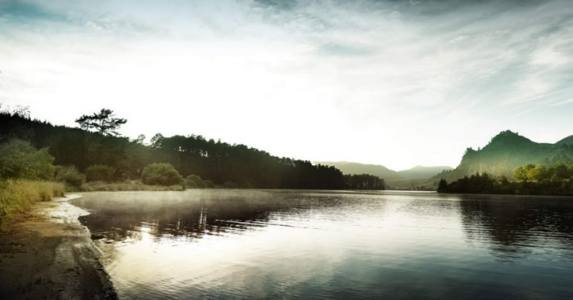
Waikato and Waipa Rivers Restoration Strategy An action plan for the restoration of New Zealand’s longest river
Keri Neilson, Michelle Hodges, Julian Williams, Nigel Bradly
BRISBANE, AUSTRALIA | 18 - 20 SEPTEMBER 2017
MANAGED BY

Slide 2
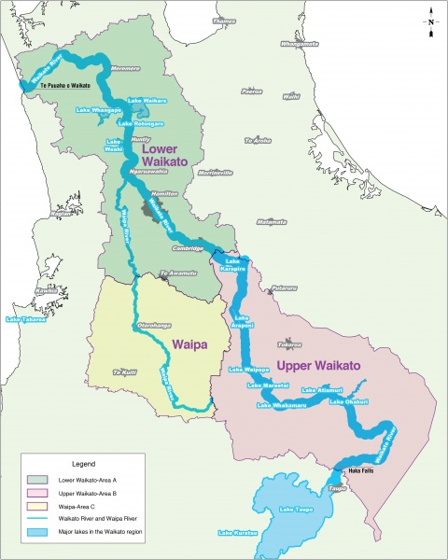
Background
425 km from Lake Taupo to Port Waikato
Physical and spiritual sustenance to Maori for at least 800 years
1860s: >3500 sq km confiscated
Forestry, sheep, dairy
8 hydro electric dams
1980s onwards – intensification
Condition changes dramatically as river flows north
BRISBANE, AUSTRALIA | 18 - 20 SEPTEMBER 2017
MANAGED BY

Slide 3
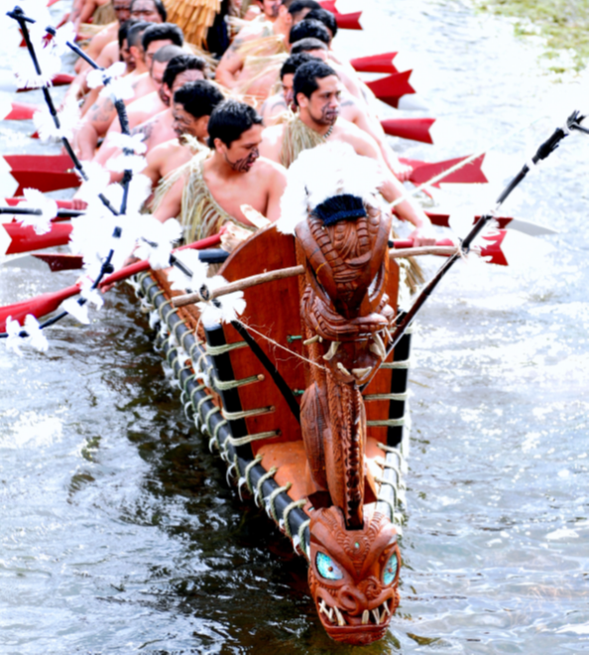
Waikato River Settlement 2009
Waikato River is the benefactor
Restoring the entire River and the relationship with the River
We all have a responsibility – co-management
Iwi, Hapuu & Marae
All of Government & Community
Be the decision maker, and influence the decision making framework
Policy
Partnerships
Joint Management Agreements
Funding
$220m Clean-Up Fund
BRISBANE, AUSTRALIA | 18 - 20 SEPTEMBER 2017
MANAGED BY
Notes:
The Waikato River settlement is a historic claim to grievances caused by the NZ Government from 1863 to 1987. The River settlement followed the Lands Settlement of 1995, which partially resolved matters relating to the confiscation of 1.2M acres of lands south of Auckland, belonging to the Waikato-Tainui tribe. The claim saw the Crown apologise for the wrongful confiscation of lands and accusations deeming the tribe as rebels against the Crown. Redress totalled $170M of which $40M was cash and the remainder made up of the commercial values of government lands returned. The catch cry for the claim was “I riro whenua atu, me hoki whenua mai” or “As land was taken, so shall it be returned”. Only 3% of the confiscated lands were returned to the tribe. The tribe decided it was time to move on from grievance to developing its future.
The River Settlement was left out of that Settlement, deemed to be too hard. It should be remembered that Waikato-Tainui held domain over the natural resources within its area. All decisions about its use sat solely with the tribe. History about the area is littered with stories related to the tribe including many battles, establishment of communities, deceit, love and laughter. After confiscation, Waikato-Tainui were removed from the rivers care, lands drained, communities flattened, and waters degraded. Waikato-Tainui wanted to restore its right of care. The River Settlement was resolved in 2009 with a clear focus on the health and well being of the Waikato River. The River is a tupuna (ancestor) to the Waikato-Tainui tribe, from where it derived its name. However, there were more than just the interests of the tribe to consider. Four other tribes have interests in the Waikato, and Waipaa River. The River also feeds NZs largest city (Auckland), and the fourth largest being Hamilton. It is also an important “asset” to the region and nation, sustaining many primary industries. Therefore a collaborative approach was required for the entire River, not just the interests of Waikato-Tainui, hence the creation of the Vision and Strategy to unify policy and people to better care for the Rivers. The approach focussed on co-management, sharing resources, coordination and leadership at the highest level. This was not the time to blame people, or organisations, for the current health issues of the River, but instead to acknowledge that everyone has a responsibility, likened to caring for your mother. The current resource management framework did not empower tribes to uphold their responsibilities as guardians, and so joint management agreements were compulsorily established between tribes and Authorities. Funding was provided to the tribes for their own activities of restoration and training. Funding was also negotiated for a regional clean up trust of $210M over 30 years.

Slide 4
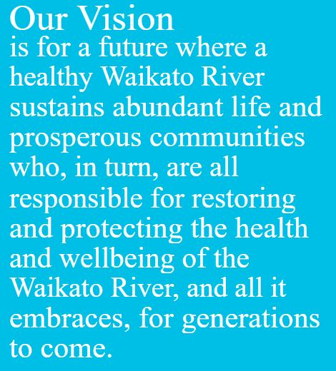
Mana o te Awa
Te
Ture Whaimana
Vision
& Strategy
Waikato River
Authority
Clean Up
Trust
Ministerial
Accords
Joint Management
Agreements
Mana
Whakahaere
Return of
River Related
Lands
Initiatives
Fund
BRISBANE, AUSTRALIA | 18 - 20 SEPTEMBER 2017
MANAGED BY
Notes:
This diagram shows the two principles of the Waikato River Settlement. Te Mana o te Wai at the apex of the model. Te Mana o te Wai refers to the mana (Authority, prestige and power) of the Waikato River. Its prestige must be acknowledged and protected. To achieve Te Mana o te Wai and the overarching purpose which is to restore the health and well being of the Waikato River, the tribe negotiated tools and entities to stand at the forefront of this new change. The Waikato River Authority is an independent entity governed by the five River Iwi and five appointees by the Government. They have two levers to achieve the overarching purpose of the settlement, Te Ture Whaimana which influcences over 20 pieces of legislation, and the Clean up Trust to support restoration activities delivered by communities, iwi and local organisations. The Waikato River Authority is responsible for the entire river.
The other principle of the River Settlement is Mana Whakahaere which is to restore the rights of the tribe. Each of the five tribes hold tools which empower their respective aspirations. It could be likened to each tribe taking care of their own house, whilst contributing to the vision of the wider community. Each iwi had river related lands returned, established joint management agreements with councils, have accords with government agencies and have their own co-management fund. All of these support the iwi to become effective guardians, in todays world. Regardless of your role, status or position, you are expected to strive towards improving the health and well being of the Waikato river.
Note: This model is called Te Kawau Maro and is a battle formation based on the flight formation of the shag. It concentrates all efforts to its apex to split enemy ranks and achieve its goal.

Slide 5
Challenge
Independent scoping study identified a cost of $2b to clean up the river
$220m awarded through the settlement
Multi-pronged approach and strong collaboration required to achieve Vision & Strategy
Regulation
Industry standard
Incentives
Question for funders – what to do and where to do it?
BRISBANE, AUSTRALIA | 18 - 20 SEPTEMBER 2017
MANAGED BY

Slide 6
Waikato and Waipa River Restoration Strategy
Purpose:
To guide future ‘on the ground’ activities for all organisations undertaking restoration through identification of specific, achievable, prioritised actions
Scope: Water quality, erosion/sedimentation, biodiversity, fisheries, cultural values, access/recreation
Non-regulatory
Focused on priorities for $400 m across the catchment
BRISBANE, AUSTRALIA | 18 - 20 SEPTEMBER 2017
MANAGED BY

Slide 7
Process of development
Review of work to date
Development of goals to direct Strategy
That iwi and community consider will best give effect to the V&S over the next 5-15 years
Identification of priority locations and actions
Modelling (sediment, nutrient, biodiversity, lakes)
Expert workshops
Review of historic and current programmes
BRISBANE, AUSTRALIA | 18 - 20 SEPTEMBER 2017
MANAGED BY

Slide 8
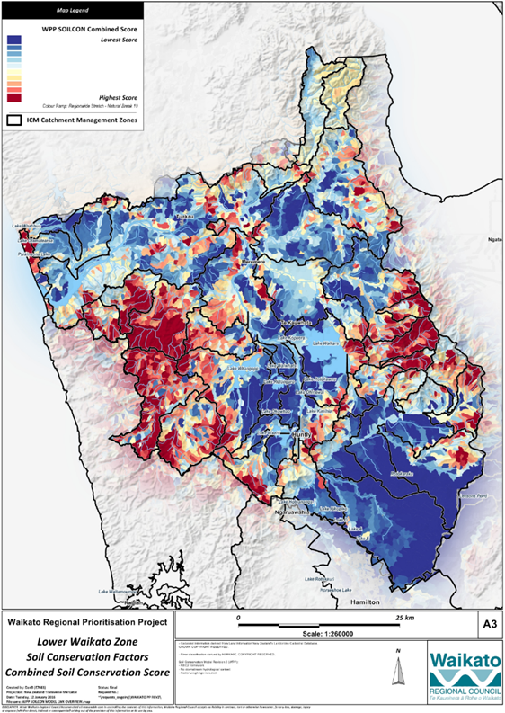
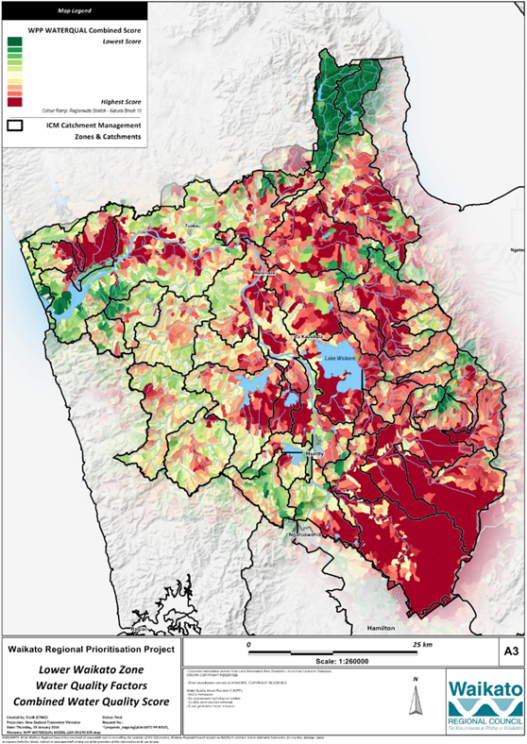
See presentation by Reece Hill
BRISBANE, AUSTRALIA | 18 - 20 SEPTEMBER 2017
MANAGED BY

Slide 9
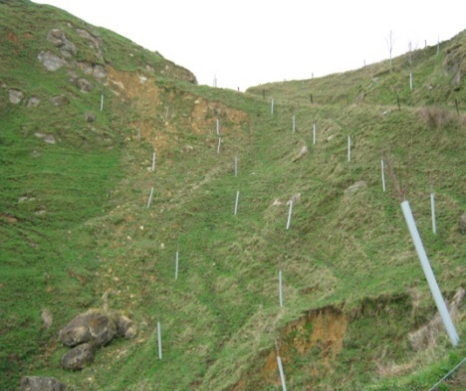
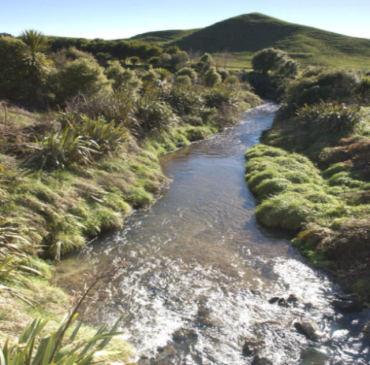
Locations and actions
Priority locations and actions established
Preferred non-regulatory actions agreed
Quantity of works estimated
Standard costs developed
Full costs per location per project estimated
Project assessments completed for each project
~200 projects
BRISBANE, AUSTRALIA | 18 - 20 SEPTEMBER 2017
MANAGED BY

Slide 10
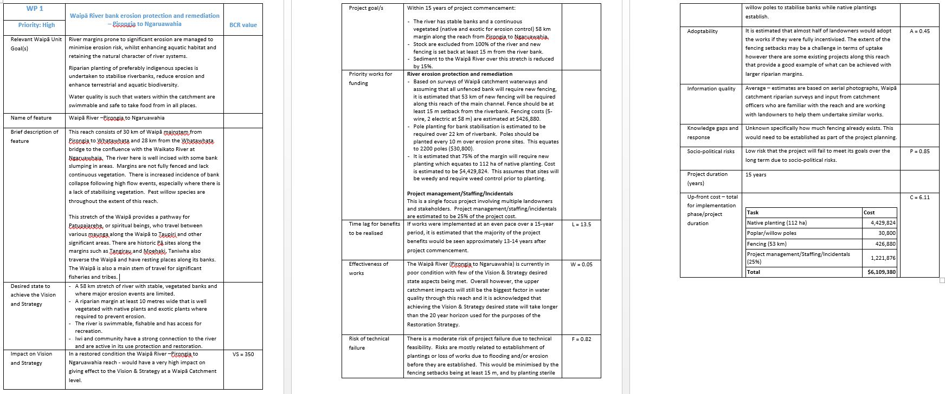
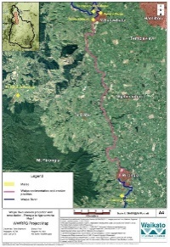
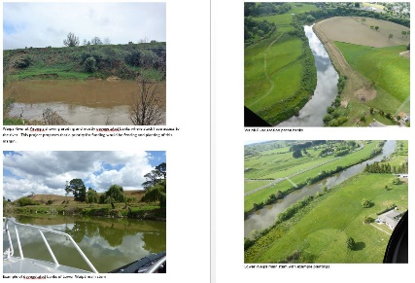
Project assessment form
BRISBANE, AUSTRALIA | 18 - 20 SEPTEMBER 2017
MANAGED BY

Slide 11
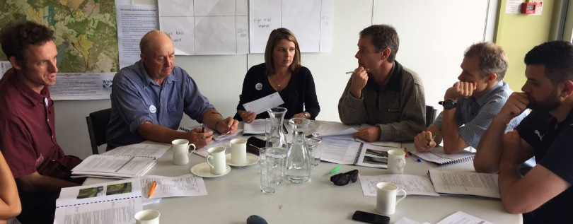
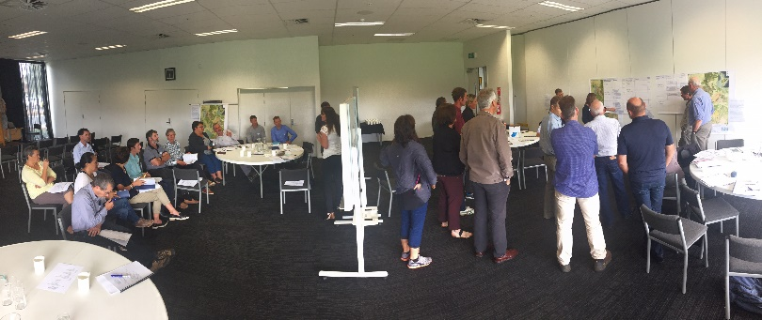
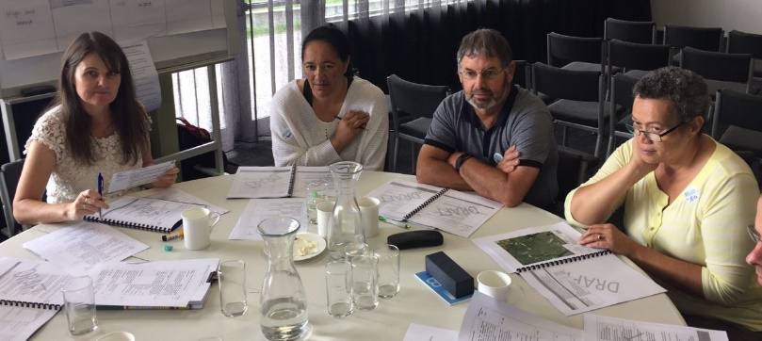
Catchment based workshops held to prioritise identified projects
Iwi, landowners, stakeholders
Industry
Conservation organisations
Territorial authorities
Care groups
Assessed factors within the “INFFER” framework
BRISBANE, AUSTRALIA | 18 - 20 SEPTEMBER 2017
MANAGED BY

Slide 12
INFFER
Investment Framework for Environmental Resources – (Natural decisions www.infer.org)
Decision support tool for funders/managers
Provides a Cost Benefit Assessment based on:
Significance of the site/feature
Effectiveness of proposed works
Technical risks
Adoptability of works
Socio-political risks
Time lag until results would be seen
Costs
BRISBANE, AUSTRALIA | 18 - 20 SEPTEMBER 2017
MANAGED BY

Slide 13
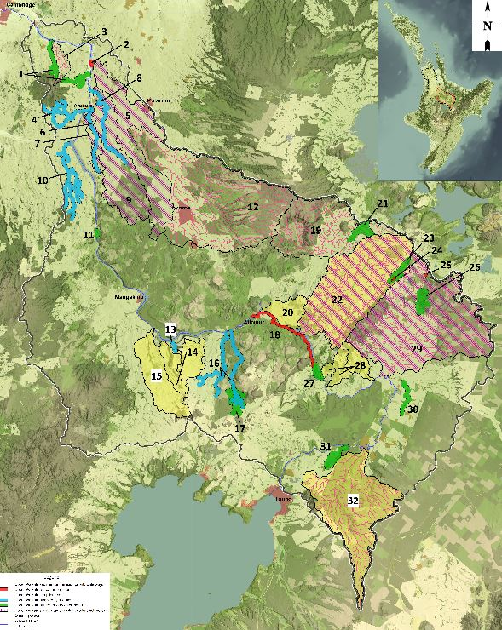
Priority projects - Upper Waikato
Erosion and sedimentation
Pole planting
Manuka/pine
Stabilising river/stream banks
Nutrients/E. coli
Retirement of wetlands, seeps and ephemeral streams
Fish habitat
Fencing/planting
Installation of habitat
Trap and transfer below dams
Access and recreation
Cycle way
2 walkways
Camping ground
Iwi cultural priorities (see other papers)
BRISBANE, AUSTRALIA | 18 - 20 SEPTEMBER 2017
MANAGED BY

Slide 14
Overall proposed work
Catchment | Fencing (km) | Planting (ha) | Revegetation (ha)
Lower/Central | 1590 | 385 | 9150
Upper | 990 | 270 | 4050
Waipa | 1200 | 410 | 7850
Lakes | 87 | 230 | -
TOTALS | 3,867 km | 1,295 ha | 21,050 ha
BRISBANE, AUSTRALIA | 18 - 20 SEPTEMBER 2017
MANAGED BY

Slide 15
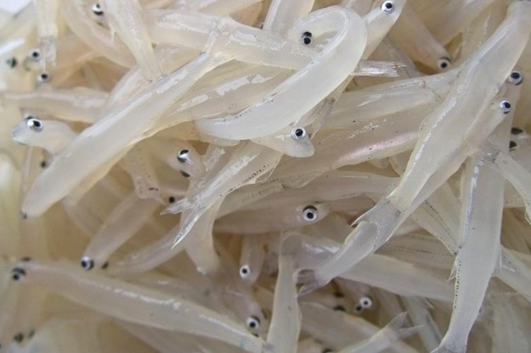
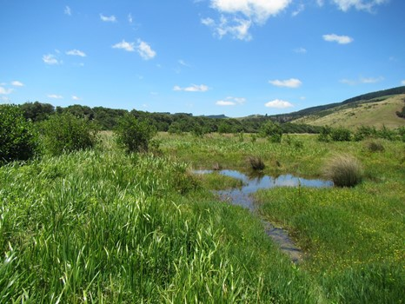
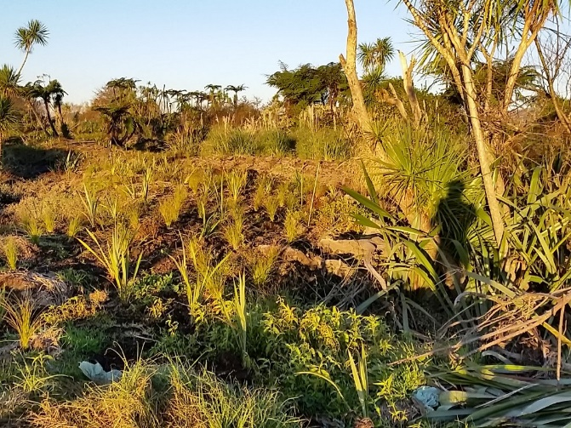
Example outcomes
70% of all potential whitebait spawning sites protected, vegetated with suitable spawning habitat
BRISBANE, AUSTRALIA | 18 - 20 SEPTEMBER 2017
MANAGED BY

Slide 16
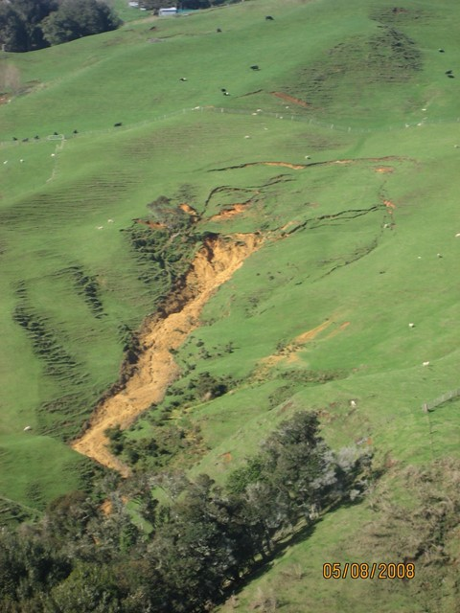
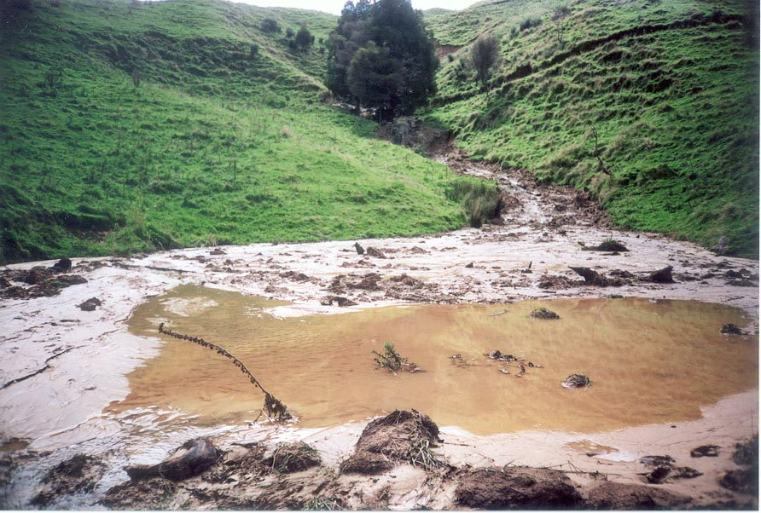
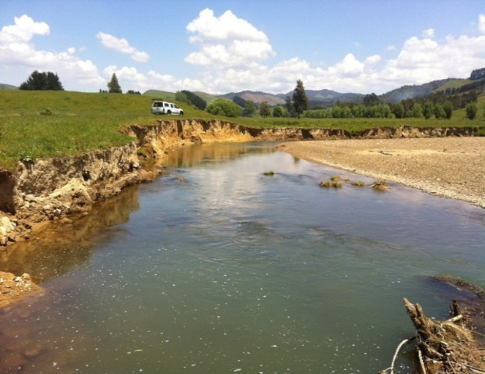
Example outcomes
Estimated 15% reduction in sediment load to the Waipa River
BRISBANE, AUSTRALIA | 18 - 20 SEPTEMBER 2017
MANAGED BY

Slide 17
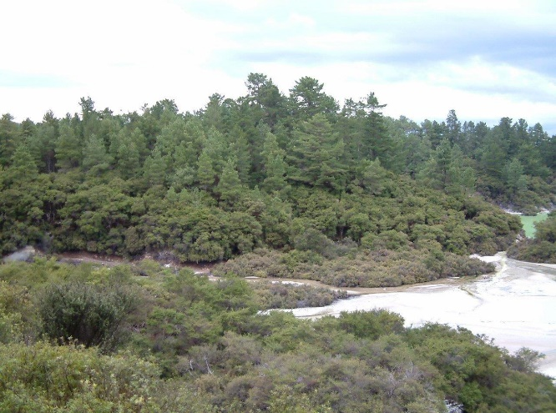
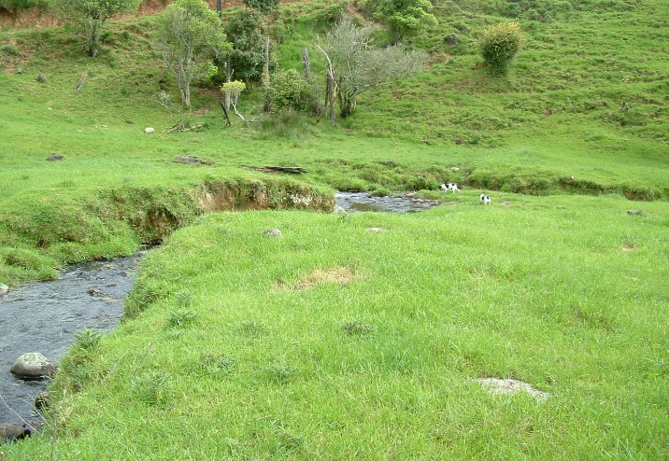
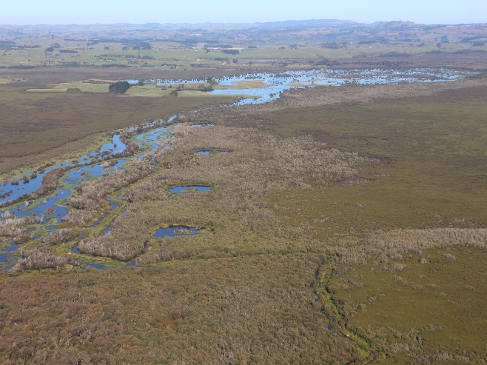
Example outcomes
Top 15% of representative aquatic biodiversity priority sites protected and enhanced
BRISBANE, AUSTRALIA | 18 - 20 SEPTEMBER 2017
MANAGED BY

Slide 18
Next steps
Restoration Strategy to be launched in November 2017
Work with iwi to increase capacity to deliver restoration projects
Work with industry to encourage and support landowner uptake
Effectiveness measured through Waikato and Waipa River Report Card (Baseline 2015)
BRISBANE, AUSTRALIA | 18 - 20 SEPTEMBER 2017
MANAGED BY

Slide 19
Acknowledgements
Project funders – Waikato River Authority, Waikato Regional Council, DairyNZ
Technical advisory group – Erina Watene-Rawiri, Karen Fisher, Naomi Simmonds, Alice Barnett, John Quinn, Maui Hudson, Tane Desmond, Reece Hill, Bruno David, Blair Keenan, David Burger
Natural Decisions – Geoff Park, Anna Roberts
Waikato and Waipa River Iwi
Landowner and stakeholder representatives
BRISBANE, AUSTRALIA | 18 - 20 SEPTEMBER 2017
MANAGED BY

