Slide 1



Taking the time:
Incorporating Aboriginal engagement into
water resource management in the Adelaide & Mt Lofty Ranges
Nadine Kilsby, Michael Field, James Peters
BRISBANE, AUSTRALIA | 18 - 20 SEPTEMBER 2017
MANAGED BY

Slide 2
BRISBANE, AUSTRALIA | 18 - 20 SEPTEMBER 2017
MANAGED BY
Notes:
*brief overview AMLR NRM region – not dissimilar to CMA
*what we are responsible for (that is WAP and e-flows)
*to-date, aboriginal engagement has been ad-hoc, project based
Desire to engage meaningfully, but as water-managers, we’re not aboriginal engagement experts – needed expertise
The rest of the talk showcases our journey so far, and the learnings and challenges we’ve come across. We say journey because we’re not presented a completed method.

Slide 3
Challenges
Previously limited, ad hoc, rushed engagement
Native Title vs Traditional boundaries
State government advice on who to engage
Our own connections (from Board to Ranger)
Change in political climate
Change in players
Nation capacity
Consideration for how others engage (LG,ENGOs etc.)
BRISBANE, AUSTRALIA | 18 - 20 SEPTEMBER 2017
MANAGED BY

Slide 4
Aboriginal Waterways Assessment
Developed by the Murray-Darling Basin Authority (MDBA) & Murray Lower Darling Rivers Indigenous Nations (MLDRIN) – based on a method determined by Māori scholars in New Zealand.
Guides Traditional Owners through considering the cultural values, uses and health of water on Country.
Process led by Traditional Owners and information remains the property of Traditional Owners – ensuring Cultural Knowledge is protected.
A way to engage with Traditional Owners on Country…
BRISBANE, AUSTRALIA | 18 - 20 SEPTEMBER 2017
MANAGED BY

Slide 5
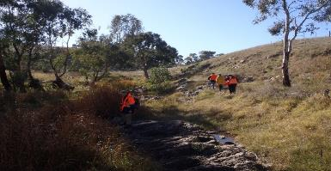
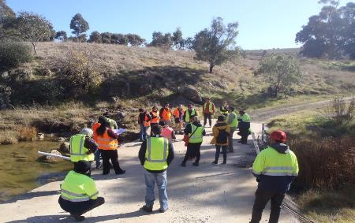
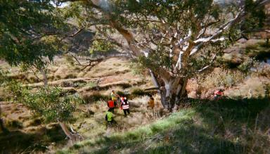
North Para River at Penrice
Bringing together 3 nations
Introduction to science
BRISBANE, AUSTRALIA | 18 - 20 SEPTEMBER 2017
MANAGED BY

Slide 6
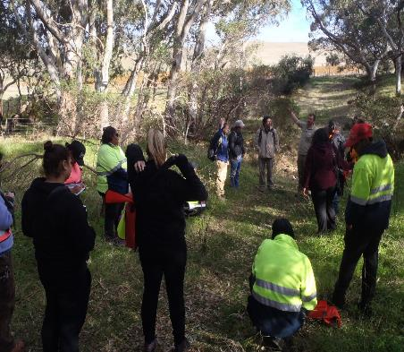
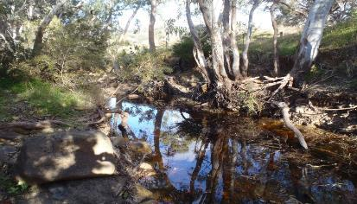
Tanunda Creek
Relationship building through open and honest discussion
Introduction to water allocation planning
BRISBANE, AUSTRALIA | 18 - 20 SEPTEMBER 2017
MANAGED BY

Slide 7
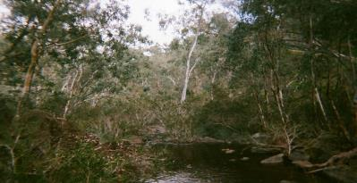
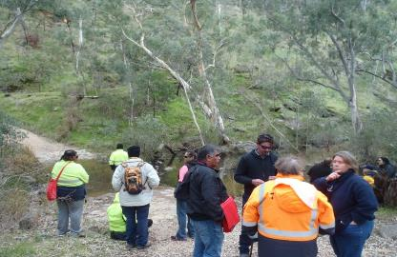
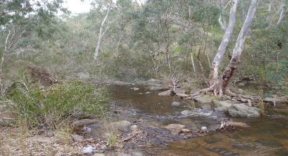
South Para River at Para Wirra
Environmental flows introduced
Cultural learning for staff
BRISBANE, AUSTRALIA | 18 - 20 SEPTEMBER 2017
MANAGED BY

Slide 8
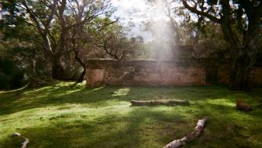
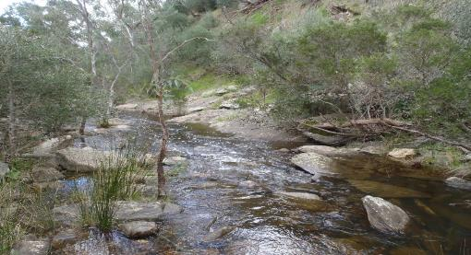
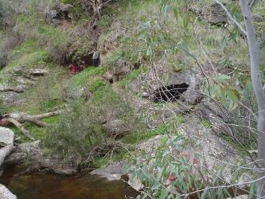
South Para River at Nolan’s
Knowledge sharing on Country
Complexities of private land ownership
BRISBANE, AUSTRALIA | 18 - 20 SEPTEMBER 2017
MANAGED BY

Slide 9
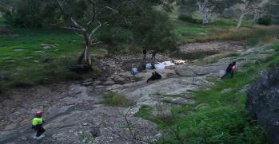
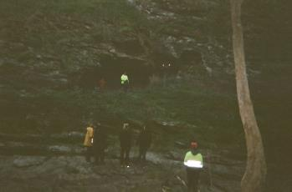
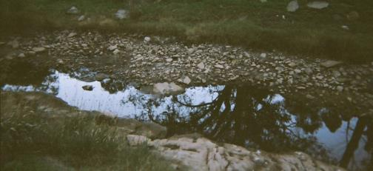
South Para River at Para Woodlands
Opportunities for improvement and further collaboration
Recognition that trust and relationships take time to build
BRISBANE, AUSTRALIA | 18 - 20 SEPTEMBER 2017
MANAGED BY

Slide 10
Next steps
Further workshops
Improvement of AWA Tool
Develop engagement method which works for everyone into the future
Demonstrate change in projects
Identify other AMLR projects
BRISBANE, AUSTRALIA | 18 - 20 SEPTEMBER 2017
MANAGED BY

Slide 11
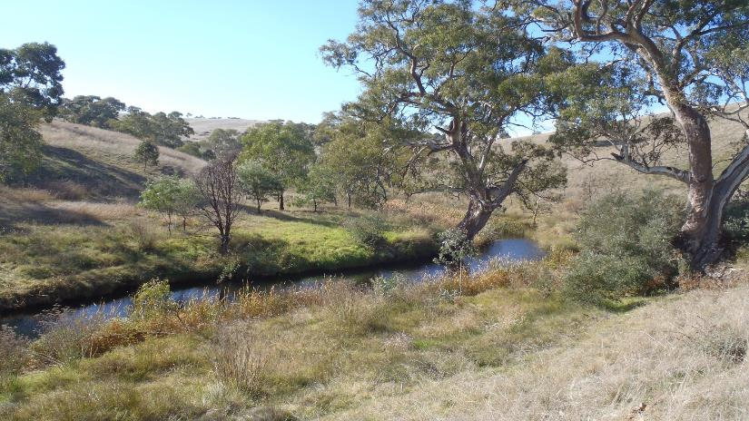
Thank You
BRISBANE, AUSTRALIA | 18 - 20 SEPTEMBER 2017
MANAGED BY

