Slide 1
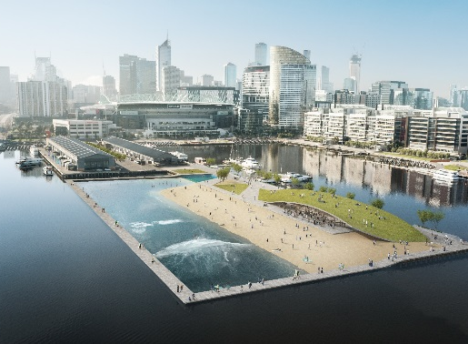
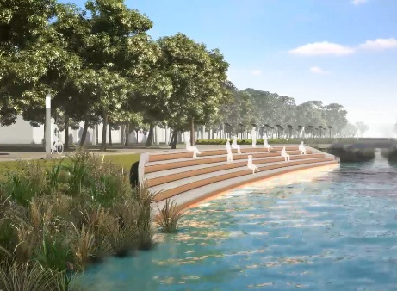
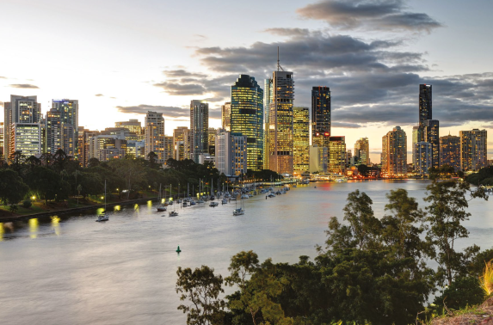
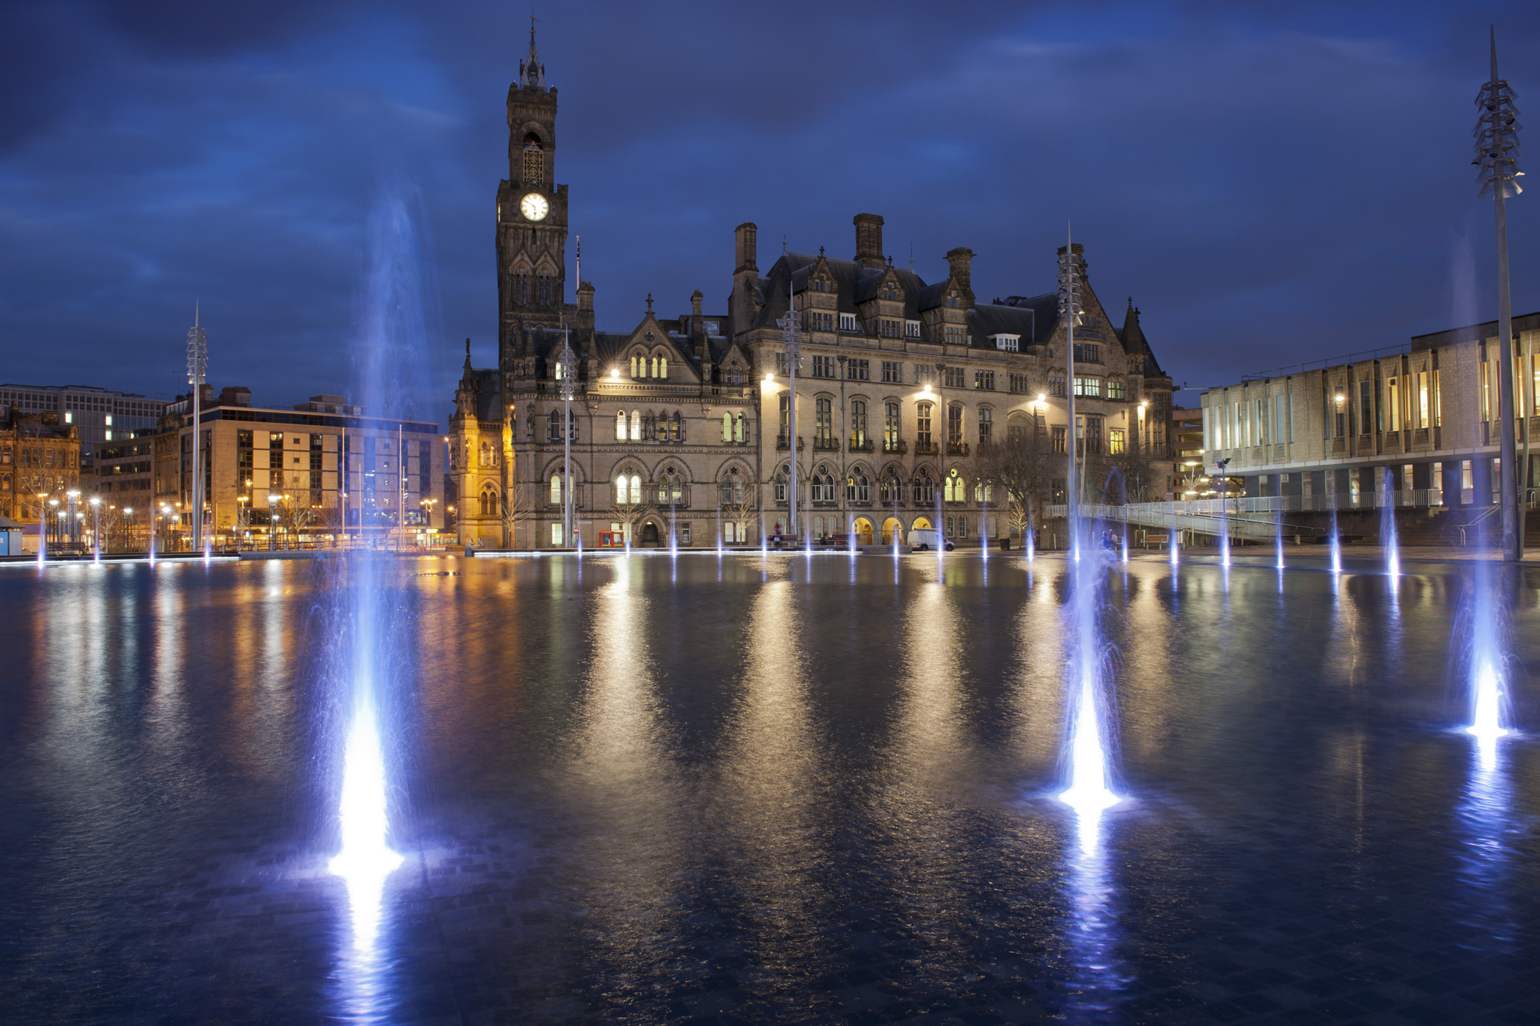
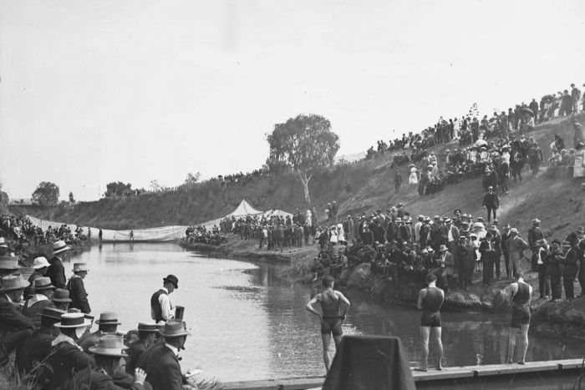
Urban Swimmability:
A driver for sustainable and liveable cities
Rhys Anderson
Geoffrey Hsu
BRISBANE, AUSTRALIA | 18 - 20 SEPTEMBER 2017
MANAGED BY

Slide 2
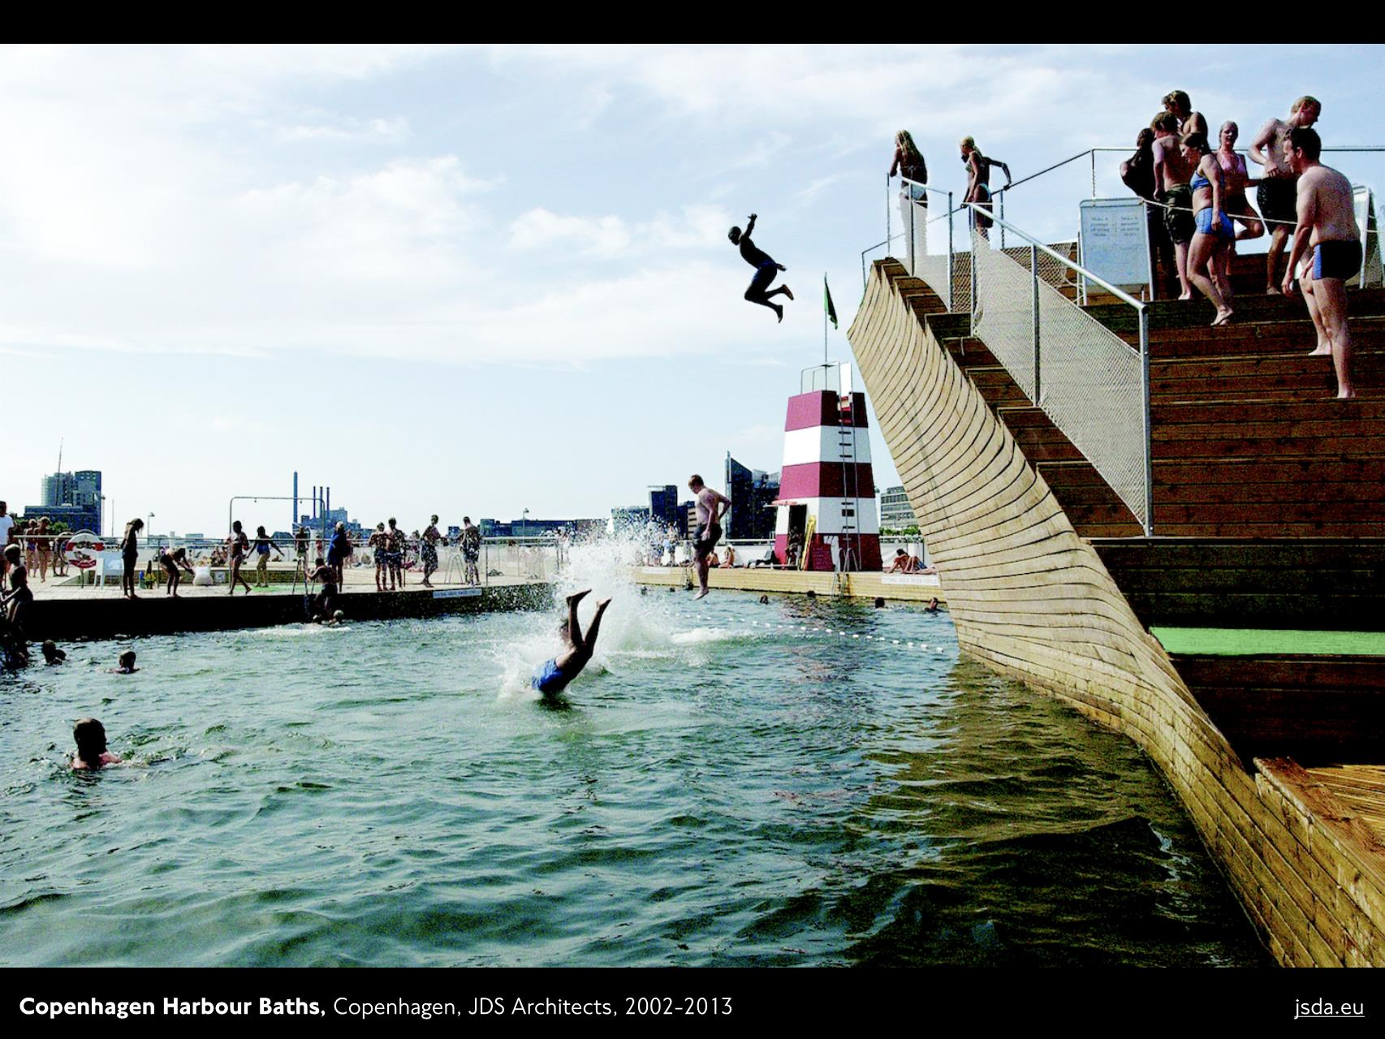
The Urban Plunge Movement
BRISBANE, AUSTRALIA | 18 - 20 SEPTEMBER 2017
MANAGED BY
Notes:
Definition of the movement:
-wild swimming in the city
-challenge the perspective of using urban water

Slide 3
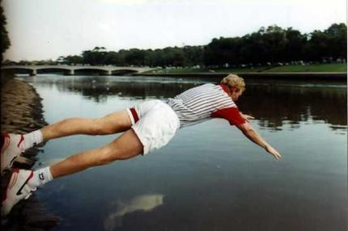
BRISBANE, AUSTRALIA | 18 - 20 SEPTEMBER 2017
MANAGED BY
Notes:
River torrens (Adelaide): http://www.abc.net.au/news/2014-12-11/taking-a-dip-in-adelaides-river-torrens/5960626
Jim Courier (Yarra): Jim Courier dives into the Yarra to cool off after his second Australian Open title win in 1993.

Slide 4
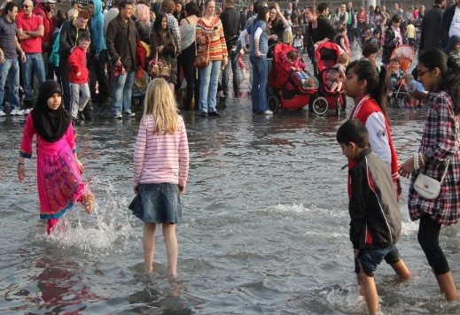
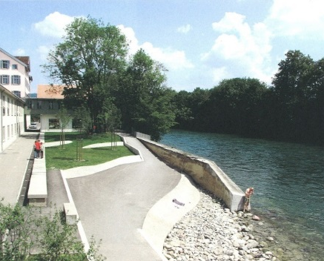
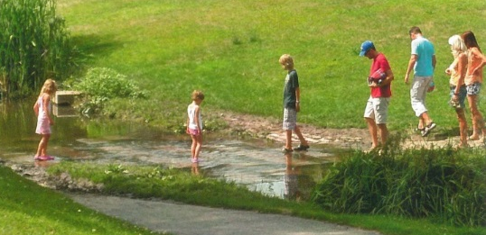
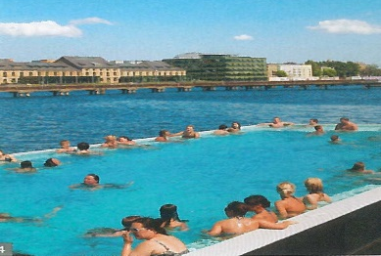
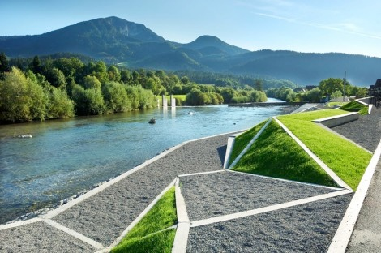
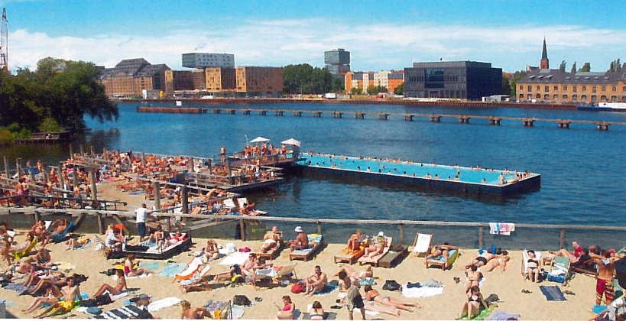
BRISBANE, AUSTRALIA | 18 - 20 SEPTEMBER 2017
MANAGED BY

Slide 5
Sustainable and liveable cities
Sets a goal that has tangible outcomes
Catalyst for engaging the community
Identifies major factors contributing to poor river quality and steps towards mitigation
Improving overall health, fitness and access to our natural environment
Integration of stormwater as a resource into urban planning
BRISBANE, AUSTRALIA | 18 - 20 SEPTEMBER 2017
MANAGED BY

Slide 6
New York
Osaka
Paris
Montreal
Riehen
Sydney
Stockholm
London
Copenhagen
Dublin
Berlin
Melbourne
Helsinki
Prague
BRISBANE, AUSTRALIA | 18 - 20 SEPTEMBER 2017
MANAGED BY

Slide 7
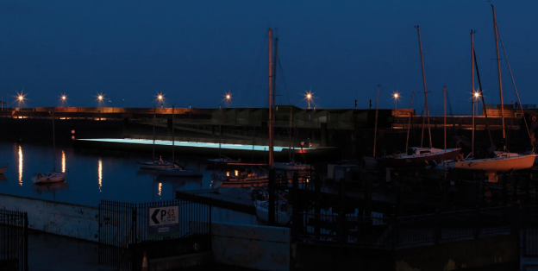
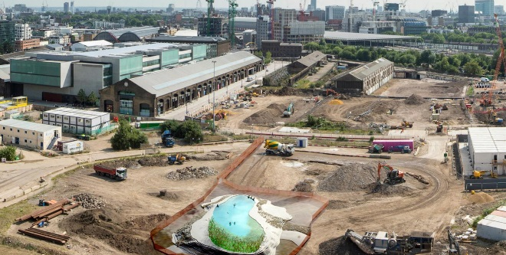
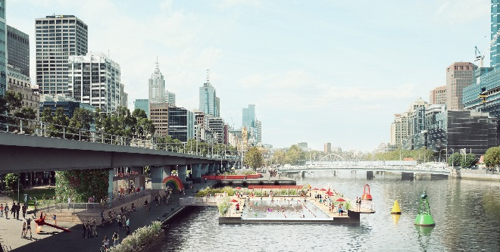
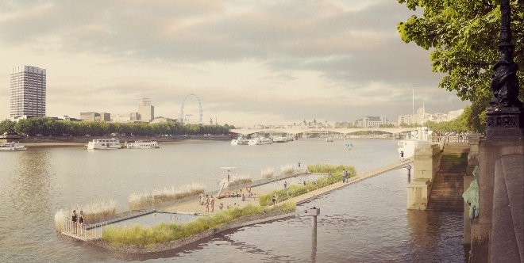
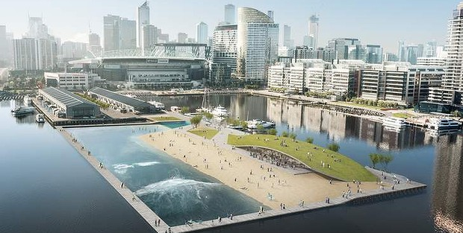
Arup Projects
+Pool, New York
Dun Laoghaire Harbor Company Floating Pool and Urban Beach, Dublin
Yarra Pools, Melbourne
Docklands Wave Pool, Melbourne
Thames Baths Project, London*
King’s Cross Pond Club, London
Clockwise from top-left
*Preliminary advice only
© +Pool
© DLHC
© Studio Ooze
© Picture Plane/ Studio Octopi/Yarra Swim Co.
© Studio Octopi
© Arup-Damian Rogers Architecture
BRISBANE, AUSTRALIA | 18 - 20 SEPTEMBER 2017
MANAGED BY

Slide 8
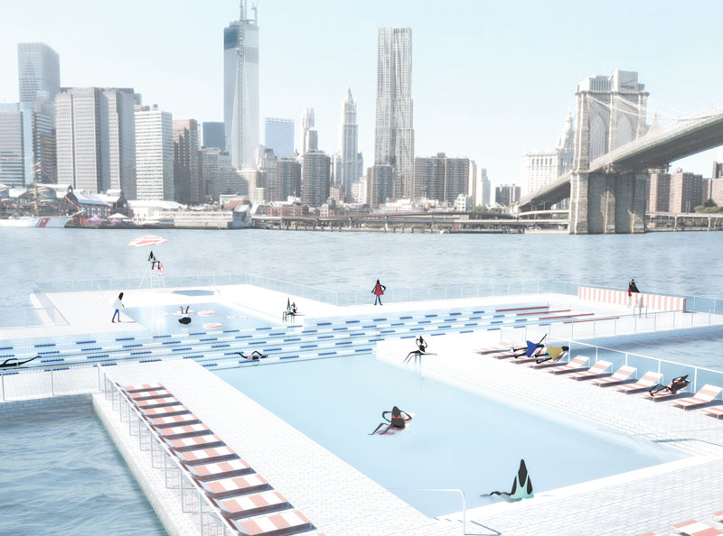
Plus Pool, New York
BRISBANE, AUSTRALIA | 18 - 20 SEPTEMBER 2017
MANAGED BY

Slide 9
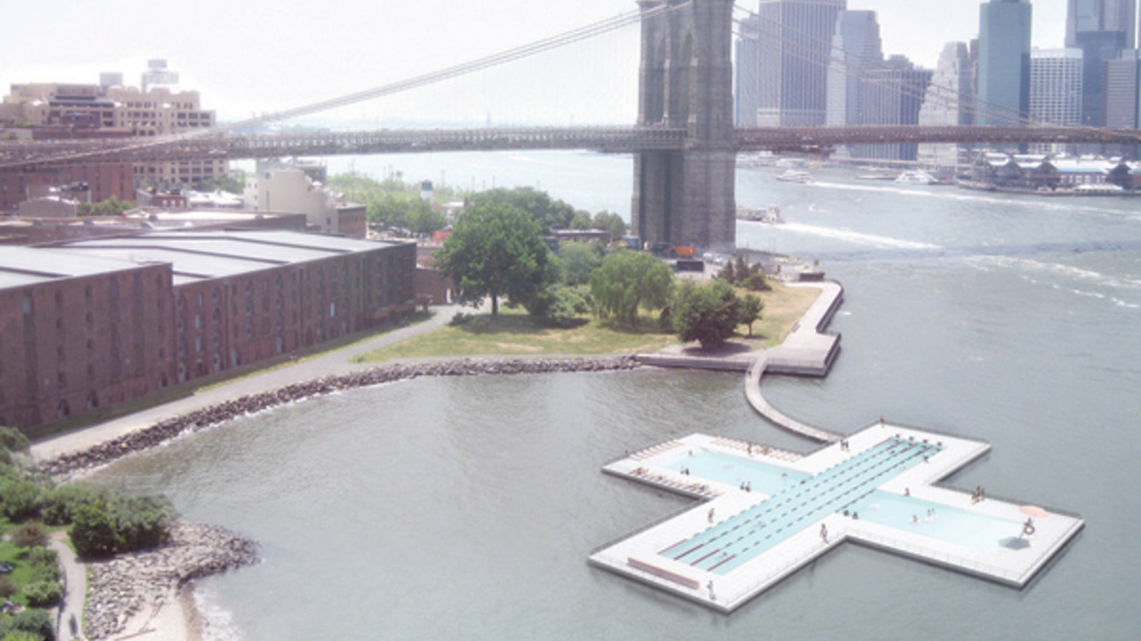
Arup is working with New York City, Family and PlayLab on a feasibility study for a floating pool
“a giant strainer dropped in the river”
Concentric layers of filter material to allow only water of swimmable standards through
Challenges: exploring use of both passive and mechanical filters
Image © West 8 + DTAH
BRISBANE, AUSTRALIA | 18 - 20 SEPTEMBER 2017
MANAGED BY
Notes:
Arup is working with New York City design studios Family and PlayLab on feasibility studies for a new floating pool that would filter New York City river water – “like a giant strainer dropped in the river,” according to the designers.
+ Pool’s proposed innovative river water filtration system represents a new model for swimming pools. The concept proposes to filter river water through concentric layers of materials integrated directly into the pool walls, leaving only safe and swimmable water that meets relevant standards of quality and produces a high psychological level of comfort in order to appeal to the public. To this end, Arup’s primary challenge has been to explore using both mechanical and passive filters to be embedded in the walls to maintain safe water quality and provide sufficient

Slide 10
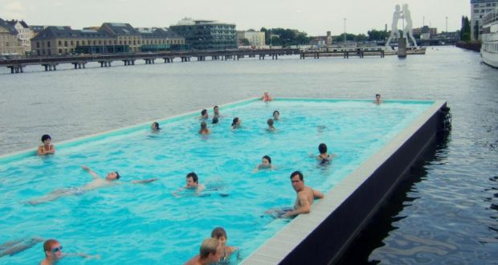
Dun Laoghaire Harbour Company (DHLC), Dublin
BRISBANE, AUSTRALIA | 18 - 20 SEPTEMBER 2017
MANAGED BY

Slide 11
Arup is working with DHLC to deliver a “heated, treated swimming pool” and urban beach
Proposed location on the east pier of the harbour
Based on the successful Berlin Badeschiff floating pool in Germany
Aim to be a significant public amenity, tourist attraction, and a hub for activity within the harbour
BRISBANE, AUSTRALIA | 18 - 20 SEPTEMBER 2017
MANAGED BY
Notes:
Arup works with port authority to deliver a “heated, treated swimming pool” and urban beach
As part of their masterplan implementation, DLHC are planning to develop an urban beach and floating swimming pool on the East pier of the harbour. The proposed development is based on the successful Berlin Badeschiff development which is a floating swimming pool on the River Spree in Germany. DLHC’s aim is that the facility will act as a significant public amenity and tourist attraction, and will create a hub of activity within the harbour.

Slide 12
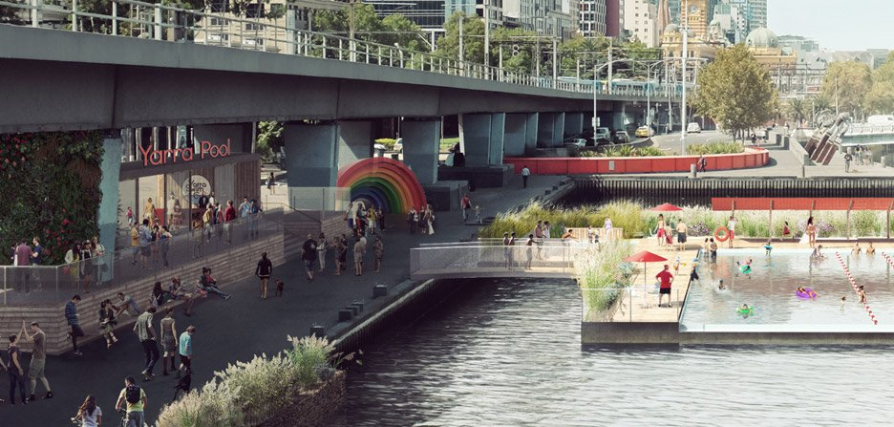
Yarra Pool, Melbourne
BRISBANE, AUSTRALIA | 18 - 20 SEPTEMBER 2017
MANAGED BY

Slide 13
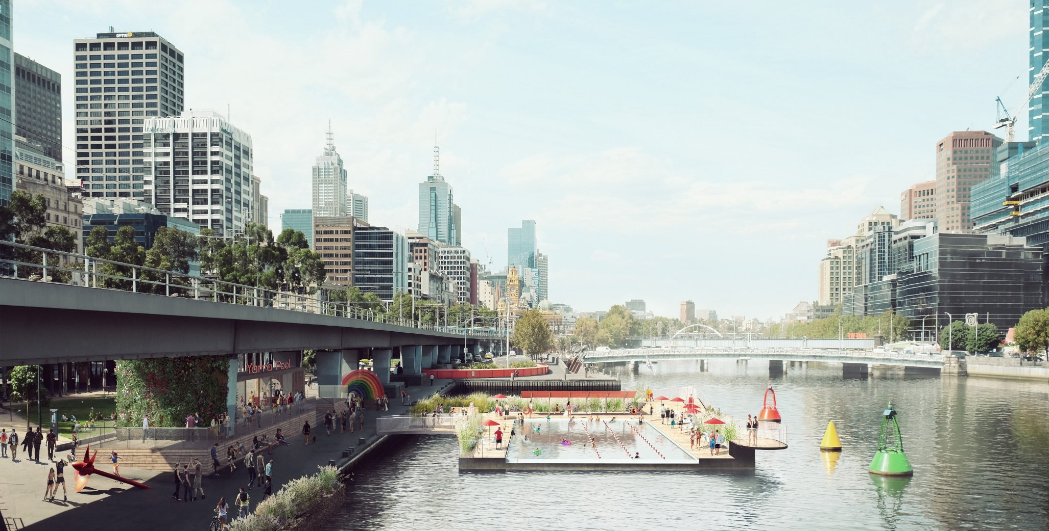
Arup is working with Yarra Swim Co. to design a floating pool in the Yarra River
Utilises existing clean saltwater from the bottom of river
Clean water is recycled back to river
No chemicals or expensive filters used
Image © Picture Plane/ Studio Octopi/Yarra Swim Co.
BRISBANE, AUSTRALIA | 18 - 20 SEPTEMBER 2017
MANAGED BY

Slide 14
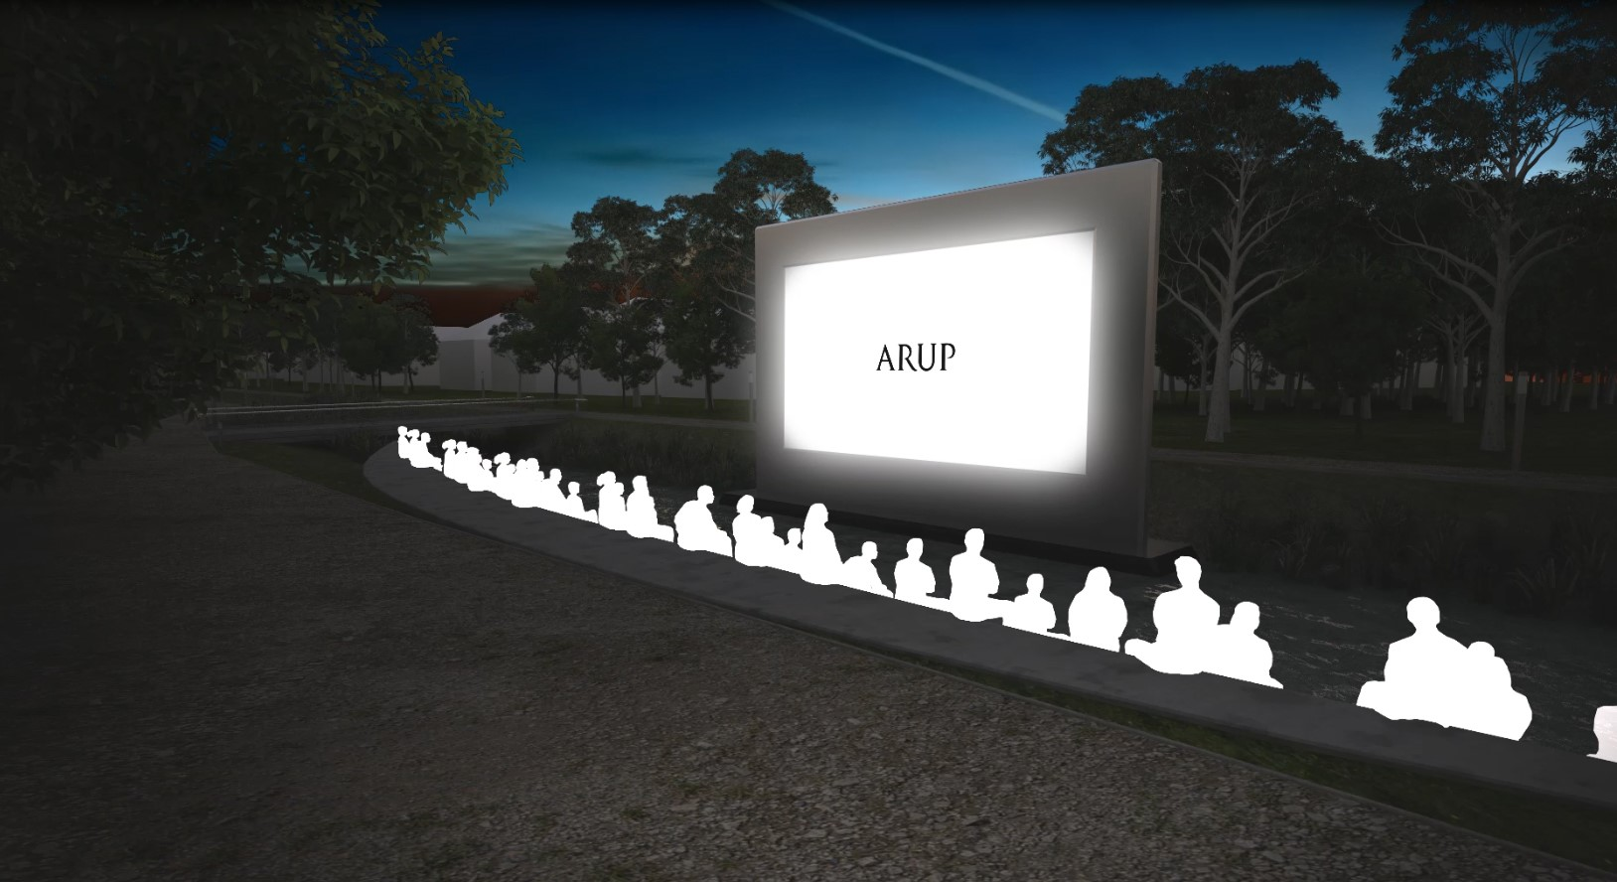
Thank you
rhys.anderson@arup.com geoffrey.hsu@arup.com
BRISBANE, AUSTRALIA | 18 - 20 SEPTEMBER 2017
MANAGED BY

