Slide 1
Environmental Water Managers:
what happens when the environment has legal rights?
Erin O’Donnell
BRISBANE, AUSTRALIA | 18 - 20 SEPTEMBER 2017
MANAGED BY

Slide 2
Environmental Water Managers: a sense of discomfort
Victorian Environmental Water Holder, 2010
A statutory body corporate to hold and manage environmental water in conditions of water scarcity
Shift from ‘a legitimate need’ to ‘just another user’ of water
The VEWH is only the most recent of a range of EWMs
EWMs: construct the aquatic environment in water law as a legal person to hold water rights and participate in water markets
What happens when the aquatic environment is constructed as a legal person?
2017: new legal rights for rivers in NZ, India, Colombia and Argentina make this question even more compelling
BRISBANE, AUSTRALIA | 18 - 20 SEPTEMBER 2017
MANAGED BY
Notes:
This question matters because:
Historic lack of legibility: the law had to find a way to ‘see’ the environment to address environmental problems
Global push for legal rights for nature: a transition from object to subject
Increasing use of environmental markets: personhood as a way to participate

Slide 3
Methods
Using the EWMs enables a detailed analysis of the relationship between legal personhood, legal context and legibility
A ‘lightly constructivist’ approach: engages with legal construction of the environment, but without losing sight of the physical reality
Case studies of two jurisdictions where most EWMs are found to support a qualitative analysis of the creation and operation of the EWMs
Legal analysis: legislation, case law, legal instruments
17 long-form interviews with EWM staff to enrich publicly available material
Content analysis using NVIVO 11
BRISBANE, AUSTRALIA | 18 - 20 SEPTEMBER 2017
MANAGED BY
Notes:
Key point: interviews as a way to see how the legal form of the EWM is operationalised through the actions and beliefs of human staff

Slide 4
The EWMs: a legal and organisational response to water scarcity
Environmental water managers (EWMs):
identifiable organisation with legal personhood
specific objectives to improve aquatic ecosystem health
capacity to acquire and/or manage water rights for the environment
Legal context: modern water rights, water markets, water rights for the environment
Legal personhood:
If someone or something is a person, it tends to count in its own right (Naffine, 2009)
EWMs are created in law as legal persons by their creation as specific legal entities
But they are limited
BRISBANE, AUSTRALIA | 18 - 20 SEPTEMBER 2017
MANAGED BY
Notes:
I specifically set out to test the hypothesis that the EWMs were reliant on a particular legal context.
I conducted a wide-ranging review of water laws, water markets and water rights for the environment to examine this relationship. This review does not establish causation, but does provide strong evidence of correlation.
EWMs only exist where there are modern water rights, active water markets and legal rights to water for the environment that are more than merely conditions on other users’ water rights.
Where one of these elements is missing, EWMs are absent.
I can provide more information on how I conducted this review during questions, if this is of interest.

Slide 5
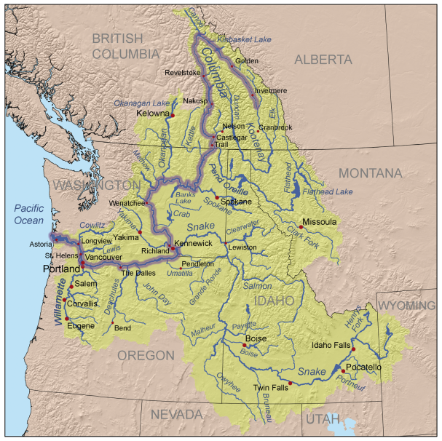
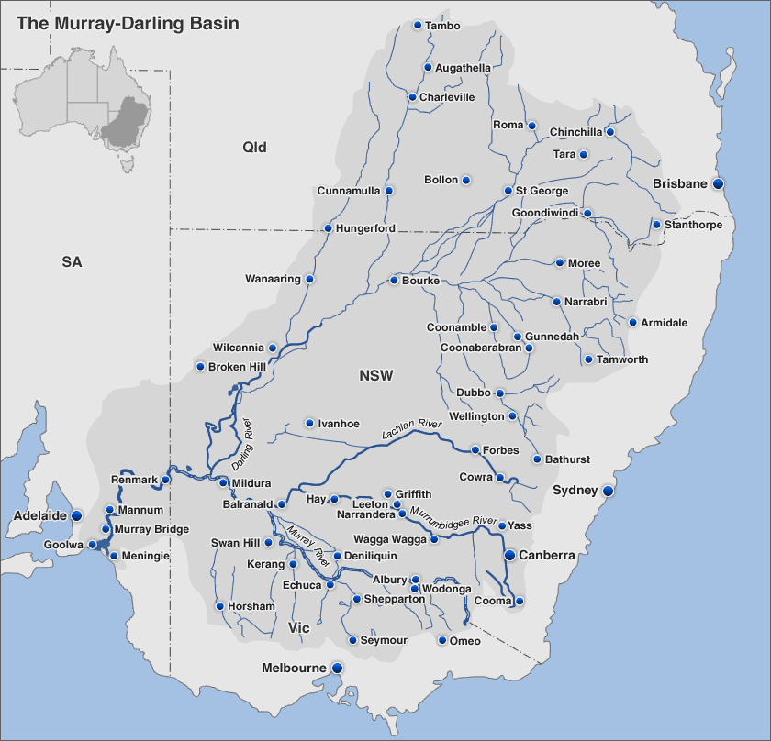
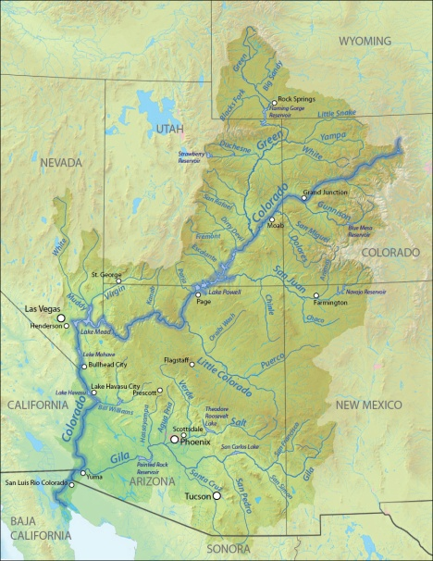
BRISBANE, AUSTRALIA | 18 - 20 SEPTEMBER 2017
MANAGED BY
Notes:
Case studies: Australia and the USA

Slide 6
Case studies: key findings
How is the aquatic environment constructed in water law?
Three ways: socio-ecological concept, legal object, legal subject
USA more complicated by prior appropriation and ad hoc approach
How are the EWMs constructed in law?
Combination of body corporate and other forms to establish personhood, set out in specific legislation
What activities do the EWMs undertake?
Australia: recovery and management; USA: appropriation and acquisition
What is the dominant narrative for the EWMs?
Australia: EWMs are just another user, they are water customers
USA: EWMs depend on consensus-based collaboration
BRISBANE, AUSTRALIA | 18 - 20 SEPTEMBER 2017
MANAGED BY

Slide 7
The paradox of the EWMs
EWMs: a step forward in environmental protection
Significant legal powers and financial investment in water rights
Improvement in quantity of water available for the environment
BUT: other water users’ fear of the legally powerful environment has limited their legal powers
AND: the form of the EWM as a legal person has weakened the narrative that the environment deserves protection
Australia: environment is merely the largest irrigator in the basin
Western USA: environment can only acquire water when it does not compromise other users: no ‘buy it up and dry it up’
The legally powerful construction may undermine the cultural narrative of why the environment is worth protecting at all
BRISBANE, AUSTRALIA | 18 - 20 SEPTEMBER 2017
MANAGED BY
Notes:
New constraints reacting against power of the EWMs as legal persons participating in environmental water recovery:
Australia: 1500GL cap
USA: limits on who can hold instream flows

Slide 8
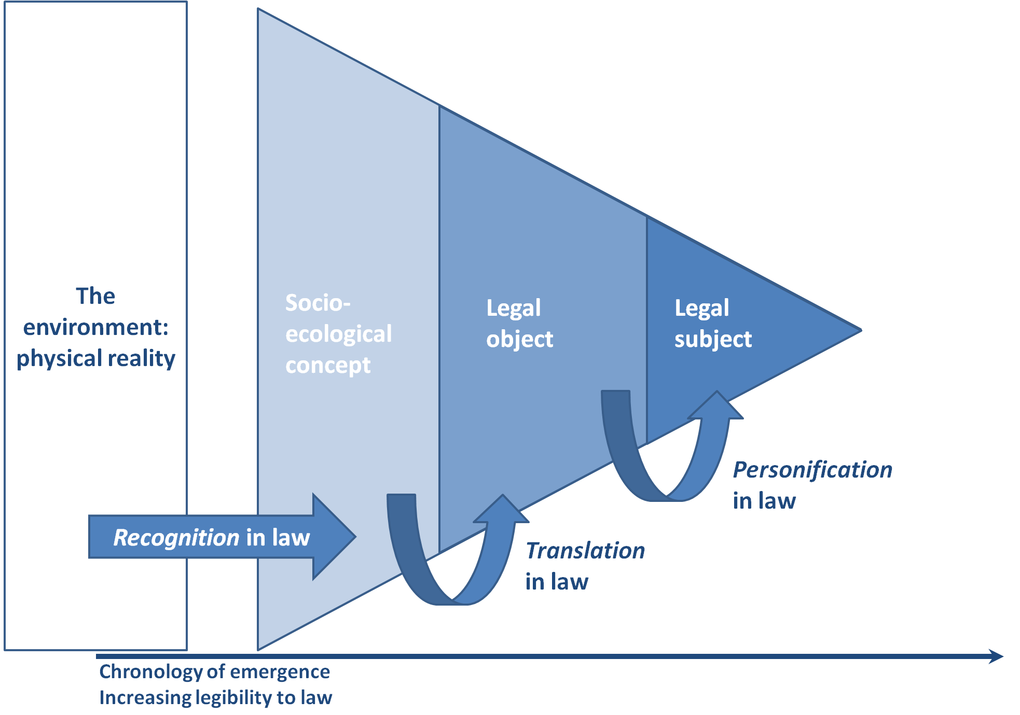
Multiple constructions interact in unintended ways
BRISBANE, AUSTRALIA | 18 - 20 SEPTEMBER 2017
MANAGED BY

Slide 9
Construction, narrative and regulatory response
Cultural narratives: discourses that shape our response to problems and solutions
Socio-ecological concept: ‘environment’ is what we say it is
Broad and flexible, but vulnerable to changing community values, requiring constant articulation
Legal object: weak but worthy of protection
Public interest regulation: the environment as an object requiring protection by others in the regulatory process
Legal subject: can, and should, look after itself
Private interest regulation: the environment as a subject with a voice of its own to compete for regulatory outcomes
BRISBANE, AUSTRALIA | 18 - 20 SEPTEMBER 2017
MANAGED BY
Notes:
Growing body of literature that shows how important narrative is to shaping our understanding of problems, and the legal response to them.
Particularly – Robin Kundis Craig, Melinda Benson Harm, Michael Burger
Kundis Craig definition: deeply embedded social stories that frame and contextualize events within a particular culture to help give them meaning
I use cultural narrative as a discourse, a story-telling tool; this is not the same as cultural values

Slide 10
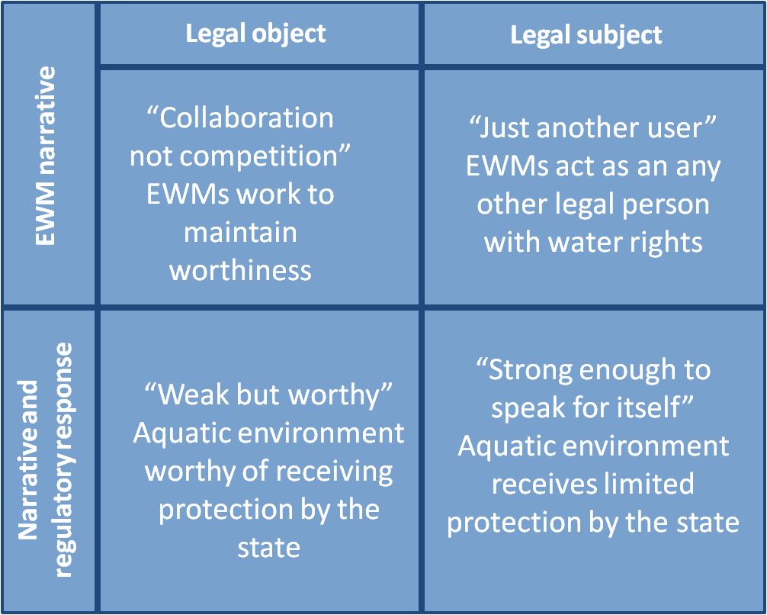
EWMs demonstrate the power of narrative
BRISBANE, AUSTRALIA | 18 - 20 SEPTEMBER 2017
MANAGED BY
Notes:
Each EWM narrative aligns more closely with specific constructions of the environment.

Slide 11
Be careful what you wish for!
Legal power can come at the cost of community support for the environment
BRISBANE, AUSTRALIA | 18 - 20 SEPTEMBER 2017
MANAGED BY
Notes:
Each EWM narrative aligns more closely with specific constructions of the environment.

