Slide 1
Watering the environment: Whose job is it anyway?
Lyndal Hasselman
BRISBANE, AUSTRALIA | 18 - 20 SEPTEMBER 2017
MANAGED BY
Notes:
I’m pleased to be presenting today some findings of research done as part of my doctoral research at the Institute for Governance and Policy Analysis. While my PhD has questioned the compatibility of adaptive management and accountability in water governance, this talk looks to the limitations of marketized governance.
The research sought to discover evidence that either confirms or refutes the real life expression of the theorised limits, rather than seeking to quantify the limits. In this exploration, a number of data sources were drawn on. This includes interviews, analysis of last year’s Senate Inquiry submissions and drawing on other published and unpublished research. In this presentation I wont go any further than that into the method, but rather focus to the findings.

Slide 2
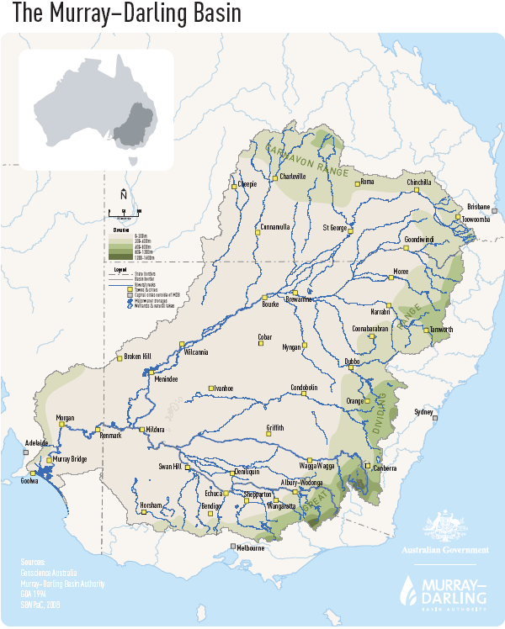
Murray-Darling Basin
Largest river system in Australia
2 million people within
1.3 million outside dependent on water
40% of Aust farms
65% of Aust irrigation
$18.6 billion GVAP
$6.7 billion GVIAP
Notes:
The research uses the Murray-Darling Basin as a case study. For those who are not familiar with the Basin, the key points to note here are that it is big, there is a lot of agricultural industry in the Basin and there are internationally significant wetlands and other water dependent assets within the Basin.

Slide 3
Governance of water in the Basin is
multilevel
and
marketised.
Notes:
Governance of the Murray-Darling Basin is multilevel and also market-based.
Marketised governance takes many forms, such as privatisation and deregulation. It also includes the creation of markets, such as in this case, where the state establishes “new property rights and encourage trade with a view to resolving specific policy problems.” Bell and Hindmoor 2009
It is an increasingly popular approach to policy and governance. Senator Ruston touched on it in yesterdays opening plenary.
In the Basin, the value of the water market has steadily grown and it is now one of the largest and most sophisticated in the world – an exemplar for others to look to. Alongside the popularity of market based approaches, there have been critics such as Sandel and . This research tested for the presence of the limits to marketized governance. While the market has undoubtedly achieved efficiencies and has been instrumental in enabling government purchase and acquisition of water for environmental purposes, but at what cost?

Slide 4
Basics of the water market
Water ‘shared’ through licences (entitlements) of different ‘qualities’
Shares are allocated each year based on availability and licence ‘quality’
Governments have acquired licences from industry to water environmental sites
Traded permanently and temporarily
Often through brokers
Notes:
Competition, property rights and prices are core to markets. Competition delivers the drive for efficiency, ensuring that the most efficient producers comer to the fore. Property rights give individuals or companies a sense of ownership and heighten their concern, ensuring efficiency and effective use of resources, it can be seen as a spur to innovation. Prices are vital as they give a shared benchmark and provide precious and timely information on what a large number of participants in the market value and how those valuations are changing.
These features of how markets work are used in market-based governance to deliver desired policy goals.
The extension of market thinking and practices is supported by claims about its virtues as a form of governance. One claim is its capacity to co-ordinate the behaviour of many actors without having to resort to costly bureaucratic regulation. Another claim is that by relying on market incentives multiple actors in effect become deciders about what is in their interests and so the system is more responsive to the needs of different stakeholders. Finally market systems give scope for efficiency gains at the societal level as the incentives in the system encourage better use of scarce resources. As Lindblom (2001: ) states a market-based system of governance can do both the “fingers and thumbs” of governing in that it can deal with the small-scale and large-scale and it can be both subtle and yet direct. It is suited to the pursuit of a mix of collective and individualistic goals. It has other advantages when used directly as a governmental tool. It creates a lot of real-time information for policymakers through price changes. It allows for sequential decision-making rather than demanding that all issues are resolved once. Finally it allows government to focus on specific concerns and issues and does not demand a God-like capacity to deal with everything. It is not surprising that market-based mechanisms are valued by policymakers.

Slide 5
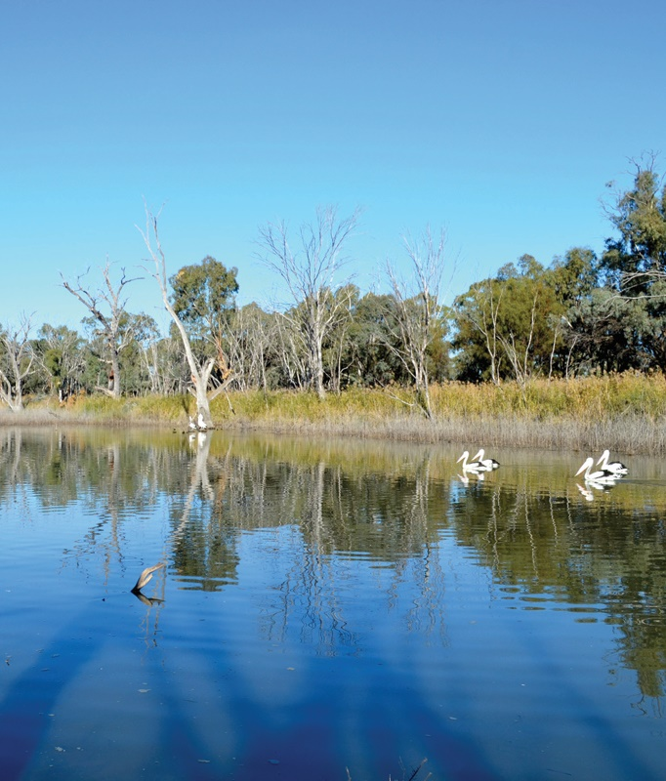
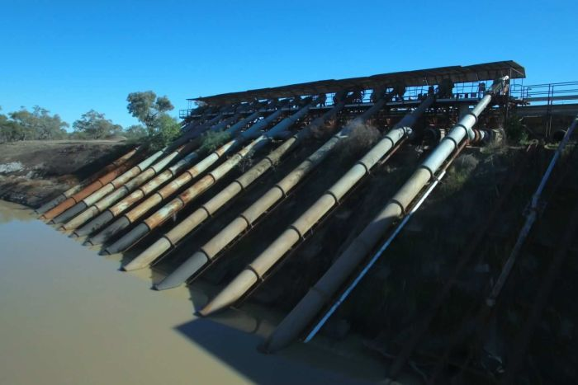
Success of the market
Notes:
Senator Ruston spoke highly of the water market yesterday and yes it has been successful – in some ways. Entitlements can be used as financial security, the market has enabled water to be shifted to its highest value use – in terms of commodity and location, with industry restructure occurring as a result. There has been modernisation of farms as efficiency gains have been chased. There is also evidence that water trade has increased regional domestic product and that this positive economic outcome persisted through drought, (Grafton et al. 2016).
The market has also been instrumental in gaining water for the environment with government purchase of water licences to achieve some recalibration of the distribution of water – for flexible and responsive environmental flow management.

Slide 6
Limits
Inequality
Fairness, voluntary participation, conflict
Economic rationalism undermines public domain
Invisible hand
Motivation
Self interest (loss of altruism), conflict and corruption
Notes:
However, alongside these successes, the research has confirmed the presence of limits to the market.
In summary,
First, that markets reinforce structured inequalities, with some participants more free to make choices than others; The inequalities mean that not all market participants are able to equally contribute to the decisions made by the market. The ‘say’ of some, such as larger entitlement holders, becomes greater than others. In a society with a government elected on the basis of one person - one vote, this inequality may not be socially desirable and create tension. There is emerging evidence, and quite public evidence of this conflict.
Secondly, that through a large number of individual transactions, the market makes decisions for society without public debate. The research found evidence of the invisible hand. As a consequence of the rising cost of water and water shifting to its highest economic use, as judged by the individual water holder, there is industry restructure occurring such as the current shift to nut production in the southern basin.
“They are affected by movements of water in and out of their community, but they don’t have the direct financial recompense that an irrigator selling their irrigation water has”
“they traded some of their water, and yeah it’s a good business decision, its not a good decision from an industry perspective and its definitely not a good business decision from a community perspective”
Thirdly, that markets encourage self-interested behaviour, with this leading to gaming, conflict and a loss of altruism.
“there is biodiversity loss obviously, because there’s less water. Some of the stuff that we were doing along those areas we can no longer afford to do”

Slide 7
Notes:
For further evidence on the limits to marketized government I invite you to check out the already published paper

Slide 8
“Markets will lead to certain outcomes, but communities might wonder whether that was the outcome that they really had wanted.”
Notes:
So now what?

Slide 9
Criteria for assessing market efficiency
The market is competitive, meaning that firms and consumers take prices as given;
Firms and consumers both have good information about the quality of the good or service being traded
The market is complete, in the sense that all relevant costs and benefits are borne by the market participants.
Keohane and Olmstead (2016)
Notes:
Given the above limits and their implications, it is clear that improvement is needed. Keohane and Olmstead (2016 p. 78) list three criteria for assessing market efficiency -
‘1. The market is competitive, meaning that firms and consumers take prices as given;
2. Firms and consumers both have good information about the quality of the good or service being traded
3. The market is complete, in the sense that all relevant costs and benefits are borne by the market participants.’
Using these criteria the water market fails this test of an efficient market. More specifically, the relatively small size of the market has meant that examples of larger buyers, such as government and larger private companies, can set the price rather than accept that market price;
information about water is not steady and the ‘quality’ of an entitlement can change dramatically through the water year with each allocation announcement, and between water years; and, of most concern, to the desired public environmental outcomes sought by government –
costs are not limited to those participating in the market, with impacts on the environment and regional communities.

Slide 10
market failure occurs when markets are ‘not pervasive enough – that is that they are incomplete’
Notes:
Keohane and Olmstead offer that market failure occurs when markets are ‘not pervasive enough – that is that they are incomplete’ (2016 p. 3) and argues that government needs to create ‘price signals that mimic the incentives that a market would provide.’ In considering the development of the market, from an economic perspective it can be regarded as unsophisticated and small with market players lacking information on the goods being traded. This was also expressed in the research interviews, ‘A number of other representative organizations have been suggesting for a long time that there needed to be a lot more transparency in the market. I think most people would say it's a bit of a dark art.’

Slide 11
So who is accountable for these failings?
Notes:
Again, Senator ruston also made mention of the current reviews, as spurred by recent media.
The market approach has successfully distanced government, not just from public choice decision making, but also from responsibility to the ongoing management of the market. Despite this, there is still scope for government accountability for the market, with metagovernance of markets (see Bell and Hindmoor 2009). Accountability is limited to the establishment of the market and the rules of the market; i.e. the structures of the market and not the decisions of the market. It is these structures that influence and permit certain behaviours of individuals by making some choices possible or more attractive than others. Government has created the market, and has done so with an absence of other complementary and coordinating policies to address the issues resulting from the market. Government can also be held accountable for this neglect. This is accountability for the market, as opposed to accountability of the market, and it is these accountabilities that appear to be forgotten as the market takes on a life of its own.

Slide 12
Whose job is it now?
Notes:
There has effectively been a separation of duties with the government stepping in to directly manage the environment; it is no longer the purview or responsibility of irrigators. If you consider how other industries have increasingly taken on corporate and social responsibilities as necessary for social licence, well, in contrast it is not the irrigation industry that is reporting their environmental performance on rivers to the public.
The use of market-based governance has so far been used to enable government to acquire water and then to directly intervene with watering of high value environmental assets. This has resulted in positive environmental outcomes, described by one interviewee as,
‘In my mind water trading has undoubtedly…helped the management of the environment …Without water trading, without environmental, buybacks for the environment, water dependent assets in Australia would be in a much worse state than they are.’
However, this has shifted the responsibility for the environment to the government, and watering of environmental assets is now a government responsibility in perpetuity.
The market can also result in environmental damage, as the location of licences and extraction is shifted and with a loss of altruism, such as the sacrifice of smaller, scattered wetlands that may have otherwise been cared for by irrigators. Currently there is imperfect knowledge on the contribution of these lesser water ecosystems to overall environmental health and biodiversity.
The potential for damage to the environment coupled with cynicism in the government’s ability to maintain action should be cause for concern by environmentalists.
The second cause for concern and indication that the market may be unable to provide meaningful environmental outcomes is with respect to the supply of water. This is firstly in terms of the delivery of water. The drive for efficiency is evident in the operation of rivers, with delivery that minimises “losses” explicitly sought with transmission losses budgeted and accounted for.
On a larger scale, the volume of water held for the environment will always be significantly less than that held for production. To achieve some biodiversity goals of environmental watering, such as using flows to trigger fish breeding, environmental water has to compete with seasonal flow regimes created by production demands. The volumes available may be an insignificant drop or dwarfed by other flows.
The only long-term genuine solution is a re-joining of production and environment, with government intervention in the market, however this role for government in managing the market was considered hazardous in the research interviews.

Slide 13
‘I think it's [the water market’s] inevitable now. It's a market. You got the genie out of the bottle and you're not going to stop it.’
Notes:
‘Governments of all persuasions are very nervous about influencing markets. The markets a beast now. For example, if there was a huge irrigation push to stop carryover or to limit trades completely from upstream and the choke to downstream, whatever, I think you’d find that the backlash would be quite significant.’
To date, the market has not been used as a tool to influence behaviours for environmental outcomes. This is contrary to the basic mechanism in which ‘market-based instruments align the incentives of private firms and individuals with the public interest to provide public environmental goods’ (Keohane and Olmstead p. 167). The values present in the market are those of the private irrigator, as a result there is an untapped potential for the market to cause environmental damage and conversely, if changed to provide environmental signals.
To balance the economic and private incentives of the market, environmental and community values are needed within the market, as created by government intervention
In the water market, while there are buyers and sellers, the product, water is produced by rainfall that leads to a government announcement of an allocation. Feedback between buyers and sellers has no scope for adjusting the behaviours of the seller with respect to the environmental or social qualities of the product, the volume of the product made, or the externalities arising from its use and sale. While it could be argued that the Sustainable Diversion Limit is an expression of environmental values, in this case it is only a partial expression as it only addresses a question of volume, not timing, distribution or quality. The pricing mechanism remains on an input of production, and not an externality. The public values of regional employment and economically viable regional townships are not addressed.
Reconnecting production to environmental stewardship with a market that no longer essentially penalises for environmentally compatible behaviours, but instead offers incentives with a value placed on environmental and community outcomes will also go some way to providing positive social outcomes of water reform.

Slide 14
Acknowledgements

