Slide 1
Los Angeles, USA – A Metropolitan “Tale of Two Rivers: the Los Angeles & San Gabriel Rivers Emerald Necklace”
Claire Robinson - President Amigos de los Rios – Emerald Necklace Group
Claire@amigosdelosrios.org
626 676 5027

Slide 2
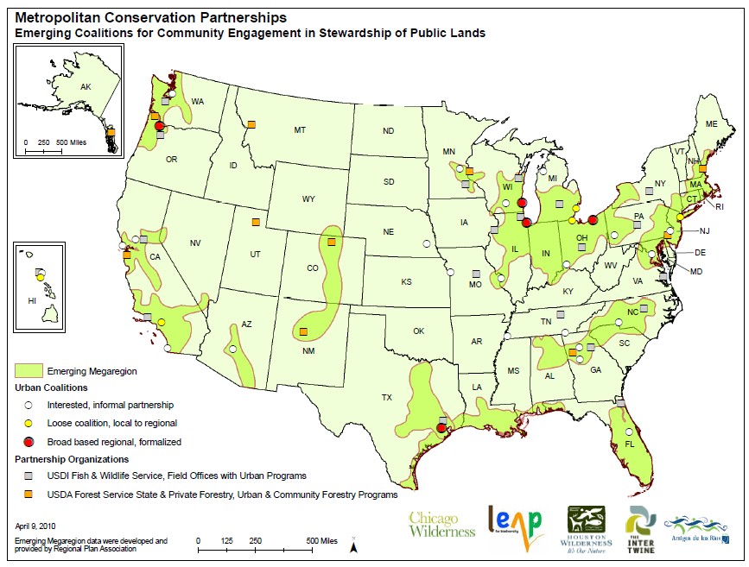
EMERALD NECKLACE INITIATIVE
Metropolitan Greenspace Alliance
Portland
Intertwine
Milwaukee
Sweetwater
Cleveland LEAP
Bay Area Open Space Council
Chicago
Wilderness
Denver Front
Range
Baltimore Wilderness
Los Angeles Basin
Heartland
Nashville
Houston
Wilderness
Amigos de los Rios

Slide 3
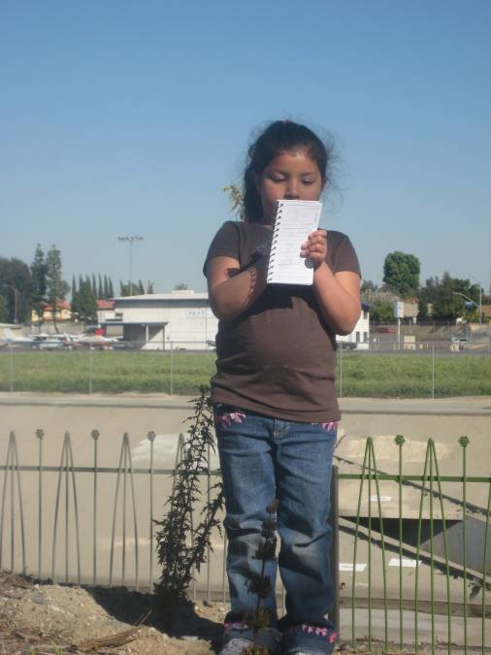
Necessity of
Natural Infrastructure
Majority of the population
live in urban areas:
PUBLIC HEALTH
Access to Recreation
Social Equity/Environmental
Justice
Nature Deficit Disorder
ENVIRONMENTAL HEALTH
Air & Water Quality
Greenhouse Gas Uptake
Heat Island Mitigation
COMPLIANCE FEDERAL
& STATE MANDATES
Clean Water & Air Acts
Ms4 Permits, SB375…
BEAUTY…CULTURAL HERITAGE
JOBS TRAINING & EDUCATION
We need to place a Human Face on river network as our natural Infrastructure
Notes:
3

Slide 4
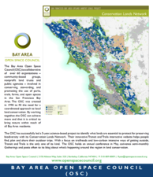
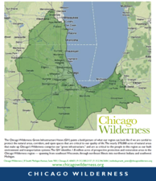
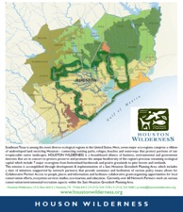
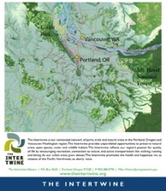
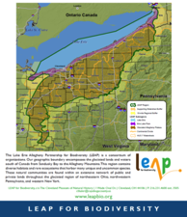
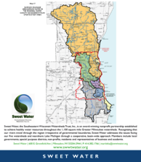
Metropolitan Greenspace Alliance
National Movement to bring nature to cities

Slide 5
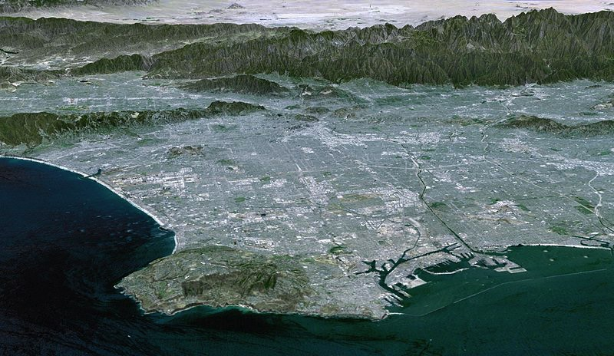
Los Angeles Basin – Major Rivers & Protected Lands
San Gabriel Mountains/Angeles National Forest
Rim of the Valley
Alternative D
Santa Monica
Mountains
San Gabriel
River
Los Angeles
River

Slide 6
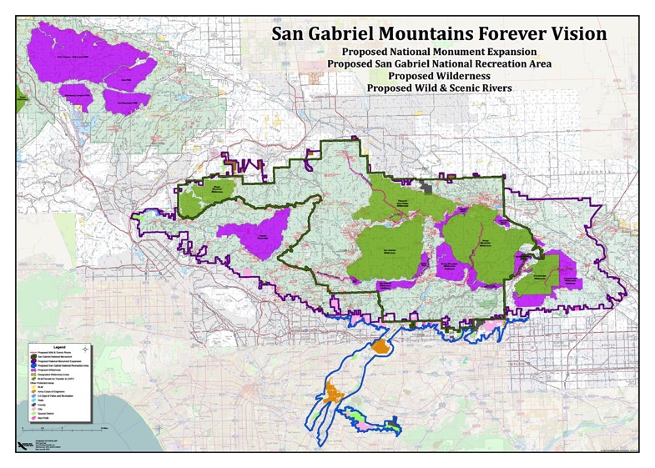
SGMF VISION MAP
Photo courtesy of Andrew M. Harvey
Notes:
Belinda

Slide 7
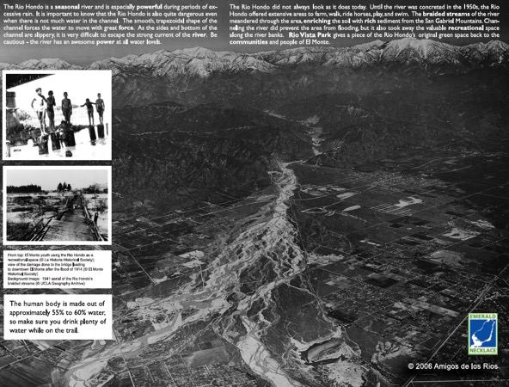
Tongva Gabrielleno – ‘Kich ’ Tribe
Historic Photo of the Rio Hondo
Notes:
7

Slide 8
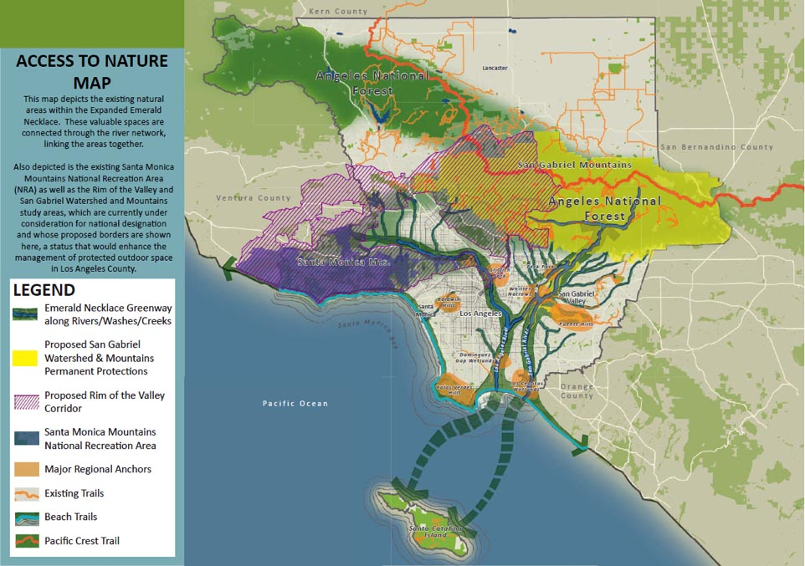

Slide 9
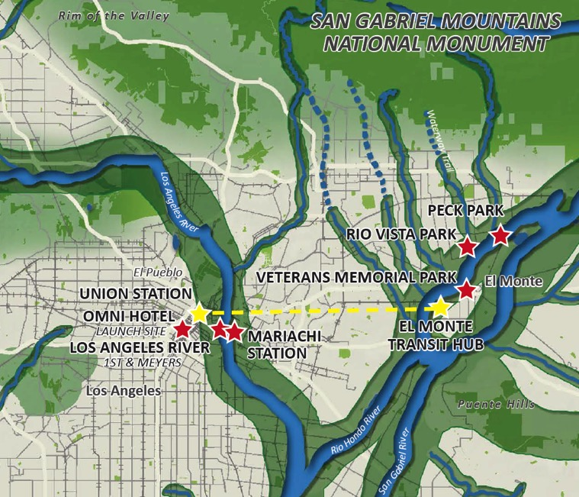
A TALE OF TWO RIVERS

Slide 10
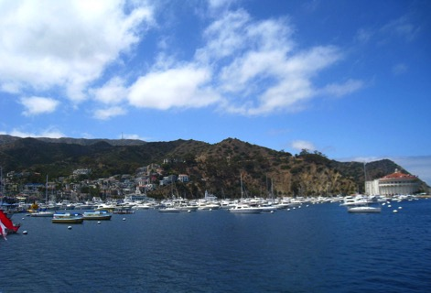
Catalina Island

Slide 11
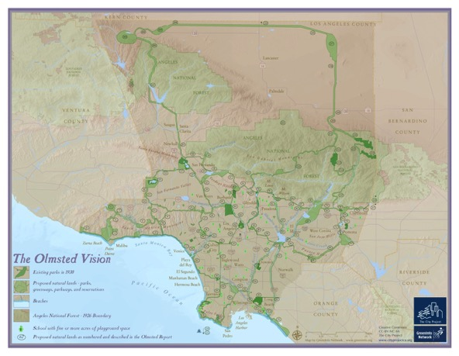
OLMSTED BARTHOLOMEW 1930
Comprehensive Trail & Greenway Network to connect
key Natural Areas throughout
the LA BASIN and beyond…
-
EXISTING PARKS
PROPOSED GREENWAYS – URBAN RIVER S
ANGELES NATIONAL FOREST
BEACHES & COASTAL TRAIL
SCHOOLS OVER 5 ACRES

Slide 13
Languages of Los Angeles
1 | AFRIKAANS | 21 | CHINESE (MANDARIN) | 41 | HAITIAN CREOLE | 61 | LITHUANIAN | 81 | PORTUGUESE | 101 | TAHITIAN
2 | ALBANIAN | 22 | CORSICAN | 42 | HAWAIAN | 62 | LOW SAXON | 82 | ROMANI | 102 | TAMIL
3 | ALSATIAN | 23 | CROATIAN | 43 | HEBREW | 63 | LUXEMBOURGEOIS | 83 | ROMANIAN | 103 | TATAR
4 | APACHE | 24 | CZECH | 44 | HINDI | 64 | MACEDONIAN | 84 | RUSSIAN | 104 | TELUGU
5 | ARABIC | 25 | DANISH | 45 | HUNGARIAN | 65 | MALAGASY | 85 | SARDINIAN | 105 | THAI
6 | ARMENIAN | 26 | DUTCH | 46 | ICELANDIC | 66 | MALAY | 86 | SCOTTISH GAELIC | 106 | TURKISH
7 | AZERI | 27 | ENGLISH | 47 | INDONESIAN | 67 | MALAYALAM | 87 | SERBIAN | 107 | UDMURT
8 | BAMBARA | 28 | ESPERANTO | 48 | IRISH GAELIC | 68 | MALTESE | 88 | SESOTHO | 108 | UKRAINIAN
9 | BASQUE | 29 | ESTONIAN | 49 | ITALIAN | 69 | MAORI | 89 | SHIMAORE | 109 | URDU
10 | BELARUSIAN | 30 | FAROESE | 50 | JAPANESE | 70 | MAPUCHE (MAPUDUNGUN) | 90 | SHONA | 110 | VIETNAMESE
11 | BENGALI | 31 | FINNISH | 51 | KABYLIAN | 71 | MARATHI | 91 | SINDHI | 111 | WALOON
12 | BERBER | 32 | FRENCH | 52 | KANNADA | 72 | MONGOLIAN | 92 | SINHALA | 112 | WELSH
13 | BOBO | 33 | FRISIAN | 53 | KHMER | 73 | MORÉ | 93 | SLOVAK | 113 | WEST INDIAN CREOLE
14 | BOSNIAN | 34 | FRIULAN | 54 | KINYARWANDA | 74 | NORWEGIAN | 94 | SLOVENIAN | 114 | XHOSA
15 | BRETON | 35 | GALICIAN | 55 | KOREAN | 75 | OCCITAN | 95 | SOBOTA | 115 | YIDDISH
16 | BULGARIAN | 36 | GALLO | 56 | KURDISH | 76 | ORIYA | 96 | SONINKÉ | 116 | YORUBA
17 | BURMESE | 37 | GEORGIAN | 57 | LAO | 77 | OSSETIAN | 97 | SPANISH | 117 | ZULU
18 | CATALAN | 38 | GERMAN | 58 | LATIN | 78 | PAPIAMENTU | 98 | SWAHILI
19 | CHECHEN | 39 | GREEK | 59 | LIGURIAN | 79 | PERSIAN | 99 | SWEDISH
20 | CHEROKEE | 40 | GUARANÍ | 60 | LINGALA | 80 | POLISH | 100 | TAGALOG

Slide 14
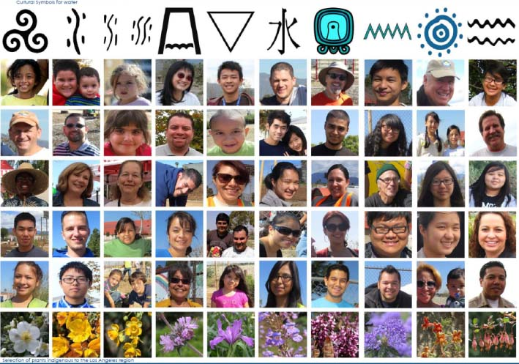
Diverse Cultural Heritage = LA

Slide 15
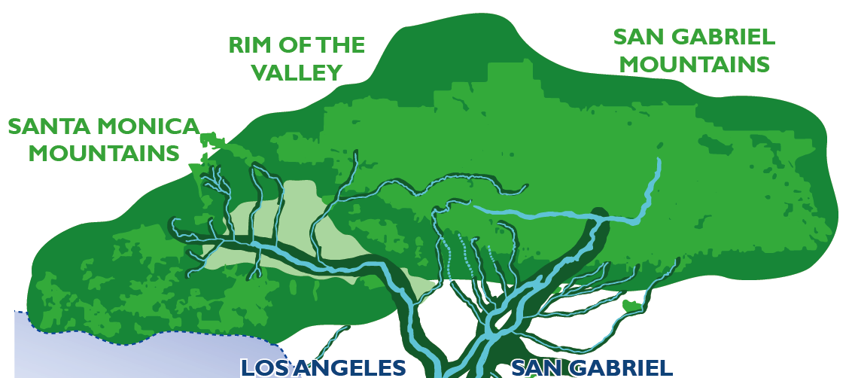
Los Angeles Basin – “Mountains to Sea”
Tree Shape
Pacific Ocean
EMERALD NECKLACE Green Infrastructure

Slide 16
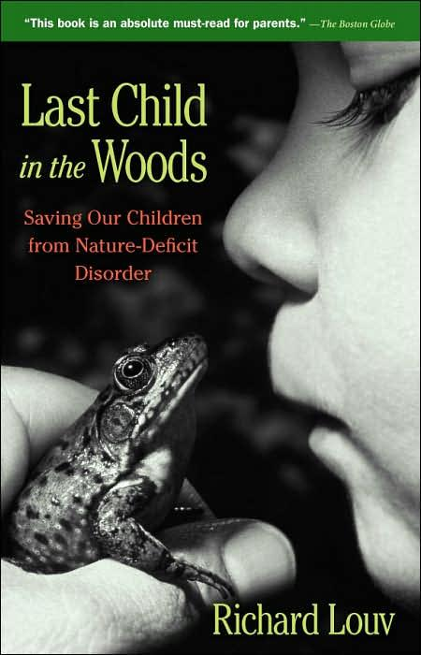
URBAN RIVERS
Children Need Time Outdoors
American Children spend 9 minutes on average outdoors
CONNECTING FAMILIES TO NATURE

Slide 17
Emerald Necklace Expanded Vision Map
San Gabriel Emerald Necklace Case Study
USACE LA River Restoration Area

Slide 18
Taxonomy Conditions - Urban River Transect
Pristine Forest/ Wilderness Areas
Forest Recreational Areas
Protected Species Areas
Single Family Housing
Equestrian Facilities
Religious Institutions
Army Corps Facilities
Transportation Yard
Major Arterial
Industrial Park
Sanitation/Fill Sites
School
Multi-Family Housing
Airport
Commercial/Retail
Industrial/ Manufacturing
Municipal Water Management/ Spreading Basins
Superfund Site
Railroad Crossing
Major Freeway
Billboard Site
Wetland
Wash, Creek & Stream
Brownfield
Vacant Lot- Commercial
Vacant Lot-Residential
Golf Course
Nurseries
Fire Station
Regional Transportation-Bus /Metro link Station
Regional Park
Pocket Park
Neighborhood Parks
Quarry – Alluvial Material
Dead End Street
Trailer Park
Bike/Pedestrian path
Ports
Office Complexes
Residual Spaces
Federal
State
County
Municipal
School District
Private

Slide 20
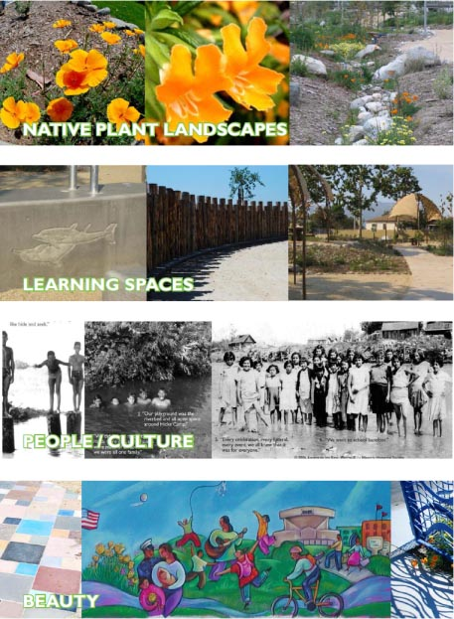
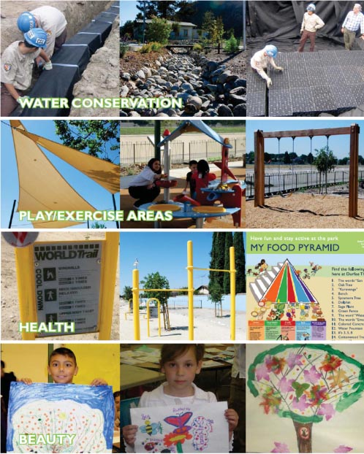
Vocabulary “DNA” of Projects
Notes:
Notes 10/17: Get Rid of this slide in favor of combining images with EN Expanded Vision Regional Goals

Slide 21
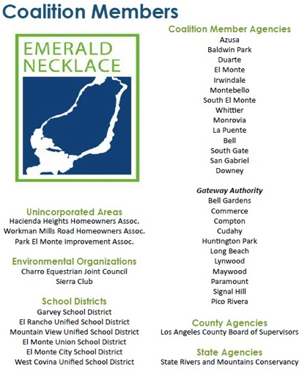
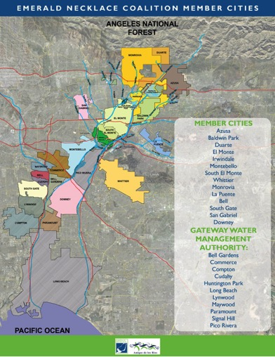
Overview: East County Los Angeles Basin – Emerald Necklace Stakeholder Collaboration

Slide 22
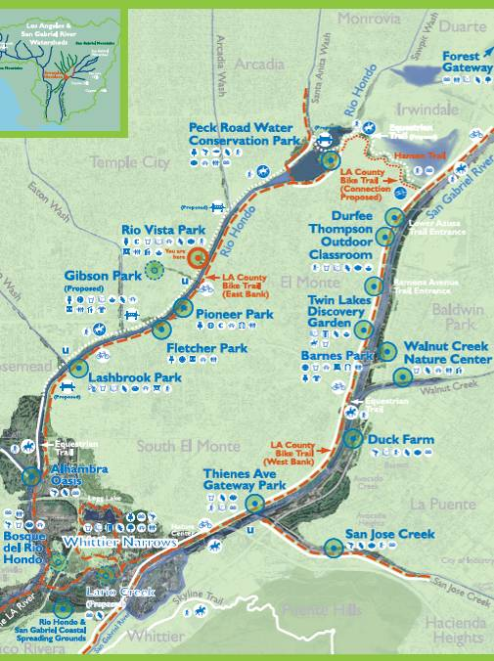
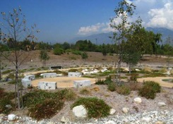
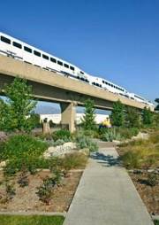
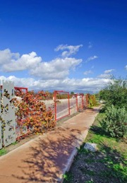
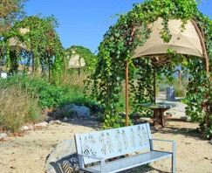
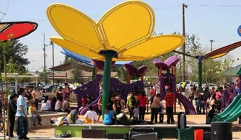
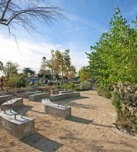
URBAN RIVER GREENWAY
PECK ROAD WATER
CONSERVATION PARK
VETERANS MEMORIAL
PARK
RIO VISTA PARK
LASHBROOK PARK
EMERALD NECKLACE
GIBSON MARIPOSA PARK
DURFEE THOMPSON
PARK

Slide 23
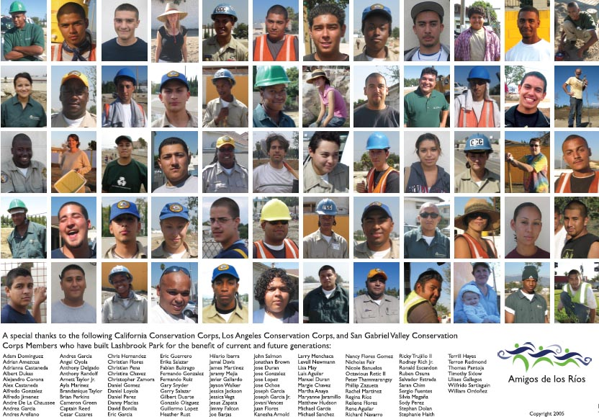
Youth Training
Notes:
23

Slide 24
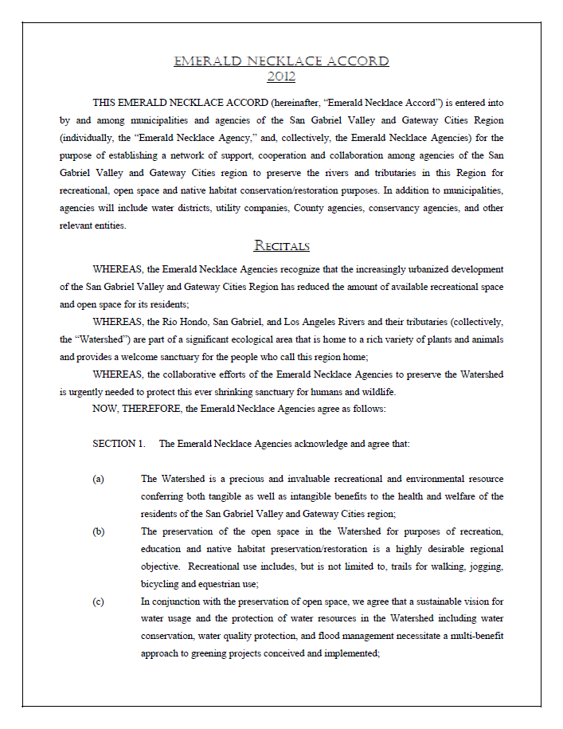

Slide 26
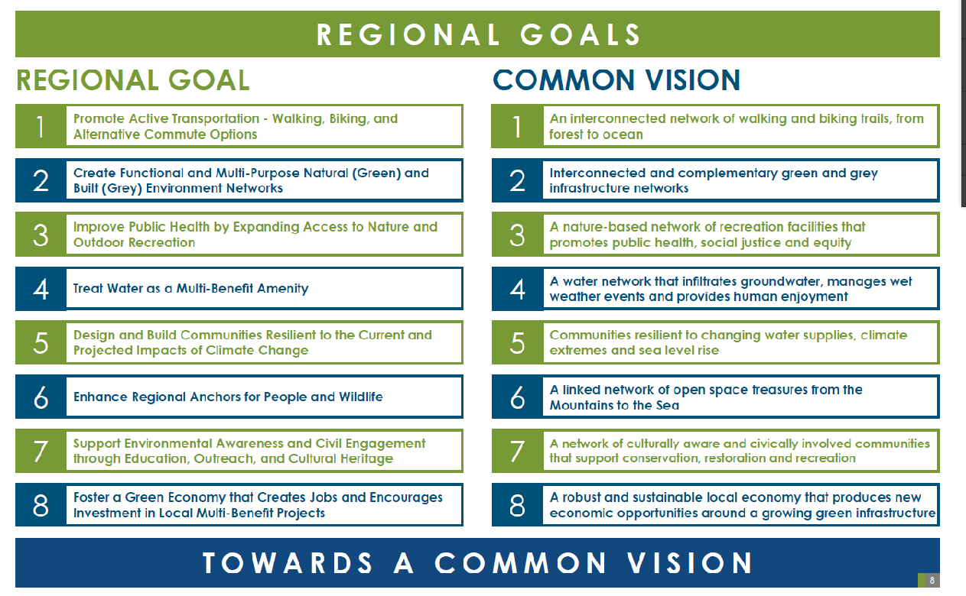
Natural Infrastructure Vision LA BASIN

Slide 27
Emerald Necklace Community Project Examples
San Gabriel Mountains Visitor Reception Center
Excess land Municipal Utility
Nature Trail Exercise Area – Lashbrook Park
Flood Control Right of Way /Army Corps of Engineers Rio Hondo River
Community Park Barrio History Rio Vista
Cultural Heritage retrofit of park
Community Park – Butterfly Theme
Former precious metals smelting factory
Nature Discovery Area – Water Conservation Park – Bird Sanctuary
Former quarry Flood Control District
Multi-benefit School Campuses & Parks along river greenway
Joint-Use School Partnerships

Slide 29
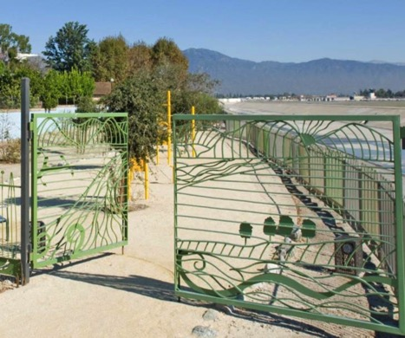
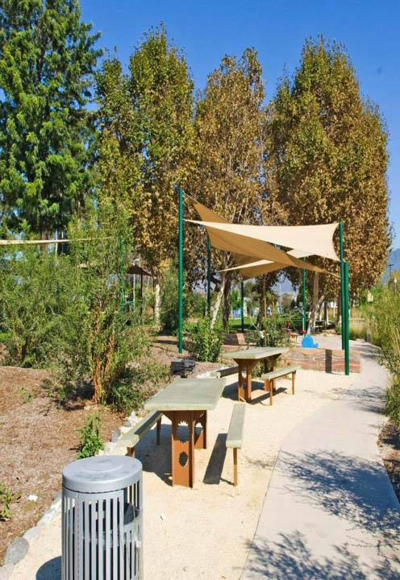
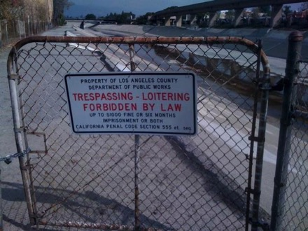
Notes:
29

Slide 31
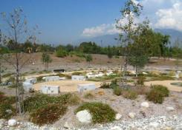
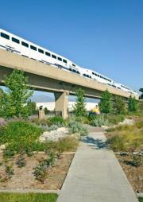
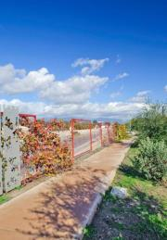
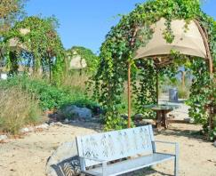
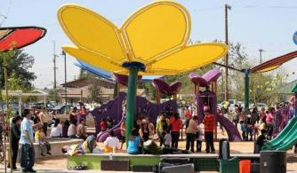
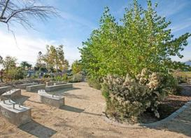
URBAN RIVER GREENWAY
_{PECK ROAD WATER}
_{CONSERVATION PARK}
_{VETERANS MEMORIAL}
_{PARK}
_{RIO VISTA PARK}
_{LASHBROOK PARK}
_{San Gabriel Canyon}
EMERALD NECKLACE
_{GIBSON MARIPOSA PARK}
_{DURFEE THOMPSON}
_{PARK}

Slide 32
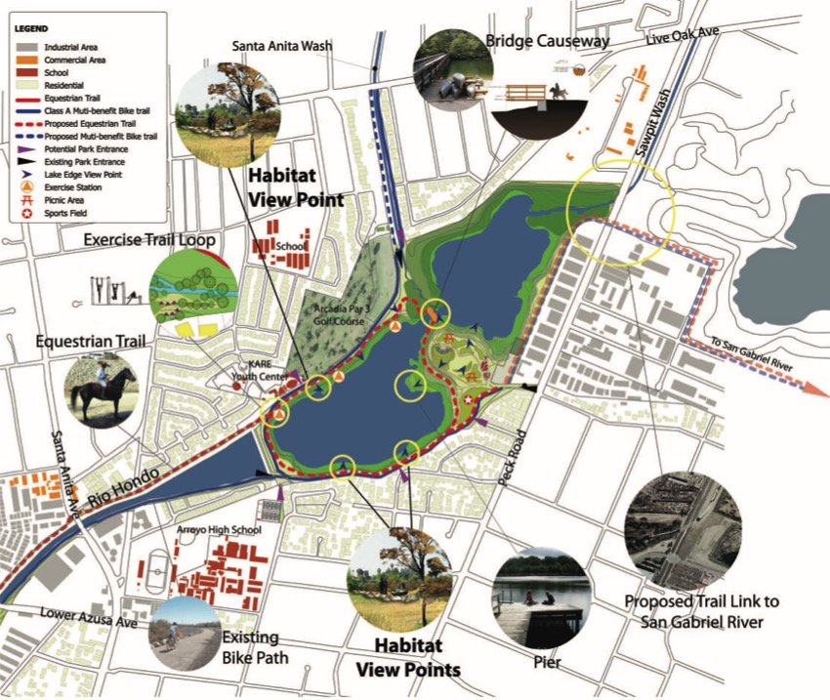

Slide 34
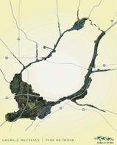
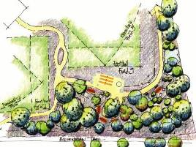
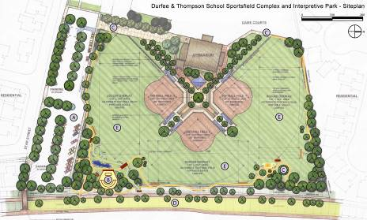
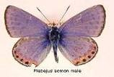
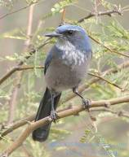
Durfee/Thompson School
PASSIVE ACTIVE INTERLACE
State-of-the-art: Sports Field and Perimeter Nature Trail
Outdoor Interpretive Area / Re Connect to Nature
_{City of El Monte}
*Congressional Appropriation- Congresswoman, Hilda Solis partial funding
Notes:
34

Slide 36
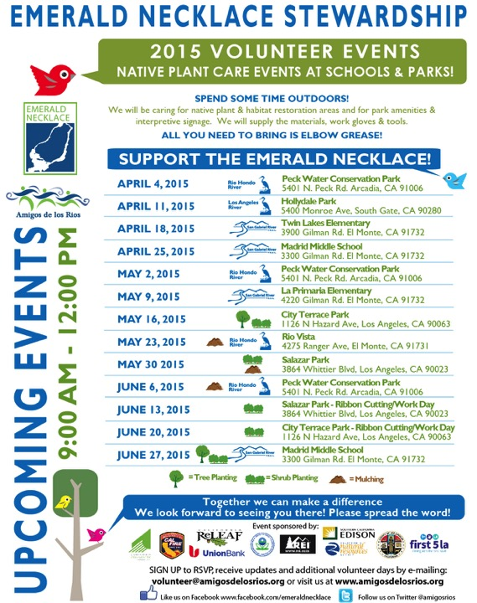

Slide 37
Natural Infrastructure RIVER PARKWAYS
Climate Response
Resilient Communities
Shared Natural & Cultural Heritage =
Public Health
Open Space
Recreation Access
Sustainable
Transportation
Biodiversity
Habitat Corridors
Water Resources
Stormwater Mgt
Resilient Communities

