Slide 1
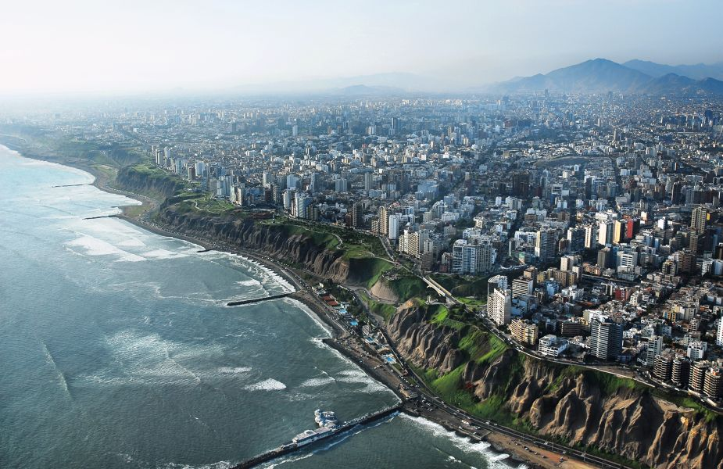
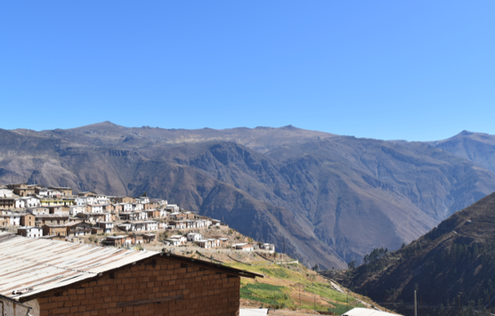
Integrating urban-rural communities through a bottom up stakeholder analysis to implement Rewarding Mechanisms of Hydrological Ecosystem Services:
Case Study of Lima, Peru.
By Ester Galende Sanchez, Bsc Forest engineering (CONDESAN)
Oscar Angulo Nuñez, Msc Integrated Water Management (SUNASS)
BRISBANE, AUSTRALIA | 18 - 20 SEPTEMBER 2017
MANAGED BY

Slide 2
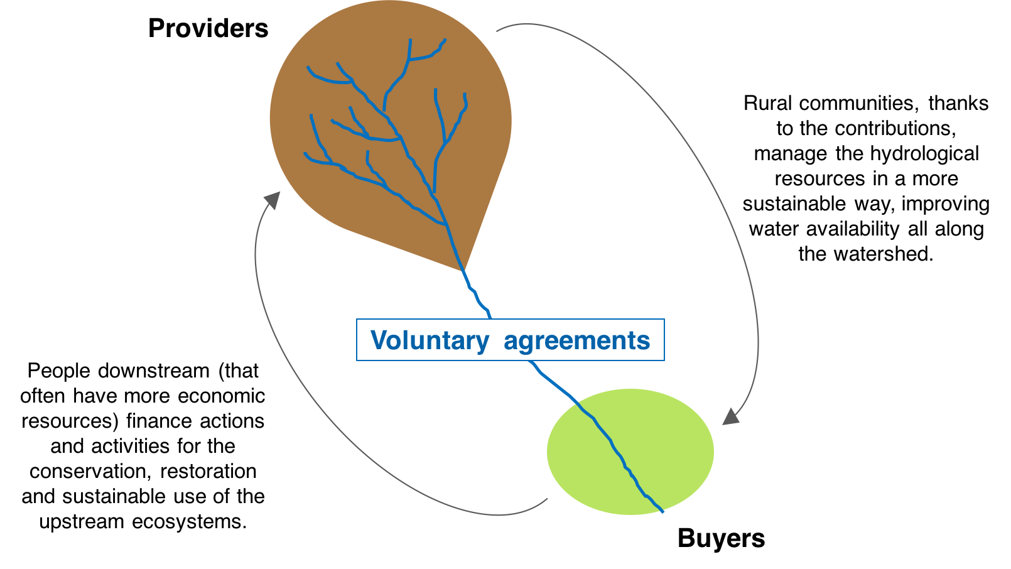
INTRODUCTION (I)
REWARDING MECHANISMS OF ECOSYSTEM SERVICES
“Instruments and incentives to generate, transfer and invest economic, financial and non-financial resources through an agreement between buyers and providers of the ecosystem service, with the objective of the conservation, recovery and sustainable use of the sources of ecosystem services” (Law 302105, 2014).
HYDROLOGICAL ECOSYSTEM SERVICES:
Notes:
Densidad demografica, habitantes, gestion del agua,

Slide 3
INTRODUCTION (II)
PROBLEMS WITH IMPLEMENTATION
?
2012
2014
2015
2016
Creation of the Incubator of Rewarding Mechanisms of Ecosystem Services
Law 30215: Rewarding Mechanisms of Ecosystem Services
Act 1240: Facilitation of RMES implementation for water resources
Regulation of the Law 30215
WHY?
STAKEHOLDER ANALYSIS
Notes:
Muchos actores que no se conocen, identifican,

Slide 4
METHOD
Bottom-up approach: Sharing the decision making
Literature review
Local stakeholders
General scheme
Stakeholders contributions
Decision-making stakeholders
Initial methodology
Stakeholders evaluation
Definitive methodology
Notes:
QUE STAKEHOLDERS?
COMO DEFINIMOS LOS STAKEHOLDERS? CONTRIBUTIONS: ACTORES LOCALES.

Slide 5
RESULTS: SA Methodology
Notes:
Necesitamos entender ambas dinamicas para integrarlas.

Slide 6
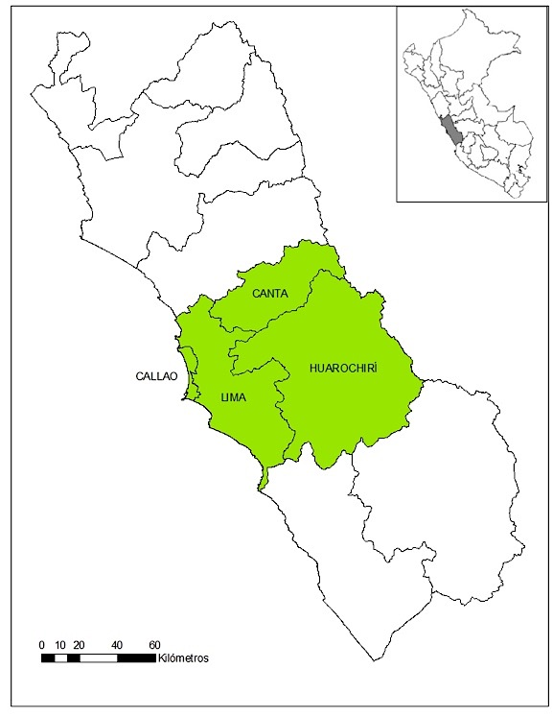
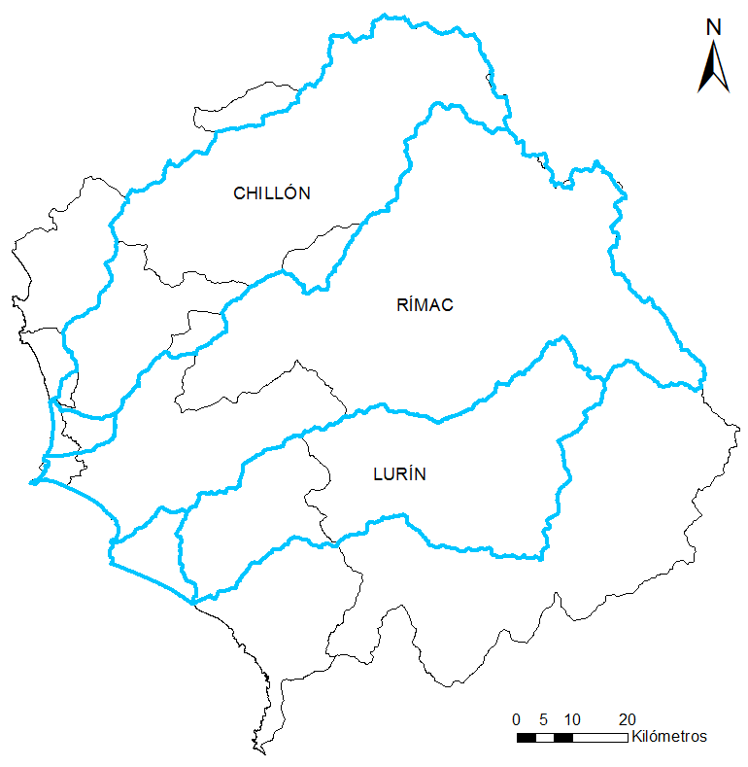
APPLICATION IN LIMA - Context
Km
Km

Slide 7
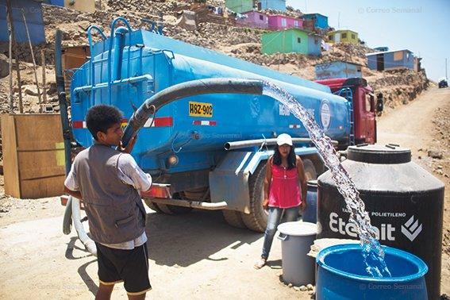
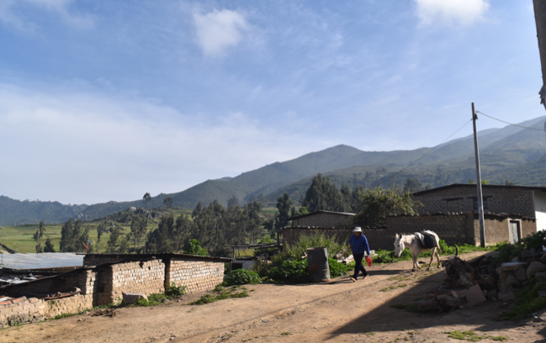
APPLICATION IN LIMA - Context
Lima: Second biggest city in the world located in a desert.
Canta and Huarochiri: Rural communities
IDH: 0,70
10 million inhabitants
700 000 people do not have access to safe water and sanitation
IDH: 0,65
74 023 inhabitants
Deficit of safe water and sanitation: 90%

Slide 8
APPLICATION IN LIMA - Stakeholder Analysis
Identification of stakeholders
22 stakeholders: 6 public institutions, 10 NGOs and cooperation agencies, 4 private, and civil population (downstream and upstream).
Characterization (stakeholders contributions)
Role of each stakeholder.
User or provider of information.
Problem identified:
Lack of technical information about the watersheds.

Slide 9
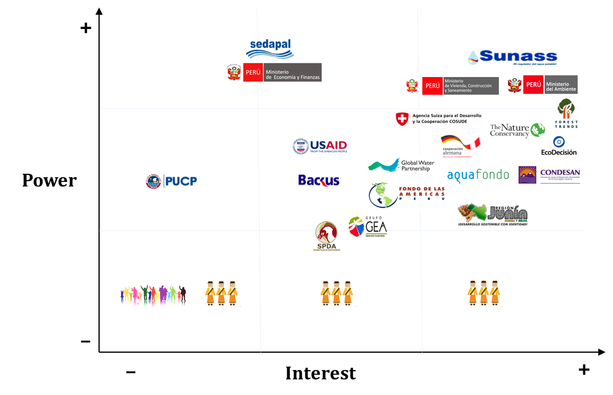
APPLICATION IN LIMA - Stakeholder Analysis
Classification
Problems identified:
Powerful stakeholders without enough interest.
Marginalisation of rural communities.

Slide 10
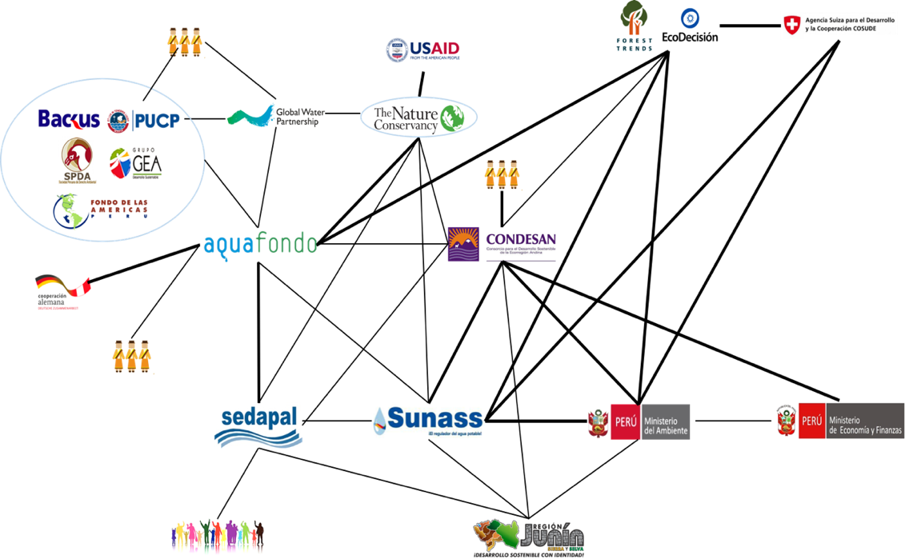
APPLICATION IN LIMA - Stakeholder Analysis
Social Network Analysis: Relationships
Problem identified:
Lack of compromise and teamwork of stakeholders.
Types of relationships (stakeholders contributions)

Slide 11
APPLICATION IN LIMA - Strategy
“Brilliant strategy is the best route to desirable ends with available means.”
Max McKeown, The Strategy Book
Available means:
Current problems
STRATEGY
Desirable ends:
Policy implemented

Slide 12
APPLICATION IN LIMA - Lessons learned
Rural communities participation and engagement is essential for RMHES to succeed.
The SA methodology presented is an effective tool that contributes to the integration of urban and rural communities, knowing and understanding their different dynamics.
Implementation: Fair and durable agreements
RMHES
Integration of urban and rural communities
SA Methodology: Deep understanding of urban and rural dynamics.
Notes:
Metodologia buena para entender a los actores y ver como integrales. Para que el mecanismos funcione hay que entender como funcionan los actores, por eso necesitamos esta metodologia.
Para integrarlos, tienes el mecanismos.
Para implementarlo tienes que entenderlo, y para entenderlos necesitas esta metodologia.

Slide 13
CURRENT CHALLENGES
The Rewarding Mechanisms of Hydrological Ecosystem Services should be studied widely.
This SA methodology should be applied in more RMHES initiatives in Peru.

Slide 14
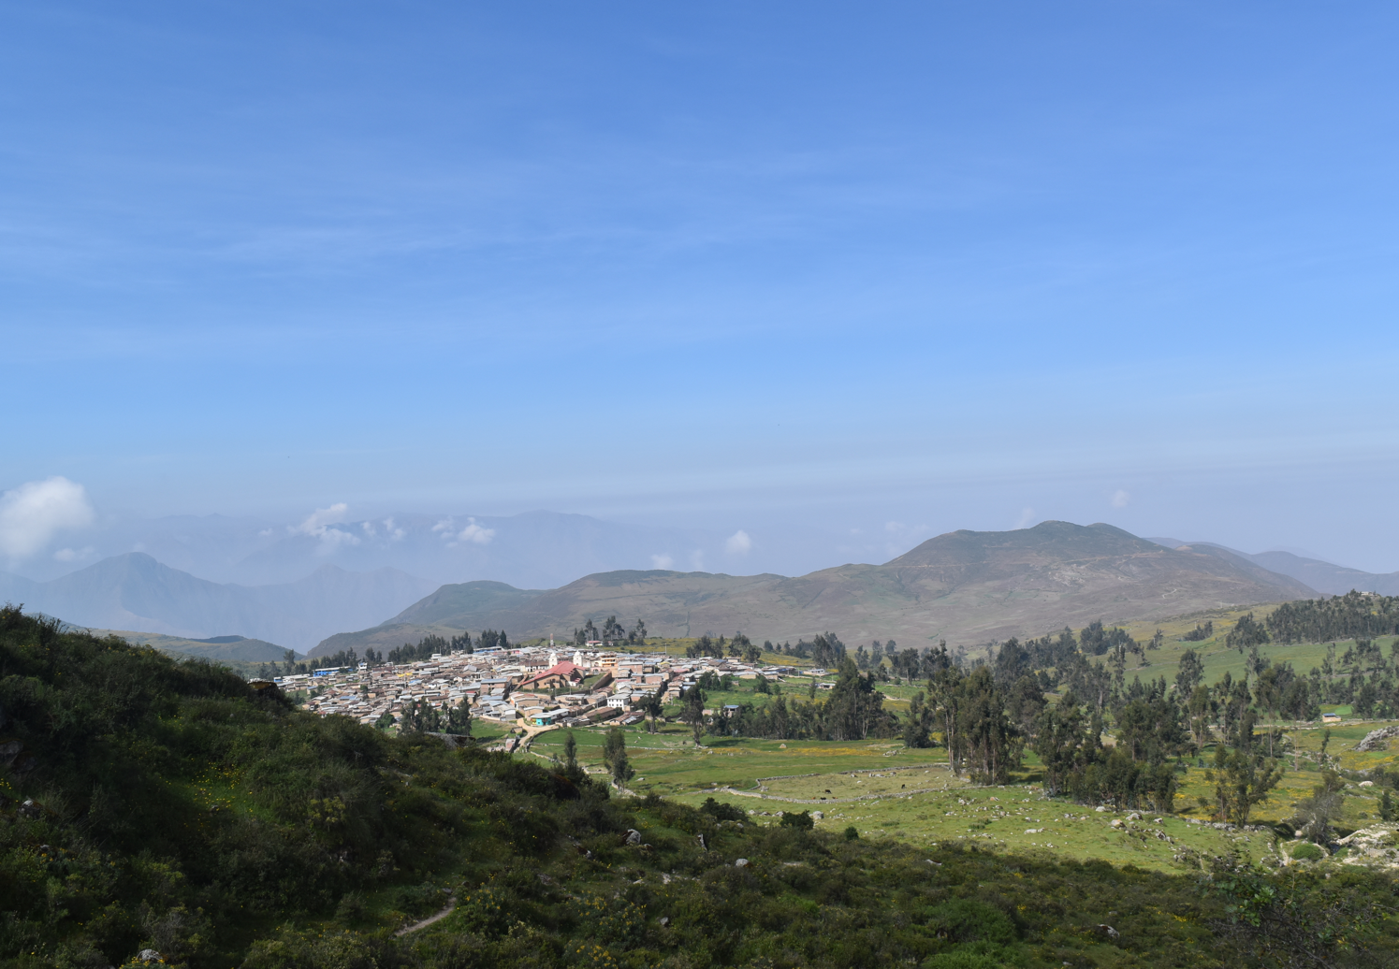
THANK YOU
Huamantanga, one of the rural communities that is implementing the RMHES.

