Slide 1


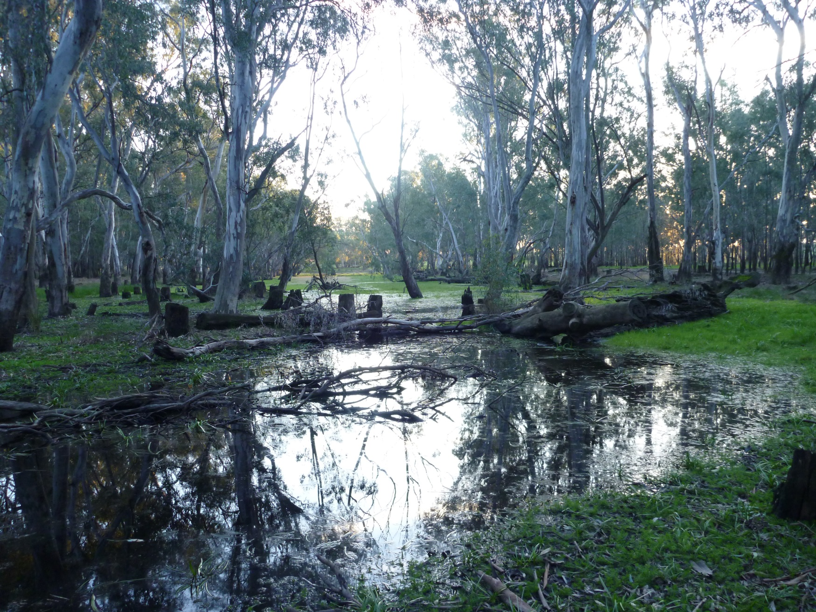

Place your
logo here
Ovens River
(NECMA)
Victorian
environmental water management framework
BRISBANE, AUSTRALIA | 18 - 20 SEPTEMBER 2017
MANAGED BY

Slide 2
Drivers for environmental water
river regulation and modification
drought
competing needs
Wimmera River at Horseshoe Bend, June 2007 (Wimmera CMA)

Slide 3
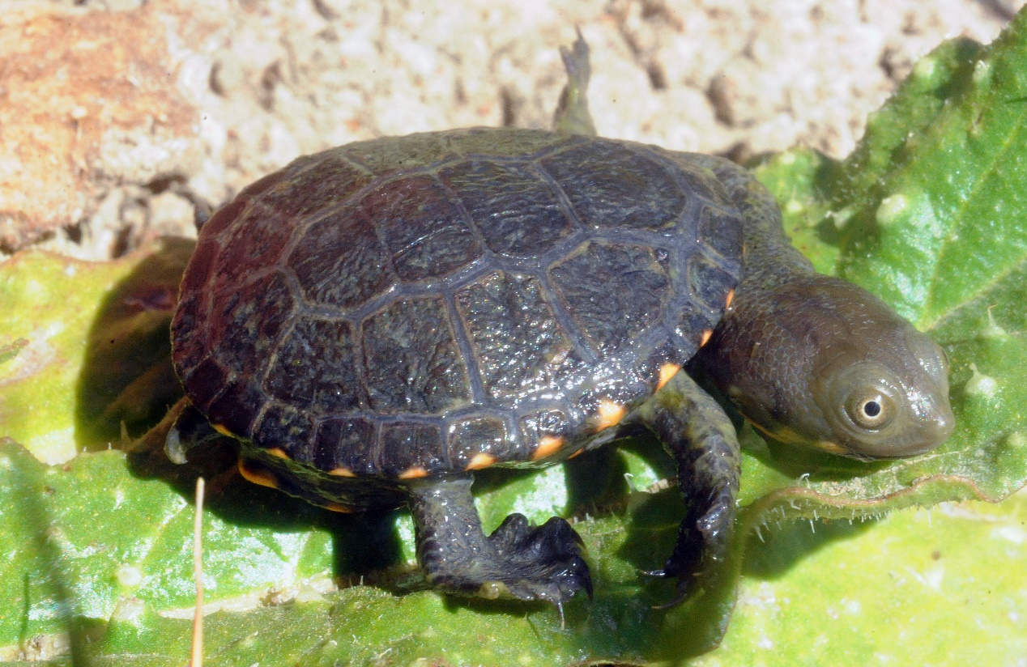
Environmental
water outcomes
legislation
policy
Eastern long-necked turtle hatchling, Opie’s Dam, Wimmera Mallee Wetlands (Rakali Consulting)
partners

Slide 4
Legislation
(pre-cursor to change - White Paper Our Water Our Future 2004)
Victorian Water Act 1989:
Environmental Water Reserve (2005)
Victorian Environmental Water Holder (2011)
Commonwealth Water Act 2007 - Basin Plan 2012

Slide 5
Policy
Sustainable Water Strategies (2006-2011) - water sharing arrangements / water entitlement framework
Victorian Waterway Management Strategy (2013) - framework elaborated
Water for Victoria (2016) - commitments / actions confirmed
& also emphasised
‘shared benefits’ of e-watering (leading to some new legislative changes)
management of e-water under climate change

Slide 6
Water Entitlement Framework
Provides equal security for all entitlement holders, regardless of how water used (environment, irrigation, urban, etc.)
Sets out arrangements to share water in all years, including severe drought
Limits on entitlements protect reliability (‘caps’)
Annual process to allocate water
Ability for trade and carryover in some systems
Surface & groundwater / reg & unreg systems

Slide 7
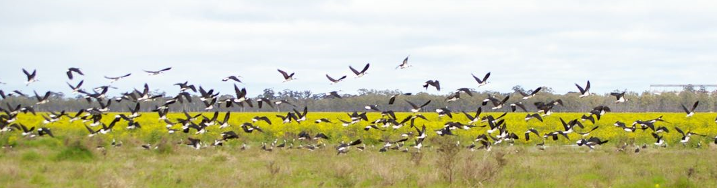
Environmental Water Reserve
Ibis at Lake Boort (North Central CMA)
Held environmental entitlements (VEWH)
Obligations on entitlements (passing flows)
Above cap water
Regulated and unregulated systems

Slide 8
Partners
DELWP
legislation, policy, investment (water & ewater)
VEWH
hold & manage environmental water entitlements
CMAs
designated waterway manager for a region, set priorities & objectives
Water
corporations
entitlement storage and delivery

Slide 9
Guiding Principles
Integrated waterway management
Maximise efficiency & seek multiple benefits
Transparent & sound decision-making
Be prepared for future conditions
Managed (not natural) systems

Slide 10
Planning
Regional Waterway Strategies
CMAs – regional scale - prioritise waterways for environmental works
Environmental Water Management Plans
CMAs – waterway scale - long-term objectives for e-water
Seasonal Watering Proposal
CMAs – waterway/system scale – annual e-water requirements
Seasonal Watering Plan
VEWH – statewide/system scale – annual plan to use holdings
Delivery

Slide 11
MER for adaptive management
Intervention / statewide monitoring programs
rivers (VEFMAP) and wetlands (WetMAP)
Event and other individual CMA monitoring (e.g. photo points)
Indices of Condition (streams, wetlands, estuaries) every 8+ years
Annual reporting – VEWH Reflections on use of held e-water, VEFMAP and WetMap on monitoring results

Slide 12
Future challenges & improvements
Climate change / drought refuges / landscape objectives
Basin Plan
Adequate monitoring for adaptive management
Alternative water sources
Shared benefits

Slide 13
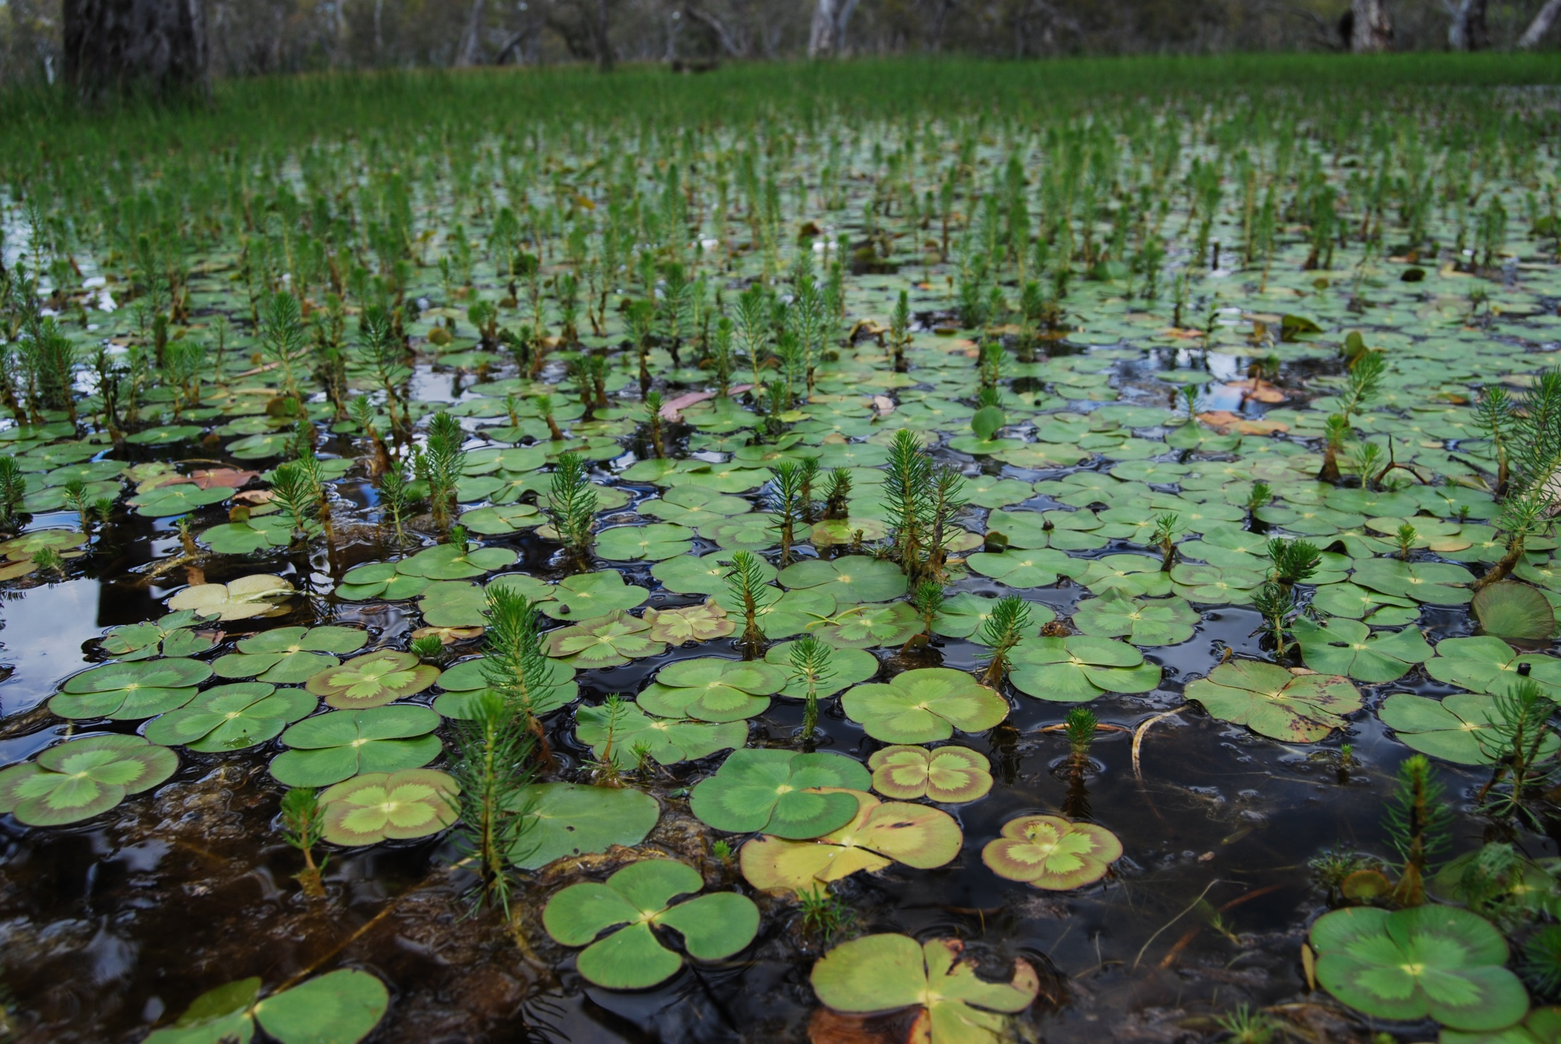
Marsilea mutica & myriophyllum at Doctors Swamp (Goulburn Broken CMA)

