Slide 1
‘This is our inherent right’
Reflecting on 10 years of the Echuca Declaration:
achievements, challenges and future directions
Murray Lower Darling Rivers Indigenous Nations (MLDRIN)
BRISBANE, AUSTRALIA | 18 - 20 SEPTEMBER 2017
MANAGED BY
Notes:
Clearly describe outcomes and lessons learned, including the process/method and achievements that have already been implemented
Share your achievements, practical experience, lessons learned and transferable outcomes
Be accessible to an international and diverse audience, which may include river practitioners, scientists, policy makers, community members and industry/business representatives
‘This is our inherent right’.
Reflecting on 10 years of advocacy for water justice: achievements, challenges and future directions.
November 2017 marks the ten-year anniversary of the Echuca Declaration – a ground-breaking statement by First Nations from along the Murray River that defined the concept of Cultural Flows. As an intervention in the discourse of water management, ‘Cultural Flows’ has worked as an effective, provocative and sometimes contested concept. It has been recognised in policy and legislation at the State and Commonwealth levels and debated by researchers, communities and decision makers. After ten years, the concept of Cultural Flows still fills a crucial role in highlighting key areas of ‘unfinished business’ in Australian water reform.
MLDRIN has pursued and promoted Cultural Flows as a fundamental objective underpinning water justice for First Nations’. In this presentation MLDRIN Directors and staff will provide an overview of achievements and challenges since the Echuca Declaration in 2007. The presenters will review disagreements and divergent approaches to deploying language about Aboriginal water rights. They will reflect on progress towards achieving Cultural Flows and explore remaining barriers and complexities.
Referencing developments over a decade of water reform, presenters will provide an analysis of the detailed strategy for achieving water justicecontained in the Echuca Declaration. Presenters will highlight current projects, policies and international precedents that offer practical pathways to realising key components of the Declaration.

Slide 2
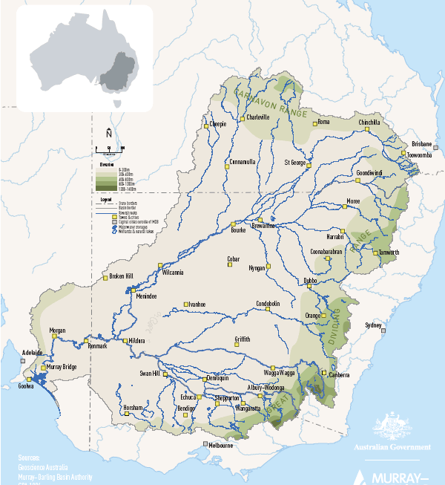
Introducing the Echuca Declaration
Asserting First Nations’ Sovereignty, water rights, values and responsibilities
Contesting ownership and management
Defining Cultural Flows
Detailing Outcomes and Mechanisms
Notes:
What is the Echuca Declaration?
A groundbreaking statement made by representatives of Indigenous Nations with custodial responsibilities and connection to the Murray River
Lays out a platform of rights, responsibilities and reform
MLDRIN 2007, NBAN 2010, work shopped with the nations
Leverages off rights discourse, international law and cultural authority to TOs,
But also very pragmatic and practical, embodying an attempt to fit within language norms of water law and management.
Contents:
November is the 10 year anniversary of the Declaration
Important to assess and review the ‘work’ that it has done, achievements and ongoing challenges

Slide 3
‘‘
“Cultural Flows” are water entitlements that are legally and beneficially owned by the Indigenous Nations of a sufficient and adequate quantity and quality to improve the spiritual, cultural, environmental, social and economic conditions of those Indigenous Nations. This is our inherent right.
’’
Notes:
What is the Echuca Declaration?
A groundbreaking statement made by representatives of Indigenous Nations with custodial responsibilities and connection to the Murray River
Lays out a platform of rights, responsibilities and reform
MLDRIN 2007, NBAN 2010, work shopped with the nations
Leverages off rights discourse, international law and cultural authority to TOs,
But also very pragmatic and practical, embodying an attempt to fit within language norms of water law and management.
Contents:
November is the 10 year anniversary of the Declaration
Important to assess and review the ‘work’ that it has done, achievements and ongoing challenges

Slide 4
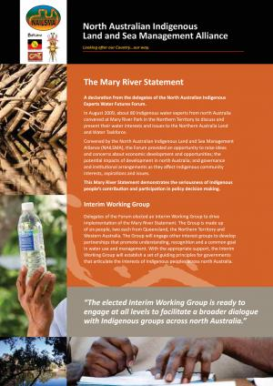
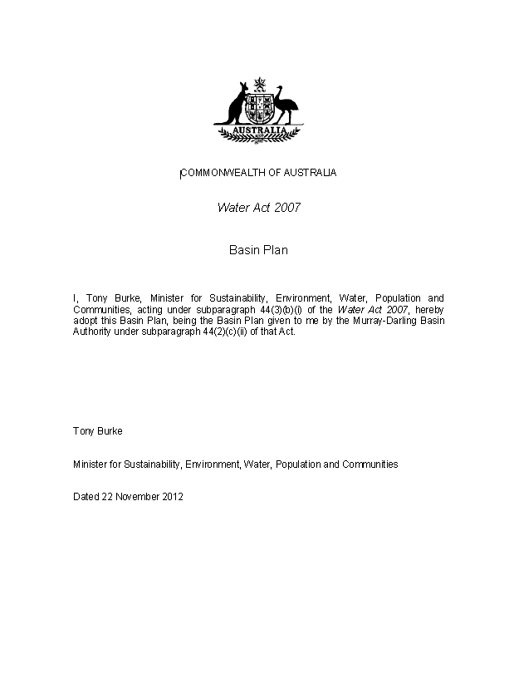
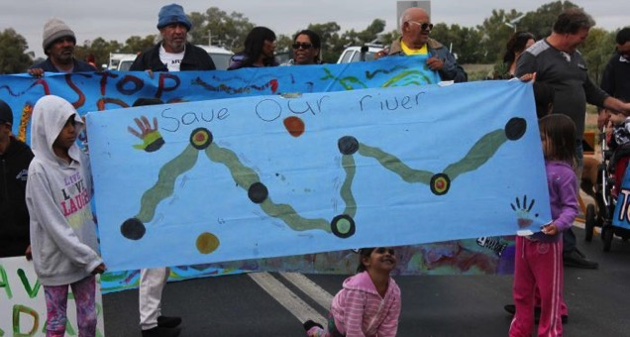
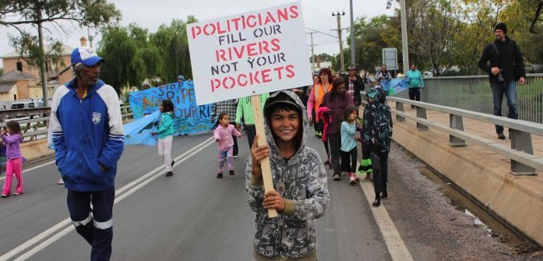
Impacts and influence
A ‘contribution’ and a challenge
A contested concept
Growing advocacy
Policy and legislation
Research and implementation
Notes:
ED as a major ‘contribution’ (Moggridge/Poelina), an innovation and challenge to western WM. It has found traction (Weir).
‘There is no clear national consensus amongst Australian Aboriginal peoples on terminology to describe relationships to water, or how cultural values should be reflected in water management.’ – Poelina et al
Jackson and Langton have critiqued the ‘cultural’ frame, suggesting cultural entitlements are limiting and are part of the ‘legal model for recognizing indigenous interests in water that has emerged from neo-liberal reforms to water governance,’ Called it a ‘weak strategy of arguing for entitlements on the basis of cultural difference’. Cultural flows ‘fails as a conceptual tool’.
‘The concept has gained attention in policy circles because it appears to accord with a preconception that indigenous groups have no significant demand for water resources. ‘
Argument of that Aboriginal people would be better placed to pursue access to conventional, tradable water entitlements.
Creation of Indigenous-specific cultural entitlements has limitations (special purpose licenses in NSW are an eg).
But these were not limitations stipulated or sought in the Echuca Declaration itself. They are later impositions of Govt. Echuca Declaration asserts a right to own water, it doesn’t specify that a new type of ‘cultural’ entitlement must be created.
What impacts has it had?
How has it influenced advocacy, policy, decisions, reform?
Contributed to growing advocacy (subsequent declarations), furnished a language which forms a useful, albeit contested, intervention in WM discourse. Building authority of Traditional Owners to speak and effect change.
Embedded in policy and legislation: Basin Plan, WRPs, Vic Water Plan (NSW Access licenses?) Weir says it has ‘influenced the national Indigenous water agenda.’
Helped to drive NCFRP – which is doing important work in developing practical pathways and reforms

Slide 5
Tracking progress of the ‘Mechanisms’
Acquiring water entitlements – funding
Decision making – informed consent
Capacity – Technical and scientific
Quantities – sufficient and flexible
Notes:
But if it has had traction, how far has its vision been achieved?
Funding to acquire entitlements
TOs have needed to use the language of the modern water entitlement framework
Technical and scientific support
Many PBCs still require support to build governance and water management capacity
Quantities
Funding – market intervention – Govt must provide the funding and make the intervention in the market
Decision making – informed consent – there must be the mechanisms for Nations to be able to make the decisions about how/when entitlements are acquired, how they are used and who holds them
Capacity – Nations must be supported to have the technical and scientific capacity
Quantities – Nations must be afforeded sufficient quantities and for these to be managed how they want
How have the ‘mechanisms’ been implemented:
Funding to acquire entitlements
Technical and scientific support
Quantities
Answer is there has been some developments but we are not really
any closer…
Why?

Slide 6
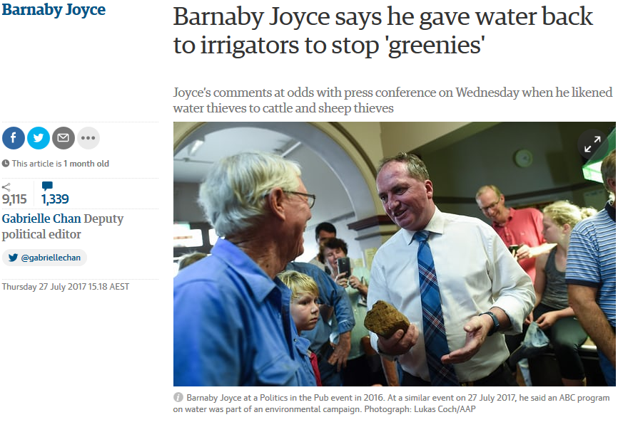
Ongoing challenges
The political cycle
Exploitation and degradation
Water values and knowledge
Property rights and water market
Conflation of ‘cultural’ and ‘environmental’
Notes:
Political cycle
Exploitation and degradation
Continuing declining river health means that it is harder to realise the benefits of water rights. Current water recovery targets have ‘indefinite decline’ of the river systems as an unspoken premise (weir).
‘Political-legal water rights are a core part of the reparations for Indigenous people, but how meaningful are those rights when the creeks and wetlands are desiccated, drowned or poisoned?’
Water theft, collusion and corruption undermine good process and close off pathways for restorative justice.
Water values
Indigenous values and knowledge systems often marginalised/trivialised
Sentient ecologies, river as ‘a continuous living being’
Utilitarian, instrumentalist, reductive concepts are privileged. It is these concepts that have created the problem.
“We need to use a different kind of thinking to address river health, rather than continuing to rely on the approaches that enabled over-allocation.” (Weir)
Marshall says we need to accept Indigenous worldview/metaphysics as real
While these views are marginalised, it is harder to prosecute the argument for cultural flows.
But some progress – Birrarung, we can look for inspiration to NZ
Property rights and water market
‘Commonwealth, state and territory ownership and management of water has long been premised on the absence of Indigenous people’s property rights to land and water.’
This exclusion continues: even when measures are contemplated to allow for Aboriginal access to the market it is stipulated that this will never impact on the rights of existing entitlement holders.
Existing entitlements are sacrosanct, enforcing a massive barrier to new entrants. Aboriginal people are in a fraught negotiating position
Conflation of cultural and environmental
Traditional Owners water requirements have been conveniently conflated with the ‘environmental pool’. It is argued that cultural outcomes are no different from environmental outcomes and that they can be serviced without specific water rights. This is a barrier to achievement of cultural flows.
These are just some of the challenges

Slide 7
Directions
Use of the terminology has evolved
Focus on ownership and self determination
Crossing categories of beneficial use
Models and implementation
Notes:
Use of the Cultural Flows terminology has evolved and matured. Langton and Jackson have critiqued the ‘primitivist’ basis of claims for cultural flows (a claim to water on the basis of tradition and ‘cultural difference’).
In its inception, the term was used to argue for getting ‘a bit more water down the river’, It was a strategic intervention to try and secure the rights and agency of the river to exist.
In practice, the language has evolved and taken on new meanings. The term now is being deployed to foreground Aboriginal ownership and access to the full range of uses of water, encompassing modern economic activity. The term has become synonymous with Aboriginal water ownership. The benefits of cultural flows are discussed in contrast to the benefits arising from procedural engagement in water planning, and refined delivery of environmental flows.
The point is: it is for Nations to determine how they want to use water.
Term offers a way for Aboriginal people to articulate their interests between and across the often conflicting categories of ‘beneficial use’ : environment and consumptive use.
Cultural flows is by its nature encompassing, and it offers a strategy to
Cultural flows has not gone away, and is not going away.
The concept has been developed and tested. It has been resilient, and is understood by many Aboriginal people.
Now we need to develop the models for its implementation – which entails quantifying water requirement, developing business cases, acquiring entitlements and making the necessary policy and legislative reforms to embed it in our WM framework.
We still need substantial reform to progress the objectives of the Echuca Declaration.
Poelina et al call for a set of reforms – many of which extend the thinking contained in the Echuca Declaration
Aboriginal contribution to WM (recommendations and policy advice) to be implemented
NWI strengthened with a national aboriginal water strategy, funded through National water infrastructure fund, and binding commitments
Resources be allocated for discussions between first Nations and water policy makers, planners and managers
Aboriginal water units bound in legislation
PBCs are resources to strengthen governance
Is re-allocation of entitlements the solution to a systemic problem? Should we be looking at a policy that prioritizes river health?
Point 3: Poelina et al suggest the idea of regional bodies formed from multiple PBCs recognise the limitations of individual PBCs, address transboundary issues
How has thinking about ways to address Aboriginal concerns and rights in relation to water management evolved?
Ie Aboriginal Environmental Outcomes?
Economic water
What new models and approaches are being developed?
Shift in the way ‘Cultural flows’ is being used: now focused on ownership and
an encompassing vision of Aboriginal needs and aspirations

Slide 8
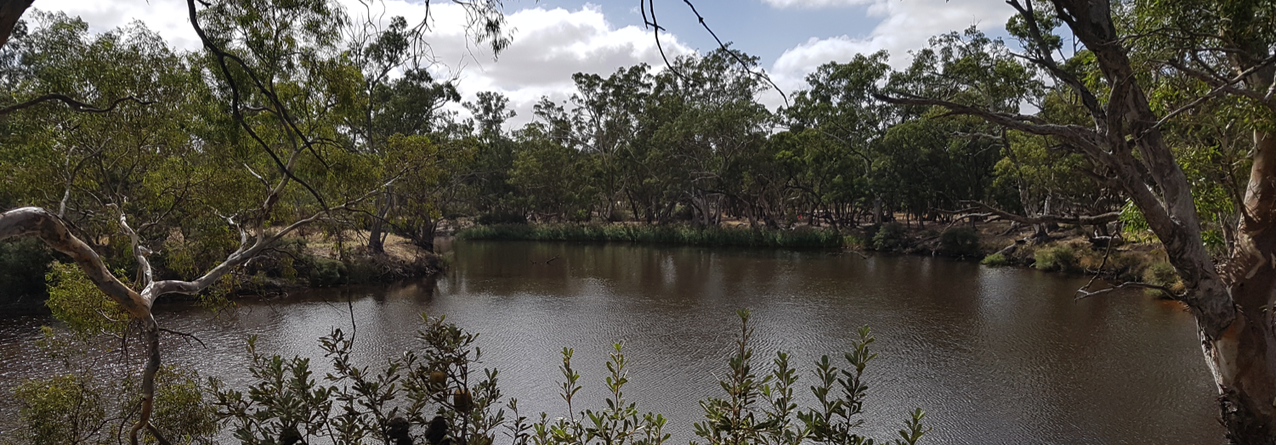
Thank you!
http://www.mldrin.org.au/publications/
facebook/mldrin
@MLDRIN
Notes:
Use of the Cultural Flows terminology has evolved and matured. Langton and Jackson have critiqued the ‘primitivist’ basis of claims for cultural flows (a claim to water on the basis of tradition and ‘cultural difference’).
In its inception, the term was used to argue for getting ‘a bit more water down the river’, It was a strategic intervention to try and secure the rights and agency of the river to exist.
In practice, the language has evolved and taken on new meanings. The term now is being deployed to foreground Aboriginal ownership and access to the full range of uses of water, encompassing modern economic activity. The term has become synonymous with Aboriginal water ownership. The benefits of cultural flows are discussed in contrast to the benefits arising from procedural engagement in water planning, and refined delivery of environmental flows.
The point is: it is for Nations to determine how they want to use water.
Term offers a way for Aboriginal people to articulate their interests between and across the often conflicting categories of ‘beneficial use’ : environment and consumptive use.
Cultural flows is by its nature encompassing, and it offers a strategy to
Cultural flows has not gone away, and is not going away.
The concept has been developed and tested. It has been resilient, and is understood by many Aboriginal people.
Now we need to develop the models for its implementation – which entails quantifying water requirement, developing business cases, acquiring entitlements and making the necessary policy and legislative reforms to embed it in our WM framework.
We still need substantial reform to progress the objectives of the Echuca Declaration.
Poelina et al call for a set of reforms – many of which extend the thinking contained in the Echuca Declaration
Aboriginal contribution to WM (recommendations and policy advice) to be implemented
NWI strengthened with a national aboriginal water strategy, funded through National water infrastructure fund, and binding commitments
Resources be allocated for discussions between first Nations and water policy makers, planners and managers
Aboriginal water units bound in legislation
PBCs are resources to strengthen governance
Is re-allocation of entitlements the solution to a systemic problem? Should we be looking at a policy that prioritizes river health?
Point 3: Poelina et al suggest the idea of regional bodies formed from multiple PBCs recognise the limitations of individual PBCs, address transboundary issues
How has thinking about ways to address Aboriginal concerns and rights in relation to water management evolved?
Ie Aboriginal Environmental Outcomes?
Economic water
What new models and approaches are being developed?
Shift in the way ‘Cultural flows’ is being used: now focused on ownership and
an encompassing vision of Aboriginal needs and aspirations

