Slide 1
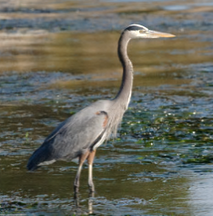
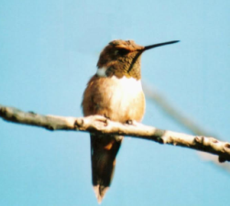
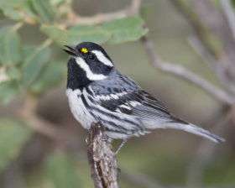
Shared neotropical migratory birds
on the Willamette – Laja basins
Arturo García, Director, Cuerpos de Conservación, Guanajuato, Mexico
Tara Davis, Willamette-Laja Twinning Project Coordinator (Contracted)
Ramiro Aragón, Oregon State University, USA
Jarod Jebousek, United States Fish and Wildlife Service
BRISBANE, AUSTRALIA | 18 - 20 SEPTEMBER 2017
MANAGED BY

Slide 2
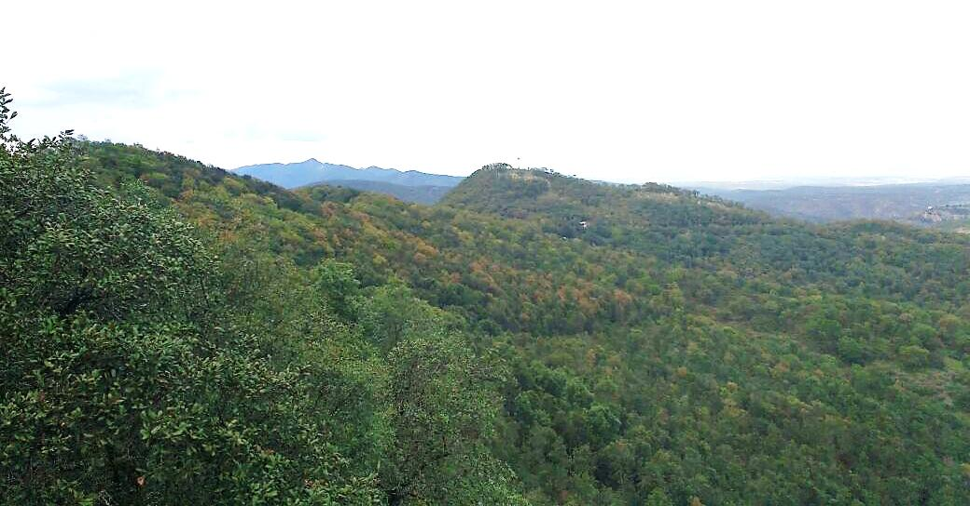
In 1993, monitoring of resident and neotropical migratory birds began in the Laja river basin in Guanajuato, Central Mexico.
Bird monitoring project was supported by the US Fish and Wildlife Service and Mary Richards (q.e.p.d.), director of the Bird Sanctuary Theodore Roosevelt of New York. It included the training of farmers as surveyors and field guides.
BRISBANE, AUSTRALIA | 18 - 20 SEPTEMBER 2017
MANAGED BY

Slide 3
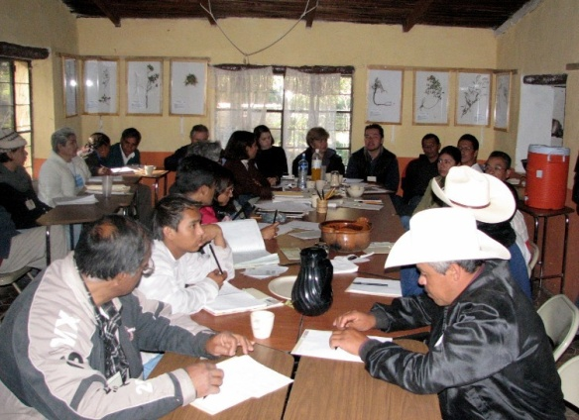
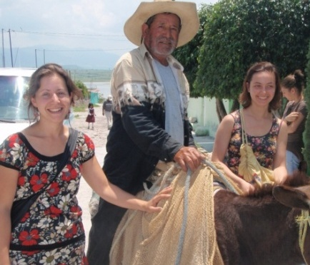
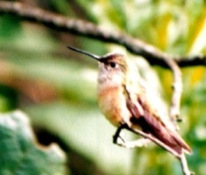
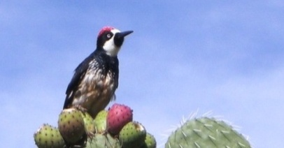
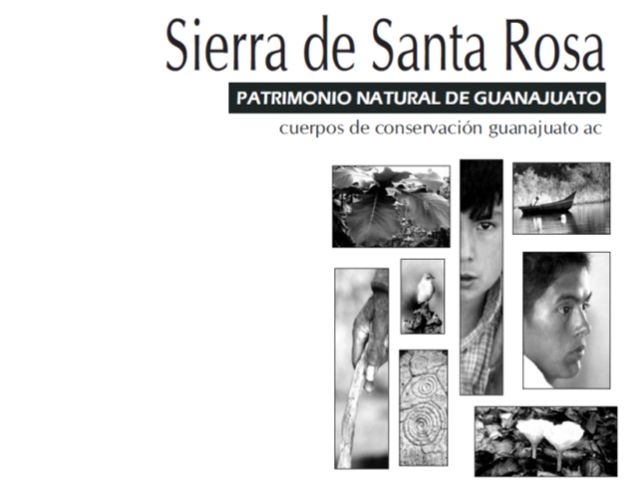
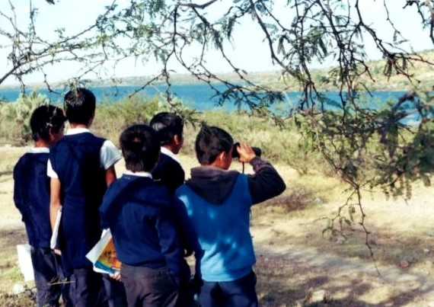
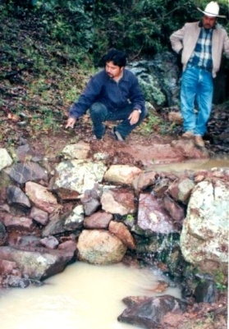
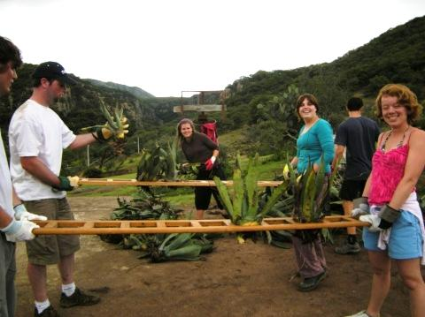
In 1998, we started the Sierra de Santa Rosa Development Program (PDS). It included the following strategic lines:
Community organization in 25 locations
Environmental education
Productive projects
Restoration of riparian wetlands, and conservation of soils and water
Avian research
Outreach
BRISBANE, AUSTRALIA | 18 - 20 SEPTEMBER 2017
MANAGED BY

Slide 4
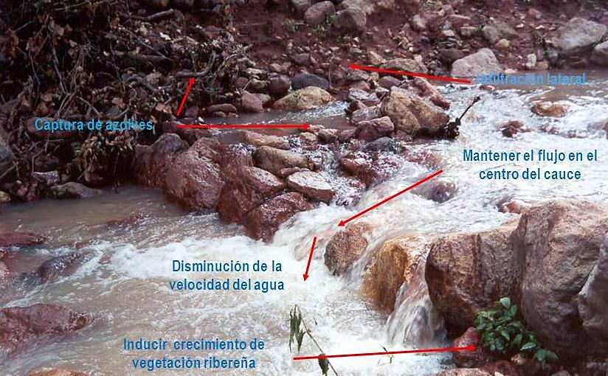
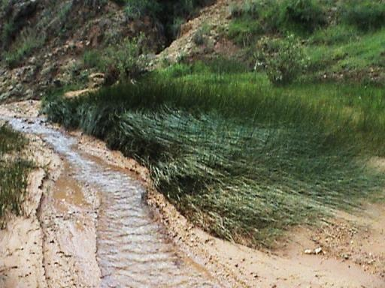
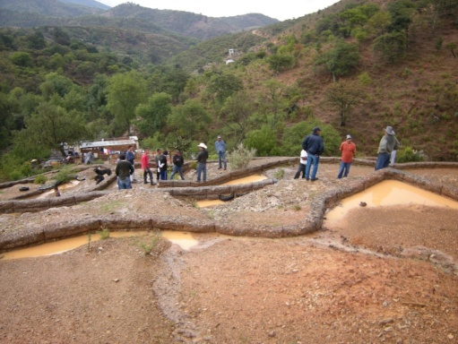
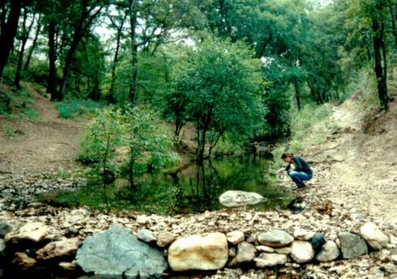
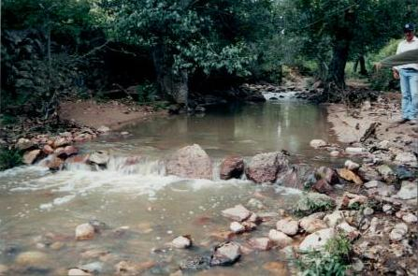
In 2001, Salvemos el Rio Laja AC and Cuerpos de Conservacion Guanajuato AC developed the Santa Rosa Sierra Bird Inventory as part of the River Restoration Project in the Laja River Sub-basin. This project was funded by the North American Wetlands Conservation Act and advised by the US Fish and Wildlife Service.
Restoration of riparian wetlands as bird habitat and better quality of life for people.
BRISBANE, AUSTRALIA | 18 - 20 SEPTEMBER 2017
MANAGED BY

Slide 5
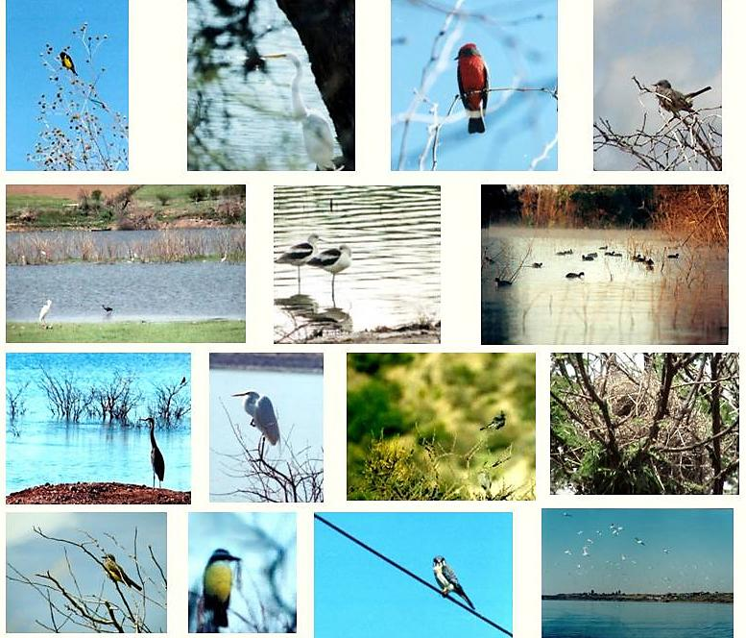
Avian richnes in Rio Laja Basin, Guanajuato, Mexico.
Taxonomic
Orders 18
Families 51
Genus 159
Species 283
BRISBANE, AUSTRALIA | 18 - 20 SEPTEMBER 2017
MANAGED BY

Slide 6
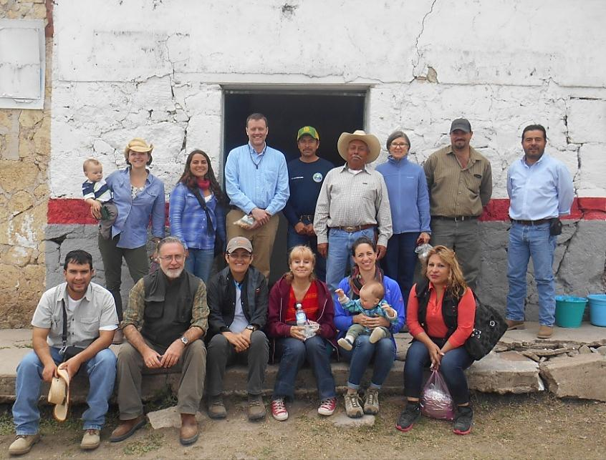
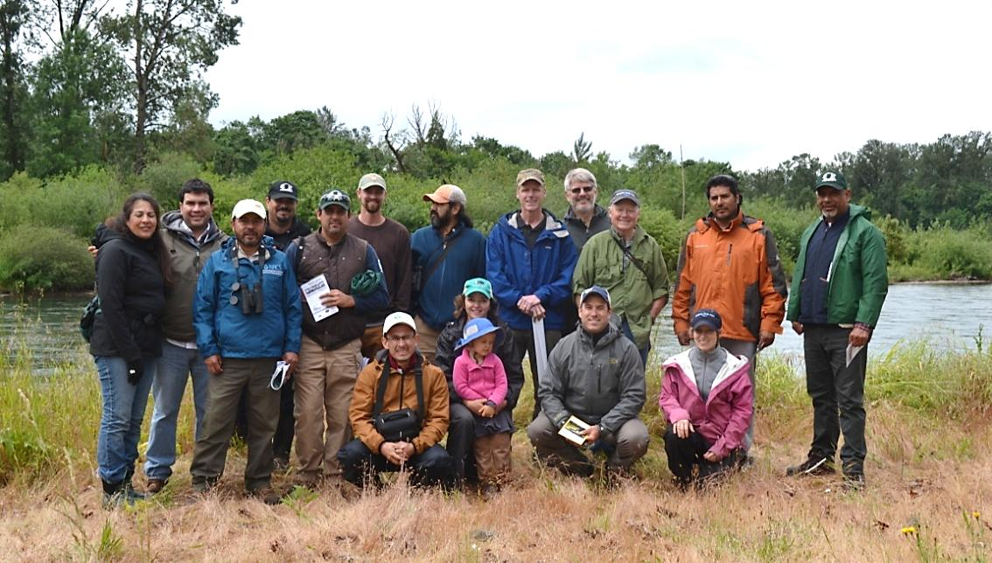
Willamette-Laja Twinning Project
In December of 2014, the Willamette and Laja basins twinning project was established, and it was approved by the International River Foundation (IRF).
Special interest in protecting the most emblematic shared bird species that link us in the restoration of the basins, taking advantage of the knowledge and information obtained in years of avian monitoring.
BRISBANE, AUSTRALIA | 18 - 20 SEPTEMBER 2017
MANAGED BY

Slide 7
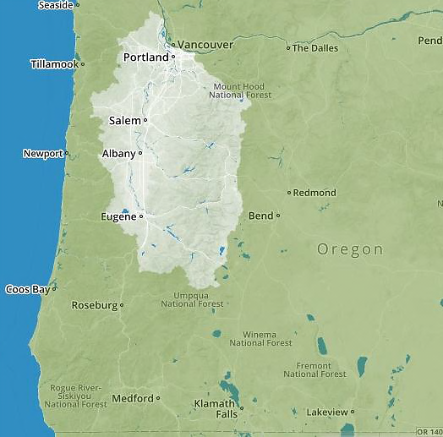
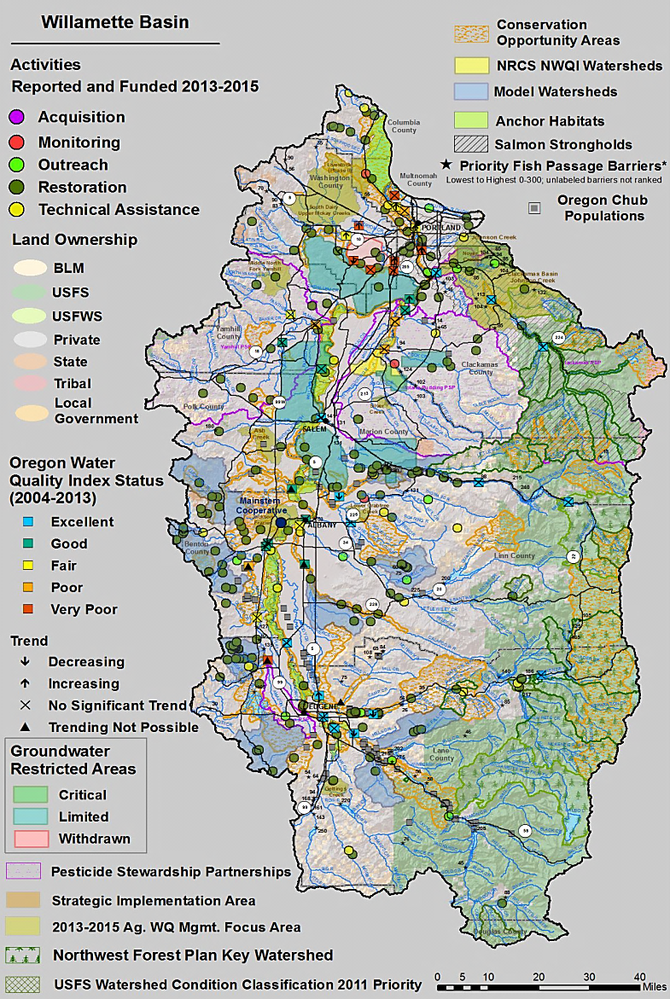
Willamette river basin , Oregon, USA.
BRISBANE, AUSTRALIA | 18 - 20 SEPTEMBER 2017
MANAGED BY

Slide 8
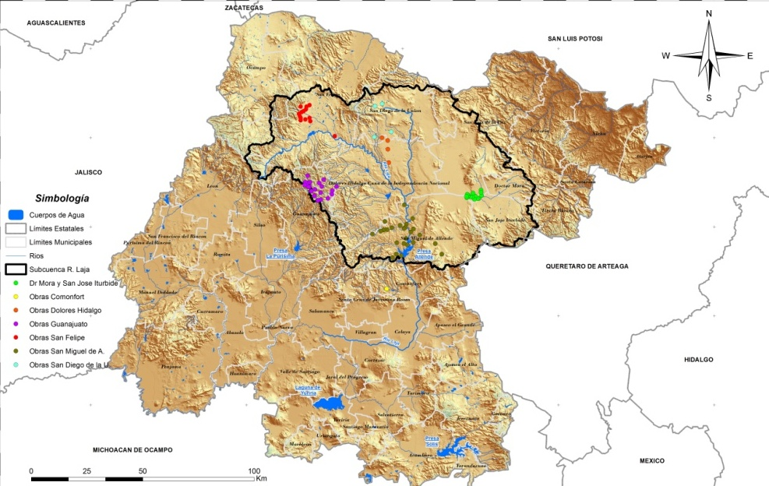
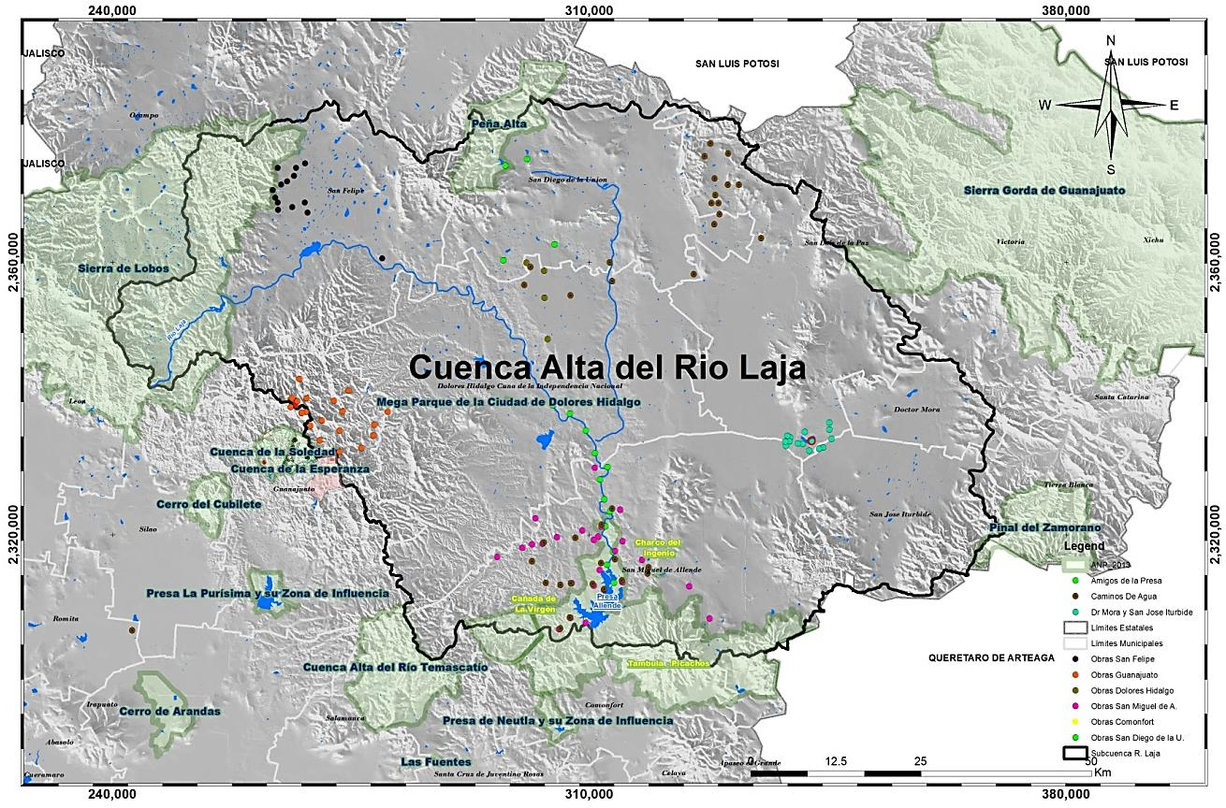
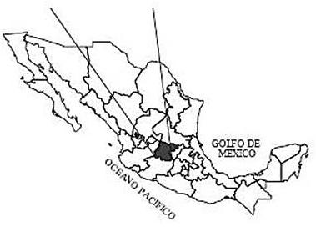
Laja River Watershed in Northern Guanajuato, Central México and map of restoration.
BRISBANE, AUSTRALIA | 18 - 20 SEPTEMBER 2017
MANAGED BY

Slide 9
Goal
Institutionalize a cross-border conservation connection using shared migratory bird species and similar habitats. Emblematic species have been chosen by our stakeholder team. Shared birds is the most visible, tangible and powerful vehicle for cross-cultural conservation communication and will enable the partners to connect our communities.
Program Objectives
Establish an advanced monitoring system for three shared birds in the Willamette-Laja basins to identify their time-space distribution, their estimated populations and their importance as indicators of restoration actions in three distinct habitats of both basins- oak, riparian and aquatic.
Train local citizens to participate in avian monitoring activities.
Design and implement an outreach program, especially as it pertains to Latino youth in both basins with consideration of a youth leadership exchange.
BRISBANE, AUSTRALIA | 18 - 20 SEPTEMBER 2017
MANAGED BY

Slide 10
Species
Species-habitat
Food preference
Ecological role
Environmental indicator
Vulnerability
Charismatic and easily identified by the local people
Scientific name | English name | Spanish name
Ardea herodias | Great Blue Heron | Garza Morena
Selasphorus rufus | Rufous Hummingbird | Zumbador Canelo
Setophaga nigrescens | Black-Throated Gray Warbler | Chipe Negrogris
BRISBANE, AUSTRALIA | 18 - 20 SEPTEMBER 2017
MANAGED BY

Slide 11
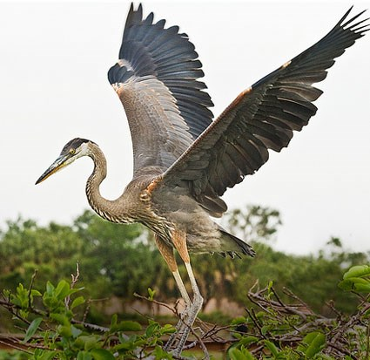
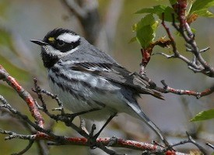
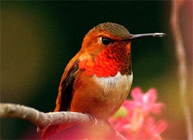
Great Blue Heron
Black-throated Gray Warbler
Rufous Hummingbird
Source: The Cornell Lab of Ornithology
http://www.allaboutbirds.org
BRISBANE, AUSTRALIA | 18 - 20 SEPTEMBER 2017
MANAGED BY
Notes:
Charasmatic
Embolic
Easy for community engagement
Representative of three habitats
Known to exist with relatively stable populations in both basins, warbler on decline

Slide 12
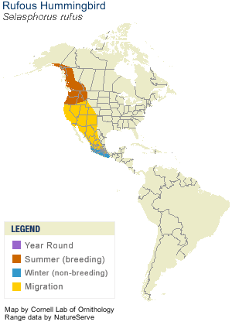
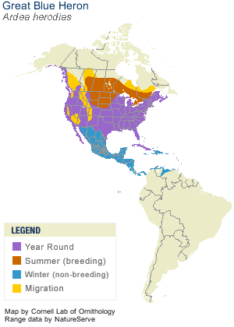
BRISBANE, AUSTRALIA | 18 - 20 SEPTEMBER 2017
MANAGED BY

Slide 13
BRISBANE, AUSTRALIA | 18 - 20 SEPTEMBER 2017
MANAGED BY

Slide 14
The Future Willamette-Laja Twinning Project
Special focus on fundraising with international, Mexican and US foundations and government entities over the year.
Leverage existing capacity and programs and begin linking them, especially as it pertains to community and youth engagement.
Youth/Community Education Committee has formed from the twinning project with several universities, foundations, and conservation groups participating.
Finalize the formation of a “collective impact model” in the Laja, or “Laja Initiative” based on the Willamette excample but shaped within the unique socioeconomic and cultural setting of Central Mexico.
Continue advancing the program for shared migratory birds by using GIS and refining river reaches, sub-basins and communities that are key focus areas for restoration and monitoring .
Gracias!!
Contact Arturo at ccgac@hotmail.com
BRISBANE, AUSTRALIA | 18 - 20 SEPTEMBER 2017
MANAGED BY

