Slide 1
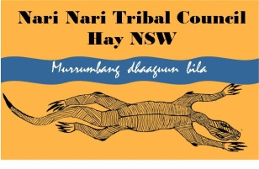
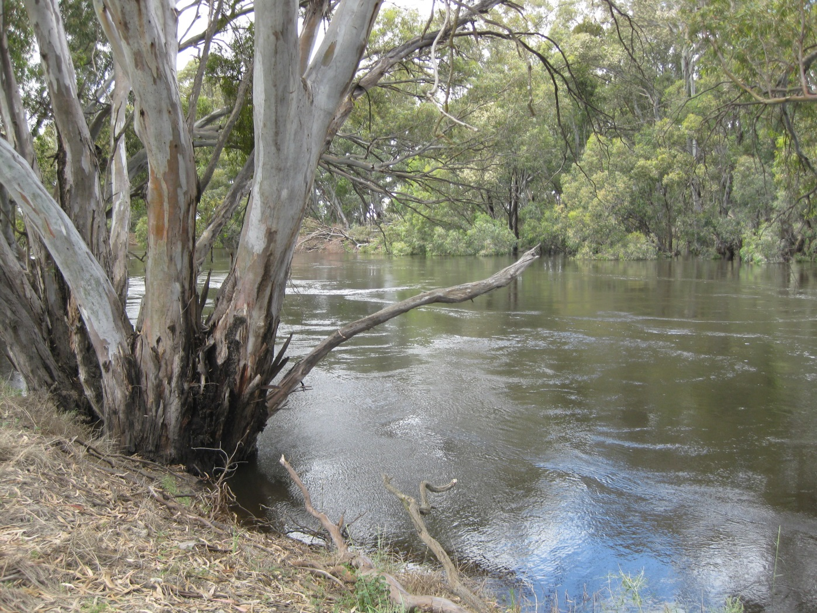
NARI NARI TRIBAL COUNCIL
Our Water, Our Way
Tara Dixon & Jamie Woods
BRISBANE, AUSTRALIA | 18 - 20 SEPTEMBER 2017
MANAGED BY

Slide 2
Our Vision: The Tribal land and water are a Place of Pride for Aboriginal People. The land and waters will be protected, it’s Cultural and Natural values enhanced, Creating a quality environment for present and future generations.
Nari Nari Tribal Council is a not-for-profit Aboriginal organisation, committed to the restoration and protection of Country and Culture.
BRISBANE, AUSTRALIA | 18 - 20 SEPTEMBER 2017
MANAGED BY

Slide 3
NNTC formed in 2000, to hold title of 11,300 hectares of land in the Hay region of NSW, after divestment by Indigenous Land Corporation.
In 2004, 4600ha was declared an Indigenous Protected area, funded by the Federal government and is still current today.
Land is adjacent to the Murrumbidgee River, and encompasses floodplain wetland areas; the very start of the Low Bidgee System.
"Nari Nari is an evolving concept. Our organisation adapts and flows like our river towards better management of natural resources, and the inclusion of Aboriginal people and culture in land management"
Ian Woods - Chairperson
BRISBANE, AUSTRALIA | 18 - 20 SEPTEMBER 2017
MANAGED BY

Slide 4
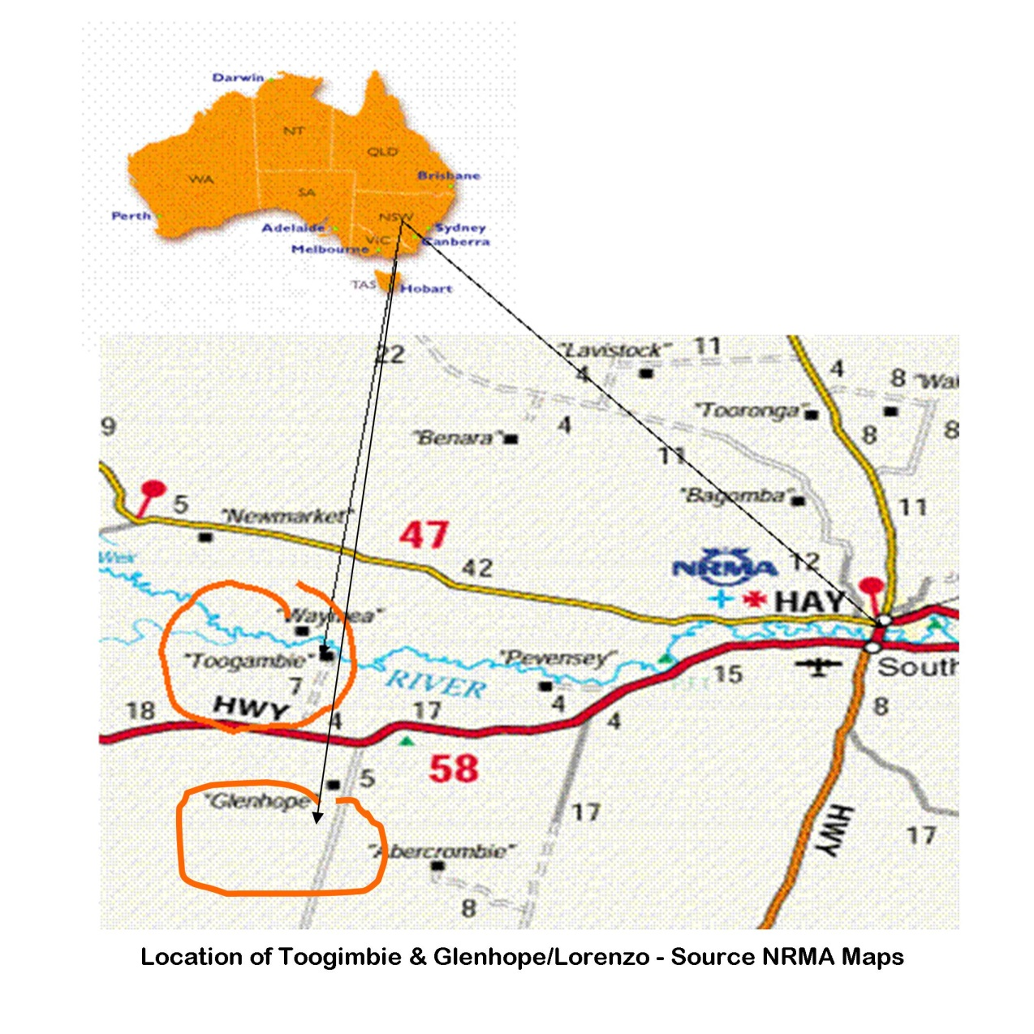
NNTC lands lie on the infamous Hay Plains, some of the flattest country on Earth.
BRISBANE, AUSTRALIA | 18 - 20 SEPTEMBER 2017
MANAGED BY

Slide 5
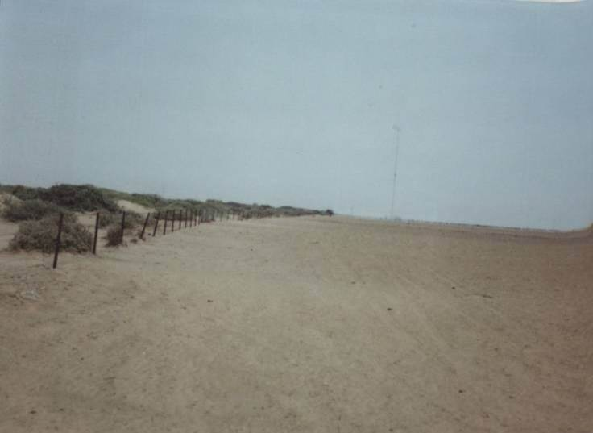
In the beginning…
… the land had been abused and needed care to recover
BRISBANE, AUSTRALIA | 18 - 20 SEPTEMBER 2017
MANAGED BY

Slide 6
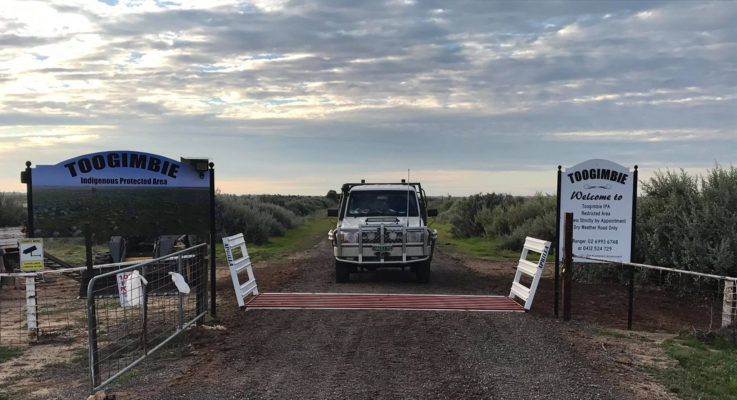
The same landscape today:
Revegetation, Weed Control, Traditional Burning, Planning & Monitoring and Wetland Revegetation .
BRISBANE, AUSTRALIA | 18 - 20 SEPTEMBER 2017
MANAGED BY

Slide 7
Community social benefits of land and water management
• Increase in confidence and self-belief in capacity
• Pride in ability to share Cultural knowledge
• Sense of peace that comes with spending time On Country
• Country gives community opportunity to come together; prevents personal social isolation and creates opportunities to discuss family, individual and mental health issues
• Re-introduction of use of traditional foods and bush medicine
• Increased capacity of community to create employment and training opportunities, helping to retain young people
Many of these benefits were being experienced, but involvement in the recent Cultural Flows Project illustrated just how vital Social Benefits are.
BRISBANE, AUSTRALIA | 18 - 20 SEPTEMBER 2017
MANAGED BY

Slide 8
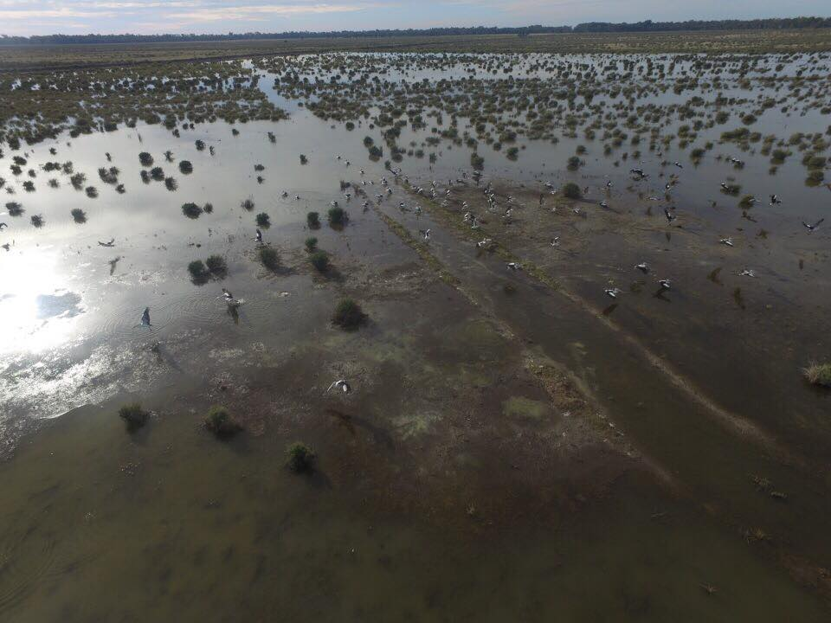
Restoring wetland areas is one of NNTCs greatest successes.
BRISBANE, AUSTRALIA | 18 - 20 SEPTEMBER 2017
MANAGED BY

Slide 9
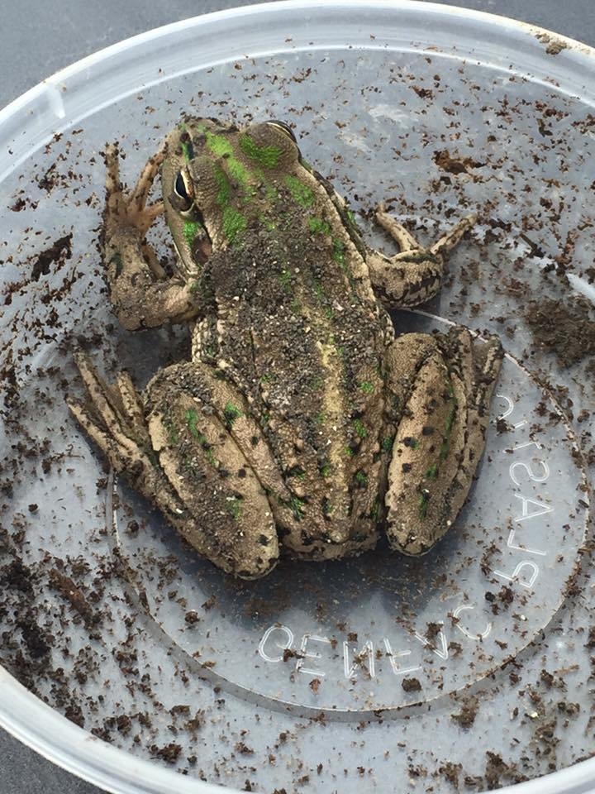
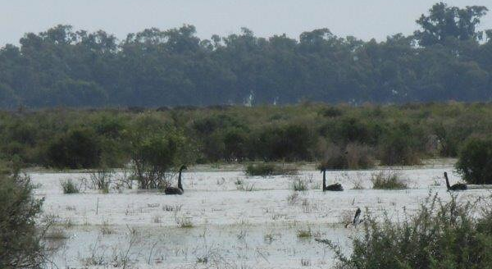
Plants and animals, birds and reptiles have returned.
The waters are cleansed, and traditional bush foods and traditional medicines are thriving.
The Cultural Flows project has shared knowledge and increased skills in the community.
Below: Black swans on the Rookery
Above: Southern Bell Frog
BRISBANE, AUSTRALIA | 18 - 20 SEPTEMBER 2017
MANAGED BY

Slide 10
The challenges of managing Country
• Initially, planning and developing priority tasks – eg. What first?
• Sourcing funding, especially for capital works and large or multi-year projects
• Convoluted process in accessing Cultural Access water licence for wetland flows
• Knowledge – inundation requirements (levels and timing), best practise for monitoring and record keeping and how to access expert advice
• Flora and fauna identification, including weeds and threatened species
• Self-funded costs involved in accessing water environmental and cultural purposes
• Attitude – dealing with negative response to Aboriginal land and water ownership by neighbours, Council and wider community
• Balancing environmental aims with the need to generate income to fund restoration works On Country
• Self belief in the process and the ability of NNTC to change how people view conservation areas, Aboriginal land and river / wetland management and traditional practices
BRISBANE, AUSTRALIA | 18 - 20 SEPTEMBER 2017
MANAGED BY

Slide 11
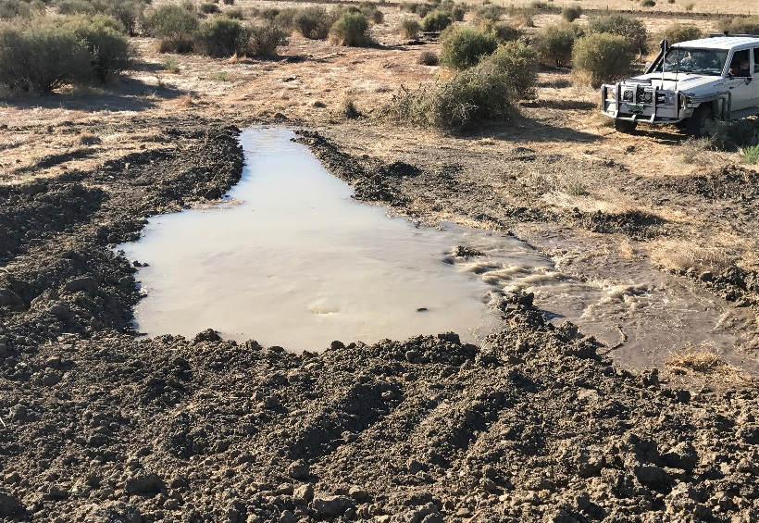
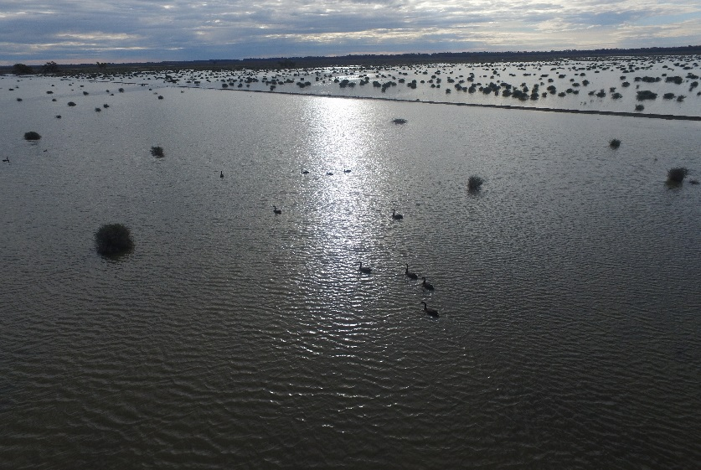
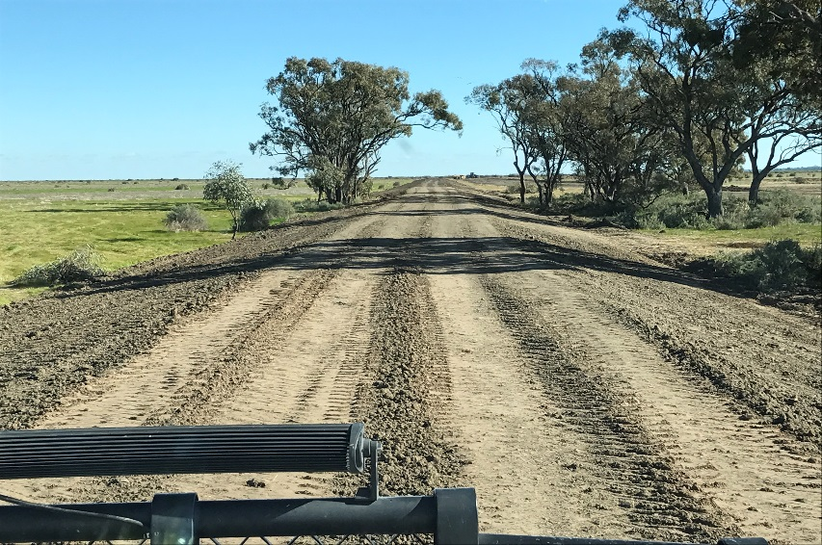
NNTC Partnership arrangement
BRISBANE, AUSTRALIA | 18 - 20 SEPTEMBER 2017
MANAGED BY

Slide 12
NNTC Our achievements
• Over $3.5 million has been invested into works On Country since NNTC custodianship, from funded projects or generated by leases or managed grazing
• Marked change in attitude of wider community
• Co-Management of National Parks and State Conservation Areas in Hay region
• Various awards and recognition, on state and national level
• Employment and training of community people and members
• Return of native birds and animals to the land, and re-emergence of bush medicines and food plants
• Protection - in perpetuity – of the burial and other Cultural sites on Toogimbie
• Inclusion of NNTC in events such as this and recognition of works over the past decade
• Development of networks and sharing of knowledge
• Pride in knowing efforts are restoring the land, which is improving the health of our Country and people, and providing an example for others
Commonwealth Environmental Water Office (CEWO)
BRISBANE, AUSTRALIA | 18 - 20 SEPTEMBER 2017
MANAGED BY

Slide 13
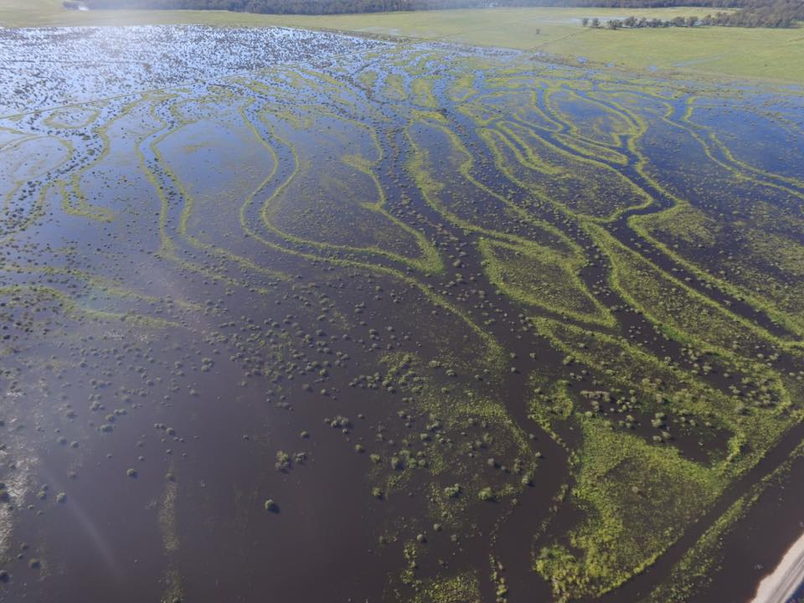
What is next?
NNTC seeks to educate community, and partner with stakeholders with a similar vision to protect wetlands, lands and rivers.
BRISBANE, AUSTRALIA | 18 - 20 SEPTEMBER 2017
MANAGED BY

