Slide 1
Risk & Determinism Opposing Paradigms driving Gated Spillway Operations during Major Floods
by
Greg McMahon
Presenter: Professor John McAneney
Ken.Pearce.RPEQ@gmail.com
BRISBANE, AUSTRALIA | 18 - 20 SEPTEMBER 2017
MANAGED BY

Slide 2
The ISSUE Deciding on dam releases during major flooding
The CONFLICT
Whether or not releases should be made as ‘predictions’,
based on the Best Available Rainfall Forecasts [BARF]
OR
Assume No Further Rainfall [NFR]
BRISBANE, AUSTRALIA | 18 - 20 SEPTEMBER 2017
MANAGED BY

Slide 3
The Poles Taghavifard et al, 2009
BRISBANE, AUSTRALIA | 18 - 20 SEPTEMBER 2017
MANAGED BY

Slide 4
Decision Point – Will the Dam Reach W4 (SEQWater, 2011 modified)
BRISBANE, AUSTRALIA | 18 - 20 SEPTEMBER 2017
MANAGED BY

Slide 5
DETERMINISM values and adheres to complete (or near-complete) knowledge
This approach to dam operations reasons that rainfall forecasts cannot be used because the best rainfall forecasts are not accurate enough or not reliable enough to be used responsibly – the decision is therefore made to follow the red line prediction
BRISBANE, AUSTRALIA | 18 - 20 SEPTEMBER 2017
MANAGED BY

Slide 6
Following the Red Line
At point A, the deterministic paradigm ends and the risk paradigm begins.
The red line starting at point A has been derived from inputs (actual rainfalls) that are derived within the deterministic paradigm
The line is near-accurate as the minimum possible future water level at the planned release rate.
That parameter, however, the ‘possible future water level’, is an output not an input, and that output has been plotted against the future
As such, that parameter is in the risk paradigm, not the deterministic.
BRISBANE, AUSTRALIA | 18 - 20 SEPTEMBER 2017
MANAGED BY

Slide 7
Examples of DETERMINISM
“The existing science suggests that such forecasts lack the reliability … necessary before they could be incorporated into such a process” –
[QFCI (Wolfdene Dam, Brisbane River), 2011]
“Myth: Rainfall forecasts are accurate enough to allow dam operations to use them reliability“–
[Engineers Australia Qld (EAQ), 2012]
“… rainfall forecasts are not 100% accurate and therefore cannot replace other sources of information and engineering judgment …”
[Water Panel, EAQ, 2016]
BRISBANE, AUSTRALIA | 18 - 20 SEPTEMBER 2017
MANAGED BY

Slide 8
RISK Approach: gives regard to Probabilities&Consequences
BRISBANE, AUSTRALIA | 18 - 20 SEPTEMBER 2017
MANAGED BY

Slide 9
Practices Overseas Use the Risk Paradigm
“… having an uncertain forecast available is preferable to complete ignorance about future hydrological events”
–[Webber et al, MetSvc Can, 2006]
“The Uncertainty Imperative … a confluence of compelling reasons … to transition to a new paradigm of hydrometeorological prediction”
–[US National Academies, 2006]
BRISBANE, AUSTRALIA | 18 - 20 SEPTEMBER 2017
MANAGED BY

Slide 10
Practices Overseas Use the Risk Paradigm
Forecast Based Operations [Faber, 2003]
“The Advanced Release Method does two things:
1. Compute the minimum required release from the most probable forecast
2. Limits the max release based on probability of impact to other users”
Adaptive Management [Schultz et al, 2010]
“ … is accomplished through using information that is collected … for the purpose of adjusting the decision in an adaptive management process over time”
–[US Corps of Engineers]
BRISBANE, AUSTRALIA | 18 - 20 SEPTEMBER 2017
MANAGED BY

Slide 11
Australian Practices using the Risk Approach
GMW (2011) is evidence given to a Victorian Government Inquiry on the use of ‘reliable’ four day rainfall forecasts in deciding pre-releases from gated-spillway dams in the Murray-Goulburn system;
Murray Darling Basin Authority (2016) gives news of the decision for Hume Dam to make pre-releases due to “the forecast for more rain”.
Yamagata et al (2016) states that WaterNSW use seven day rainfall forecasts at Burrinjuck Dam.
SEQWater (2009) adopted a risk approach at Wolfdene Dam, 2009 to 2011
Callide Dam Flood Inquiry criticised Sunwater for not using rainfall forecasts in operating Callide Dam in 2015 (MacKenzie, 2015)
BRISBANE, AUSTRALIA | 18 - 20 SEPTEMBER 2017
MANAGED BY

Slide 12
DEFENCES of NFR 1. NFR by Default 2. NFR is theoretically superior
Sources:
Publications by Qld Flood Commission of Inquiry [QFCI], Engineers Australia [EA], Engineers Australia Qld [EAQ], EAQ Flood Sub-ctte
Presentations to and feedback from Engineering School UoQ, SEQWater, Dept of Energy & Water Supply, EAQ, EAQ Flood Sub-Ctte, and EAQ Water Panel
Reviews and Responses to Submissions / Papers to QFCI, EA, EAQ, and ANU
Discussions / Responses at Conferences – EA, IWA, FMA, NZHI, including Babister (HWRS 2014 & FMA 2016) and Nathan (HWRS 2014 & NZHI 2016)
BRISBANE, AUSTRALIA | 18 - 20 SEPTEMBER 2017
MANAGED BY

Slide 13
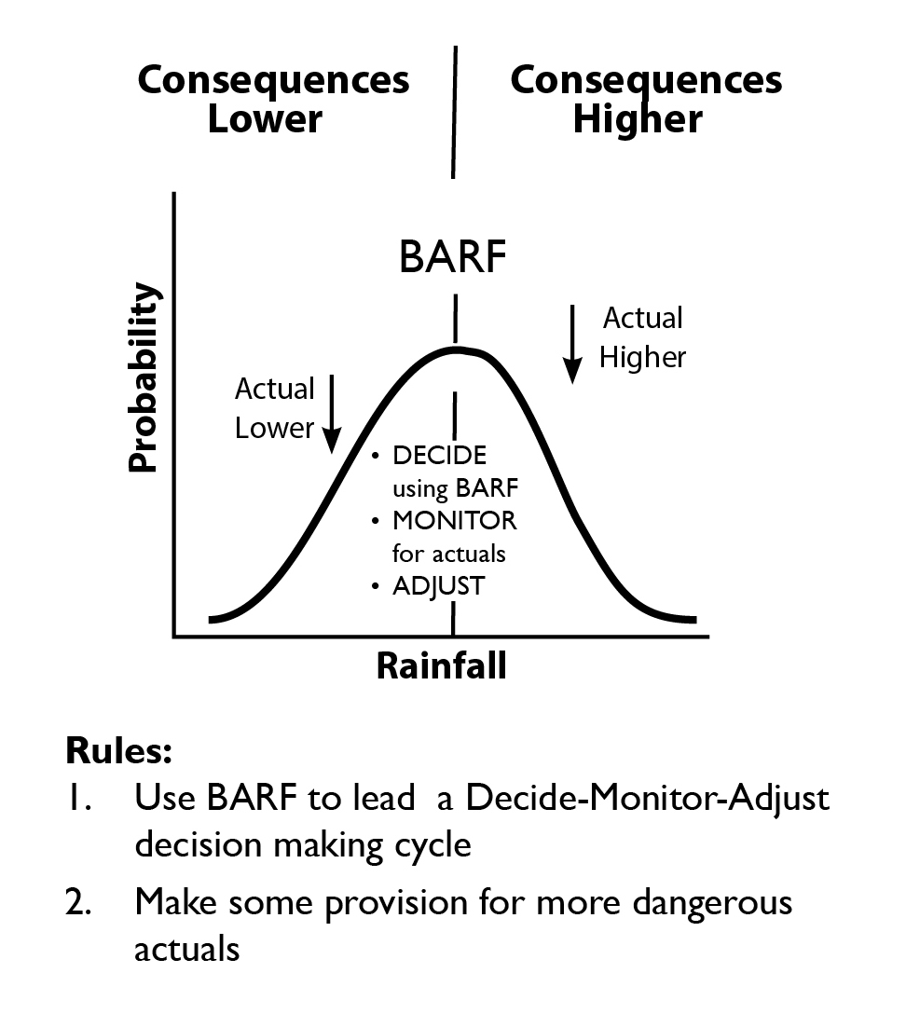
The BARF Proposed in Presentations / Papers

Slide 14
NFR by DEFAULT – Example 1: Basis: ACCURACY Van den Honert, R. C. and McAneney, J. (2011)
BARF fails, so use NFR - on a Basis of
ABSOLUTE ACCURACY
BUT, NFR is worse – on a Basis of RELATIVE ACCURACY

Slide 15
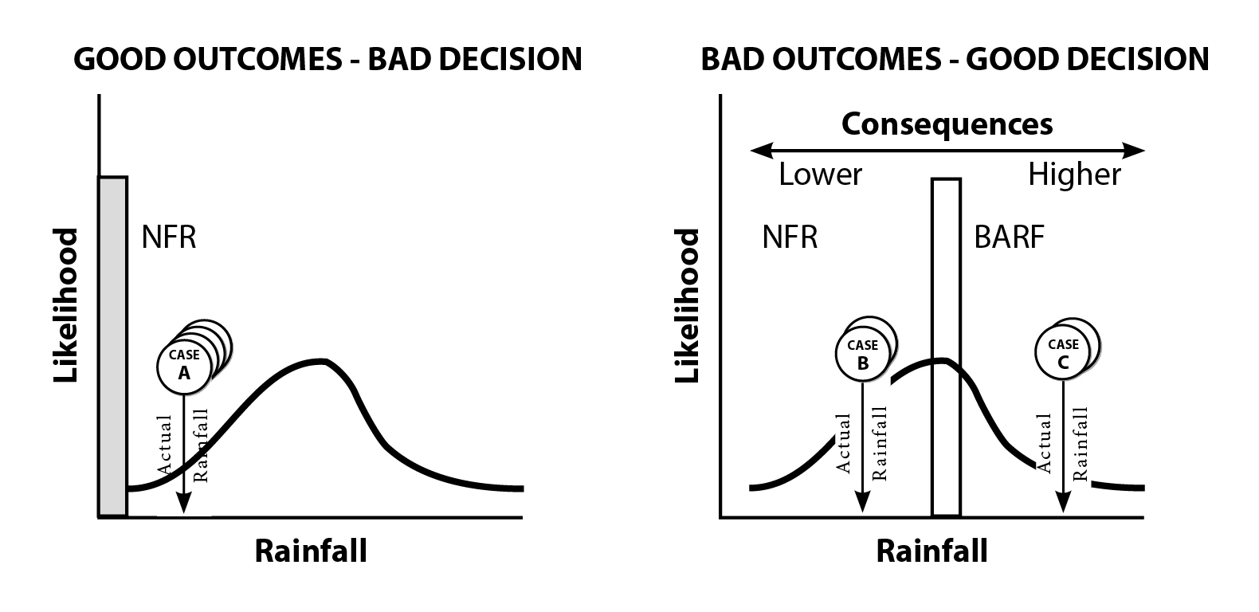
NFR by DEFAULT – 2: Basis: OUTCOMES Van den Honert, R. C. and McAneney, J. (2011)
BRISBANE, AUSTRALIA | 18 - 20 SEPTEMBER 2017
MANAGED BY

Slide 16
A Theoretical Defence of NFR (Daniell, 2016)
The Self-Correction Thesis
… When optimizing dam operation there is less penalty for a delayed decision as the interaction of dam stage storage curves and stage discharge curves partially self corrects for the delayed decision. If you delay moving to a higher discharge the dam fills faster triggering your next decision earlier. You will not achieve the optimum outcome but you generally only just overshoot. This is generally a low regret decision as the dam routing physics provide a fair degree of built in self correction.
The Wasted Storage Thesis
When using forecast rainfall or adopting early decisions you are fighting this self correction. The system tends to either waste the saved storage by delaying the next decision step resulting (in) no real advantage for using the forecast or the forecast does not occur and you have significantly overshot the peak as you cannot recall released water.
BRISBANE, AUSTRALIA | 18 - 20 SEPTEMBER 2017
MANAGED BY

Slide 17
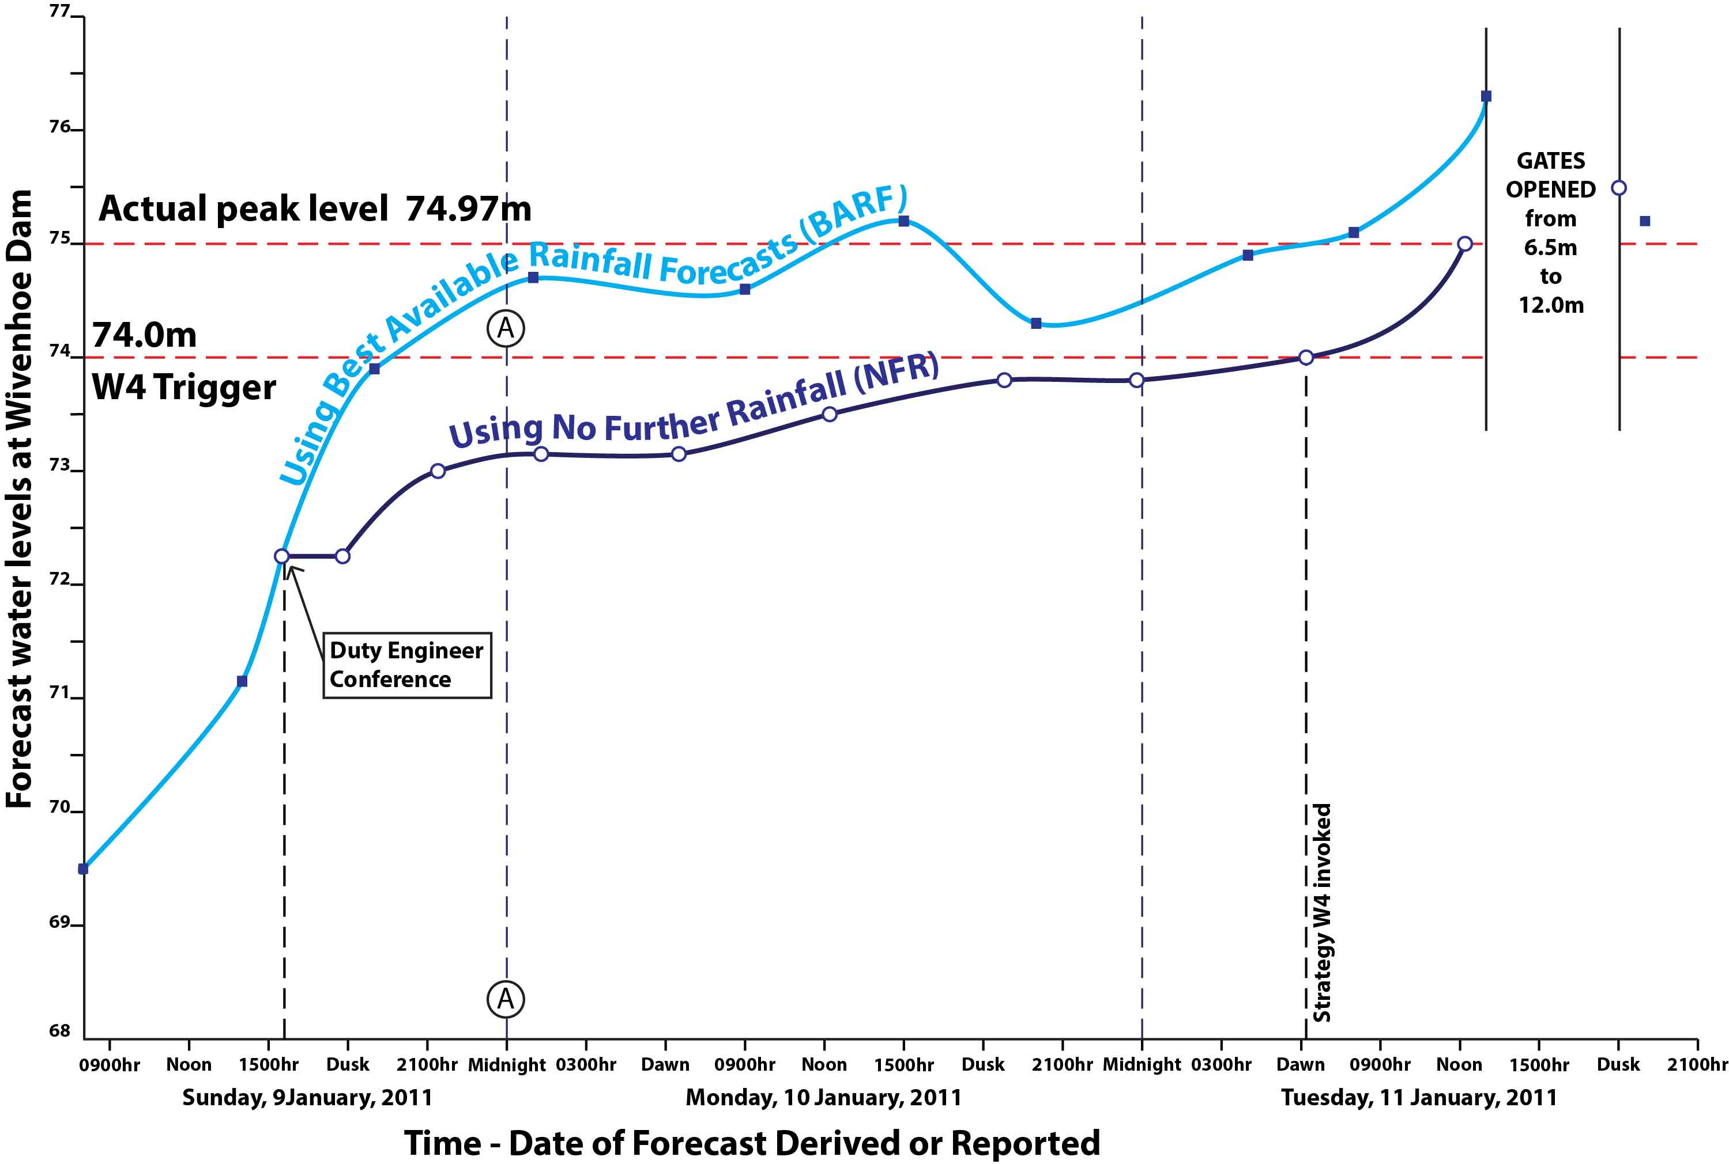
Wivenhoe 2011 & the Self Correction Thesis

Slide 18
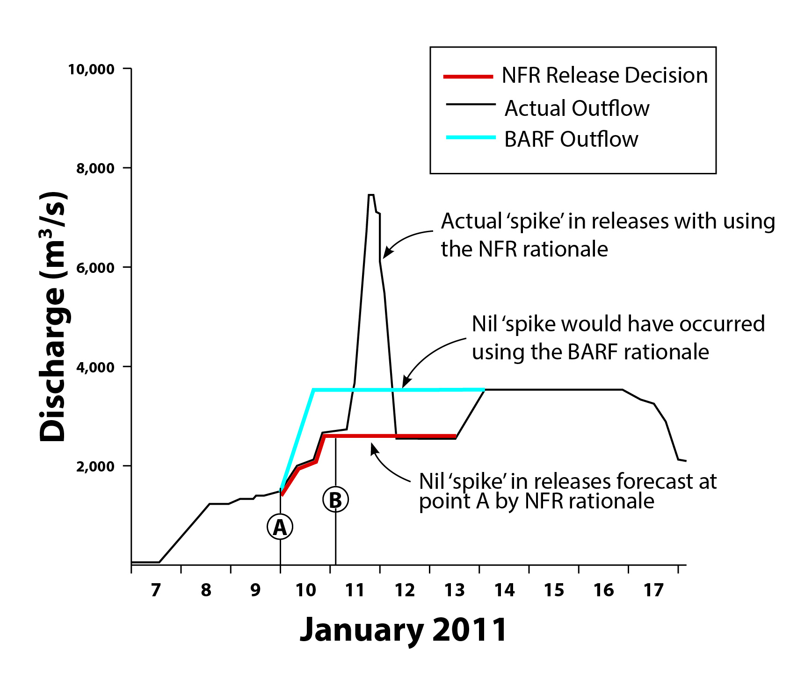
Wivenhoe & the Wasted Storage Thesis

Slide 19
CONCLUSION
The reversion by the Queensland Government from BARF to NFR is going against developments overseas and practices elsewhere in Australia.
The thinking behind this reversion appears to have been muddled by mixing of notions from deterministic and from risk paradigms, and by confusing a good outcome in uncertainty situations to be caused always by a good decision.
A narrow perspective on good-outcome-bad-decision risk scenarios, used to justify a deterministic NFR operational regime, alien to risk management, may have surrendered its credibility with that narrow consideration.
BRISBANE, AUSTRALIA | 18 - 20 SEPTEMBER 2017
MANAGED BY

Slide 20
REFERENCES
Daniell, K. (2016), Review of Paper, Australian Journal of Water Resources, Engineers Australia, October 2016.
DEWS (2014), Wivenhoe and Somerset Dams Optimization Study, Department of Energy and Water Supply, Queensland, Australia, March 2014.
Faber, B. (2003), The Potential for Adaptive Reservoir Operations Provided by Forecast Information, Californian Extreme Precipitation Symposium, 6 June 2003.
Goulburn-Murray Water (2011), Submission No 48, Inquiry into Flood Mitigation Infrastructure Victoria, August.
Goh, S. and Weekes, B. (2012), Comments on Queensland Flood Commission of Inquiry Final Report, Engineers Australia Queensland Division, 9 July 2012.
Murray Darling Basin Authority (2016), Releases from Hume Dam continue ahead of forecast rain, 8 September.
McEwan, I. (2017), Professional Communication, 13 January 2017.
MacKenzie, I. (2015), 2015 Callide Creek Flood Review, Inspector General Emergency Management, June.
McMahon, G. (2012), Use of Forecast Rainfall in the Control of Flooding, Hydrology and Water Resources Symposium, Sydney, November 2012.
McMahon, G. (2013a), Presentation and meeting with Engineers Australia Qld Division Committee, February.
McMahon, G. (2013b), Presentation with Flood Sub-Committee of EA Qld Division Committee, 18 March.
McMahon, G. (2013), Presentation and meeting with SEQWater, 2 September 2013

Slide 21
McMahon, G. (2014), Risk management and the design and operation of flood mitigation dams, Risk Conference, Engineers Australia, Brisbane May 2014
McMahon G. (2016), Presentation with Qld Water Panel, 16 November 2016
NRC [National Research Council] (2006) Completing the Forecast: Characterising and Communicating Uncertainty for Better Decisions Using Weather Forecasts, The National Academies Press, Washington 2006
QFCI, (2011). Interim Report; Queensland Floods Commission of Inquiry: Brisbane, 1 August 2011
Schultz, M., Mitchell, K. and Harper, B. (2010), Decision Making Under Uncertainty, Engineer Research and Development Centre, US Army Corps of Engineers, November 2010.
SEQWater. (2009), Manual of Operational Procedures for Flood Mitigation at Wivenhoe Dam and Somerset Dam, Revision 7, SEQWater, November 2009.
SEQWater. (2011), January 2011 Flood Event: Report on the Operation of Somerset Dam and Wivenhoe Dam; SEQWater, Brisbane, QLD, Australia, 2 March 2011.
SEQWater. (2015), Manual of Operational Procedures for Flood Mitigation at Wivenhoe Dam and Somerset Dam, Revision 13, SEQWater, November 2015.
Taghavifard M, Damghani K, and Moghaddam R, (2009), Decision Making Under Uncertain and Risky Situations, Society of Actuaries, 2009.
US Army Corps of Engineers, (2002), Forecast-Based Advance Releases at Folsom Dam: Effectiveness and Risks – Phase 1, Hydrologic Engineering Centre, December 2002.
Van den Honert, R. C. and McAneney, J. (2011), The 2011 Brisbane Floods: Causes Impacts and Implications, Water, 3, 1149-1173.

Slide 22
Weber, F. Perreault, L. and Fortin, V. (2006), Measuring the Performance of Hydrological Forecasts for Hydropower Production at BC Hydro and Hydro Quebec, Proceedings of the 18th Conference on Climate Variability and Change, AMS, Atlanta, January 2006.
Weeks, W. (2013), Queensland Flood Commission of Inquiry: Engineers Australia Contribution, Floodplain Management Association Conference, 2013.
Yamagata K., Khan M., Prathab A., and Nachiappan N. (2017), Performance of short-term flood operations management of Burrinjuck Dam releases during CARM, Floodplain Management Association National Conference, Newcastle, May 2017.

